Slide 1
Accelerator Division
Sergei Nagaitsev
Scientific Advisory Council
6 April 2015

Slide 2
What is on our plate?
Operating the Fermilab accelerator complex
  MI beam power ramp-up (part of operations)
    450 kW (now) to 700 kW in mid FY16
  Proton Improvement Plan (PIP) in Linac and Booster
    Multi-year campaign managed like a project, but constrained within operations
  Muon Campus projects (4 AIPs)
  Test facilities (cryo plants, beam test facilites, SRF, magnet)
Projects: Muon g-2, Mu2e, LBNF, LCLS-II (at SLAC), PIP-II
Programs: MAP, LARP, ILC
Research: High-Power Targets, SCRF, R&D towards cost-effective technologies, accelerator science, new beam diagnostics, future colliders
Commercialization of our accelerator technologies

Slide 3
Accelerator Operations
Fermilab operates a total of 16 km of accelerators and beamlines
A 400-MeV proton linear accelerator (0.15 km)
An 8-GeV Booster synchrotron (0.5 km)
An 8-GeV accumulator ring (3.3 km)
A 120-GeV synchrotron (3.3 km)
Soon: A Muon Campus Delivery ring (0.5 km)
Soon: Muon g-2 ring
Transfer lines and fixed target beam lines (8 km)
Two high power target stations, several low-power targets
And maintains
130 buildings, structures, service bldgs, parking lots…

Slide 4
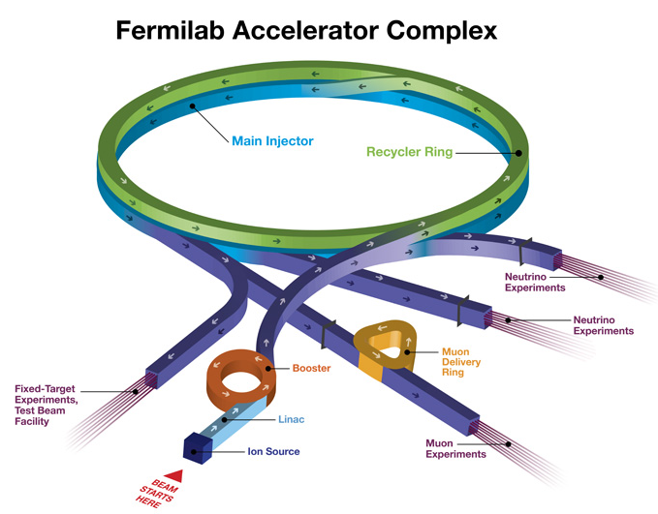
Fermilab Accelerator Complex
Linac: MTA
BNB: MicroBooNE
NuMI: MINOS+, MINERvA, NOvA
Fixed Target: SeaQuest, Test Beam Facility, M-Center
Muon: g-2, Mu2e (future)
Also, test and R&D facilities:
ILC Cryomodule
IOTA
SRF
Cryo
PXIE

Slide 5
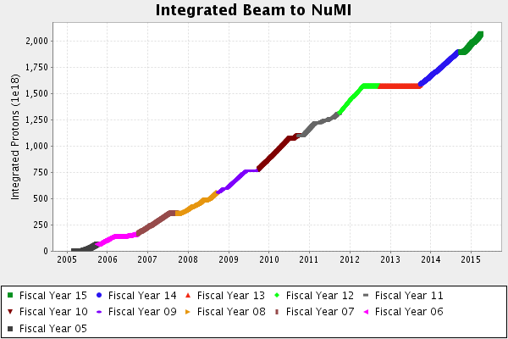
Accelerator Performance for NuMI
Started delivering protons to NuMI in 2005
  ~1.55e21 in 7 years; NOvA goal is 3.6e21
  Most intense high energy neutrino beam in the world

Slide 6
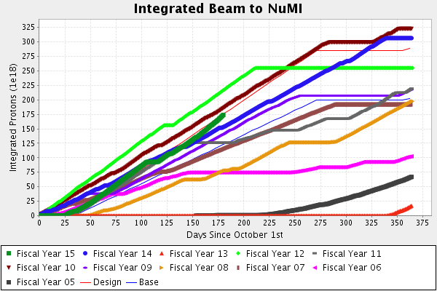
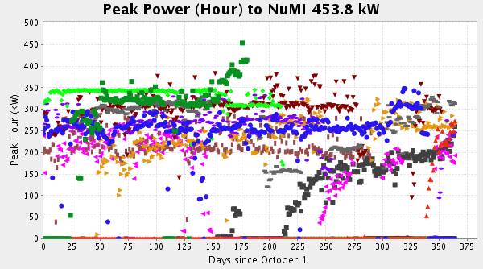
Beam power in FY15 on track and increasing
1h with no beam to SY120

Slide 7
Reorganization since the Tevatron era
Muon department replaced Tevatron and Pbar departments
New PIP-II department
APC departments
  IOTA/ASTA
  Muon Accelerator R&D
  Modeling / Energy Deposition / Theory
  Accelerator Training
Recent new Target Systems department
  Responsibility for NuMI, BNB, g-2, Mu2e target stations
  R&D in high-power targets and radiation damage in target environments

Slide 8
AD personnel, ~450 FTEs
(mostly former operators who are now accelerator experts)
Scientists are a relatively small fraction of AD personnel

Slide 9
AD FTEs in FY15 : actuals vs budgeted

Slide 10
Challenges with managing the AD workforce
Operations are chronically under-funded.
About 30% of FTEs have to be “sold” to projects.
  In FY14 we were not able to supply requested FTEs to projects, thus we over-run on operations salaries and had to convert M&S to salaries at the end of the year (roofs were fixed, etc).
  In FY15, the operations expanded, the budget remained flat.
Projects want to treat AD as a “tool rental store”, paying only for fractional FTEs. Someone else has to pay for the rest of the FTE. Usually, it is Operations or Program Support
  Ideally, projects want people with operational experience only.
Even if a project has money for a fraction of an FTE, we can’t hire a new person because there is not enough Ops funding to support the rest of the FTE.

Slide 11
Scientists in AD
Few young scientists
  Can’t hire postdoc if no research money to support, can’t engage in research without them;
  If postdoc’s research is in short-term R&D (to benefit experiments), get locked into operational responsibilities
Not enough funding for participating in HEP experiments
  This funding not held by AD

Slide 12
Engineers and fragmentation
Aging workforce is an issue with engineers as well as scientists
Diverse pool of engineers but effort highly fragmented in projects
  Projects want engineers with operational experience

Slide 13
Positive developments
Peoples Fellowship advert already in place (see CERN Courier, April issue) and we plan to recruit the very best internationally by the end of summer. Deadline for applications June 30, direct potential applicants to the website;
LDRD on IOTA funded at FNAL, with significant matching support from NIU. A Fermilab post-doc is also advertised in CERN Courier April issue, deadline May 31, Again, direct potential applicants to the website;
Focused Workshop on Scientific Program on IOTA planned April 28 and 29 with participation of scientists and representatives from external academic universities (NIU, Univ. of Chicago, IIT Chicago, Maryland, Cornell, Berkeley, Oxford, Univ. of Tennessee at Knoxville, Stanford), industry (e.g. Tech-X and RadiaBeam) and labs (FNAL, ANL, SLAC, BNL, RAL, LBNL). About 35 participants only to focus on four classes of experiments: nonlinear dynamics of space-charge dominated intense beams; optical phase space cooling, quantum nature of a single electron and associated photon field and beam shaping using lasers. A set of four initial experiments will be intensely worked upon for possible launching in 2016/2017 time frame;

Slide 14
More positive developments
Some minimal level of coordinated activity in FCC and g-2 by University colleagues (e.g. Swapan C and Mike Syphers working on both);
Some limited number of AD scientists have joined the DUNE collaboration;
The Fermilab Accelerator Strategy is being worked on via Theme Teams in collaboration with TD;
AD eagerly awaits outcome of the GARD subpanel (report will be orally presentedtoday, Monday, April 6 by Chair Don Hartill) and also on the developments on the USPAS;

Slide 15
More positive developments
Several AD scientists joined faculty at local universities;
FNAL-NIU cluster of research excellence in accelerator science is moving forward with planned recruitments in the coming year;
Proposal submitted by NIU to have a Ultra-cold Electron Source R&D based on nano-emitters. This work will be done in the Bright Electron Source Lab;
The BESL is planned for relocation to IARC in time to allow a working engine to stimulate industrial collaboration.

Slide 16
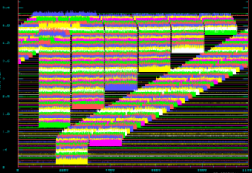
Current high power operation and plans
Commissioned slip-stacking in the Recycler
Currently slip-stacking 6+2 batches, 3.1E13 ppp every 1.333 sec
  450 kW beam power (400 kW with SY120)
  Reconfigured Recycler transverse dampers
  Commissioned MI collimators
  Increased number of Booster turns
Plan to test 6+4 operation (460 kW) prior to the summer shutdown with current Booster rep rate (7.5 Hz, no beam to BNB)
  Also test low intensity beam at 15 Hz after 17 refurbished RF cavities
After shutdown will have
  19-20 refurbished Booster RF stations installed
  New Booster shielding assessment taking into account use of Total Loss Monitors to allow higher flux in Booster
Increase intensity with 6+4, commission beam at 15 Hz in Booster, commission 6+6 (challenge is keeping losses low)
time →
position in Recycler ring

Slide 17
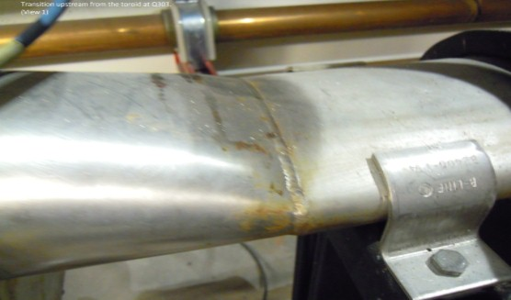
MI/Recycler issues
Recycler vacuum
  Recycler TSP-based vacuum system has exceeded design lifetime; not suitable for a proton machine
  Plan for replacement of ~400 TSPs with ion pumps will take 3 long shutdowns (lots of cutting and welding)
Replacing MI beam pipe in MI-30 collimation region with duplex stainless pipe with higher corrosion resistance
Designing collimation system for Recycler

Slide 18
Proton Improvement Plan
Goals and Scope (Established in 2011)
Increase the beam repetition rate from the present ~7.5 Hz to 15 Hz
  Need at least 9 Hz for NOvA 12-batch slip-stacking
  Requires refurbishment of Booster RF cavities
Eliminate major reliability vulnerabilities and maintain reliability at present levels (>85%) at the full repetition rate
Eliminate major obsolescence issues
Increase the proton source throughput, with a goal of reaching >2E17 protons/hour
  Presently operating at <1E17 protons/hour
Ensure a useful operating life of the proton source through at least 2025 (now extended to 2030 to accommodate PIP-II schedule)

Slide 19
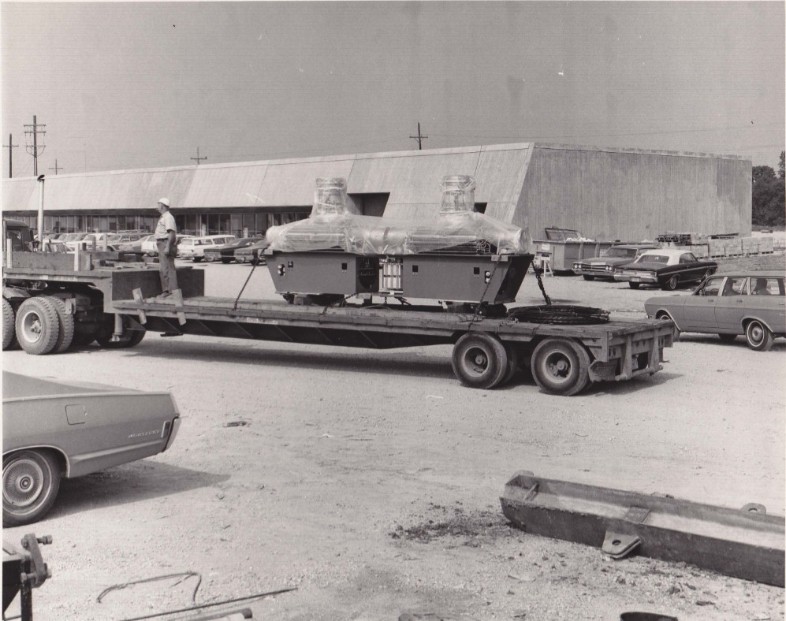
Booster RF cavities
July 1970 Flatbed semi delivering Booster RF cavity pair
Cavities built by GE

Slide 20
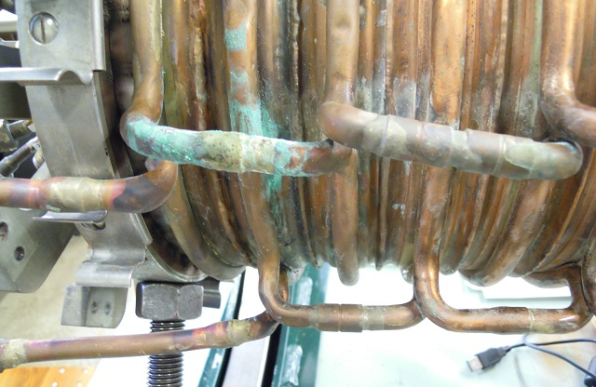
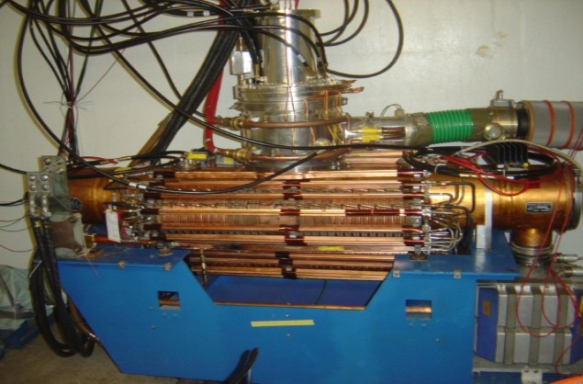
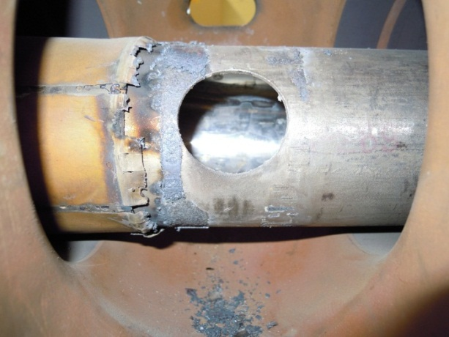
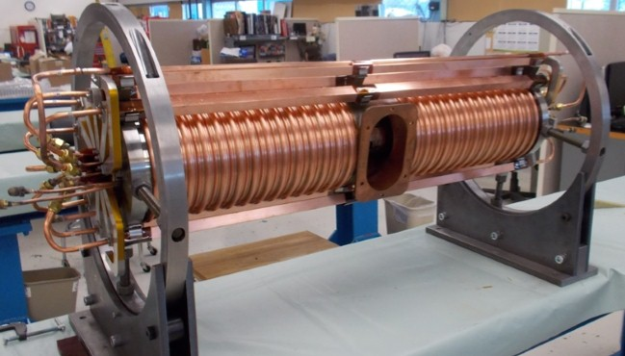
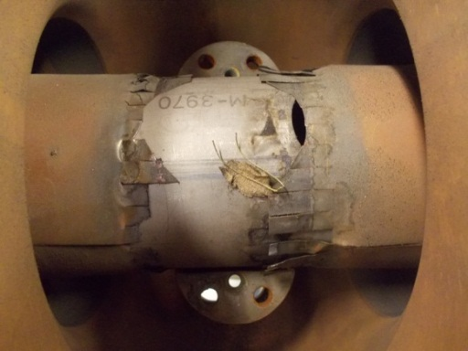
PIP – Booster Cavity Refurbishment
Has been a challenge but now almost complete (17th of 22 stations this month)
East gallery complete and running 15 Hz tests
Additional 20th cavity being tested 15 Hz (salvaged original cavity – major rebuild)
After 2+ years vendor able to produce suitable ferrite for new tuners
Old cavities had many problems - especially the tuners:
Water Leaks
Burnt RF Fingers
Connection Flange
First new tuner – built & tested

Slide 21
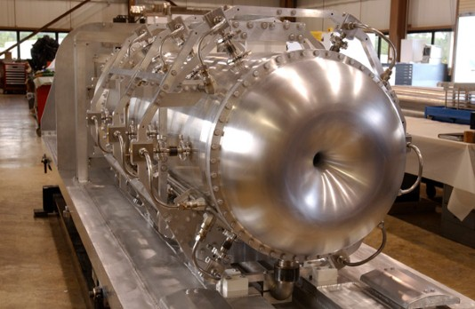
Booster Neutrino Beam
Preparing to run to MicroBooNE
In the process of changing the horn
  Removing and adjustor platform and horn extraction mechanism with new design (was not designed to last this long)
This horn lasted ten years and >400,000,000 pulses – expected lifetime was about one year and 100,000,000 pulses
Looking into requests for upgrades for Short Baseline Neutrino program but limited manpower

Slide 22
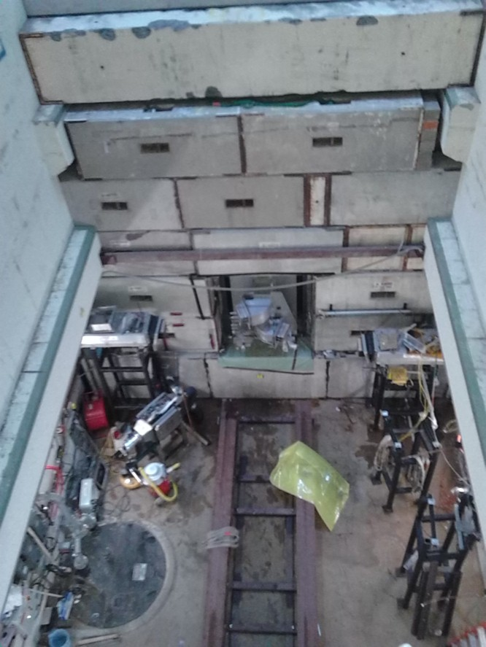
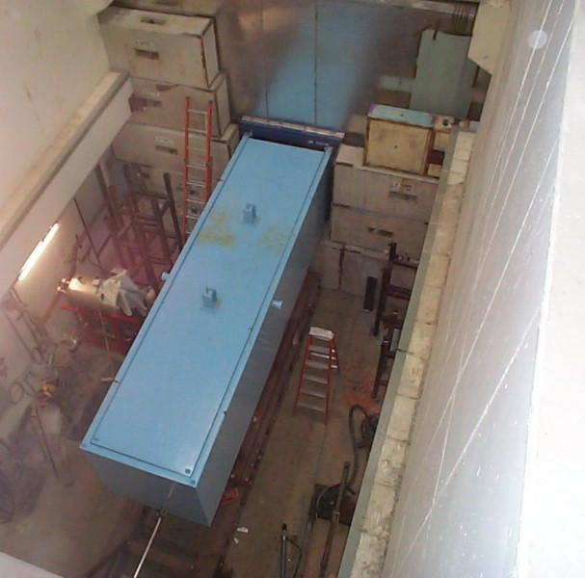
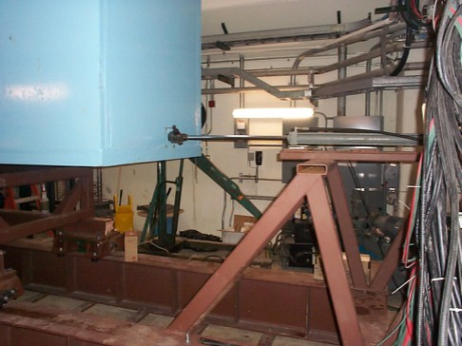
BNB horn removal

Slide 23
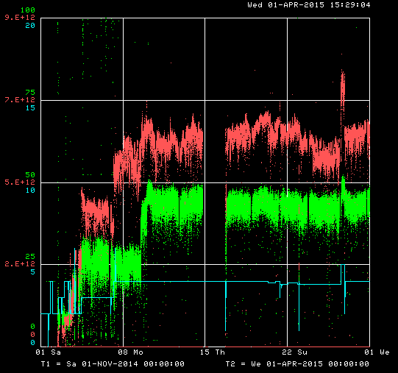
SY120 (120 GeV fixed target program)
Delivering beam to Fixed Target Test Beam Facility as needed (the facility is fully subscribed)
Supporting a second test beam for LArIAT (repurposed ArgoNeuT liquid argon time projection chamber)
Modified primary beamline to allow clean transport of higher intensity beam to SeaQuest
Intensity
Duty factor
# Booster turns
Now able to provide more intensity than SeaQuest can use

Slide 24
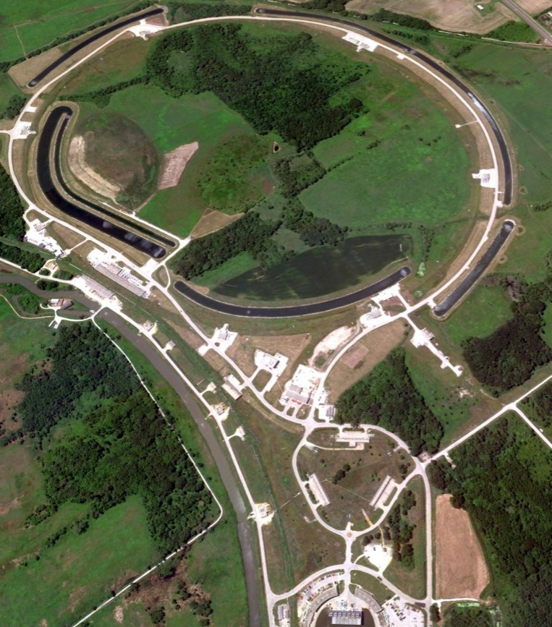
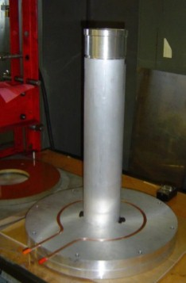
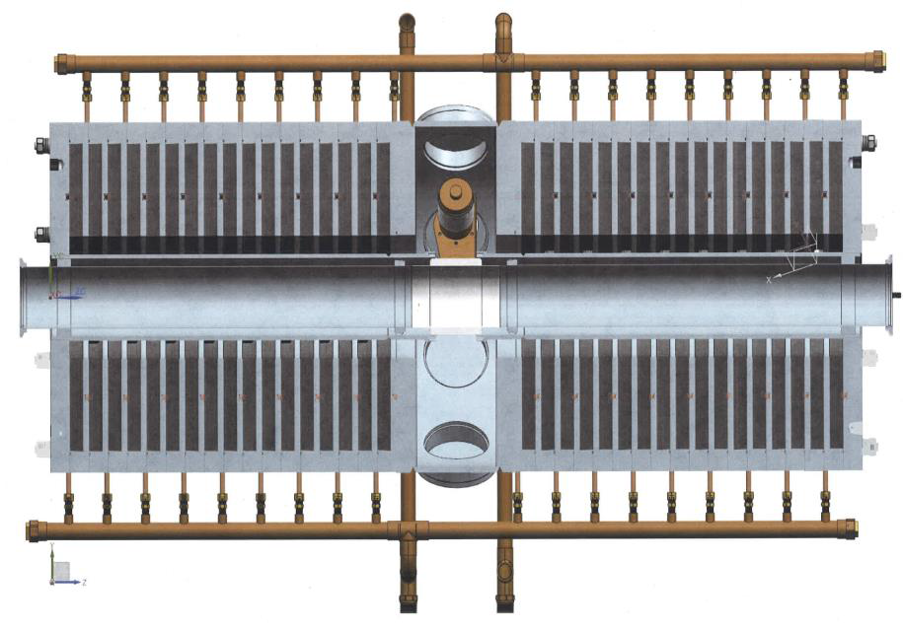
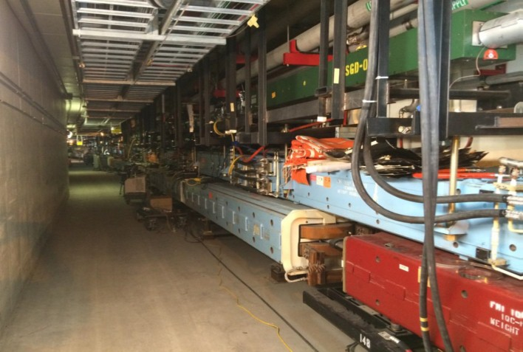
Muon Campus Recycler modifications
Recycler Ring
Assembling new RF cavities to install in FY16
g-2 Target Station
Beam Transport and Delivery Ring
New connection from RR to P1-line to be installed this summer
(Drives the length of the shutdown)
Muon Campus

Slide 25
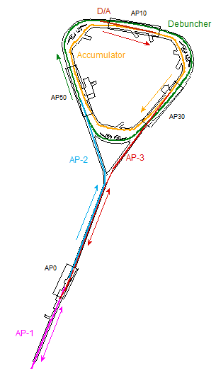
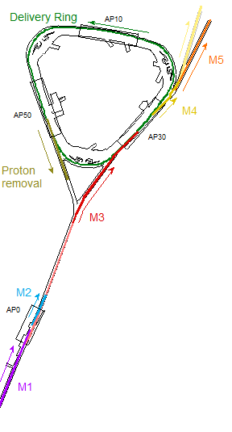
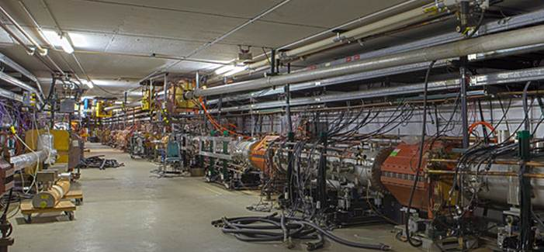
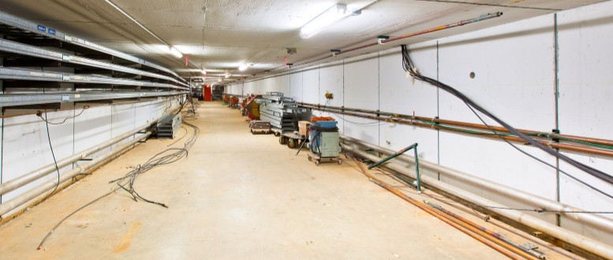
Pbar to Muon reconfiguration for Muon Campus / g-2 / Mu2e
5/8/14 start of decommissioning
3/23/15
reconfiguration of new injection/ extraction region
Remove existing magnets
Reconfigure cables, cooling water, electrical bus, lighting
Install injection and extraction lines
Reinstall Delivery Ring magnets

Slide 26
Proton Improvement Plan-II
Goal: Provide >1 MW at the time of LBNF startup (~2023)
800 MeV superconducting pulsed linac + enhancements to existing complex; extendible to support >2 MW operations and upgradable to continuous wave (CW) operations
  Builds on significant existing infrastructure
  Capitalizes on major investment in superconducting rf technologies
  Eliminates significant operational risks inherent in existing linac
  Siting consistent with eventual replacement of the Booster as the source of protons for injection into Main Injector
Whitepaper available at
projectx-docdb.fnal.gov/cgi-bin/ShowDocument?docid=1232

Slide 27
PIP-II schematic
120 GeV
Main Injector
8 GeV
Recycler
1.2 MW
target
New 800 MeV
SRF Linac
Existing 8 GeV
Booster

Slide 28
PIP-II Performance Goals
Performance Parameter | PIP-II
Linac Beam Energy | 800 | MeV
Linac Beam Current | 2 | mA
Linac Beam Pulse Length | 0.5 | msec
Linac Pulse Repetition Rate | 20 | Hz
Linac Beam Power to Booster | 13 | kW
Linac Beam Power Capability (@>10% Duty Factor) | ~200 | kW
Mu2e Upgrade Potential (800 MeV) | >100 | kW
Booster Protons per Pulse | 6.4×10¹²
Booster Pulse Repetition Rate | 20 | Hz
Booster Beam Power @ 8 GeV | 120 | kW
Beam Power to 8 GeV Program (max) | 80 | kW
Main Injector Protons per Pulse | 7.5×10¹³
Main Injector Cycle Time @ 120 GeV | 1.2 | sec
LBNF Beam Power @ 120 GeV* | 1.2 | MW
LBNF Upgrade Potential @ 60-120 GeV | >2 | MW
*LBNF beam power can be maintained to ~60 GeV, then scales with energy

Slide 29
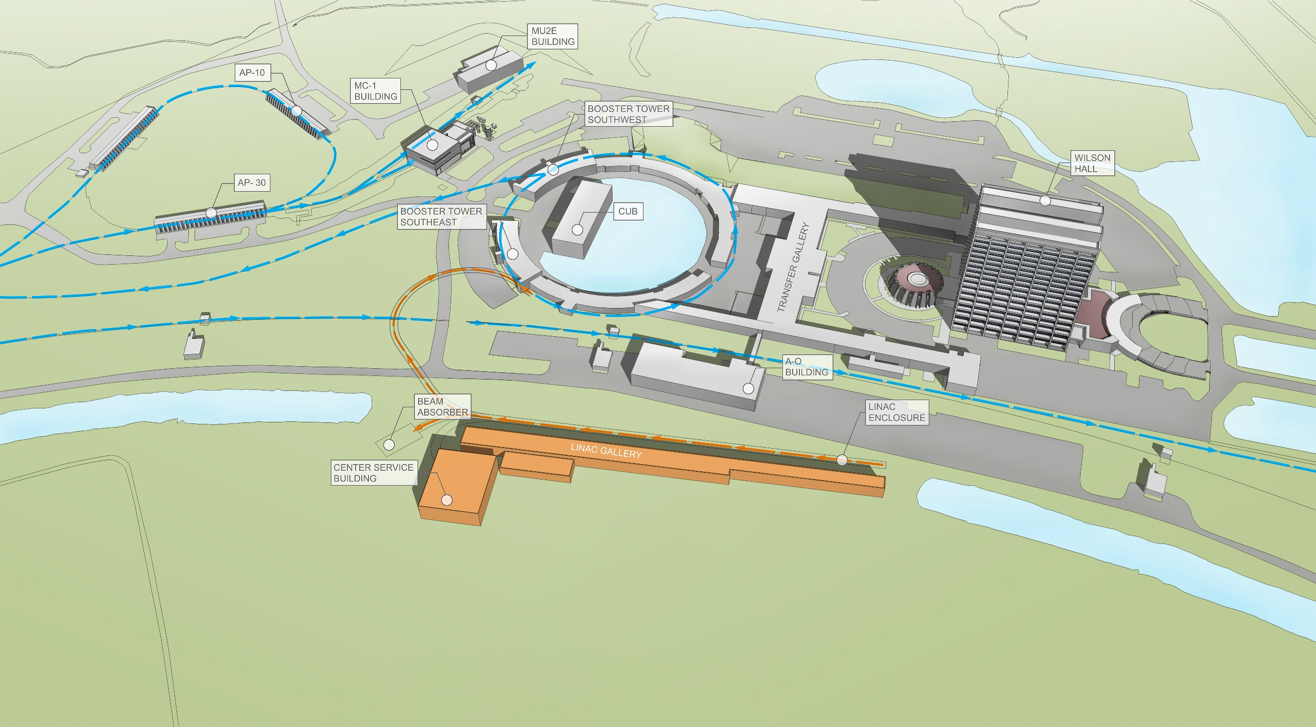
PIP-II Site Layout (provisional)

Slide 30
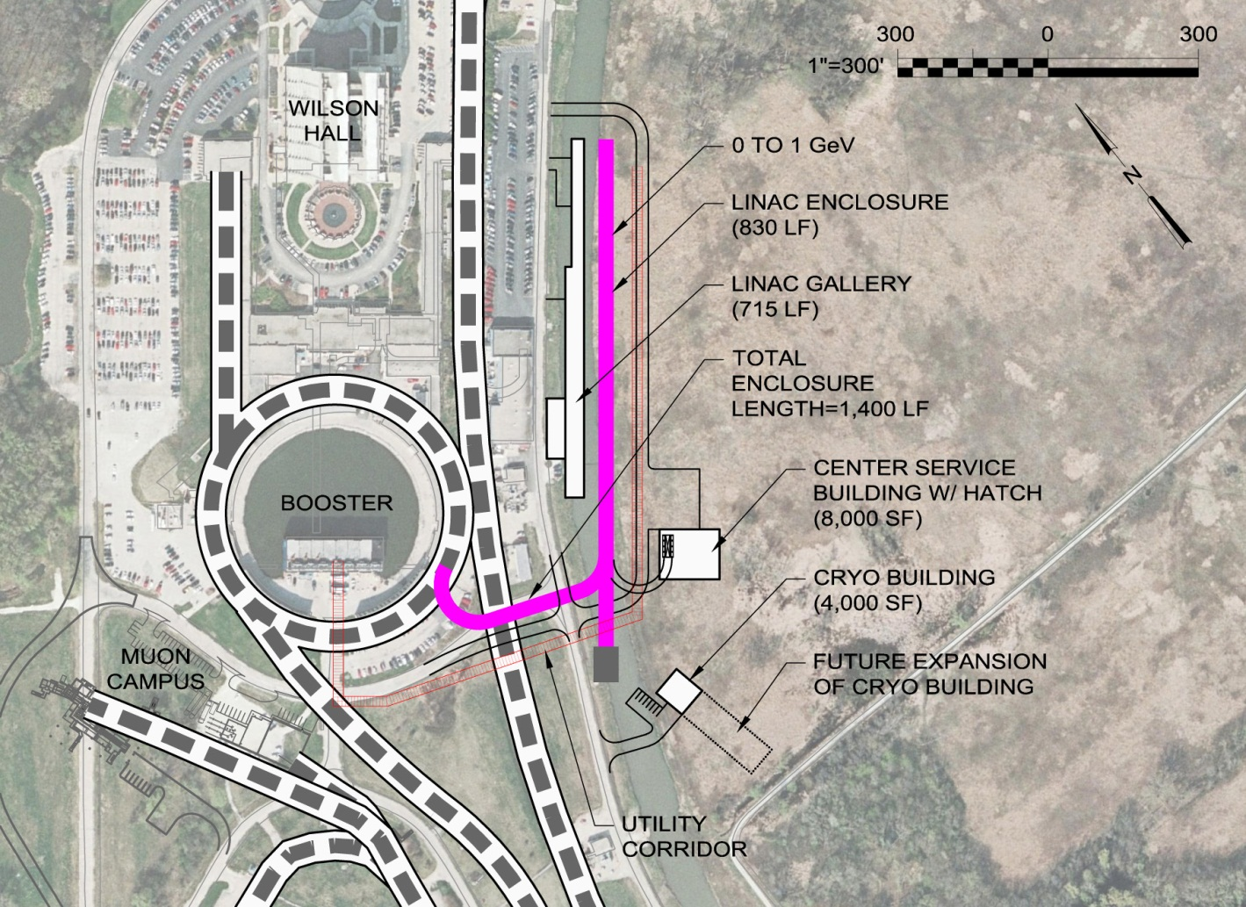
PIP-II Status
Development phase
  R&D program supports 2018-2019 construction start
  Collaboration with India
Strong support from P5, U.S. DoE, and the Fermilab Director
Five year construction period would support operations startup in 2023

Slide 31
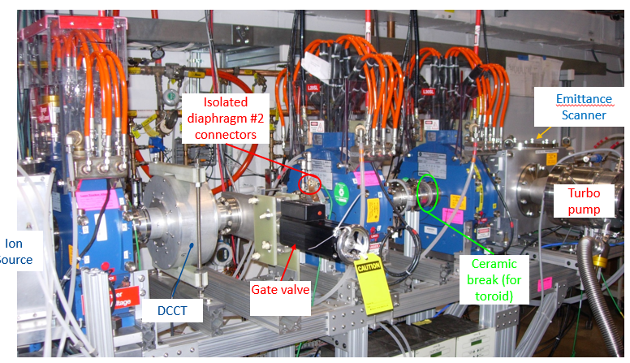
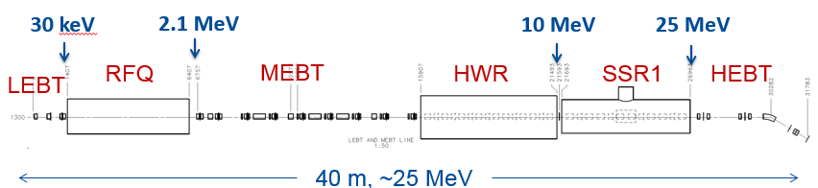
PXIE : Front End Test of PIP-II H- Source thru SSR1
PIP-II R&D facility under operation to address technical risks: source, warm RFQ, SC HWR and SSR1
Research goal: demonstrate feasibility of the most technically challenging PIP-II front end systems
Technical challenge: to demonstrate fast beam chopping pre-chopping, operation of SSR with beam, emittance preservation and beam halo formation through the front end
FY14 highlights: 30 keV IS and LEBT installed and commissioned with beam
Partnerships
ANL: HWR
LBNL:LEBT, RFQ
SNS: LEBT
BARC: MEBT, SSR1
Operations: 2014-

Slide 32
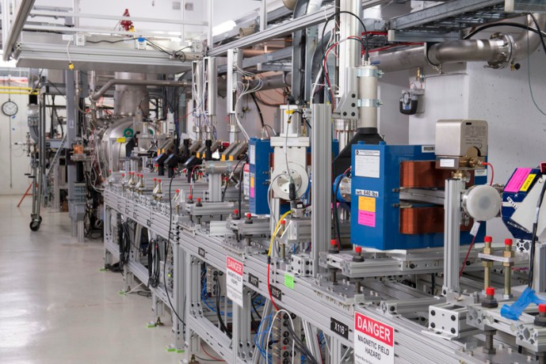
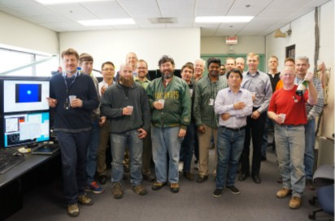
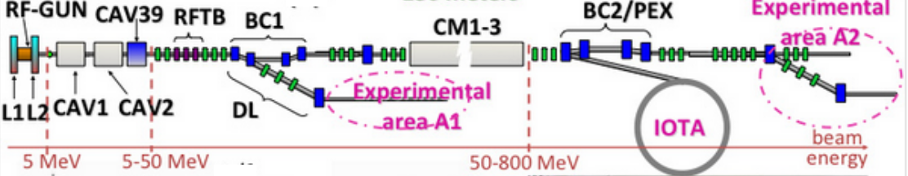
ASTA / IOTA
First beam to the absorber 3/27/15 – 20 MeV new record electron beam energy at Fermilab

Slide 33
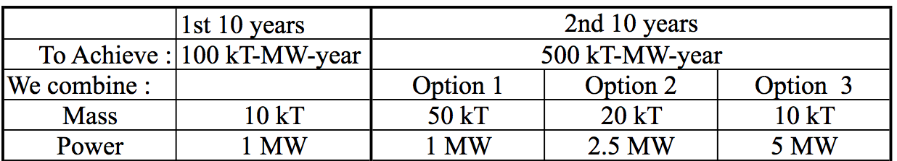
R&D toward multi-MW beams and targets at Fermilab
Beyond PIP-II (mid-term)
  Strategy after PIP-II depends on the technical feasibility of each option and the analysis of costs/kiloton versus costs/MW
  R&D on cost-effective SRF, control of beam losses in proton machines with significantly higher currents (Q_{SC}) and on multi-MW targets
  Establishing IOTA facility to explore novel approaches to rings
PIP-II

Slide 34
Summary
Fermilab is ready for the Intensity Frontier
  highest power neutrino beam at present
  well-defined strategy to maintain world leadership (PIP-II)
Accelerator improvements will soon enable the SBN and the muon program (Muon g-2, Mu2e)
  concurrently with NOvA
R&D toward multi-megawatt beam power and targets on the way
  IOTA, SRF, HPT, RaDIATE
Significant contributions at present and in the future to:
  LARP, MAP, LCLS-II
Continue to work with our partners on FCC and ILC design.

