Slide 1

700 kW Operations for NOvA at FNAL
Phil Adamson
pa@fnal.gov
IPAC 2015
5th May 2015

Slide 2

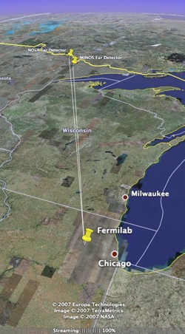
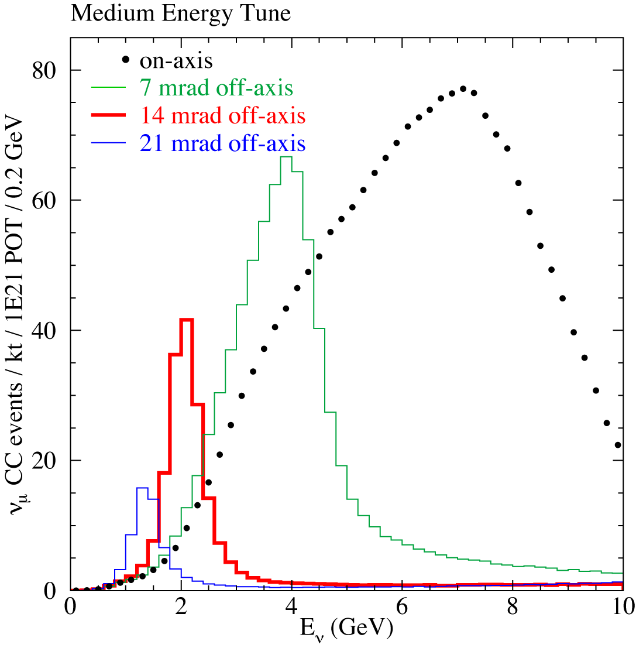
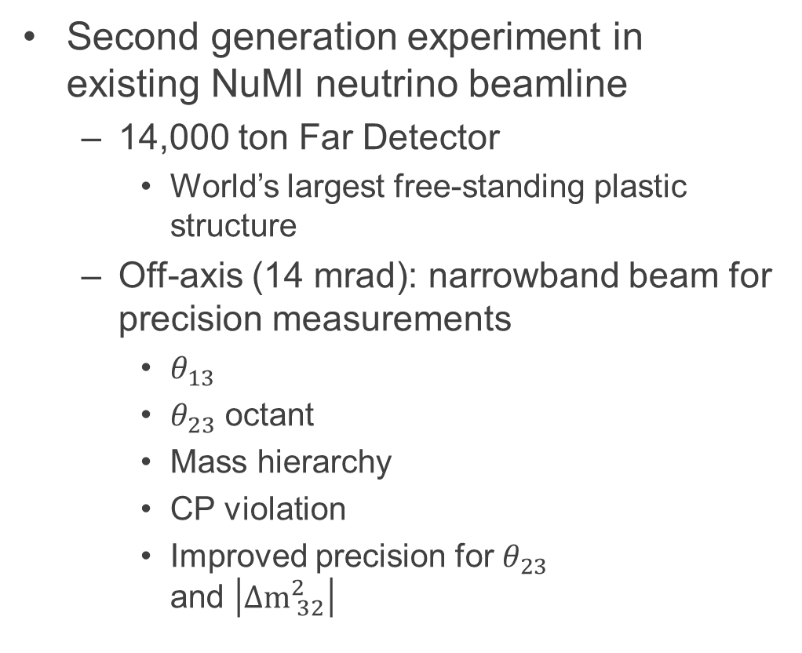
NuMI Off-axis $ν_{\text{e}}$ Appearance Experiment
Second generation experiment in existing NuMI neutrino beamline
  14,000 ton Far Detector
    World’s largest free-standing plastic structure
  Off-axis (14 mrad): narrowband beam for precision measurements
    $θ_{13}$
    $θ_{23}$ octant
    Mass hierarchy
    CP violation
    Improved precision for $θ_{23}$
    and $\left|Δ{\text{m}}_{ 32}^{2}\right|$

Slide 3
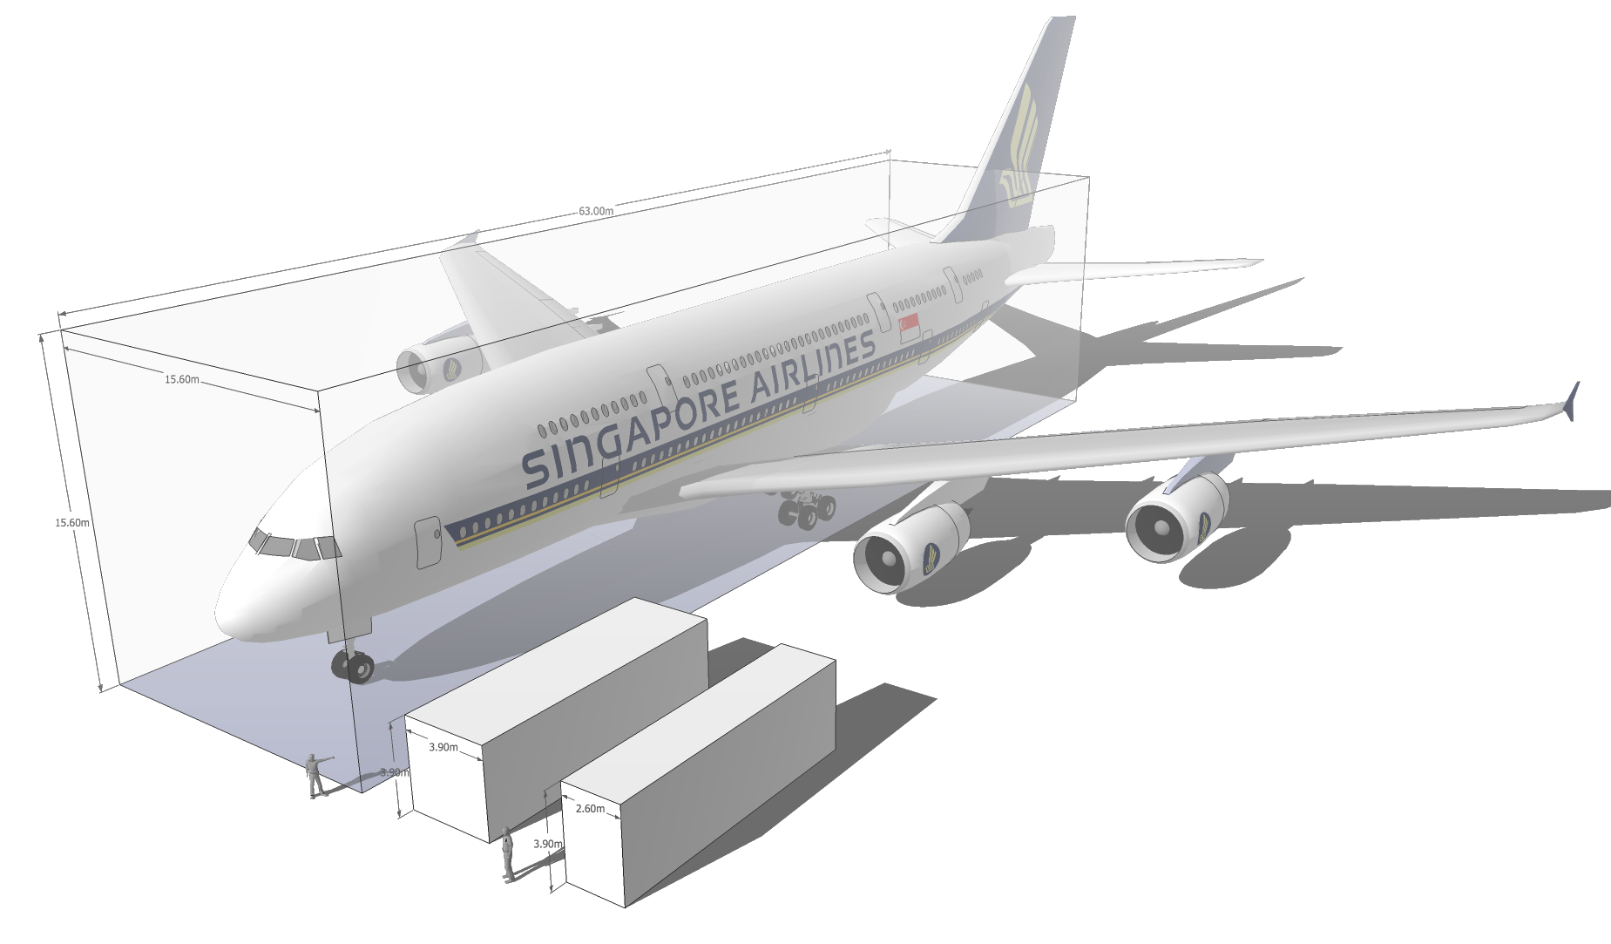
How big is NOνA far detector?
Image: A. Norman
FD is 15m ×15m ×63m
Imagine a shipping crate for an Airbus A380
Or a 6×6×5 stack of shipping containers

Slide 4
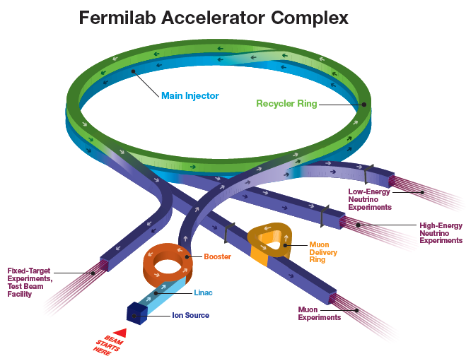
Providing beam to NuMI
H⁻ linac
Booster: 15Hz resonant
  400 MeV -> 8 GeV
  h=84
Main Injector
  8 -> 120 GeV
  h=588 (7*84)
  6 booster batches
  Double up with slip-stacking
NOvA project
  Increase NuMI power
  400 kW -> 700 kW

Slide 5
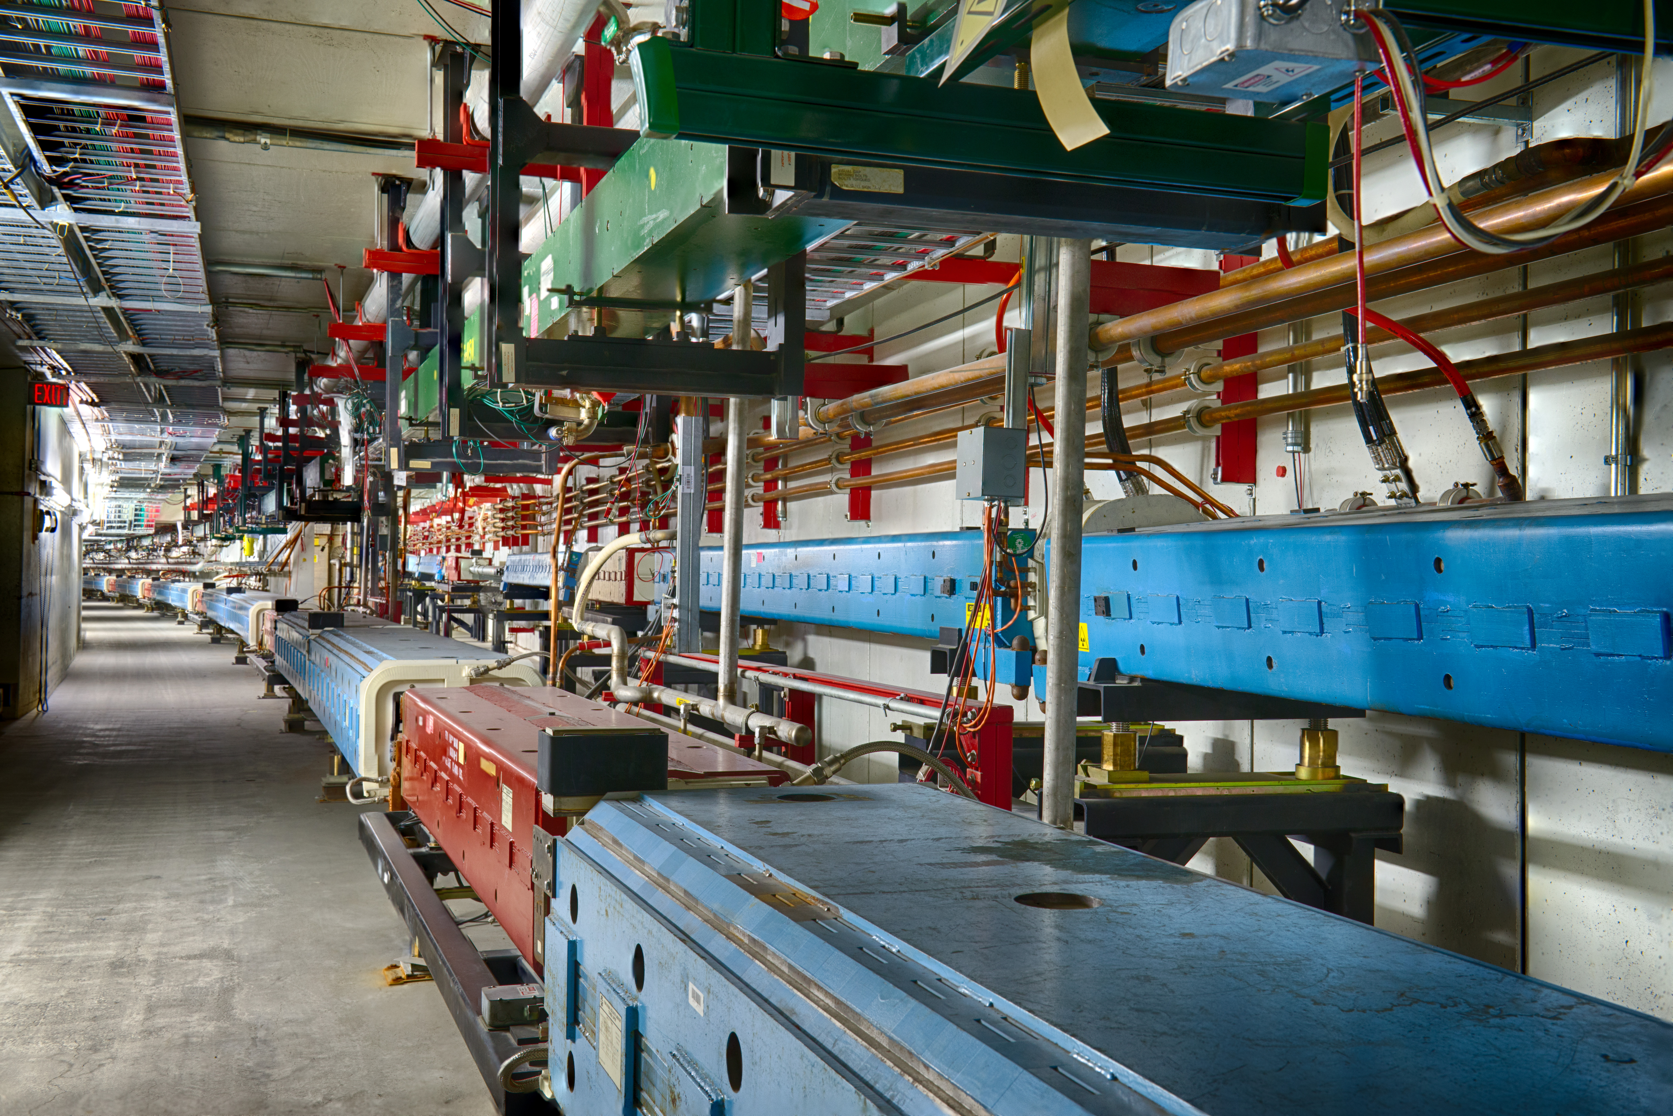

Recycler after the Tevatron
Recycler is a permanent magnet 8.9 GeV/c storage ring in the Main Injector tunnel
  Combined function strontium ferrite magnets, FODO lattice
    Strontium ferrite quads in straight sections
    Powered trim dipoles / quads / sextupoles
  TSP vacuum ${<10}^{−10}$ torr
Recycler
Main Injector

Slide 6
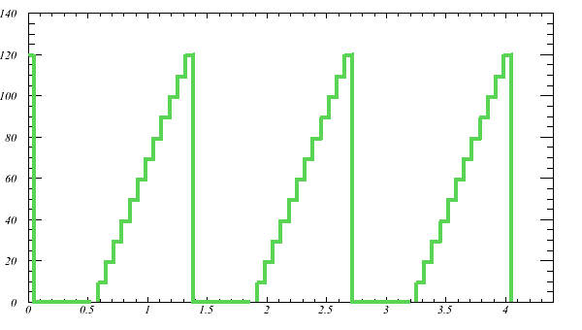
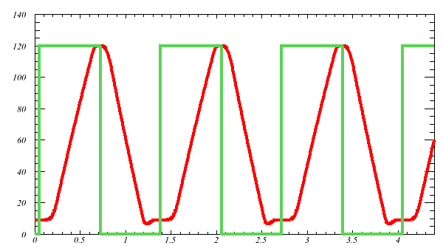
Scheme to increase beam power
Move slip-stacking to Recycler
  11 batch -> 12 batch
    (faster kickers)
Increase MI ramp rate (204 GeV/s -> 240 GeV/s)
  1.33s cycle time
380 -> 700 kW with only ~10% increase in per-pulse intensity
  Don’t expect new beam physics issues
  ~ double protons through Linac / Booster: need PIP
Recycler
Red: MI momentum
Green: beam intensity
Main Injector

Slide 7
Proton Improvement Plan
Linac / Booster deliver 2.3E17 protons per hour at 15 Hz
  Factor 2 increase in pulse rate and proton throughput
Operate Linac through 2023 / Booster through 2030
Project contains many elements throughout proton source:
  Reduce beam losses
    Notching / Magnetic Cogging / Apertures / Dampers
  Increase reliability (old equipment)
    rf solid state drivers / power distribution / LCW / linac modulator
  Eliminate risk of unavailability of spares (old equipment)
    7835 inventory / replacement modulator / klystron prototype
  Enable 15 Hz operation (Tevatron era: limit ~7.5 Hz)
    rf cavity refurbishment / tuner cooling upgrade
    700kW NOvA requires 9.8 Hz, then add BNB and g-2/mu2e

Slide 8
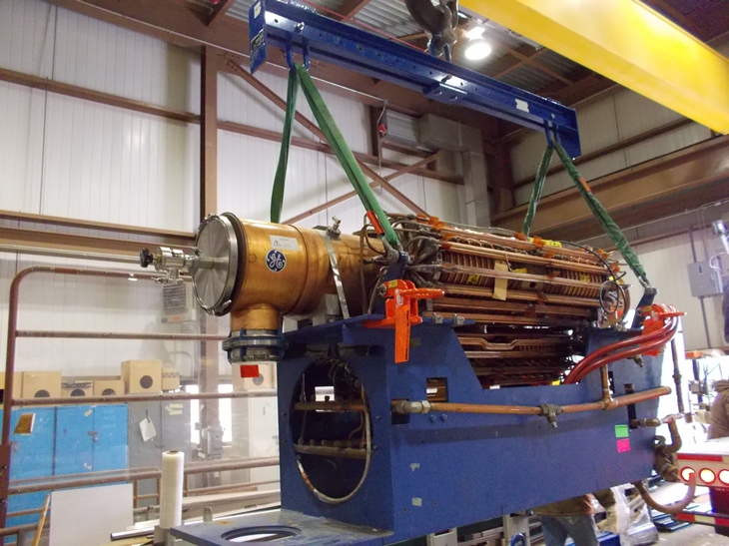
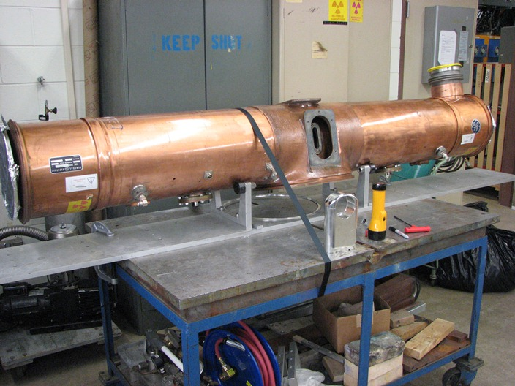
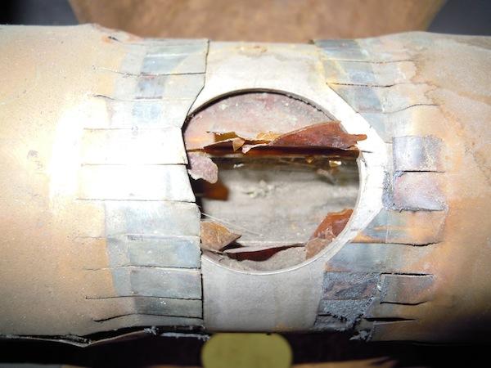
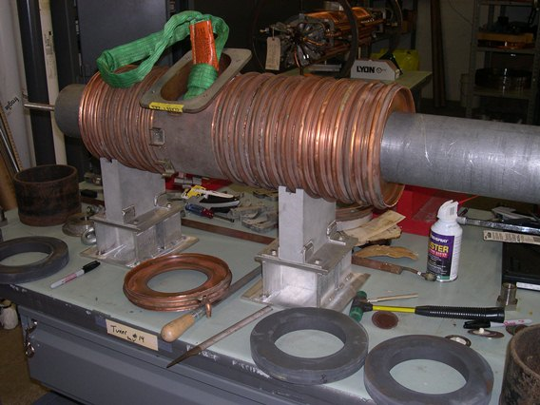
Booster Cavity Refubishment
Booster cavities were new in 1969
Refurb began Jan 2012
Booster had 19 cavities
  Remove two at a time for upgrade
  17 is minimum for 4.3E12 ppp
17th cavity installed last week
  Begin 15 Hz commissioning
20 cavities by end 2015

Slide 9
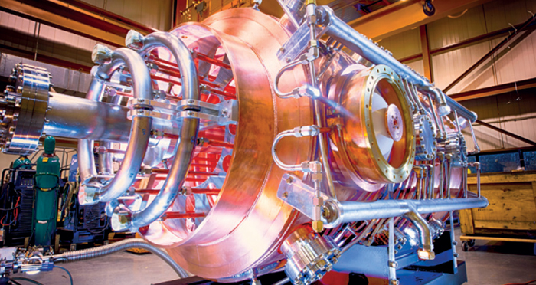
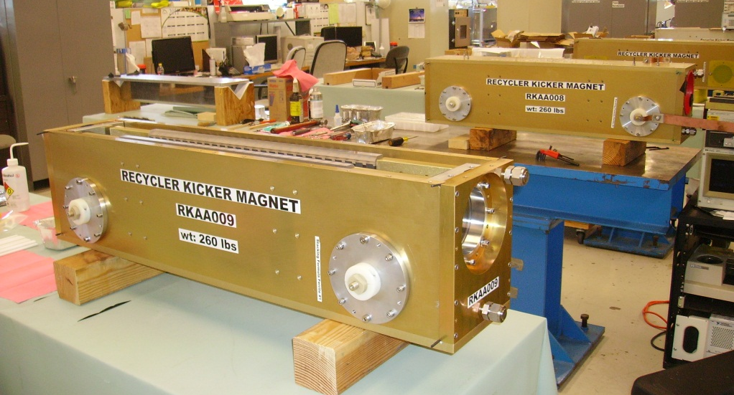
Necessary Recycler Upgrades
Remove pbar era hardware
Shim gradient magnets
  Change base tune and chromaticity
New injection line MI8 -> RR
  Short, fast kickers
    ~50ns full rise/fall
New RR -> MI transfer line
53 MHz RF (slip-stacking)
  2 cavities at ~100kV each, plus one spare
More trim quads / sextupoles
Instrumentation
  BPMs
  Low-mass Ti multiwires
  IPMs
  Dampers
Maintain TSP vacuum

Slide 10
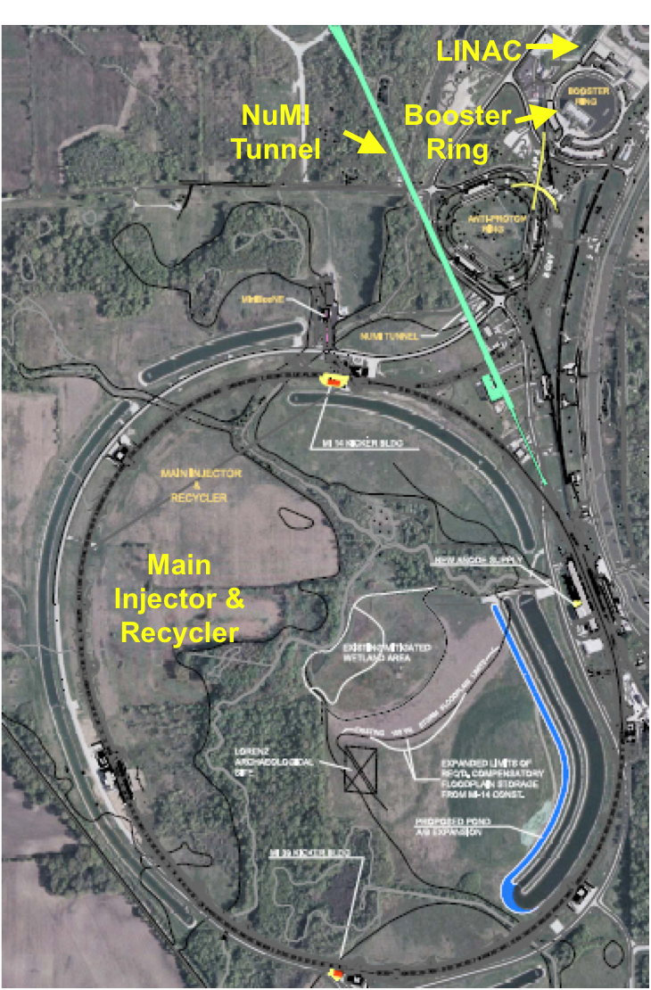
Long shutdown
Shut down from May 2012 to September 2013
  Recycler upgrades
  Faster MI ramp rate
    Add 2 MI RF stations (maintain bucket area)
    MI quad power supply / transformer upgrade
  Install 700kW target / horns in NuMI target hall

Slide 11
Recycler Commissioning
Turn on after shutdown with Main Injector
  NuMI at 240 kW
  SY120 (SeaQuest / Test Beam): Reduces NuMI power by 10% (program planning choice)
Commission recycler in parallel (effectively a brand new machine)
  Open up apertures (sequential!)
    Some issues with new installation
    Some pre-existing issues (pbars ~6π, protons 15-20π)
  Commission Recycler RF system and transverse dampers
  BLM soft/firmware upgrade: no dead time
  Orbit and tune corrections while MI is ramping
  Condition beam pipe (scrubbing)

Slide 12
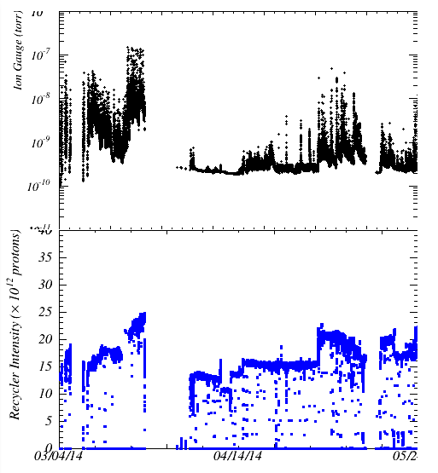
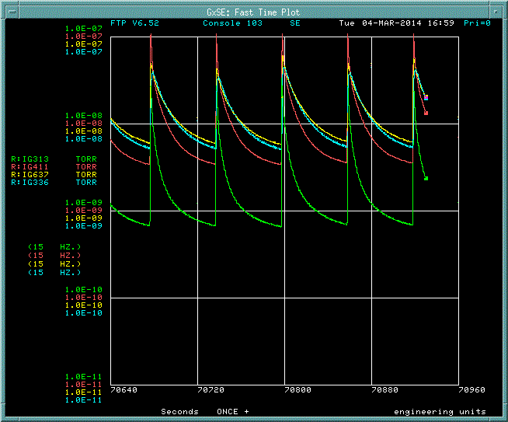
Vacuum Scrubbing
Dedicated scrubbing
1-2 pulse per minute
Vacuum response to beam, one pulse per minute
Start of scrubbing
1-2 pulse per minute commissioning
Electron bombardment of beam pipe surface liberates adsorbed gasses
Pressure reduction from gas desorbtion/pumping and SEY decrease

Slide 13
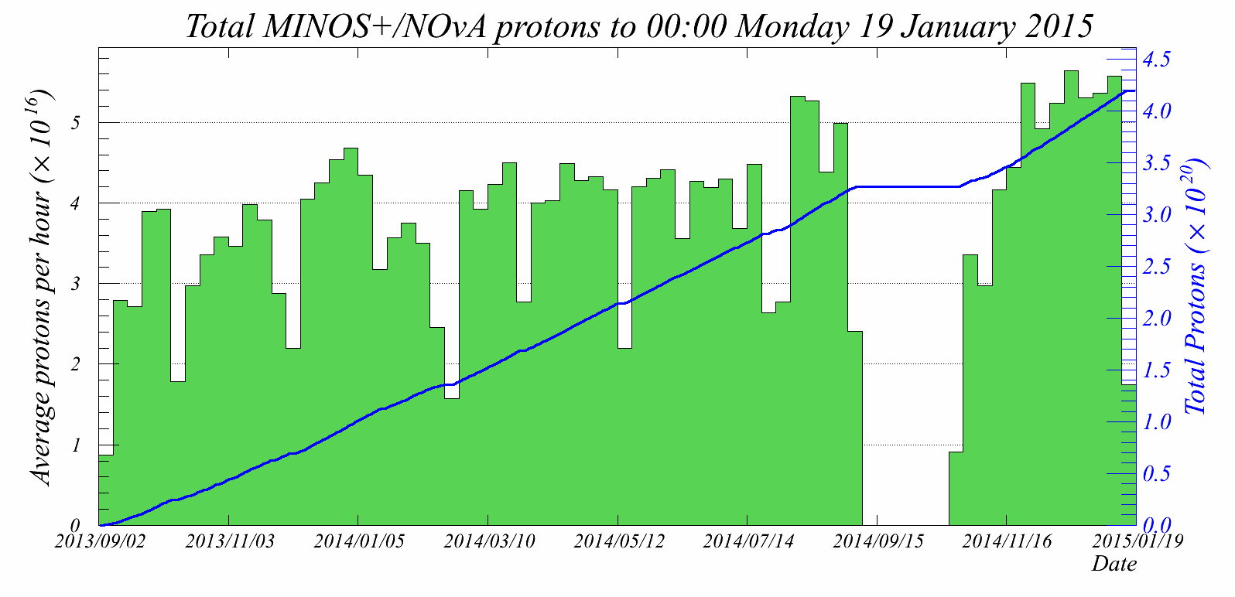
Recycler Commissioning
320 kW with recycler
Typical 240 kW with MI only
Switch to recycler when reach break-even (6 batch boxcar)
  Discovered horizontal instability (more later)

Slide 14
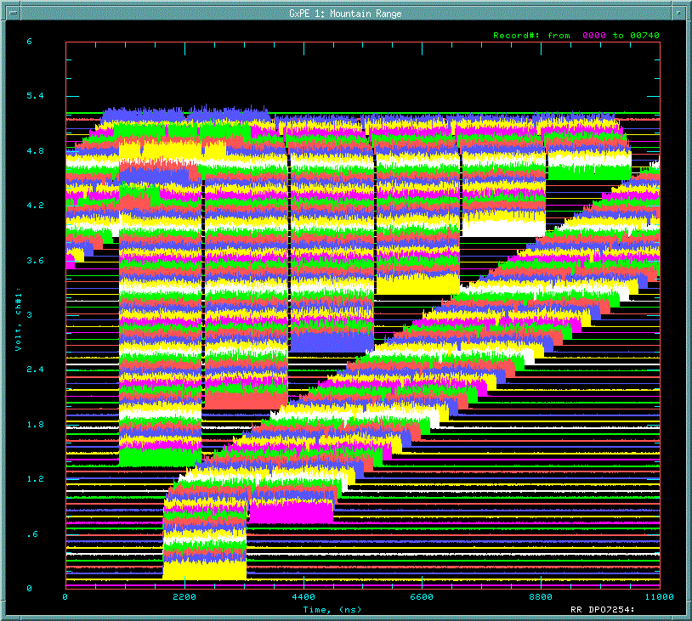
2+6 slip-stacking
Can operate without upgraded Booster rep rate
2+6 ->
  Decelerate 2 batches
  Inject 6 more
  Recapture by firing transfer kickers at right time
    Into ~1MV MI bucket
  Recycler injections on MI downramp
0.5 seconds
Recycler circumference

Slide 15
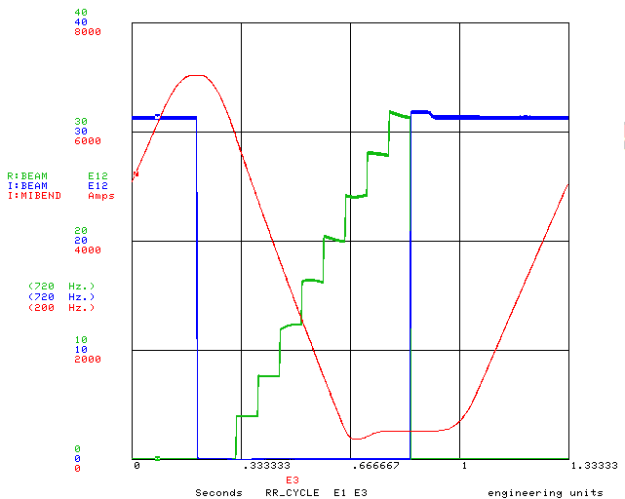
2+6 slip-stacking
Can operate without upgraded Booster rep rate
2+6 ->
  Decelerate 2 batches
  Inject 6 more
  Recapture by firing transfer kickers at right time
    Into ~1MV MI bucket
  Recycler injections on MI downramp

Slide 16
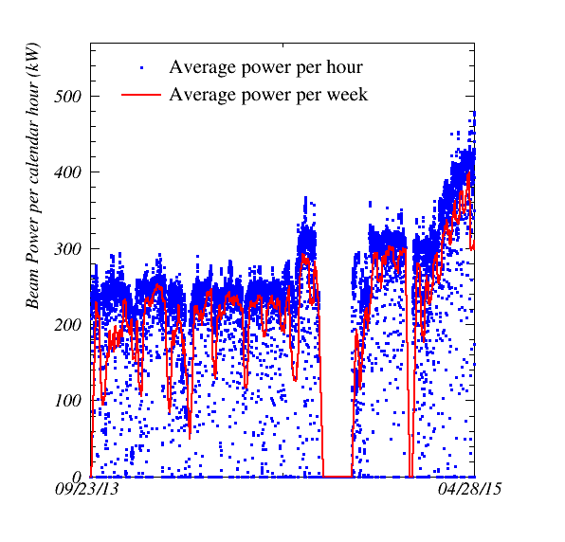
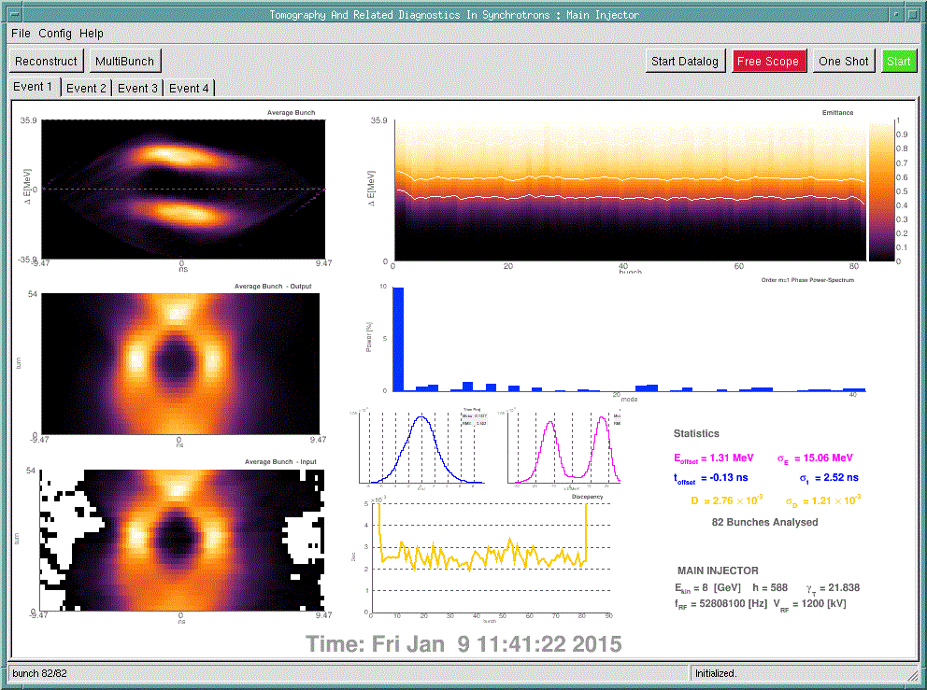
2+6 slip-stacking
Slip-stacking recapture in MI
RR 2+6
RR 6-batch
MI only
ΔE (MeV)
Time (ns)

Slide 17
2+6 slip-stacking
Shown is beam power per calendar hour (blue) and per rolling 168 hour week (red)
  Peak hour 482.8 kW
    No SY120
  Best continuous week average 400.4 kW
    With SY120
RR 2+6
RR 6-batch
MI only

Slide 18
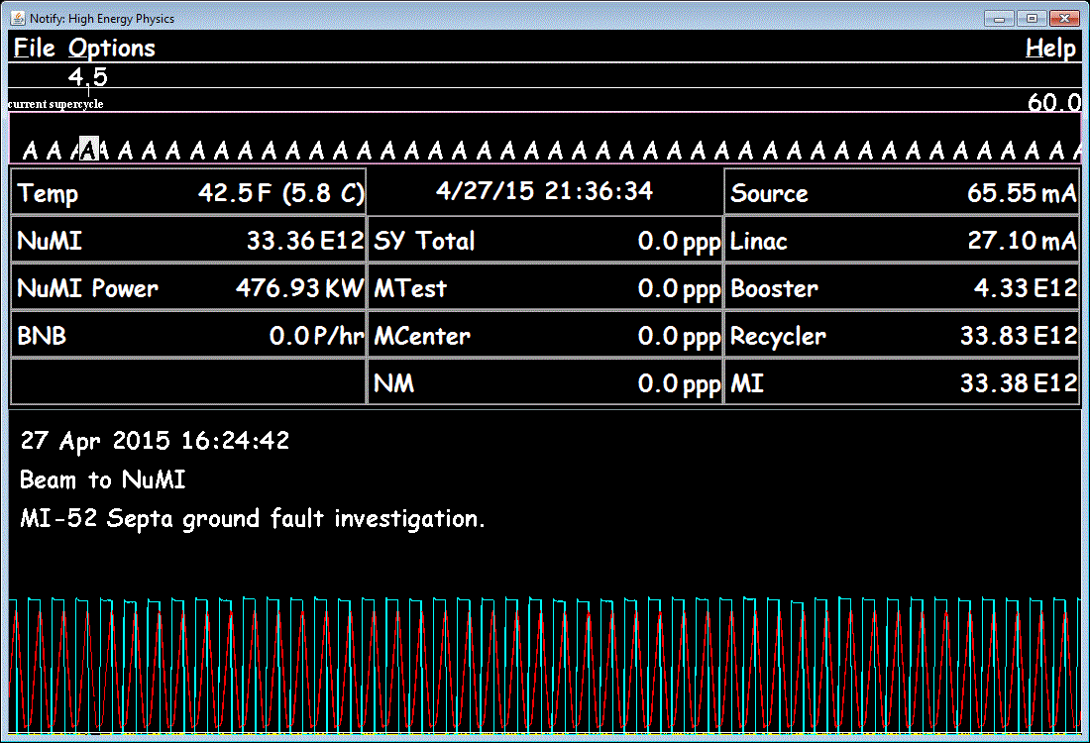
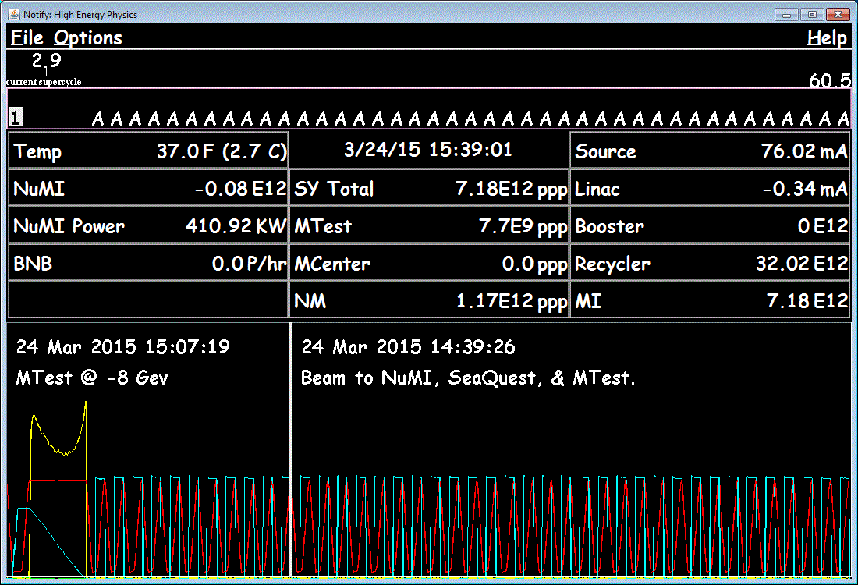
Normal Operation
SY120 not running
SY120 running

Slide 19
Roadmap to 700kW
700
Current Operation
  2+6 slip-stacking
  460-480 kW (without SY120 in timeline)
  4.3E12 per booster batch
  6.8 Hz booster pulsing
Met 2+6 milestones in March
RR 2+6
RR 6-batch
MI only

Slide 20
Roadmap to 700kW
700
RR 2+6
RR 6-batch
MI only
May 2015
  Run 4+6 slip-stacking for 1 hour
  Needs 8.3 Hz booster pulsing

Slide 21
Roadmap to 700kW
700
RR 2+6
RR 6-batch
MI only
October 2015
  After shutdown
  4+6 slip-stacking operational at current 460 kW
  Needs 8.3 Hz booster pulsing

Slide 22
Roadmap to 700kW
700
RR 2+6
RR 6-batch
MI only
November 2015
  4+6 slip-stacking operational at 575kW (4.3E12 per booster batch)
  Needs 8.3 Hz booster pulsing

Slide 23
Roadmap to 700kW
700
RR 2+6
RR 6-batch
MI only
January 2016
  6+6 slip-stacking operational at 575kW
  Needs 9.8 Hz booster pulsing

Slide 24
Roadmap to 700kW
700
RR 2+6
RR 6-batch
MI only
February 2016
  6+6 slip-stacking operational at 700kW (4.3E12 per booster batch)
  Needs 9.8 Hz booster pulsing

Slide 25
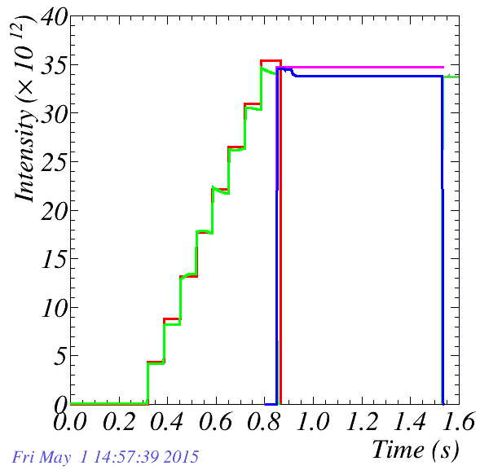
Current Beam Losses (400kW + sustained operation)
Recycler efficiency 98.5% -> 440W loss
  cf. MI transverse loss in Tev era
MI start of ramp loss 2% -> 670W loss
MI transition 40W loss
Total tunnel loss 1.2kW
  360 mW/m
But it’s not distributed round the ring
Injected to RR
RR DCCT
Transfer line
MI
NuMI
Typical current cycle

Slide 26
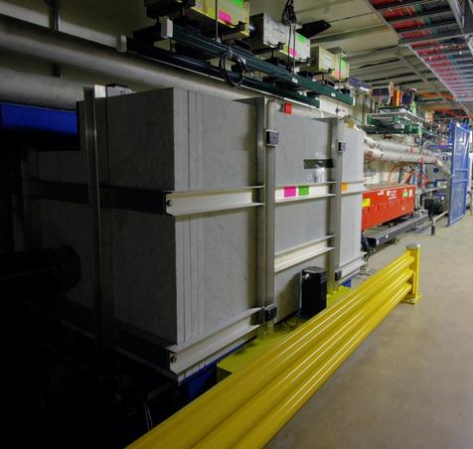
Collimating losses
MI start of ramp loss 670W, but ~95% captured by MI ring collimators
  30W loss elsewhere (Lambertsons)
  40W transition loss (few spots in
  arcs)
RR 440W loss mostly at a few
locations with poor aperture
  Build recycler collimators to trap
  these losses
    Only a couple of high-ceiling spots
    suitable (RR usually less than 1 foot from ceiling)
    Design in progress (like MI, but vertical only?)
    Aim to install in 2016 shutdown

Slide 27
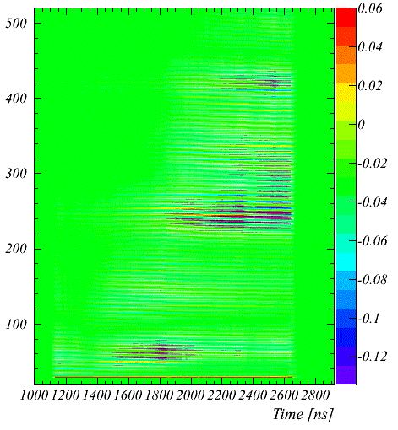
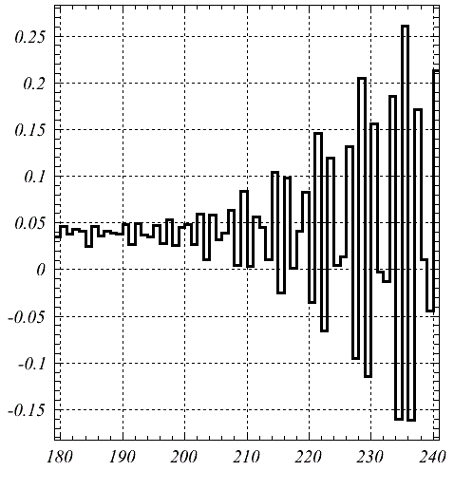
Recycler Horizontal Fast Instability: a surprise
Color scale shows horizontal motion
When we started to run the six-batch boxcar cycle at high intensity
Fast instability at injection for high linear charge density
  Only in horizontal plane
  Single batch effect – not made worse by more beam in machine
    In fact, the opposite
    Before 2014 shutdown, first batch intensity ~80% of others
  After shutdown, can run full intensity without instability
  Hints that threshold increased with vacuum scrubbing
Growth rate 10-15 turns
Machine turns
½ synchrotron period
One batch, at injection

Slide 28
Recycler Horizontal Fast Instability: a surprise
Color scale shows horizontal motion
Doesn’t occur in Main Injector at same intensity
  (even with shorter bunches)
Differences between RR and MI
  Combined function magnets?
  RR beam tube a little smaller
  Studies and simulations in progress
    E-cloud is a popular explanation given the fast growth rate, but we can’t yet explain all the details
  Similar instability seen at extraction in CERN PS?
    R. Steerenberg et al., PAC07
  Does not occur for 700kW operations
    Potential issue at PIPII intensity
Growth rate 10-15 turns
Machine turns
½ synchrotron period
One batch, at injection

Slide 29
Outlook for Main Injector / Recycler
This decade
  Current peak hour 482.8 kW / 400.4 hour continuous week
  Deliver 700 kW to NuMI to support NOvA physics
    700 kW milestone next February
  Install Recycler collimators
  Replace TSPs with ion pumps (next 3 years)
  Install 2.5 MHz rf, extraction line in Recycler for g-2/mu2e
Next decade: more power. PIP -> PIP-II
  Initial 1.2 MW to LBNF/DUNE
  Same slip-stack scheme as current 700 kW, but 50% more beam per pulse (and small rep rate increase)
    New rf in RR, MI
    New beam physics issues?
  End of the road for lossy slip-stacking – replace Booster to go higher

Slide 30
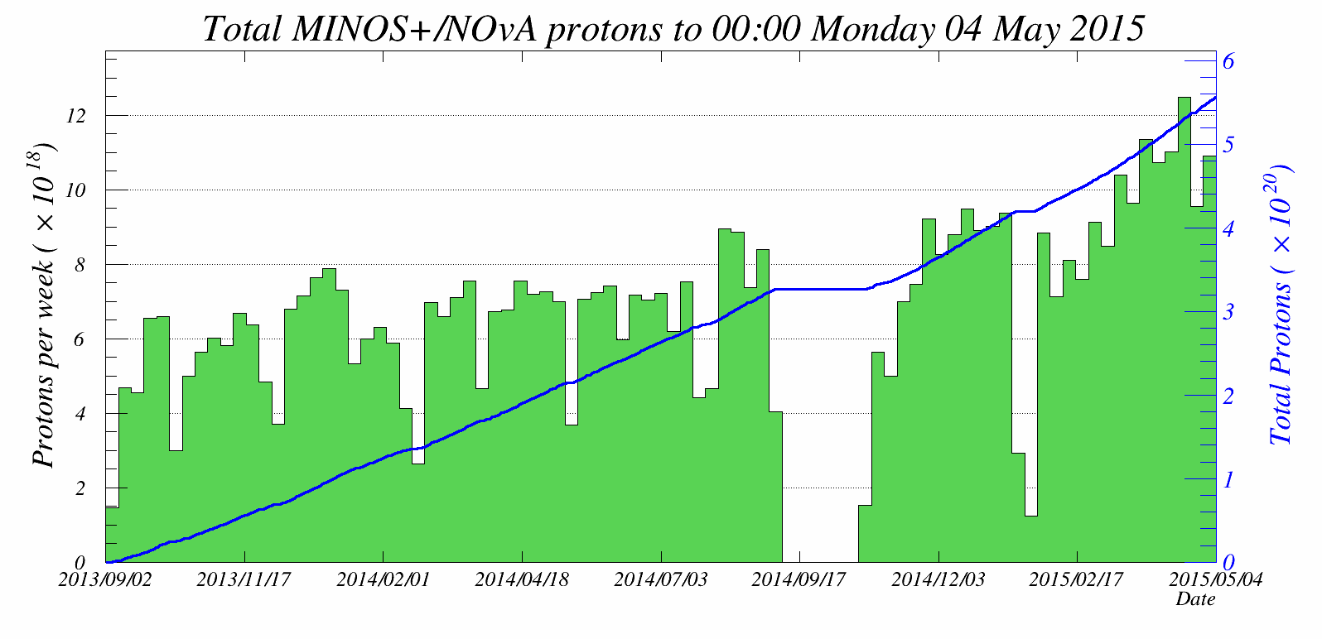
Backup Slides

Slide 31
Challenges for 4+6 and 6+6
Transverse damping challenging for region where beams overlap
  Small for 2+6, larger for 4+6 and 6+6
  Need to run with larger chromaticity to gain stability
    Expect to be a little lossier, but ran like this in MI
4+6
6+6

Slide 32
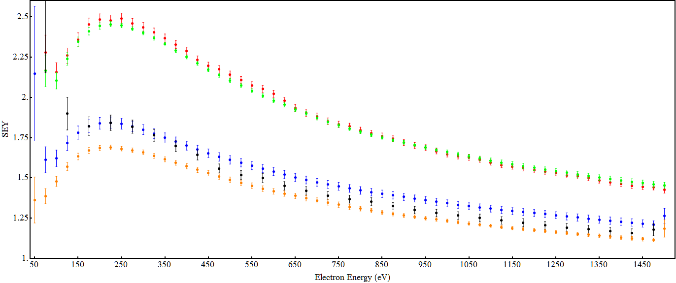
MI SEY (316L SS) for different intensities
Initial
3E10 p/b
5E10 p/b
5E10 p/b
6E10 p/b

Slide 33
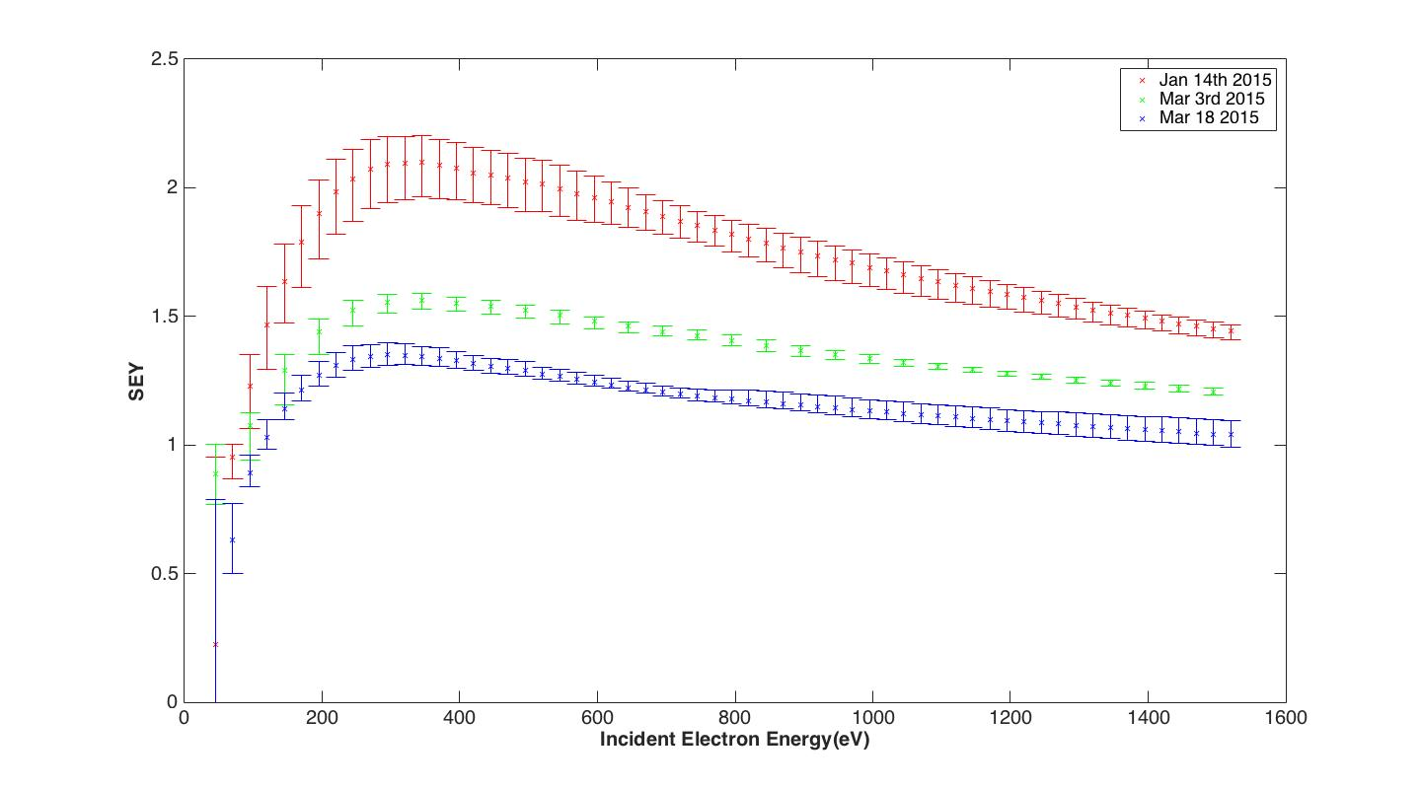
MI SEY (TiN coating) for different intensities
Initial
6E10 p/b
8E10 p/b

Slide 34
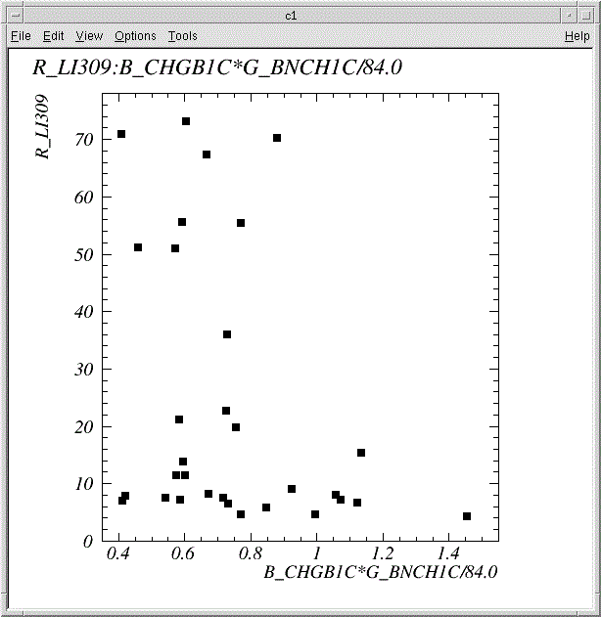
Leading small batch stabilizes large batch
A batch that would go unstable is stable if there’s already a small batch in the machine
  Depends on total beam in the small batch
  Not on bunch intensity or number of bunches
But has to remain in the ring. Replacing the small batch with the large one doesn’t have stabilizing effect
Loss monitor at 309
Total intensity in small batch

Slide 35
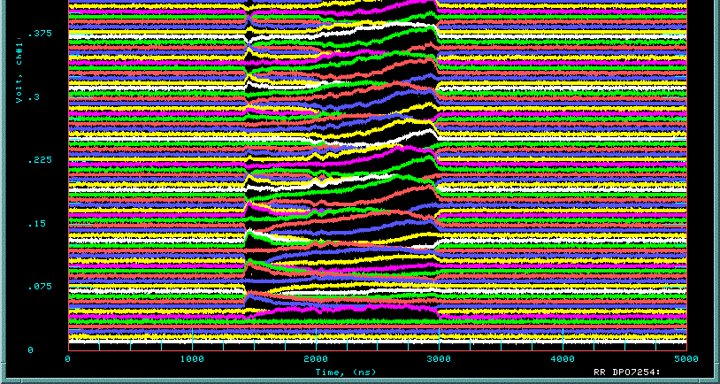
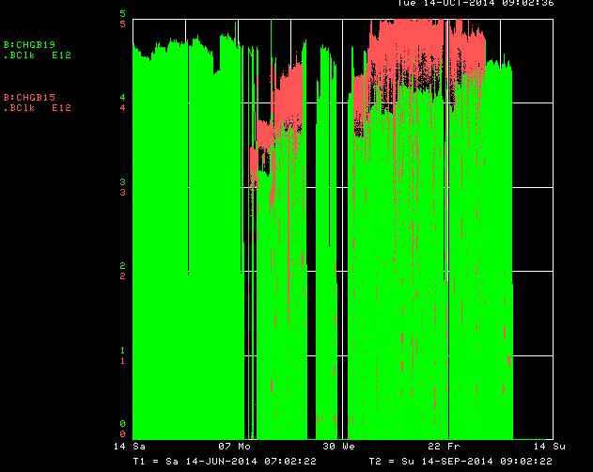
A surprise: Recycler fast horizontal instability
Coherent horizontal motion grows in second half of batch
  Coupling between bunches
Before fall shutdown
  Instability present for second and subsequent injections on multi-batch cycle, but threshold is higher
    Green: first injection
    Red: Other injections
Since shutdown, instability does not impede normal operation
  Don’t need smaller first batch

Slide 36
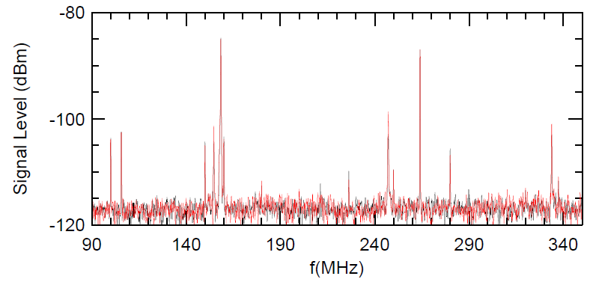
Some causes of Recycler Instability ruled out
Happens with and without transverse dampers
RF cavity modes match simulation – no surprises
Changing cavity tuning has no effect
Other impedance in machine a few orders of magnitude too small to make 10-15 turn growth rate

Slide 37
