Slide 1



Final Cooling For a High-luminosity High-Energy Lepton Collider
David Neuffer
Fermilab
Don Summers, Terry Hart
(University of Mississippi)
H.Sayed (BNL)

Slide 2
Outline
Motivation
Final Cooling for a Collider & Simulation
  – R. Palmer & H. Sayed
Final scenario variation
  w /D. Summers & T. Hart
  round to flat and slicing ….
  emittance exchange
  bunch combination

Slide 3
P5 Goals: Long-Range Accelerator R&D
“For e⁺e⁻ Colliders the primary goals are:
  improving the gradient and lowering the power consumption”
    P5, Building for Discovery , p. 19 (May 2014)

Slide 4
P5 Goals: Long-Range Accelerator R&D
“For e⁺e⁻ Colliders the primary goals are:
  improving the gradient and lowering the power consumption”
    P5, Building for Discovery , p. 19 (May 2014)
Both goals are achieved by increasing the mass of the electrons
  Higher mass electrons will not radiate; enabling multipass acceleration; gradient is improved by number of turns
  Non-radiating electrons, multipass acceleration, consume less power
Changing the electron mass … (m_{e} is quantized)
  0.511, 105.6, 1777 MeV
105.6 MeV is optimum for next generation e⁺e⁻ Colliders
  requires E‘ >> m_{e} / cτ_{e} = 0.16 MV/m

Slide 5
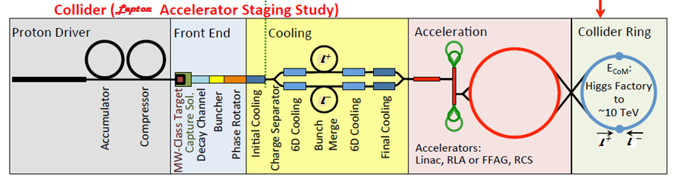
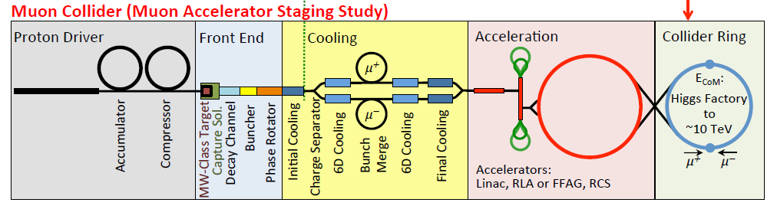
Towards multi-TeV lepton colliders
Parameter | Unit | Higgs factory | 3 TeV design | 6 TeV design
Beam energy | TeV | 0.063 | 1.5 | 3.0
Number of IPs |  | 1 | 2 | 2
Circumference | m | 300 | 2767 | 6302
β* | cm | 2.5 | 1 | 1
Tune x/y |  | 5.16/4.56 | 20.13/22.22 | 38.23/40.14
Compaction |  | 0.08 | -2.88E-4 | -1.22E-3
Emittance (Norm.) | mm·mrad | 300 | 25 | 25
Momentum spread | % | 0.003 | 0.1 | 0.1
Bunch length | cm | 5 | 1 | 1
H. electrons/bunch | 10¹² | 2 | 2 | 2
Repetition rate | Hz | 30 | 15 | 15
Average luminosity | 10³⁴ cm⁻²s⁻¹ | 0.0025 | 4.5 | 7.1

Slide 6
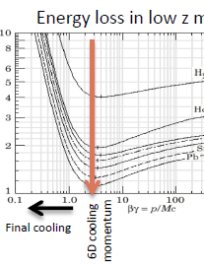
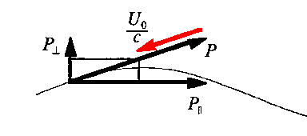
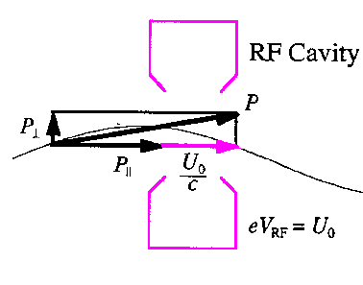
High-Luminosity Lepton Colliders need cooling
light e⁻
  radiation damping
Lose P_{e,t} in bends - synchrotron radiation
Regain only P_{z} in rf
heavy e⁻
  “ionization cooling” ….
Lose P_{l,t} in material –
Regain only P_{z} in rf
Heating by
multiple scattering

Slide 7
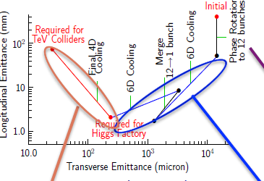
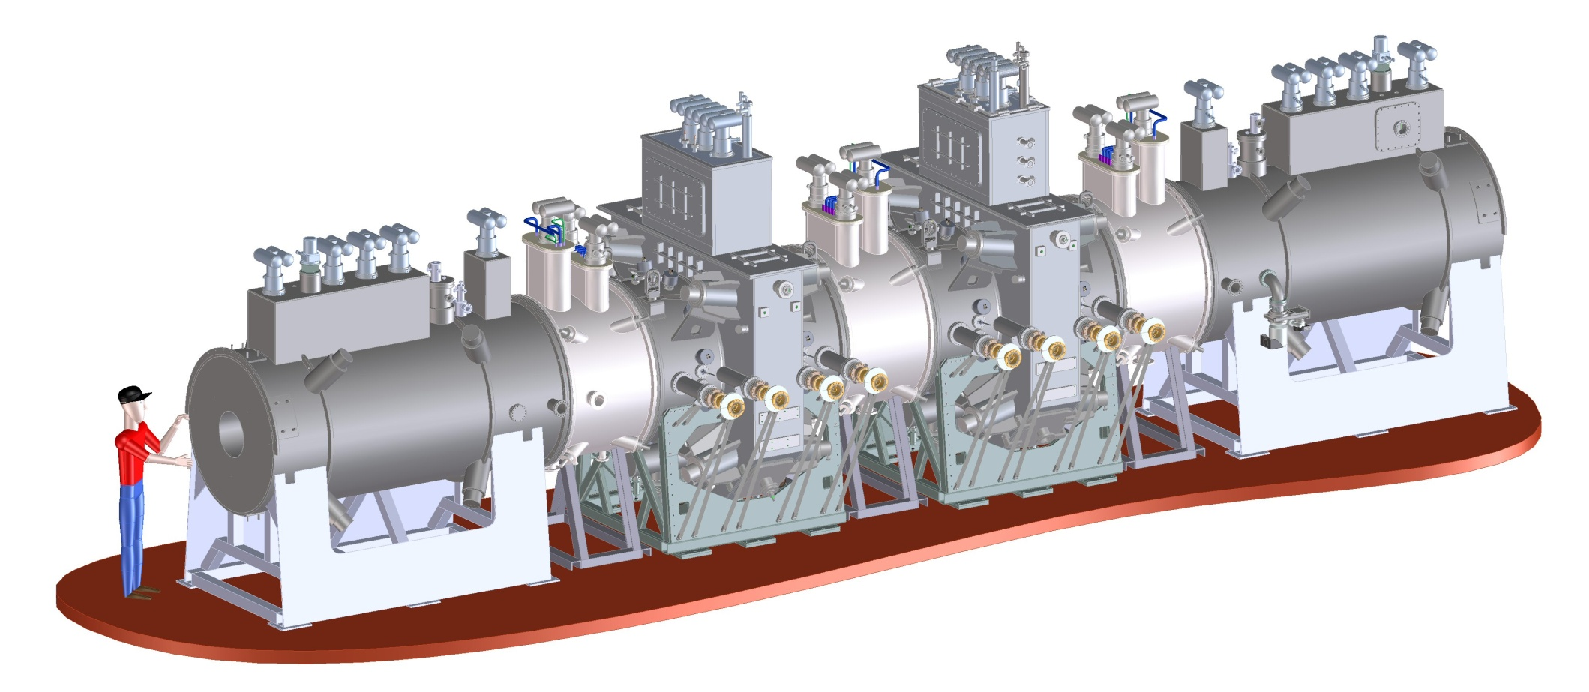
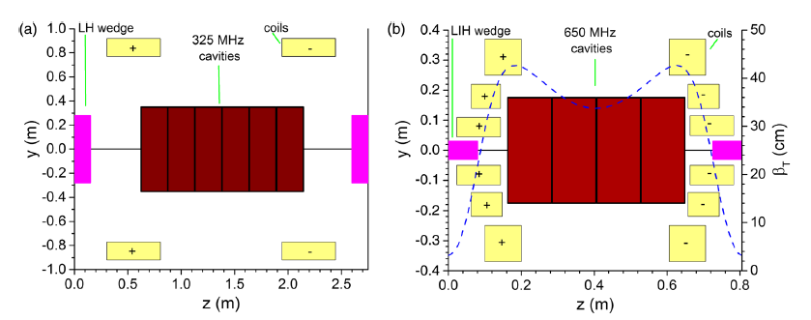
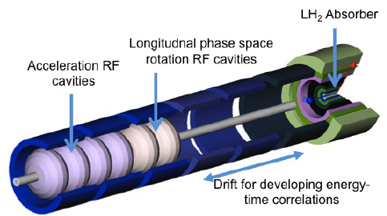
Cooling for High Energy יי Collider
Need Beam Cooling to reach high luminosity
  Early stages: Cool ε_{t,N} ~ 0.02 m -→0.0003 m
    (10cm × 0.1 rad)→(1cm ×0.02 rad)
      enough for 0.125 TeV Collider
  Established by simulation, MICE
    uses 325/650 MHz rf
    solenoidal focusing; B 2T →14T
        Stratakis et al. PRSTAB 18, 031003 (2015)
  Final Cooling more difficult:
    more extreme parameters
    B → 50T ; f_{rf}: 20→4MHz; E→ 4 MeV

Slide 8
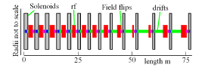
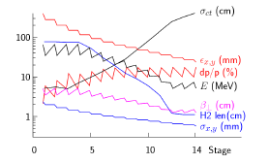
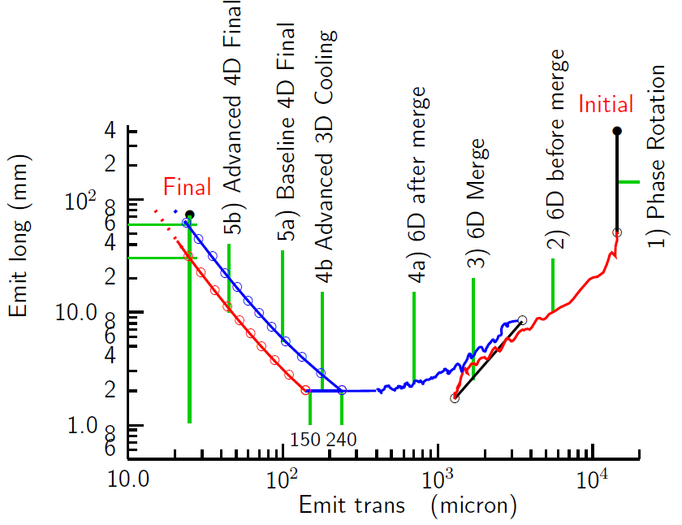
Final cooling baseline
(R. Palmer et al. IPAC12)
Baseline Final Cooling
  solenoids, B → 50T
  H₂ absorbers,
  Low momentum
  ε_{t,N} : 3.0 →0.3 ×10⁻⁴ m
  ε_{L} : 1.0→70mm
    expensive emittance exchange

Slide 9
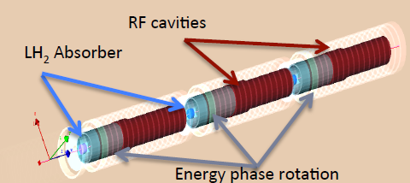
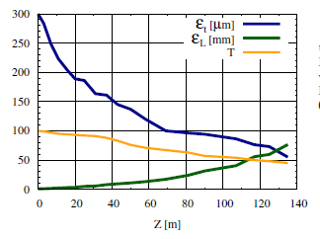
Detailed simulation of final cooling
(H. Sayed et al. IPAC14)
G4Beamline simulation of final cooling scenario
  System is ~135m long
  ε_{t,N} : 3.0 →0.5 10⁻⁴ m
  ε_{L} : 1.0→75mm
    P_{l} :135 → 70 MeV/c
    B: 25 →30 T; 325➔ 20MHz
    not quite specs
  Transmission ~ 50%
Predominantly ε_{t,N} / ε_{L}
emittance exchange

Slide 10
Variant Approaches
Keep P_{l}, B, E’, f_{rf} within ~current technology
  P > 100MeV/c; B~8➔15T; f_{rf} > ~100MHz
Explicitly use emittance exchange in final cooling
  Round to flat beam transport
  bunch coalescence
  thick wedge energy loss
  Beam slicing and recombination
Vary technology choices
  “Flat beam” variations
  solenoid → quad focussing
Not (yet) including extreme methods
  Li lens, parametric resonances

Slide 11
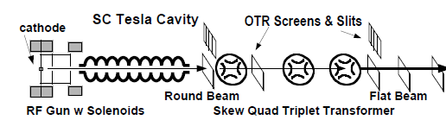
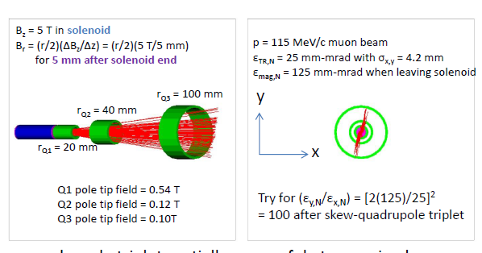
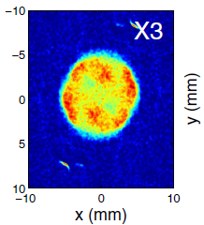
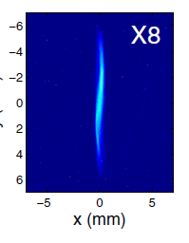
Round to flat transformation
Light electron source ~MeV
Cold source immersed in solenoid
  large canonical L
solenoid to skew quad triplet
Changes “round” beam to flat
Heavy Electron source ~100MeV
Cooled within solenoids
  cools transverse P_{k}
  large canonical L (if no field flips)
Can develop large difference in emittance modes
D. Edwards et al.,
Linac2000 p.122
P.Piot et al.,
PRSTAB 9,031001
2006

Slide 12
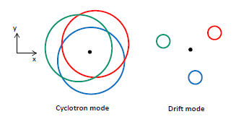
Beam Dynamics:
Eigenmodes in solenoid
Round to Flat transform requires round beam formation in a solenoid
In solenoid:
  Coordinates are x, p_{x,} y, p_{y}
    k_{x}= mγv_{x}
Alternative canonical coordinates:
  Cyclotron mode
  Drift mode
  Round to flat: (k, d) to (x, y)
References
A. Burov, S. Nagaitsev, A. Shemyakin, PRSTAB 3 094002 (2000)
A. Burov, S. Nagaitsev, Y. Derbenev, Phys. Rev. E 66, 016503 (2002)
K.J. Kim, PRSTAB 6 104002 (2003)

Slide 13
Cooling within solenoids
Ionization cooling
  Absorbers within solenoids
    Cools k₁, k₂
  Cyclotron mode is preferentially cooled
  With
  Typically (at ε_{x}= ε_{y}= ε_{t})
    ε₁ε₂ =ε_{k} ε_{d}= (ε_{t}-ℓ) (ε_{t}+ℓ)
With field flips:
  k_{1,} k₂ and d₁, d₂ change identities with each flip
  Both modes are equally damped
    Angular momentum is damped
Without field flips
  One mode is preferentially cooled
  Canonical angular momentum not damped

Slide 14
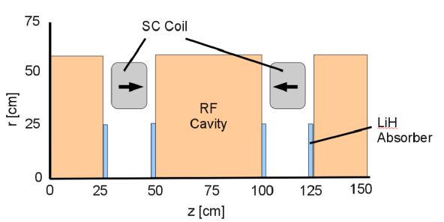
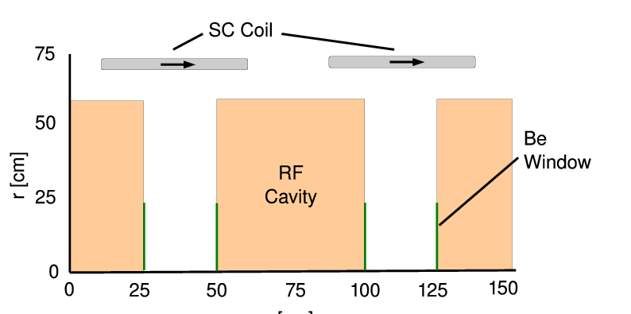
Example: Front End Cooling
With field flip
  100m of cooling:
ε_{┴,N} : 0.016→0.0054
  ℓ damped:0.45→0.05
    ε₊ , ε₋ both damped
Without field flip
  100m of cooling
ε_{┴,N}=(ε₊ ε₋)^{1/2} :0.016→0.0078
  ℓ increases:0.45→1.20
    ε₊ /ε₋ = ~15
  k_{x,}k_{y} are damped d_{x}, d_{y} not damped
ε_{+c}
ε_{+c}
ℓ
ε₋
ε_{t,N}
ε_{t,N}
ℓ
ε₋

Slide 15
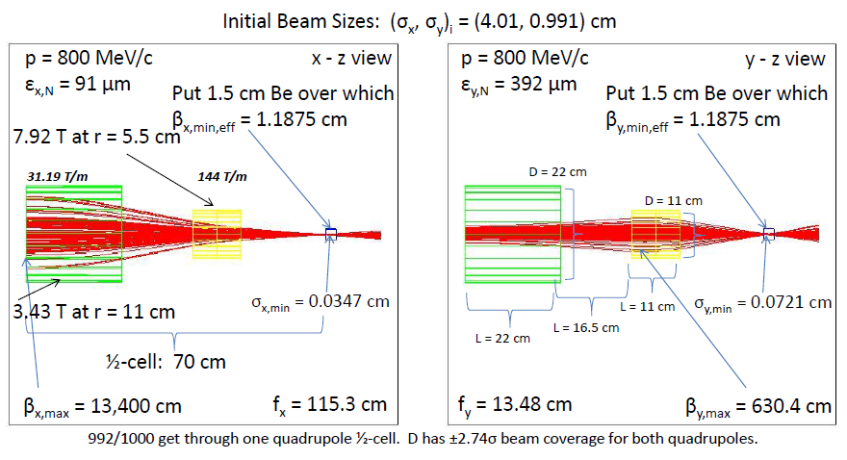
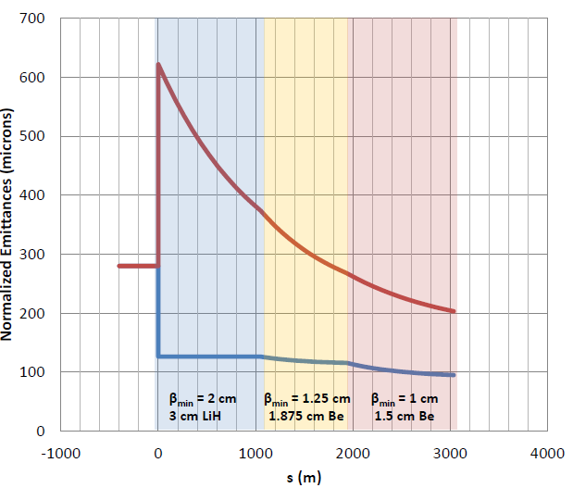
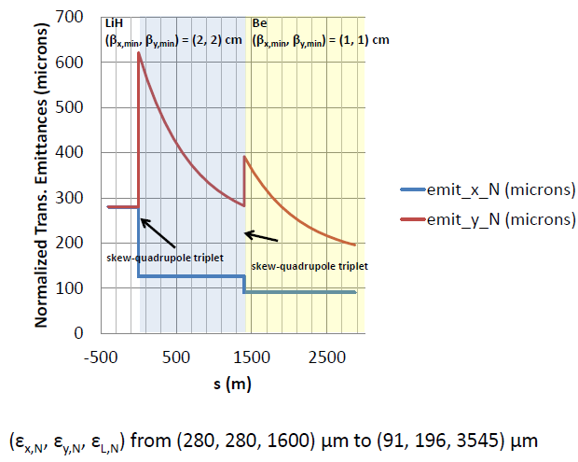
Variant: Quad focusing for final cooling
T. Hart, D. Summers IPAC15
Focusing onto short absorbers (LiH /Be)
  Can obtain small β*
Quad focusing
  use higher energy (0.8 GeV)
  β_{x} ≠ β_{y} -- obtains flat beam ?
    cool in only 1-D ?
  use B_{max}=8 T → 14T
  cool in rings (multipass)

Slide 16
Variant: “thick” wedge transform
If δp/p introduced by wedge >> δp/p_{beam};
  can get large emittance exchange
    exchanges x with δp (Mucool 003)
Example:
  100 MeV/c; δp=0.5MeV/c
    ε⊥= 10⁻⁴m, β₀=1cm
    Be wedge 0.6cm, 140° wedge
  obtain factor of ~5 exchange
  ε_{x} →0.2 ×10⁻⁴m; δp=2.5 MeV/c
Much simpler than equivalent final cooling section

Slide 17
Variant scenario: Cool, Round-to-flat, Slice, Recombine (w/ D. Summers, T. Hart)
Cool
  Cool until system parameters are difficult
    ε_{x,y} (ε_{t}) →~10⁻⁴ m, ε_{L} → ~0.004 m
  set up beam for round to flat transform
Round to flat beam transform
  ε_{t} → ε_{x} =0.004; ε_{y} =0.00025 ?
    method used in ILC source
Slice transversely in large emittance
  using “slow extraction-like” septum to form 16 (?) bunches
    ε_{x} =0.000025; ε_{y} =0.000025
Recombine longitudinally at high energy
  bunch recombination in 20 GeV storage ring (C. Bhat)
    ε_{x} =0.000025; ε_{y} =0.000025, ε_{L}=0.07m

Slide 18
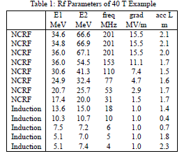
1. Cool
Start with “final cooling” scenario
  or quad alternative or …
Stop at ~step 5 – where parameters are still reasonable…
  ε_{t} ~ 0.0001m
  ε_{L}~ ~0.0025m
Beam is at ~100--135 MeV/c
  66→ 40 MeV kinetic energy
No field flips to obtain high-canonical momentum
  Hisham has a simulation with
    ε₊ = 0.001; ε₋= 0.000025
No more cooling

Slide 19
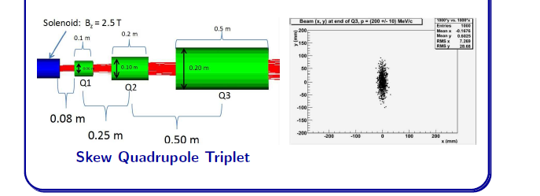
2. Round to Flat beam transform
Example:
Solenoid to quad +skew-quad transport
Factor of 16 transform ratio:
  ε_{x} ~ 4 × 10⁻⁴ m, ε_{y} ~2.5 × 10⁻⁵ m
  ε_{L} ~ 2.5 × 10⁻² m
Accelerate to energy for next transformation

Slide 20
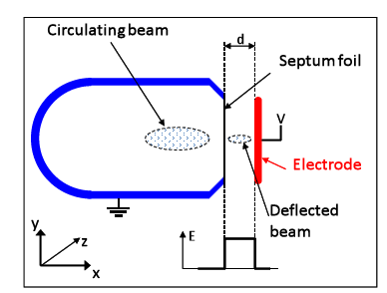
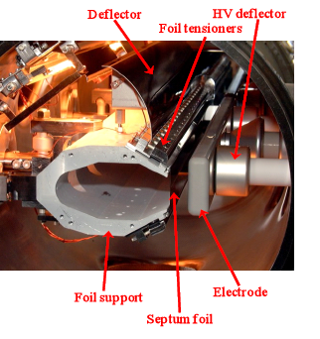
3. Slice transversely
match into Slicer optics (~linear or ring)
  small storage ring (?) with extraction optics
    slicer is thin; slices in large emittance
Slice beam transversely into n bunches
  ε_{x} ~ 4 × 10⁻⁴ /16 → 2.5 × 10⁻⁵ m (for n=16)

Slide 21



4. Recombine Longitudinally
Recombine Longitudinally
  within High Energy Storage ring
    snap coalescence
      modeled on pbar
    Accelerate to higher energy
      recombine train of bunches to single bunch
Coalescence example (R. Johnson, C.Bhat et al. PAC07)
  Inject 17 ℓ bunches into 21 GeV ring
  Long wavelength rf gives each bunch a different energy
  merge in 20 orbits (capture with short wavelength rf)
    emittance dilution, decay loss ~10%
0.25 × 10⁻⁴m ε_{x} × ε_{y ;} ~70×10⁻² ε_{L} --- HLHEC parameters

Slide 22
Variant without Round to Flat transform:
1. Cool bunch to ~10⁻⁴m ε_{T}
  ~3×10⁻³ ε_{L}
2. Transverse slice to 10 bunches:
  10⁻⁴ε_{x} × 10⁻⁵m ε_{y}
  Separated longitudinally
3. Accelerate as bunch train; recombine longitudinally
  10⁻⁴m ε_{x} × 10⁻⁵m ε_{y}
  ~3×10⁻² ε_{L}
Collide as flat beams;
  luminosity ~ same as ε_{t}= ~3×10⁻⁵

Slide 23
Flat beam Collisions ?
IF x-y emittance product same as for baseline (round) Collider scenario
  Can obtain ~ same luminosity
Flat beam lattice easier to design
  Chromatic correction easier
    10/1 emittance aspect ratio ?
Flat beam (with y as wide dimension) greatly reduces “neutrino radiation” problem
    Bonus feature
Some disadvantages
    hourglass effect is worse
Flat beam may be more natural result of cooling?

Slide 24
Summary
Final Cooling for High-luminosity HEC explored
  Baseline approach possible; confirmed by simulation
    inefficient, pushes state of art
Variations can greatly improve the scenarios
  use more practical parameters
    explicit emittance exchange procedures
    Round to flat beam transformations, beam slicing,
    bunch coalescing, quadrupole-based cooling,
    flat beams
  Beyond state of art methods not (yet) included
    Li lens, plasma lens, parametric resonance focusing
      could greatly increase Luminosity from baselines

Slide 25
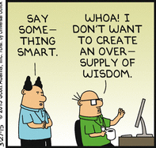
Thank you for your attention !

Slide 26
P5 → Heavy Electron Particle Accelerator Program
multi MW proton source
  needs CD0
multi MW target facility
  producing heavy leptons > 10²¹/yr. (π→ℓ+ν )
GARD- high B magnets, normal rf, SRF
  HEPAP is only program that can use all of these …
LHC → HE/HL LHC → 100 TeV
  need signs of new physics to build multiTeV HEC

Slide 27
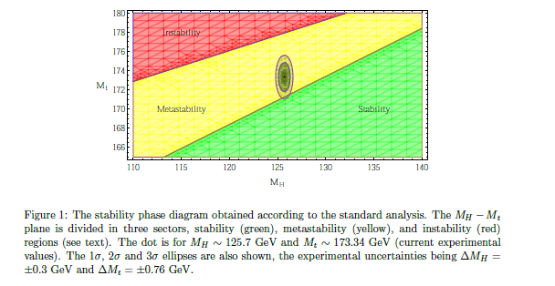
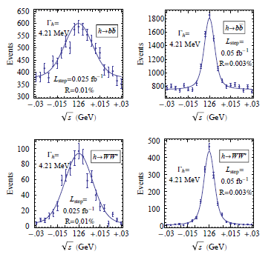
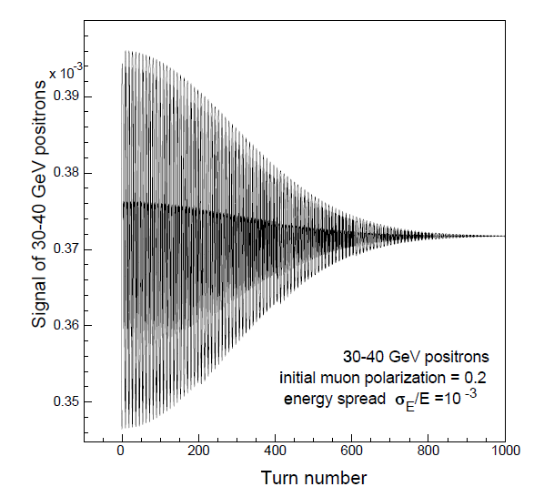
“Use the Higgs as a tool for Discovery”
Higgs Mass and Width can be directly measured at 125 GeV s- channel ℓ⁺ℓ⁻ Collider
  mass and width, spin 0
coupling to lepton mass
Higgs and top mass
  Do we need to know them to high precision ??
δm_{H} to < 0.0001GeV
δm_{T} to <0.001 GeV
measured by spin precession

