Slide 1
XFR Modification to Resetting
Beam Sync (AA) and Offset Beam Sync (OAA)
Craig Drennan
Review of Proposed Modification
5/12/2015

Slide 2
Objectives
Provide a fixed time delay between the MI_Reset from Booster and the Offset Beam Sync marker (OAA) returned from MI/RR.
Ensure the modification works for beam injection into both the Main Injector and Recycler rings.
Avoid changes to logic and timing functions other than resetting MI/RR markers for injection of Booster beam.
NOTE: Some timing details in the early part of the discussion are neglected for clarity. Detailed timing is presented in the test results near the end.

Slide 3
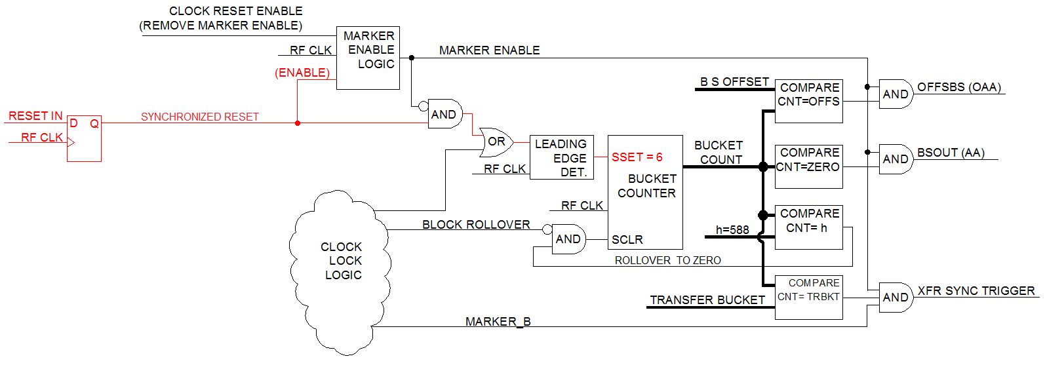
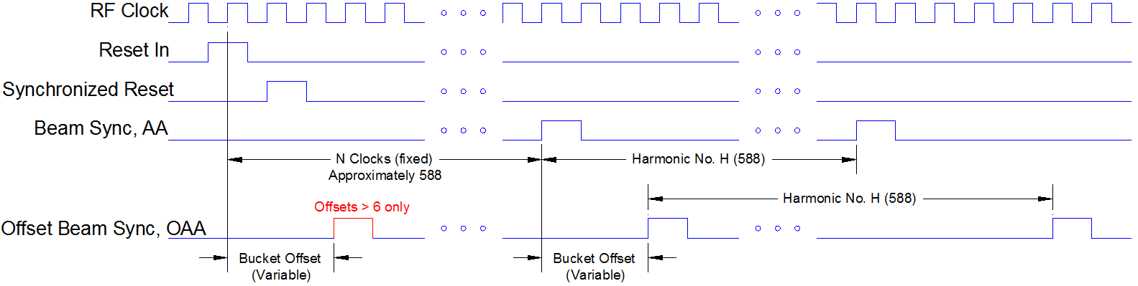
Channel 1, FPGA U18 Simplified Logic

Slide 4
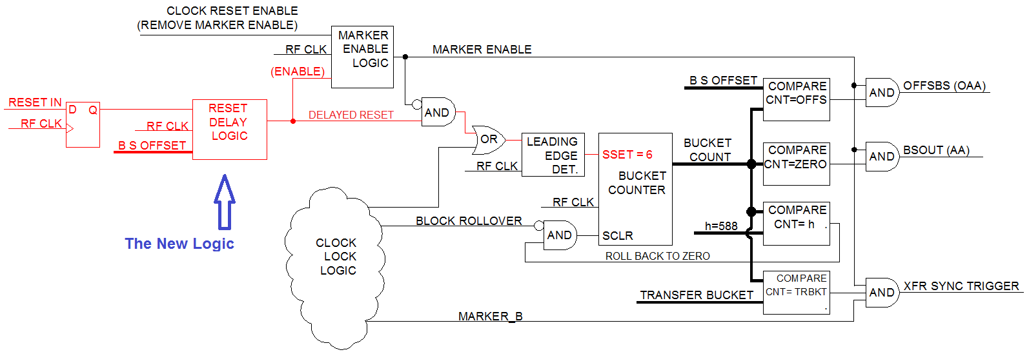
Channel 1, FPGA U18 Simplified Logic (Modified)

Slide 5
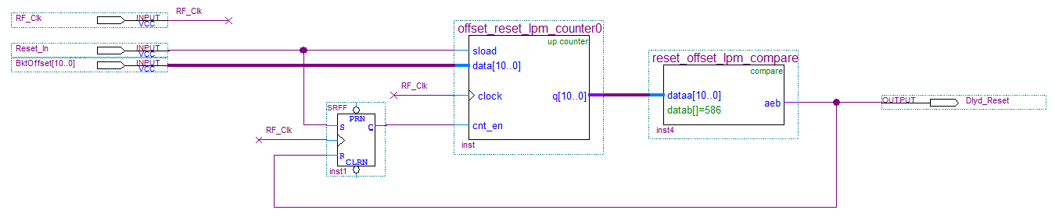
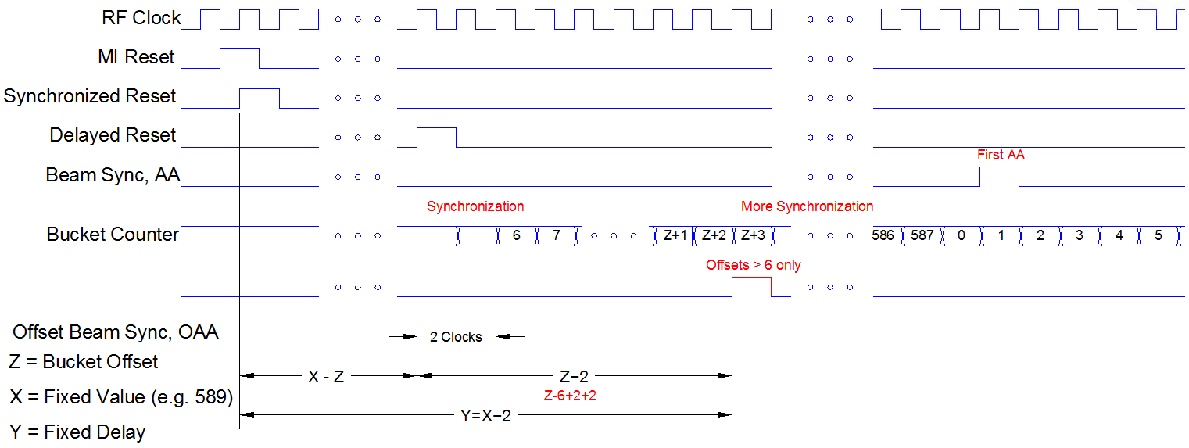
Reset Delay Logic, First Iteration

Slide 6
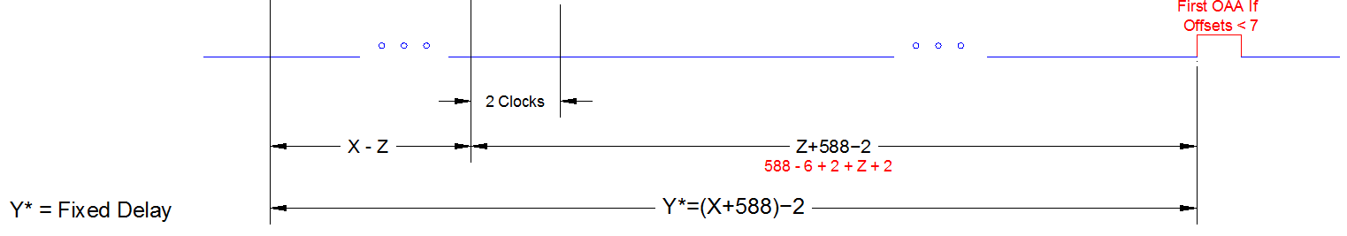
Reset Delay Logic, First Iteration (cont.)
We still have two possible locations for OAA for Offsets 0 to 587

Slide 7
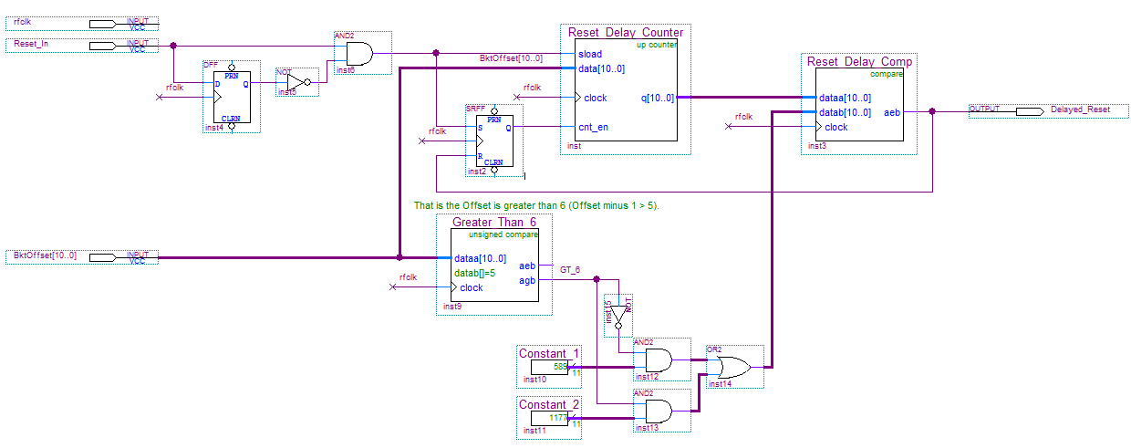
Reset Delay Logic, Second Iteration
Case 1: Offset < 7, X = 589
Case 2: Offset > 6, X = 589 + 588 = 1177

Slide 8
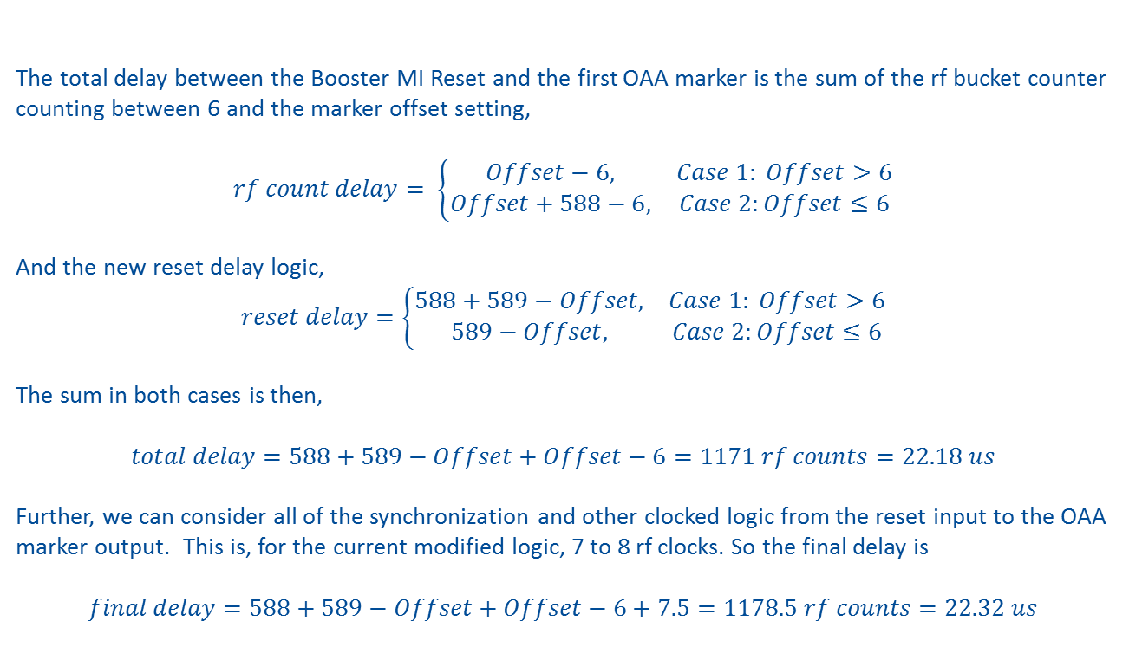
Reset Delay Logic, Second Iteration (cont.)
The total delay between the Booster MI Reset and the first OAA marker is the sum of the rf bucket counter counting between 6 and the marker offset setting,
$$rf count delay= \left\{\begin{matrix}Offset−6, & Case 1: Offset>6 \\ Offset+588−6, & Case 2:Offset≤6\end{matrix}\right.$$
And the new reset delay logic,
$$reset delay=\left\{\begin{matrix}588+589−Offset, & Case 1: Offset>6 \\ 589−Offset, & Case 2:Offset≤6\end{matrix}\right.$$
The sum in both cases is then,
$$total delay=588+589−Offset+Offset−6=1171 rf counts=22.18 us$$
Further, we can consider all of the synchronization and other clocked logic from the reset input to the OAA marker output. This is, for the current modified logic, 7 to 8 rf clocks. So the final delay is
$$final delay=588+589−Offset+Offset−6+7.5=1178.5 rf counts=22.32 us$$

Slide 9
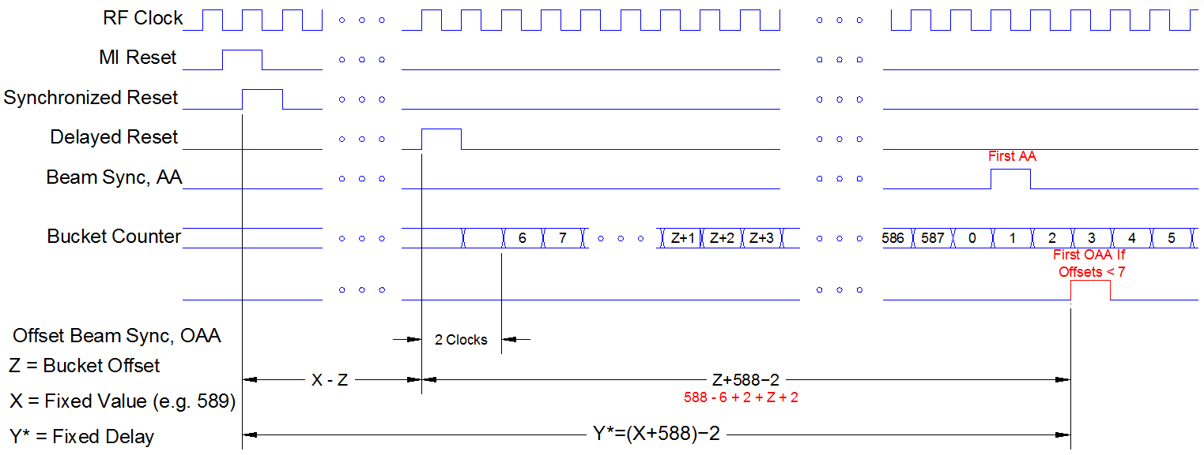
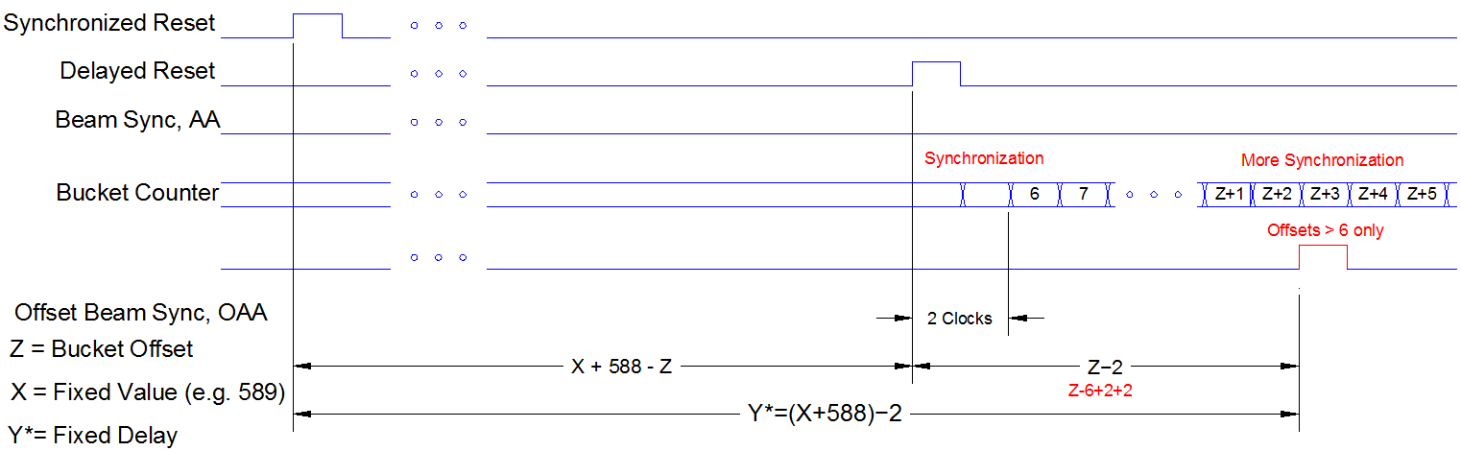
Reset Delay Logic, Second Iteration (cont.)
Offsets < 7
Offsets > 6

Slide 10
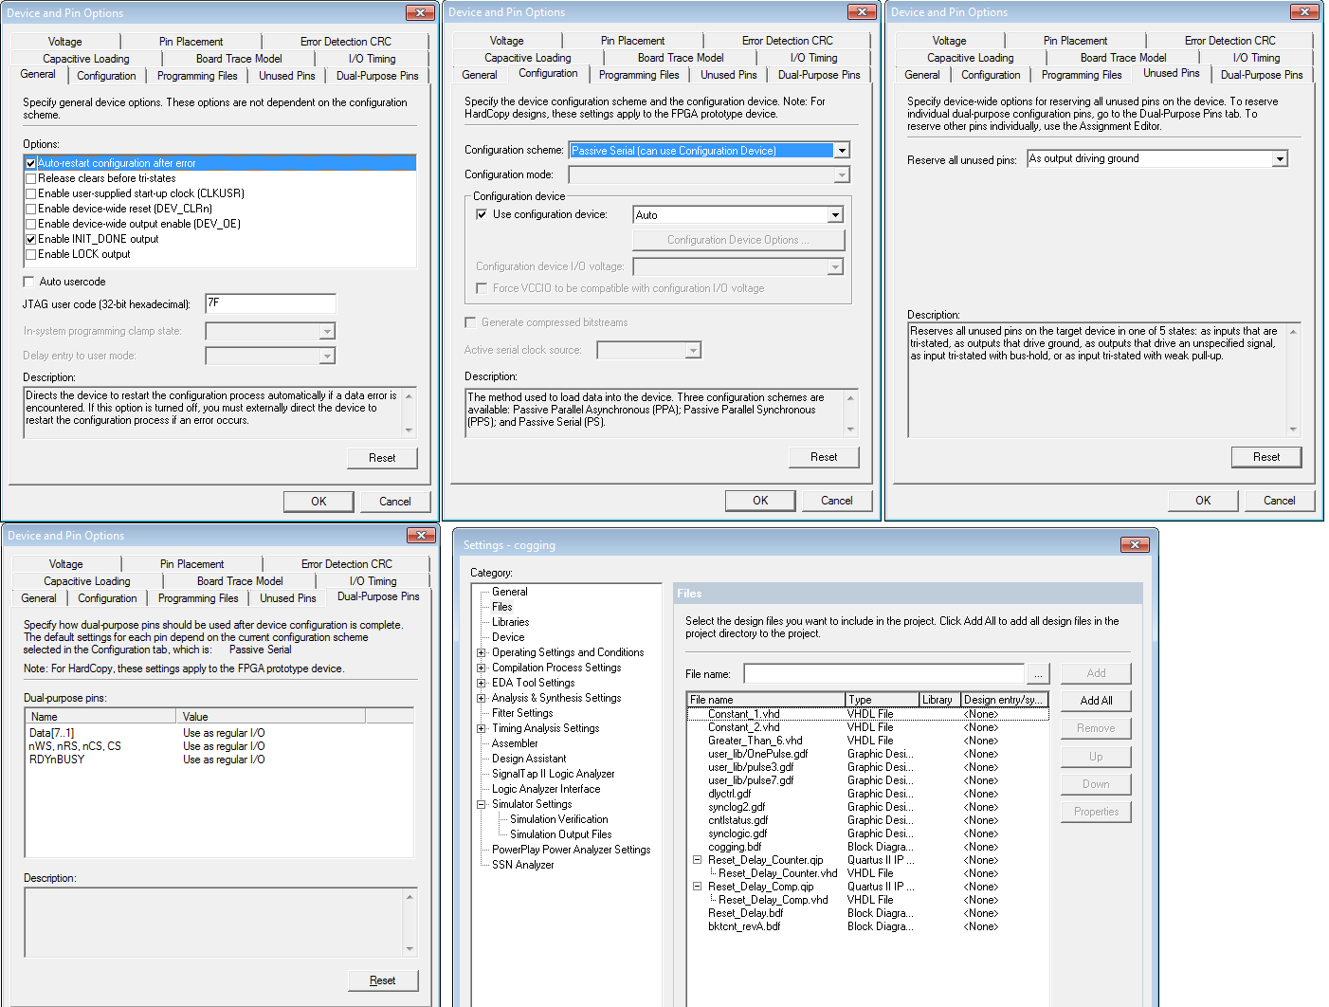
Details Generating FPGA Configuration Files

Slide 11
Details Generating FPGA Configuration Files (cont.)
There is a single EPROM configuration device on the XFR Module that programs three FPGA’s. U18 is the timing logic for Channel 1, U19 is the timing logic for Channel 2 and U20 decodes MDAT. When programming a new configuration EPROM, the code for all three FPGA’s must be combined into a single *.pof programming file with which to burn the EPROM. The Altera Stat Sheet that describes how an EPROM was programmed is given in Listing 4.1
Module Name: XFR
(Recycler Nova U19 version Plus Booster Reset Delay U18 version)
Files to be found @
\\beamssrv1\rf.bd\projects\LLRF\Components\Hardware\Altera files\XFR\xfru21_Booster_Nova\
Maxplus or Quartus version compiled last: Quartus 9.0
Project name: XFRU21_Booster_Nova
Compilation Date: 05/6/2015
Device type: EPF10K20TC144-3
Programming files (POF and/or SOF): cogging.sof (NEW file for U18)
Cogging_nova_Ch2.sof (file for U19)
U20.sof (file for U20)
xfru21_B_N_v2.pof (pof resulting from the combination)
POF Checksum: 00BC9AF0
Listing 4.1 Altera Stat Sheet data for programming the EPROM.

Slide 12
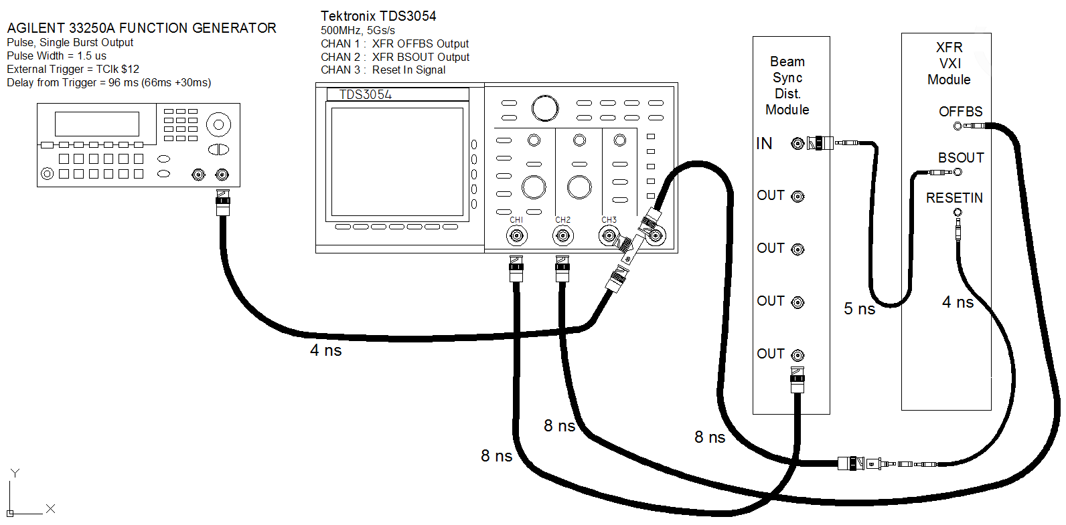
Testing Modified XRF

Slide 13
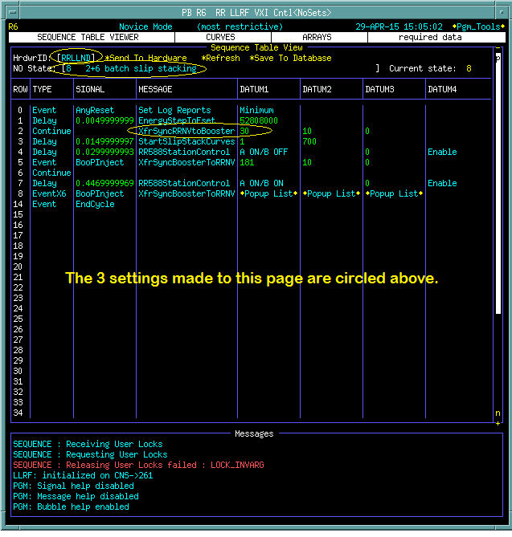
Testing Modified XRF (cont.)

Slide 14
Testing Modified XRF (cont.)

Slide 15
TODO Next

Slide 16
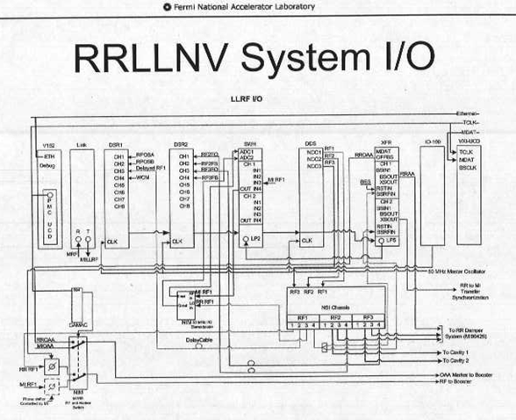
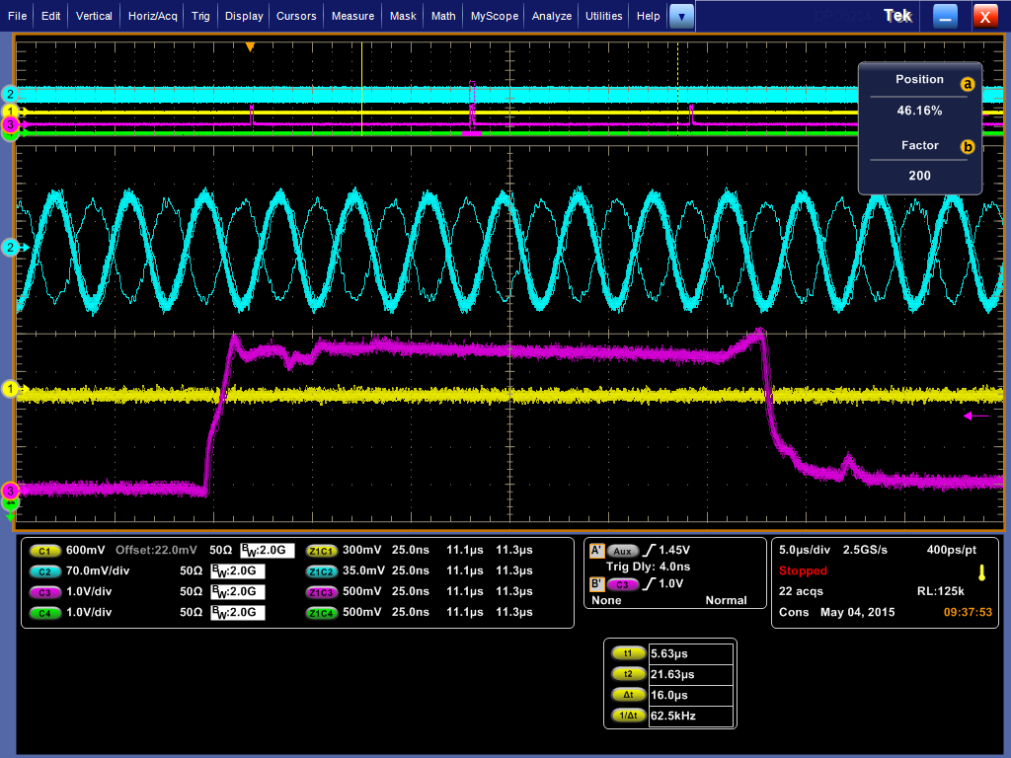
Phase offset between MIRF and RRRF relative to the OAA
MIRF
RRRF
OAA
RR OAA
MI OAA
RR RF
OAA to the Booster
Time Line: $23 $E3 $E3 ……..$E3
MI RF
RF to the Booster

