Slide 1
Linac Marx Modulator Update
Trevor Butler
5/20/2015

Slide 2
Overall Status Update
Ordered parts for both 28 & 54 cell system
  Waiting on capacitors for the 54 cell system
Assembling internal support structure to hold cells
Finished Design & Drafting of FPGA/CPLD Controls
  Started assembling and testing these control cards
Completed design of PLC interlock & interface touch screen
Building Control System Relay Rack (almost complete and ready for testing)
Tested Cells for corona and passed at 35 kVrms.
Resigned cell heat sink, rounding corners, to lower corona.
Thermal analysis of main switching elements
  54 cell test would need a parallel diode in charging supply
Assembled and tested new differential air pressure system
Presently building 28 cells with modified heat sinks (50%)
Received and testing charging supply.

Slide 3
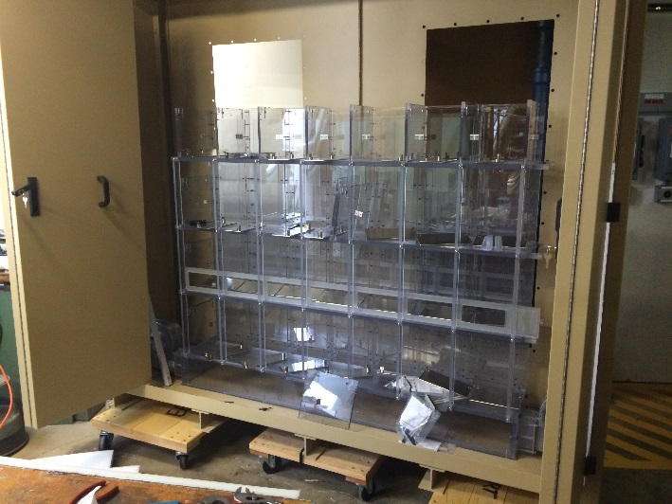
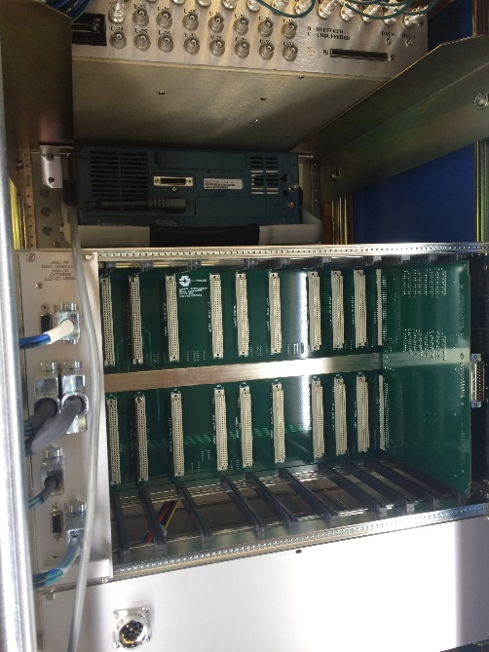
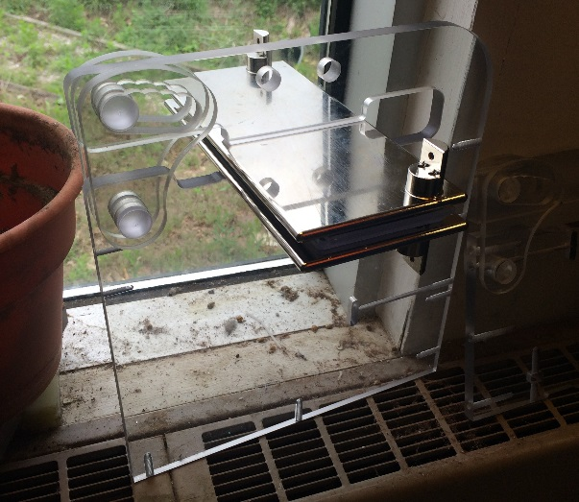
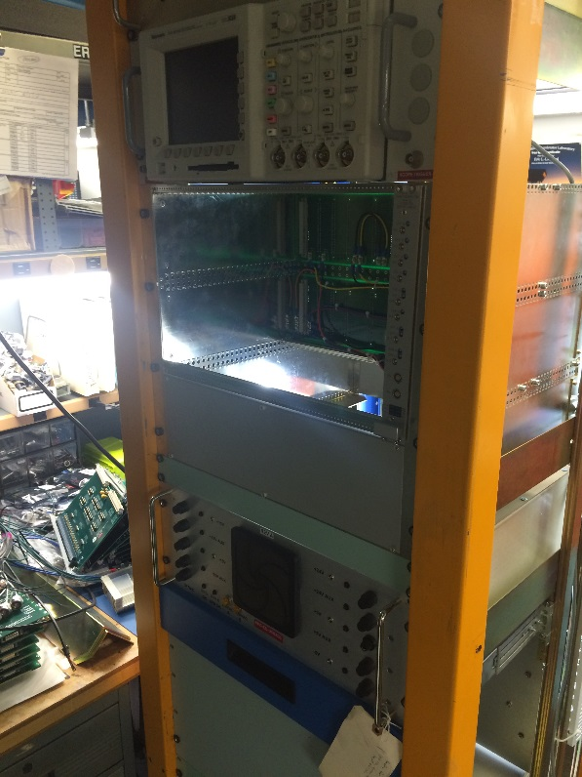
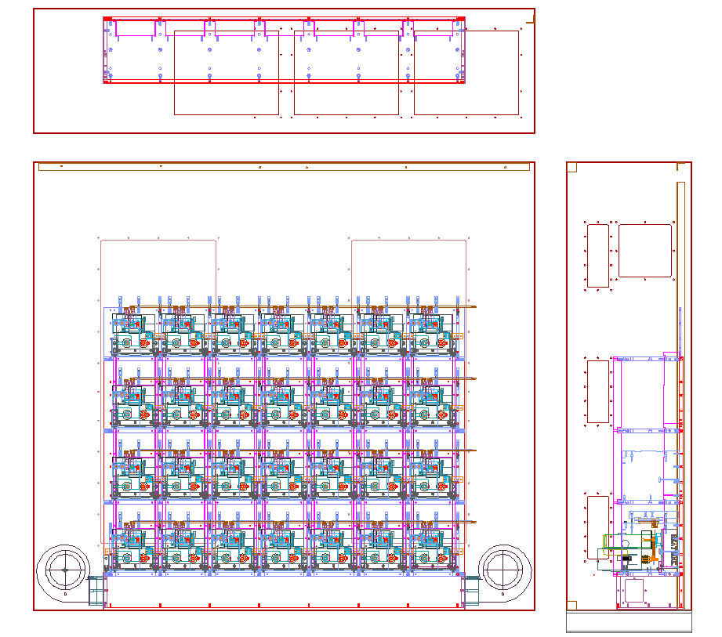
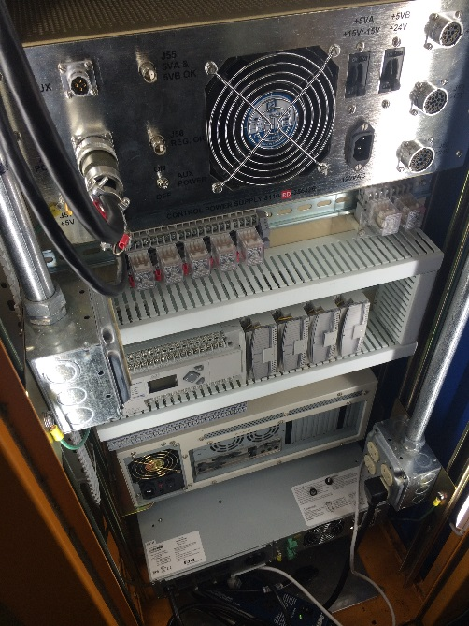
28 Cell Version Pictures

Slide 4
Location, Location, Location

Slide 5
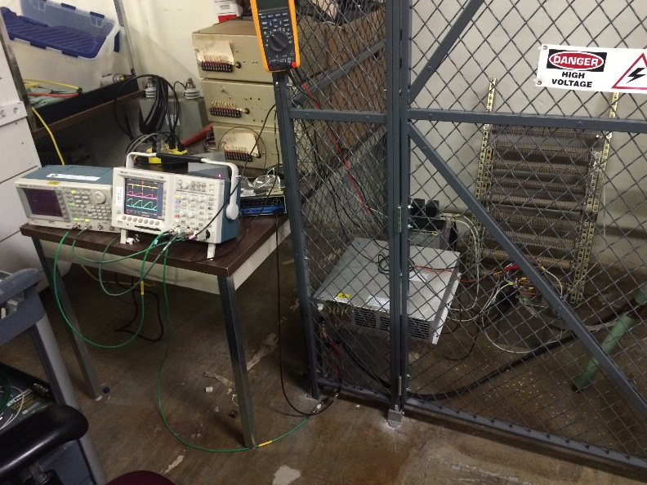
Charging Supply Testing
Testing for 15 Hz operation
Running close to full rated power rating of the supplies
Supplies create power for <$1 per watt, comparted to almost $2 Watt for the Lambda supplies

Slide 6
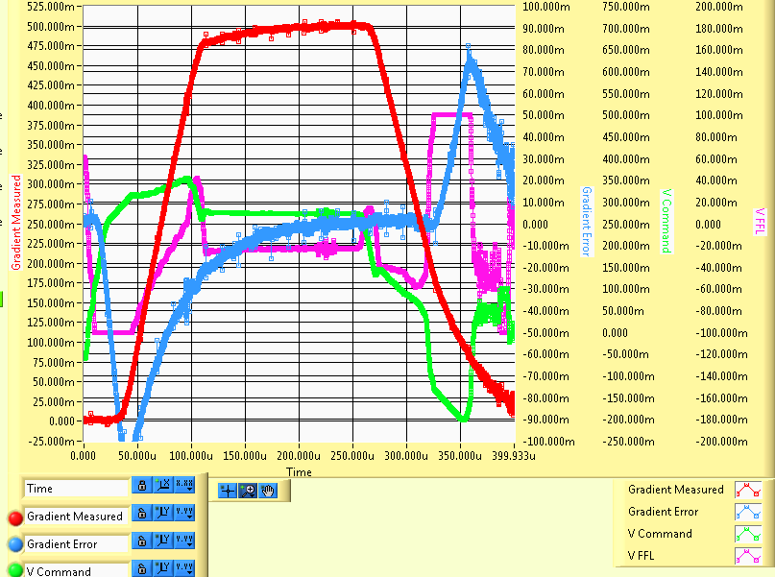
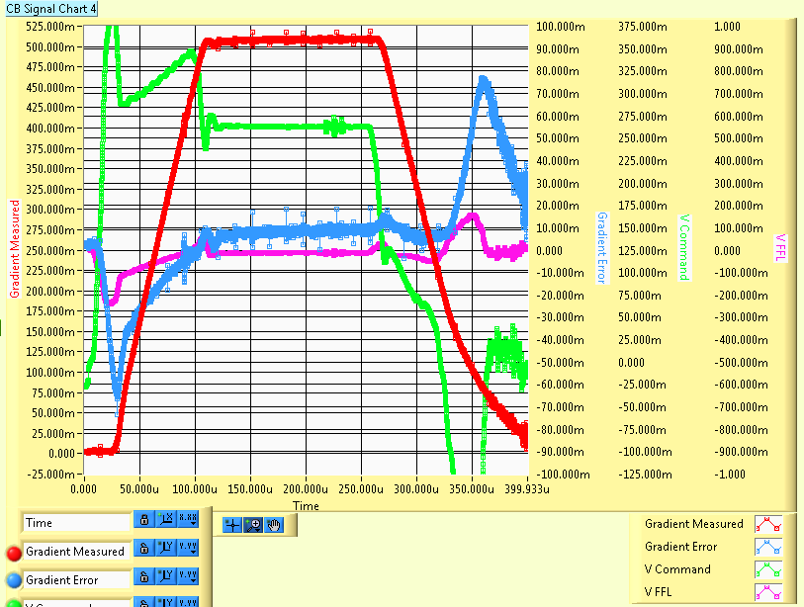
Controls Learning Studies
Implemented both Feed-forward & Learning
Determined there was a large amplifier gain change after spark, undermining the feed-forward calculation, which assumes a fixed gain
Added spark detection to clear learning after spark
Future studies involve testing beam learning

Slide 7
28 & 54 Cell Next Steps
May-June 2015
  Finish Assembly of 28 Cells (~50% Complete)
  Setting up for single cell test
    Each of the 28 Cells
    Short circuit test
  Finalize Design and order Cabinet for 54 Cell Design
  Start Assembly of 54 Cells after 28 cells are completed and Capacitors arrive.
  Finish up Details of Charging Supply Control System
    Start testing individual cards in rack
    Continue development of CPLD and FPGA code
    Determination of fault modes and appropriate responses
  Order 6 addition Charging Supplies
  Design and build Charging Supply Power Supply Relay Rack
    Interface with existing A3 Power System
    Finalize location of racks and power flow
  Finish Mechanical assembly (28 Cell)
    Finish fabrication of the strip line
    Fabricate interface cables for coaxial line
    Assemble all cells in system
    Install air flow sensors into system
July-August 2015
  Complete Assembly of 54 Cells
  Start Mechanical Assembly (54 Cell)
    Assemble mechanical structure
    Create Stripline components, (fabricate, solder, plate)
  Test the 28 Cell Unit in the development area
    Calibrate the delay of each Marx cell for ripple optimization to compensate for cabling
    Test system for corona
    Test for temperature rise & cooling efficiency
    Debug the many complexities of the system
    Test new Charging Power Supplies under full loading conditions
August – September 2015
  Install 25 modulator into LRF1
  Install 480 VAC power for charging power supplies, and 120 VAC power for controls
  Test control system
    Feed – Forward parameter optimization
    Learning versus real time feedback
    Short Circuit response
      7835 Cavity Spark
      Accelerating Cavity Spare
  Solve many unknown complexities

Slide 8
Extra Slides

Slide 9
Different cavity gradient regulation schemes
Direct Gradient Analog Feedback
Presently used to regulate our vacuum tube modulators
Op-Amp feedback loop with adjustable proportional gain
Advantages
  Simple in design, and robust in operation
  Direct feedback cancels out any pulse to pulse variations as it noticed significantly on LRF1
Disadvantages
  Lack of real time tuning and optimization via ACNET.
  Interfacing with existing LLRF Learning Algorithm can be problematic and require frequency tuning
Feed-Forward Operation (often confused with Learning)
Uses a system model of the load (the 7835 triode, accelerating cavity, and beam intensity) to predict the required amount of voltage to get the desired gradient level
Advantages
  Can act as a first guess before implement any learning or feedback
Disadvantages
  Almost impossible to get perfect model.
  Even if you could, it could drift over time, requiring constant tuning to stabilize gradients

Slide 10
Different cavity gradient regulation schemes
Learning Operation
Learns the waveform error from pulse to pulse, placing correction on next pulse
If the Learning Operation is used on top of the Feed-Forward loop, then the system would have less error to correct
Advantages
  Able to learn out slow process (Aging of tube, drifting of cavity frequency,
Disadvantages
  Unable to regulate voltage within the pulse.
Real-Time Feedback
Realtime operating system, like the SoC FGPA topology
Error between the cavity fields is calculated in realtime and the error is sent to the PWM for correction within the pulse
Advantages
  Able to Control cavity fields within the pulse, accounting for pulse to pulse variations
Disadvantages
  Complex to design
  Long development time

