Slide 1
On discrepancy between transmission model and 3D CST simulations
Gennady Romanov
2nd Harmonic cavity Meeting
21/V-2015

Slide 2
Thermal losses in the transmission model
From 16April2015_2nd_Harm.ppt
L_{ferr} =( μ₀ μ_{r})/(2 π) Log[rf_{outer}/rf_{inner}]
For μ = μʹ=3.5 the model gives f = 76 MHz (start of ramp).
For tanδ_{m} = μʹʹ/μʹ = 0.000467 and voltage of 100 kV the model gives instantaneous thermal losses (Tan)
P = 62.5 kW.
According to the 3D simulations the instantaneous thermal losses at the start of ramp are
P_{total} = P_{ferrite} + P_{copper} = 12 kW + 9 kW = 21 kW
This is a big discrepancy.
A primary suspect responsible for that is non-uniformity of fields.
Here μ“ and μ‘ are average over garnet volume, i.e. the field non-uniformity in the so called “Thin plate” set-up is not taken into account properly.

Slide 3
Thermal losses in 3D model
Garnet with fixed parameters μʹ=3.5, tanδ_{e} = 0.0001 and tanδ_{m} = 0.000467. Equivalent to transmission model
Garnet with parameters obtained from “thin plate” experiment. H_ext = 35000 A/m. dH = 3.88 Oe.
Loss density
F = 75.792 MHz
P_{ferrite} = 67 kW
P_{copper} = 9 kW
P_{total} = 78 kW
F = 78.07 MHz
P_{ferrite} = 10.6 kW
P_{copper} = 9 kW
P_{total} = 19.6 kW
Quite different loss density distribution presumes different total losses. But difference is too big to be explained by non- uniformity only. An additional factor is material properties obtained by averaging from “thin plate” experiment.

Slide 4
Impact of non-uniformity
H_ext = 32926 gives F = 75.9 MHz. ΔH = ? Let’s assume it’s 30 Oe, then P_{total} = 40 kW.
H bias internal, 5- 32.5 kA/m
Distribution of μʹ, 2-19, average 3.6 (!)
H_rf. This distribution defines loss density in case of constant μʹ.
Loss density distribution, 20-1160 W/m³. Distribution of μʹ dominates.

Slide 5
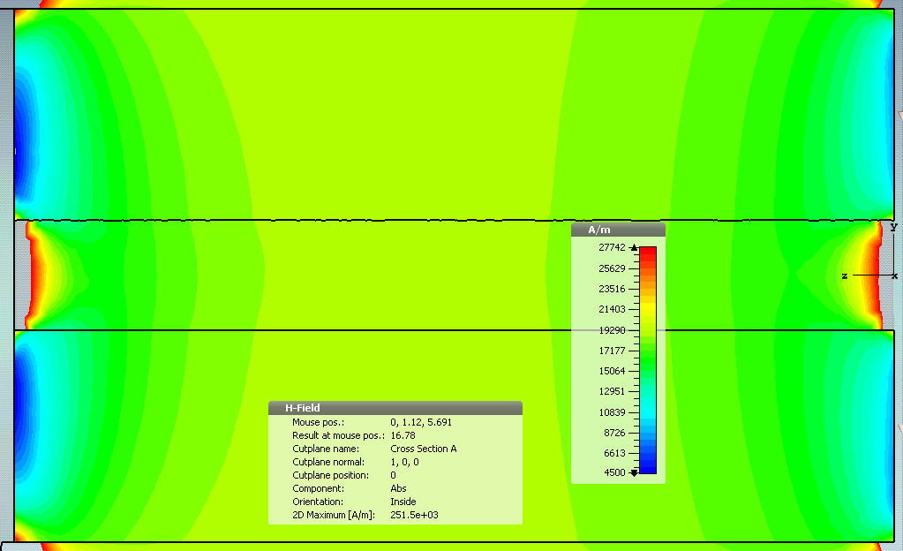
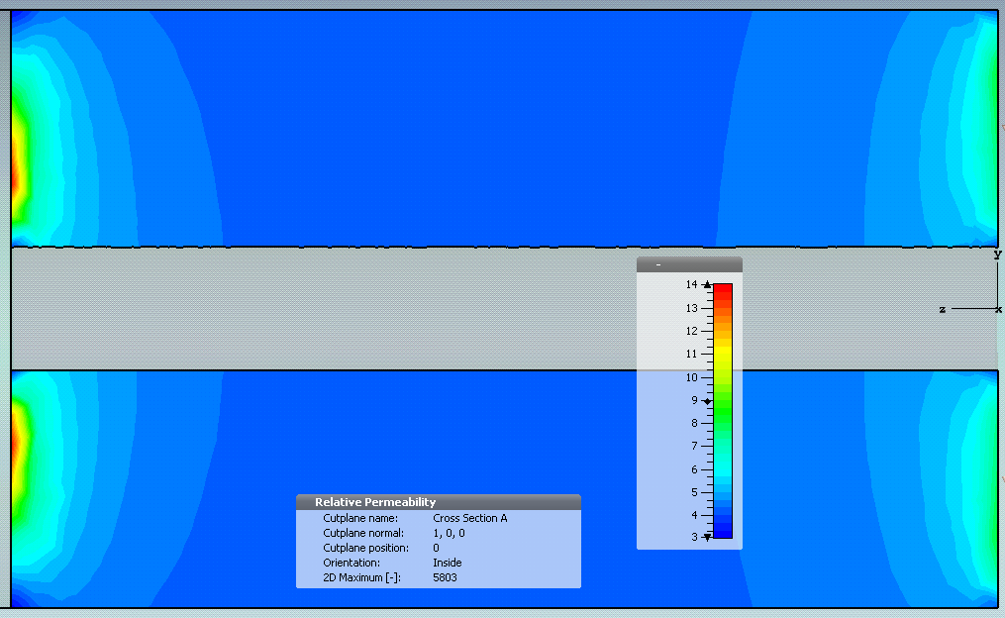
New material parameters
I_sol = 30 A, F = 82.48 MHz.
H internal 4500-27750 A/m
μʹ=3-14, average μʹ=5.35

Slide 6
Average μʹʹas a function of average μʹ
μʹ=3-14, average μʹ=5.35
Which is right? Both are right being applied to the particular set-up.

