Slide 1
Anode Supply Update

Slide 2
Current Status
Capacitor Bank
Completely built and hipotted
Diode Bridge
Built up
Needs refrigeration tubing connections
Needs surge arresters mounted
Mocked one up, the rest of the mounts need to be made
Switch Rack
Built
Load up completely by the end of the week
Mount water cooled resistors (1 day)
Wiring (2-3 days, with additional time during install)
Step start cabinet
Modify second cabinet (2-3 days)
Install Ross Gear (1 day)
Controls (1 week)

Slide 3
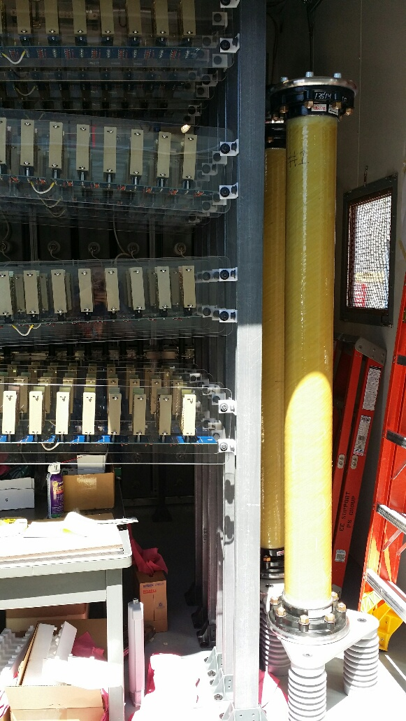
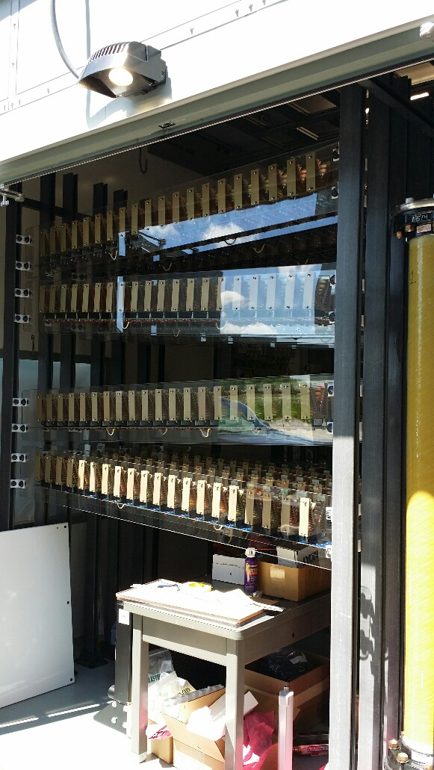
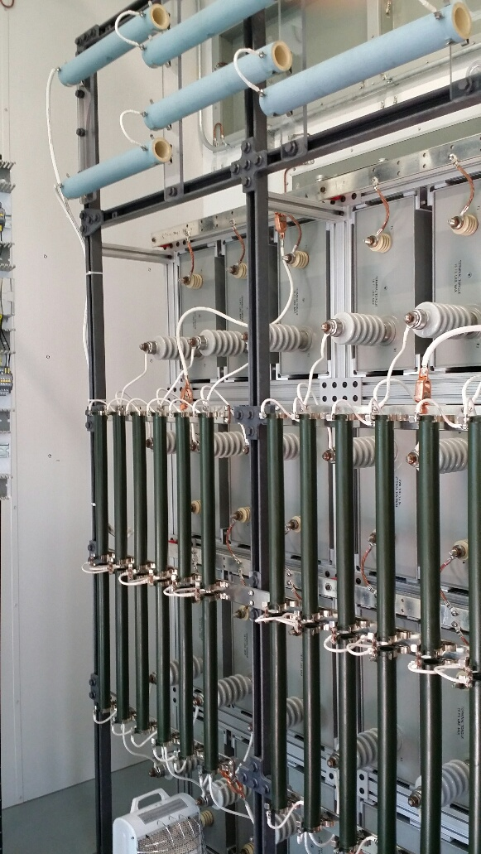
Current Status

