Slide 1
Building a Second Harmonic Radio Frequency Cavity for the Booster
Maggie Lankford
SIST Intern 2015
The College of Wooster
4 August 2015

Slide 2
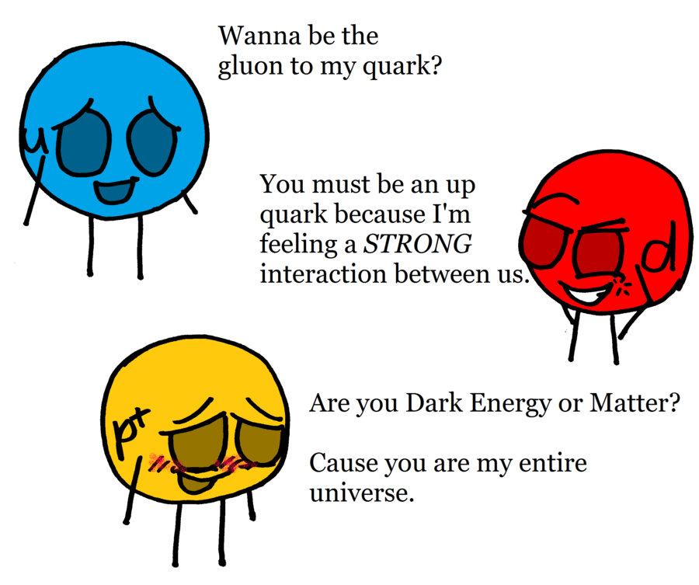
Outline
Radio Frequency Cavity Basics
Cavity Tuning
Calculating Permeability
Comparison Between Real and Model Cavity
Power Amplifier Basics
Building a Temperature Probe

Slide 3
Radio Frequency (RF) Basics
Short
Outer Conductor
Accelerating
Gap
Beamline
Inner Conductor
B-Field
E-Field

Slide 4
Tuning the Cavity
What do we do when the beam speeds up??
$$v=\frac{c}{με}$$
$$\frac{λ}{4}ω=\frac{c}{με}$$
Changing μ changes the resonant frequency of the cavity!
v: speed of light in medium
c: speed of light in vacuum
µ: permeability
ϵ: permittivity
λ: wavelength
ω: angular frequency

Slide 5
Tuning the Cavity (cont.)
Solenoid
Outer Conductor
Ferrite Rings
Inner Conductor

Slide 6
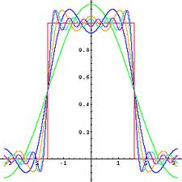
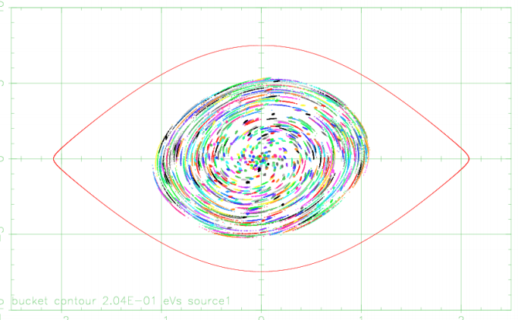
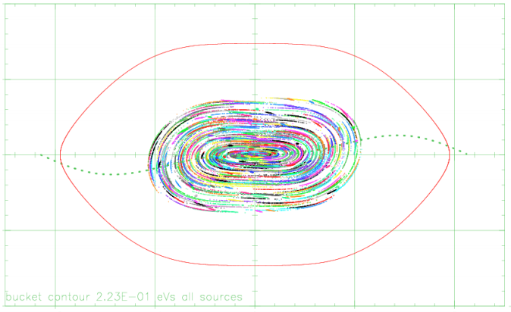
Why Second Harmonic Cavity?
Use wave physics to create a more square wave for injection
A rectangular bucket has larger area and reduces space charge effects
Phase-Space plots from C. Y. Tan

Slide 7
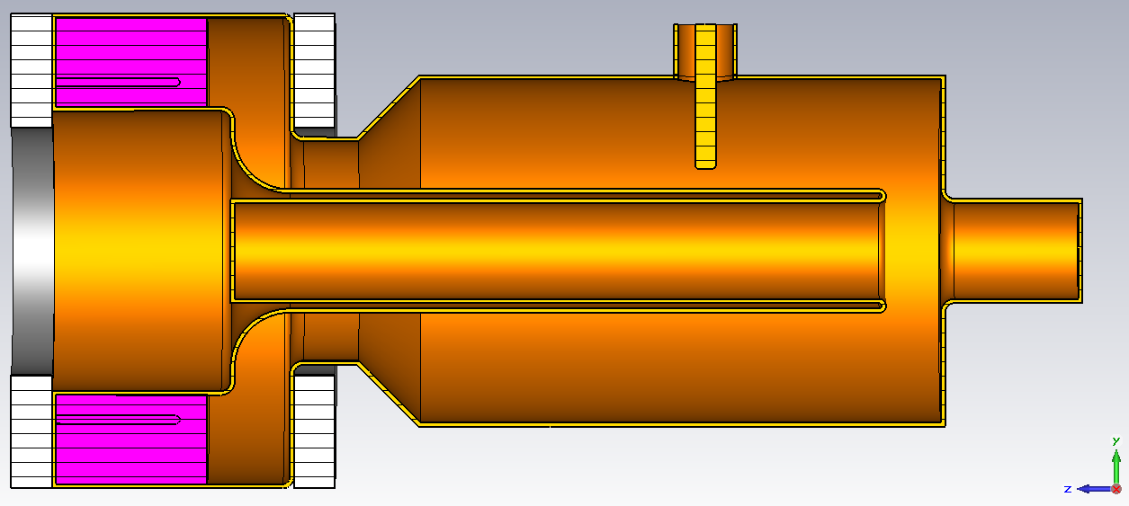
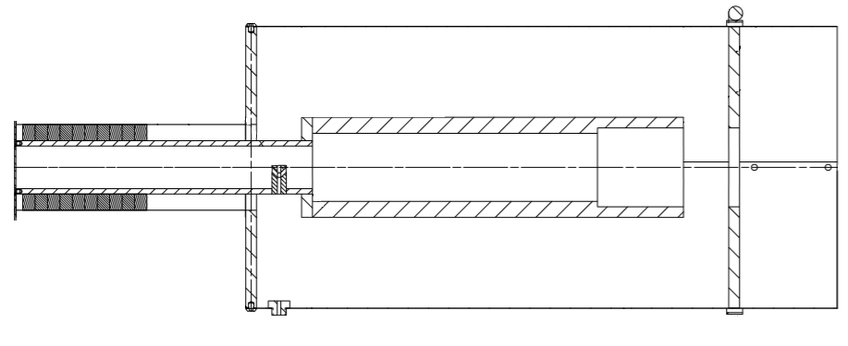
Real and Model Cavity Cross-Section
Cavity Designs Courtesy of Gennady Romanov and Kevin Dule
Notes:
Perpendicular biasing has less loss
We need one cavity in small space to give a large acceleration with the power amplifiers that we currently have

Slide 8
Ferrite Permeability Study
Solenoid
$$μ=μ^{′}+i μ′′$$
Tuning parameter
Lossy component
Plug
Measured: Q-value, Resonant Frequency
Ferrite-Filled Cavity
$$μ^{′}=\frac{1}{ε}{\left\lceil \frac{c}{4lf}\right\rceil }^{2}$$
$$μ′′=\left(\frac{1}{Q}−1×{10}^{−4}\right)μ^{′}−F(f,Dim.)$$
Function of frequency and cavity dimensions

Slide 9
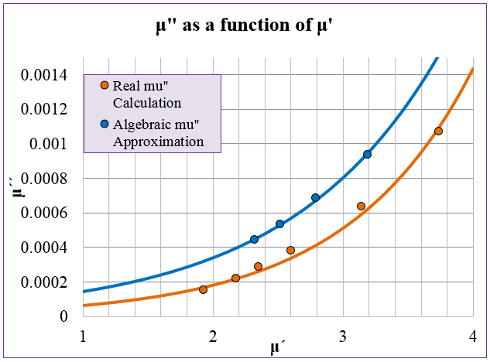
Calculating permeability
76 MHz
106 MHz
Real mu’’ experiment and calculations by Yuri Terechkine and Gennady Romanov

Slide 10
Poisson Superfish Models
Investigating
Change in dimensions
Fundamental frequency
Change in µ
Difference between Real and Model
Real Cavity 438.89 MHz 5/4 λ Resonance

Slide 11
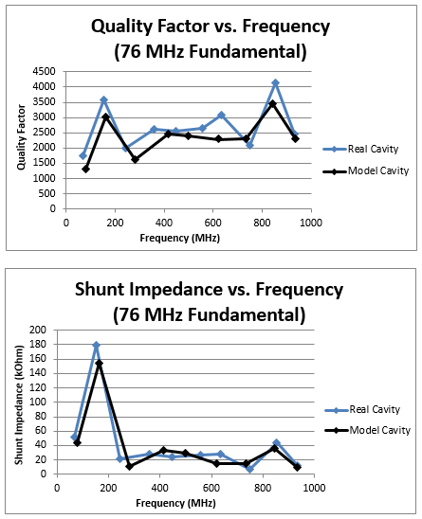
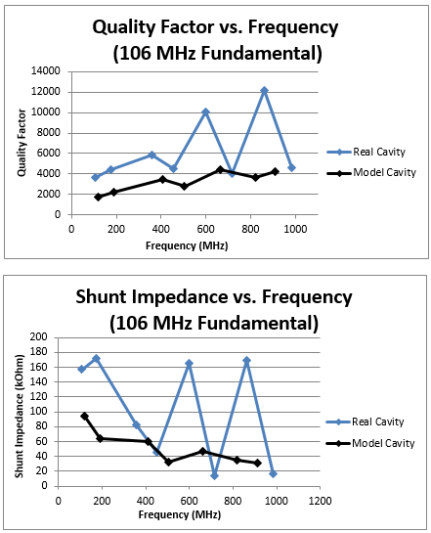
Difference between Real and Model cavity

Slide 12
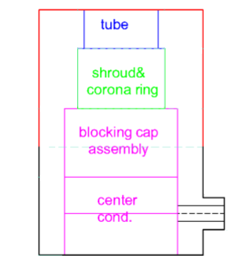
Power Amplifier Basics
Existing 53 MHz Power Amplifier
76 MHz Power Amplifier Design
50 Ohm Load
PA Power Module
Tube
Shroud & Corona Ring
PA Power Module
Test Resonator
Blocking Capacitor Assembly
Test Resonator
Center Conductor
Difference is in load position and resonator shape

Slide 13
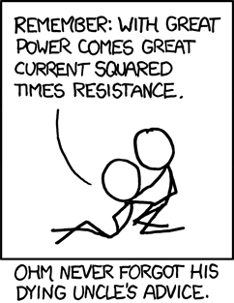
Power Dissipation to Temperature
Specific Heat Equation
$$∆T=\frac{Q}{mc}$$
Using the rate of water flow in the cooling solve for mc
Heat added over time is the power
T: Temperature
Q: Heat Added
m: Mass
c: Specific Heat
https://xkcd.com/643/

Slide 14
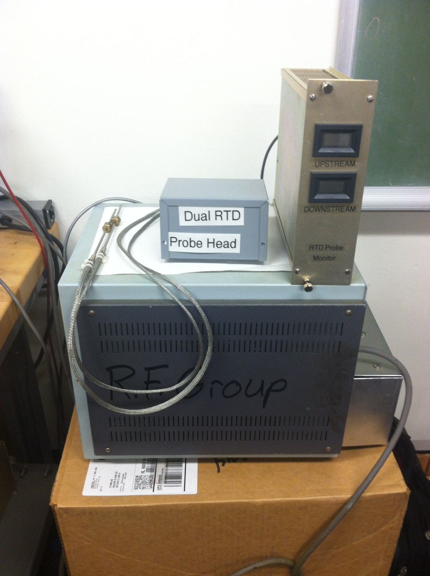
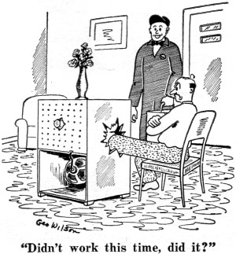
Current State of Electronics
RTD probe readout electronics complete
Troubleshooting complete
http://www.rfcafe.com/references/radio-electronics/comics-january-1958-radio-electronics.htm

Slide 15
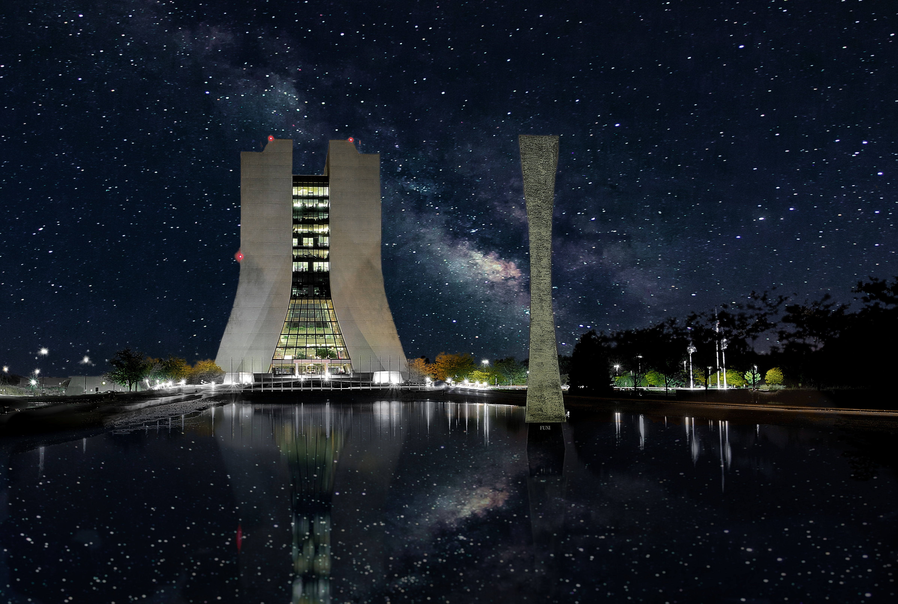
Conclusions
Comparison study of real and model cavity with Superfish
Permeability study of the ferrite
Power Amplifier RTD electronics complete
http://www.fnal.gov/pub/today/archive/archive_2014/today14-07-31.html

Slide 16
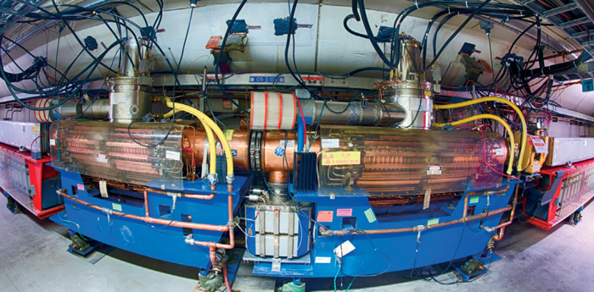
Future Work
Assembly of physical model cavity
76 MHz Power Amplifier testing
Study higher order modes in the model cavity
http://cerncourier.com/cws/article/cern/55333

Slide 17
Acknowledgments
Robyn Madrak Plant for her endless help and mentoring
C. Y. Tan for giving project motivation and background
The RF Group for their help with the PA electronics
Dave Peterson for his feedback on the presentation
The SIST committee for the opportunity to intern at Fermilab
https://rootsrated.com/chicago-il/cycling/fermilab-cycling

