Slide 1
Second Harmonic Cavity Window
Ding Sun
Meeting
Aug, 2015

Slide 2
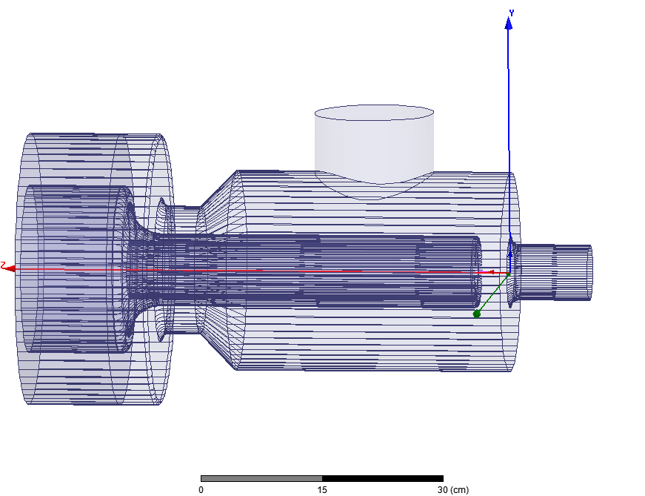
RF Window
The 1st window (coupling side) is doable (peak and average power are not very high). Is there enough space to make a ceramic window with flanges on both side?
The 2nd window (inside cavity) is a challenge. There are 3 limiting factors:
Limited space
Assembly procedure
Electrical/Thermal --- breakdown/heating (joint area, volume loss)…
These 3 factors together make the task too complicated to start with.
So I have to ignore the first 2 factors (for the time being) and just look at the 3rd factor: (1) can we put 2nd window at any location we want? (2) compare with the windows being used in booster cavity.
DIA 6 inch

Slide 3
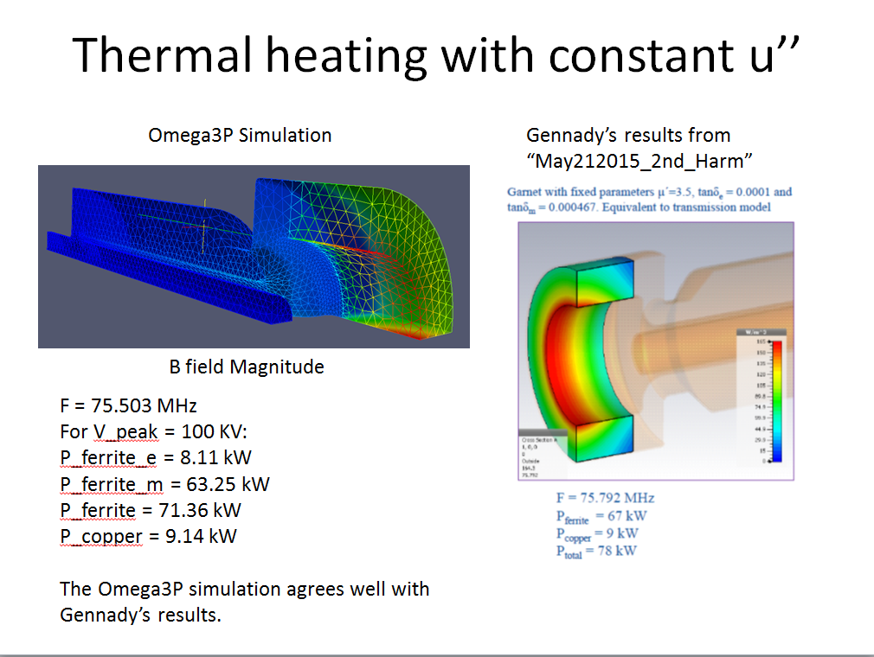
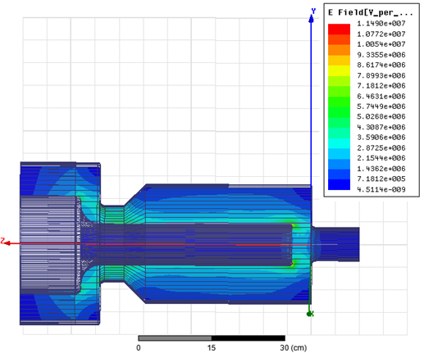
Check simulation software
Verify simulation results HFSS/MWS:
(1) 75.6 MHz/47.2kW (Gennady), 75.015MHz/52.5kW (HFSS)
(2) For larger tanδ (m) 0.000467, 75.5MHz/78kW(Gennady), 75.05MHz/93.43kW (HFSS), but the models may not be the same.
---discrepancy is likely due to the detail of field distribution and the integration in gap area which affects the scaled results (100kV).
But it doesn’t matter too much for the study in next slide --- we can always scale the results of HFSS to that of MWS.
Al800_New2: εr 14, µr 3.5, tanδ(e) 0.0001, tanδ (m) 0.000206
HFSS

Slide 4
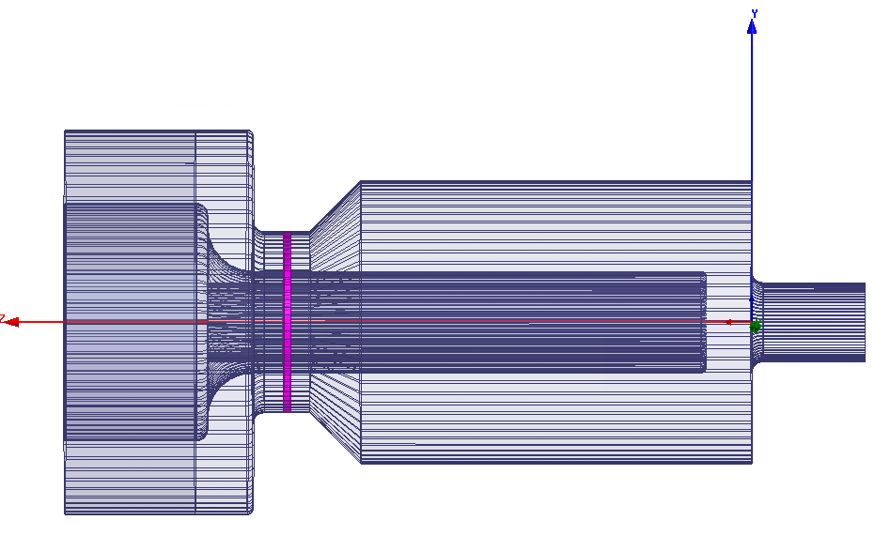
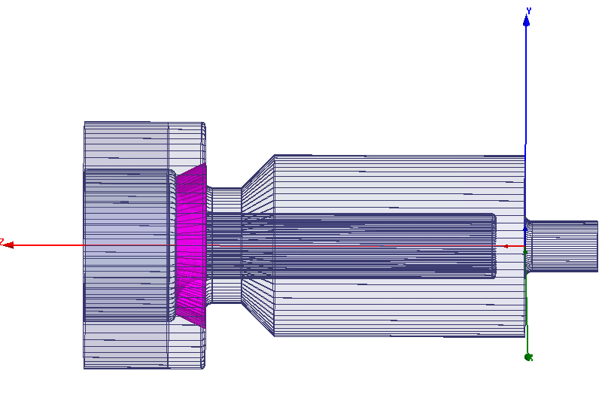
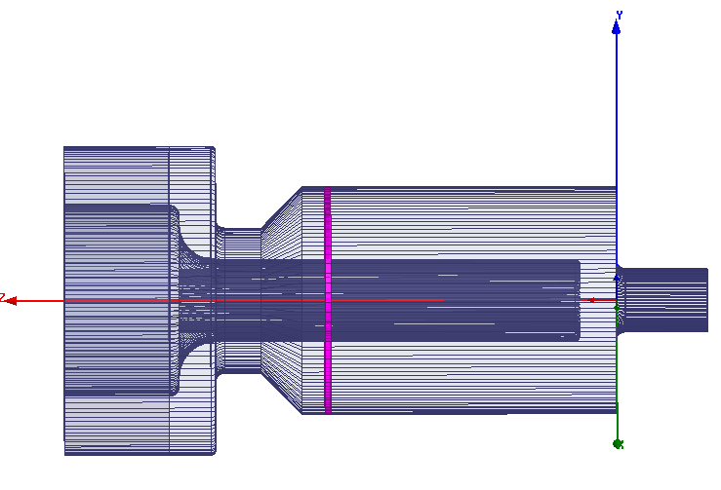
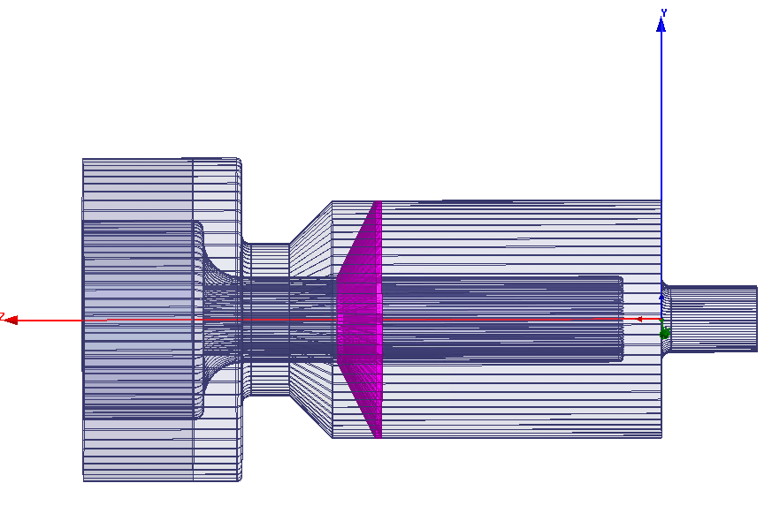
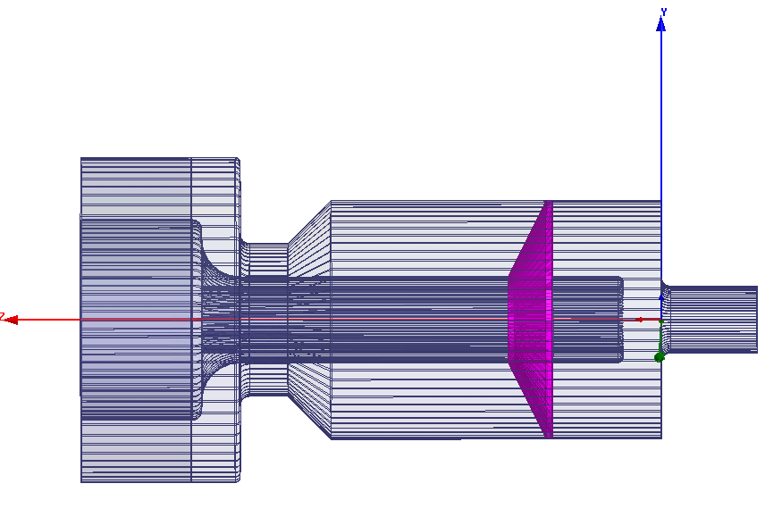
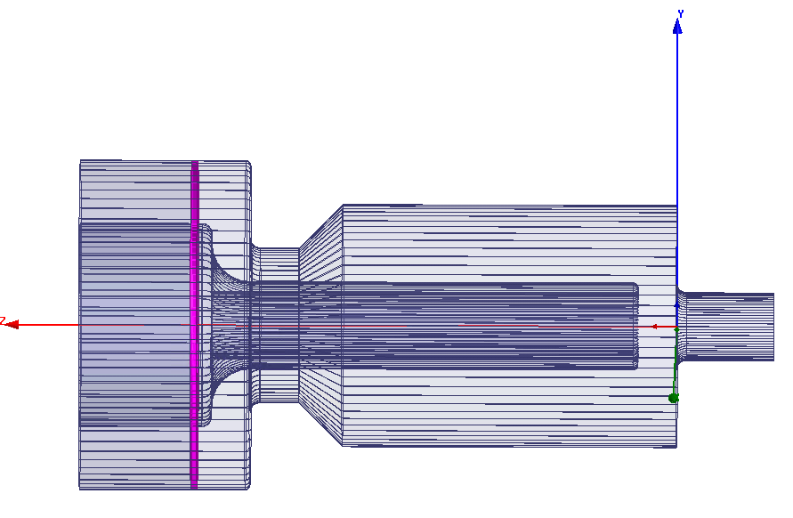
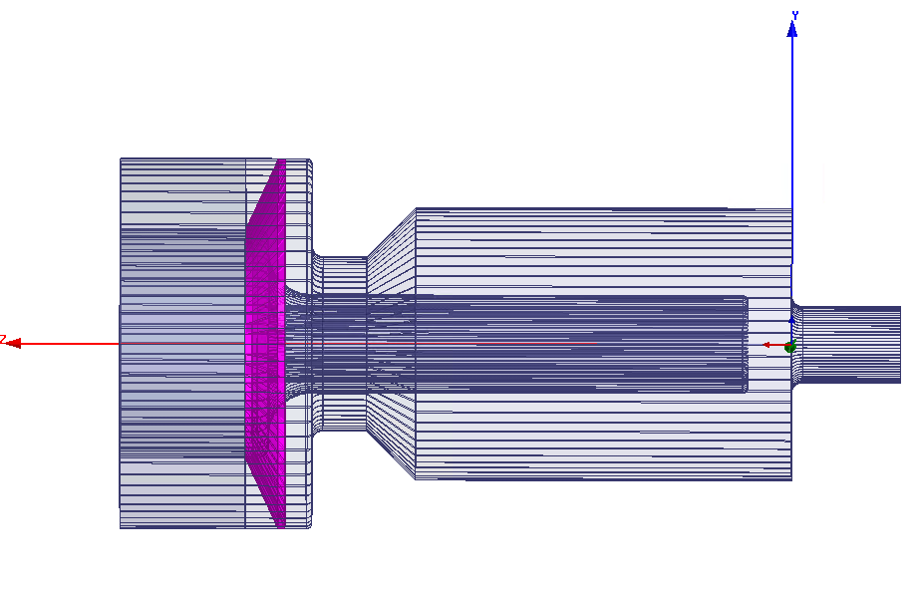
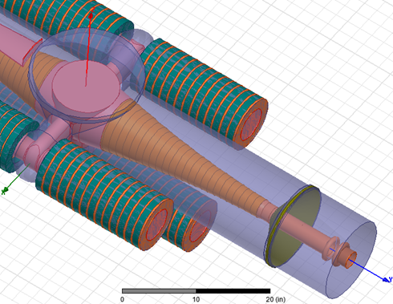
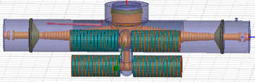
If you can find other locations, please let me know……
At 16 cm from cavity wall

Slide 5
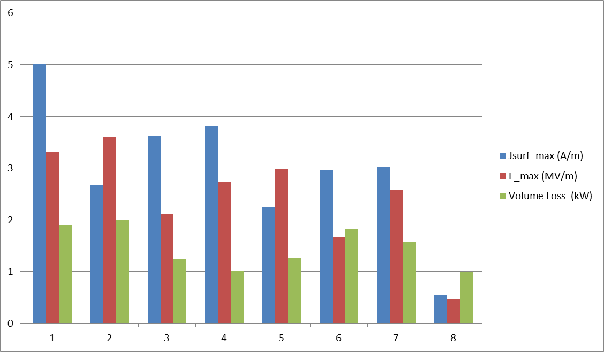
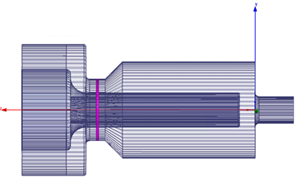

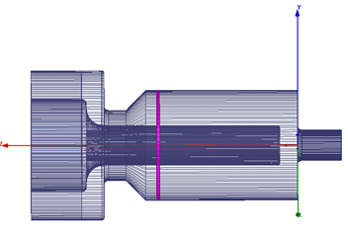





Surface current density max. / E_field max. / Volume loss
Al2O3: 0.25 inch thick
#1-7 100 kV
Al800_New2: εr 14, µr 3.5, tanδ(e) 0.0001, tanδ (m) 0.000206
#1 – 7
Al2O3: εr 9.7, tanδ(e) 0.0002
#8 Booster cavity 27.5kV
Al2O3: εr 9.4, tanδ(e) 0.006
So the volume loss would be ~ 33 W if use tanδ(e) 0.0002

Slide 6
Not a conclusion…
If the max. E in #1 position is truly as high as HFSS result, the window may have to be on the left side to be verified (Gennady).
If the max. E in #2 position is truly as high as HFSS result, the window may have to be at #6 or 7. (triumph window is in that area, coincidence?)
Volume loss may not be a big problem due to low duty factor (stress simulation needed --- Kevin?).
RF current heating at ceramic-copper joint (lower conductivity and imperfection etc.) --- no absolute criterion… What is the cause of failure in booster cavity window?

Slide 7
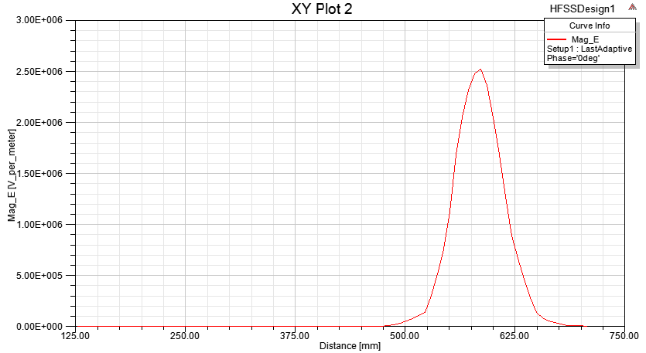
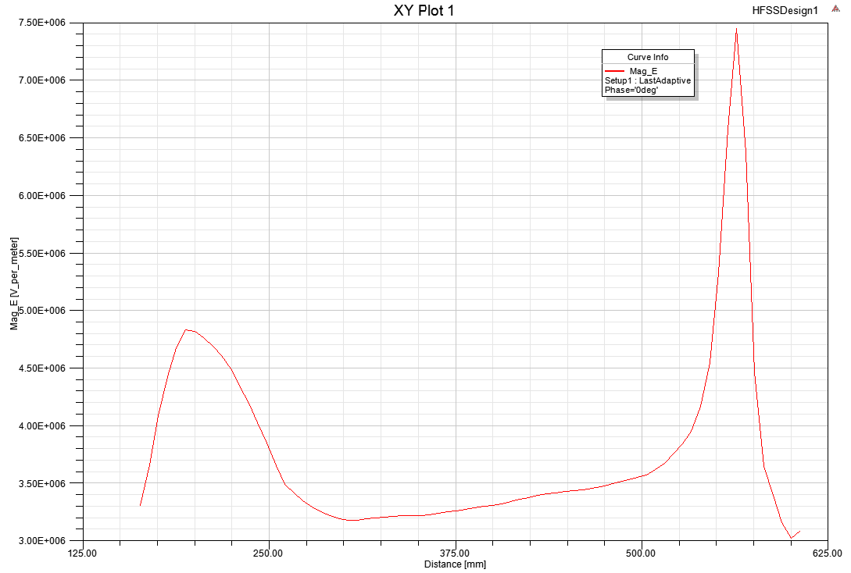
Misc. plots
E-field at 4.6 mm along beam line (1 Joule stored energy).
E-field at center of beam pipe along beam line (1 Joule stored energy)

