Slide 1


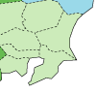
19th Nov. 2015
APT Seminar @FNAL
Muon Production target at J-PARC
& thermal diffusivity measurements
Tsukuba
(KEK)
Toukai
(J-PARC)
Tokyo
J-PARC Center, MLF Division, Muon Section (KEK)
Shunsuke Makimura (shunsuke.makimura@kek.jp)

Slide 2
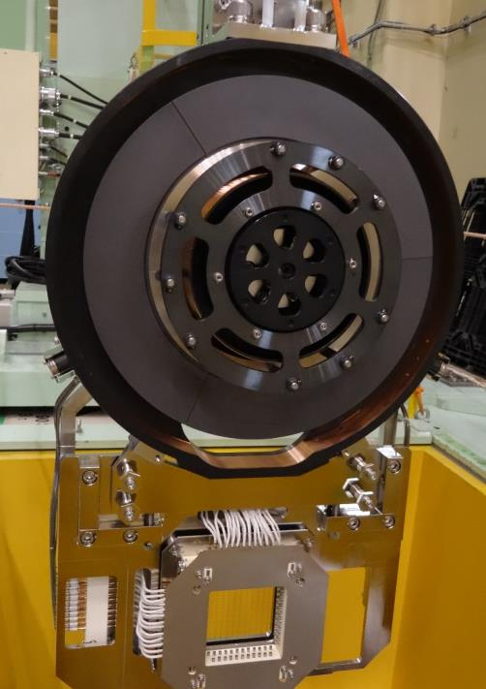
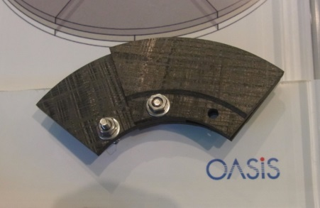
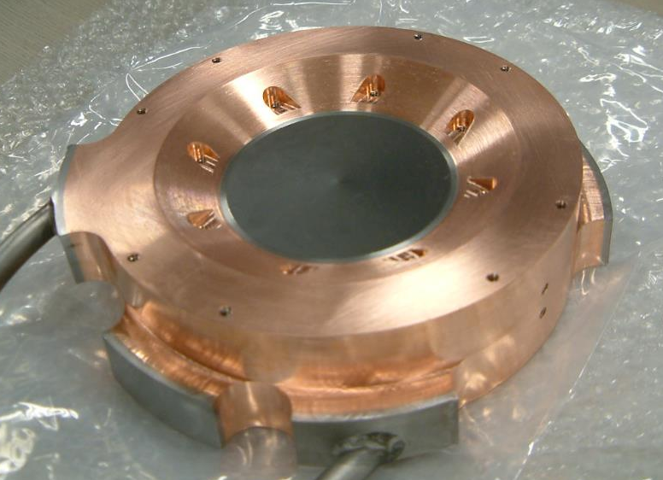
Contents
Introduction of Muon Target
Fixed Target
Rotating Target
Silicon Carbide Target
~~~Break~~~
Non-destructive measurement for thermal conductivity of used muon target
Notes:
When we started proton beam operation in 2008, the fixed target was installed in the beam line. Then

Slide 3
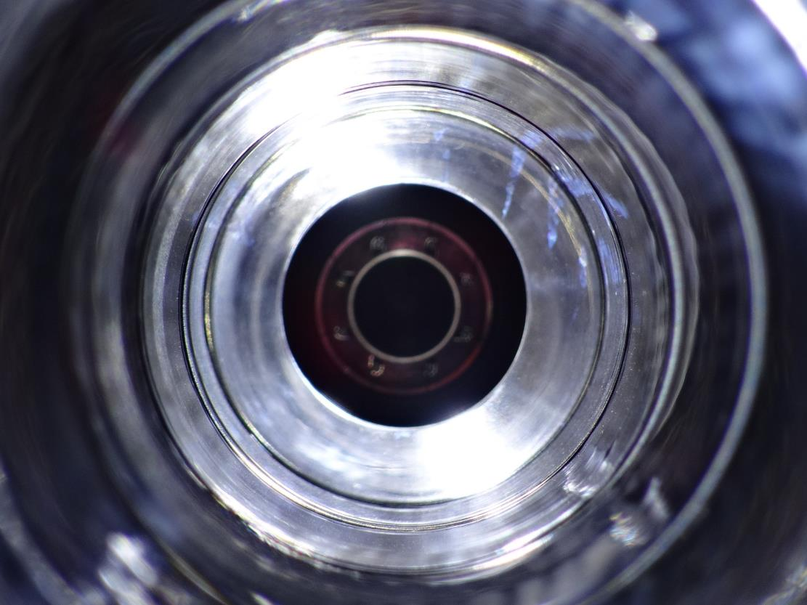
1. Introduction of Muon Target

Slide 4
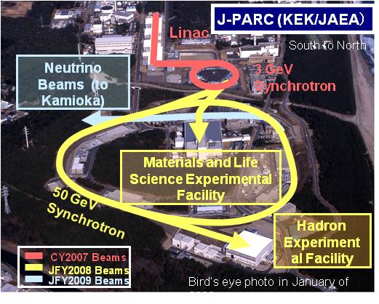
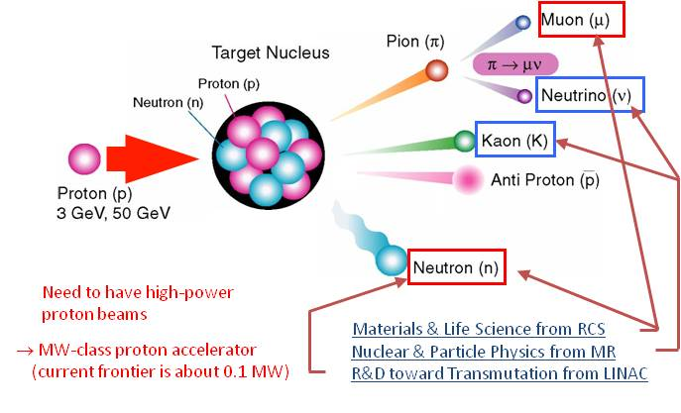
Japan Proton Accelerator Research Complex
(J-PARC)

Slide 5
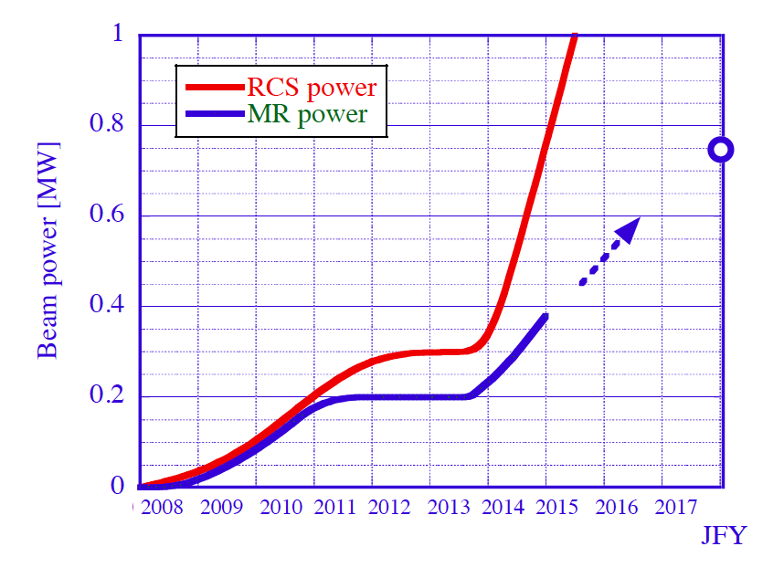
PSI; 1MW
Rotating Target
LINAC Upgrade
New RCS schedule (undecided)
We are here
MR New PS
ISIS/RAL; 200kW
Fixed Target
Earthquake
Hadron Acc.
Country | Japan | U.K. | Switzerland
Facility | J-PARC MUSE | RAL ISIS | PSI
P Intensity [MW] | 1.0(Goal) | 0.16 | 1.3
Surface Mu+ [/s] | 6 x 10⁷(U)@0.2MW | 6 x 10⁵ | 3 x 10⁷
DC / Pulse | Pulse (25Hz) | Pulse (50Hz) | DC
5
The fixed target at J-PARC had been used for five years without replacement. The fixed target was replaced with rotating target in Sep. of 2014.

Slide 6
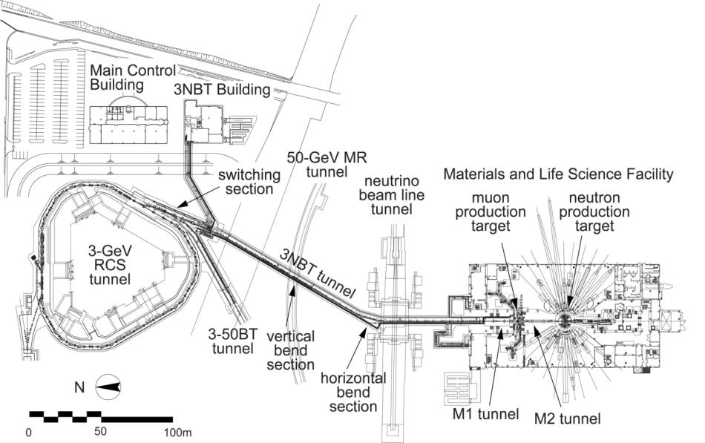
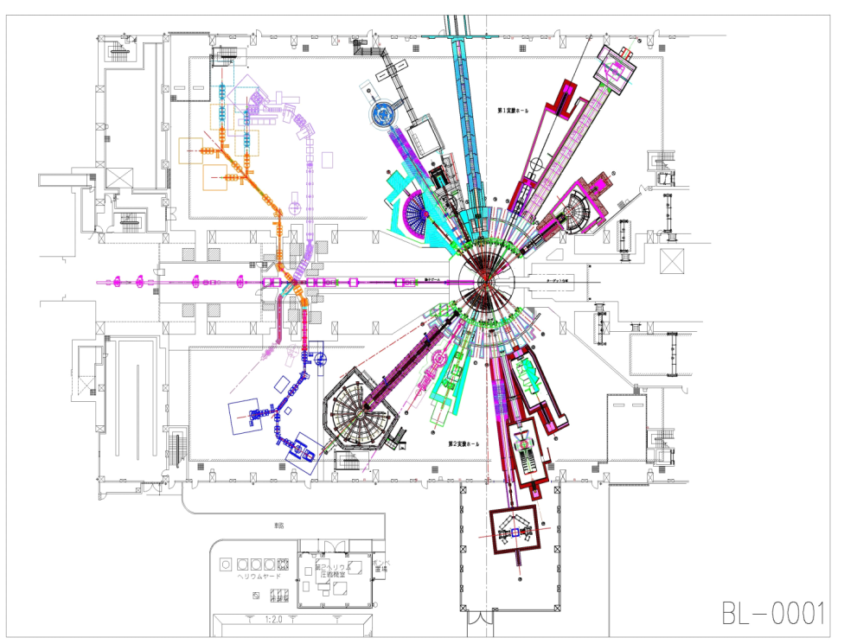
Materials and Life Science Experimental Facility
& MUON TARGET
Neutron Target
3GeV-RCS
Muon Target
1MW in future
500kW at present
Materials and Life Science Experimental Facility (MLF)
The most intense pulsed muon beam all over the world

Slide 7
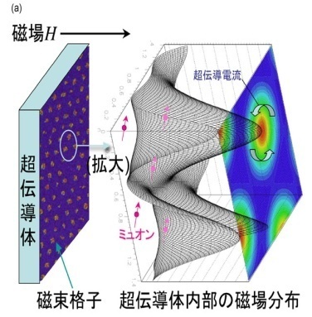
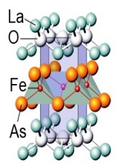
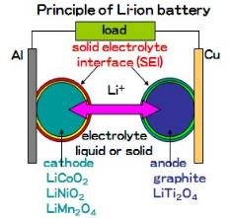
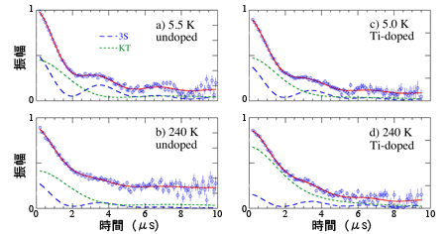
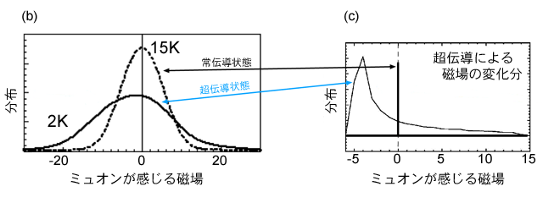
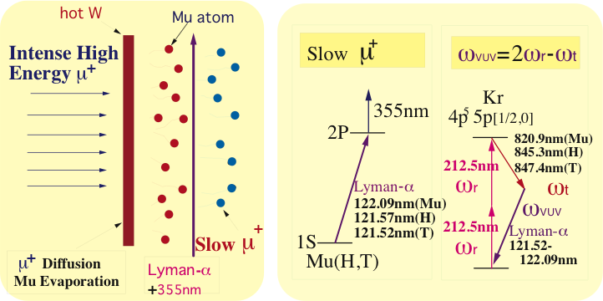
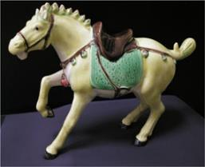
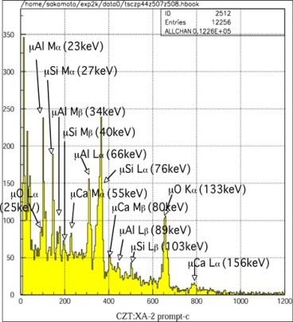
Topics Explored by Muon
Batteries Material and Hydrogen
Positvie Muon
Magnetism and Superconductor
Positive Muon
H behavior
Determination
of internal magnetic field distribution
Ultra Slow Muon Generation
Non-destructive Measurement
Negative Muon
100 µJ
@122 nm
Ultra Slow μ⁺（ >10⁵⁻⁶/s） surface muon (4×10⁸/s)
Characteristic X-ray measurement by negative muons
Surface Muon (4 MeV, Range ~0.1mm) for BULK
Ultra Slow Muon(0.05-30 keV, Range 1 nm to ~100 nm)
  ●Study Nano-science(Interfaces or multi-layered film)
  ●Surface Chemistry-Catalysis on nano-particle

Slide 8
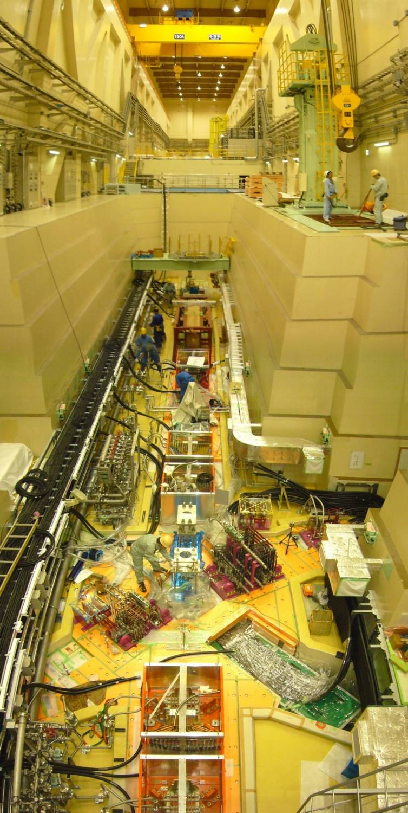
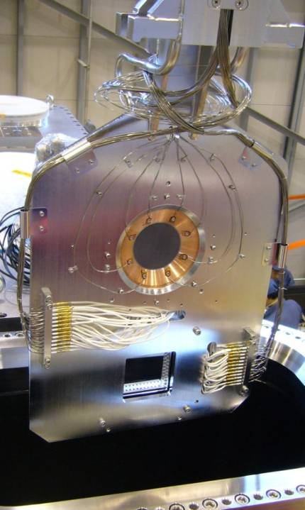
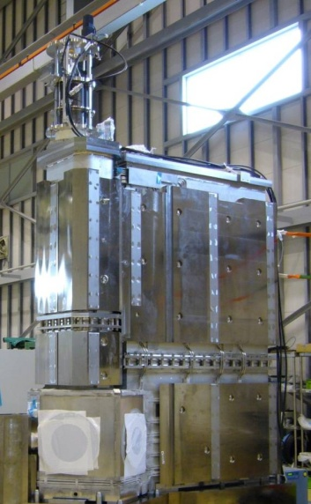
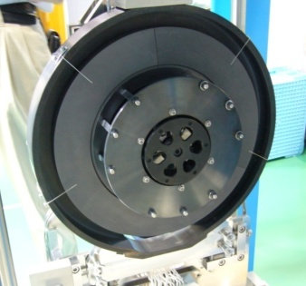
INTRODUCTION for Muon Target
Muon Target
System
To Hot cell
Muon Target
(Graphite)
FL4m
Muon Target System
To neutron source
Radioactive components
Fixed Target
Muon Target
FL1.6m
Irradiation Damage of graphite
Post Irradiation Effect
Proton Beam
Operation
Replacements and Checking
To Exp. Hall
To Exp. Hall
Rotating Target
Remote controlled task in Hot cell
From RCS and BT Line
Silicon Carbide Rotating Target

Slide 9
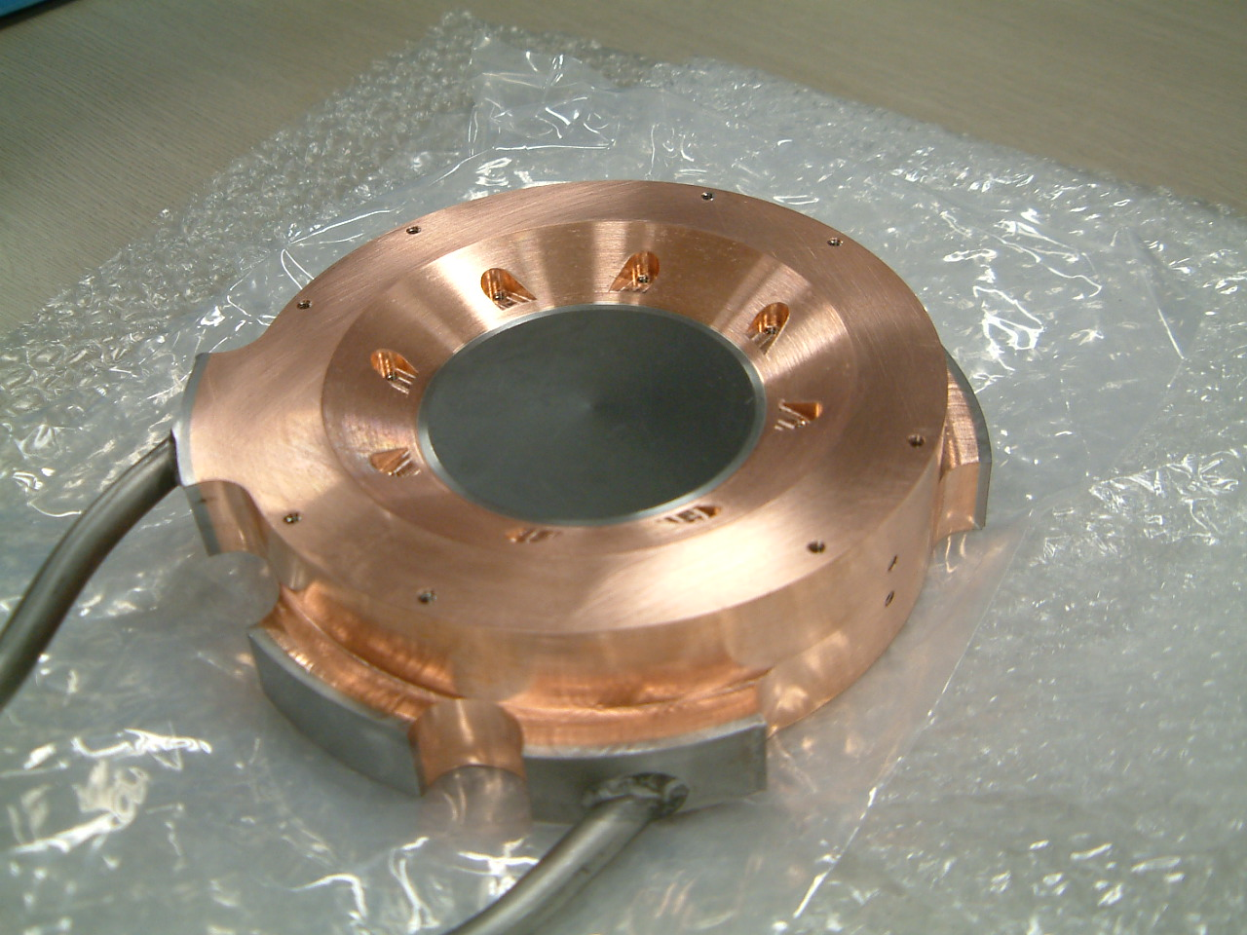
Current Muon Target (Fixed Target)
Isotropic Graphite
IG-430U (Toyo Tanso)
Diameter; 70mm
Thickness; 20mm
P-Beam diameter; 16 mm (2σ)
4kW heat @ 1MW proton beam
70 mm
20 mm
Titanium layer
as stress absorber
Silver brazing method
Stainless steel pipe (Water)
Copper frame
Hot Iso-static Press method
Journal of Nuclear Materials 377 (2008) 28-33.

Slide 10
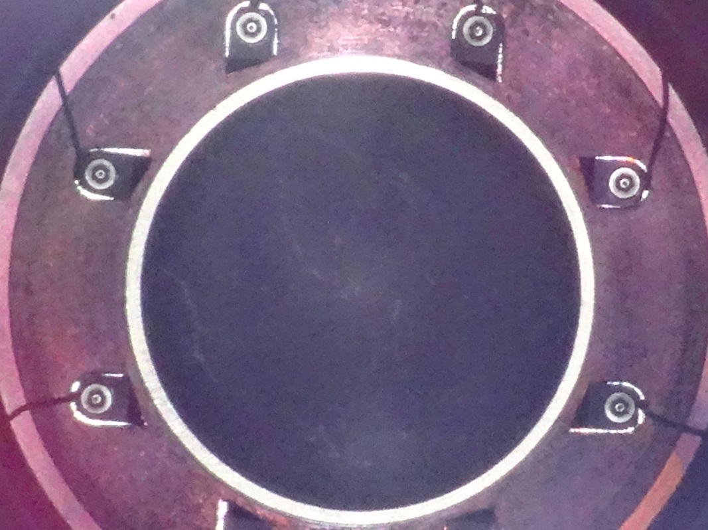
Stable Proton beam operation
Stable proton beam operation without replacements for 5 years
MLF beam operation; Total 15000 hours
Proton beam stop by MPS of muon target; 3 hours (Water flow Low)
 | 2008 | 2009 | 2010 | 2011 | 2012 | 2013 | 2014
Proton Beam
Earthquake
200kW Op.
Hadron acc.
Replacement to Rotating Target
Sep.Day1
120kW Op.
20kW Op.
Dec. 300kW
300kW Op.
200kW Op.
No crack was observed.
To neutron source
Radiation dose; 750μSv/h @12 m
(150mSv/h @30cm）
Muon Target
Digital camera
7th July, 2014

Slide 11
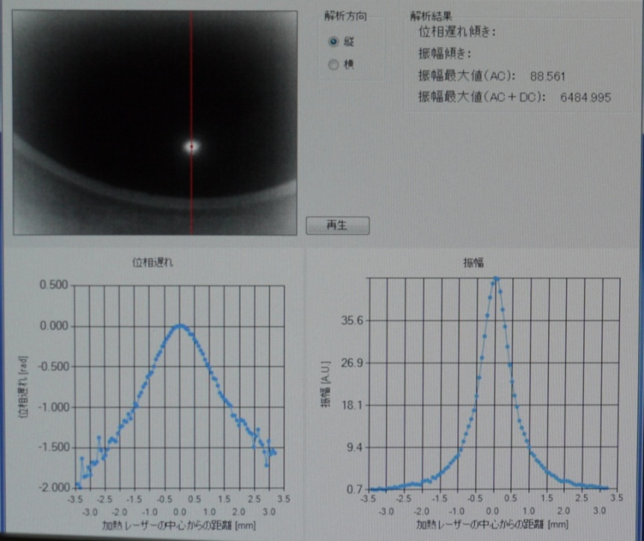
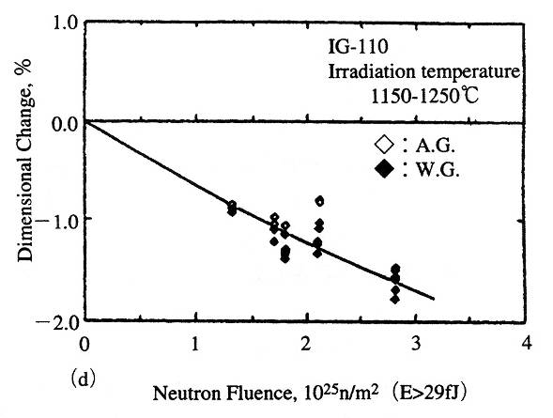
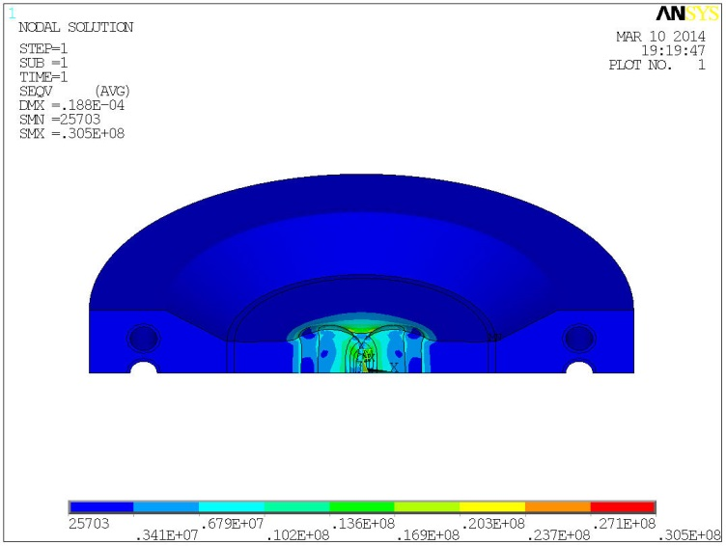
Radiation damage of graphite
Thermal conductivity
Dimensional change
New method
Laser spot heating technique
Temp. Var. by Periodic heating LD
2-D thermo-viewer
1dpa
Measurement of thermal conductivity for muon target at J-PARC/MUSE
0.002dpa80℃
Journal of Nuclear Materials 195(1992)44-50.
graphite1991 [No.150] 290-302
Max. Mises stress; 30MPa
Strength; 39 MPa
0.25dpa200℃
Un-irradiated
170W/m/K
Evaluation for July, 2014
Beam spot will shrink by proton irradiation.
Journal of Nuclear Materials 450 (2014) 110-116

Slide 12
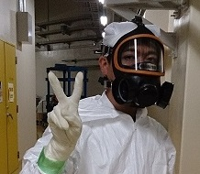
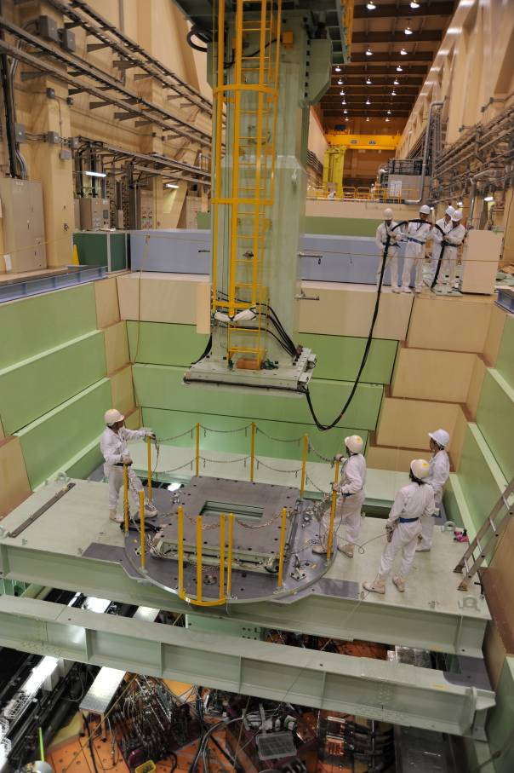
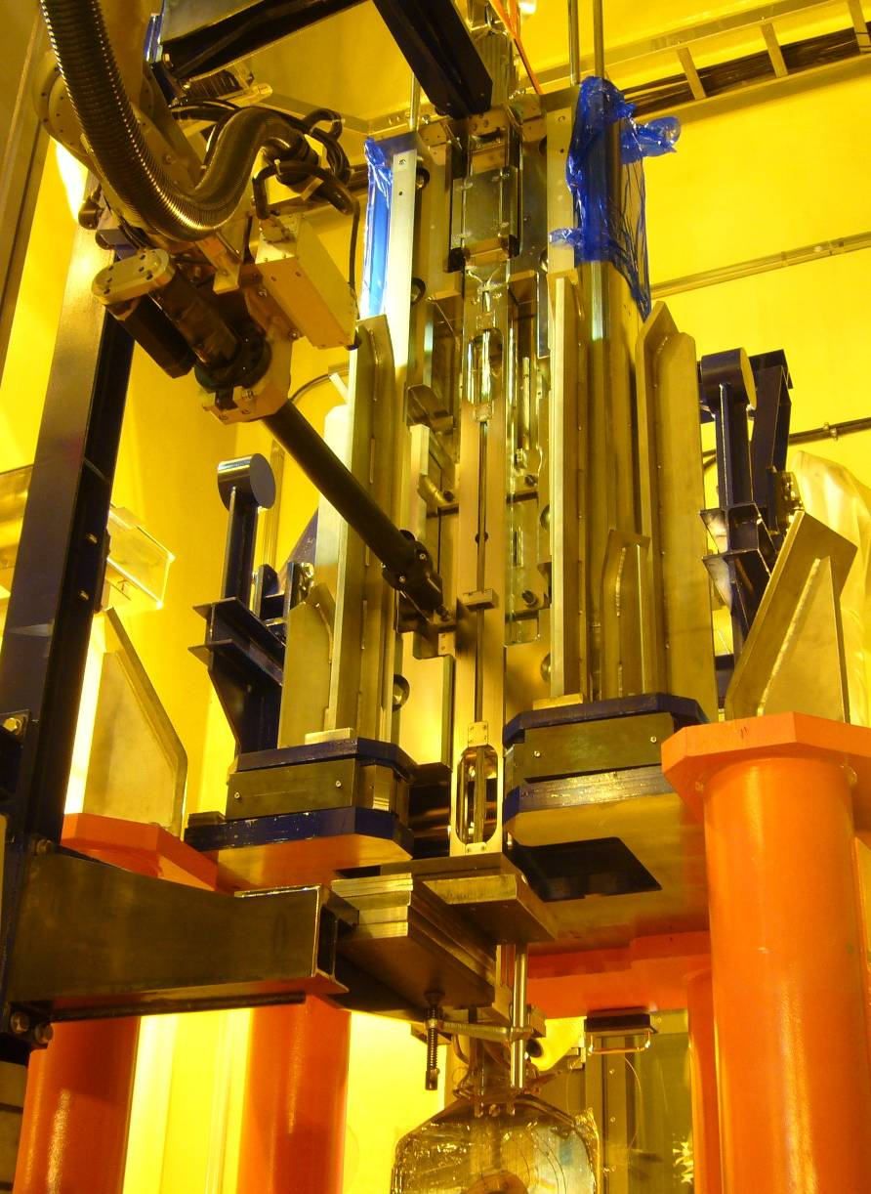
Replacement of Muon Target
Residual radiation dose of muon target; 5 Sv/hour @surface
Lifetime will be less than 1 year @ 1 MW operation.
We are eager to prolong lifetime.
I must do it!!
Time, Manpower, and cost are required for replacement.
Replacement in Hot cell

Slide 13
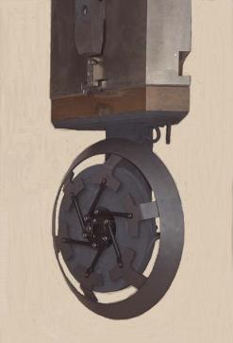
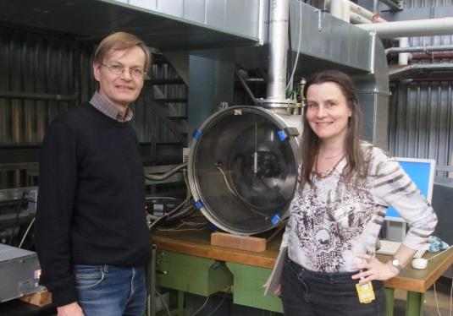
Rotating Target
Learning from Paul Scherrer Institute,
Rotating target method is applied to disperse the irradiation damage of graphite to a wider area.
Proton beam
Current fixed target
Rotating target
The lifetime of graphite becomes long enough.
The lifetime of bearings is critical.
Solid lubricant;
Silver coating with MoS2 at PSI
Disulfide tungsten at MUSE
Expected lifetime; 10 years
E target at Paul Scherrer Institute (PSI)
Lifetime; less than 1 year
April, 2013
Collaboration with PSI Target group since 2004

Slide 14
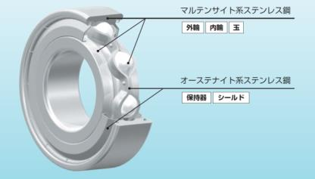
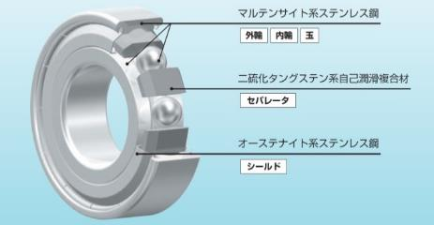
Bearing & Solid lubricants
For our target, the bearing is used under 100 MGy/year, 400 Kelvins, 10⁻⁵ Pa
 | Type | Temp. (Kelvins) | Pressure (Pa) | Radiation | Speed (rpm) | Storage | Lifetime @15rpm (hour)
MoS₂ | coating | <570 | 10⁵ to 10⁻⁵ | general | <500 | air | 1100
Ag | coating | <600 | 10⁻³ to 10⁻¹⁰ | general | <500 | vacuum | 5800
WS₂ | Separator | <600 | 10⁵ to 10⁻⁵ | few | <210 | air | 110000
Retainer, balls, & rings, coated by MoS2 or Silver
Separator made of sintered compact of WS2
Captured from JTEKT(KOYO) Catalog
Evaluation by the formula of the JTEKT Catalog
Great amount of Lubricant
Disulfide Tungsten is used for MUSE target.
Anticipated Lifetime is 20 years!!
Radiation resistance of WS2 should be confirmed.

Slide 15
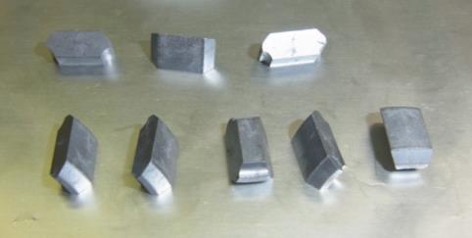
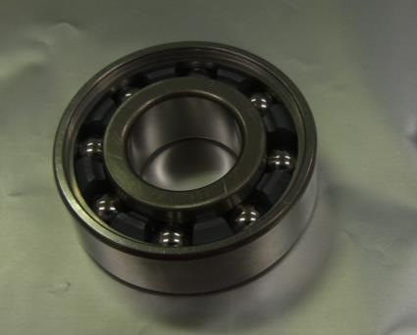
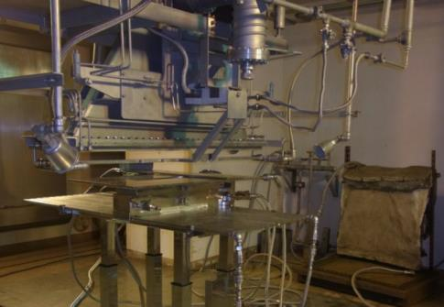
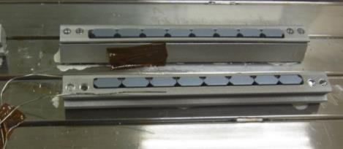
Radiation Resistance of WS₂
Electron beam irradiation
JAEA, Takasaki,
2MV, 1mA, 20hours, 100MGy
Durability tests with load & heat
4.5 million revolutions,
1year@ beam line
No irradiation effect was observed.

Slide 16
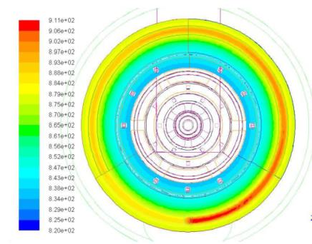
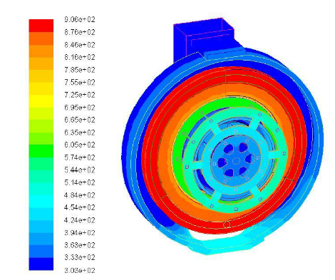
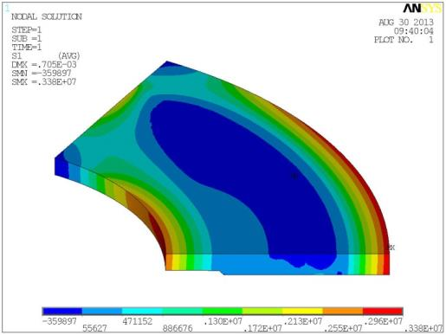
Analysis of rotating target
Analysis of ordinal operation by FEM on ANSYS & Finite Difference Method on Microsoft Excel
Maximum temp. 920 Kelvins, Difference; 80 Kelvins
Thermal stress ;3MPa
Rotation speed at beam line should be 15 rpm.

Slide 17
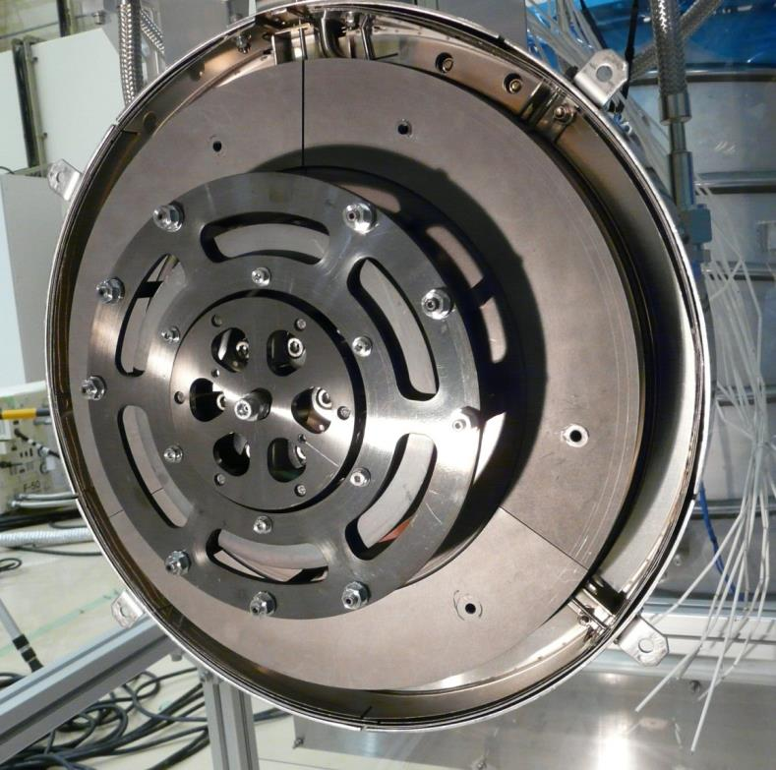
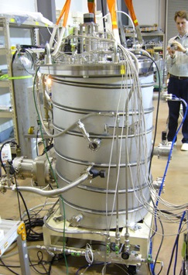
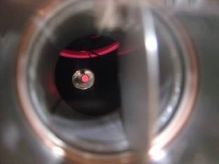
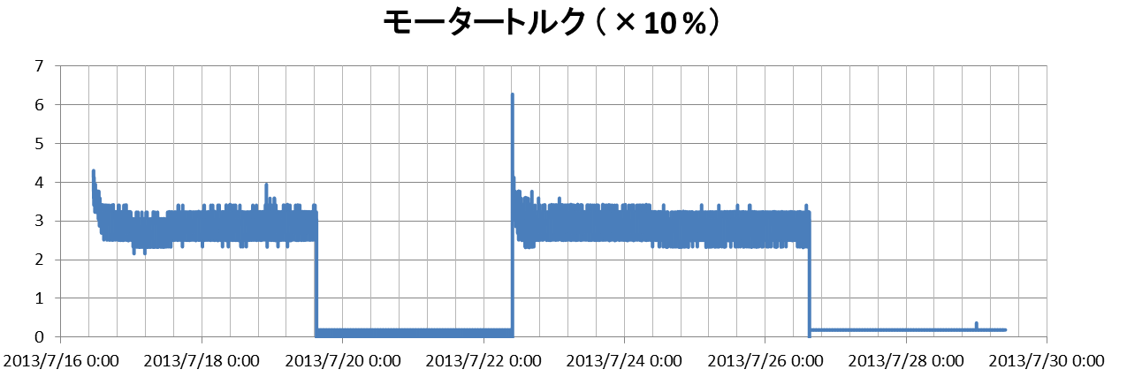
Mock-up of Rotating Target
330 mm
Durability tests of
Target & bearings
Heating & Rotating tests
Proton beam
Heating test
Motor torque (x 10 %)
Operation for 4 days
Operation for 5 days
9 days with 300 r.p.m. (4800h @15 r.p.m.)
It will work at least for 1 year!!

Slide 18
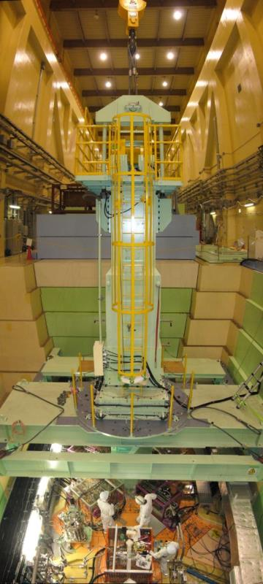
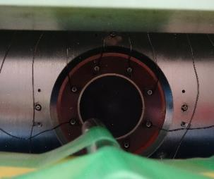

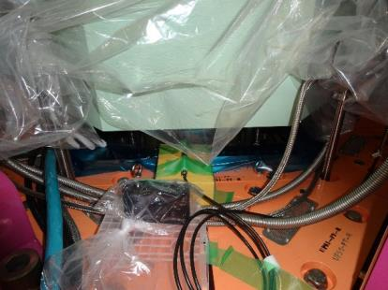
Replacement of the used Fixed target
30th July, 2014
M2 line
M1 line
To neutron source
Radiation dose;
750μSv/h @12 m
(150mSv/h @30cm）
Remote-controlled camera
No crack was observed.
400 mSv/h @20cm
Dose-meter & Digital camera
10cm gap
Transportation to tentative storage vessel
7th July, 2014
FL4m

Slide 19
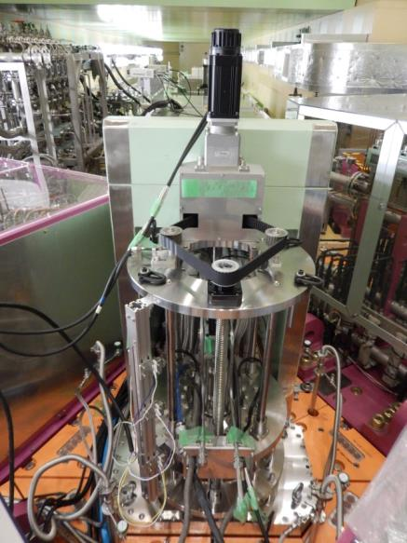
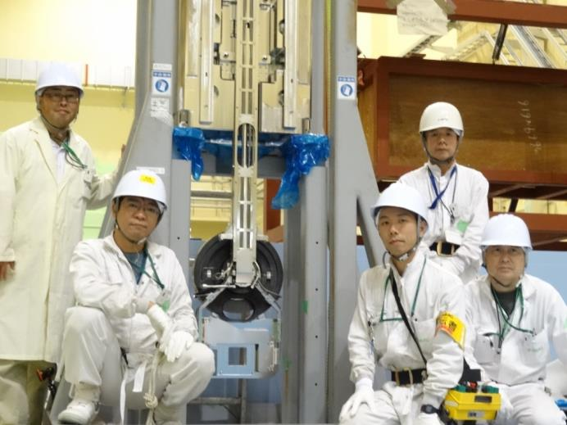

Installation of Rotating Target
Rotating Target was successfully installed on 16th September of 2014.
Vacuum pressure; 10⁻⁵ Pa
Control system; Confirmed

Slide 20

Operation of muon rotating target
Cooling Jacket
300-kW & 400-kW operation for 3 months
600-kW operations for 1 hour on 8th Apr./2015
Continuous 500-kW operation
Motor torque has been remaining constant.
Horizontal shaft
Bearing
Trial tests for interlock in case of beam stopping
Thermo-couples for shaft temp.
Proton beam
Graphite wheel
Graphite temperature by thermal radiation
 | 300kW | 500kW | 1MW
Shaft (Simulation) | 71 degC | 84 degC | 112 degC
Shaft (Measurement) | 78 degC | 95 degC | -
Graphite (Simulation) | 400 degC | 475 degC | 620 degC
Th. radiation (Measurement) | 45 degC | 60 degC | -

Slide 21

Silicon Carbide Rotating Target for DeeMe Project
DeeMe Project;
  Muon-electron Conversion Search
  Representative; M. Aoki, Osaka University
by Aoki at Osaka Univ.
μ⁻ + A(Z,N) → e⁻ +A(Z,N)
Graphite (C) → Si: 11-times larger overlap
μ⁻ reaction ε: 8%(C)→67%(Si)
Forbidden in the Standard Model(SM) of particle physics.
No signals found yet.
Discovery of the signal
→ a proof of the physics beyond SM.
  Complementary to high-energy frontier experiments: LHC, ILC.
  Can explain the neutrino oscillation phenomena (Seesaw Mechanism).
μ⁻(Si)
C nucleus
Si nucleus
μ⁻(C)
r/aBohr
Silicon Carbide
Eff. of Muon Reaction: 6 times larger than C.
2nd Stage approval from Muon PAC of KEK/IMSS
Hopefully, Silicon Carbide is replaced with graphite as soon as possible.

Slide 22


Developments of Silicon Carbide Rotating Target
 | Density (Beam loss) | Young’s modulus | Bending Strength
Graphite (IG-430) | 1.82 g/cc (4kW) | 11 GPa | 45 MPa
SiC (SC1000, Kyocera) | 3.2 g/cc (8 kW) | 440 GPa | 450 MPa
Comparison with graphite (Very rough discussion)
Thermal stress depends on Product of temperature (2 times) and Young’s modulus (40 times).
“Thermal stress; 80 times” VS “Strength; 10 times”
SiC has 8 times larger risk than graphite about thermal stress.
Max. temp.; 780 degC
Preliminary heating test on Aug. 6th , 2013
Design work to reduce thermal stress

Slide 23


SiC/SiC Composite (NITE & NIC SiC)
Possibility to introduce SiC/SiC for muon target
Advanced materials developed for nuclear & fusion reactor
by OASIS Group.
Collaboration is in progress.
FEEMA Project at OASYS
Support program at KEK (Kasokuki Shien Jigyo)
High thermal conductivity (controllable)
Large and Complex Shapes
Excellent Mechanical Properties (Strength or Pseudo-ductility)
Excellent Radiation Resistance anticipated
It can be also applied for accelerator field.
SiC Target Collaboration
1/3 model for muon target
Collaboration with A. Kohyama, C. Kanda, D. Hayasaka, H. Kishimoto and Y. Kohno Organization of Advanced Sustainability Initiative for Energy System/Material (OASIS Gr.)
Muroran Institute of Technology & GUNZE Co., LTD.

Slide 24



Advantage of SiC with regard to Physics requirements
COMET Experiment;
These information were supplied by Dr. Mihara.
Muon-Electron Conversion
Hadron Experimental Facility at J-PARC
Phase-I; 8 GeV-MR, 3.2 kW, Graphite target
Phase-II; 8 GeV-MR, 56 kW, High-Z target
Muon Transport Section is designed for Phase-II.
To reduce the disperse of muon production in the solenoid, SiC target is preferable to graphite for Phase-I.
Under discussion, with Dr. Mihara.
MuSIC/RCNP at Osaka Univ. by Dr. Sato
Target is also located in capture solenoid.
Pion Production Target
Capture Solenoid

Slide 25
Summary for Muon Target
Outline, Introduction of Muon Target
Fixed Target
Rotating Target
Silicon Carbide Target
~~~Break~~~
Non-destructive measurement for thermal conductivity of used muon target
We are here.
Since 2008, Stable beam operation by Graphite Fixed target.
Graphite Rotating Target was installed this September.
Stable proton beam operation by Graphite Rotating target

Slide 26
Non-destructive measurement for thermal conductivity of used muon target
Proton Irradiation effect to thermal conductivity of graphite at J-PARC/muon target
Non-destructive measurement

Slide 27


Motivation for PIE tests in our case
Lifetime; dimensional change of graphite
by proton irradiation
Domestic conditions in Muon Gr.
We are Muon Experimental Group, not Muon Target Group.
The Man-power for Muon Target is incredibly small.
,which depends on the irradiated temp.
Then, How much is it?
We must guess the thermal conductivity.
The utilized data is obtained at same condition?
We hope to know actual radiation damage.
(Even if the measurement is performed in R.T.)
No active disposal, Non-destructively
Target can be used again.
Low costs, Low man-power
But High performance
IG-430
Titanium
Beam profile
Neutron irradiation effect to thermal conductivity
Cu frame
By Kawamura
T. Maruyama et al., Journal of Nuclear Materials 195 (1992) 44-50.
Stainless tube

Slide 28

Measurement for thermal conductivity of graphite
Thermal diffusivity are measured instead of Th. conductivity.
λ=Dρc (λ; Th. Conductivity(W/m/K), D; Th. diffusivity(m²/s), ρ; Density (kg/m³), c; Th. Capacity (J/kg/K))
Conventional Method
(Laser-flash technique)
New method for this experiment
Laser Spot Heating technique
2-dimensional
thermo-meter
Non-destructively
Target can be used again.
Decreasing nucl. wastes
High spatial resolution
Cutting of specimen
Measurement
Temp.@
Heated spot
Modified Thermal Imaging Scope
(Bethel. Co. LTD.)
time
Periodic heating Diode Laser
Temp. @
Mating
surface
Comparison of Amplitude
time
Temp. variation @ Heated spot
Delay of transmission
Curve of temerature rise
time
Temp. variation @distant position from heated spot
The target must be destroyed.
We must consider transportation and the scattered radioactive powders.
The spatial resolution is limited by sample size.
time
Delay of transmission; θ
(H. Kato et al., Meas. Sci. Technol. 12 (2001) 2074-2080)

Slide 29

Theoretical Background of this technique
Thermal transport equation
D; Th. diffusivity(m²/s), ρ; Density (kg/m³), c; Th. Capacity (J/kg/K))
-1
Amplitude
θ
Carslaw H S and Jaeger J C 1959 Conduction of Heat in Solids (Oxford: Clarendon)p 263
r
θ
Feasibility of Apparatus
gradient
Thermo-meter
Distribution of Th. Cond. must be measured.
2-dimensional infrared thermo-meter
r
Periodic heating on Point
Pexp(iωt)
Amplitude includes given heat by laser, P
Expensive!!
Comparison of Amplitude
Evaluation by Delay
High quantitative performance
Evaluation by Amplitude
Low quantitative per., but low costs
Temp. variation @ Heated spot
time
Temp. variation @distant position from heated spot
Relative measurements based on an exact Th. Cond., obtained by other technique (Laser flash method).
Un-irradiated Th. Cond. 170W/m/K
time
Delay of transmission; θ
ΔT; about 5 K

Slide 30




Measuring Apparatus of thermal conductivity
Vicinity of Muon Target; 5Sv/h, 5Gy/h for organic material (by Kawamura)
Assumption; Lifetime of measuring device, 100Gy, this means 20 hours
50mm iron shielding decreases the dose to 20 %. Extended Lifetime; 100 hours
Measurements with mirror reflection
Laser spot heating apparatus
Muon Target will set on the plug stand
Integrated measuring apparatus is set on a three-dimensional movable stage, which is set on plug stand.
Relative position is confirmed by laser displacement meter.
mirror
Laser displacement meter; resolution 1μm
CCD camera
Shielding for radiation
2-dimensional
Thermo-meter
Periodic Heating LD
The devices are set on the 3-dimensional motion stage.
Position resolution; 10μm
Laser spot heating apparatus
Indirect measurement through mirror reflection

Slide 31

Beam Profile and Anticipated Th. Conductivity
20mm x 16mm
Map pitch2mm
The variation of thermal conductivity irradiated by neutrons
Annealing effect
Horizontal
pitch1mm
Vertical
Pitch1mm
Max. 0.25dpa
Data for IG110
T.Maruyama et al., Journal of Nuclear Materials 195 (1992) 44-50.
From Simulation
Th. Conductivity can be anticipated,
0.25dpa on center 200degC; 5W/m/K
0.002dpa on edge 80degC; 10W/m/K
0.002 dpa
If decrement of conductivity is proportional to radiation dose, the distribution for the thermal conductivity corresponds to the beam profile.
Measurement in Hot cell

Slide 32

Results
20mm x 16mm
Map pitch2mm
We could observe an annealing effect on the center of beam spot because of high temperature.
The beam profile for horizontal/vertical could be observed.
Thermal conductivity was higher than the prediction.
Horizontal
pitch1mm
Vertical
Pitch1mm
Ellipse shape
 | Rad. Dose (dpa) | Th.Cond. Prediction | Th.Cond. Results
Center of target | 0.25 (200 degC) | 5 W/m/K | 15 W/m/K
Edge of target | 0.002 (80 degC) | 15W/m/K | 50 W/m/K
0.002dpa80℃
0.25dpa200℃
Un-irradiated
170W/m/K

Slide 33
Ellipse shape
Results
(Mapping)
20mm x 16mm
Map pitch2mm

Slide 34
Summary & Future Plans
Advantages of this new technique
Non-destructively
Target can be used again.
Decreasing nuclear wastes
High spatial resolution
Summary &Future Plans
Improvement of quantitative performance by meas. of θ
~High speed infrared thermo-meter
We began to measure proton-irradiation damage to thermal
conductivity of graphite by brand-new laser spot heating
technique.
Measurement can be performed, non-destructively, without
contact, and with high resolution. Target can be used
again.
Distribution of thermal conductivity (relatively) can be measured successfully.

Slide 35

Amplitude measurement
FEM is introduced to obtain the thermal diffusivity from maximum amplitude.

Slide 36

Quantitative performance
Reproducibility; Good (Effect of surface, scratch)
Relative measurements
Horizontal
every 5mm
Vertical
every 5mm

Slide 37

Spatial resolution
Diameter; 0.9mm
Averaged thermal conductivity

Slide 38

Generation of Ultra Slow Muons (USM lead by Torikai)
W(2000C)
Surface Muon (4 MeV, Range ~0.1mm) for BULK
Ultra Slow Muon(0.05-30 keV, Range 1 nm to ~100 nm)
Notes:
Page 23, There, J-PARC 4 MeV Surface muons are stopped in the hot W. Then towards Mu, intense lasers are introduced to ionize Mu via 1S-2P-unbound transitions.
Then Ultra Slow Muons are accelerated for the nano-meter muSR
Studies.

Slide 39


Non-destructive analysis by using negative muon
Comparison of Electron beam X-ray analysis and negative muon X-ray analysis. By adjusting implantation energy, composition at any depth can be obtained.
Hayabusa-Project II
Nature Scientific Reports SREP-13-06016-T
「A new X-ray fluorescence spectroscopy for extraterrestrial materials using a muon beam」

Slide 40
Isotropic Graphite
1mm/month
Isotropic graphite
(polycrystalline graphite)
⇔Highly Ordered Pyrolytic Graphite (HOPG)
For accelerator, nuclear reactor
Low density
High resistance to heat
Low Young’s modulus
High strength
Low residual radiation
IG-430U (Toyo Tanso); Muon Target
(IG-110; irradiation data obtained systematically)
0.001mm/month
2000 degC
1600 degC
Evaporation rate of graphite
（M.S. Avilov et al., Nuclear Instruments and Methods, A618 (2010) 1）
Neutron irradiation effect to thermal conductivity
(T. Maruyama et al., Journal of Nuclear Materials 195 (1992) 44-50.)
Irradiation effect to thermal conductivity

Slide 41


Dimensional change by proton irradiation
HOPG (Highly Oriented Pyrolytic Graphite)
c-axis; expansion, a-axis; shrinkage (expansion > shrinkage)
(B. T. Kelly et al., Phil. Trans. A, 260 (1966) 37-49.)
Isotropic Graphite
No effect was observed under 2300 K without irradiation.
Pore closure, Pore growth, Crystal growth
(G. B. Neighbour, J. Phys. D: Appl. Phys. 33 (2000) 2966-2972)
Gradient; Dimensional change rate (%/dpa)
temp. dependence
Expansion (< 300 degC <), Shrinkage
Radiation damage (dpa)
Proportional to rad. damage in our case. Dimensional change rate (%/dpa) depends on temperature.
Dimensional change (%)
G. B. Neighbour
http://www.toyotanso.co.jp/Products/Pruduct_j.pdf
Radiation damage (dpa) – Dimensional change(%)

Slide 42



Bevel gear for rotation of target
The Others
Bearing of rotation F.T.
Thermal expansion
To-be-installed Rotating Target
Rotation shaft
Heavy shielding
Top
Target rod
Bearing of which inner ring is fixed to shaft.
Bearing (not fixed)
coupling
THK spline nuts DP15
Coupling
Absorption of thermal expansion of the long shaft
Completed!!
Remote-controlled commissioning at Hot cell
Spline nut

Slide 43


Regular maintenance for Rotating Target
Aiming lifetime; 10 years, Possibilities of break-down
Lifetime of some components in maintenance area; Several years (Replacement by regular maintenance)
1. Components, which can not be replaced easily.
Most of Bearings in vacuum & Coupling
Target itself
Lifetime; > 10 years
2. Components, which can be replaced in maintenance area (out of vacuum)
Motor for rotation, motor for up-down
Timing belt for up-down motion
Lifetime; 2~3years
3. Components, which can be replaced in maintenance area (in vacuum)
Magnetic coupling FT for Rotation introduction into vacuum
Coupling. Bearing with the heaviest load
Lifetime; 2~3years

Slide 44


Outline of Replacement tasks
Preliminary observation of the fixed target from 12-m upstream
Removal of used Fixed Target
Observation of Vicinity of the target chamber
Installation of new Rotating Target
Tentative storage vessel
Preparation of new Rotating Target
Storage of used Fixed Target
Transfer cask;
Shielding, Transport, & Gripping function
Accessible area during beam operation
Tentative storage vessel
Side view
Movable shielding
FL10
FL10
Maintenance area
FL6
FL4
FL4
Shielding
P-Beam line
Neutron Target
P-beam line
FL1.6
FL1.6
Target assembly
Target assembly
Observation from upstream
Transport of movable shielding
Replacement by cask

Slide 45




Preliminary observation of the used Fixed target
M2 line
M1 line
Photographing of the fixed target at the position of 12-m upstream by target-observation device. “Wireless Digital camera”
Alignment function & Wireless Real-time observation
No crack was observed.
To neutron source
Radiation dose;
750μSv/h @12 m
(150mSv/h @30cm）
Remote-controlled camera
Alignment function
7th July, 2014

Slide 46




Removal of used Fixed Target
30th July, 2014
Transportation of Used Fixed Target from beam line to tentative storage vessel
Additional shielding was hanged to cask base.
Maintenance door is equipped on the shielding.
Maintenance door
Transfer Cask
Additional shielding for maintenance area
Cask base
FL6m
Dose-meter & Digital camera
10cm gap
FL4m

Slide 47







Removal of used Fixed Target
30th July, 2014
Successfully, used fixed target was removed from beam line and was inserted into tentative storage vessel.
15μSv/h
45μSv/h
15μSv/h
Transfer cask can be controlled from FL-10m.
50μSv/h
Radiation dose on the surface of transfer cask including used target
400 mSv/h @20cm
80 μSv/h
4mSv/h
Checking of contamination
Small contamination was observed.
Use fixed target at tentative storage vessel
Spatial radiation dose; 6 μSv/h (Height 1m)

Slide 48




Fabrication of Mock-up
Heating test
Horizontal shaft; 140 °C
(Numerical simulation for beam line;120 °C)
Rotating test; 200rpm ~500rpm
(Actual rotating speed; 15 ~ 20 r.p.m.)
Purpose
Durability tests of Bearings
Improvement for structure of the target
Development of Measuring system
Entire heating
Thermal Radiation Thermometer
Vacuum chamber

Slide 49



Rotary Motion Feed-through,
Bevel gear, Motor
Rotary Motion Feed-through
  Anelva 954-7606, Magnetic clutch
  Maximum torque; 5.3N・m
  Allowable rotating speed; 500r.p.m.
  Cobalt Magnet, SS304, 440C stainless steel
Bevel gear
  SS440C stainless steel, without lubricant
  Load; almost 0 (N) for normal operation
  Comparison through SEM;
  After and before a long interval test
Radiation-resistant AC servo motor
  Wako-giken CO., LTD.
  Resolver Encoder
  Power output; 60W
  Torque; 0.76Nm

Slide 50



Rotating Target
Suppression of thermal conduction from Graphite to bearings
3 Pieces of graphite are integrated to a wheel by centrifugal rings.
Thin flat bars will absorb the thermal expansion between CF ring and outer ring of target support. They must support weight and inertia of the graphite.
Items to be considered for multi-MW target
Maximum temperature of bearing, graphite
Thermal stress on graphite and the flat bars
Target support
Cooling jacket (Cu)
Graphite
Bearing
Chamber

Slide 51



Temperature & Thermal stress on graphite
Beam spot
Diameter; 16mm
Beam loss; 3500W (1MW)
Adiabatic heating by pulsed beam
  Thermal stress; 0.8MPa @1MW
  Strength; 10 MPa (assumption)
  10 MW can be accepted.
Temperature & Thermal stress by quasi-static heating on graphite (With rotation)
  Temperature difference VS Thermal stress
  on graphite
  3MPa @100 degC 10MPa @330 degC
  Limitation of temp. difference (assumption);
  330 degC
  Temp. difference;
  80 degC @1MW, 120 degC @2MW,
  280 degC @5MW
  5 MW can be accepted.
  Limitation of temp. 1600 degC
  (Evaporation rate in Vac.)
  650 degC @1MW, 840 degC @2MW,
  1150 degC @5MW
  5 MW can be accepted.
Fatigue property of IG-110
JAERI-M-84-148
Simulation by FEM & finite difference method

Slide 52

Thermal stress on bearing & flat bar
Temperature at bearing
  Limitation of temp. (assumption);
  Space between rings and balls; 150 degC
  By Re-design of bearing, limitation will be 300 degC.
  120 degC @1MW, 155 degC @2MW,
  235 degC@5MW
  2MW can be accepted by the current target.
  5MW can be accepted by a replaced target with re-design of bearings.
Thermal stress on flat bar
  Limitation of temp. difference(assumption);
  200MPa @350 degC, inconel strength
  110 degC @1MW, 125 degC @2MW,
  135 degC@5MW
  5MW can be accepted by the current target.
As far as the target itself is concerned, 2MW can be accepted by the current target. And 5MW can be also, with re-design of bearing.

Slide 53


Detection of cracks
Analysis of severe crack model
Max. temp.; 1480 degC
Actually, the sensitive monitoring has been achieved. The offset of the beam position can be monitored by the unbalance of the diagonal temperature .
left
right
Temperature difference at T.C. ; 7.2 degC
It is larger than the actual temp. difference.
Cracks can be observed, through observation of diagonal thermo-couples,
①
③
⑦
⑤
Actual temperature difference at T.C.@ RUN47 ; 2.2 degC
4mm offset; Beam position Down-Left

