Slide 1
Magnetic Cogging and Extraction Lock
New DDS System
Kiyomi Seiya, Craig Drennan
Workshop on Booster Performance and Enhancements
23 November 2015

Slide 2
Outline
T. Boe
S. Chaurize
D. Dick
C. Drennan
W. Pellico
K. Seiya
T. Sullivan
K. Triplett
A. Waller
Cogging
Radial Cogging and Magnetic Cogging
Beam studies
Operation Status
Plan
  Synchronization to the LINAC Notch
  Bucket control during Phase lock
New DDS System

Slide 3
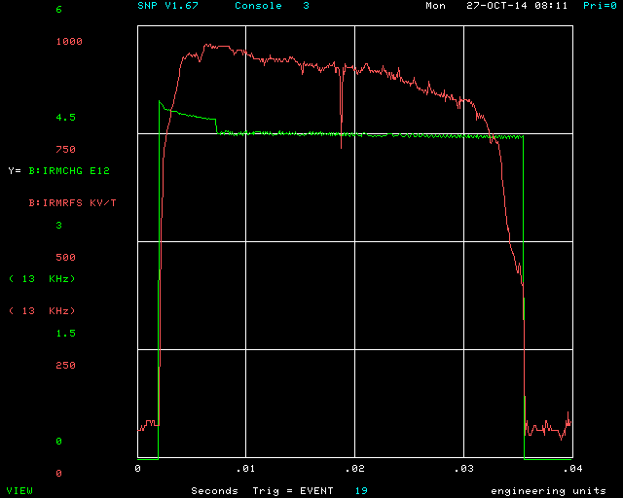
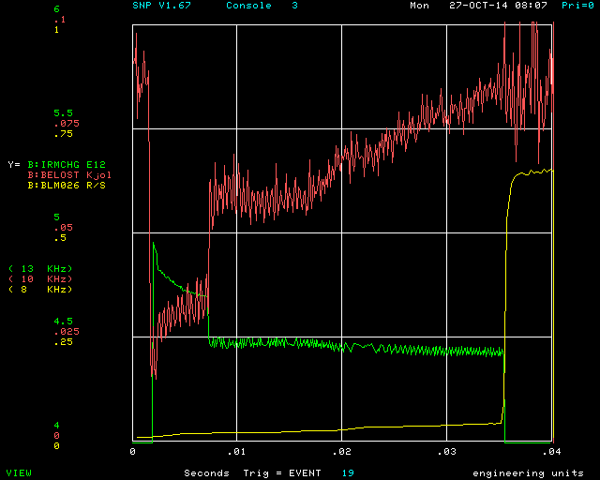
Intensity and beam loss in the Booster cycle(Oct. 2014)
RF
Extraction kicker gap (Notch)
Intensity
Beam Energy Loss
Int. at Injection: 5.0E12 ppp
Int. at Extraction: 4.5E12 ppp
Efficiency: 90%
Energy: 400 MeV – 8GeV
RF freq. : 37.9 – 52.8MHz
Intensity
Beam loss/cycle = 0.075 kJ → 1125W
(525 W Administrative Limit)

Slide 4
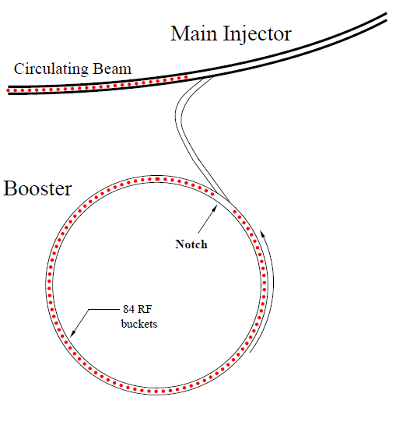
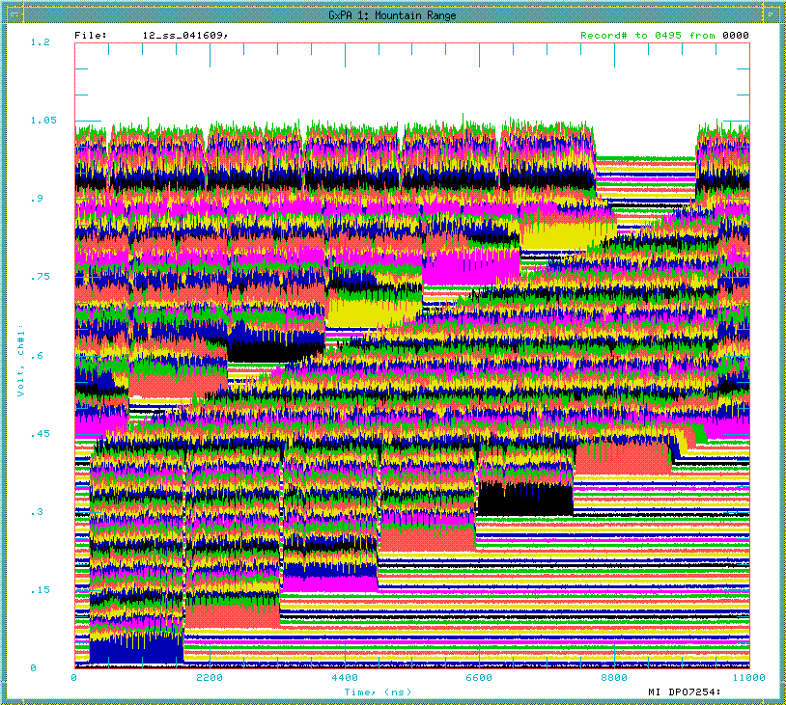
Notch and Cogging
Time
h=588
Main Injector / Recycler
Gap
for the extraction kicker
h=84
2nd Booster batch
81 bunches + 3 empty buckets
1st Booster batch
MI/RR revolution
Notch(extraction kicker gap) – Booster extraction kicker – MI/RR injection kicker

Slide 5
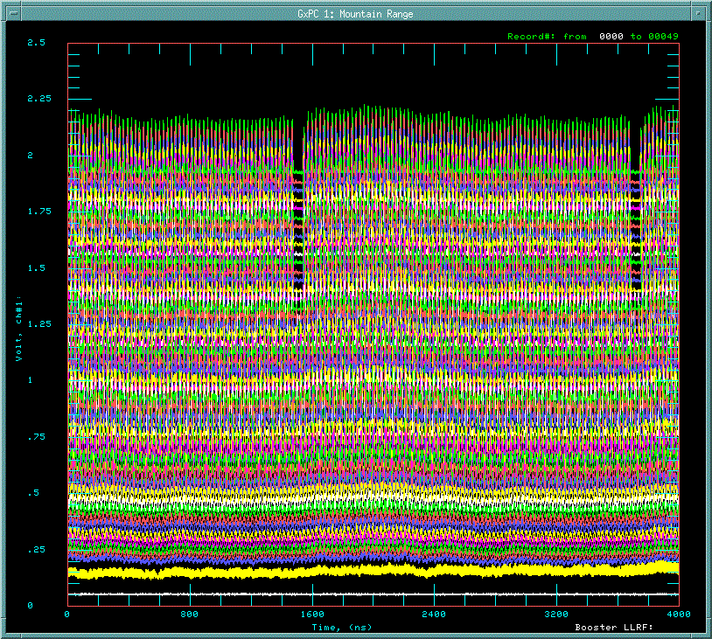
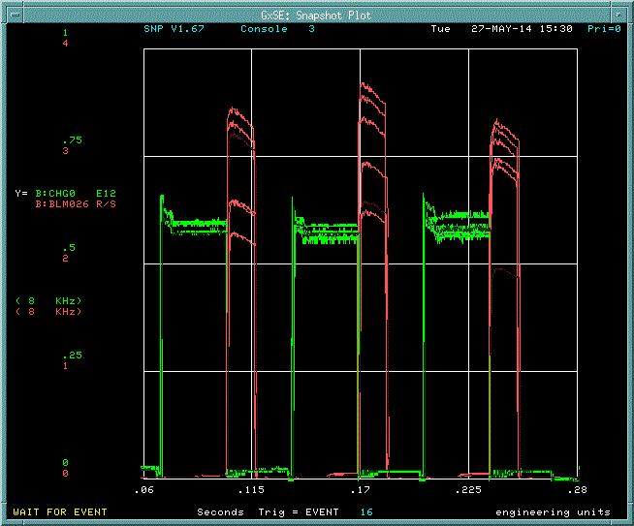
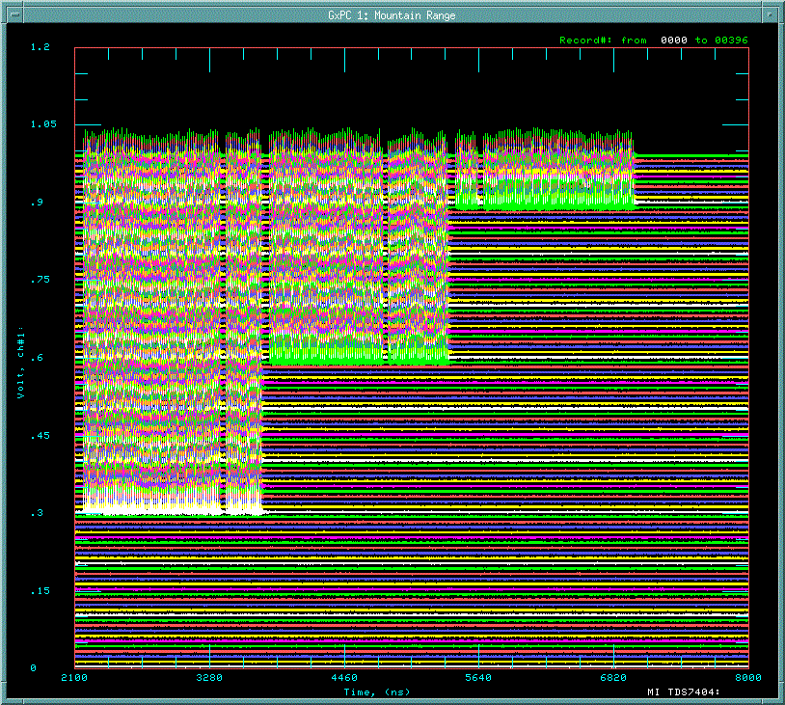
Beam at injection and extraction without Cogging
1 Booster revolution
at injection
Notch
→ 81 bunches + 3 empty buckets
Time
Adiabatic capture with 37MHz RF
→ 84 bunches
Injection from LINAC @ 400MeV
at extraction
at MI/RR injection
Intensity
Lost 3 bunches
every Booster
extraction.
2nd
1st Booster batch
Beam loss at extraction
Notch

Slide 6
Total bucket count during Booster cycle
Booster:
15 Hz resonant circuit
RF frequency: 37.7 – 52.8MHz
Total rf bucket count = const.
Total rf bucket count = const. -- Notch is at same position at extraction

Slide 7
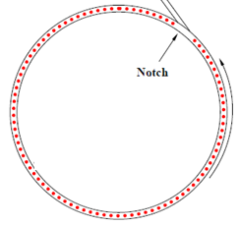

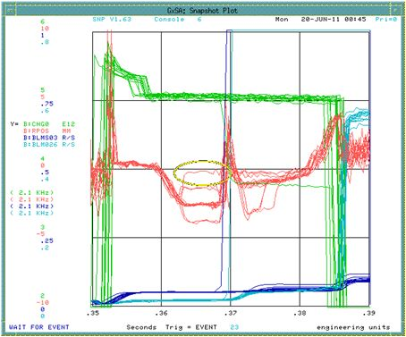
Revolution frequency control with radial cogging
Path length (radial position) of the beam
Intensity
Radial position
Creates notch at 700MeV.
Moves orbit before/after transition.
@ 700 MeV

Slide 8

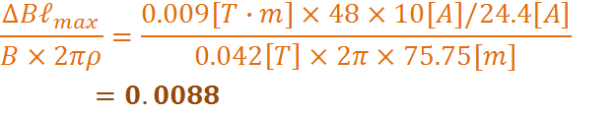
Magnetic Cogging using 48 new dipole corrector magnets
Fixed with RPOS feedback
Changed by dipole corrector
Dipole corrector: 0.009[T-m] @ 24.4[A]
(Assuming 10[A] change )
B field error ~1% can be compensated.
Keeps beam on central orbit and save aperture.
Creates notch anytime after injection( even LINAC notch)
→ reduce beam power loss by 40%.

Slide 9
Field error and integration of difference of rf counts
Booster: 15Hz resonant circuit synchrotron synchronized to the 60Hz power line.
B_main dipole field
Simulation
Measurement
Number of MI/RR revolution

Slide 10
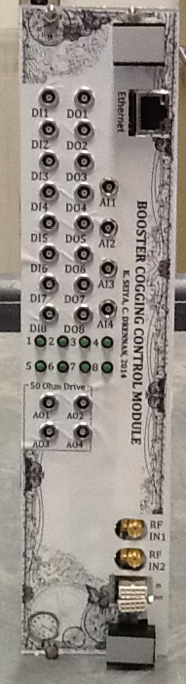
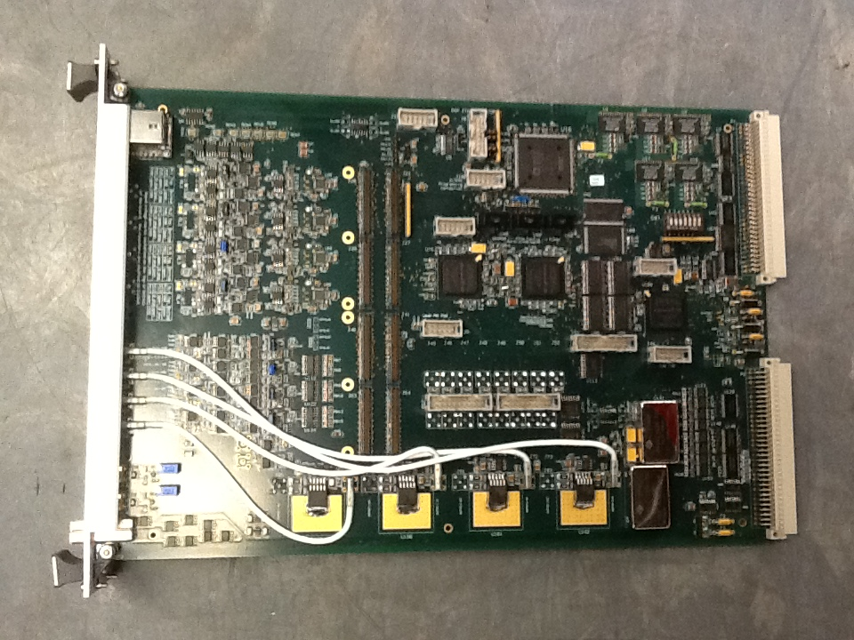
New Booster VXI board (C.Drennan)
8 x digital inputs
8 x digital outputs
4 x ADC inputs
4 x DAC outputs
2x RF inputs
Replacement for the 15 years old present Booster VXI/DSP board

Slide 11
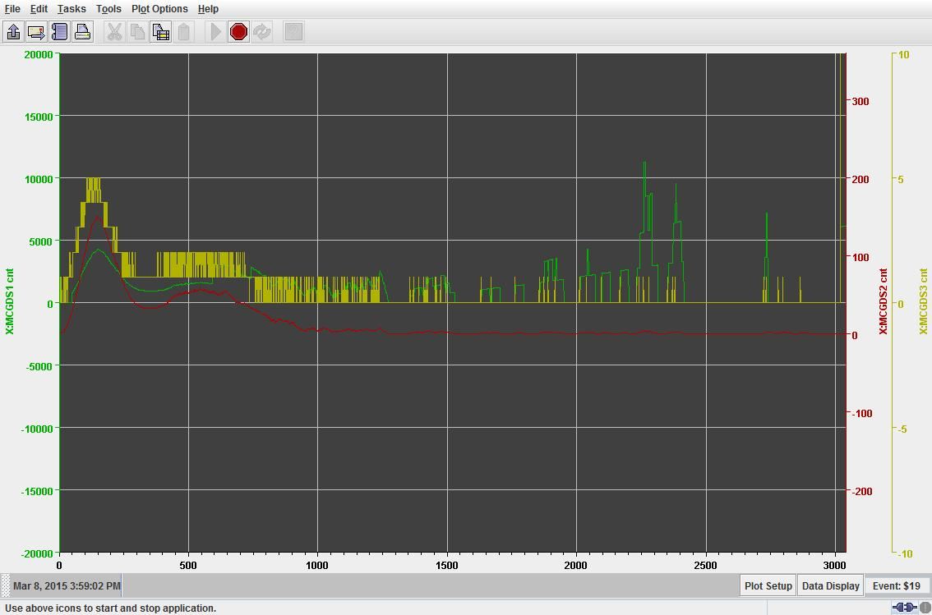
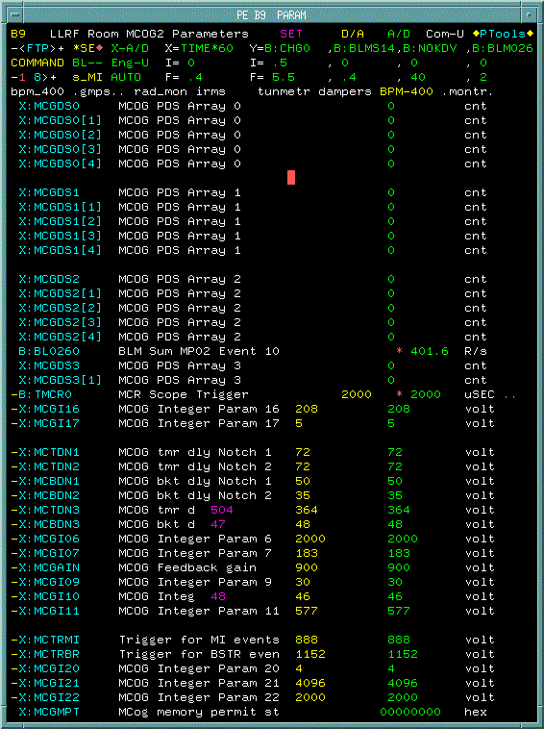
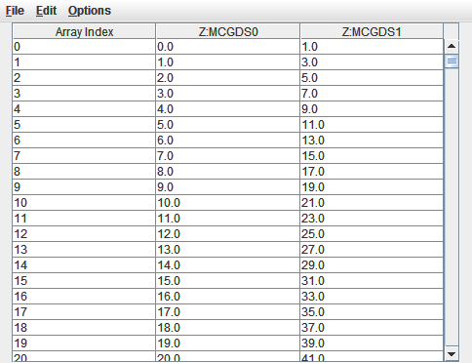
Parameters and Plots on console (A. Waller)
4 array data from memory
Bucket error
32 turns average
32 turns average x Gain curve

Slide 12
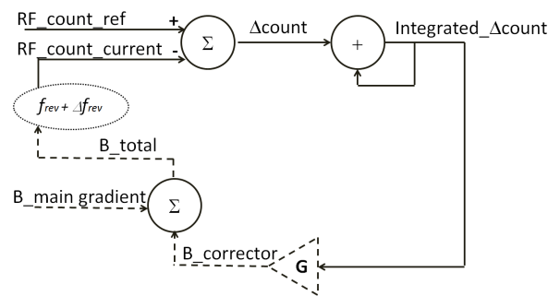
Block diagram of Cogging feedback
Bdot
BRF
11 μsec (MI/RR RF x 588)
Integrated diff. bucket count has to be ‘0’ at the end of cycle.

Slide 13
Simulation for the feedback and measurements
Integrated error w/o feedback (simulation)
With feedback (simulation)
With feedback (MEASUREMENTS)

Slide 14
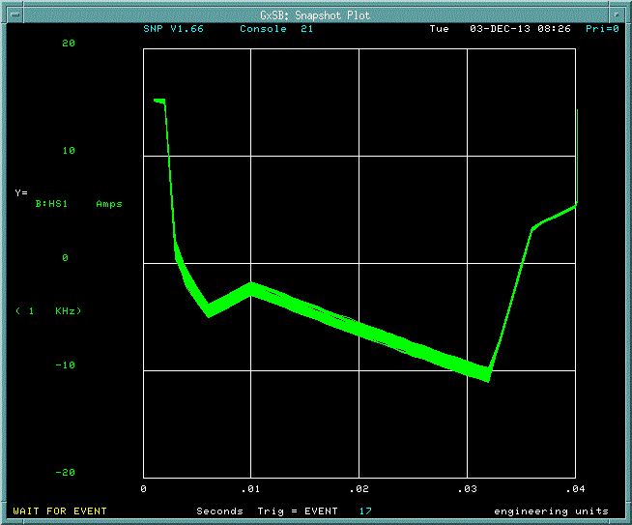
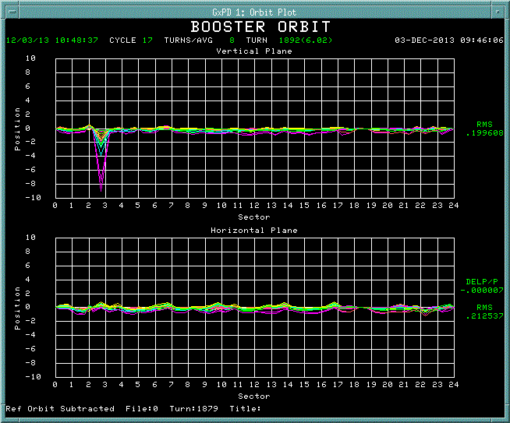
Orbit changes during Cogging operation
Corrector current
Orbit difference
2A
+/- 10 mm
Corrector current : +/- 1A
Orbit change < 1mm

Slide 15
Notch at 700MeV to 400MeV
Reduced beam energy loss at the Notch creation by 40 % and the total cycle loss by 15%.

Slide 16
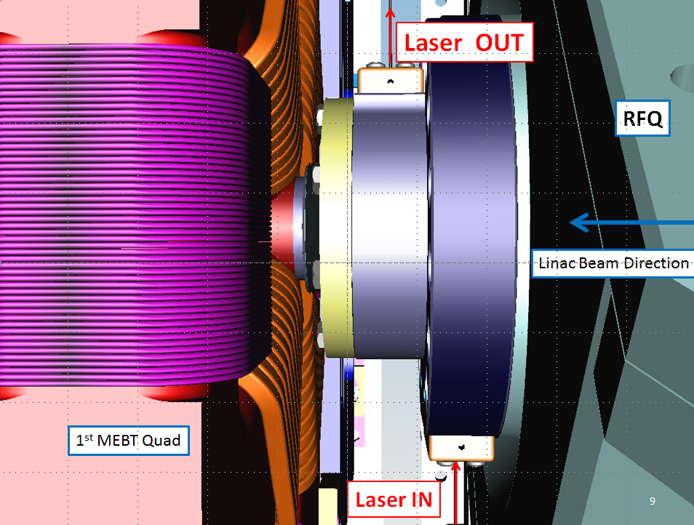
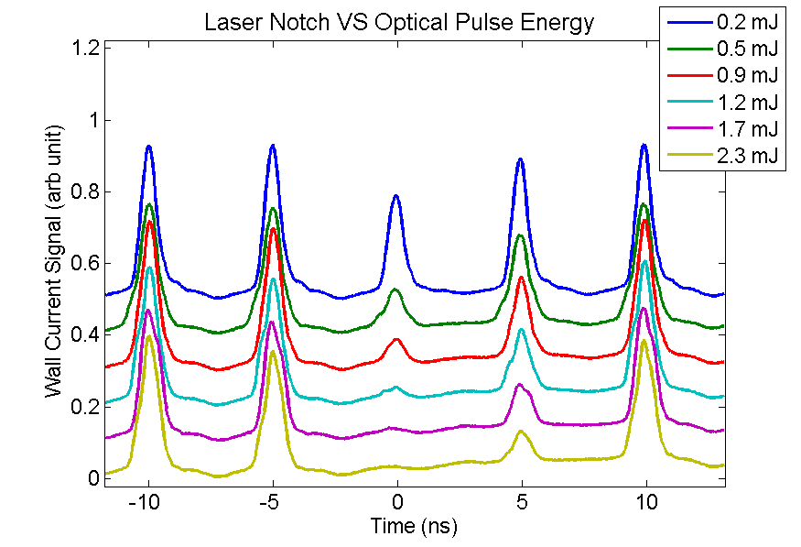
Sync to the LINAC Notch
Laser notching cavity installed on the downstream RFQ flange.
Wall current monitor signal in the LINAC with 6 different optical pulse energies.
LINAC Notch– Booster extraction kicker – MI/RR injection kicker
The logic for the Cogging supposed to be modified.
No more beam energy loss from Notch creation in the Booster.

Slide 17
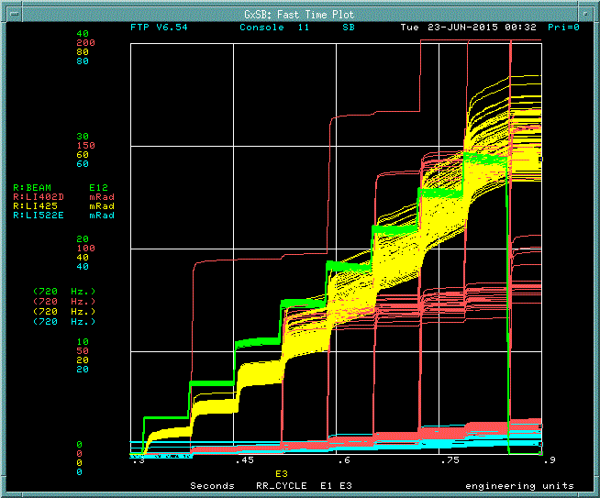
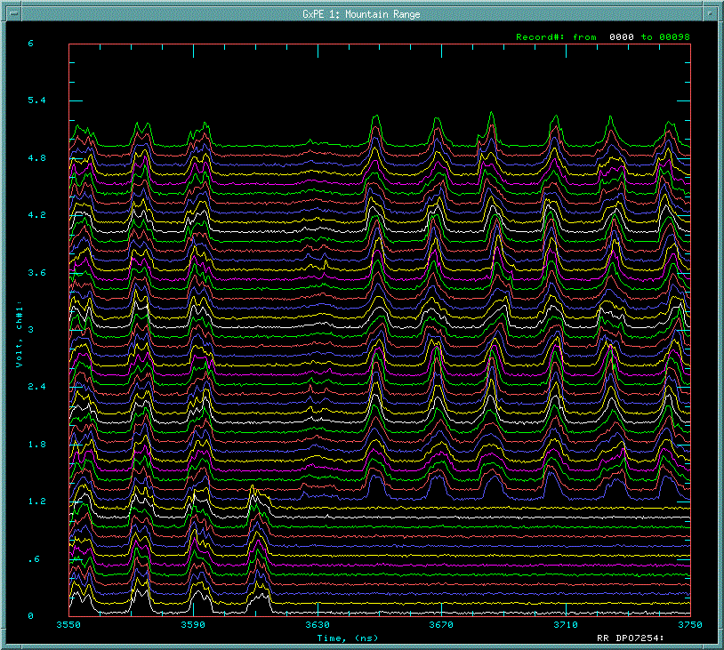
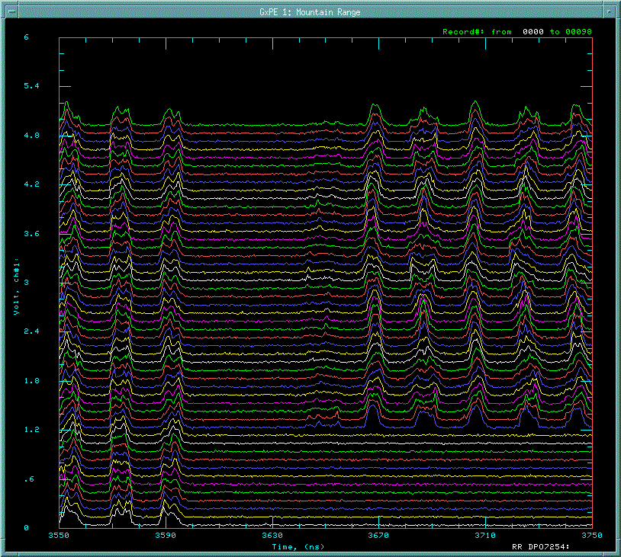
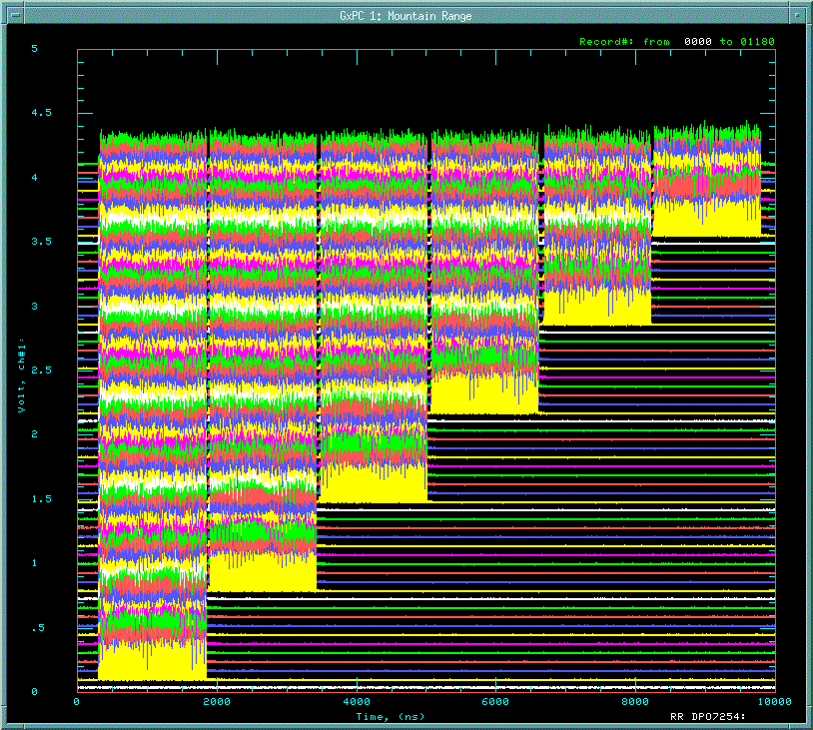
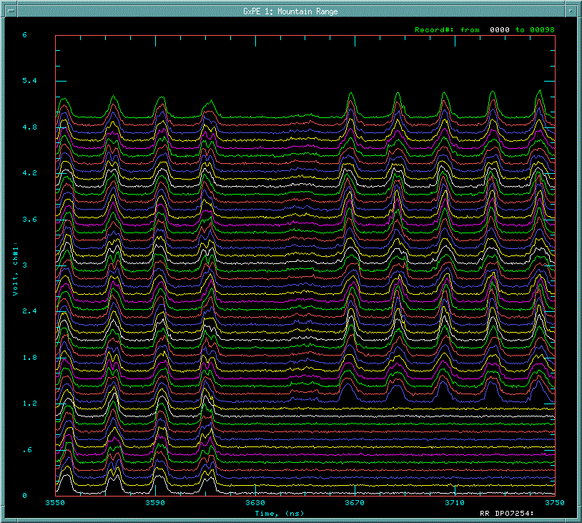
Injection bucket error in Recycler
RR Intensity
Beam loss
@ RR Inj.
RR revolution

Slide 18
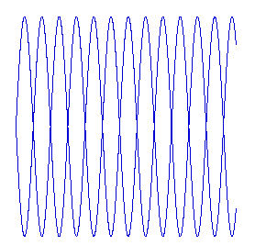
Cogging and Phase Lock
h=588
Main Injector / Recycler RF
Main Injector / Recycler
Booster RF
h=84

Slide 19
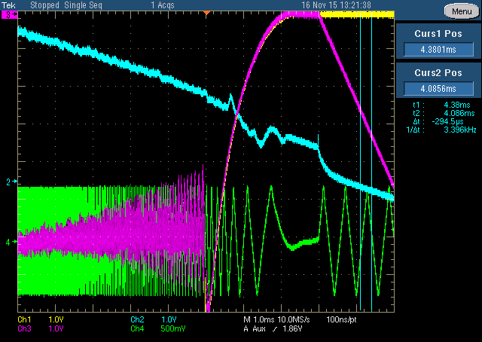
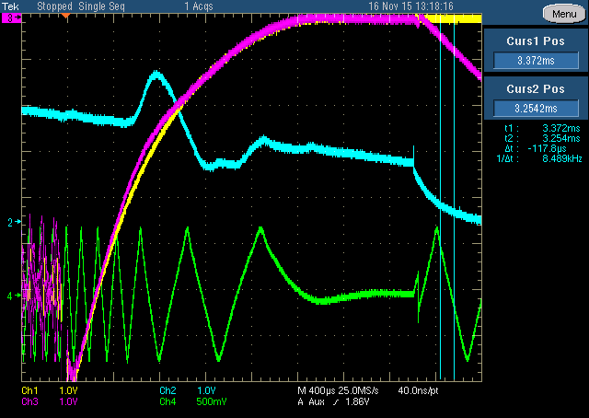
Phase Lock Loop at the end of the cycle
End of the cycle
90 deg
Δφ/32
RPOS
PL reference curve
180 deg
Δφ
0 deg
0 deg
1msec/div
400μsec/div
fMI – fBooster < 8kHz
RPOS feedback is turned off
PLL is turned on
when Δφ = φMI - φBooster = 0
8 RF buckets

Slide 20
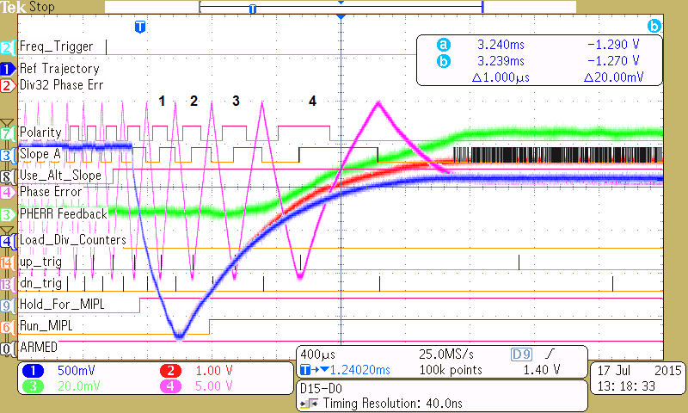
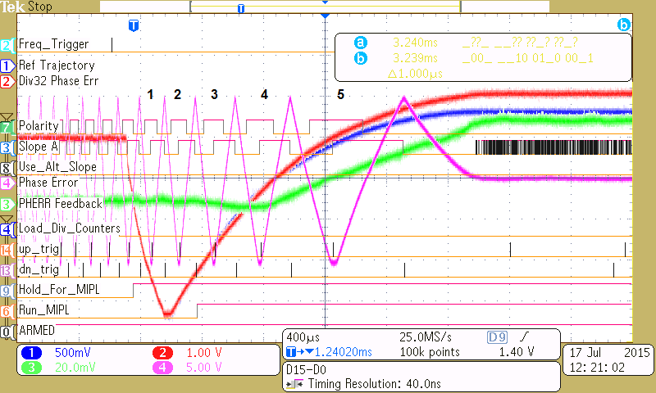
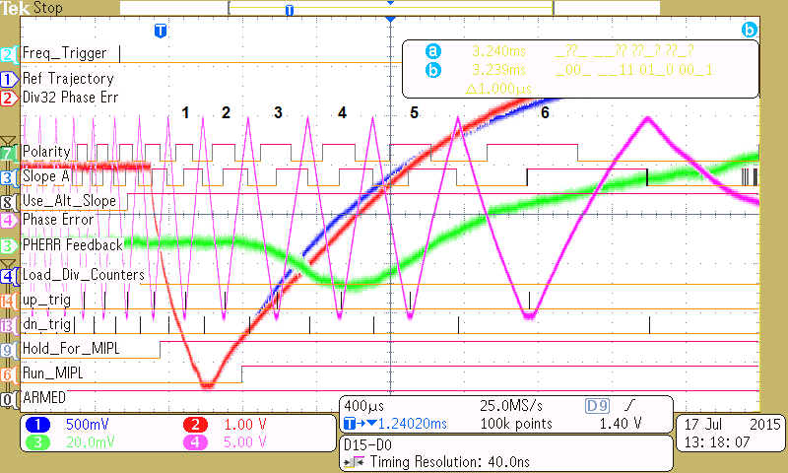
PLL curve adjustments
PLL ON
Notch
4 RF buckets
5 RF buckets
Make communication between Cogging and Phase Lock system
Fix +/- 1 buckets error for the MI/RR injection
Could reduce the gap length from 3 to 2 buckets
6 RF buckets
For more info on the MI Phase Lock Controller go to: AD DocDB Beams-doc-4781-v2

Slide 21
Summary and Plan
Summary
New beam extraction synchronization system called “Magnetic Cogging” was developed at the Fermilab Booster.
The system was successfully implemented to the operation in March 2015.
The gap creation used to be at 700 MeV with the RF Cogging and it was moved to 400MeV with Magnetic Cogging. The Magnetic cogging reduced beam energy loss at the Notch creation by 40 % and the total cycle loss by 15%.
Plan
Synchronize Cogging to LINAC Notch
Fix +/- 1 buckets error for the MI/RR injection

Slide 22
A New LLRF Frequency Reference for Booster
Craig Drennan
Workshop on Booster Performance and Enhancements
23 November 2015

Slide 23
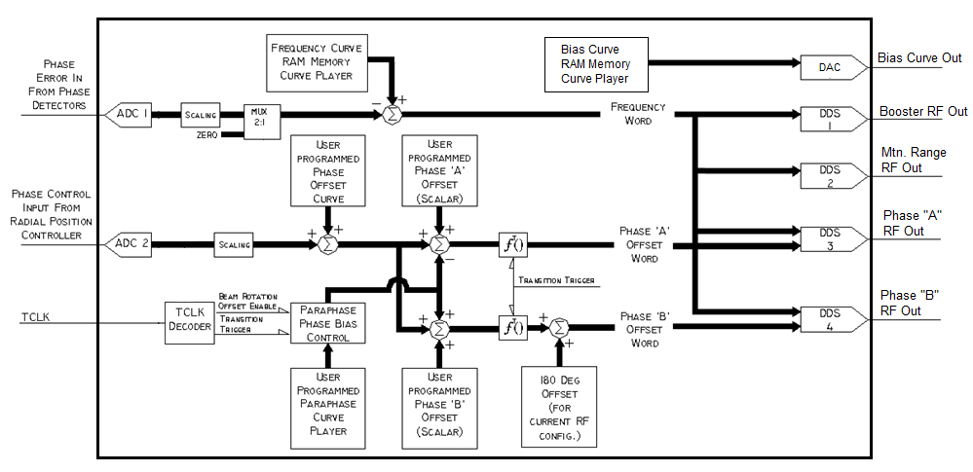
Four Channel DDS Booster LLRF Reference
Yes, a better phase lock --- But, it is a complex install.

Slide 24
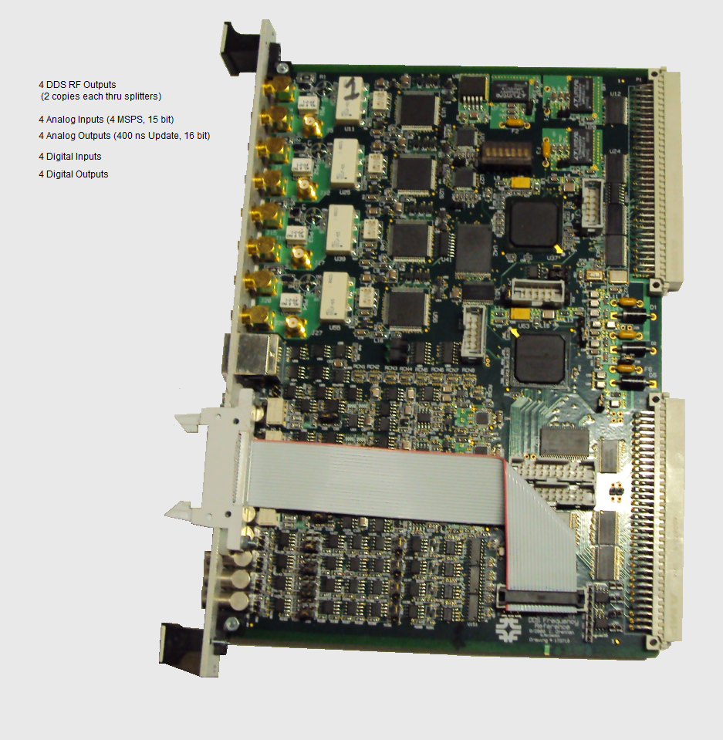
Four Channel DDS Booster LLRF Reference
Benefits
More flexibility in producing the Bias Curve
Possibility for different curves for different Booster cycle types
Replaces difficult to maintain broadband analog RF phase shifters (paraphase, RPOS)
Can produce smoother MI phase lock.
Can provide more reproducible phase manipulations.
The acceleration phase lock and RPOS control loops, and injection, cogging and MI phase lock can have a more integrated control policy (or not).
For more info go to Beams-doc-3891-v3 and https://www.youtube.com/watch?v=lAjt-3XEtaM

Slide 25
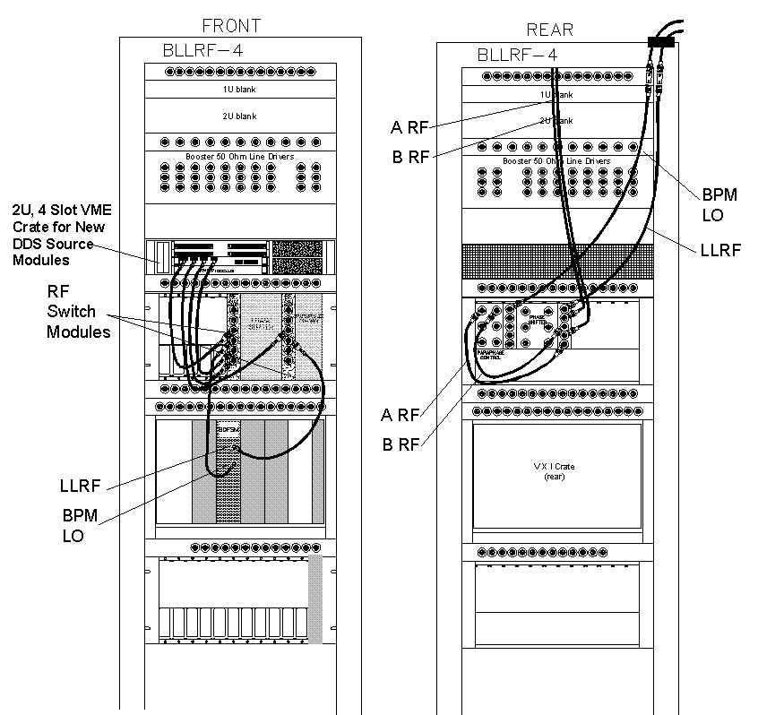
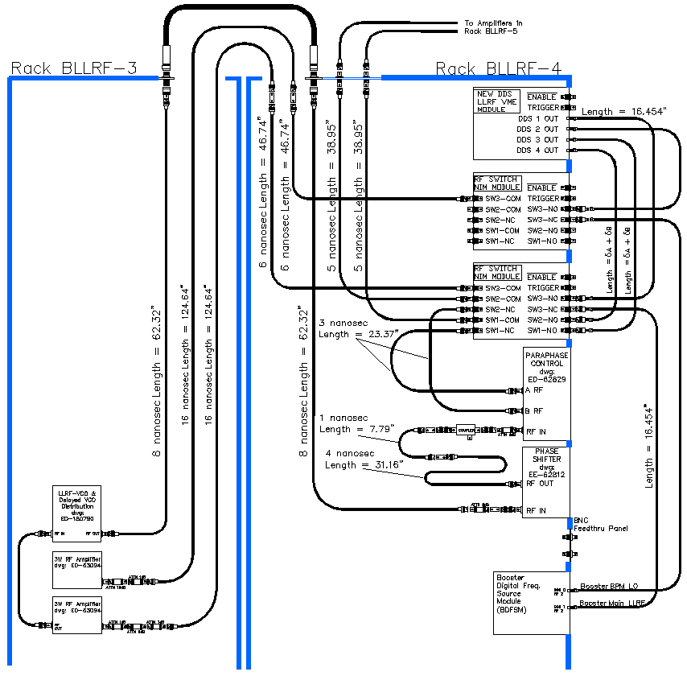
Four Channel DDS Booster LLRF Reference
There is a first draft for cabling the module in for testing in the Booster, and staging the implementation of the LLRF control functions.
For more info go to Beams-doc-3891-v3 and https://www.youtube.com/watch?v=lAjt-3XEtaM

Slide 26
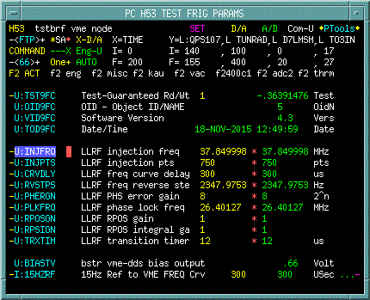
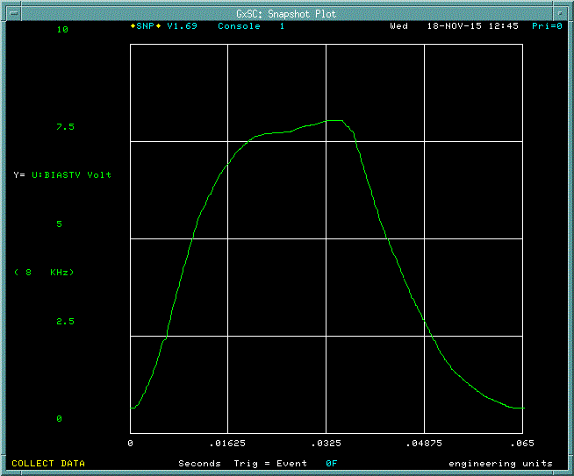
Booster DDS ACNET Controls (Brian Schupbach, Programmer)
DDS parameter read backs and settings available via ACNET MOOC functionality. Parameter page H53<66>
DDS board provides DAC outputs to ACNET MADC. The bias curve is currently available via snapshots.

Slide 27
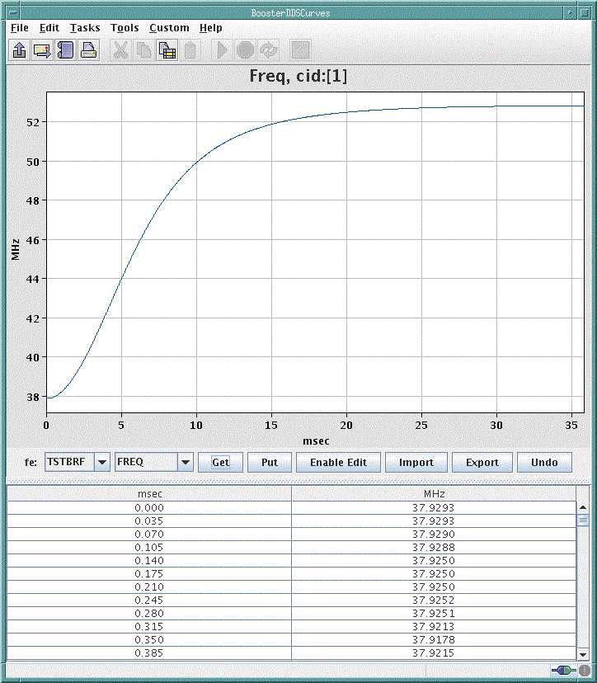
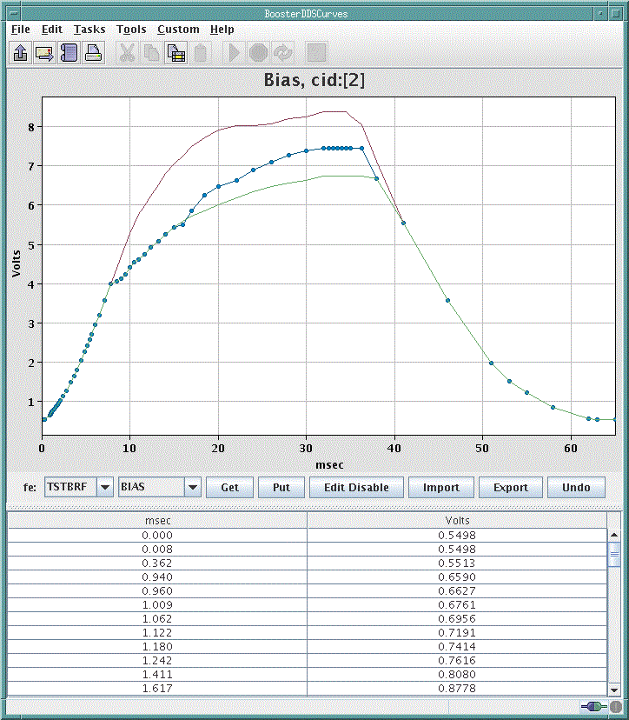
VME front-end facilitates TCP connection to Java GUI, B129
Inspect, edit, import, and export Freq, Bias, Para curves etc…

