Slide 1
PIP Update
Jan 13th 2016

Slide 2
Agenda
Summary Update
Additional Meetings/Notes

Slide 3
Linac
SBK: Finishing up final tests – may ship this week or early next
LN:
Modulator: 28 cell run on station 1 testing continues – looking to get interlocks in place for unattended running modes. 54 cell progressing in areas where labor is available – Rack work
Booster
Beam Studies:
Booster optics software: several more rounds of beta corrections and early injection capture
Investigating lower efficiency with corrected beta functions
Early injection did not increase efficiency but do see slightly better longitudinal emittances
Booster Longitudinal dampers: Task is done
Booster BPMs: Transition board done, Timing board still being layed out, Alexei coding digitizer
Collimators: Ready to install primaries – working with secondary's/positions, simulations continue
Refurbished cavity:
Cavity #20: Done
Station 20, Completed - Completed
15 Hz: Some operations at higher rep rates - up to 14Hz, users demand/studies not consistent
New Tuners: # 13 underway
Ferrite: The last 70 low mu have arrived and going through testing – but so far they look good!
Bias Supplies: Completed
Anode Supplies: Completed
Transformer: Completed
Perpendicular bias cavity: Meeting tomorrow, machine shop delays, testing of ferrites continues
Rework of cavities 21 & 22: Preparing to put wide bore on stand (tuners being installed)
New cavities: Notes later
Shielding: Tony and Keith – working on documentation
Absorber/Kicker: Scans and orbit work continues –
Flux – record hourly and weekly flux last week – pushing 1.7E17 pph

Slide 4
Recent PIP Budget/News
Budget:
Reduction of 1.5 M FY16 to cover AD shortfall – still do not know
Update of RLS to reflect this change
Replacement cavities schedule being revised (T. Kroc)
Meetings to discuss transition PIP to PIP-II continue
Not much is happening until budgets are completed and PIP II funds required labor
PIP PMG – Next PMG Feb. 4th – Quarterly report to be provided

Slide 6
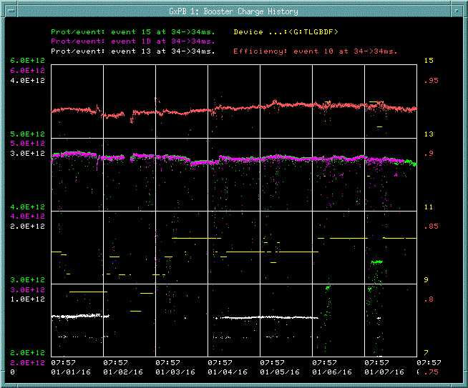
Booster Operation Summary Jan 1st – Jan 8th 2016
Total proton: 2.38E19
proton/hour:1.71E17
Rep. rate : 14Hz
Eff. : 92%
~$15: 4.7E12 p/p
~$1D: 4.7E12 p/p
~$13: 0.52E12 p/p

Slide 7
Upcoming Talks
Keith/Tony – TLM install and operations
New Cavities (plans) Tom Kroc

