Slide 1
An Update on Early Injection Capture in the Booster
Chandra Bhat
PIP General Meeting
January, 27, 2016

Slide 2
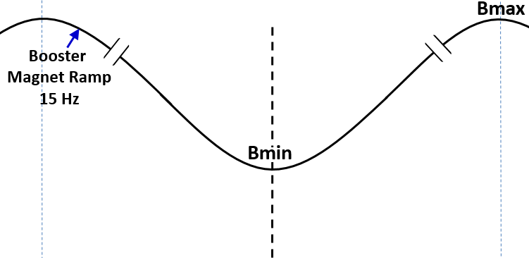
Schematic of the Early Injection in the Booster with a pseudo front-porch
Impose Beam Capture in
Stationary rf Buckets ($\dot{P}$=0)
Start End
Begin Inj.
Simulations have been conducted under varieties of beam conditions from injection to extraction.
Change in
Es <0.24MeV
≈ 40μs
injection
Beam Acceleration using
37-52 MHz RF system
175μs
capture for >260μs (no debunching)
1/15Hz ≈ 0.0666 s
Energy Acceptance > 4MeV
Beam ΔE ≈ 1.3MeV
f_{sy} = 8kHz-27kHz @ Vrf=0.035-0.4MV

Slide 3
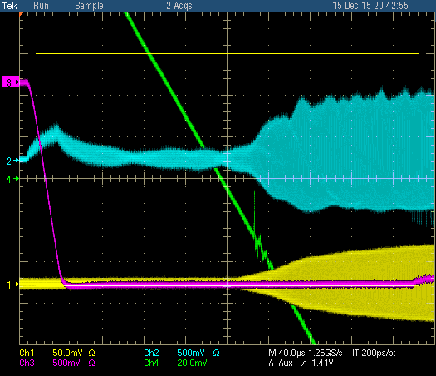
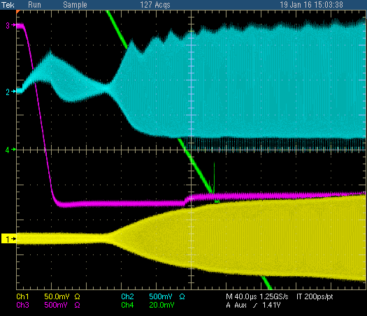
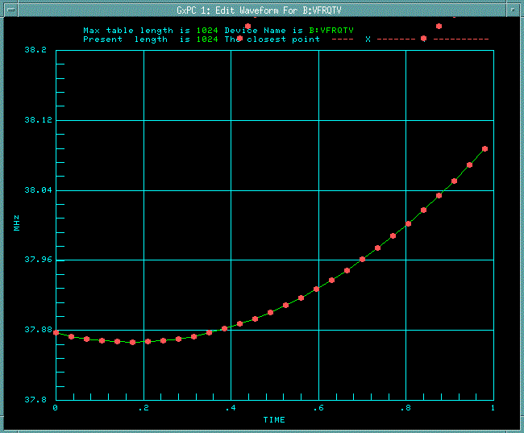
What has been Done So far?
The implementation of the EIS is carried out in a few steps
December 18, 2015
Changed the B:RSTDLY from 64635µs to 64490µs
→ Beam injection nearly 200µs early.
Loaded a new APG curve, i.e., RF voltage curve, keeping PARAT, VBIAT, VRFQT, Radial offset, Radial gain, Cascode current curves the same as before. This RF curve implied ~20% less RF operating power.
With some tuning we had about 90% efficiency with 11BT on 15s and 13BT on 1Ds
January 8, 2016 ← started early capture
January 20, 2016 ← Bfield & Freq. synchronization
These changes were made with minimal interruption to beam delivery to the downstream machines.
B:VXTPPP=2192µs
B:VAPLON=2235µs
WCM
Bdot=0
RF
Beam
B:VXTPPP=2020µs
B:VAPLON=2217µs
Bdot=0
Booster freq. curve
(1st 1 ms)
B:VFRQTV[1]=37.877201MHz
where as
B:VFINJ=37.982539MHz

Slide 4
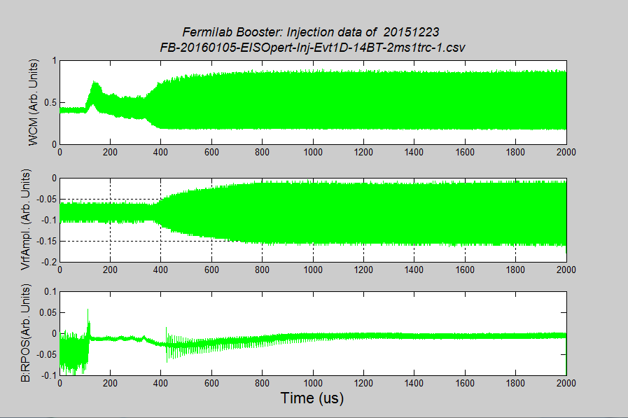
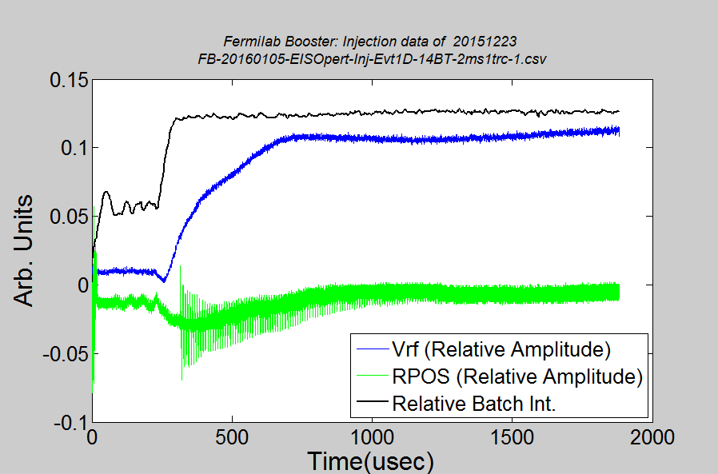
EIS Beam Data and some Analysis (Injection)
14BT Beam; 4.9E12ppb
B:VXTPPP = 2192 with Operational Paraphase
B:VAPLON= 2235
WCM
Vrf (Peak)
Gap Vrf
RPOS

Slide 5
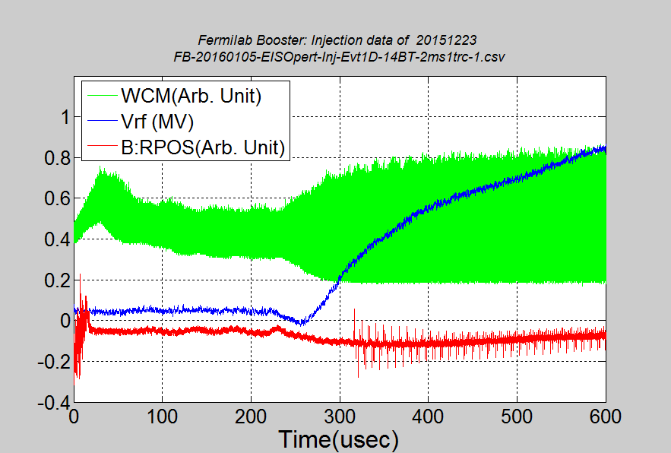
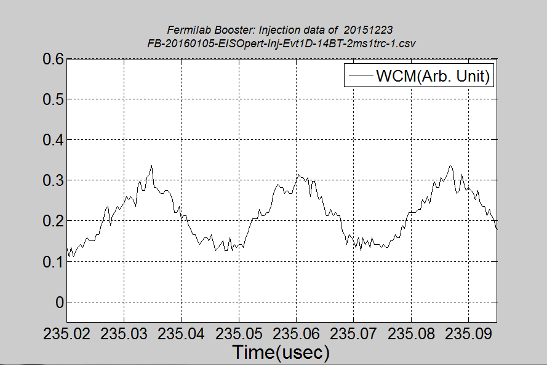
EIS Beam Data and some Analysis (Injection)
14BT Beam; 4.9E12ppb
B:VXTPPP = 2192 with Operational Paraphase
B:VAPLON= 2235
Beam still being captured
~43µs
26.3 ns
B:VXTPPP
B:VAPLON

Slide 6
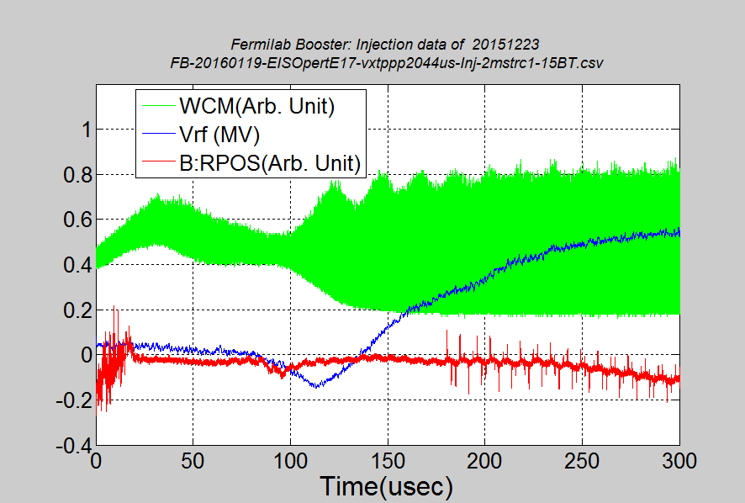
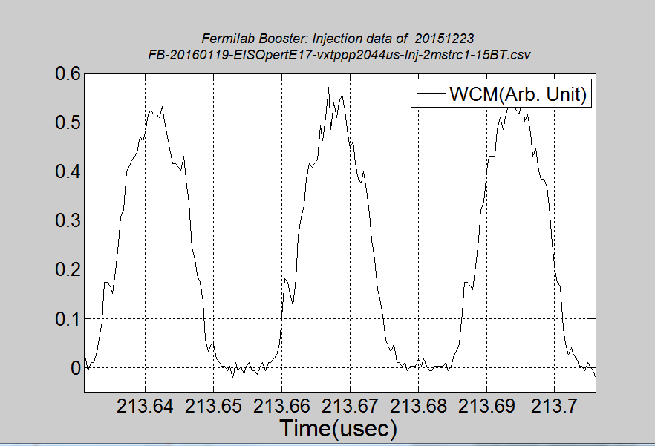
EIS Beam Data and some Analysis (Injection)
15BT Beam; 4.9E12ppb
B:VXTPPP = 2000 with Operational Paraphase
B:VAPLON= 2217 Vrf=0.41MV
LE = 0.056eVs
×
~140µs
19.2 ns
B:VXTPPP
B:VAPLON

Slide 7
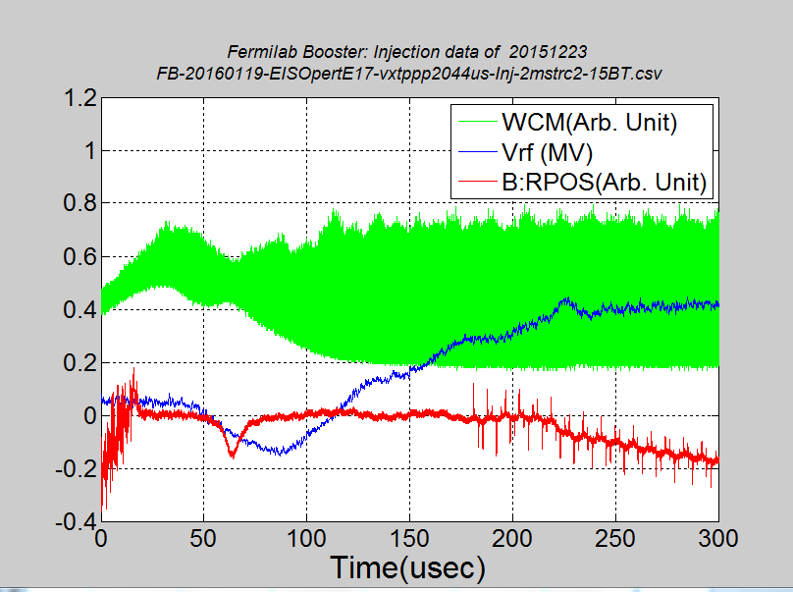
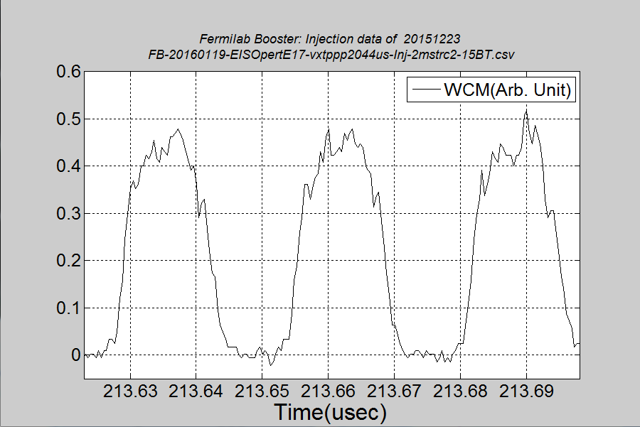
EIS Beam Data and some Analysis (Injection)
15BT Beam; 4.9E12ppb
B:VXTPPP = 2044 with paraphrase curve file =6 (adiabatic)
B:VAPLON= 2217, Vrf=0.38MV
LE = 0.053eVs
×
170µs
19.2 ns
B:VXTPPP
B:VAPLON

Slide 8
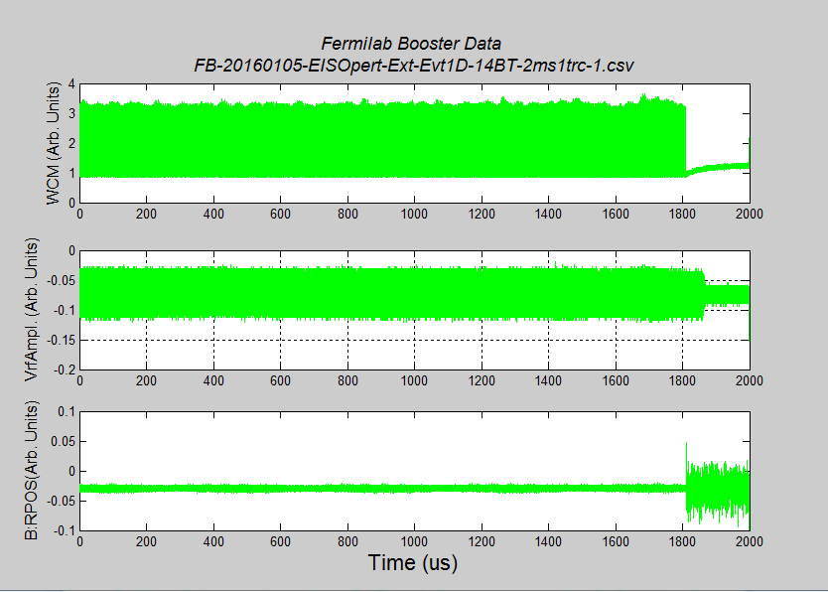
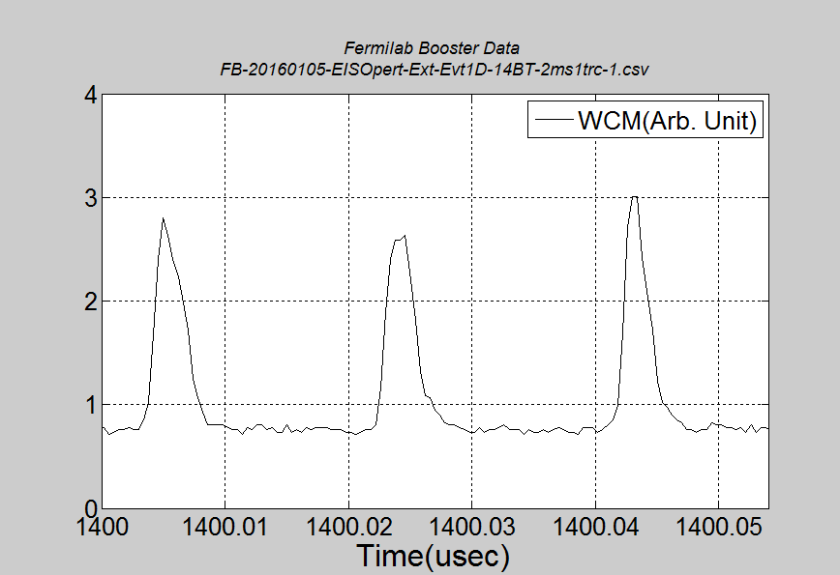
EIS Beam Data and some Analysis (Extraction)
15BT Beam; 4.9E12ppb
B:VXTPPP = 2000
B:VAPLON= 2217, Vrf=0.4MV
LE = 0.086eVs
×
WCM
4.5 ns
Gap Vrf
RPOS

Slide 9
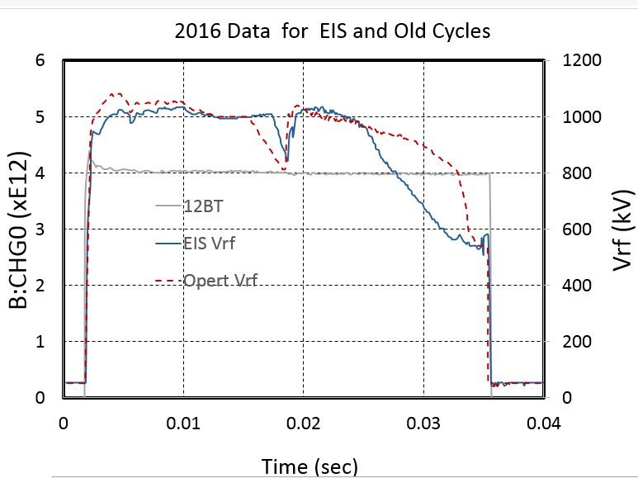
Summary
EIS is made operational successfully with the help of many since Dec 18, 2015
We certainly see
Some gain in RF power
Lower emittance to the down stream machines
We are running with about >92% efficiency in operation
Providing 11 BT to RR slip stacking and 15BT beam to MicroBoone

Slide 10
Plans
Working on a better paraphrase curve for adiabatic beam
Simulations strongly suggests one can capture more adiabatically. ( I have to analyze the data and come out with a curve).
We have to optimize various timings.
Big difference between B:VFINJ and B:VFRQTV[1].
This clearly shows that there are some issues to be understood. I believe that we have to use a better frequency curve based on measurements not using calculations. ← Currently I am investigating it.
Bill’s (B:LGEM8G) and RR measurements (Phil Adomson) show the longitudinal emittance of the beam is smaller now. However, bunch rotation before extraction many not be optimal. So,
we are investigating snap bunch rotation (revisit the method used in the past) in the Booster. In future, when 2nd harmonic rf system becomes available we should use it to linearize for better bunch rotation.
I certainly expect it would take some time to reduce beam losses in the cycle. Currently, I do not see any loss in the first 1-1.5 ms of the cycle.
We are working on transition crossing ← this needs some hardware development.
All these developments can be done with 1-shot sequencer

Slide 11
Backup Slides

Slide 12
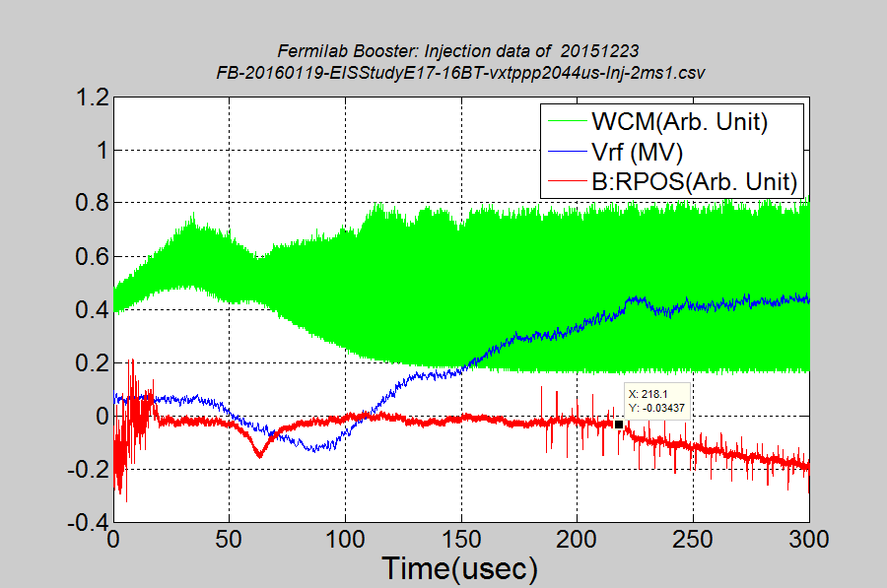
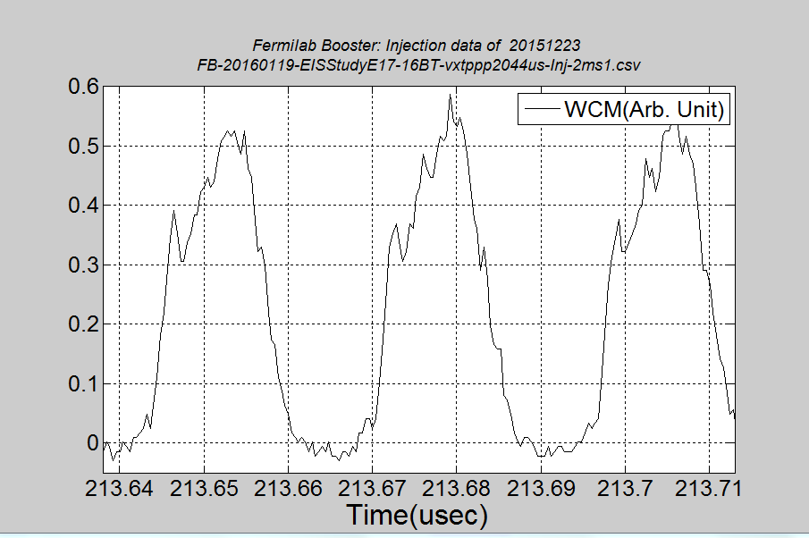
Beam Emittance at Begin of Acceleration
16BT Beam; 5.3E12ppb
B:VXTPPP = 2044 with paraphrase curve file =6
B:VAPLON= 2217, Vrf=0.38MV
LE = 0.05 eVs
170µs
19.5 ns
B:VXTPPP
B:VAPLON

Slide 13
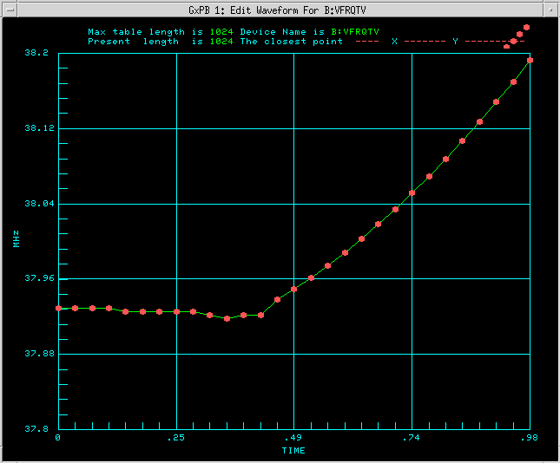
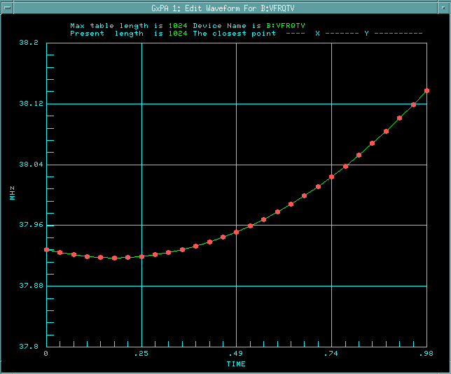
Beam Experiments after shutdown of 2015
ACL script has been updated/improved that includes
rf frequency to B field synchronization at the early part of the cycle
Early beam capture
20 rf cavities with modulator limits
Ability to read rf curves from external files → This is a big deal
RF Frequency Curves
EIS
Operational
Bmin
reference line
Bmin
reference line

Slide 14
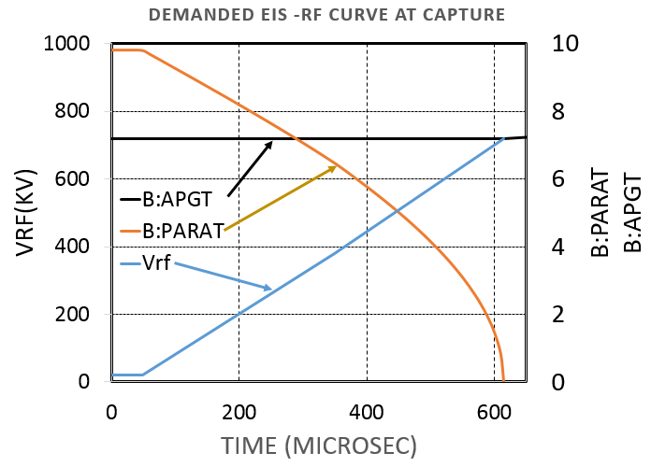
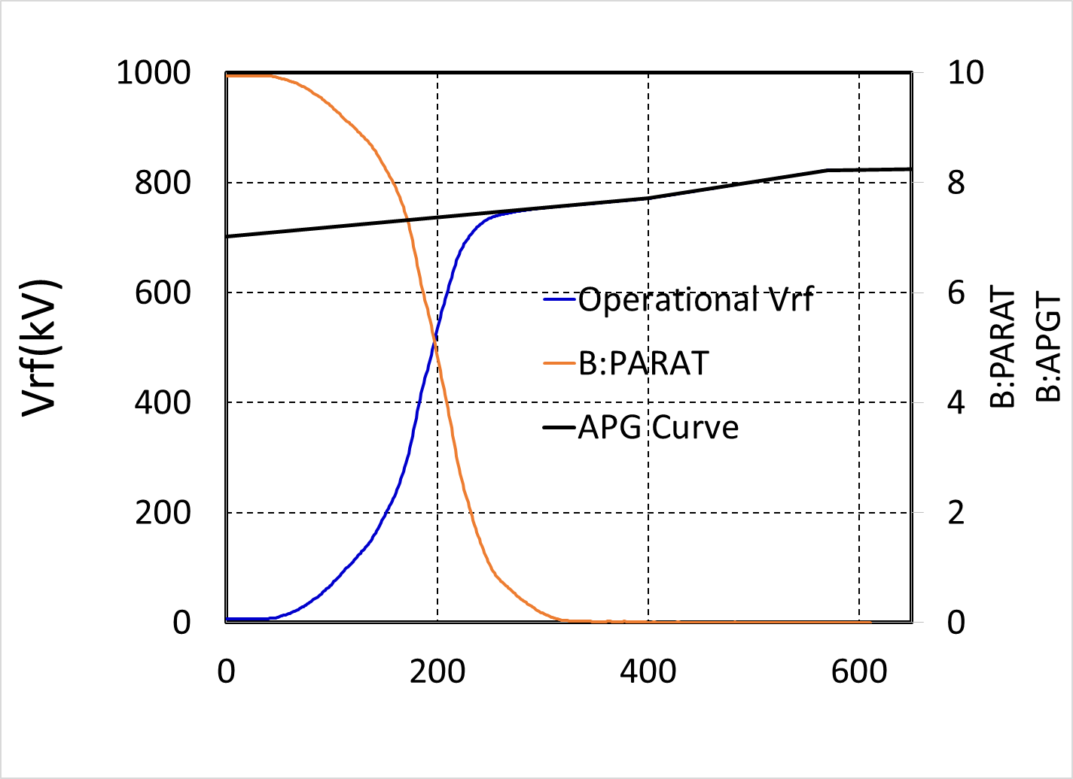
RF curves at Inj. in use(till 10 days ago) and desired
Demanded by EIS scheme
Vrf
Front porch in
B:APGT curve
Paraphase Angle
Used in Operation
Time (µsec)

