Slide 1
PIP Update
Feb 10th 2016

Slide 2
Agenda
Summary Update
Additional Meetings/Notes
Ken Domann budget controls update
Trevor – Linac Modulator

Slide 3
Linac
SBK: Delivered (working on gallery drawings)
LN: Working to resolve issue with pulse stability – no splicing done yet….
Modulator: Update talk
Booster
Booster optics software: several more rounds of beta corrections and early injection capture
Investigating lower efficiency with corrected beta functions
Booster BPMs:
Instrumentation department busy with Recycler DCCT and other issues – but should now be a point to start some testing….
Collimators:
Installed primaries – will start studies next week? Update talk next week.
RF:
Waiting for welder to lap on material for Cavity 21 (as of Monday)
Wide bore Cavity 22 will be re-worked – when time permits
Tuner 13 tested good – tuner 14 will be completed by end of week – need to ship next set of ferrite
11 cones completed and pressure tested – waiting for electrical testing
A requisition for an additional 20 castings?
Replacement cavity – still working on simulations for perpendicular design and waiting on wide bore tests
Perpendicular bias cavity: Meeting tomorrow – discuss mechanical assembly/issues
PA tester nearly ready – test PA at higher frequency
Shielding: Tony and Keith – running at limit now – Will complete write-up this month
Absorber/Kicker: Scans and orbit work continues –
Flux – Running at 1.8E17 pph limit – loss limit not much higher these days

Slide 4
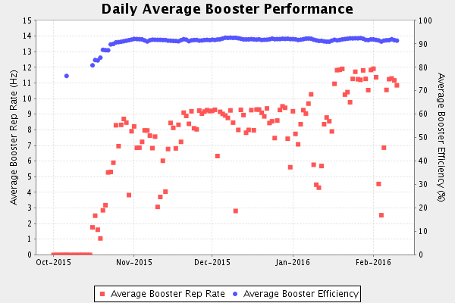
Present Operations

Slide 5
Budget:
Reduction of 1.5 M FY16 to cover AD shortfall – still do not know
Update of RLS to reflect this change
Meetings to discuss transition PIP to PIP-II put on hold – Steve Holmes
PMG – Feb. 4th – No real comments or concerns
Quarterly report completed – will be release today

Slide 6
Upcoming Talks
Collimator – Simulations and plans: V Kapin
TLM install and operations: Tony
Shielding assessment: Keith
New Cavities (plans) Tom Kroc

