Slide 1
PIP Update
March 2nd 2016

Slide 2
Agenda
Summary Update
Additional Meetings/Notes
Ken Domann budget controls update
Trevor – Linac Modulator

Slide 3
Linac
SBK: Delivered – waiting on final write-up/documentation
LN: Splice work done – update talk today
Modulator:
28 Cell Prototype
Continued testing on LRF1. Interlocks and trip states are being upgraded to bring the 28 cell prototype closer to an operational state.
54 Cell Prototype
Cell construction continues.
The Marx cabinet interior construction is nearly finished.
The Lumina charging supplies for the 54 cell prototype arrived and we’ve begun testing them
The control boards for the charging supply cabinet are being fabricated, expected by the end of the month.
The charging supply cabinet is being built at Equipto, expected by the end of the month.
Plans are being made for supplying power to 58 cell unit when placed near LRF 5. Ranson walkthrough with options..
Booster
Booster optics software: Still working on improving efficiency with beta corrections in…focusing on tune space/bands
Booster BPMs:
Instrumentation department busy with Recycler DCCT and other issues –
Collimators:
Requested 2 hour study has been given to Runco – waiting for date – hopefully within a week will do first set of scans
RF:
Plumbing the girder for cavity 21 or 22, this was from scratch.
Waiting on machinist for wide bore cavity on mill.
Cleaning welds on cavity 21 inner assembly.
Building inner packages for new tuners.
Tuners: Preparing to box up ferrites for Tuner #17
Replacement cavity – still working on simulations for perpendicular design and waiting on wide bore tests!
Perpendicular bias cavity:
In discussions with ferrite vendor, have received quotes for materials
PA tester nearly ready – test PA at higher frequency
Working on mechanical design

Slide 4
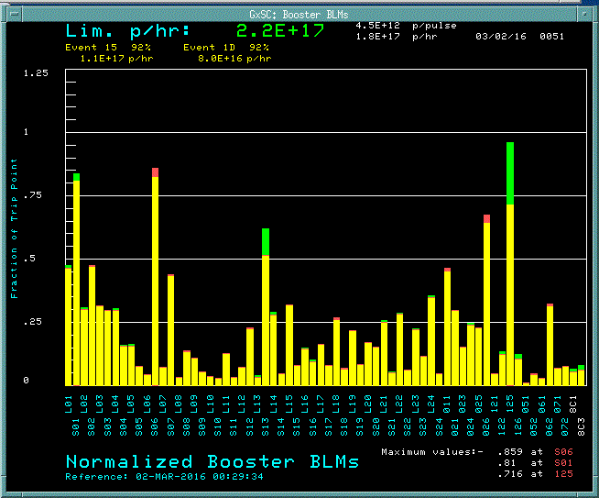
Work continued
Stations 21 and 22
1kW SSD amplifier heat sink fabrication going well. Last time I checked all the tubing has been cleaned and fabricated, the chassis' have been assembled, and one chassis is complete. Hopefully by the end of the month this will be completed.
We will need to order ~550 feet of copper bus bar.
A drawing showing the details for the bus bar lengths has been made.
Offset power supply transformers for the FBS have been ordered.
Bias supply housing units have been placed – higher than expected cost but ordered..
Shielding: Tony and Keith – running at limit now – complete write-up this month
Flux – Running at 1.8E17 pph limit – loss limit not much higher these days
Running 1.8 E17 pph
Beam loss limit at 2.2E17 pph
With a good Linac notch – would reach 2.3 - 2.4 E17 pph

Slide 5
Budget:
Reduction of 1.5 M FY16 to cover AD shortfall – still do not know
Update of RLS to reflect this change
Budget meetings at DOE this week….
Director reserves funds still not finalized…..
Meetings to discuss transition PIP to PIP-II put on hold – Steve Holmes

Slide 6
Upcoming Talks
TLM install and operations: Tony
Shielding assessment: Keith
Harmonic cavity update: CY Tan
New Cavities (plans) Tom Kroc

