Slide 1
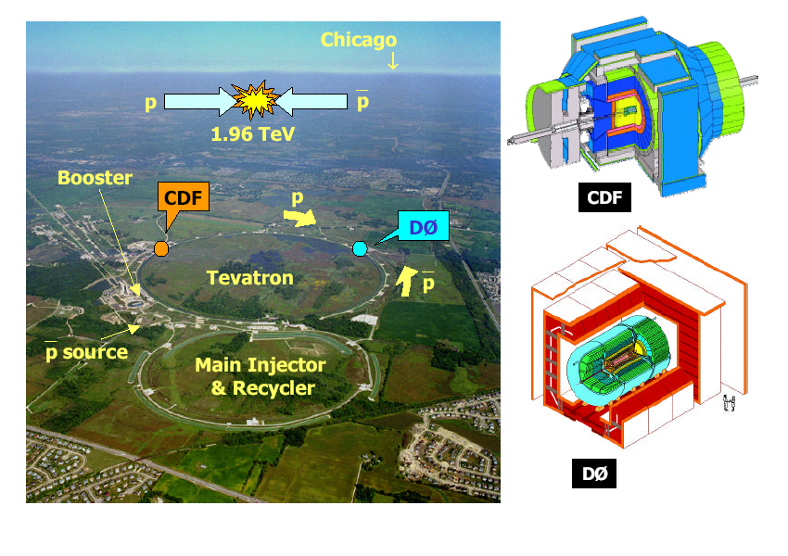
Tevatron Collider at Fermilab (Oct. 13, 1985 - Sep.30, 2011)

Slide 2
Long Range Beam-Beam Effects in the Tevatron p-pbar Collider Run II:
Operational Realities & Corrections/TELs
Vladimir Shiltsev
Accelerator Physics Center, Fermilab
November 30, 2015

Slide 3
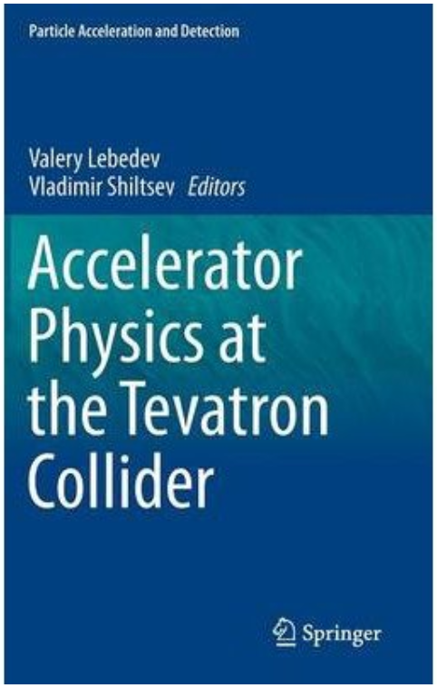
Long-range beam-beam – arguably, #1 Tevatron Run II Issue
Many people studied the effects
(operations, theory, studies, analysis)
  Y.Alexahin, J.Annala, T.Bolshakov, V.Boocha, H.Cheung, B.Erdely, P.Garbincius, B.Hanna, P.Ivanov, J.Johnstone, A.Kabel, V.Lebedev, P.Lebrun, M.Martens, R.Moore, J.Qiang, T.Sen, F.Schmidt, D.Shatilov, V.Shiltsev, J.Slaughter, E.Stern, D.Still, G.Stancari, A.Tollestrup, A.Valishev, M.Xiao, X.L.Zhang, F.Zimmermann
2014, $149.00

Slide 4
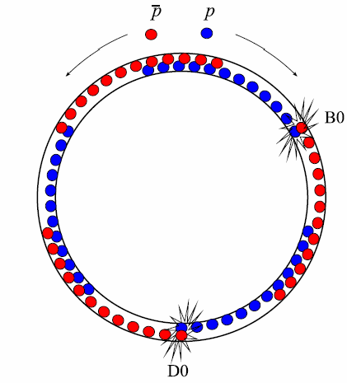
36 proton x 36 antiproton bunches
Same magnetic
fields → same
orbits →
72 IPs
396 ns
bunch separation
→ 59 m btw IPs
Need only 2
→ separate at 70
→ Electric field

Slide 5
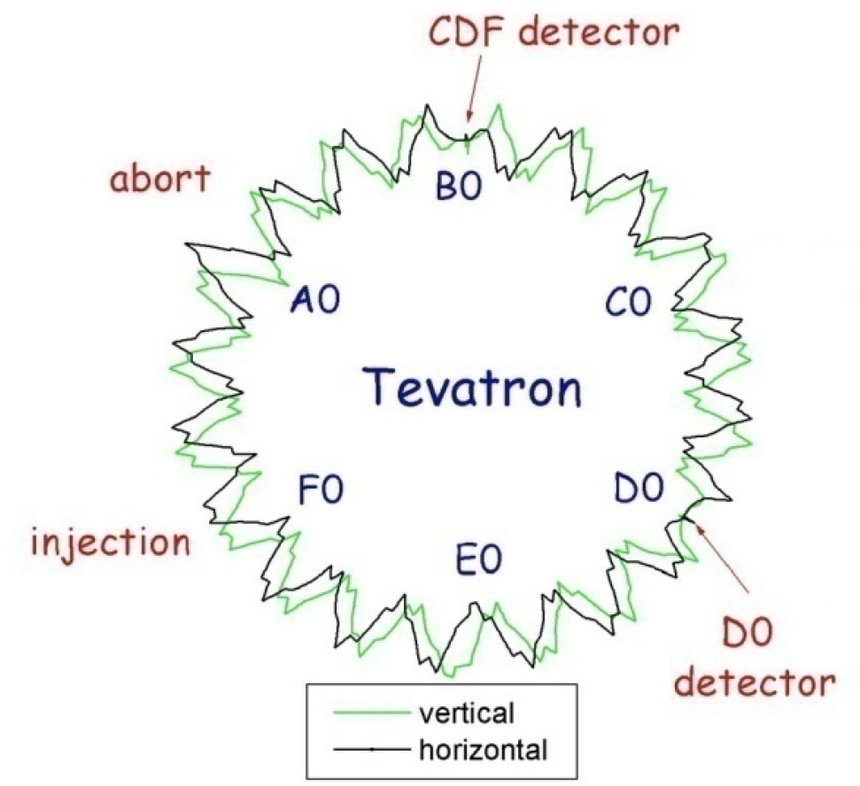
Tevatron: Helical Orbits
separation
~ 12-15 mm
at 150 GeV
6-8 mm
at LB

Slide 6
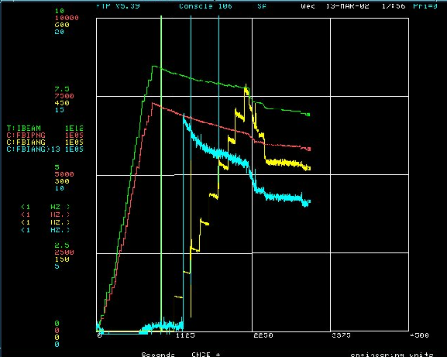
LR-Beam-Beam Effects in Tevatron (early Run II)
on 150 GeV helix
Mar 13, 2002
Loss in Low-Beta squeeze:
fixed by rearranging
separator voltages in squeeze, so d/σ increased from 1.8→2.7

Slide 7
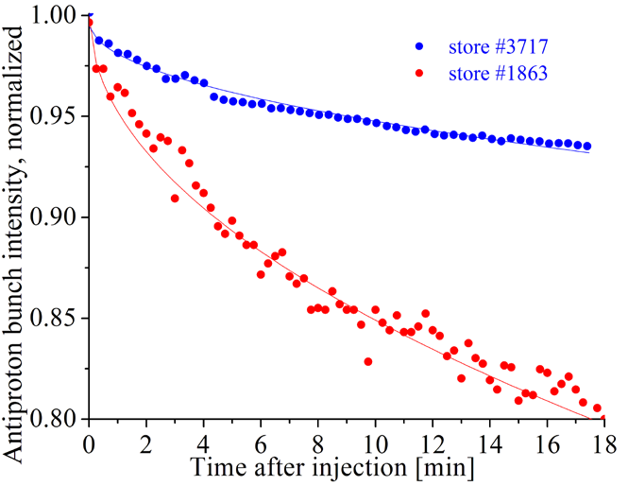
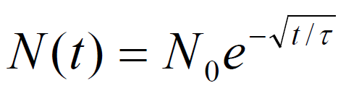
Separated beams – Long-range effects at injection, ramp, squeeze
Diffusion on b-b aperture
at injection

Slide 8
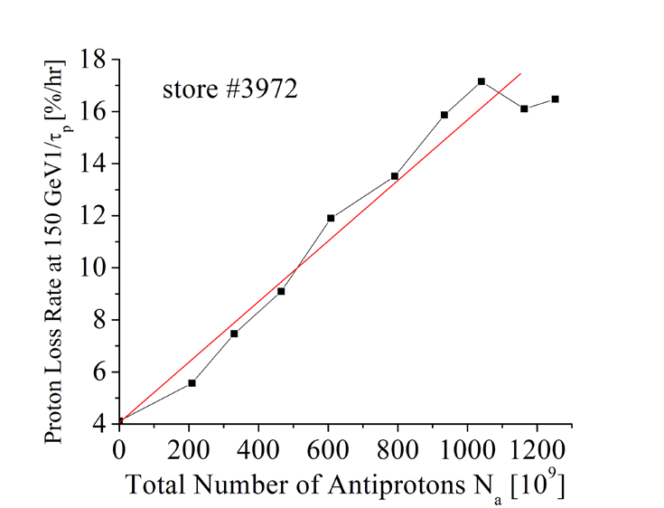
Losses Driven by Opposite Beam
Proton loss rate at 150 GeV 1/τ_{p} (%/h)
Total number of antiprotons N_{a} (10⁹)

Slide 9
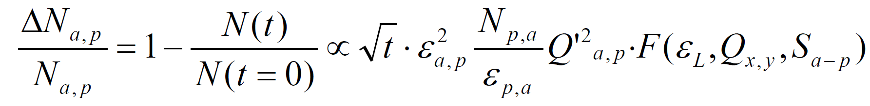
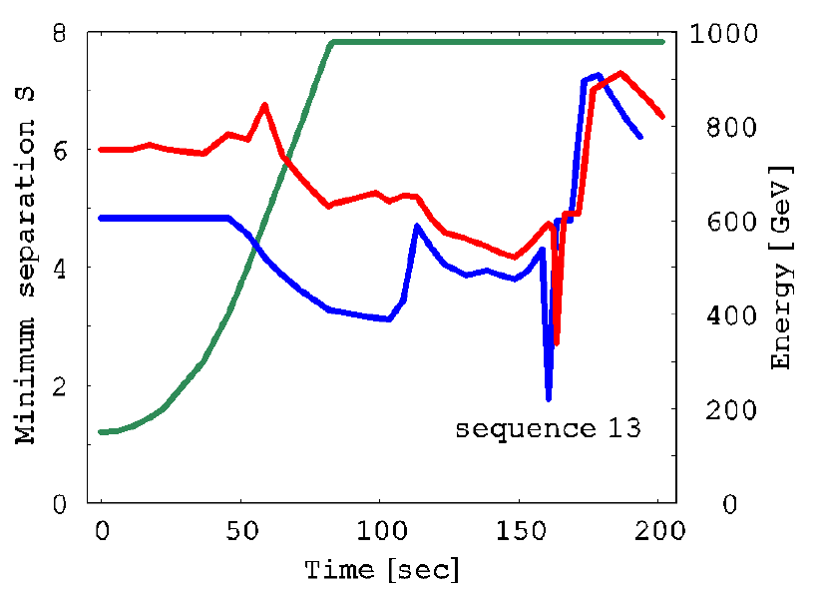
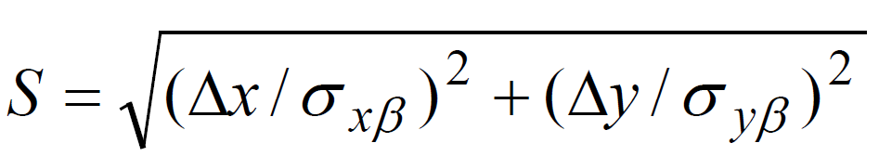



Empirically Found Dependencies
Losses were dependent on :
Therefore: focus on Separation, emittances, tunes:
Decreased Q’ to ~3 and
then to ~0 (new octupole
circuits

Slide 10
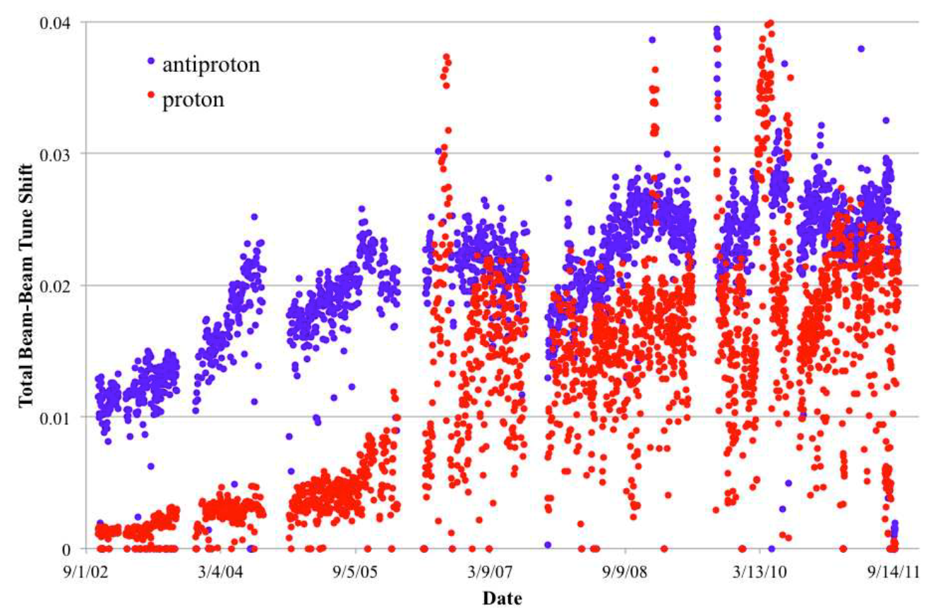

Beam-beam During Collisions

Slide 11
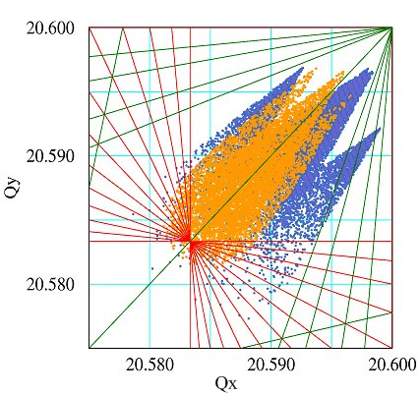
Situation at Low-beta: Confinement
5th order resonances:
Q=3/5=0.600 –
EMITTANCE BLOWUP
pbar
protons
antiprotons
12th order resonances:
Q=7/12=0.583 -
Bad lifetime
Q_{y}
p
7th order resonances:
Q=4/7=0.571 -
HIGH LOSSES
Q_{x}

Slide 12
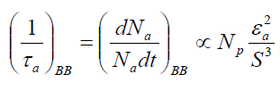
Luminosity Lifetime Constituents
(9-11) + (16-18) +(25-45)+(70-80) =(5-5.5) hrs
Emittance growth = >90% IBS + <10% Beam-Beam
Pbar lifetime = (80-85)% burnup + ~15% LRBB
Proton lifetime = >50% Beam-Beam + <50 % burnup
Hougrlass lifetime = >90% IBS + <10% Beam-Beam
IBS determined ~50-55% of lifetime
Burnup due to luminosity – another 30-35%
Beam-Beam reduces lumi-lifetime@LowBeta by 12-17 %

Slide 13
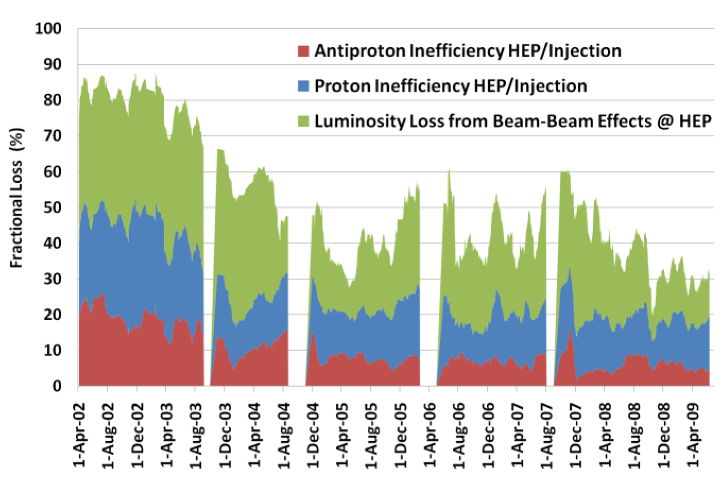
Total Luminosity Loss due to Beam-Beam
At the end of Run II
22-32% hit on Int.Lumi

Slide 14
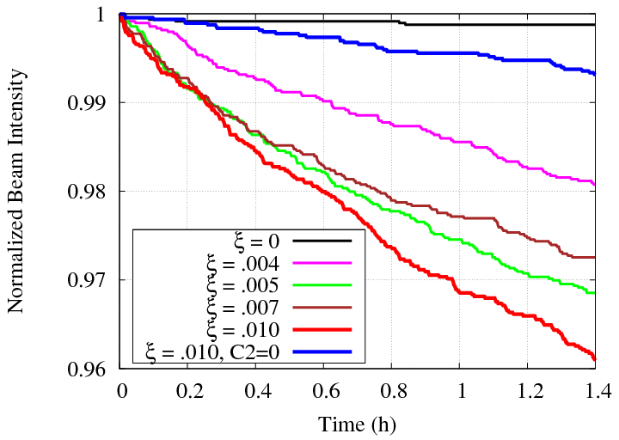
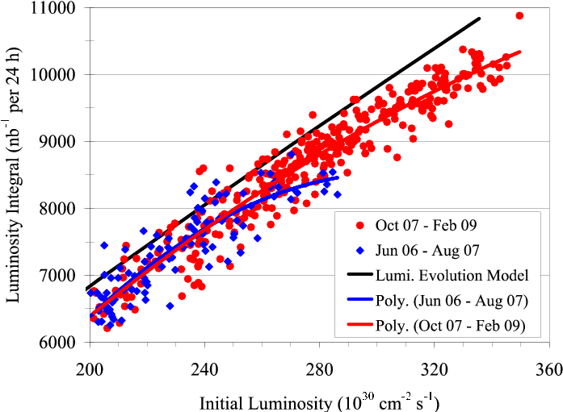
Effect of β* Chromaticity: Simulation → Practical Implementation
C2=-16000
C2=500
by reconnect
sextupoles

Slide 15
What helped us to reduce LRBB-effects
Injection, ramp, low-beta squeeze:
  Opened apertures (replaced magnets), increased helix
  Q’ reduced: Transverse Dampers & Octupoles
  Emittances improved (thanks to injectors)
At low beta (in collision stores)
  Use new separators, helix optimized (1st LR IPs >6 sigma)
  Lower Q’, pbar blowup, tune stabilization
  Chromatism of beta-function (Q” ) greatly reduced
Operational Machine Stabilization:
  Stable intensities and emittances from injectors
  Drastically stabilized Tevatron (orbits, tunes, chromaticities)
Outstanding development of beam diagnostics
  Tunes (3 instruments), emm (3), Intensity (3), lumi (2), BPMs
(First ever?) trustable beam-beam simulations
First ever (!) operational electron lenses !

Slide 16
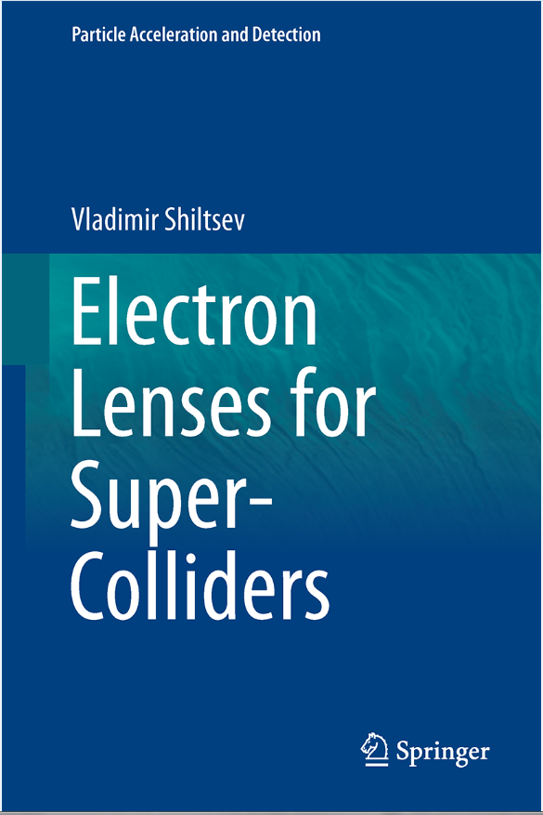
Electron Lenses for BB-Compensation – First time@Tevatron
Many people worked on the LRBB compensation with e-lens program (operations, theory, studies, analysis)
  A.Alexandrov, Y.Alexahin, K.Bishofberger, A.Burov, V.Danilov, D.Finley, R.Hively, V.Kamerdzhiev, M.Kufer, G.Kuznetsov, S.Kozub, A.Martinez, M.Olson, V.Parkhomchuk, H.Pfeffer, V.Reva, G.Saewert, V.Scrapine, A.Seryi, D.Shatilov, A.Shemyakin, V.Shiltsev, N.Solyak, G.Stancari, D.Still, B.Sukhina, V.Sytnik, M.Tiunov, L.Tkachenko, A.Valishev, L.Vorobiev, D.Wildman, D.Wolff, X.L.Zhang, A.Zinchenko, F.Zimmermann
Dec 9, 2015, $109.00

Slide 17
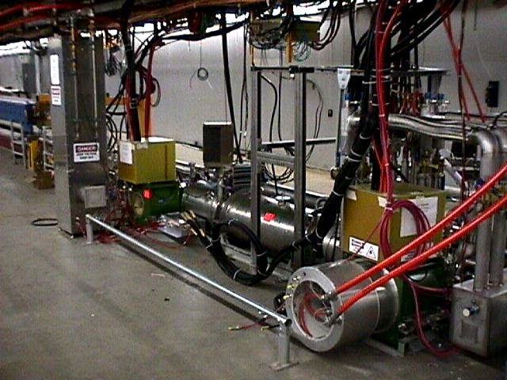
Tevatron Electron Lens #1 (F48): 24/7 operation 2001-2011

Slide 18
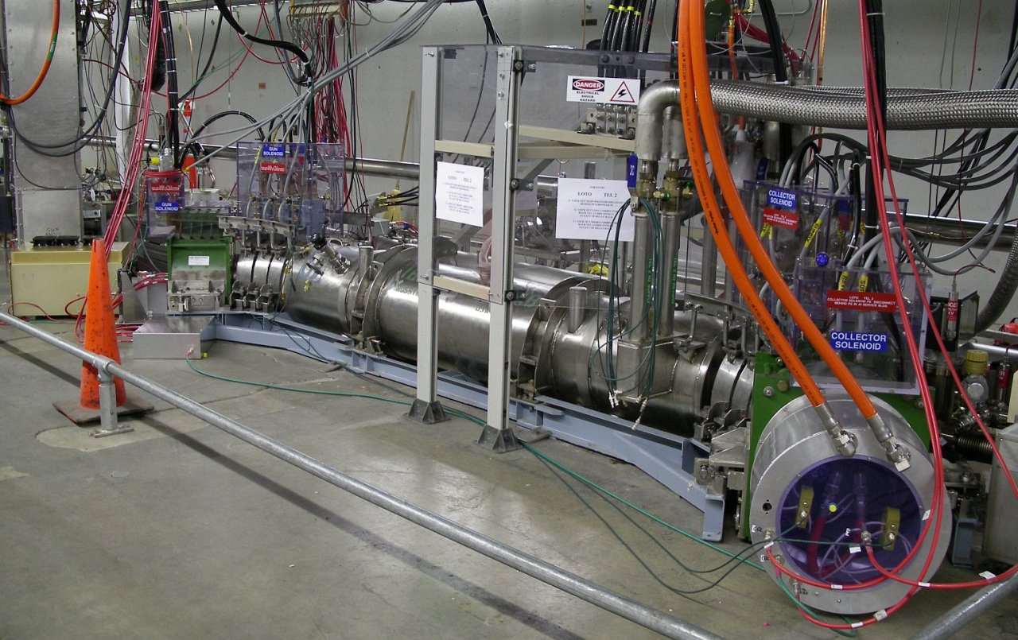
TEL2 (A11): 24/7 operation & studies 2004-2011

Slide 19
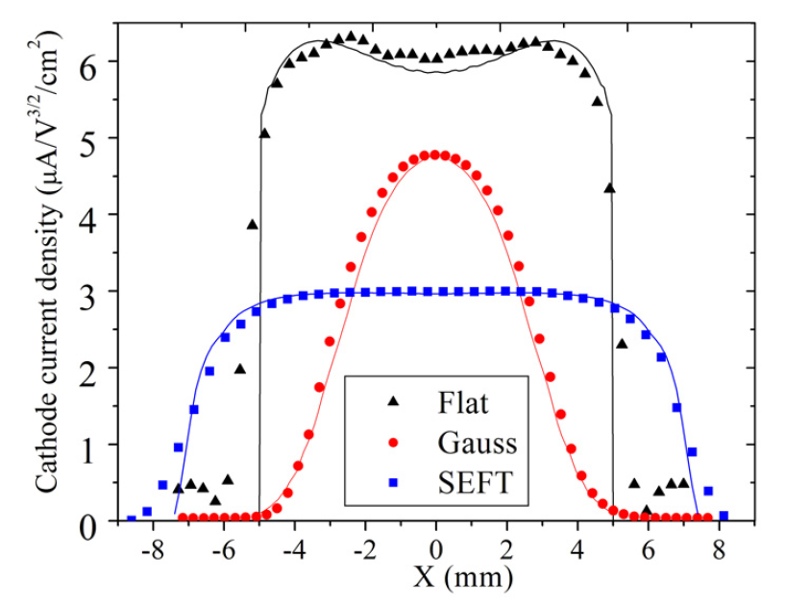
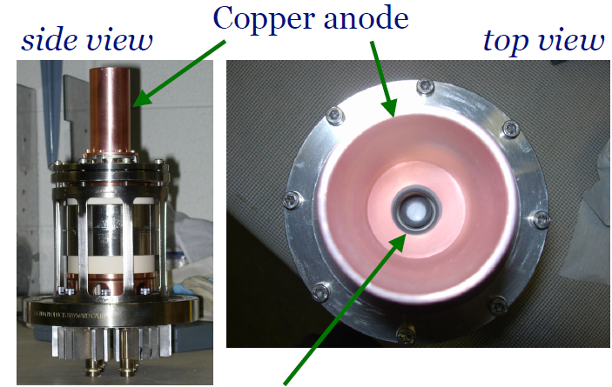
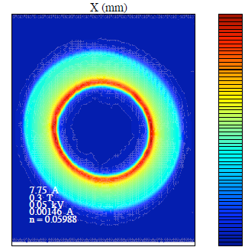

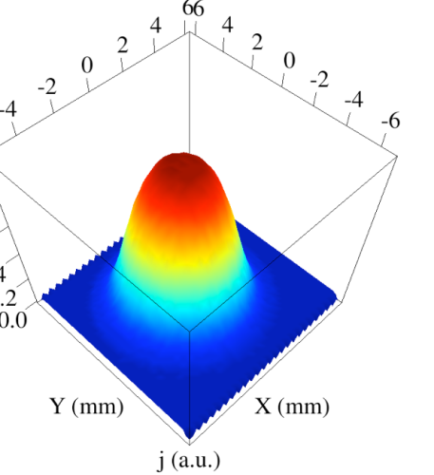
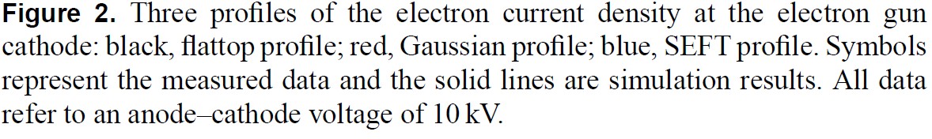
TELs: Electron Charge Distribution
Electron gun
Shiltsev et al., PRL 99, 244801 (2007). Shiltsev et al., NJP 10, 043042 (2008).
G. Stancari, et al., (2011)
Phys. Rev. Lett. 107, 084802

Slide 20
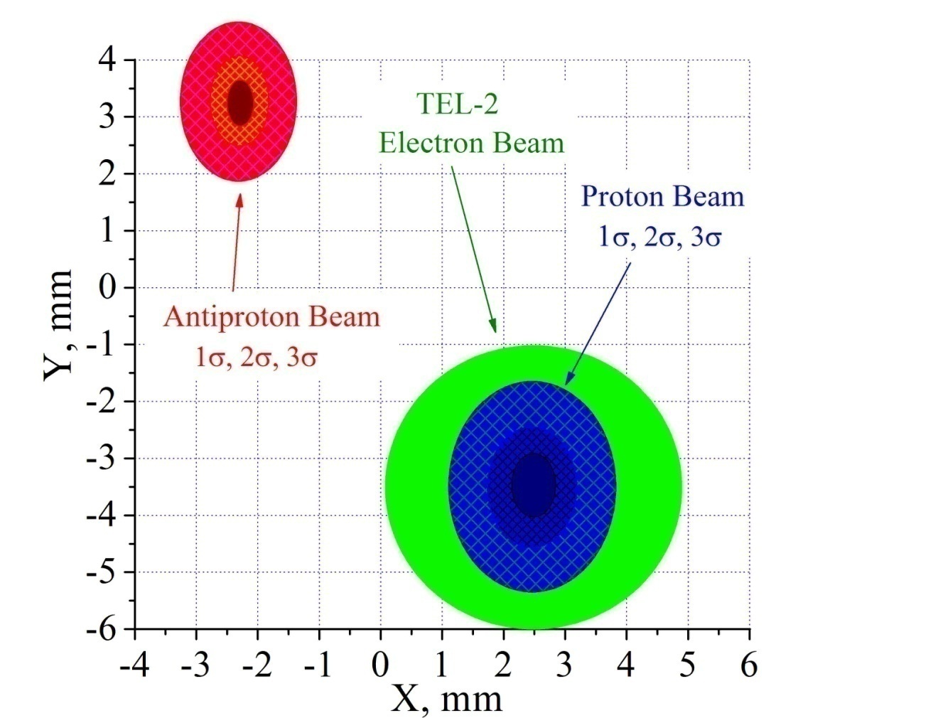
TEL e-beam aligned and timed on protons
in space
in time
TEL
P12
A24
P9
P10
P11
Transverse e-p alignment is very important for minimization of noise effects and optimization of positive effects due to e-beam. Timing is important to keep protons on flat top of e-pulse – to minimize noise and maximize tune shift.

Slide 21
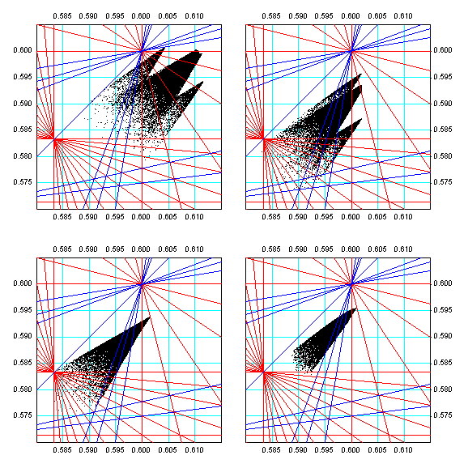
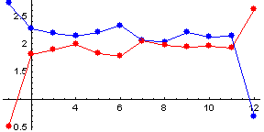
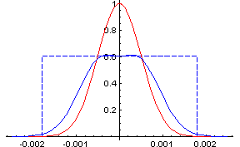
TELs: Long-Range Beam-Beam Compensation
vary the currents bunch-by-bunch in two e-lenses installed at β_{x}≠ β_{y}
I_{e}[A]
TEL1
TEL2
n_{bunch}
e-beam p-bars

Slide 22
Effects of Long-Range Beam-Beam @ Collisions
All beam indicators become bunch dependent due to LR-BB:
Orbits vary by ~50µm
Tunes and couplings by ~0.005
Chromaticities by ~5 units
Bunch losses by ×(2-3)
Emittance growth (under certain conditions)
In both – proton and pbar beams
Have 3-fold symmetry trains of 12

Slide 23
Some Facts on Electron Lenses
~4 mm dia 2 m long very straight beam of ~10kV ~1A electrons (~10¹²) immersed in 3T solenoid
Generates electric field E~0.3MV/m, dQ^{max}_{p,pbar}~ 0.010

Slide 24
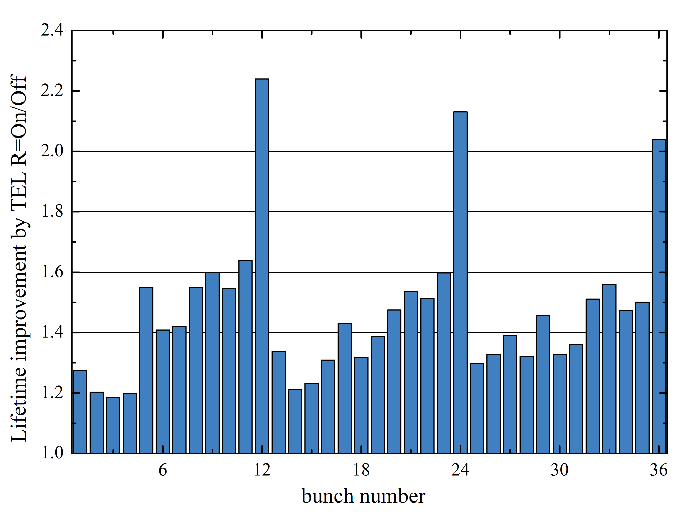
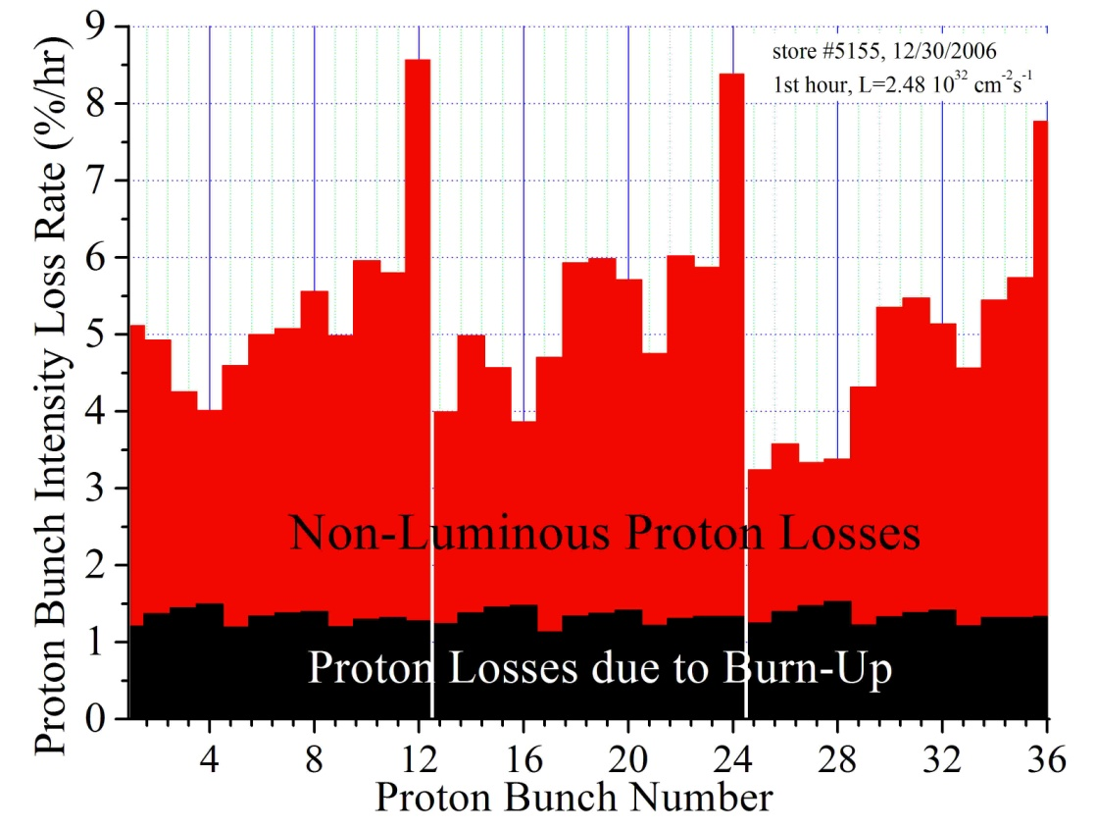
Electron Lens Doubles Beam Lifetime
Protons @ collisions 980 GeV :
ξ_{max}=+(0.016-0.024)
TEL2 moves Q_{v} up 0.002
Bunches P12, 24, 36 have systematically the lowest vertical tune that reduces beam lifetime (too close to 7/12 resonance). TEL2 raises the tune up by dQ~+1.5e-3 at 0.6 A

Slide 25
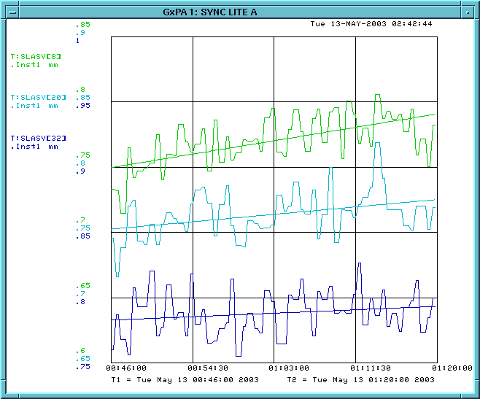
Emittance Growth of A33 Suppressed by TEL-1
Store #2540
May 12, ‘03
A9
4.1 π mm mrad/hr
A21
2.2 π mm mrad/hr
A33
1 π mm mrad/hr
-TEL on it

Slide 26
Long-Range Beam-Beam @ Collisions
All beam indicators become bunch dependent due to LR-BB:
Orbits vary by ~50µm
Tunes and couplings by ~0.005
Chromaticities by ~5 units
Bunch losses by ×(2-3)
Emittance growth (under certain conditions)
In both – proton and pbar beams
Have 3-fold symmetry trains of 12

Slide 27
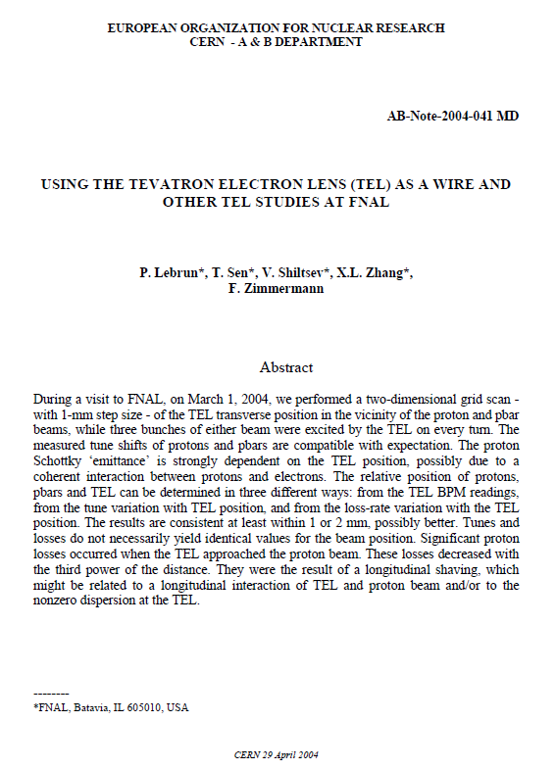
Electron Lens as a Wire – 1st time @Tevatron
2004 Tevatron Collider Run II, one MD to test operational use of electron lenses as “wires”:
  P.Lebrun, T.Sen, V.Shiltsev, X.L.Zhang, F.Zimmermann
Successful “Proof of Principle”
Electron wire is fully consistent with operation of a hadron super collider
Many important beam physics insights with 0.6A e- beam: Gaussian, 0.6 mm → dQ=0.007
timed on triples of p/pbar bunches
2004

Slide 28
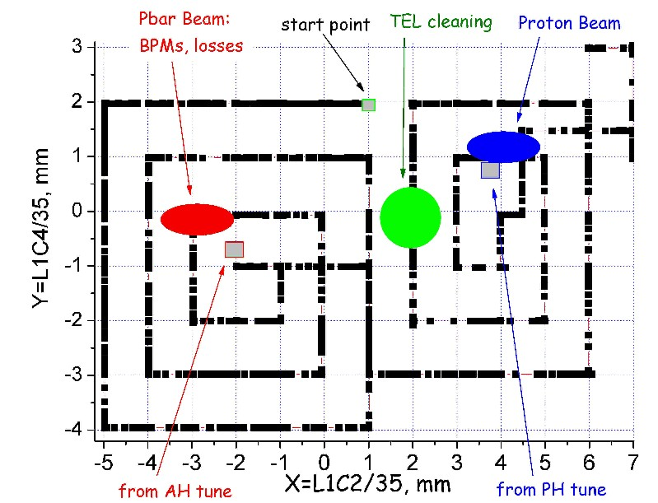
MD results: moving e- beam around p/pbars

Slide 29
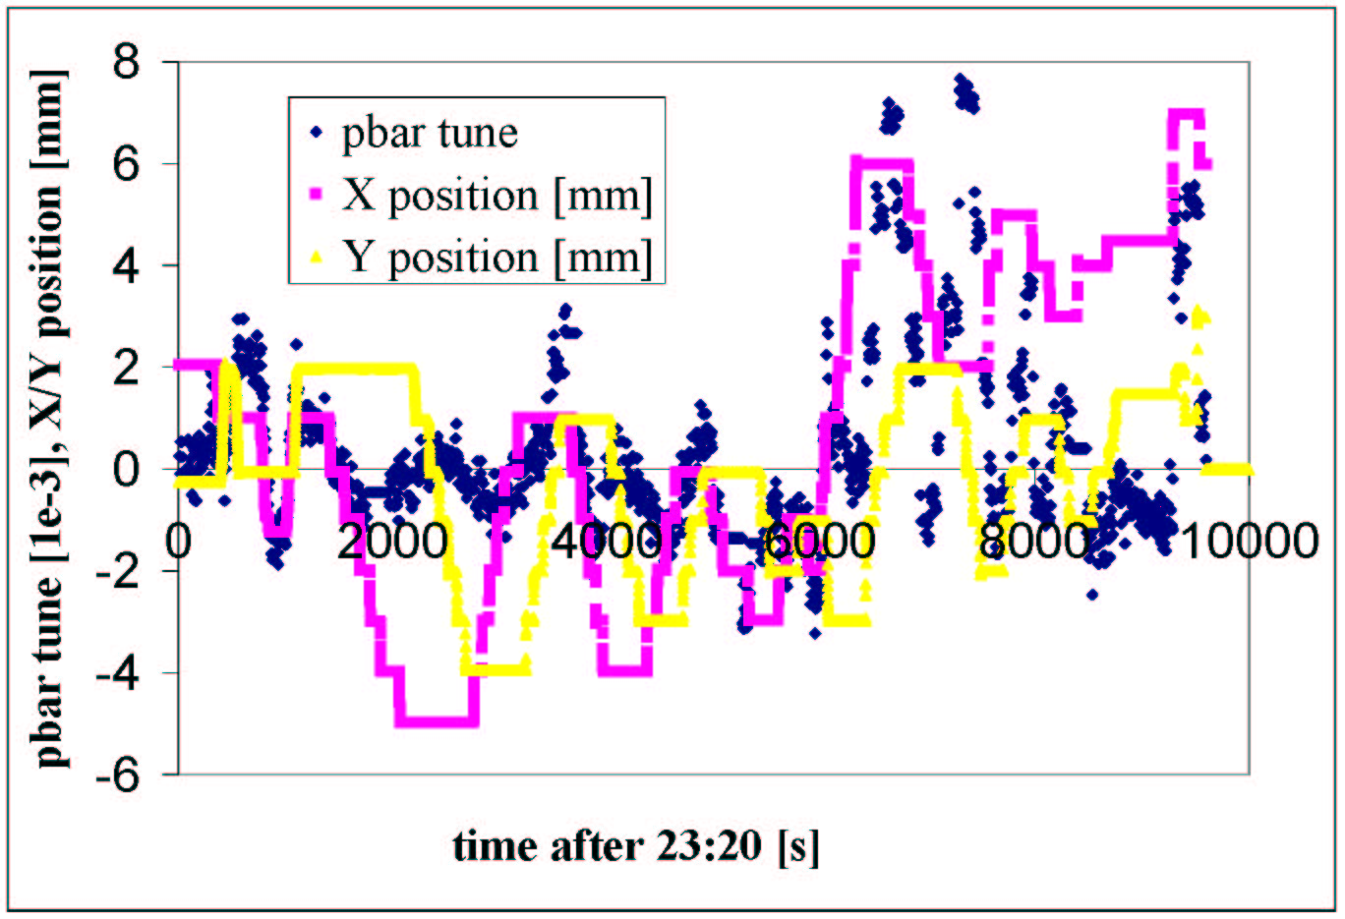
Tuneshift vs e- beam position: 0.007

Slide 30
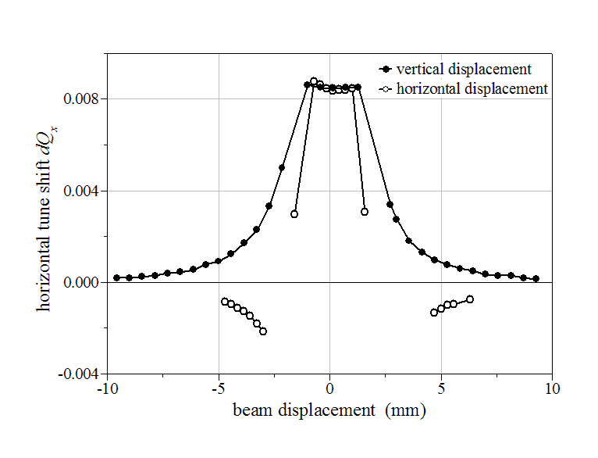
Proton Hor tuneshift dQ_x vs d_x, d_y
(another MD, TEL-1, J_{e} =1A, U_{c} =6.0 kV, flat-top electron gun)

Slide 31
Summary
Long-range beam-beam effects occurred in the Tevatron at all stages (injection, ramp, squeeze, collisions) and in both beams
They resulted in significant beam losses, and, sometimes, in emittance blow-ups – with bunch-to-bunch dependent patterns
Even after careful optimization of helices and many operational tune-ups and upgrades – at the end of the Tev Run II beam-beam claimed ~25% of Integr. Lumi but at ~40x higher peak L
  LR beam-beam compensation by TELs demonstrated
  Electron lenses operated for 17 years combined
  In MDs, TEL was used as a “wire”
  Trustable LIFETRAC simulations helped us a lot
  Tevatron/TEL experience can help HL-LHC

Slide 32
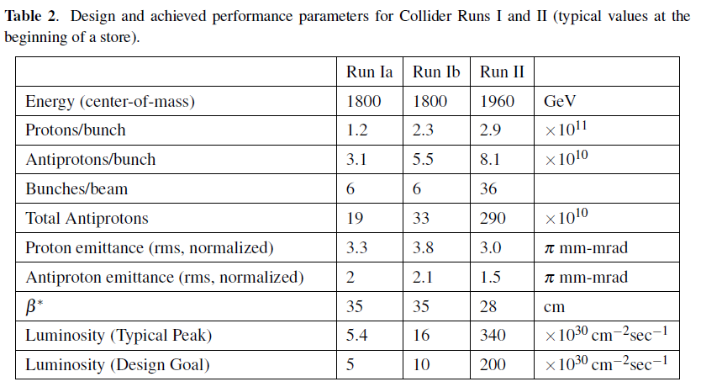
Tevatron Parameters

Slide 33
What we’ve found empirically
Losses were dependent on :
The can be described by the model of “Diffusion + DA set by Beam-Beam sets DA and drives diffusion → sqrt (t)
Dynamic aperture
set by parasitic
beam-beam
interactions
A_{transverse}
Physical aperture
A_{longitudinal}

Slide 34
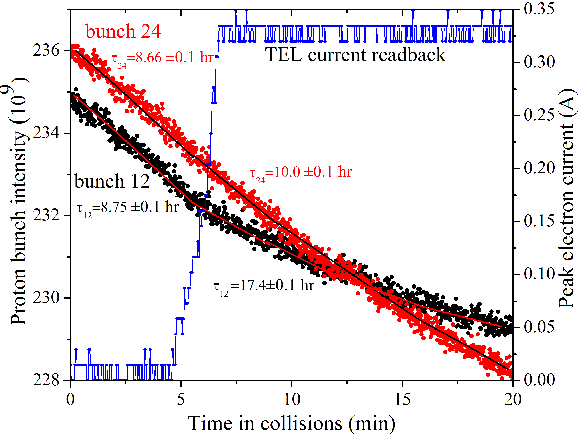
TEL2 on One Proton Bunch P12
When TEL off:
bunches #12 and #24
have same lifetime of
8.7 hrshrs=11%/hr loss
When TEL on:
bunch #12 lifetime
is ~2x #24 lifetime:
17.4 hrs vs 10.0 hr

Slide 35
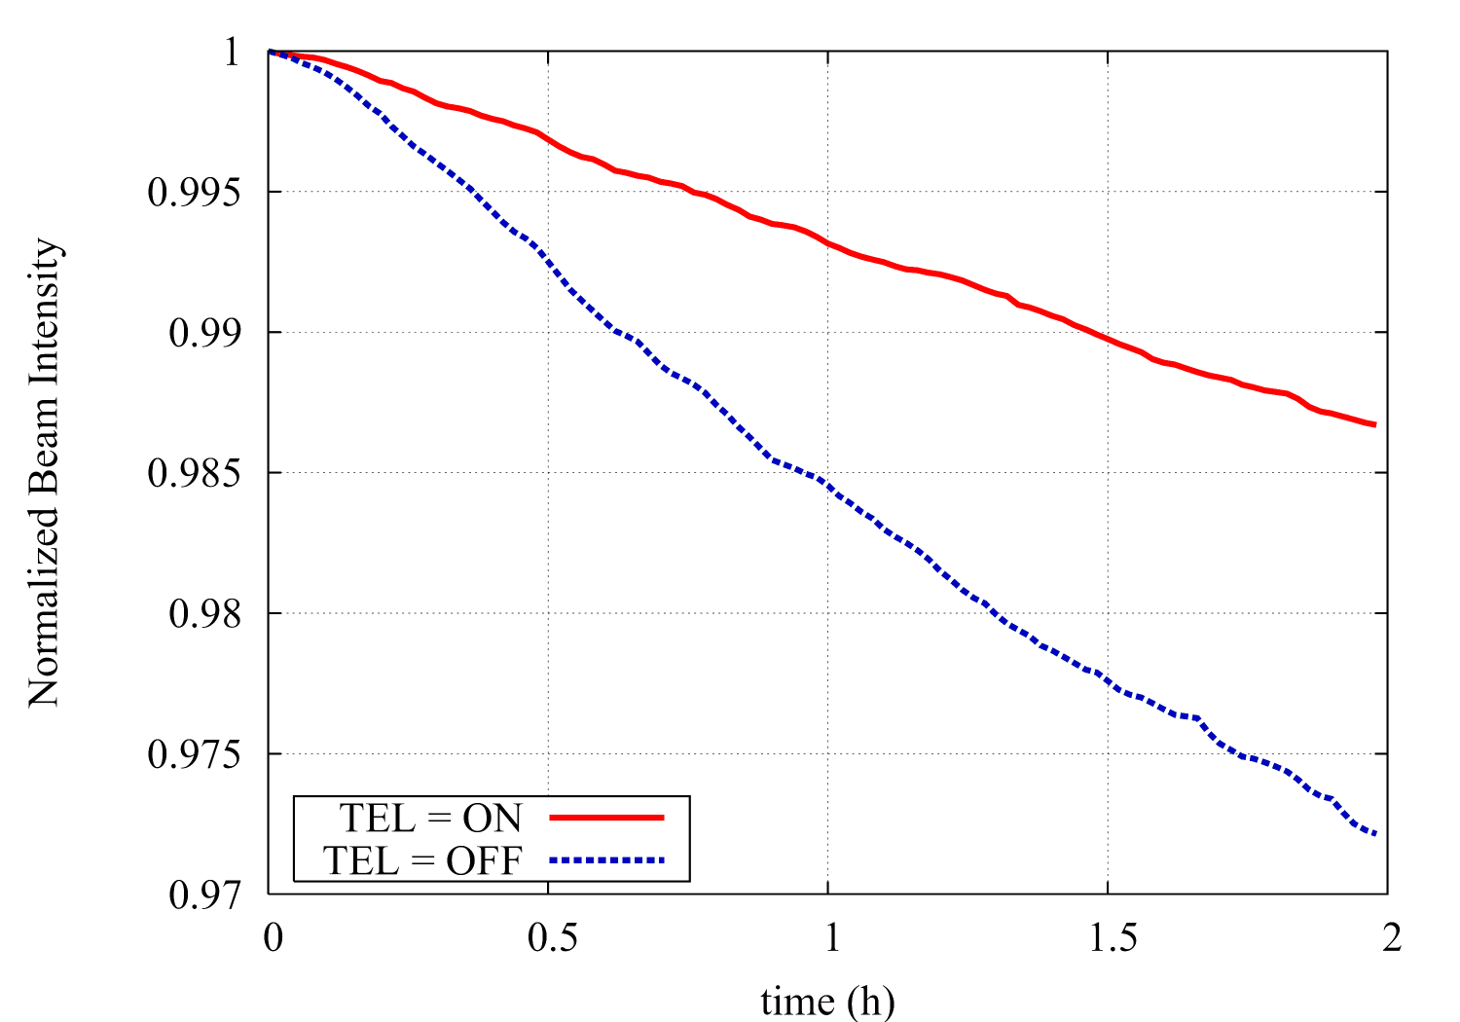
LIFETRAC Simulation of TEL
A.Valishev

