Slide 1
Fermilab Accelerator R&D Program
Vladimir Shiltsev, Accelerator Physics Center
Institutional Review of the Fermi National Accelerator Laboratory
11 February 2015

Slide 2
Fermilab Accelerator Program: P5-Aligned
Advanced Accelerator R&D Towards Next Generation Machine
Exploratory Long-term R&D
Operational Support and Complex Upgrade (PIP-II)
Accelerators Training and Education
Accelerator and Beam Physics
Develop and explore transformative concepts and technologies for beyond next-generation multi-MW accelerators at IOTA/ASTA and in the area of SRF
Assess feasibility and demonstrate technologies for future 100 TeV pp collider and conclude ionization cooling demo for possible future muon facility
Provide accelerator physics and technology support for operation and upgrades of the Fermilab’s accelerator complex, ν and µ experiments
Educate the next generation of accelerator designers and builders through the USPAS and Fermilab programs
Contribute to the fundamental understanding of beam dynamics through experiment , simulation and theory

Slide 3
Map of Fermilab’s Accelerator R&D Activities
Beam physics at operations machines
R&D for Projects/Facilities: PIP-II, LCLS-II, ILC – session 3E
GARD (General Accelerator R&D):
  High-field Magnets and Materials – session 7A
  IOTA Research Towards Multi-MW Beams – session 6A
  High Power Targets R&D
  Cost-Effective SRF Technology – session 3E
  Accelerator Science, Modeling & Design – session 5C
Accelerator Training and Education
  Accelerator R&D Programs: MAP and LARP – session 6A
Accelerator Test Facilities Operation and IARC

Slide 4
Accelerator Science – Lab Goals (see Nigel’s talk Tue)
Extend the scientific reach of existing accelerator facilities
  Improved performance of Fermilab accelerators with intense beams and low losses are critical to achieving the muon and neutrino programmatic goals.
Launch a test facility to enable ‘transformative’ Accelerator Science
  The Integrable Optics Test Accelerator (IOTA) is needed to address key questions related to affordable future accelerators at the intensity frontier and engage the community in frontier accelerator science research.
Explore scientific limits to gradients and Q0 for future SRF accelerators
  Future accelerators (e.g. PIP-II, LCLS-II, ILC, FCC, industrial linacs) need to be energy efficient and cost-effective (i.e. rapid acceleration and low loss).
Establish Fermilab as essential contributor to future large accelerators
  Advanced capabilities in high-field magnets, SRF accelerators and beam dynamics will position the Lab as an essential contributor to future high-energy physics facilities (e.g. TeV-class e+e- and 100 TeV pp colliders).
Show importance of accelerator science & HEP to US competitiveness
  Important aspect of IARC is to apply HEP technologies to industrial and societal challenges in health, security, energy, and the environment.

Slide 5
Content
Highlights of 2012-2014:
  Studies, achievements, team, education, collaborators
Current Issues and Challenges:
  Instabilities, targetry, collimation, ED, modeling
Shaping Post-PIPII Future:
  Options for multi-MW complex upgrade (PIP-III)
  IOTA R&D program
Long-term R&D Towards HEP Frontier:
  FCC research
  MAP/MICE ramp-down

Slide 6
Highlights of Fermilab’s
Accelerator Program
2012-2014
Page 6

Slide 7
FNAL Accelerator Program: Major Drivers/Developments
Beam physics limitations on the FNAL accelerator complex performance:
  PIP, beam studies
Document Tevatron legacy in beam physics
  for the benefit of accelerator science and future colliders
R&D and design effort toward next facility:
  ILC → Project-X → PIP-II
  Integral part of community planning (Snowmass, P5)
Establish R&D beam facilities for the next- and generation-after next machines:
  NML→ ASTA→IOTA
Collaboration with Universities & Training

Slide 8
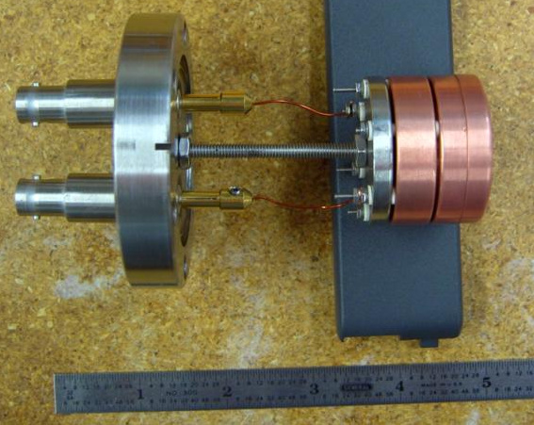
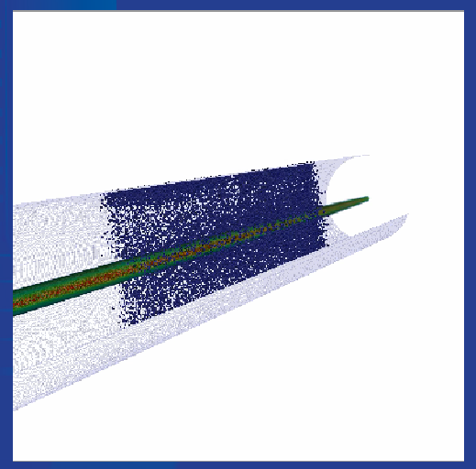
Main Injector: e- Cloud Experimental Station
E-Cloud Station in Main Injector :
2 experimental Chambers (coated and SS)
  Test various coatings for ECloud suppression
  Measure spatial extinction of ECloud
3 Fermilab and 1 Argonne RFA
  Retarding Field Analyzers
  Directly measure electron flux
3 microwave antennas and 2 absorbers
  Measure ECloud density by phase delay of microwaves
So far, three materials tested:
  TiN (2009-10) – suppressed vs. Stainless (5-1000x)
  α-C (2010-12, from CERN) – similar suppression as TiN
  DLC (2013-, from KEK) – Awaiting the return of beam
Fermilab RFA
R.Zwaska
P.Lebrun, J.Amundson, P.Spentzouris, et al
Augmented by comprehensive simulations
Utilization of SYNERGIA and ComPASS tools :
  ComPASS VORPAL e-cloud simulation of MI experiments
Model microwave experiment (only possible with ComPASS tools), RFA response
Code comparisons with “standard” tools such as POSINST

Slide 9
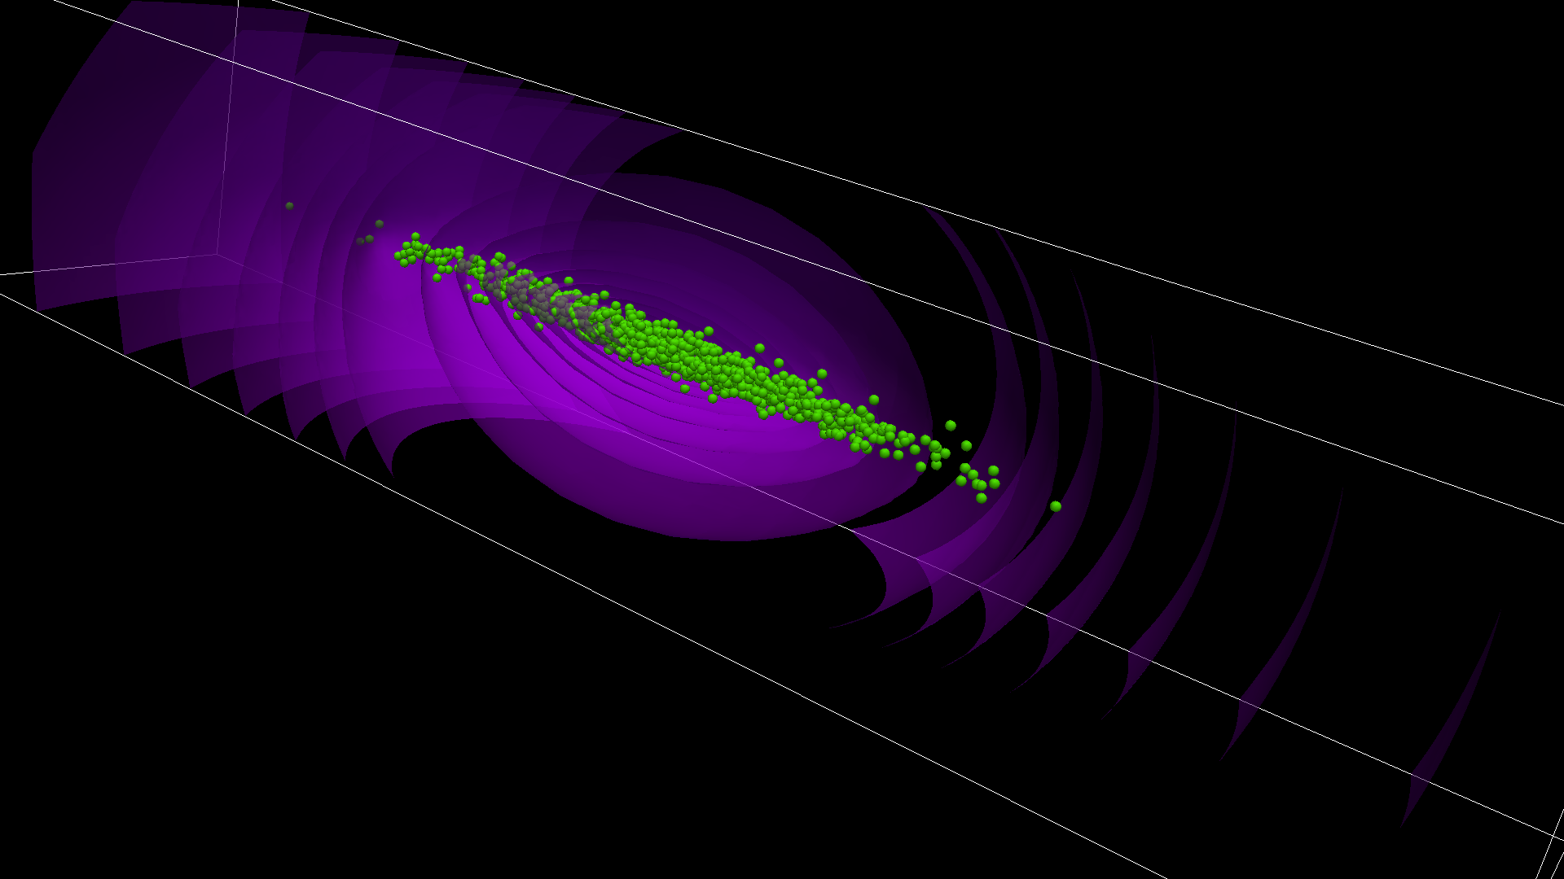

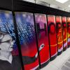
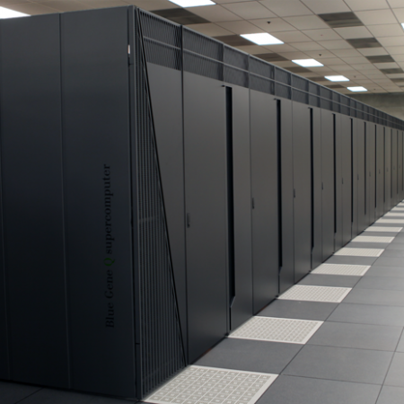
Synergia: Accelerator Modeling Tool
Beam Dynamics Framework
Developed at Fermilab with support from SciDAC
Collective effects
Fully nonlinear single-particle dynamics
Modeling Fermilab and CERN Machines
Booster
  Space charge + wakefields
Main Injector and Recycler
  Slip stacking with space charge
CERN Injectors for HL-HLC
  Space charge
  (more in parallel Session 5C)
P.Spentzouris, J.Amundson, E.Stern, et al
Synergia run on everything from laptops to supercomputers
MIC and GPU versions in development
laptops and desktops

Slide 10
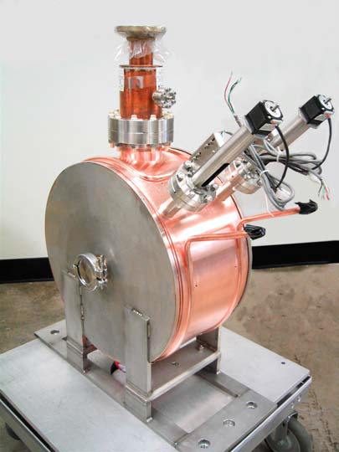
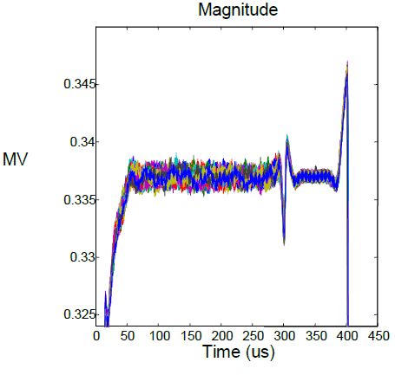
Six-Cavity Test @ HINS
  “Six-Cavity Test’ has demonstrated the use of high power RF vector modulators to control 6 RF cavities + RFQ driven by a single high power klystron
  demonstrated the energy stability with a 7-mA proton beam accelerated through the six cavities from 2.5 MeV to 3.4 MeV.
Diagnostics development and tests:
  together with RAL and Argonne
Finished operation Jan’2013
Will move to ASTA (p’s for IOTA)
D.Wildman, J.Steimel, V.Scarpine, M.Chung, et al
~ 1 ms pulse
fast feedback
< 0.2 deg RF phase
<0.2% voltage control

Slide 11
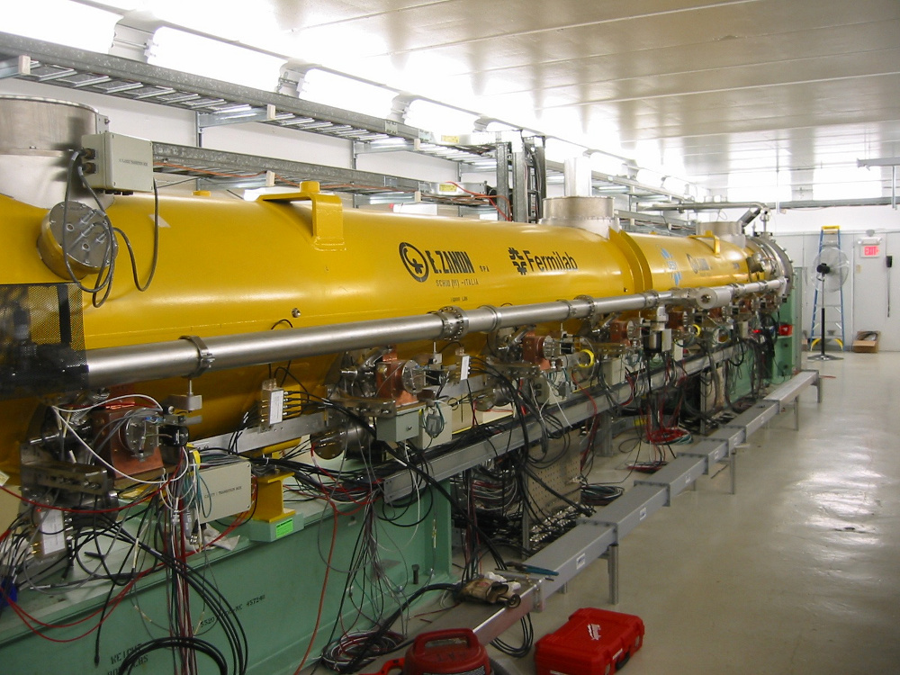
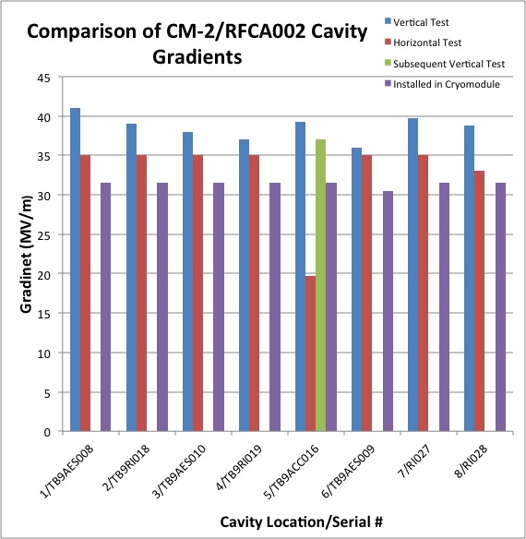
CM2 – World’s Highest Gradient CM
ILC Milestone = 31.5 MV/m
W.Shappert, E.Harms, N.Solyak, et al

Slide 12

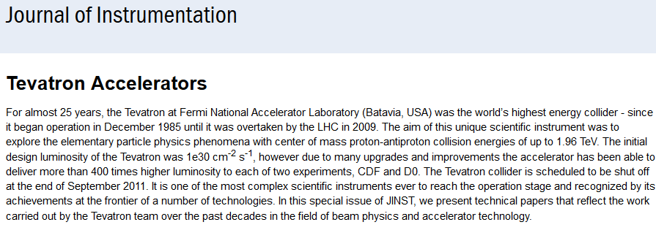
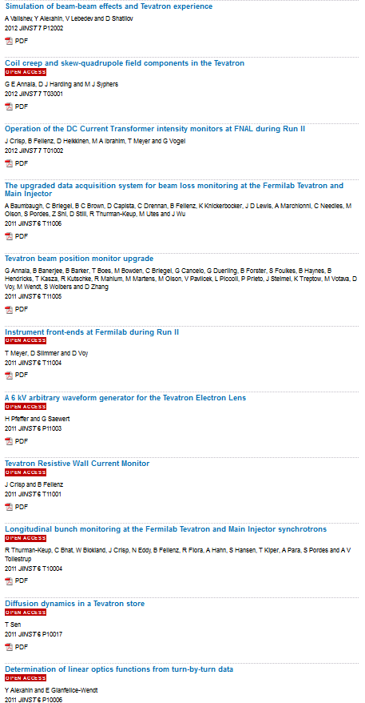
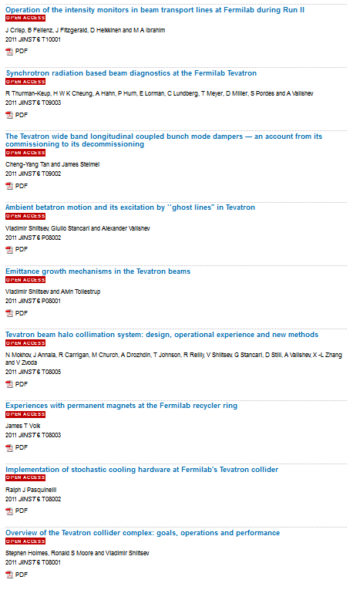
Beam Physics @ Tevatron
Available on Amazon.com

Slide 13
Beam Theory and Simulations
A number of outstanding advances in beam theory:
  A series of works by Burov, Balbekov,and Lebedev on beam dynamics of longitudinal and transverse instabilities with space-charge
  Theory of nonlinear but integrable (stable) beam optics
  “Outstanding” PRSTAB Article of 2010: V. Danilov, S. N., PRSTAB, 13, 084002 (2010)
  “Outstanding” PRSTAB Article of 2011: P. Piot, Y.-E Sun, J. G. Power, and M. Rihaoui, PRSTAB 14, 022801 (2011).
A suite of modeling tools, developed at Fermilab:
  MARS 300 users, 40 institutions
  Synergia 30 8
  OPTIM 20 5
  Lifetrac 10 5

Slide 14
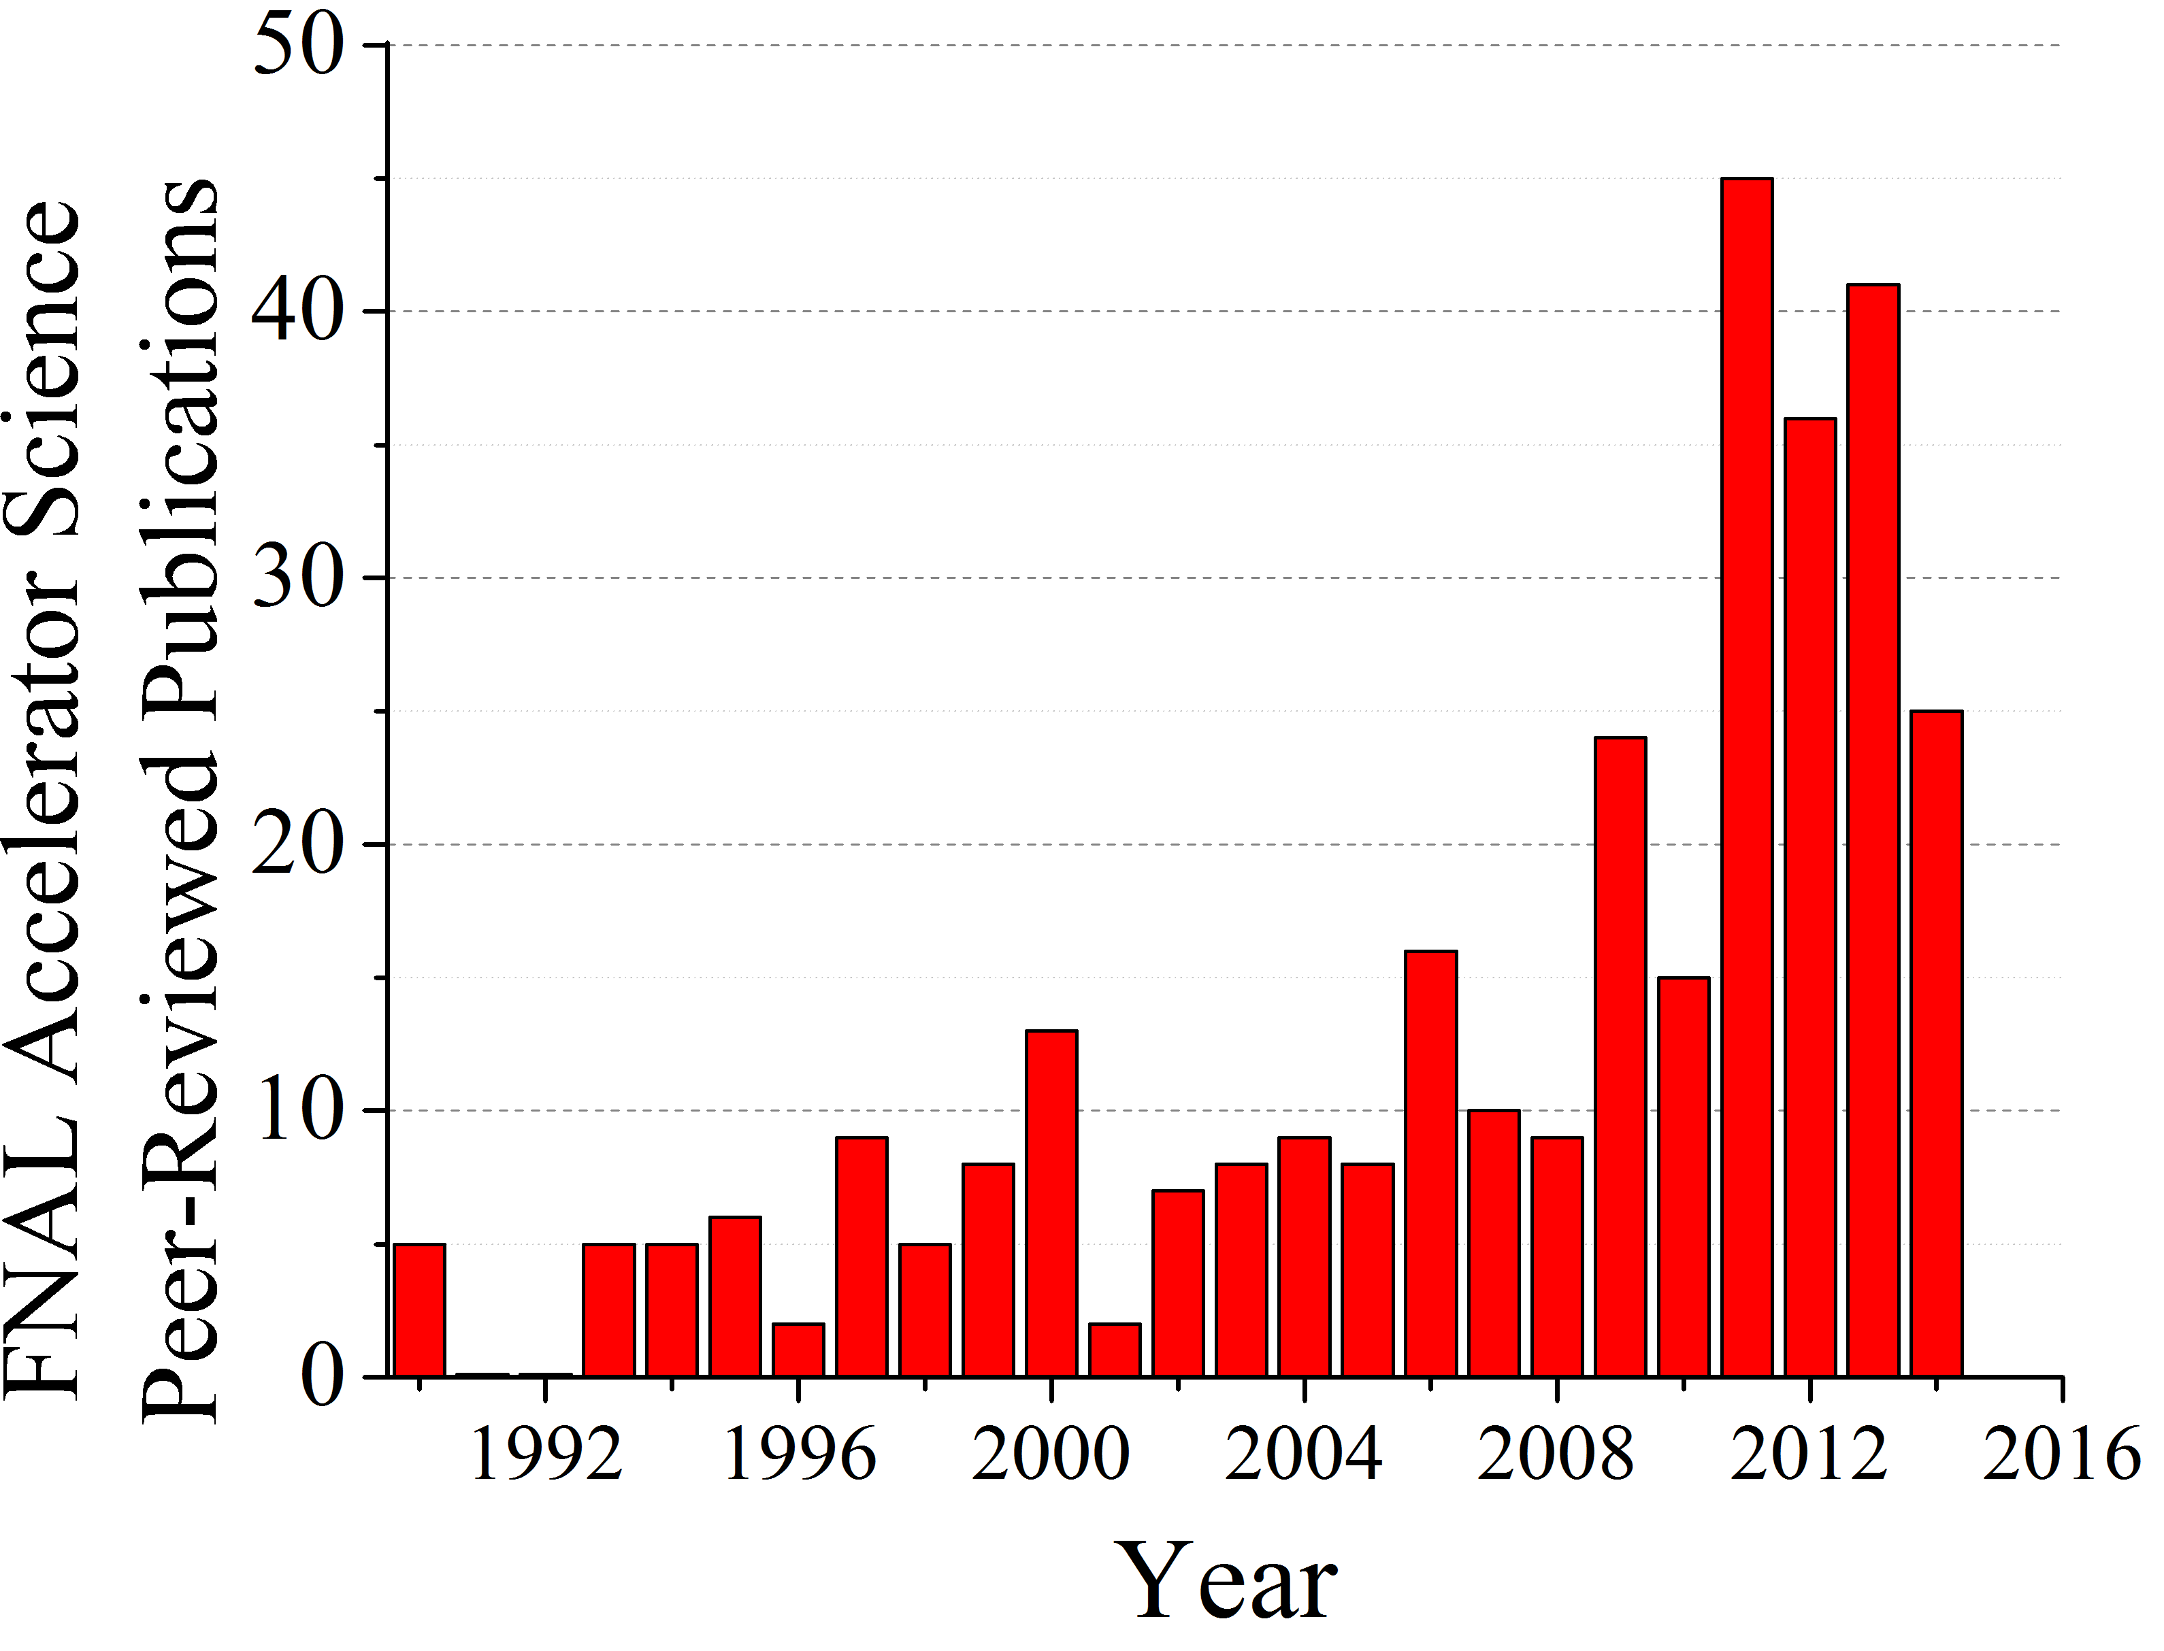
FNAL Peer-reviewed Accelerator Sci & Tech publications

Slide 15
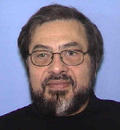

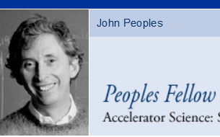
Accelerator Training
Host US PAS :
  Office, >40 instructors +assistants in 2009-2014
Summer Internships – Lee Teng :
  5+5 jointly with ANL (E.Prebys, chair)
Peoples Fellows (now 3):
  “Future leaders” in accelerators (tenure track)
Bardeen Fellows (2):
  For outstanding engineering graduates
Joint Appointments (4):
  “50-50” arrangements , now NIU & IIT
Joint University-FNAL PhD Program:
  6-8 students to carry out accelerator
  physics and technology R&D at Fermilab

Slide 16
PhD Degrees based on research at Fermilab :
13 over 2009-2014
Gene Kafka 2014 IIT
Timofei Zolkin 2014 University of Chicago
Julia Trenikhina 2014 IIT
Ben Freemire 2013 IIT
Denise Ford 2013 Northwestern
Timothy Maxwell 2012 Northern Illinois University
Alexey Petrenko 2012 Budker Institute of Nuclear Physics
Arun Saini 2012 University of Delhi
W.-M. Tam 2010 Indiana University
Dan McCarron 2010 Illinois Institute of Technology
Igor Tropin 2010 Tomsk University
Uros Mavric 2009 University of Ljubljana
Timothy Koeth 2009 Rutgers University
Currently – 6 students in Joint University-Fermilab Accelerator PhD program,
4 Joint Appointments: NIU: P.Piot, Y.M.Shin, S.Chattopadhyay; IIT: P.Snopok
Adjunct/Visiting Professorships: S.Nagaitsev (UC), V.Shiltsev (NIU)

Slide 17
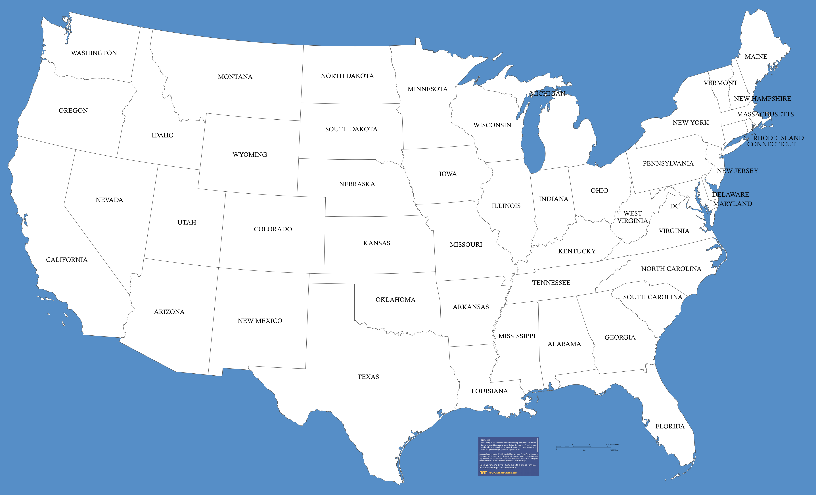
Universities – Collaborators in FNAL-based Accel. R&D

Slide 18
University | Primary Topic(s) | Funding Agency
IIT | SRF technology; machine concepts; Novel Accelerator technology | DOE-HEP grant, NSF
U. of Chicago | Beam dynamics (IOTA) | Fermilab, NSF, U.of Chi
NIU | SRF technology; beam dynamics (IOTA); Accelerator technology | DOE-HEP grant, NSF, DOD, NIU
IU | Beam dynamics; machine concepts | DOE-HEP grant
U. of MD | Beam dynamics | DOE-HEP grant, NSF,ONR
U. Tenn. | Accelerator technology; beam dynamics | DOE-HEP grant
U. Wisc. | SRF technology | DOE-HEP grant
MSU | SRF technology; beam dynamics; machine concepts | DOE-HEP grant; NSF
U. Of Colorado | Beam dynamics; accelerator technology | DOE-SBIR
Colorado State | SRF technology | ONR, High-Energy Laser Joint Tech Office
Cornell | SRF technology | DOE; NSF
MIT | Machine concepts | NSF

Slide 19
Current Accelerator
Issues and Challenges
2015-
Page 19

Slide 20
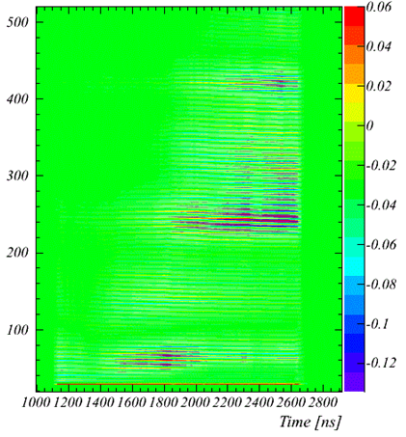
Recycler Instability Studies
turn
x
Last year (before shutdown) Recycler suffered from fast horizontal instability
  had 10-20 turns growth rate
  affected bunches in the second half of the injected batch
  depended strongly on bunch length
  had no obvious tune / chromaticity dependence
  could be averted by first weak batch
Task force formed to investigate
  Experimental and theoretical studies ruled out all potential sources of the instability except for e-cloud
    Don’t yet have an explanation for the details of the observed behavior
Does not hamper operations now
  studies are necessary to understand the implications for PIP-II parameters
½ synchrotron period
P.Adamson, Yu.Alexahin, et al
Onset of instability after injection of a single batch of nominal intensity 4⋅10¹²

Slide 21
Treatment of Beam Losses: ED & Collimation
Coupled MAD and MARS for precise multi-turn tracking and energy deposition / radiation modeling in accelerators for beam loss studies and collimator design
Several collimation systems were MARS-designed and set in Tevatron, Main Injector, MI-8 beamline and Booster.
Currently being applied to Recycler and Booster.
Energy Deposition (ED) studies for projects: development of physics modules for even better description of meson and neutrino production in applications with 0.5 to 120 GeV beams (Mu2e, g-2, ELBNF, PIP-I and PIP-II) thoroughly benchmarked against data including recent MIPP’s one.
  See next slide

Slide 22
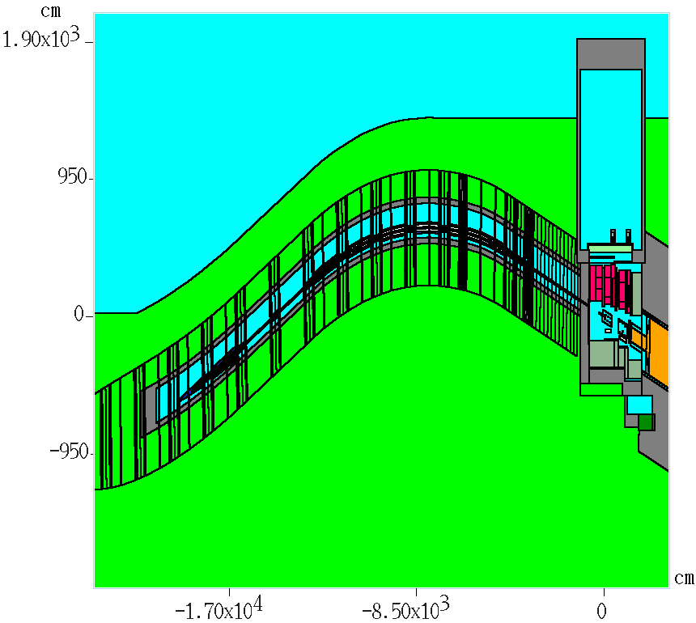
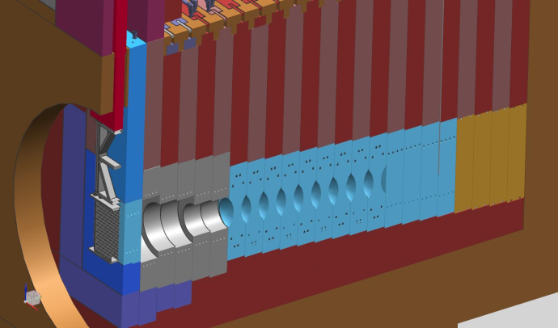
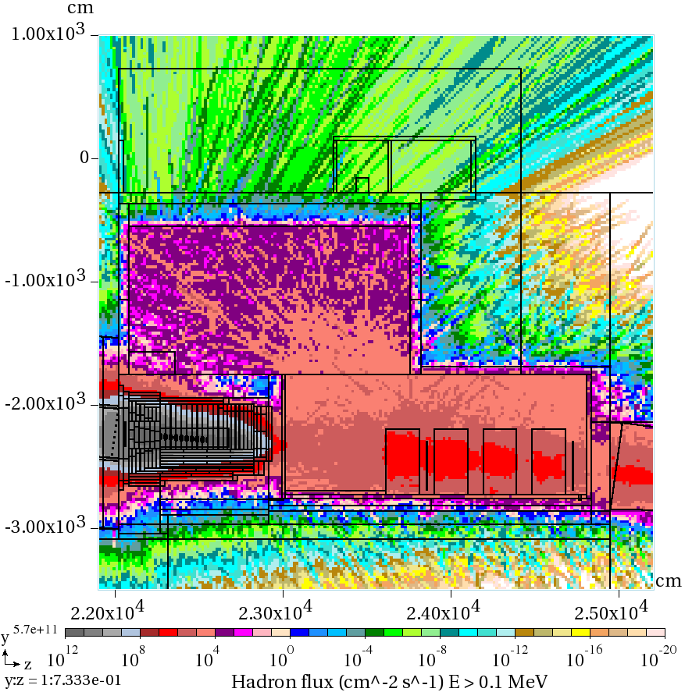
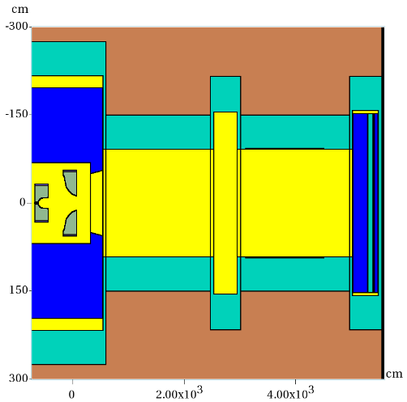
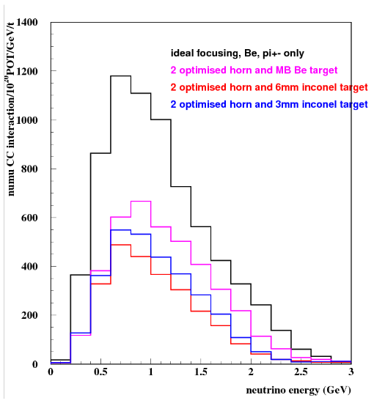
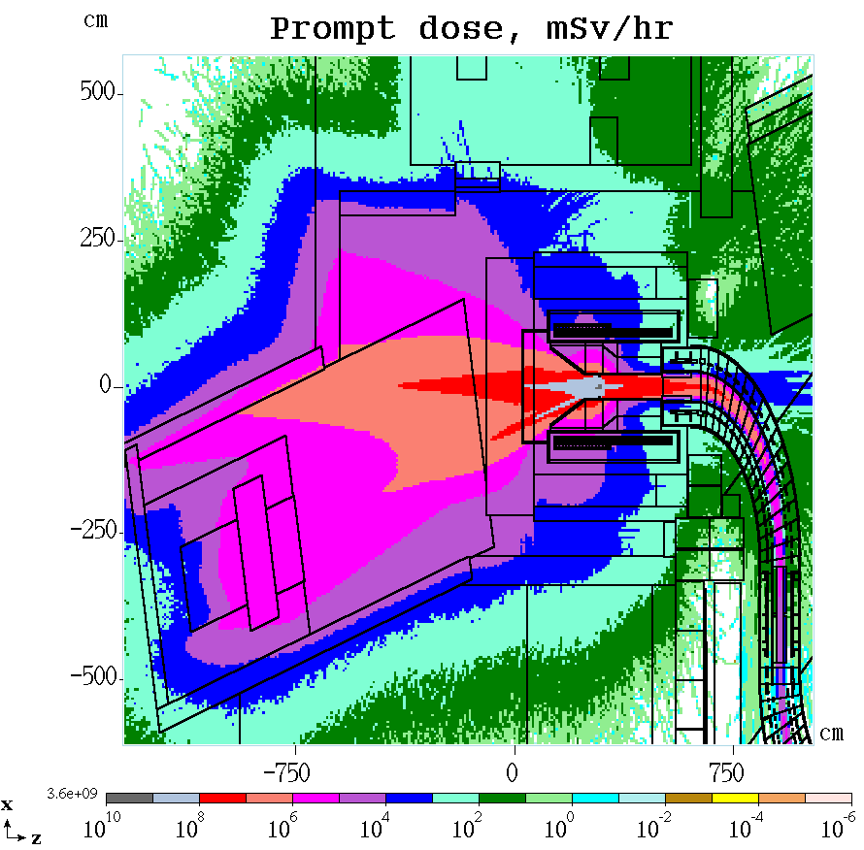
Recent MARS-Based Design Breakthroughs
ELBNF: from Main Injector, through primary/neutrino beamlines and absorber to Near Detector
Mu2e CD2/3 quality target station
BNB: New horn/target/collimator design and ν_{μ} CC rate
N.Mokhov, et al

Slide 23
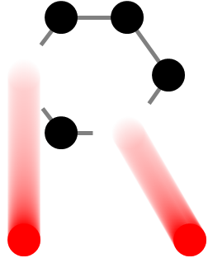
High Power Targetry R&D Status and Plans
RaDIATE Collaboration (Radiation Damage in Accelerator Target Environments)
  MOU revision (adding 7 institutions) received DOE approval
    NuMI beryllium beam window Post-Irradiation Examination (PIE) at Oxford
    Planning for low-energy ion irradiation studies at various universities
    Continuing PIE at BNL of irradiated graphite (2009)
  Other activities
    Design of compact fatigue tester for hot cell use
    Evaluation of new/upgraded irradiation facilities for HEP-HPT purposes
NuMI primary beam Be window dose map comparison
Radiographic film (left) versus MARS calculation (right) shows good agreement
Undergoing micromechanical evaluation of material properties
P.Hurh, R.Zwaska, et al

Slide 24
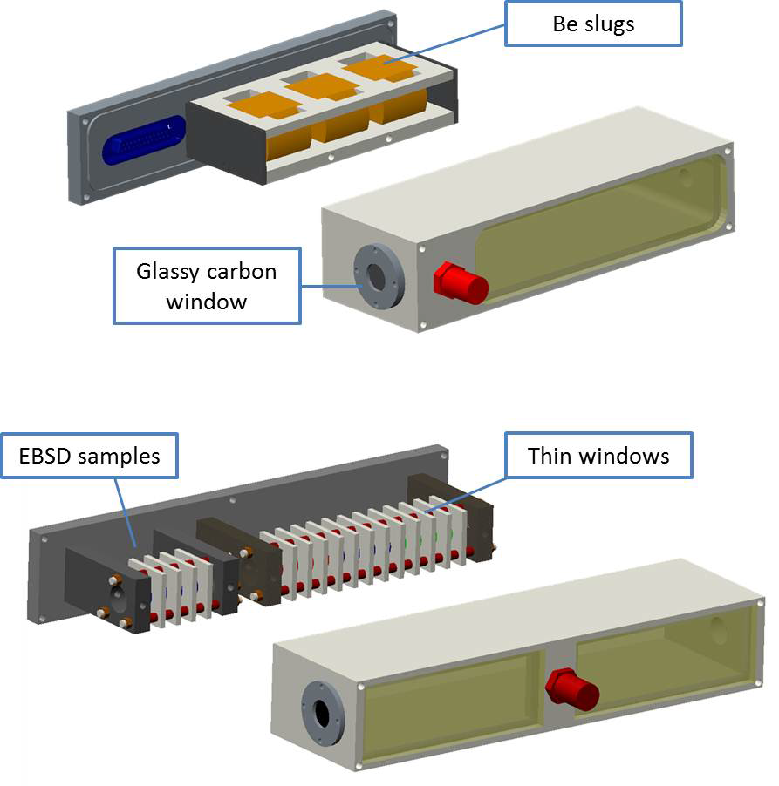
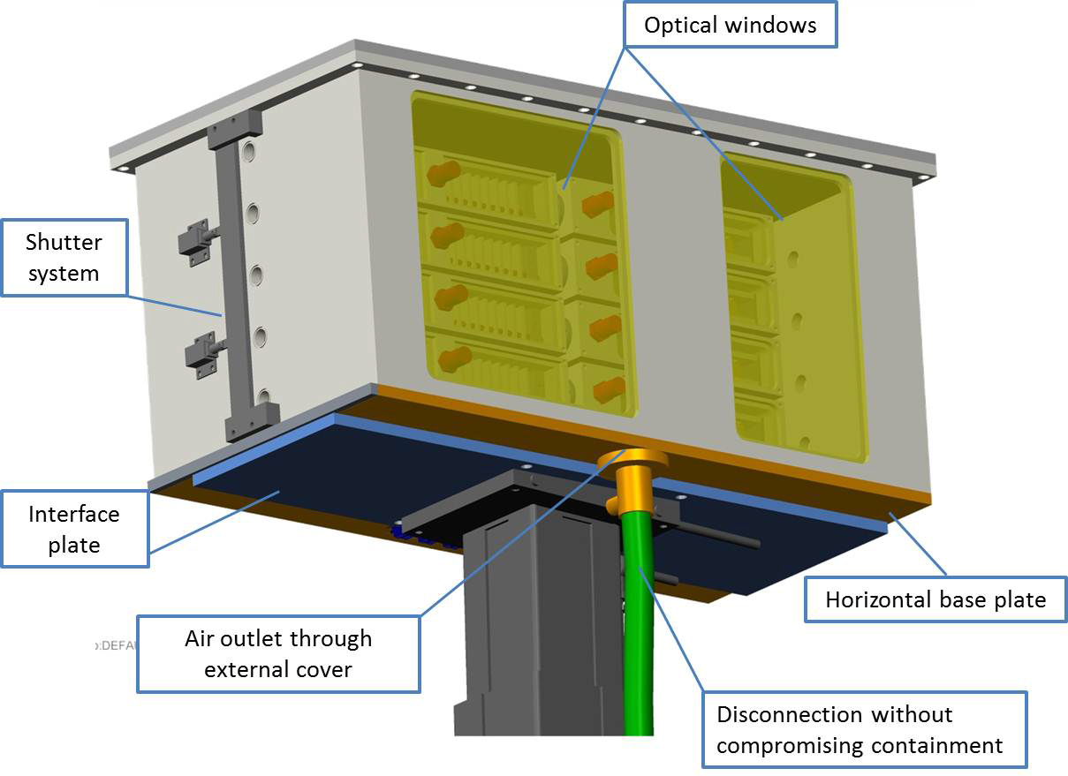
High Power Targetry R&D Status and Plans
Thermal Shock R&D activities
    Approval of BeGrid experiment at CERN’s HiRadMat beamline
    Test 4 grades of beryllium to varying intensity HE proton beam
    Objectives of the 4 institution study (FNAL, RAL-STFC, Oxford, CERN):
      Study the initiation of small scale damage from high intensity, single pulses
      Explore failure limits of Be
      Compare response of various grades/forms of Be
      Validate simulation techniques and strength/damage material models
P.Hurh, R.Zwaska, et al

Slide 25
Shaping Post-PIP-II Future
“Decade of R&D”
Page 25

Slide 26
P5 Report (2014): Strategic Considerations
(Near Future domestic program = PIP-II and LBNF)
Neutrinos: aim at ~600 kTon*MW*yr
“Power upgrades beyond PIP-II will require R&D for high average power proton linacs and target systems.”
“Support the discipline of accelerator science through advanced accelerator facilities and through funding for university programs.”
“Focus on outcomes and capabilities that will dramatically improve cost effectiveness for mid-term and far-term future.”
“Strengthen University - National lab partnerships.”
Incorporate the balance of mid-term vs far-term R&D as well as impacts.
→created HEPAP Subpanel to assess GARD program and recommend alignment to P5 priorities

Slide 27
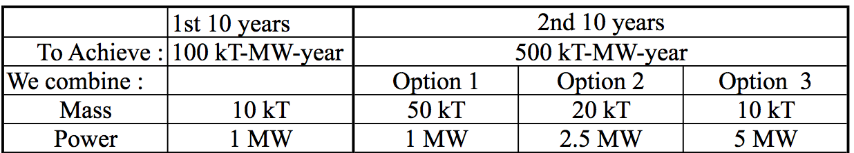
R&D to address future of FNAL complex
How to get to ~600 kTon*MW*yr ? →
The need in novel techniques for multi-MW beams and targets
  Mid-term strategy after PIP-II depends on the technical feasibility of each option and the analysis of costs/kiloton versus costs/MW
PIP-II
Beyond PIP-II (mid-term)

Slide 28
Accelerator Complex Now
120 GeV RCS
Main Injector
8 GeV
Recycler
0.4→0.7 MW
target
400 MeV
NC Linac
8 GeV RCS
Booster

Slide 29
“Near future”, PIP-II , ca 2023-24
120 GeV RCS
Main Injector
8 GeV
Recycler
1.2 MW
target
800 MeV
SC Linac
8 GeV RCS
Booster

Slide 30
PIP-III “multi-MW” - Option A: 8 GeV linac
120 GeV RCS
Main Injector
8 GeV
Recycler
>2-MW
target
8 GeV SC Linac
=0.8→3→8

Slide 31
PIP-III “multi-MW”- Option B: 8+ GeV smart RCS
120 GeV RCS
Main Injector
8 GeV
Recycler ?
>2 MW
target
new 8-12 GeV “smart” RCS
i-Booster
800 MeV
SC Linac

Slide 32
Post PIP-II : PIP-III -?
So far – a “thinking” towards:
Accelerator complex performance increased to “multi-MW”
  >2 MW… up to 5 MW
At “affordable” cost
  Do we know what’s affordable?
    E.g., 1.5B$ TPC Project-X was not
    0.97 B$ LCLS-II is “affordable” for DOE-BES
    0.4B$ PIP-II TPC to DOE-OHEP is “affordable”
The choice requires analysis, planning and R&D

Slide 33
PIP-III: Intelligent choice requires analysis and R&D
Either increase performance of the synchrotrons by a factor of 3-4:
  E.g. dQ_sc >1 → need R&D
  Instabilities/losses/RF/vacuum/collimation
  (see below on IOTA/ASTA R&D)
Or reduce cost of the SRF / GeV by a factor of 3-4:
  Several opportunities → need R&D
  (see Alex Romanenko’s talk, session 3E)
And – in any scenario – develop multi-MW targets:
  They do not exist now → extensive R&D needed

Slide 34
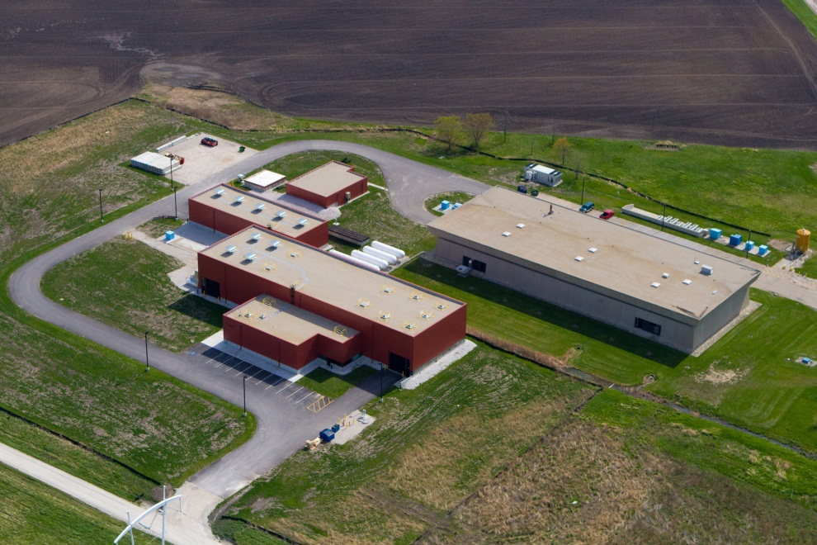
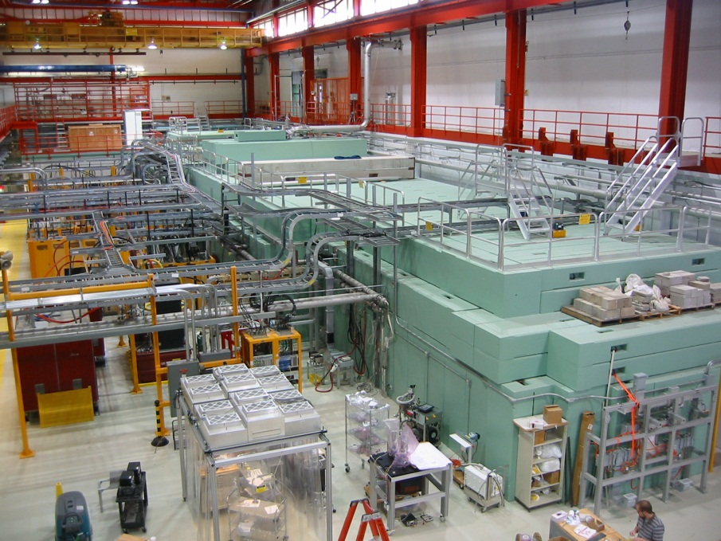
IOTA R&D Facility is (being) built to address feasibility of multi-MW
proton synchrotrons
* I’ll give just basic facts – more detail tomorrow in A.Valishev’s talk
IOTA = Integrable Optics Test Accelerator

Slide 35
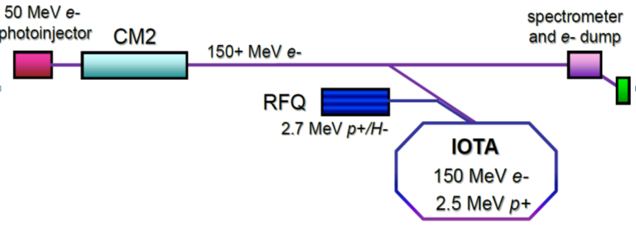
IOTA Schematic
IOTA/ASTA facility:
  IOTA storage ring
  electron injector based on existing ASTA electron linac
  proton injector based on existing HINS proton source.
The cost to complete construction ~6.5M$ in FY15-17
See also A.Valishev talk – session 6A

Slide 36
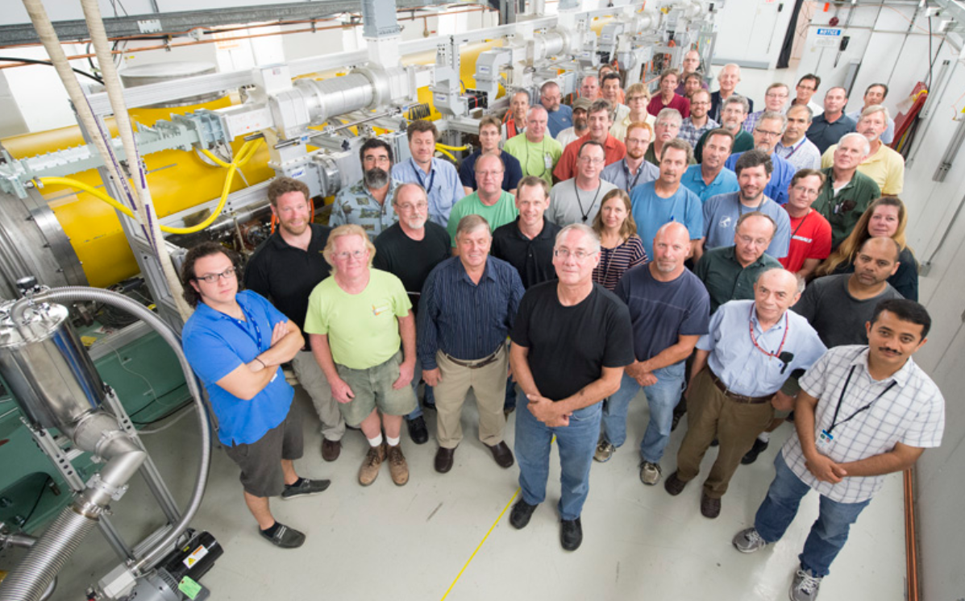
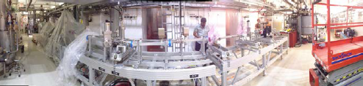
IOTA/ASTA : Fermilab’s Major Accelerator R&D Beam Facility
Unique R&D facility close to completion: IOTA ring, high-brightness photo-injector, SRF cryomodule, proton/H- RQF
~90M$ invested by OHEP since 2006
Science goal: Experimentally demonstrate novel techniques of integrable beam optics and space charge compensation, SRF research
Technical challenge: fabrication high-precision nonlinear magnets; injector for delivery of pencil electron beam and high-current low energy proton beam, beam thru SRF CM
FY14 highlights: Big part of IOTA ring built; commissioned 5 MeV e- injector and SRF CM2 at 250 MV
Partnerships
DOE labs: ANL,BNL,ORNL,Jlab,LBNL
U.S. universities: 6
International: 4
Operations start: 2017 (full IOTA)

Slide 37
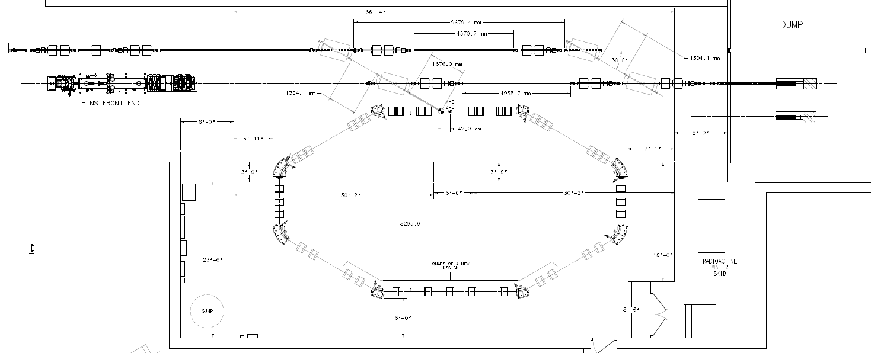
IOTA Ring: 40 m ; 2.5 MeV p+ or 150 MeV e-
e- beam line
p beam line
2.5 MeV RFQ
NL2
NL1
EL
OSC

Slide 38
IOTA/ASTA Construction Plan
FY14:
  Beam studies @ 5 MeV photoinjector injector
  Completed 25 MeV injector
  CM2 RF commissioning studies (no beam)
FY15:
  25-50 MeV beam thru full injector to beam dump, 1st experiments
  Start installation high-energy beamline from CM2 to HE dump
  Construction/fabrication of remaining IOTA elements
FY16:
  Finish HE beamline, ~300 MeV beam from CM2 to dump
  Finish IOTA construction & installation, 150 MeV e-beam to IOTA
  Move and install the HINS proton injector (50% completion)
FY17:
  HINS commissioned, inject protons in IOTA
  Full accelerator research program at IOTA (first – with electrons)

Slide 39
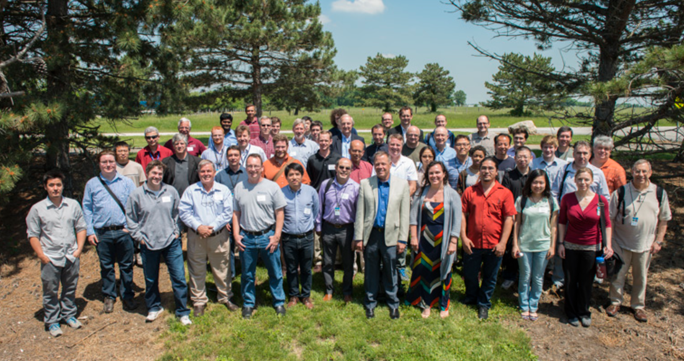
IOTA/ASTA Collaboration
participants of the 2nd ASTA Collaboration Meeting, June 2014

Slide 40
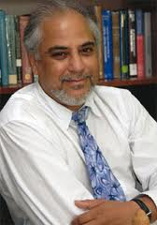
IOTA/ASTA – Centerpiece for Academic Partnership:
Collaborations with NIU, Universities of Chicago and Maryland
Cluster of research excellence is being established under direction of S. Chattopadhyay, joint appointee between FNAL and NIU
  Four NIU faculty working collaboratively with FNAL: three joint appointees with FNAL (S. Chattopadhyay, P. Piot and Y. Shin). The fourth collaborator (B. Erdelyi) a joint appointee of NIU and ANL;
  APC Director V. Shiltsev an Adjunct Professor at NIU;
  Three new faculty to be recruited for the NIU-FNAL accelerator research cluster;
  NIU-FNAL research cluster faculty are to work seamlessly with FNAL accelerator and engineering staff on :
  (i) beam dynamics and technology problems of FNAL accelerator complex;
  (ii) develop an advanced scientific program on IOTA;
  (iii) enhance and stimulate further education, training and outreach in accelerators;
Collaboration with Univ. of Chicago
  The first accelerator science ‘professor part-time’ from FNAL appointed: S. Nagaitsev. Research program under evolution.
Synergistic Collaboration with Univ. of Maryland
  Investigation of space-charge dominated nonlinear dynamics in novel “smart boosters” via complementary research on IOTA and UMER: (R. Kishek et al)
S.Chattopadhyay, et al

Slide 41
Far Future HEP Accelerators,
Long-term Accelerator R&D
Page 41

Slide 42
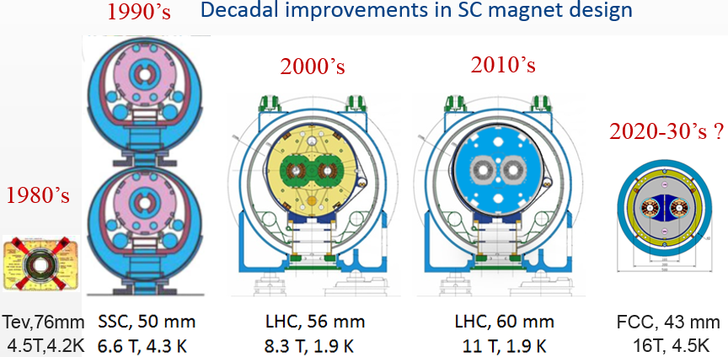
P5 Priority: Future 100 TeV Scale p-p Collider R&D
Biggest Challenge: Cost Effective High Field SC Magnets
A.Zlobin, G.Apollinari, T.Sen, et al
Major goal for FNAL HFM GARD Program: ~16 T SC Magnet Development – see A.Zlobin’s talk , session 7A
Many serious beam physics issues (B-B, SR, MDI, etc): modest involvement to capitalize on the Tevatron experience

Slide 43
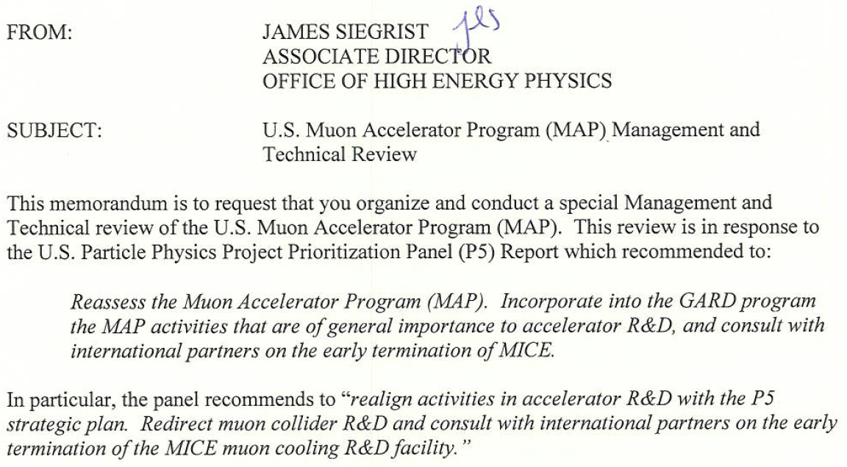
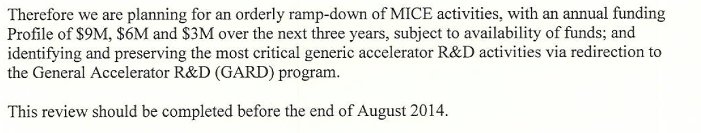
P5 item: Muon Accelerator Program and MICE
After the P5 recommendations, OHEP (J.Siegrist) requested a review to determine how to handle the MAP recommendations:
M.Palmer, K.Yonehara, D.Bowring, et al
  Review 08/12-14/14: a) support “reduced” MICE effort to demonstrate ionization energy loss combined with RF re-acceleration of the muons (the complete cooling process) by 2017; b) GARD items identified

Slide 44
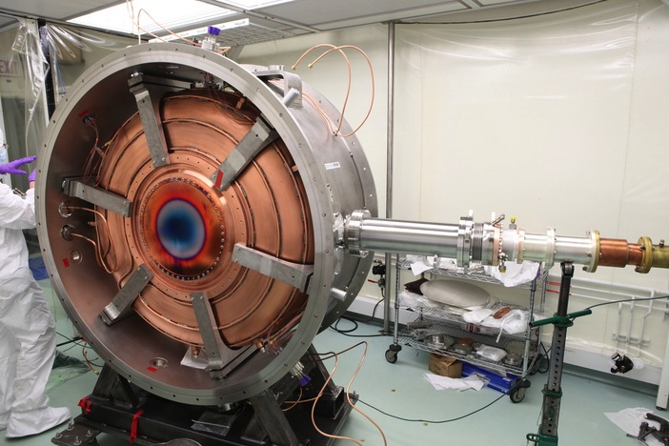
MICE-”4.5”: Expedited Muon Cooling Demonstration
Legend:
-SS = Spectrometer Solenoid-
-FC = Focus Coil-
-AFC = Absorber-Focus Coil Module-
-RFA = RF-Absorber Module-
Plan developed in response
to P5 recommendations
Operational 2015
-Absorber-
-Tracker1-
-FC-
-Tracker2-
Represents reduced cost and technical risk relative to MICE Step V
-SS1-
-AFC-
-SS2-
Operational
2017
Secondary
-Absorber1-
Primary
-Absorber-
Secondary
-Absorber2-
NEW
Expedited
MICE Final
Configuration
-Tracker1-
-FC1-
-FC2-
-Tracker2-
-SS1-
RFA1-
-AFC1-
-AFC2-
RFA2-
-SS2-

Slide 45
Summary
Fermilab is a world leader in Accelerator Science and Tech
Lab’s Accelerator R&D program is (being) realigned to address the P5 report recommendations, with focus on:
  Cost-effective approaches to multi-MW proton beams
    SRF and space-charge dominated rings
  High power targets
  High field magnets for 100-TeV scale pp collider
  Maintain core competencies in accelerator science, design and modeling; accelerator training
IOTA - the leading accelerator R&D beam facility - is being built and commissioned in FY15-17
Collaboration with Universities in accelerator science and technology is healthy and growing

Slide 46
Back up slides

Slide 47
16 APS Fellows are involved in Fermilab’s Accelerator R&D
E.Barzi
A.Bross
S.Geer
E. Prebys
H.Edwards
H.Padamsee
S.Holmes
S.Mishra
V.Lebedev
N.Mokhov
S.Nagaitsev
D.Neuffer
V.Shiltsev
A.Tollestrup
V.Yarba
A.Zlobin
S. Nagaitsev | Accelerator R&D HEPAP Subpanel meeting

Slide 48
Also…
Awards:
  APS Wilson Prize 2014 H.Padamsee
  DOE Early Career 2013 A. Grassellino
  DOE Early Career 2012 P.Snopok, T.M.Shen, A.Romanenko
  APS Thesis 2010 R.Miyamoto
  IEEE PAST 2009 K.Seyia
Editors and Editorial Boards
  W.Chou ICFA Beam Dynamics Newsletter , RAST
  L.Cooley Superconductor Science and Technology
  V.Shiltsev Phys. Rev. ST-AB, JINST
Referees for Peer-Review Journals
  Phys. Rev. Letters, Phys. Rev. ST-AB, JINST, NIM-A, IEEE Trans. Nucl. Sci., Review of Scientific Instruments, European Physical Journal, Physics Procedia, NIM-B, NIM-B Proc, Prog. Nucl.Sci.Tech.
  APS Outstanding Referee - V.Lebedev 2015, T.Sen 2013 ,
Membership in Program and Organizing Committees of all major accelerator conferences and workshops:
  IPACs, NA-PACs, AAC, HB, BIW, LINAC, RESMM, SRF, MT, etc
S. Nagaitsev | Accelerator R&D HEPAP Subpanel meeting

Slide 49
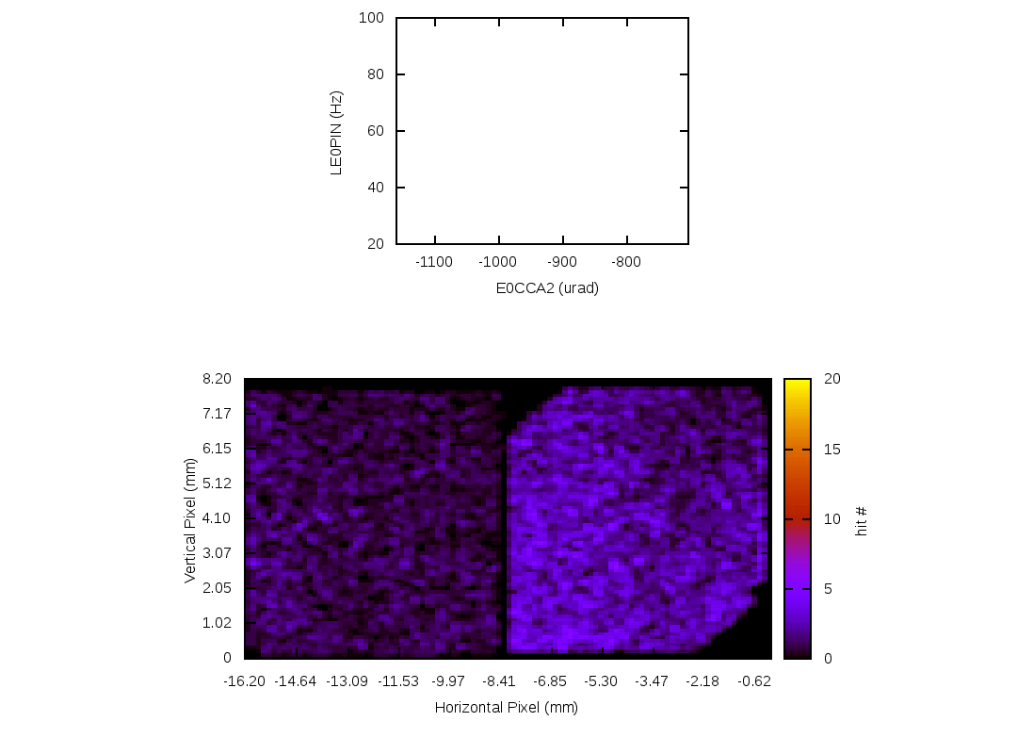
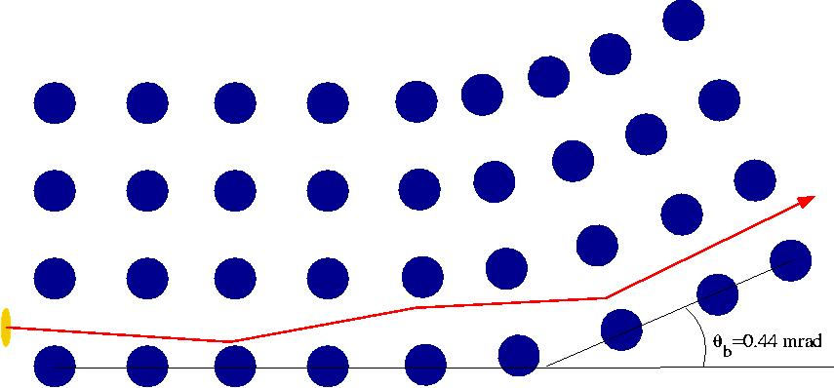
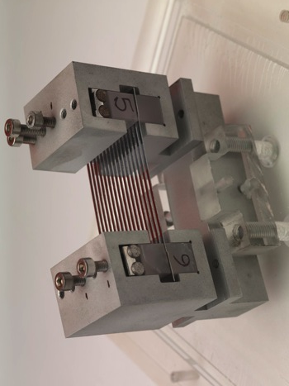
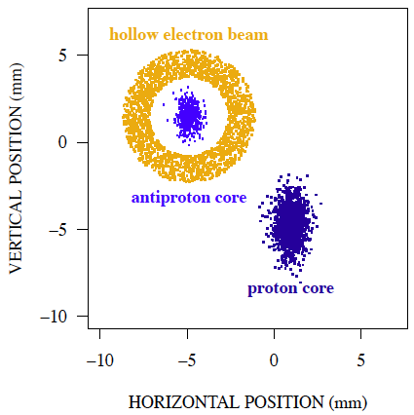
Novel Halo Collimation Methods
Hollow Electron Beam
Bent Crystal Collimation
A hollow el beam (Tevatron electron Lens)
No E-field inside
Strong E-field ouside drives resonances
Fast diffusion = “soft collimator” effect
Works near beam as well (no material)
1
Loss Rate
2
Crystal Angle
5
G. Stancari et al., PRL 2011
T980 Results
D. Still et al. IPAC12
N.Mokhov, et al JINST
6 T08005 (2011).
Channeled beam image on pixel detector

Slide 50
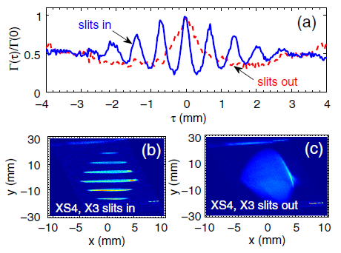
Transverse-to-longitudinal phase space exchange
Demonstrated transverse to longitudinal emittance exchanges
Demonstrated bunch current profile shaping
Y.-E. Sun et al., PRL 105, 234801 (2010)
P. Piot et al., PRSTAB 14, 022801 (2011)
J. Ruan et al., PRL 106 244801 (2011)

Slide 51
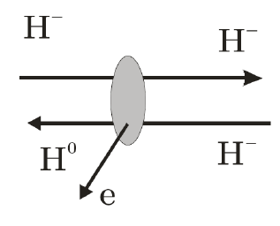
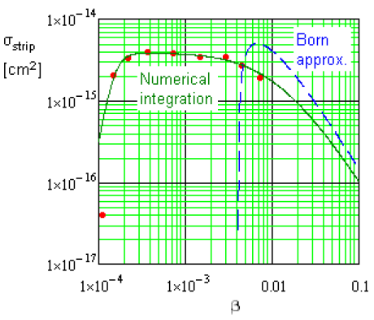

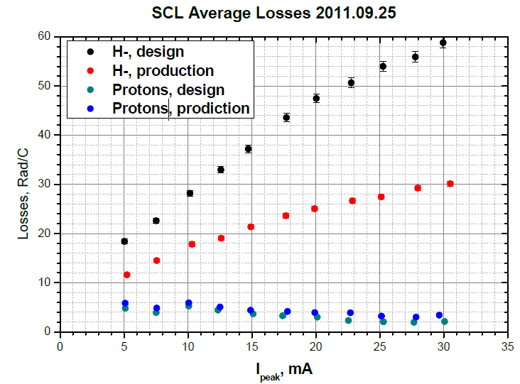
New Effect: Intrabeam Stripping of H- in linacs
Predicted by V.Lebedev:
  H⁻ + H⁻ -> H⁻ + H⁰ + e (intrabeam stripping) leads to losses and can explain higher than expected losses in in the SNS linac
Theory was developed together with SNS colleagues
Experimental beam studies:
  comparison of beam loss in the superconducting part (SCL) of the SNS for H⁻ and protons
  observed significant reduction in the beam loss for protons
A. Shishlo, V. Lebedev, et al
PRL 108, 114801 (2012)
V. Shiltsev, Proc. 3rd CARE-HHH-APD
G. Stancari et al., PRL 2011

Slide 52
GARD Thrusts (FNAL Proposal to the GARD Subpanel)
High-field magnets and materials
Multi-MW beams and targets
Cost-Effective SRF Technology
Advanced Accelerator Concepts
Accelerator Science, Modeling & Design
Core Accelerator Competencies

Slide 53
GARD Thrusts: Rationale and Goals
High-field magnets and materials
  Long-term; maintain US leadership in SC magnets; Nb₃Sn, HTS
  Significant T*m cost reduction, modest support of global design
Novel techniques for multi-MW beams and targets
  Mid-term strategy after PIP-II depends on the technical feasibility of each option and the analysis of costs/kiloton versus costs/MW
  R&D on effective control of beam losses in proton machines with significantly higher currents (Q_{SC}) and on multi-MW targets
PIP-II
Beyond PIP-II (mid-term)

Slide 54
GARD Thrusts: Rationale and Goals (2)
Cost-Effective SRF Technology
  Crucial enabling technology for accelerators
  Aim at a substantial reduction in construction and operation costs
  Improve gradients, increase Q-factor, study new materials;
  Affects both far- and mid-term accelerators
Advanced Accelerator Concepts
  Conceptual and technical feasibility of advanced collider concepts; aim at HEP applications and significant total cost reduction
  Intense secondary beams for next-generation precisions experiments (such as “beyond mu2e”, “beyond g-2” and a NF)
  Both long- and mid-term

Slide 55
GARD Thrusts: Rationale and Goals (3)
Accelerator Science, Modeling and Design
  Conceptual design and modeling of new machines
  Cross-cutting accelerator theory and experiments
  Excellence in high-performance high-fidelity computer modeling
  Combination of both mid-term and long-term efforts
Core Accelerator Competencies
  Accelerator training and education for HEP and beyond
    Jointly - Universities and National Labs
  Novel particle sources; Advanced beam instrumentation
  NC rf and cost-effective rf sources
  Both mid-term and long-term efforts

Slide 56
Integrable Optics

Slide 57
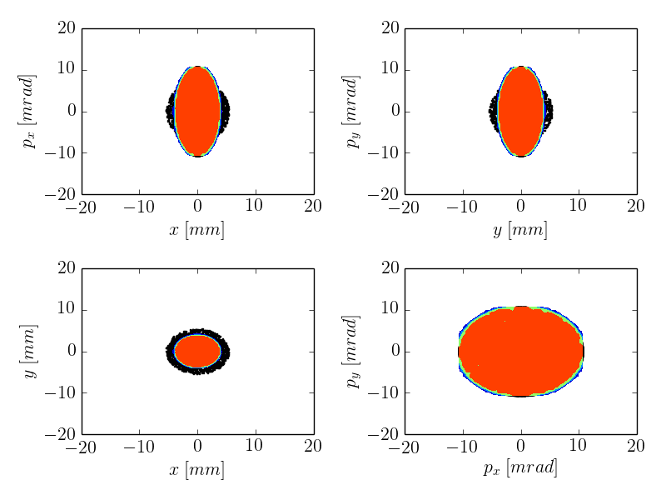
Space Charge in Linear Optics
ΔQ_{sc} ~ –0.7
System: linear FOFO 100 A linear KV w/mismatch
Result: quickly drives test-particles into the halo
Tech-X, RadiaSoft simulation

Slide 58
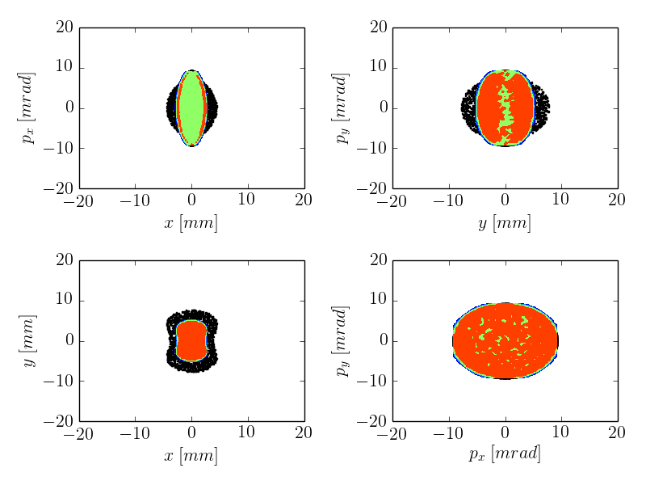
Space Charge in NL Integrable Optics
ΔQ_{sc} ~ –0.7
System: linear FOFO 100 A linear KV w/mismatch
Result: nonlinear decoherence suppresses halo
Tech-X, RadiaSoft simulation

Slide 59
Resources needed
 | FY15 | FY16 | FY17 | Sum
e⁻ injector (finish HE beamline) | 6.8 FTE 540k$ M&S 2,100k$ |  |  | 6.8 FTE 540k$ 2,100k$
IOTA (build and commission) | 2.9FTE 580k$ M&S 1,230k$ | 2.2 FTE 270k$ M&S 770k$ |  | 5.1 FTE 850k$ 2,000k$
p injector (move and commission) |  | 2.4 FTE 680k$ M&S 1,230k$ | 2.4 FTE 580k$ M&S 1,130k$ | 4.8 FTE 1,260k$ 2,360k$
Total Construction | 9.7 FTE 1,120k$ M&S 3,330k$ | 3.6 FTE 950k$ M&S 2,000k$ | 2.4 FTE 580k$ M&S 1,130k$ | 15.7 FTE 2,650k$ 6,460k$
Research | 4.4 FTE 0k$ M&S 1,140k$ | 5.2 FTE 160k$ M&S 1,410k$ | 5.5 FTE 360k$ M&S 1,800k$
User Support | 4.6 FTE 160k$ M&S 1,220k$ | 6.0 FTE 350k$ M&S 1,730k$ | 6.8 FTE 350k$ M&S 1,910k$
Facility Operations | 2.5 FTE 320k$ M&S 890k$ | 3.5 FTE 650k$ M&S 1,450k$ | 4.5 FTE 670k$ M&S 1,590k$
TOTAL | 6,580k$ | 6,590k$ | 6,430k$ | 19,600

Slide 60
Proposed ASTA Funding in FY 15, 16, 17
 | FY15 | FY16 | FY17 | Comm.
TOTAL Req’d | 6,580k$ | 6,590k$ | 6,430k$ | (see previous slide, bottom)
GARD for ASTA | 2,250k$ | 2,300k$ | 2,300k$
SRF & 18 (scenario 1) | 3.0FTE=690k$ M&S =330k$ 1,020k$
AD NML Facility Ops** | 3.3FTE=760k$ M&S =0k$ 760k$ | 3.3FTE=760k$ M&S =0k$ 760k$ | 3.3FTE=760k$ M&S =0k$ 760k$
NEED DOE suppl | 2,550k$ | 3,530k$ | 3,370k$ | 9,450k$

Slide 61
IOTA/ASTA Resources in FY18 and beyond
 | FY18
Research | 5.5 FTE 420k$ M&S 1,860k$
User Support | 7.3 FTE 350k$ M&S 2,070k$
Facility Operations | 4.8 FTE 670k$ M&S 1,590k$
Total ASTA | 17.6 FTE 1,440k$ M&S 5,660k$
Out of: KA2501012 KA2202021 | 4,900k$ 760k$
Notes:
consolidated and funded programmatically?

Slide 62
Accelerator R&D and Test Facilities
Facility | Purpose | Beam-type | Energy | uniqueness | status
ASTA | SRF, energy & intensity frontier | e⁻ | 50 MeV and 300 MeV | High repetition rate, high peak & average bright-ness beam | Commissioning, ~20 MeV electrons expected in CY 2014
IOTA | R&D towards multi-MW beams | e⁻/p | 2.5 MeV (p) 150 MeV (e⁻) | Ring suited for integrable optics and SC-compen-sation expt’s | Under construction, operational estimated in 2017
PXIE | PIP-II, intensity frontier | p | 30 MeV | High-I CW, SRF, chopped beams | Ion source operational
CMTS-1 | SRF cryomodule testing | n/a | n/a | CW and pulsed RF at various frequencies | Under construction, operational FY2016
VTS | SRF, energy frontier | n/a | n/a | 325/650/1300 MHz bare cavities | 2/3 stands operational
MDB | SRF, energy & intensity frontier | n/a | n/a | 325/650/1300/ 3900 MHz dressed cavities and couplers | 3/4 areas operational
SC magnet | Energy frontier | n/a | n/a | 1.9K-4.5K, 30kA ∅0.6m x 3.7m | Operational
HBESL | e⁻ source R&D, stewardship, education, energy frontier | e⁻ | ≤5 MeV | Electron source coupled with multiple laser systems, emittance exchange | Operational
MI-8 targetry | High Power Targetry, intensity frontier | n/a | n/a | 200 kA pulsed PS for horn testing, CNC TIG welder | Operational
MTA | Muon source R&D | p/H- | 400 MeV | Combination of beam, RF, SC magnet, cryo | Operational

