Slide 1
Accelerator and Beam Physics Program at IOTA/FAST:
Status and Plans
Vladimir Shiltsev
DOE/OHEP briefing
December 17, 2015

Slide 2
Content
High Level Rationale & Scope for IOTA/FAST
  P5, HEPAP/GARD Subpanel, Goals, Milestones
2015 IOTA/FAST – impressive achievements
  Construction/commissioning progress/timeline/issues
2016 IOTA/FAST – key R&D beam facility
  Plans, issues
2017 & beyond, R&D, Collaborations, etc
  - IOTA Science Workshop April 28-29, 2015

Slide 3

IOTA/FAST in the GARD Program
Recommendation 2. Construct the IOTA ring, and conduct experimental studies of high-current beam dynamics in integrable non-linear focusing systems. (p. 9, 18)
  GARD thrust: Accelerator and Beam Physics
Recommendation 3. Support a collaborative framework among laboratories and universities that assures sufficient support in beam simulations and in beam instrumentation to address beam and particle stability including strong space charge forces. (p. 9, 17)
  GARD thrust: Accelerator and Beam Physics

Slide 4
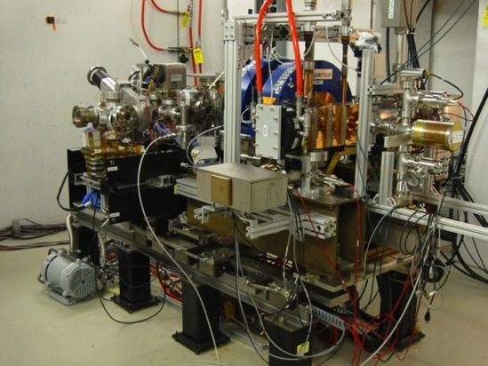

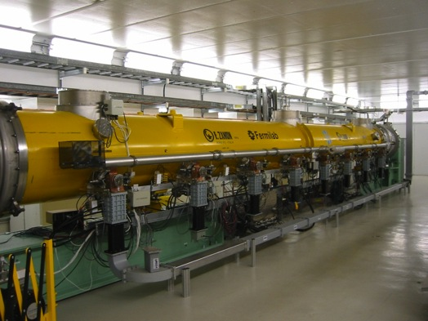
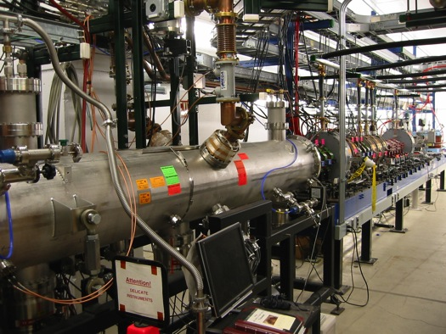
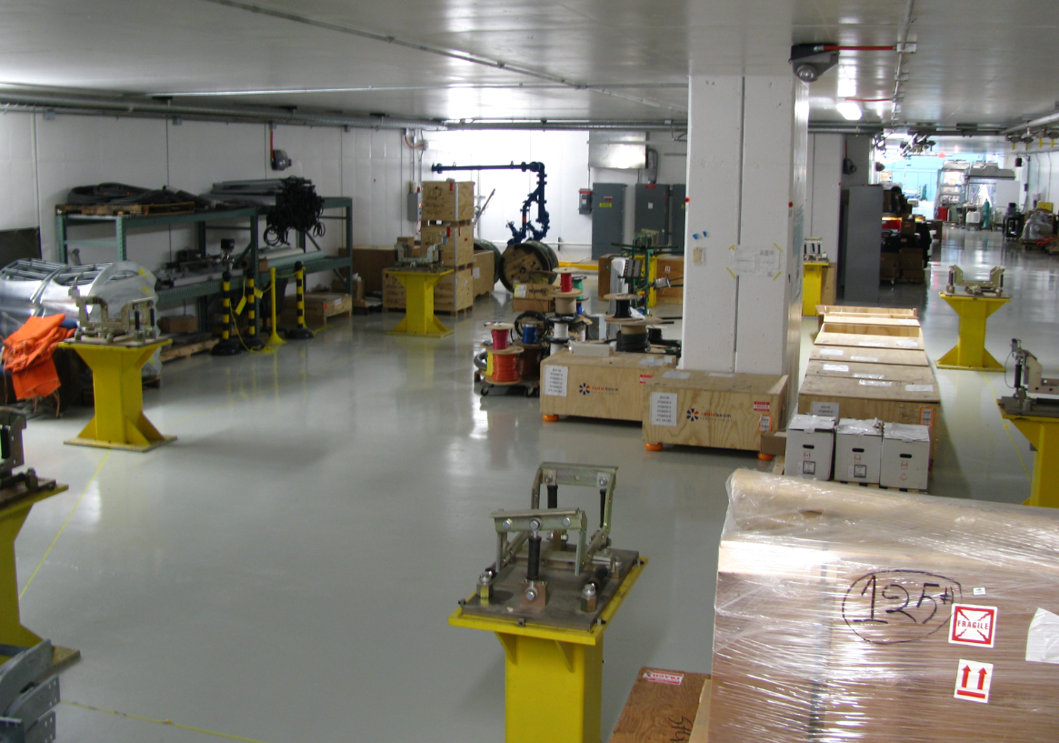
IOTA @ Fermilab Accelerator Science and Technology
Need accelerator R&D beam facilities !
facility

Slide 5
IOTA/FAST Plan
contingent on funding
(see below)
Phase 1: FY15 -19 *
Construction of main elements of the FAST/IOTA facility:
  electron injector based on existing FAST electron linac
  IOTA ring
  proton injector based on existing HINS proton source
  special equipment for IOTA experiments.
Commissioning of the IOTA ring with 150 MeV/c electron beam – FY17/18 *
  need electrons to be able to measure beam optics to <1 %
Research single-particle dynamics in integrable optics with pencil electron beams – FY18/19 *
  need pencil e- beam to quantify phase-space dynamics

Slide 6
IOTA/FAST Plan
contingent on funding
(see below)
Phase 2: FY20* - ca FY24
Commission IOTA operation with 70 MeV/c proton beams
Research space-charge compensation with nonlinear optics and electron lenses.
  Study the application of space-charge compensation techniques to next generation high intensity machines.
Expand the program beyond these high priority goals to allow Fermilab scientists and a broader accelerator HEP community to utilize unique proton and electron beam capabilities of the FAST/IOTA facility

Slide 7
FAST Program Organization
S.Nagaitsev, CAO
V.Shiltsev, APC
FAST Program Director
Construction and Commissioning
Beam Physics Research
J.Leibfritz, MS
Construction
Installation, Engin’ng
Facility Operations
A.Valishev, APC
IOTA Construction
Commissioning
Beam Operations
A.Valishev, APC
Intensity Frontier Exps
Space-Charge Collab’n
S.Chattopadhyay,NIU
Advanced Physics Exp’s
University Collaborations
International Collaborations
A.Valishev, APC
Integrable Optics experiments (e-/p+)
E.Harms
SRF Installation
SRF Commissioning
D.Broemmelsiek
Beam Commissioning
Beam Operations
Opt.Stoch.Cooling
(V.Lebedev, et. al)
Single e- Correl.
(Swapan C., et. al)
Channeling X-ray
(P.Piot, et. al)
other experiments
G.Stancari, APC
e-lens program, Space -Charge Compensation
E.Prebys, APC
RFQ Re-Commiss’ing
RFQ Relocation

Slide 8
Resources for FAST/IOTA at FNAL
FAST/IOTA is a significant and recognized effort at Fermilab – one of the Director’s “Top 10 Fermilab Priorities”
Quite complex now:
  Construction, installation, commissioning, research
FAST/IOTA Department in Accelerator Division / Accelerator Physics Center – led by Dr. Alexander Valishev
  Department of 15 (scientists, engineering physicists, engineers, technicians)
  Mission: IOTA/FAST construction, operation, and research
  Other involvements (fractions on LCLS-II/CMTS, PXIE, LARP, LDRD)
  3 graduate students
Support of AD service departments
  Mechanical Support, Electrical Eng. support, Controls, Cryo, ESH, etc
Support of TD (Magnets department)

Slide 9
Fermilab Accelerator Science and Technology facility ( FAST )
Construction:
  DOE/OHEP proposal (2014): est. 18.7M$ over 2015-2017
  Funded by GARD, no extra $$, limited and flat support
    FY16 9.6FTEs+726k$M&S=2,060k$ direct, or about 3.5M$ fully loaded
  significant schedule slip w.r.t. “original optimistic plan” (ca Q1 2014)
start R&D
e- 2017
p+2018

Slide 10
IOTA/FAST Research Start vs $$
Timeline with $$ “as is”
with extra $1.5M in FY16-18
FY15 | 20 MeV e- commissioned HE beam line 30% IOTA parts 50%
FY16 | 50 MeV e- commissioned HE beam line 100% IOTA parts 80%
FY17 | 150 MeV CM2 to dump IOTA installed
FY18 | IOTA e- commissioned IOTA research starts with e-
FY19 | Proton RFQ move 50%
FY20 | Proton RFQ move 100% Proton RFQ commissioned IOTA research starts with p+
FY15 | 20 MeV e- commissioned HE beam line 30% IOTA parts 50%
FY16 | 50 MeV e- commissioned HE beam line 100% IOTA parts 80%
FY17 | 150 MeV CM2 to dump IOTA e- commissioned IOTA research starts with e-
FY18 | Proton RFQ moved 100% p+ RFQ commissioned
FY19 | IOTA research starts with p+
FY20 | (IOTA research continues)

Slide 11
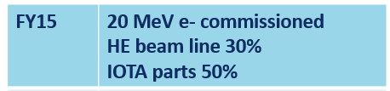
(2) FAST /IOTA in 2015

Slide 12
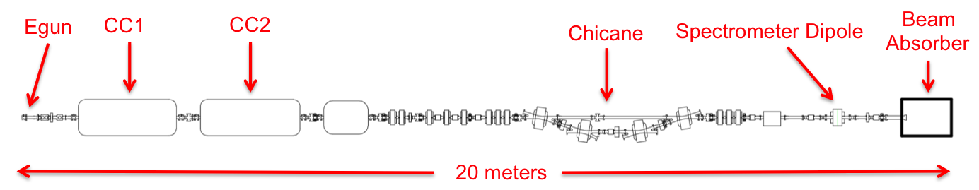
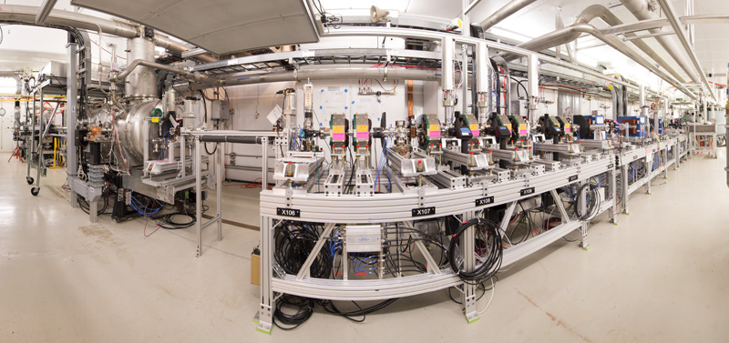
IOTA Electron Injector @ FAST

Slide 13
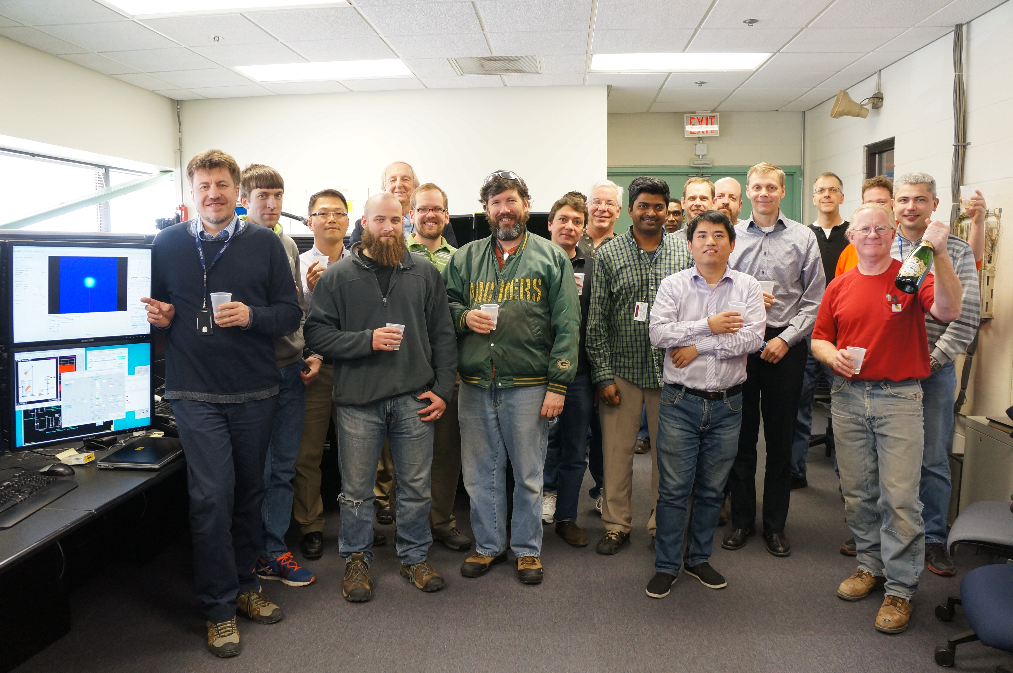
20MeV e⁻ beam through FAST injector
March 27, 2015

Slide 14
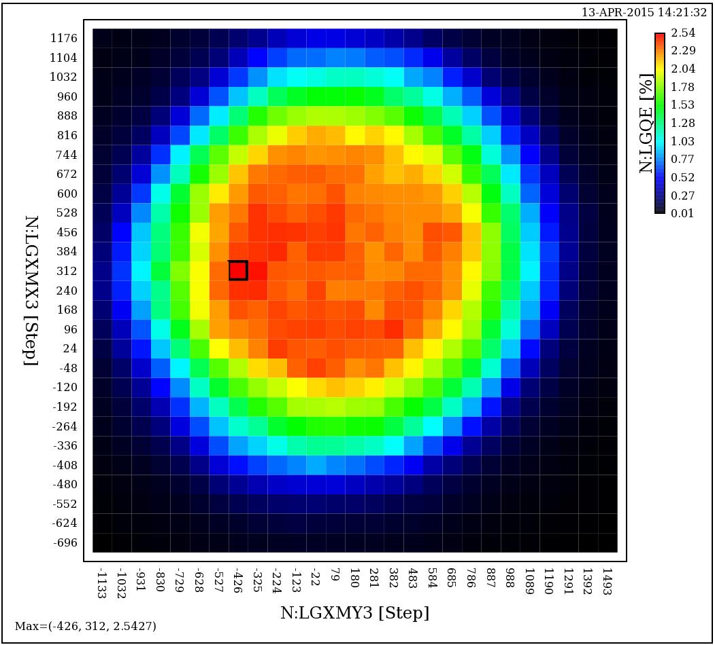
e- Photo Injector: characterization
Cathode QE Scan

Slide 15
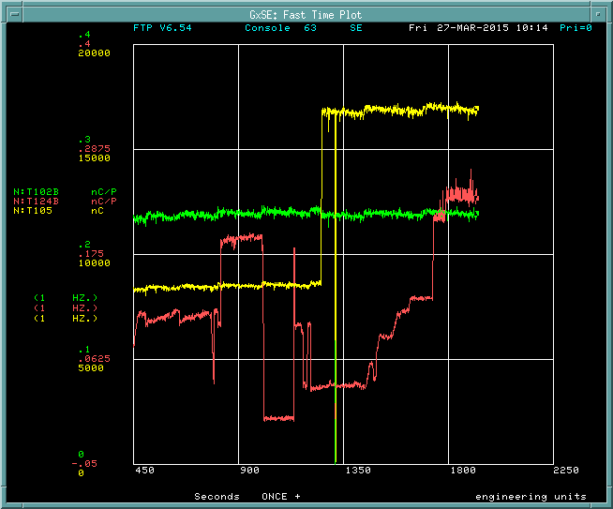
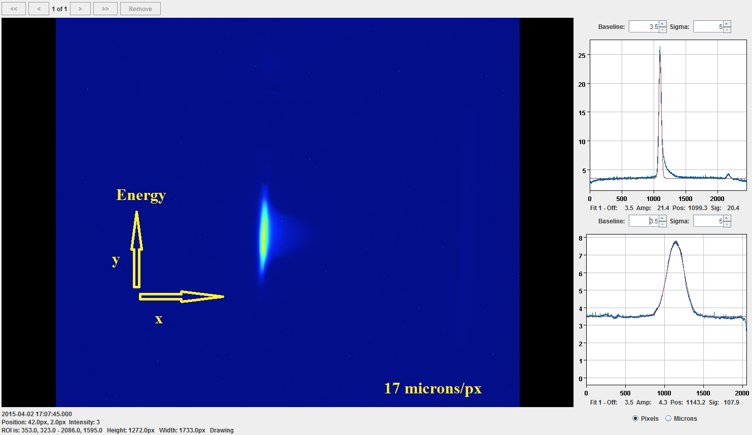
First Beam to Low Energy Absorber

Slide 16
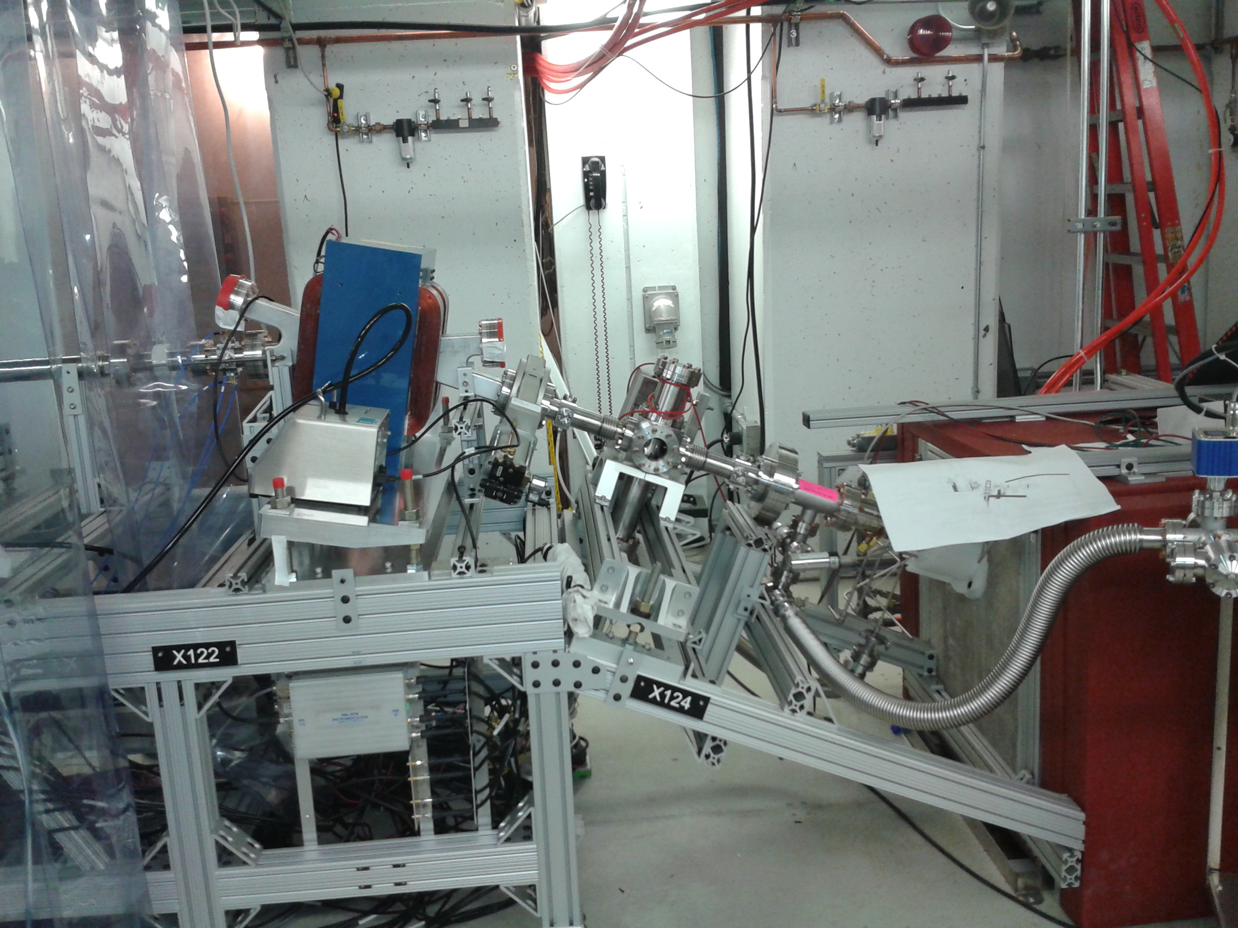
Energy Measurement: Beam thru Dipole

Slide 17
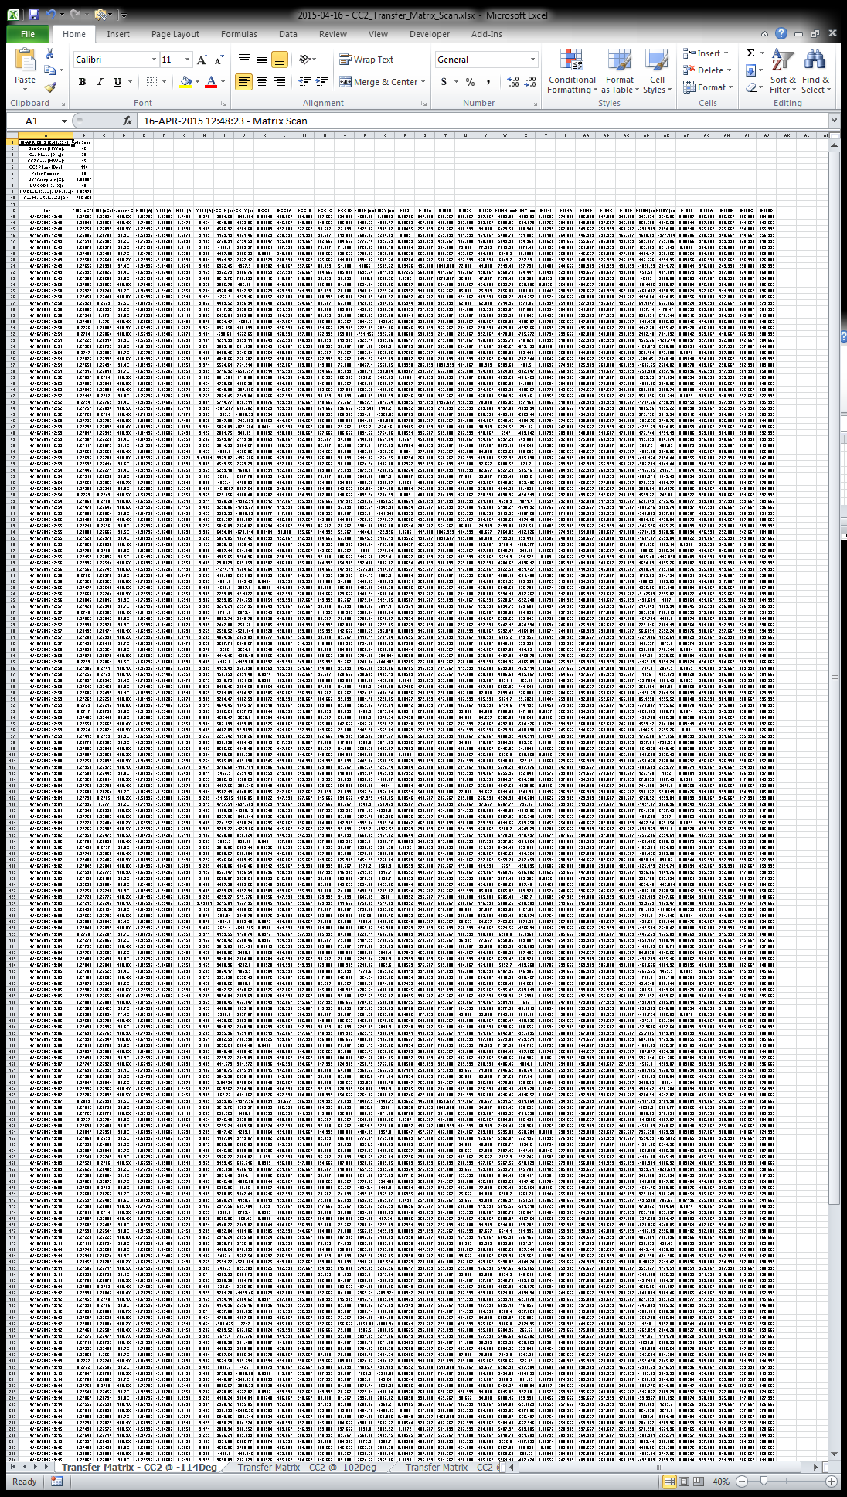
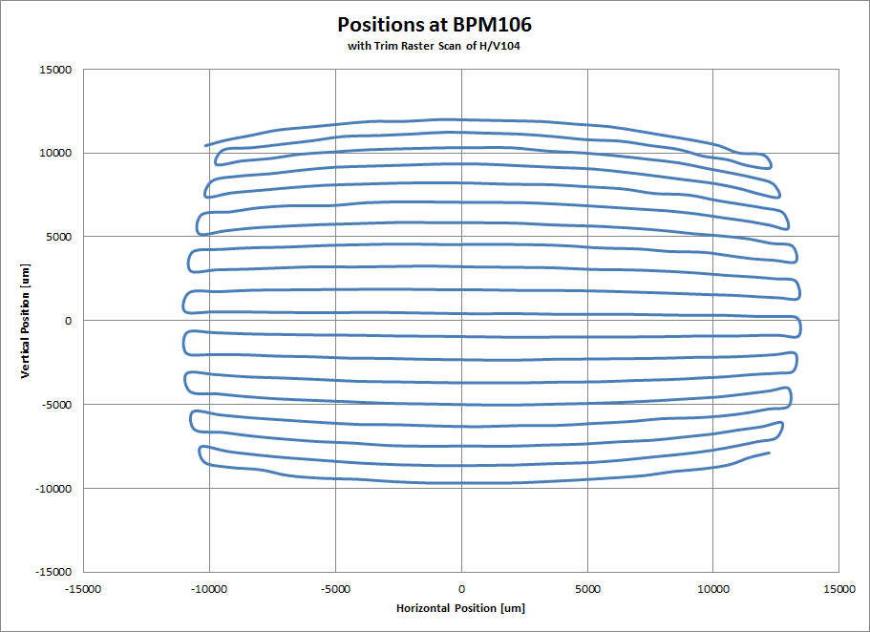
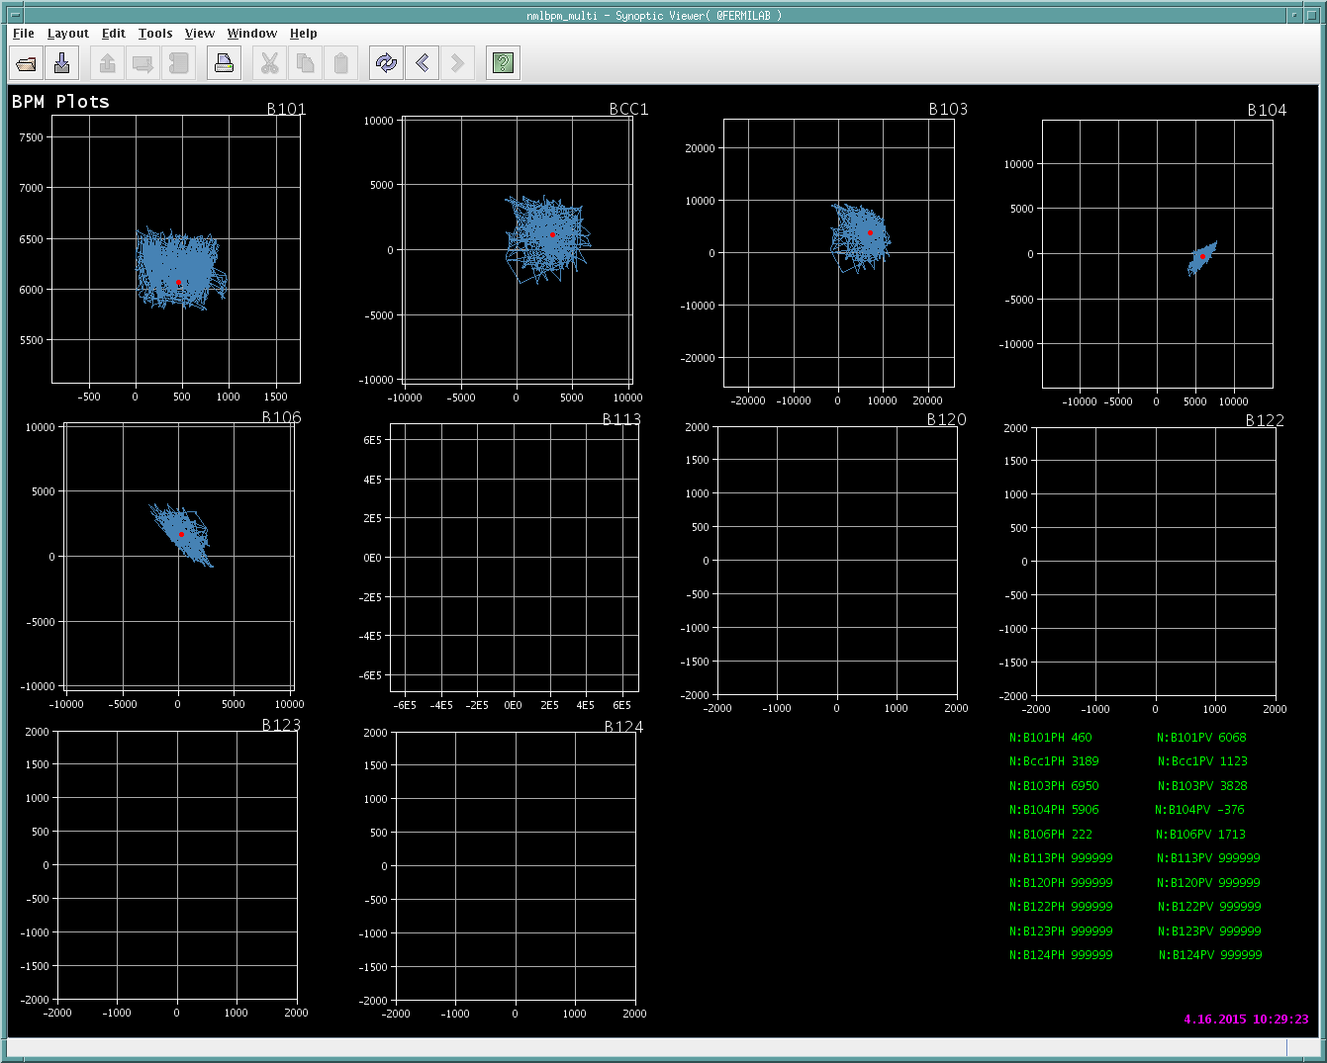
Tesla cavity/CC2 ransfer matrix measurement

Slide 18
FY15 e- Injector Commissioning Activities
Extensive checkout list:
Instrumentation
  9 BPMs, 2 Toroids, 1 WCM, Loss Monitors, Imaging Stations
Machine protection system
Machine stability and reproducibility
Quad scan emittance measurements
Beam based trajectory alignment
Typical parameters:
Bunch charge | 0.25 nC
Gun gradient | 42 MV/m
CC2 gradient | 16 MV/m
Beam energy | 20 MeV
Bunch length | 6-8 ps (rms)
Notes:
2 months of operations

Slide 19
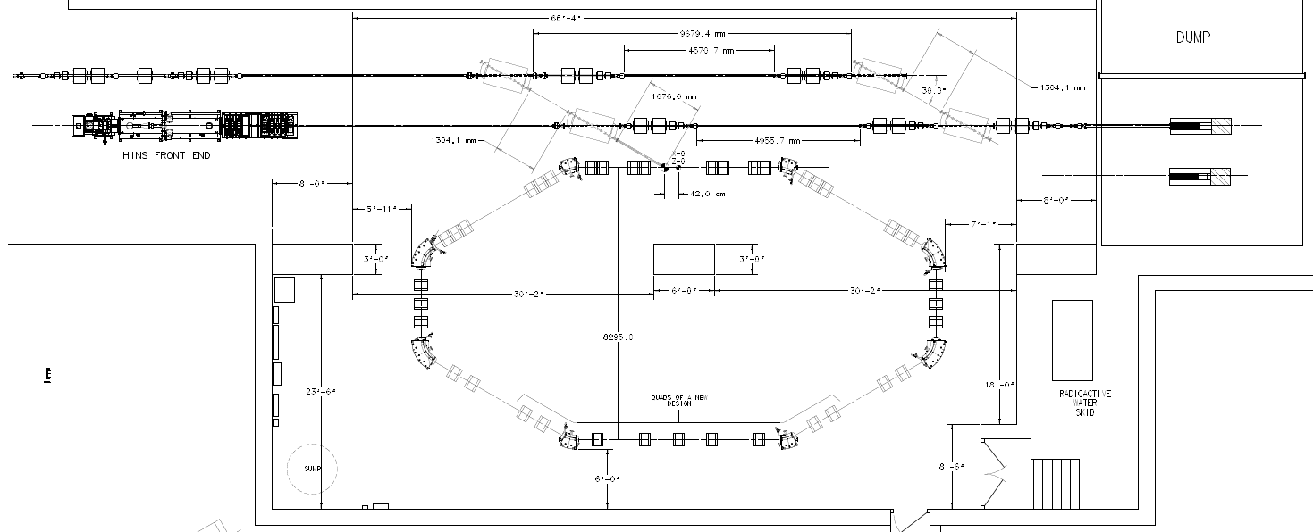
IOTA Ring
e- beam line
p beam line
2.5 MeV RFQ

Slide 20
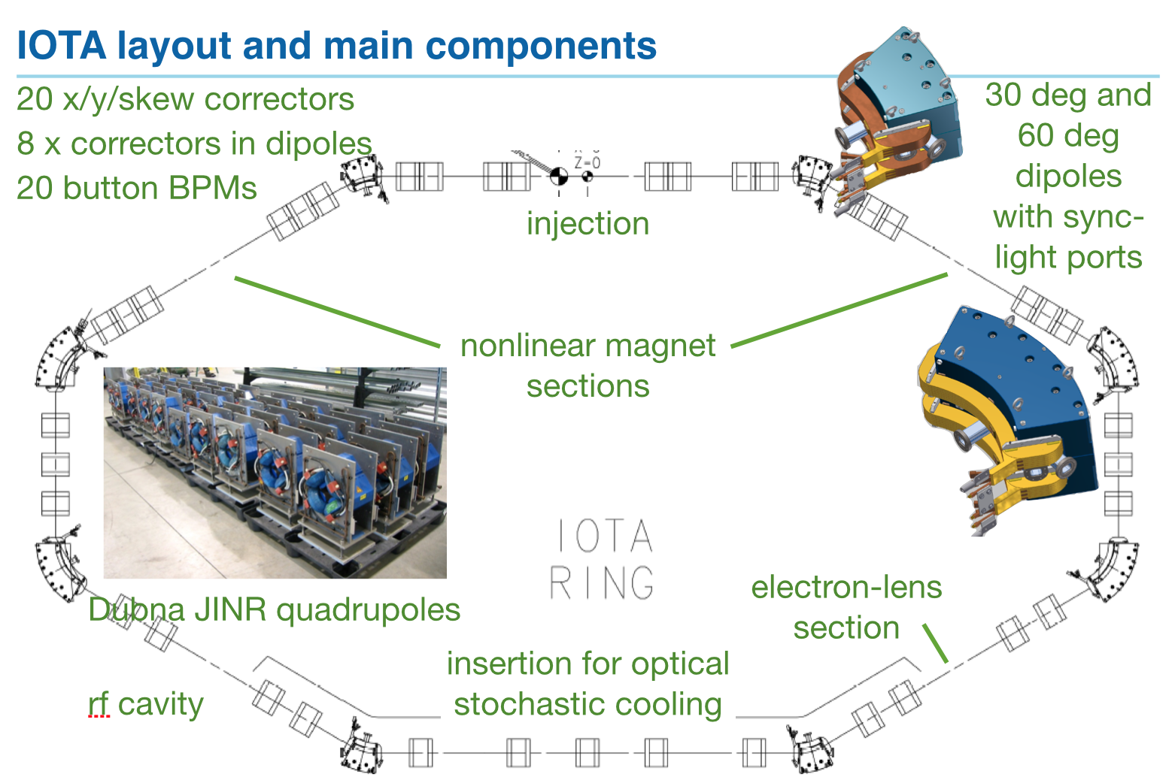
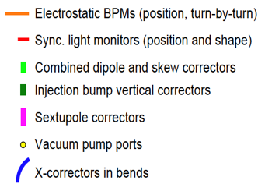
IOTA Layout

Slide 21
IOTA Progress in FY15 (what’s for FY16)
Magnetic system:
  Main dipoles manufacturing in progress, first magnet delivered Nov. 2015, the rest (9) to be delivered in 2016
  32 ‘Dubna’ quadrupoles refurbished, performing magnetic measurements
  10 new quadrupoles ordered, to be delivered in March 2016
  Corrector magnets (20) delivery Jan.-Feb. 2016
  Power supplies purchased, installed. Cable pulls in progress.
Vacuum system:
  Dipole alum. chambers manufactured.
  Vacuum pumps and gauges purchased.
Mechanical:
  Support stands designed, prototype in production.

Slide 22
IOTA Status
RF system:
  Old pbar cavity redesigned and refurbished/need RF generator
Vacuum system:
  Dipole alum. chambers manufactured.
  50% Vacuum pumps and gauges purchased/ 50% in FY16
Injection system:
  Kicker designed,parts procured, manufacturing in progress/ FY16
  Pulse generator is reused from Tevatron, tested.
  DC Lambertson design in progress / construction in FY16
Instrumentation:
  BPM bodies (21) manufactured, received; electronics procured.
  Synchrotron light system (8) components procured / FY16-17

Slide 23
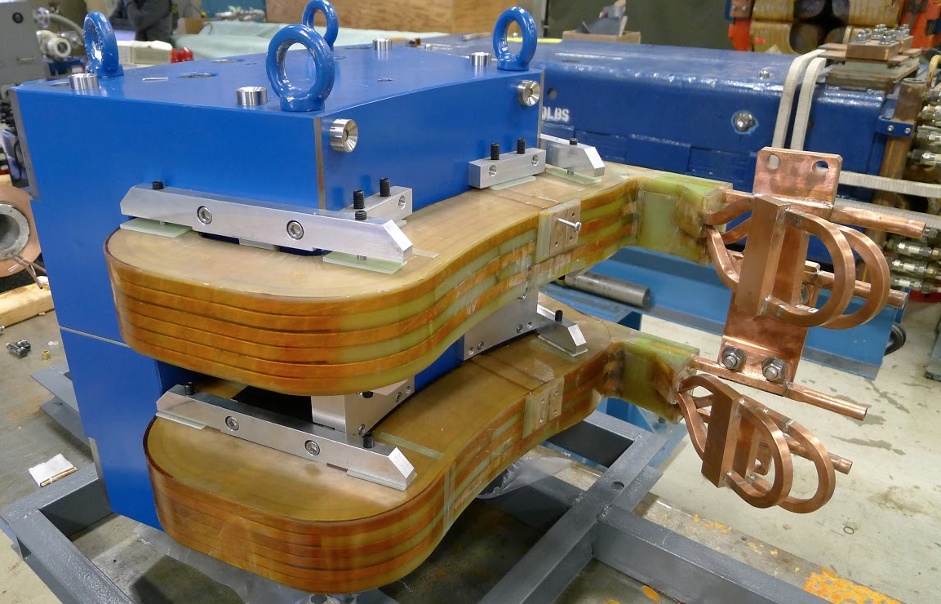
IOTA 30-deg. dipole

Slide 24
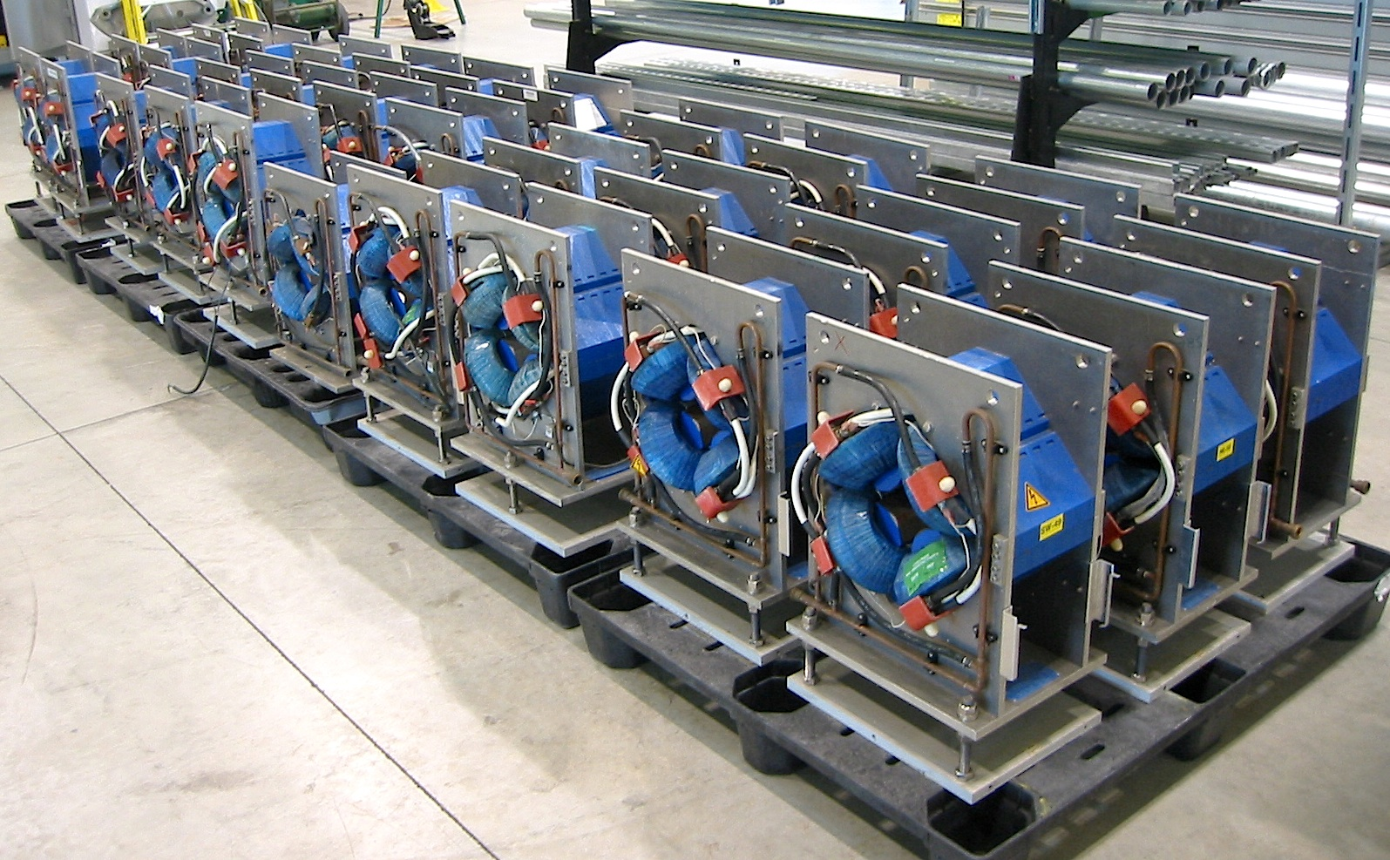
IOTA ‘Dubna’ quadrupoles

Slide 25
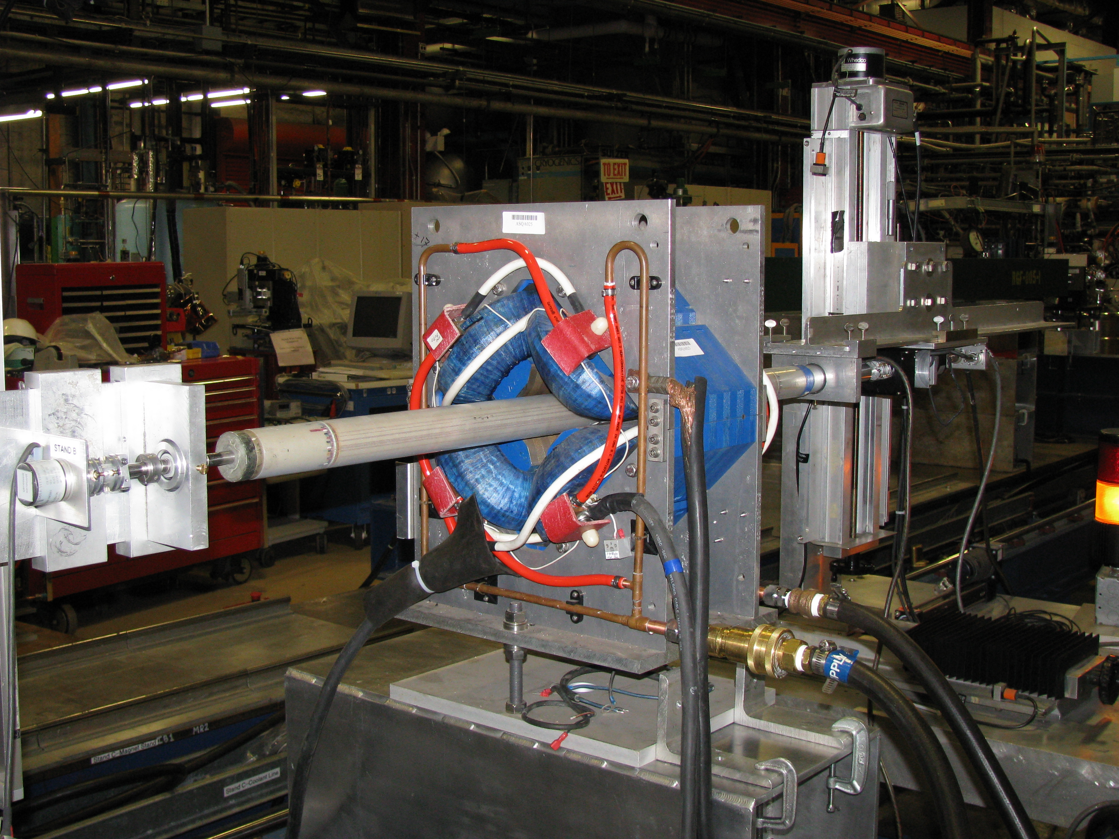
IOTA quadrupole at magnetic test

Slide 26
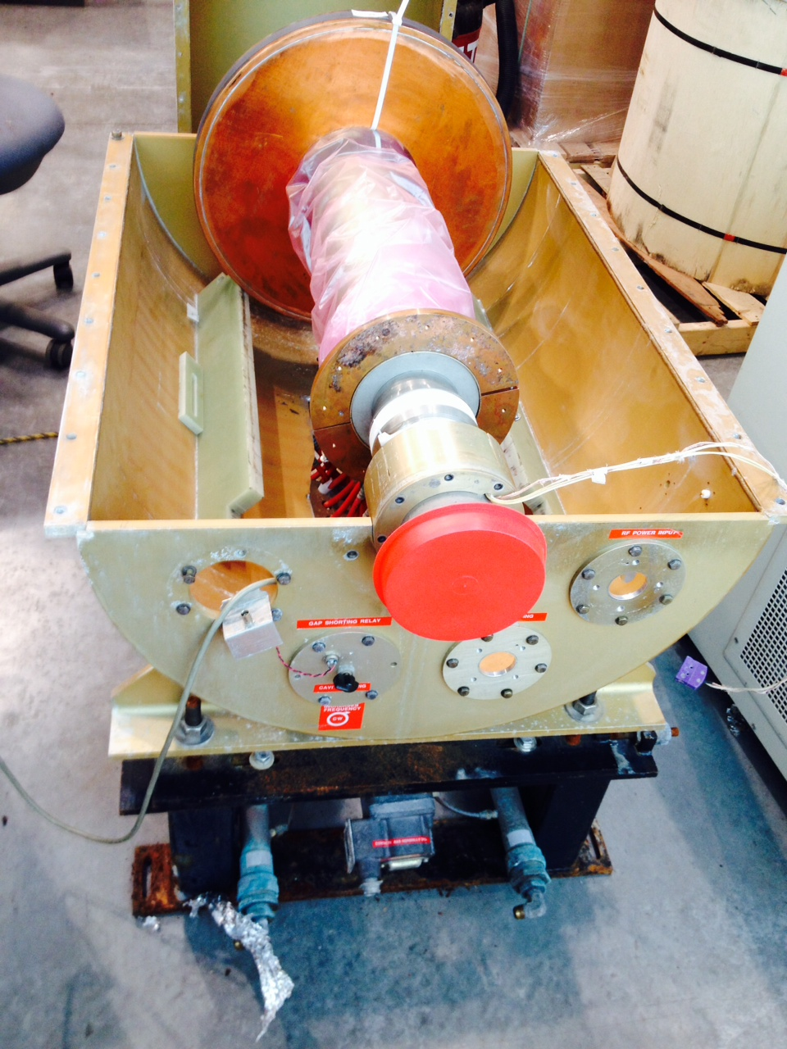
Pbar RF cavity refurbished for IOTA

Slide 27
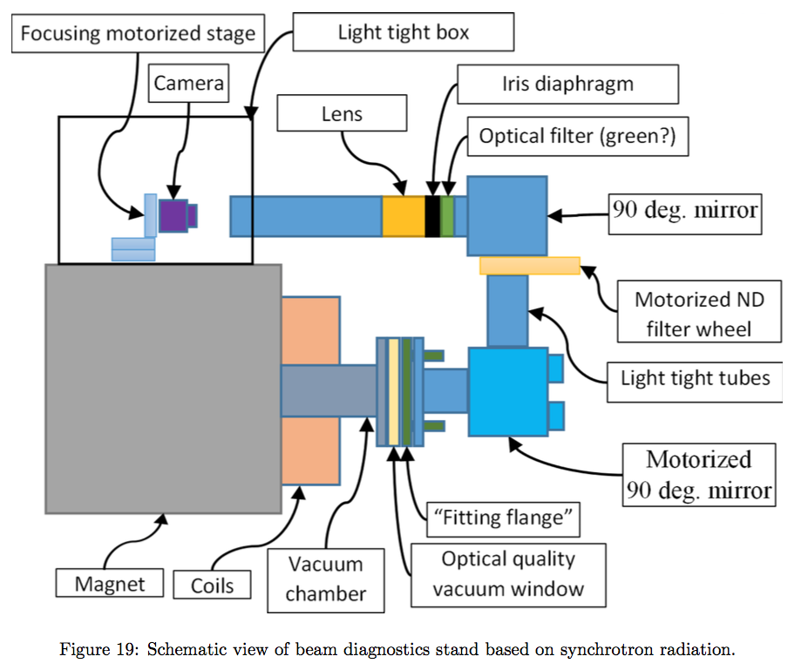
IOTA Synchrotron Radiation Monitors (schematic)

Slide 28
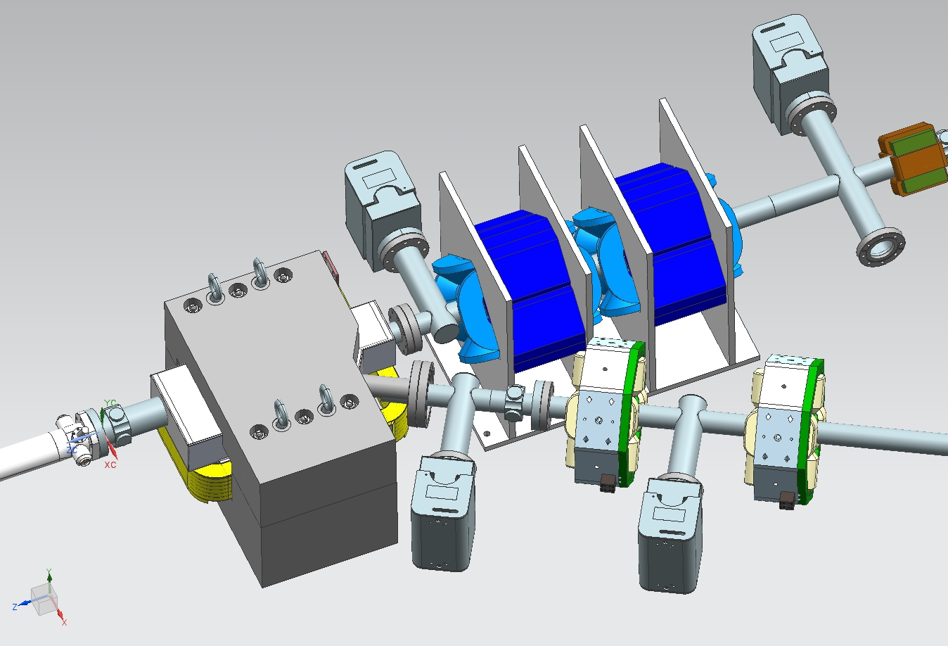
IOTA injection Lambertson magnet: designed

Slide 29
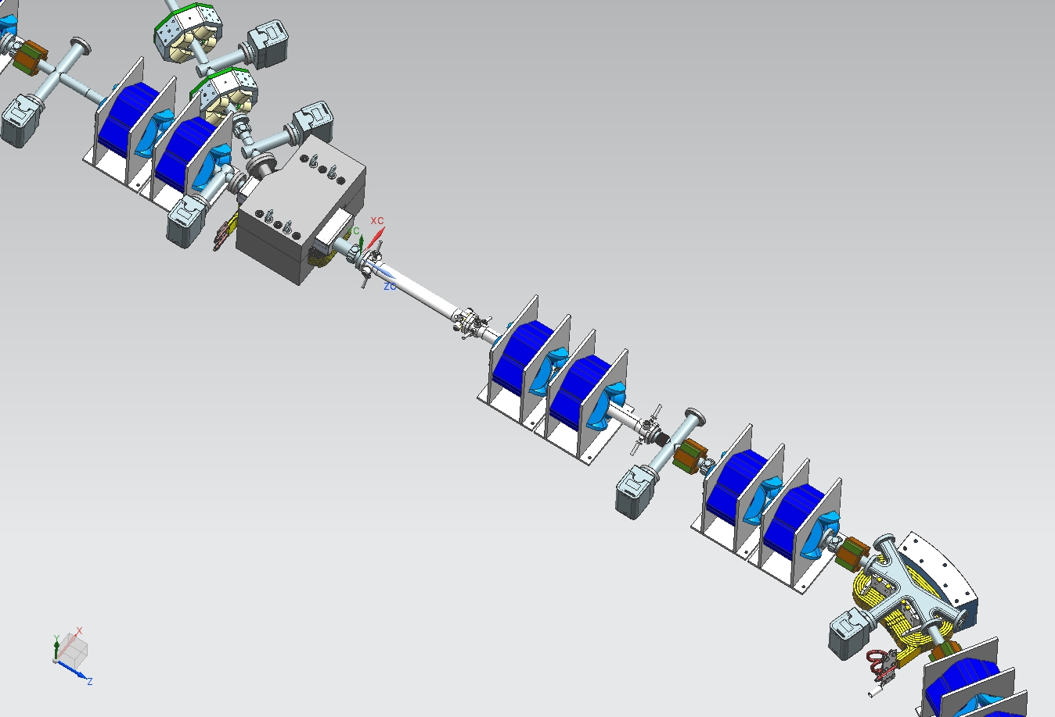
IOTA injection section: designed

Slide 30
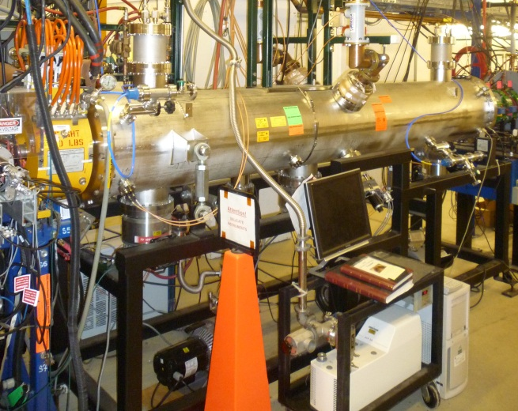
IOTA Staging – Phase II
After the IOTA commissioning with e-, we will move the existing 2.5 MeV (70 MeV/c) proton/H- RFQ to FAST to inject protons into the IOTA ring.
Allows tests of Integrable Optics with protons and realistic space charge beam dynamics studies
Allows space charge compensation experiments
ΔQ_{SC} =0.5 for one-turn injection
*multi-turn injection possible
2.5 MeV RFQ
Notes:
multi-tun injection possible

Slide 31
IOTA Proton Injector
To study high-intensity proton beam physics we need proton beam. Will use existing HINS 2.5MeV H- RFQ.
The HINS (“High Intensity Neutrino Source”) was developed as the front end of a pulsed “Project X” 8 GeV proton linac
Because of cooling problems, it never reached its design pulse rate
Project-X (now PIP-II) specification was changed to a CW front end
  HINS->PXIE
HINS RFQ available for our use
50 keV
2.5 MeV
3.0 MeV
Vector modulators distribute the power from a single klystron to 6 cavities
– we will not need them (hence, 2.5 MeV kinetic energy=70 MeV/c omentum)
31
12/17/2015

Slide 32
FAST Proton Injector: Plan
Plan: resurrect HINS in situ at MDB (2016-2017)
Completely characterize its performance (2017-2018 *)
Once it works, move everything to FAST (2019 *)
  Put all high power RF hardware in the upstream gallery and run coax to the RFQ itself
* 1 year sooner with modest extra funding
source, RFQ and injection girder
Charging supply,modulator, pulse transformer, and klystron

Slide 33
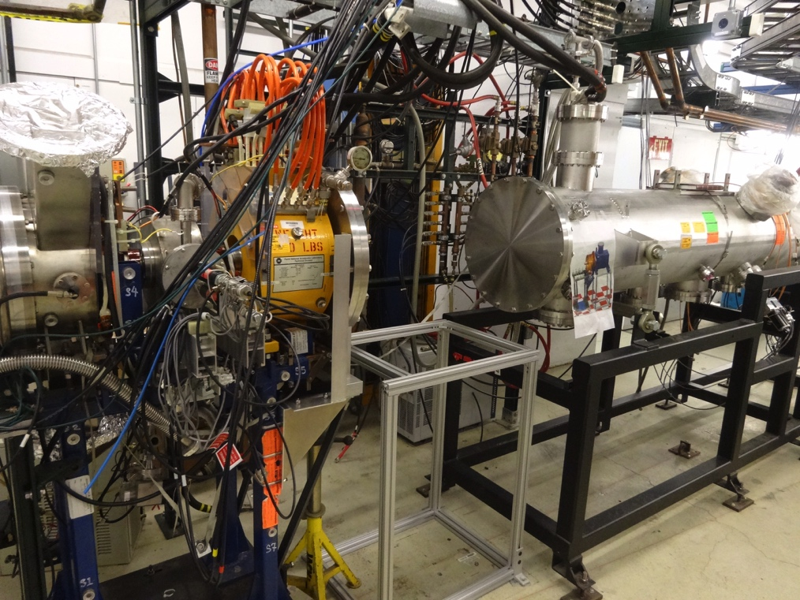
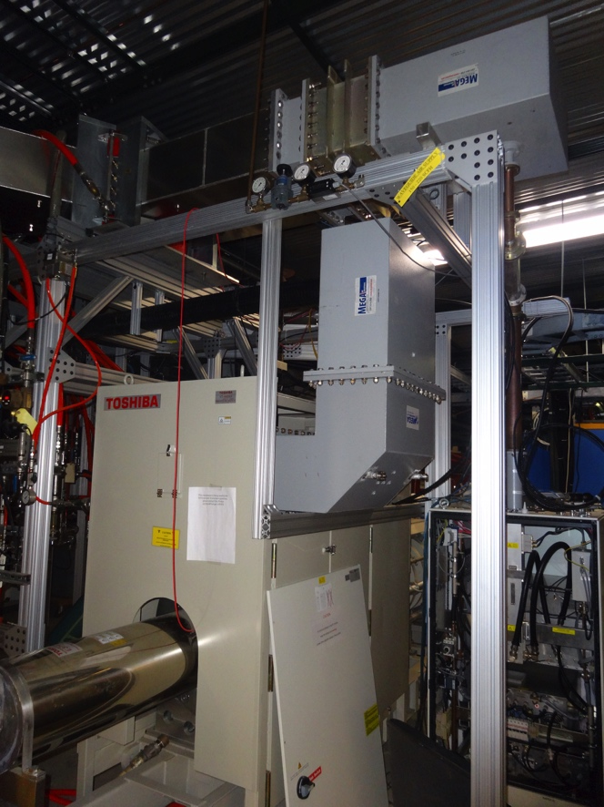
2015 Progress on IOTA Proton Injector
80 k$ supplemental (thank you!) has greatly helped to progress proton injector work:
Ion source separated from RFQ in preparation for instrumentation.
All parts requisitioned for refurbishment.
On track to re-commission in January.
Reconnected 325 MHz klystron to waveguide and coax.
Continuing reconnection to RFQ.
On track to deliver beam in spring of 2016.

Slide 34
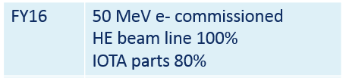
(3) FAST /IOTA in FY2016

Slide 35
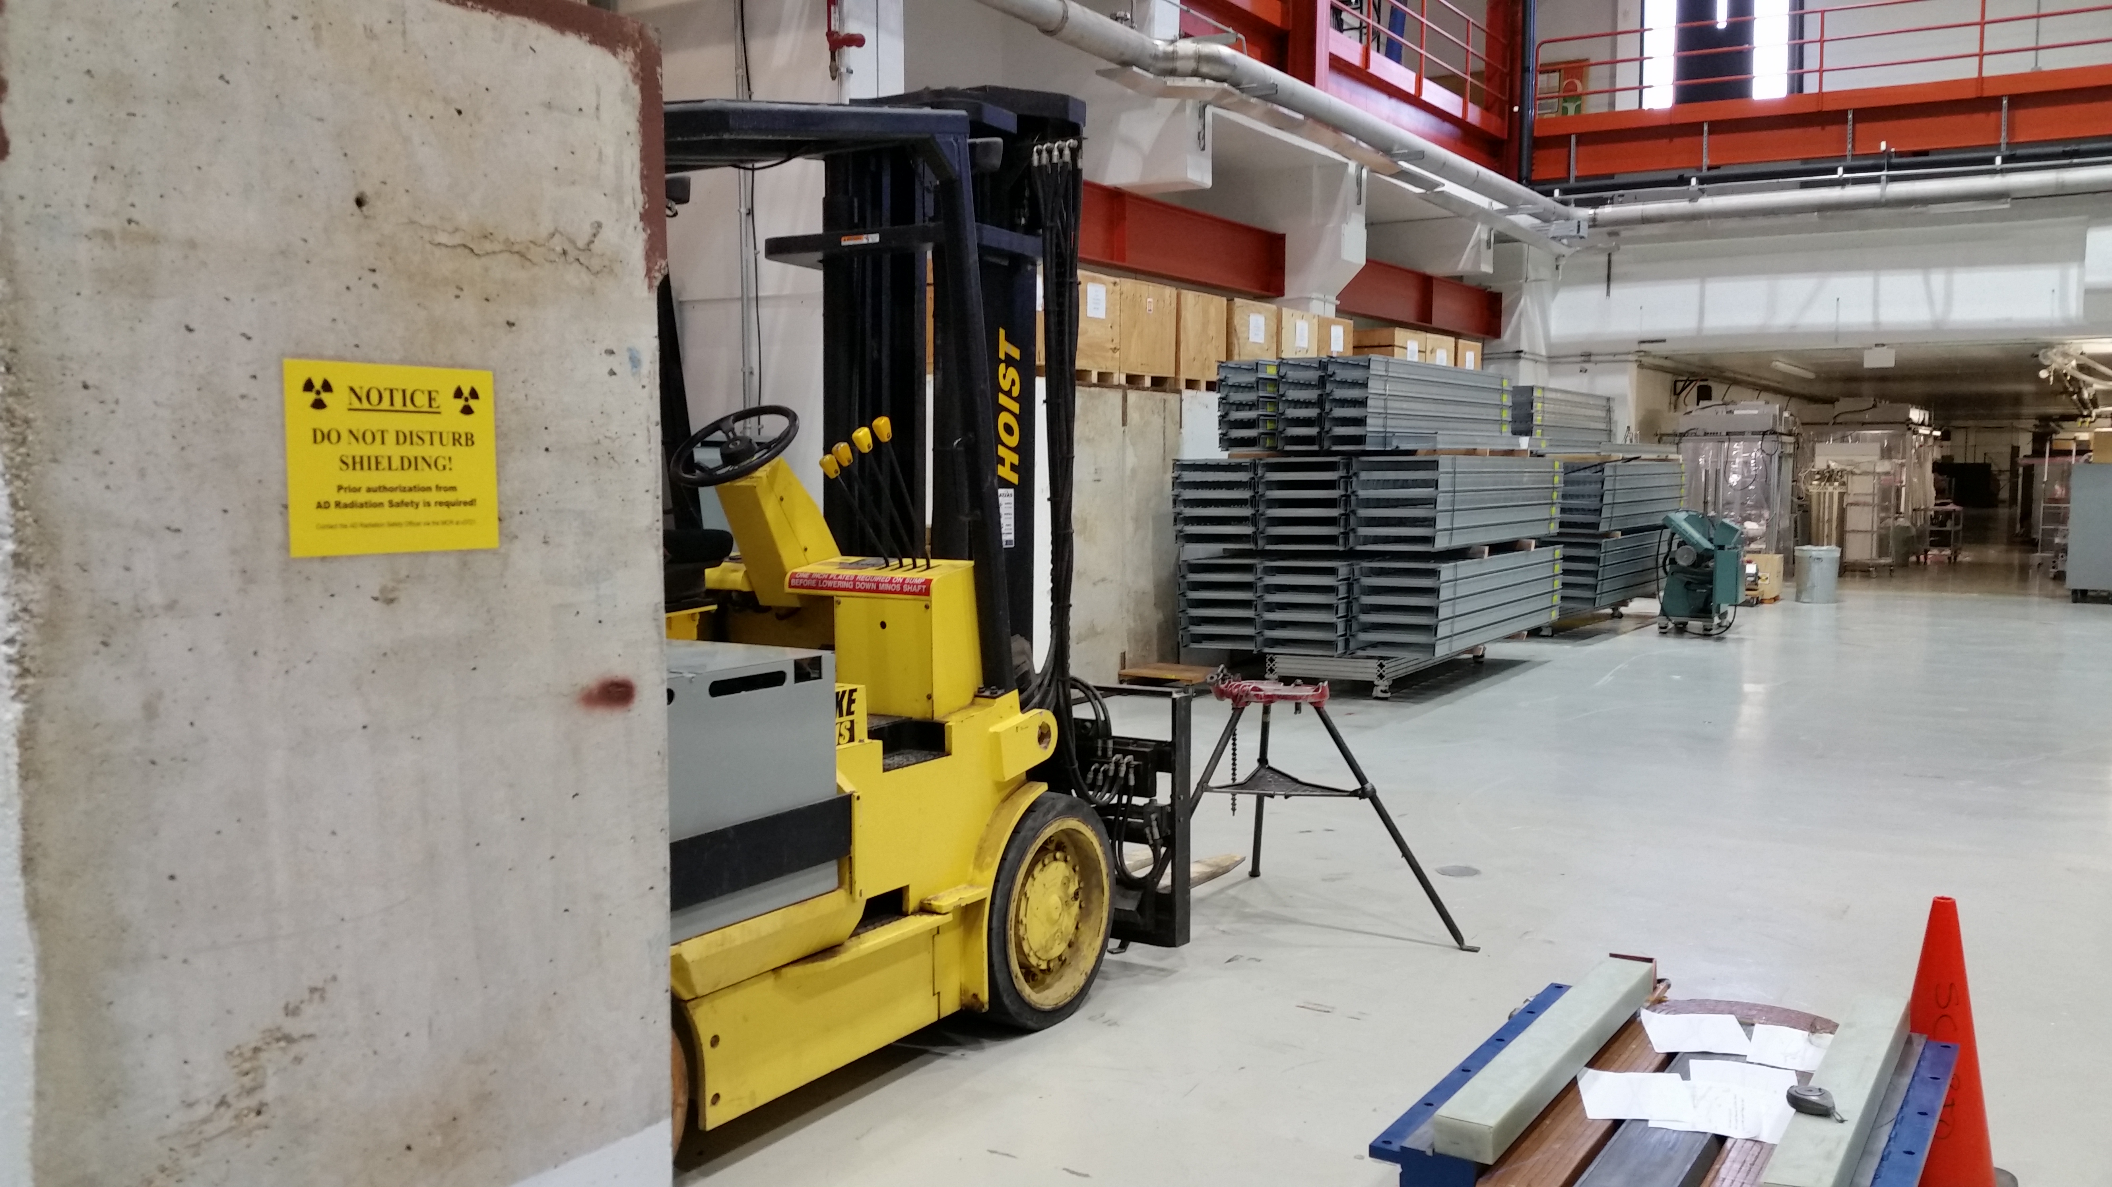
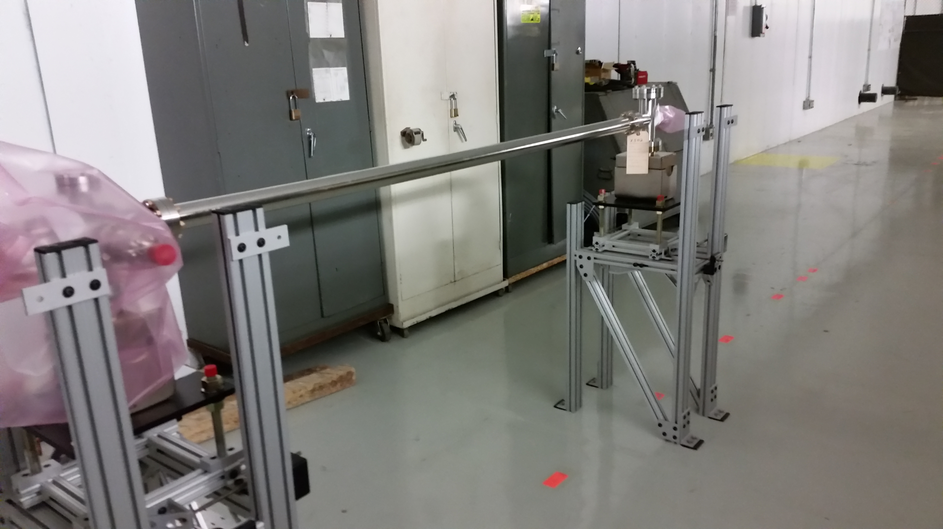
High Energy Beamline and Enclosure (FY16)

Slide 36
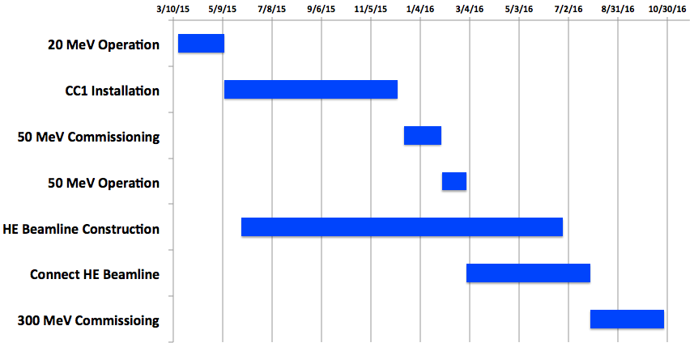
FAST Schedule in FY16
Mostly determined by availability of mechanical, cryo and electrician labor (lab priorities)

Slide 37
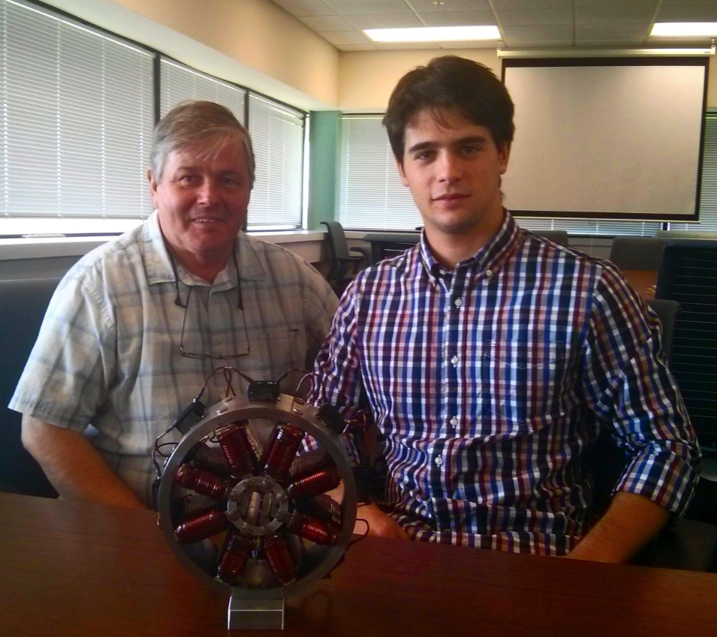
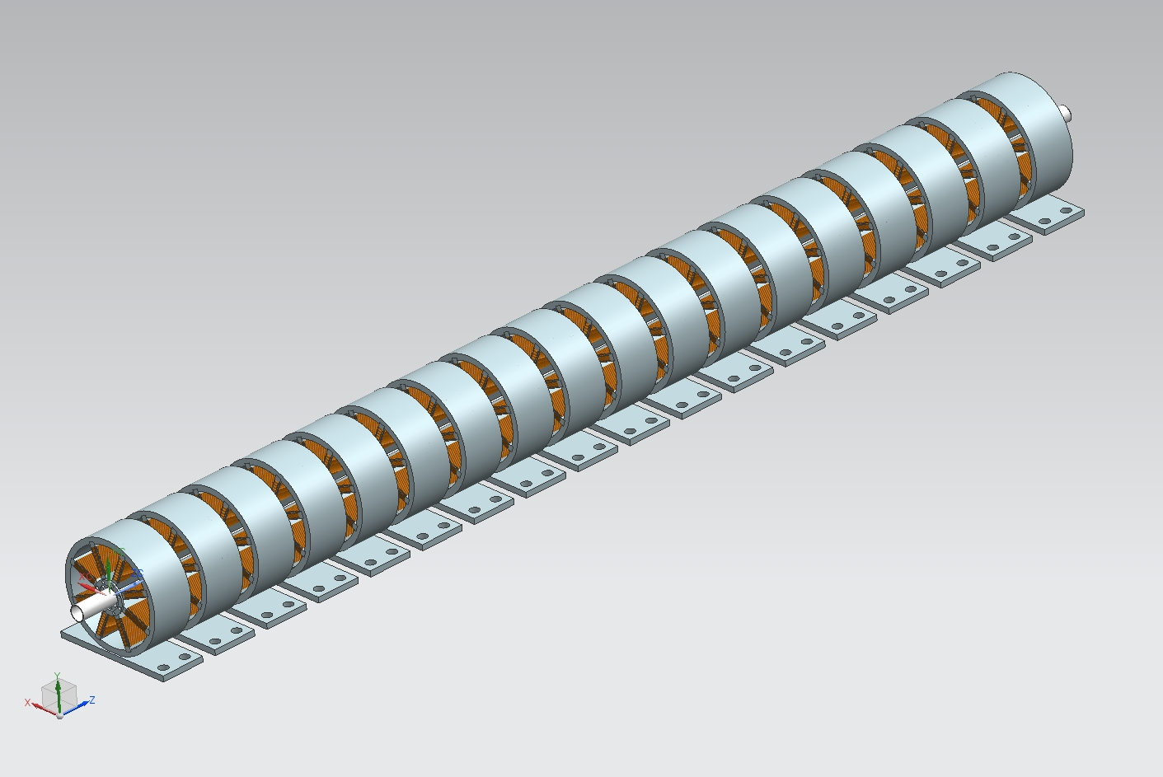
Octupoles for IOTA Quasi-Integrable System
(in addition to many magnets to be built in FY16 already mentioned above)
18 octupoles will be built
all parts in hand except coils
K.Carlsson, R.Castellotti
Summer engineering internship project

Slide 38
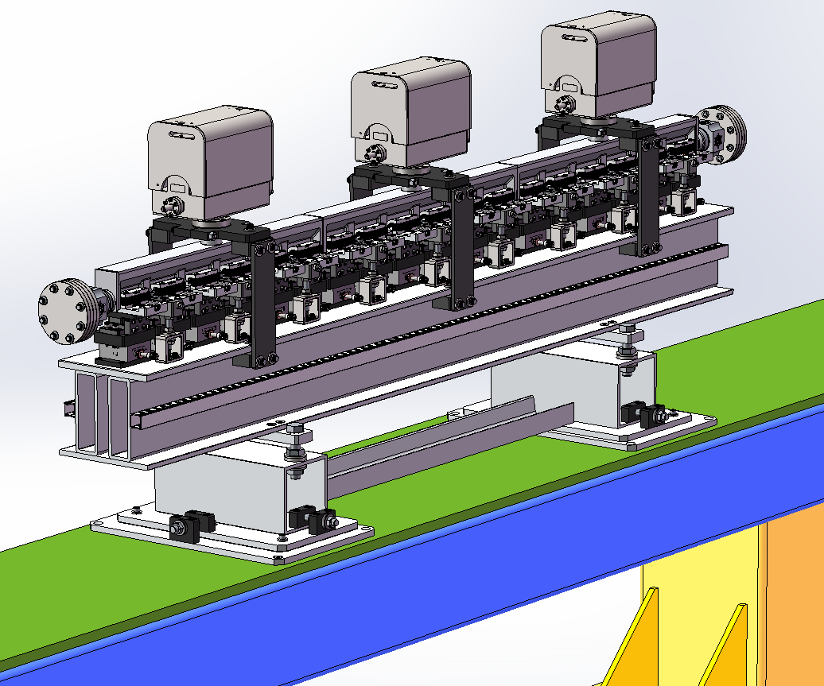
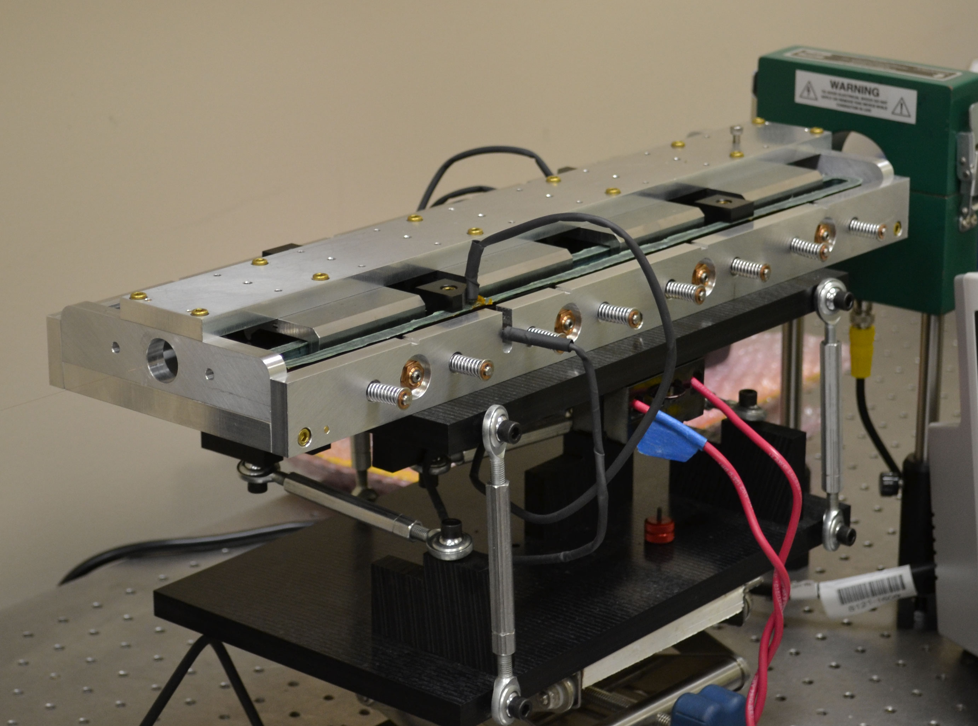
Nonlinear Magnet for Integrable IOTA
Joint effort with RadiaBeam Technologies (Phase I and II SBIR)
Short prototype built in Phase I
1.8-m long magnet to be delivered in 2016

Slide 39
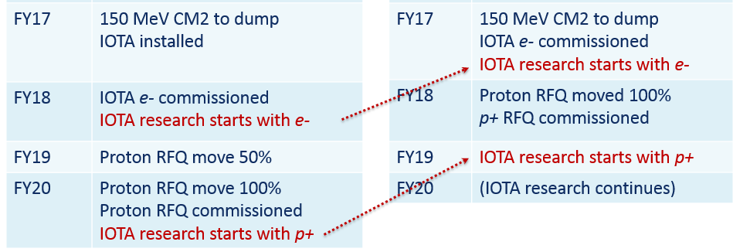
(4) FAST /IOTA in FY2017 and beyond, R&D, Collaborations

Slide 40
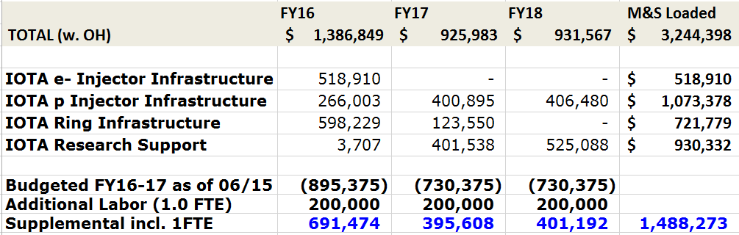
To Start IOTA p+ in FY19 : Add’l Resource Table
* assuming FY17 as in FWP and FY18 same as FY17

Slide 41
IOTA Research: Beam Physics Drivers
Nonlinear Integrable Optics – Experimental demonstration of Non-linear Optics lattice in a practical accelerator
Space Charge Compensation – Suppression of SC-related effects in high intensity circular accelerators
  Nonlinear Integrable Optics
  Electron lenses
  Electron columns
  Circular betatron modes
Beam collimation – Technology development for hollow electron beam collimation
Optical Stochastic Cooling – Proof-of-principle demonstration
Electron Cooling – Advanced techniques
Laser-Plasma Accelerator – Demonstration of injection into synchrotron
Quantum Physics – Localization of single electron wave function
GARD
Collaborators
under discussion by collaborators:
Collaborators

Slide 42
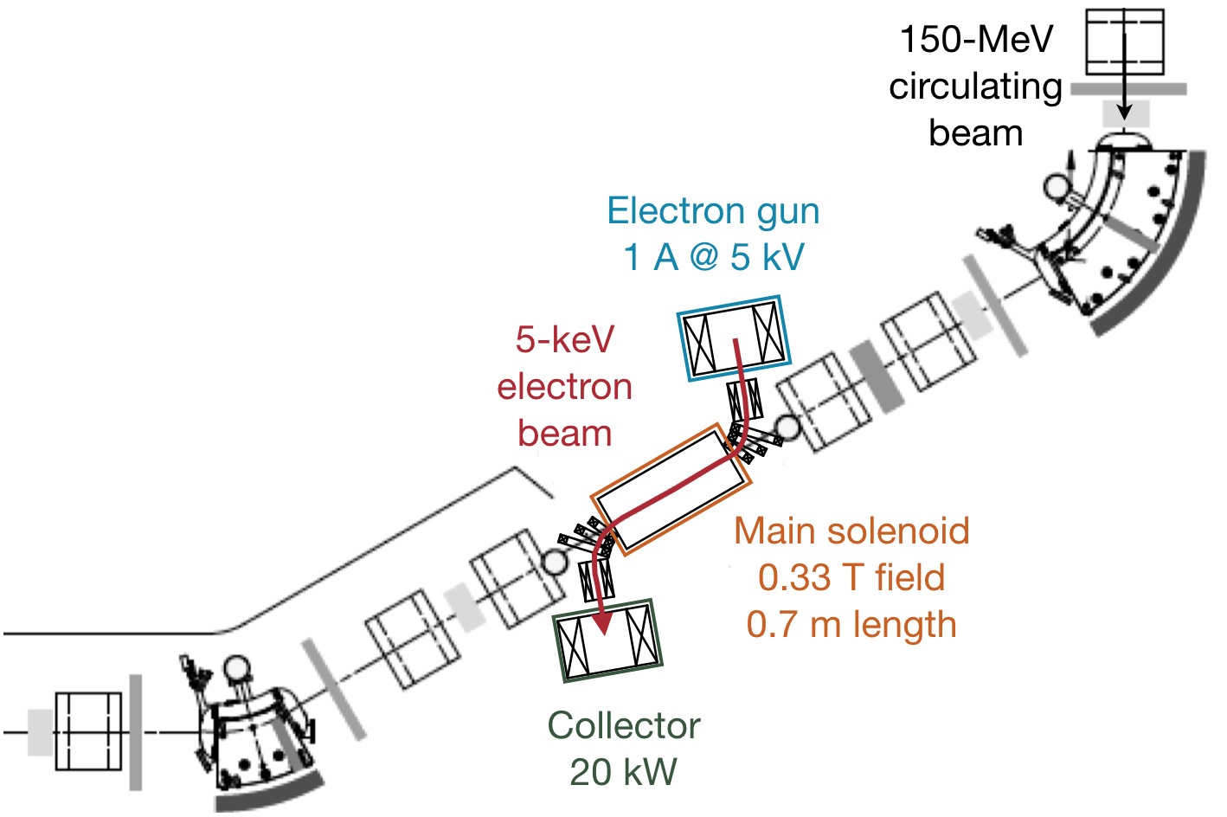
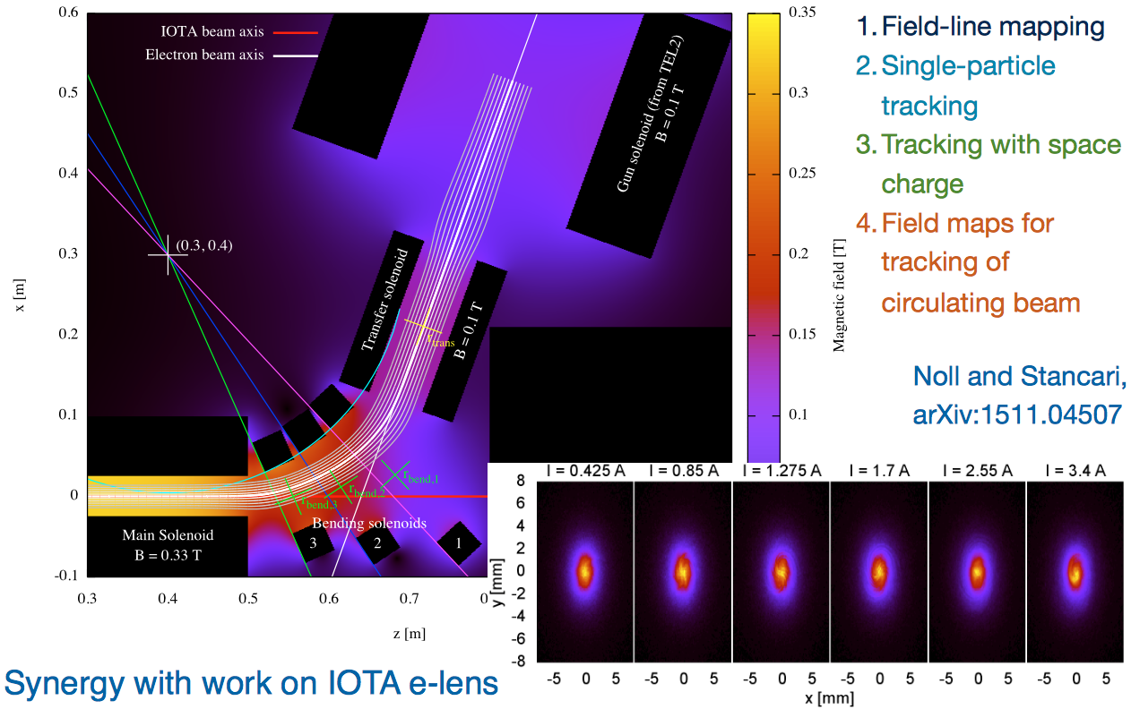
IOTA Electron Lens: Design Simulations
Capitalize on the Tevatron experience and recent LARP work
Re-use Tevatron EL components:
  Removed TEL-2 gun & collector from Tev tunnel
  Refurbishment in progress

Slide 43
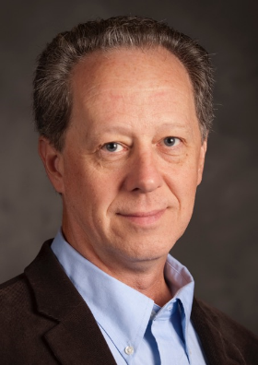
Scientific IOTA Collaboration Formed
22 Partners:
  ANL, Berkeley, BNL, BINP, CERN, Chicago, Colorado State, IAP Frankfurt, JINR, Kansas, LANL, LBNL, ORNL, Maryland, Michigan State, Northern Illinois, Oxford, RadiaBeam Technologies, RadiaSoft LLC, Tech-X, Tennessee, Vanderbilt
NIU-FNAL: Joint Cluster of Research Excellence →
NIU/FNAL Joint Appointees:
Swapan Chattopadhyay
Philippe Piot
Bela Erdelyi
Young-Min Shin
Michael J. Syphers
FNAL Cluster members:
Sergei Nagaitsev
Vladimir Shiltsev
M.Syphers

Slide 44

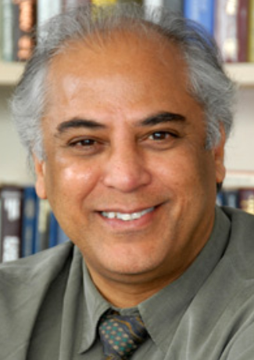

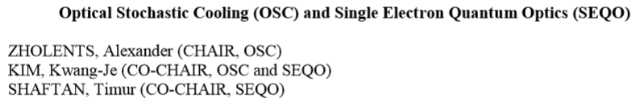

IOTA Science Workshop – April 2015
By invitation only: 40 participants, 30 not from Fermilab
~25 presentations
Three Working Groups:
Swapan Chattopadhyay
Workshop Chair
https://indico.fnal.gov/conferenceDisplay.py?confId=10547
* WP drafted

Slide 45
What Collaborators Bring to IOTA/FAST: Resources
Instruments/Diagnostics
SBIR Phase II RadiaBeam Technologies
  nonlinear magnet
NIU (PI Chattopadhyay)
  M&S $300k matching
Fermilab LDRD (PI Chattopadhyay)
  M&S $300k
Submitted DOE GARD
  UoC (PI Kim, Nagaitsev)
  NIU (PI Chattopadhyay, Erdelyi)
  LBNL (PI Mitchell)
Research
NIU (PI Chattopadhyay) – OSC
  1 Postdoc + PhD student + M&S
UoC “Innovations in Bright Beam Science”
  3-year NSF (PI Kim)
NIU (DOE HEP, PI Piot) – OSC
  PhD student + M&S
NIU (DOE/DHS, PI Piot) – ϒ-ray source
  $1.94M over 5 years with RadiaBeam & FNAL
Fermilab LDRD (PI Valishev) – IOTA->PIP-III
  1 Postdoc + PhD student
SBIR Phase II RadiaSoft
  space charge simulations

Slide 46



Simulations of Space Charge Effects on
Beam Dynamics in the IOTA Ring
An Example of IOTA/FAST Collaboration
&
#
^{ψ}
D.L. Bruhwiler& N. Cook& S. Webb& R. Kishek^{&,ψ}
A. Valishev# E. Prebys# S. Nagaitsev#

Slide 47
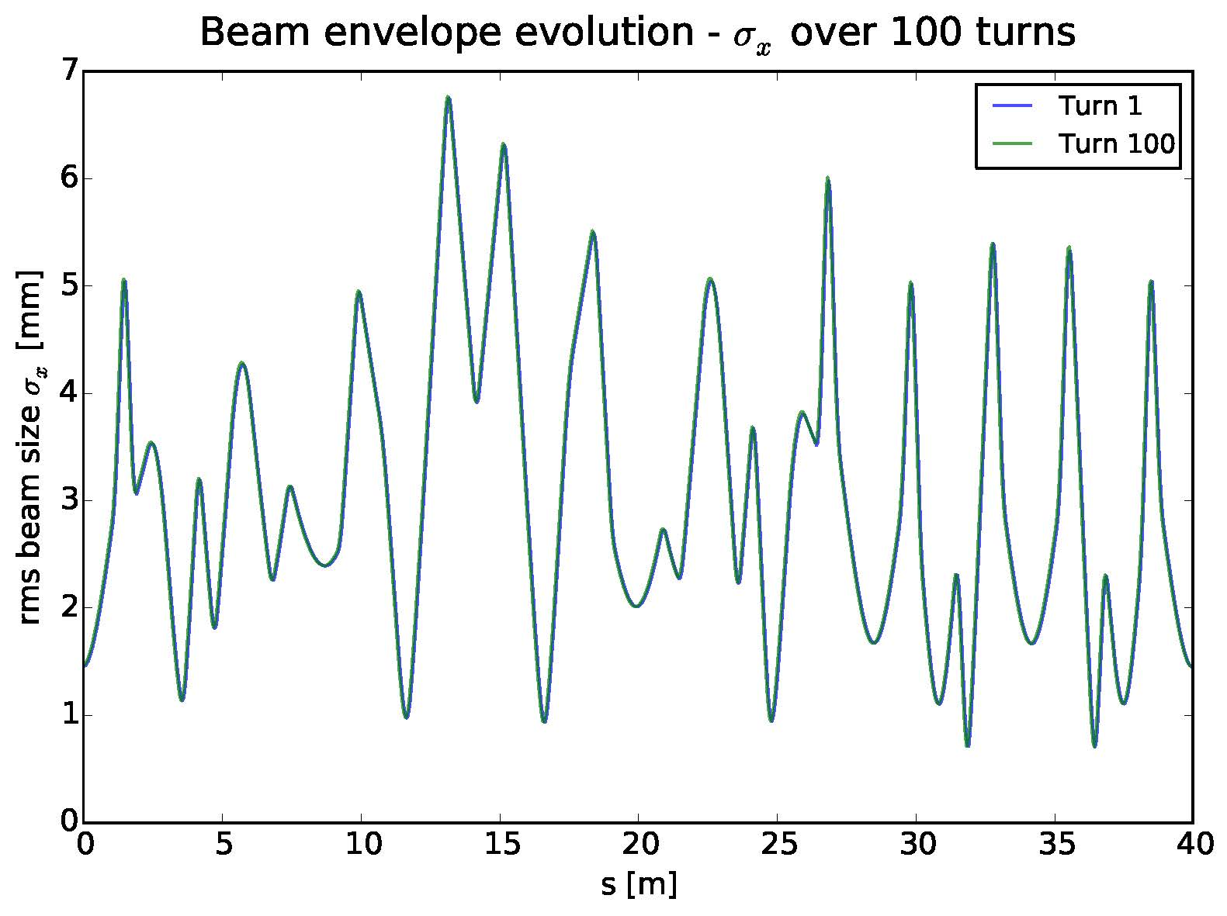
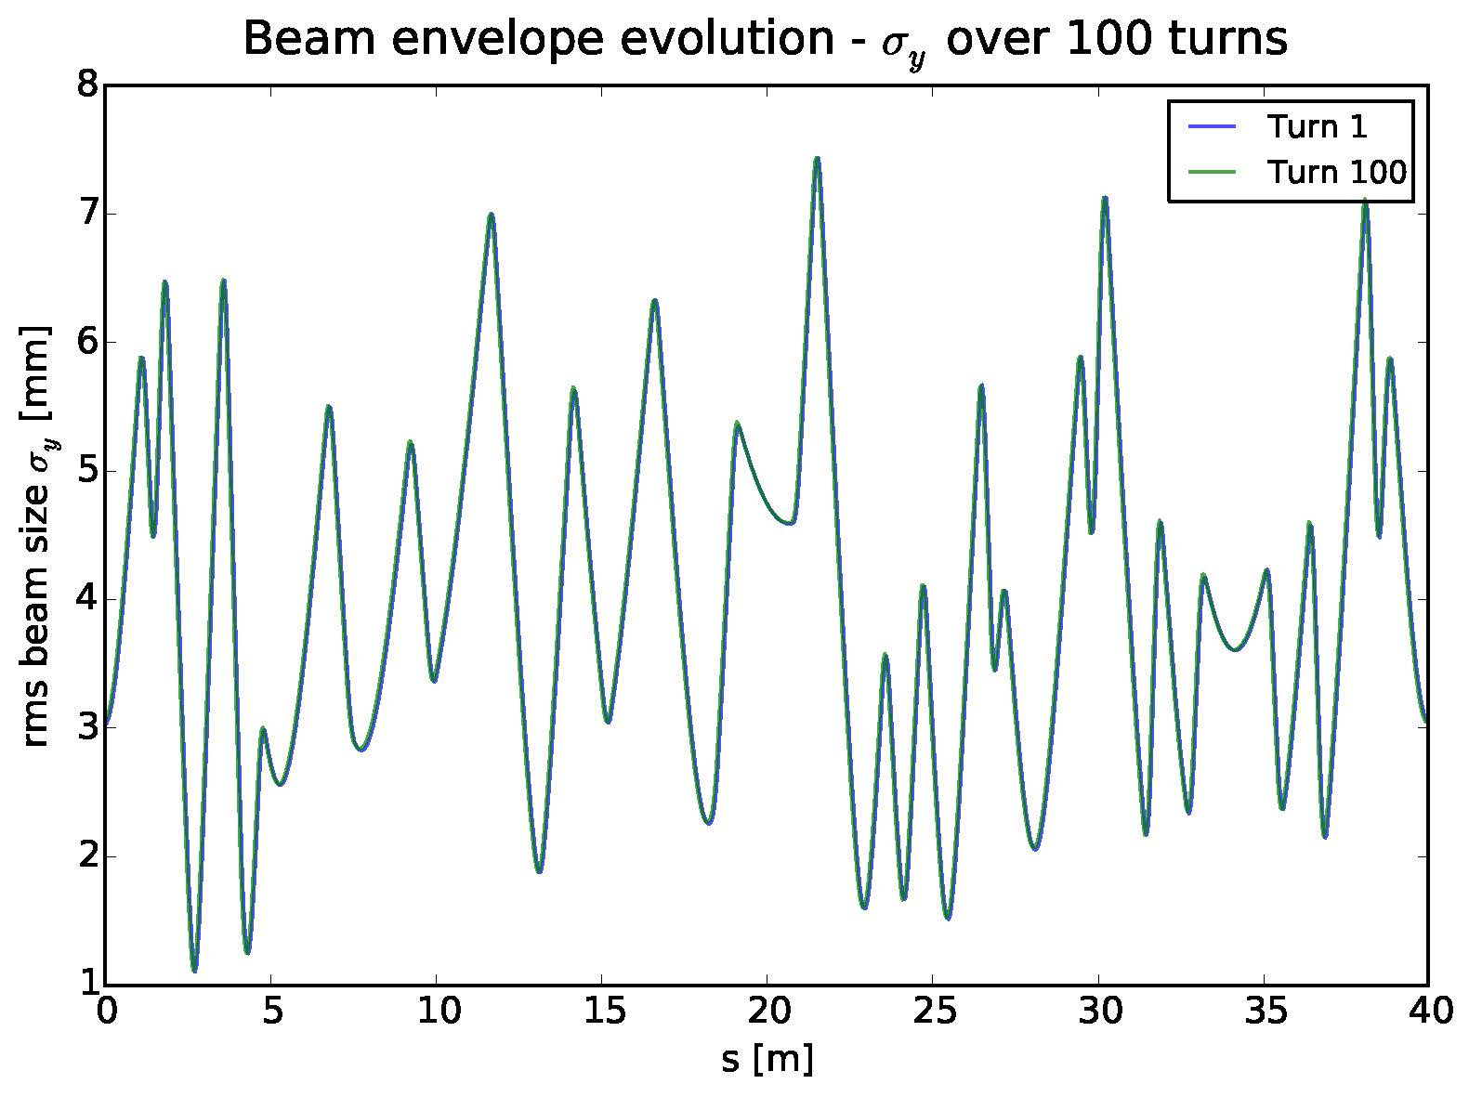
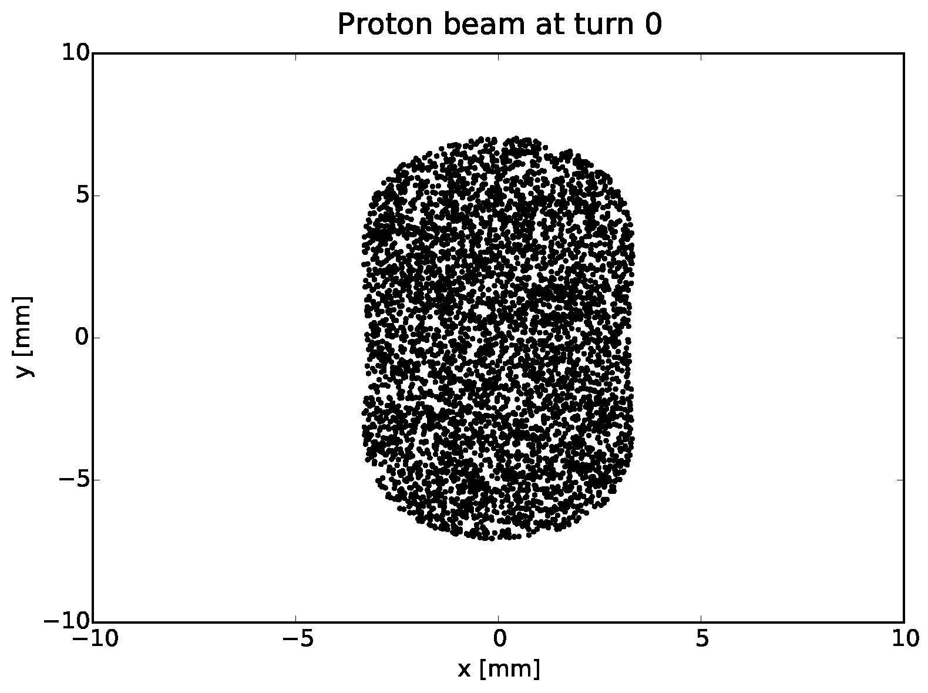
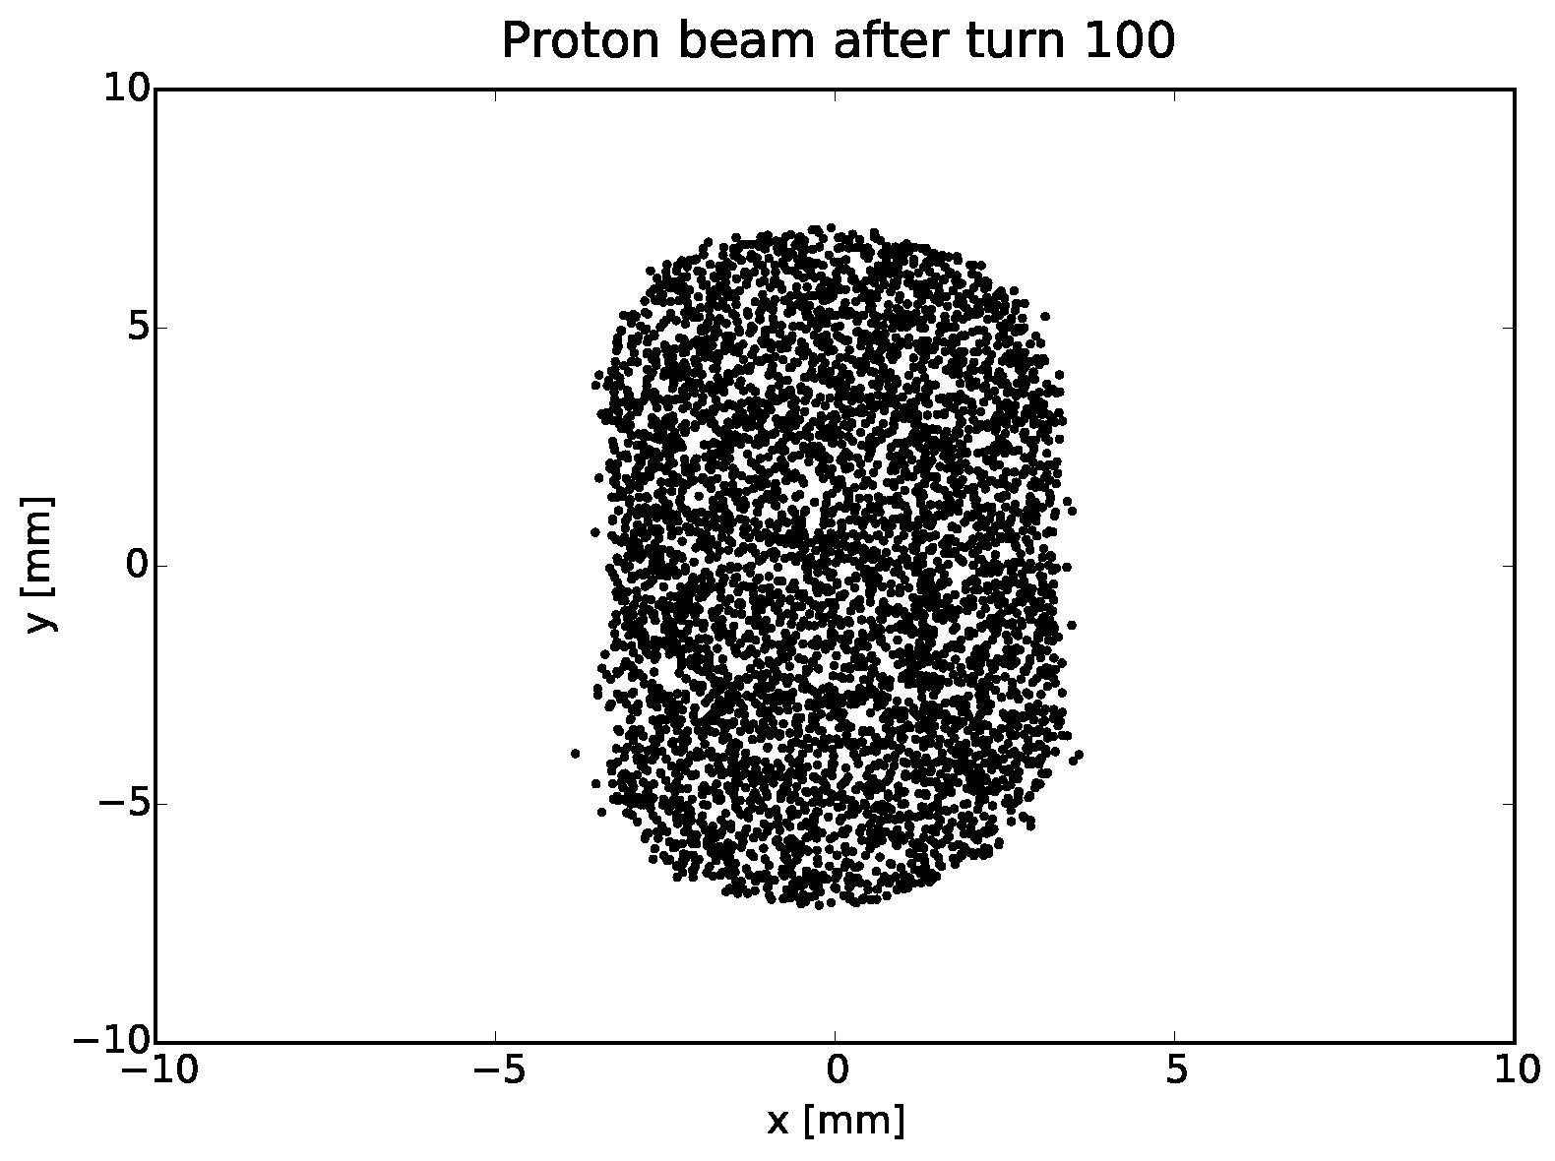
SYNERGIA: 100 turns @ 14 mA – p+ beam is stable

Slide 48
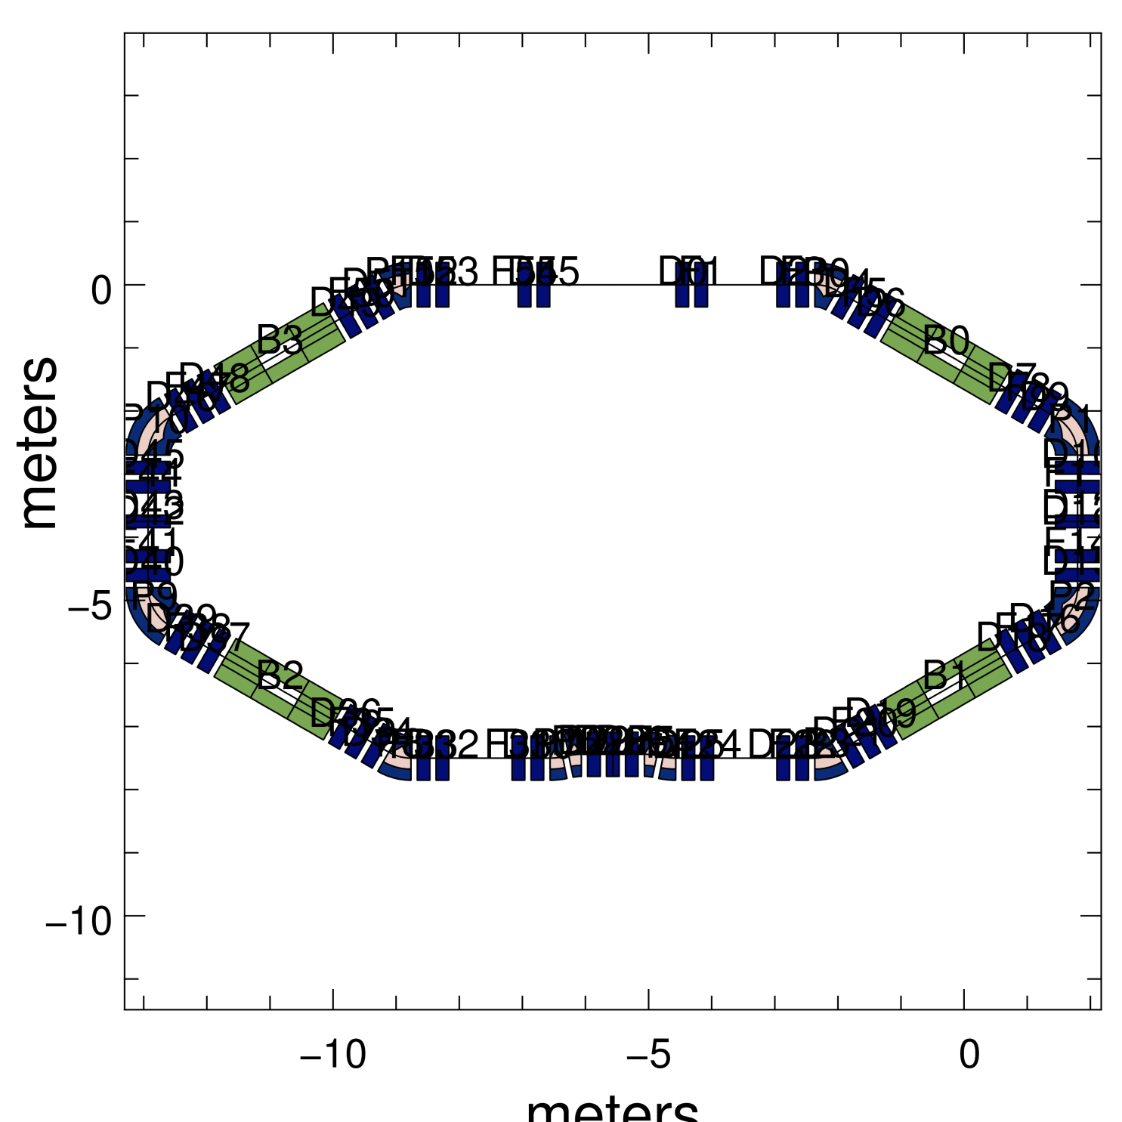
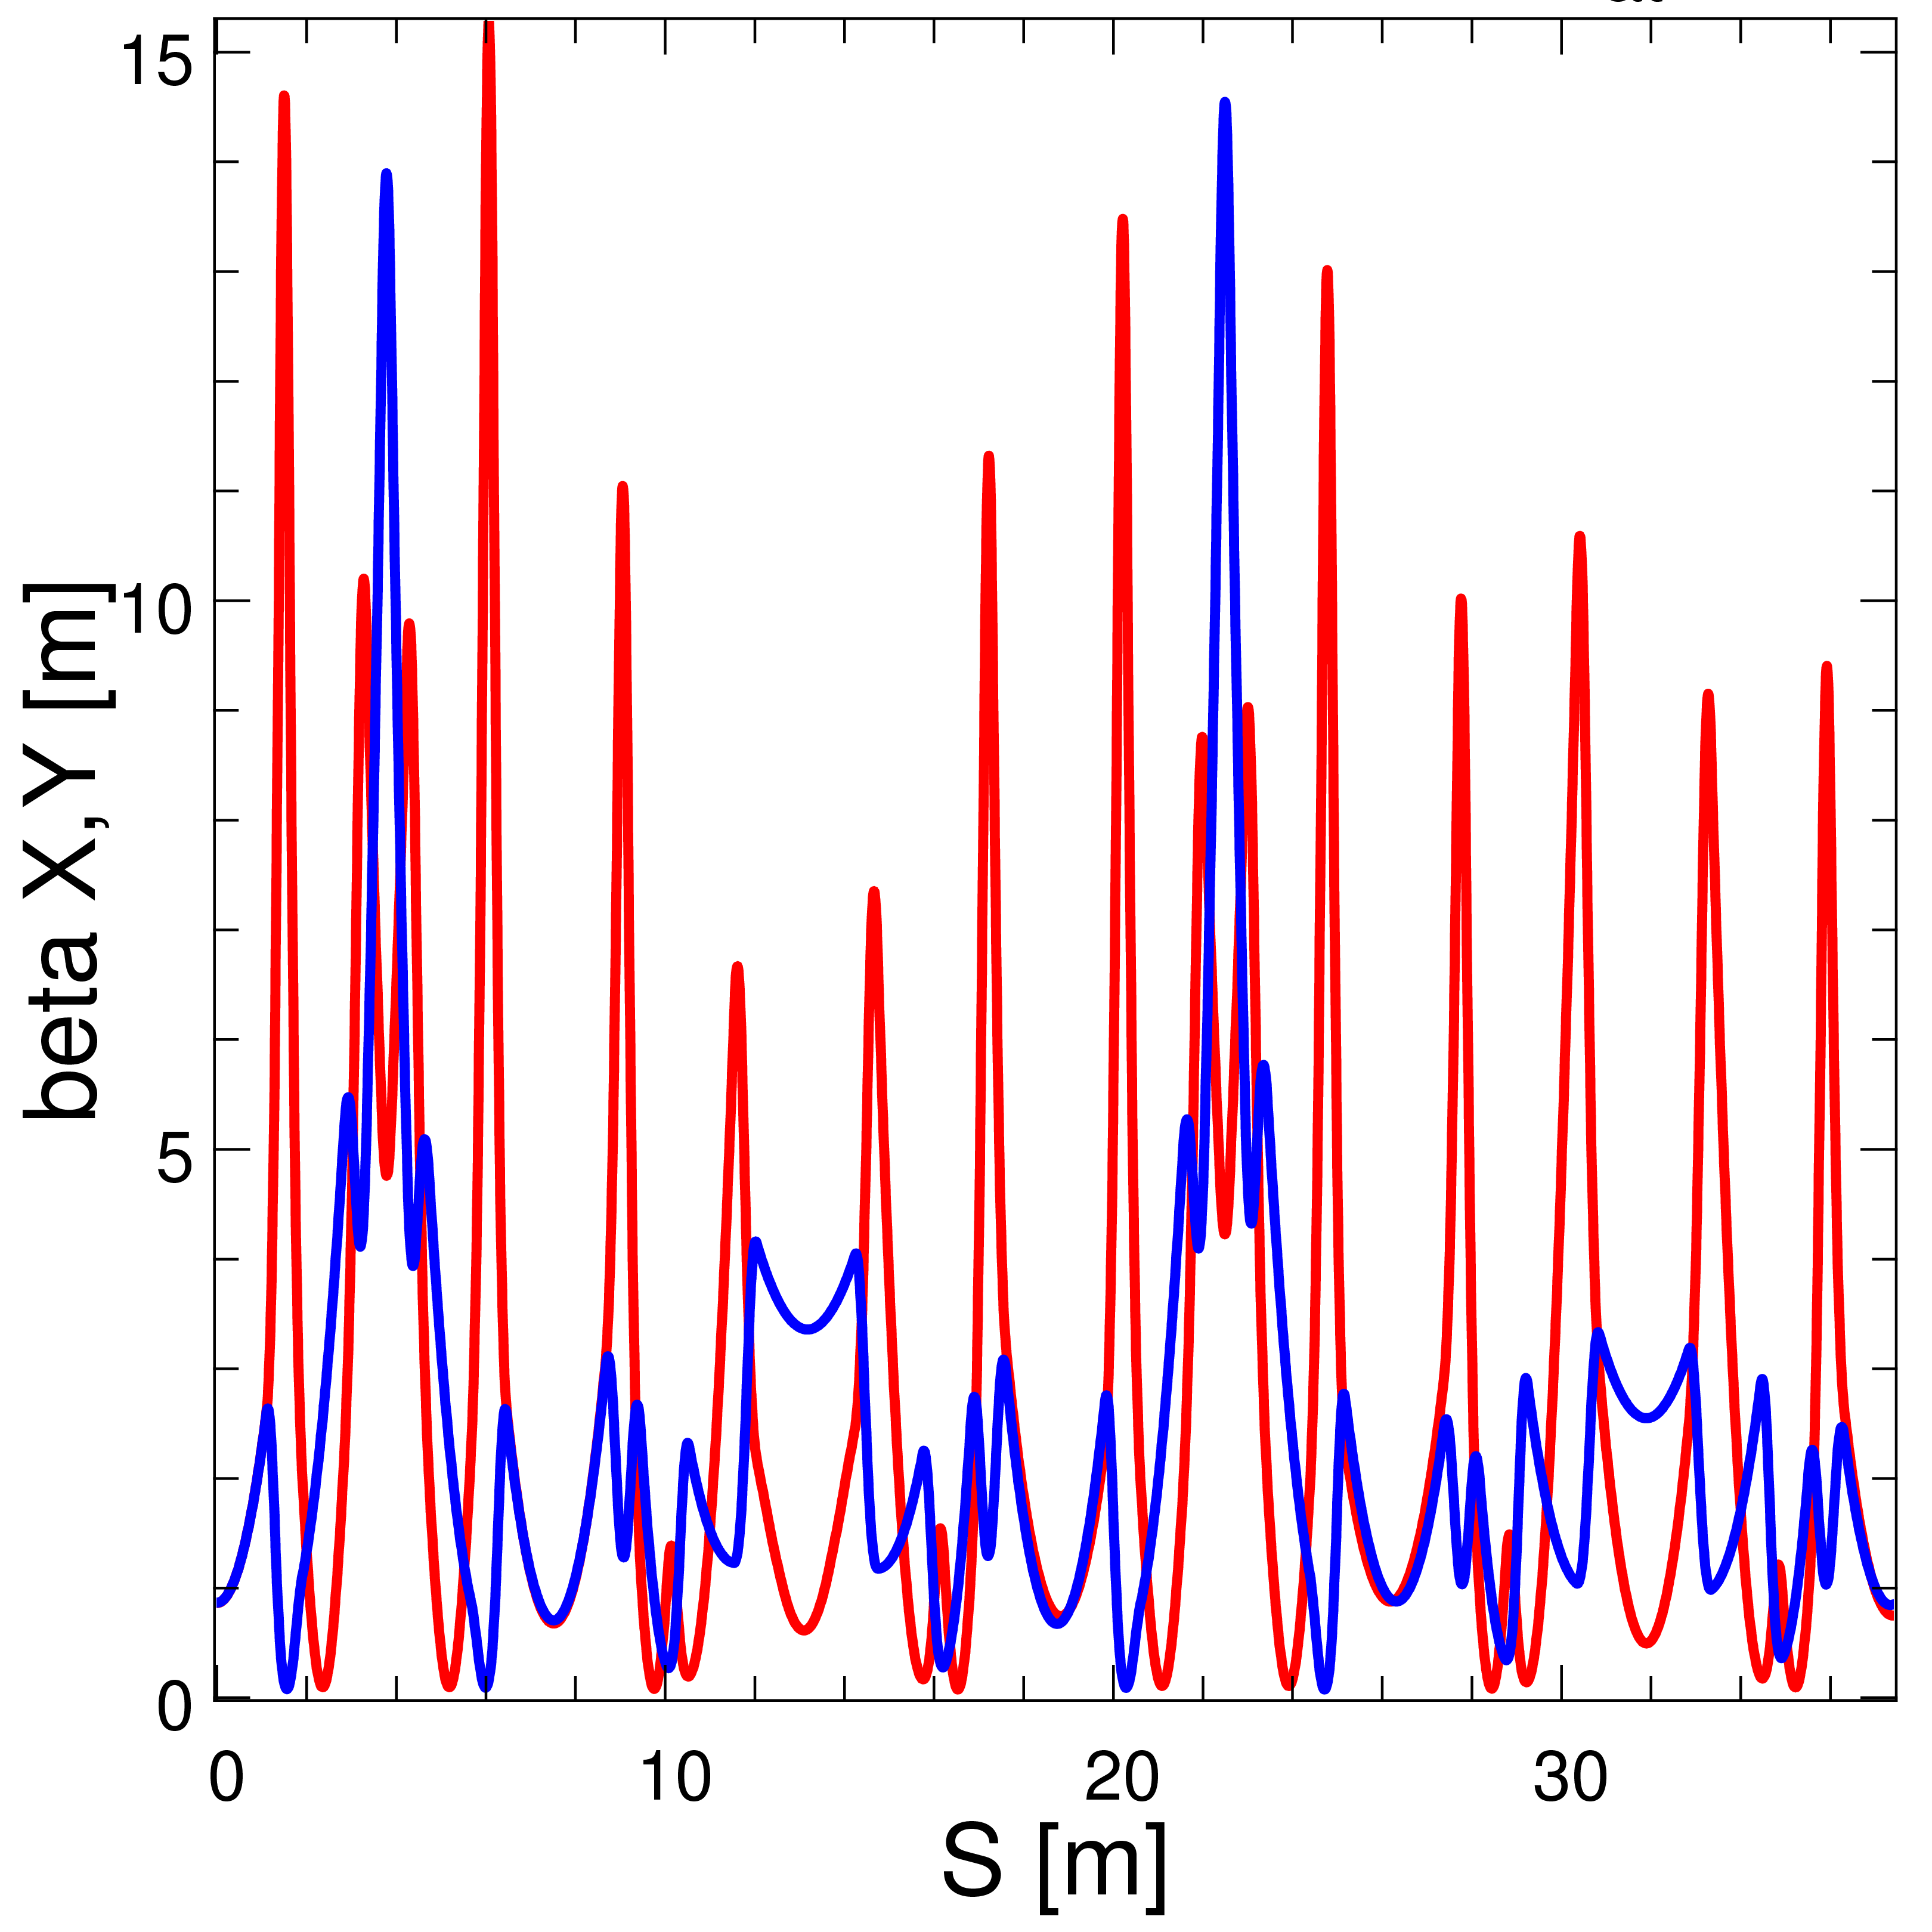
WARP simulations of IOTA (ring)
Looking at matching of underlying linear lattice @ 14 mA
  must be well-behaved, to optimize nonlinear dynamics
WARP can model injection from the RFQ in full detail
  will require 3D mesh of the entire ring

Slide 49
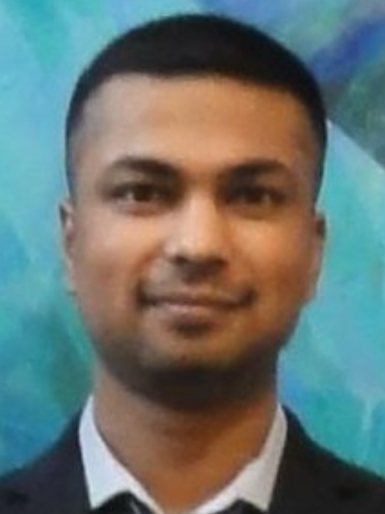


Students at IOTA/FAST
2015 Graduates
Sriharsha Panuganti
PhD
NIU
Frederic Lemery
PhD
NIU
David P. Lopez
MSci
Universidad de Guantajuato (Mexico)

Slide 50

IOTA/FAST Publications (since ~ Nov’14)
Peer-reviewed papers (5):
  D.Noll,G.Stancari, arXiv:1511.04507 (2015)
  S.Antipov, S.Nagaitsev, A.Valishev, arXiv:1502.01688 (2015) – subm. for pub.
  F. Lemery P. Piot, PRSTAB 18, 081301 (2015)
  D. Mihalcea, et al, APL107, 033502 (2015)
  Y. M. Shin, et al, NIM-B 355, 94 (2015)
Conference proceedings (12)
  IPAC’15 – 9
  Other - 3
Misc. technical reports (21)
Book on e-lenses
  Chapter 5 on Space-charge compensation with electron lenses

Slide 51
Summary
IOTA/FAST construction continues, follows HEPAP Accelerator R&D Subpanel recommendations #2, #3
  GARD thrust: Accelerator and Beam Physics
Impressive progress in FY15:
  FAST electron injector began operations with 20MeV beams
  CC2 transfer matrix and other measurements performed
  About 50% of IOTA parts fabricated
  (with supplemental support) p+ RFQ source refurbishment began
Aggressive Plans/Expectations for FY2016:
  Installation of CC1 will make 50MeV e- possible in early CY16
  FAST plans for 150-300MeV e- beam in Q4 of 2016
    Subject to continued and timely engineering and mechanical support

Slide 52
Summary – 2
Plans for FY17 and beyond:
  e- beam in IOTA FY17
  1st IOTA experiment on nonlinear integrable optics with e- is in good shape
    Simulations done
    Nonlinear magnets on track
  p+ beam schedule depends on resources:
    2020 with flat/planned funding
    2018 with extra ~1.5 M$ *
      ~1 FTE of EE and Mechanical Eng for 3 years and ~$900k M&S
    Availability of engineering/mechanical labor may impact schedule
Significant effort and resources are needed to establish experiments with protons:
  Beam Profile Monitor; Loss Monitors; Scrapers; Reverse-injected pencil e- beam; Electron lens; Damper/anti-damper system;
  (besides GARD funding) collaborators greatly help
*with current knowledge/expectation of FY17-18 budget

