Slide 1
PIP Update
April 6th 2016

Slide 2
Agenda
Summary Update
Additional Meetings/Notes
V. Kapin – Collimator Work
R. Tesarek – Beam Profile Measurement

Slide 3
Linac
SBK: Delivered –Task is being closed
LN: Amp at vendor, Working on ps setting limit firmware, Keep alive board is being assembled
Modulator:
28 cell: Continued LRF1 operations, working on identifying reasons for trips
54 cell: Cell construction almost done, charging ps testing all done, working on ground bar hardware, ctrls rack work
Plan is to proceed to testing prior to shutdown – order parts for next modulator
Booster
Booster optics software: No LOCO update this week, One more tune scan scheduled this week….talk in two weeks
Booster BPMs:
Work just getting started again – Labor lost to DCCT seems to be returning….
Collimators:
Update talk today…
RF:
Cavity 21: Bottom tuner on stand, waiting upon windows (will use old windows since new ones are delayed)
Cavity 22: On stand - waiting for bus bars, testing will begin after assembled
Tuners:
#15 Slightly higher resistance – taken apart looked good – put back together again had higher resistance - investigate
#16 waiting for final test by RF department
#17 ferrites shipped to TD
#18 ferrites prepared
#19 – enough ferrites for 19 tuners (allow for several low mu ferrites) – looking into spare inventory for all hardware
Replacement cavity – still working on simulations for perpendicular design and waiting on wide bore tests!
Perpendicular bias cavity:
Vendor visit last week went well – looks like they can do all the necessary cutting
Working on mechanical 3D design
PA tested at 71 MHz looked good, moving on to 105MHz test which means building a new resonator cavity -
Shielding assessment – supporting documentation provided to ES&H, will complete package – then off to committee….

Slide 4
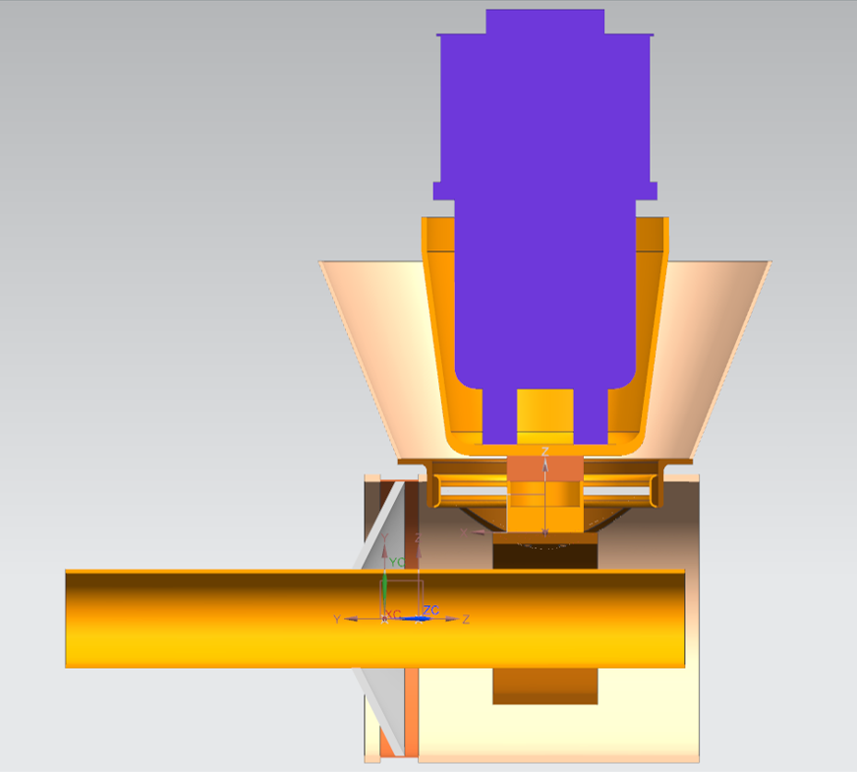
Perpendicular cavity without ferrites and solenoid
Investigating areas of mechanical concern
Issues:
Two windows
Coupling constraints
Tight welding areas
Ability to repair when necessary
Support weight

Slide 5
Budget:
Reduction of 1.5 M FY16 to cover AD shortfall – still do not know
Adjusting Linac modulator purchases to accommodate funding
Still need to understand stations 21 and 22 M&S
Meetings to discuss transition PIP to PIP-II put on hold – Steve Holmes

Slide 6
Upcoming Talks
TLM install and operations: Tony
Shielding assessment: Keith
Harmonic cavity update: CY Tan
LOCO physics: CY Tan
New Cavities (plans) Tom Kroc

