Slide 1
BH Measurement of G-510 Ring
John Kuharik
Booster 2nd Harmonic Cavity Meeting
5 May 2016

Slide 2
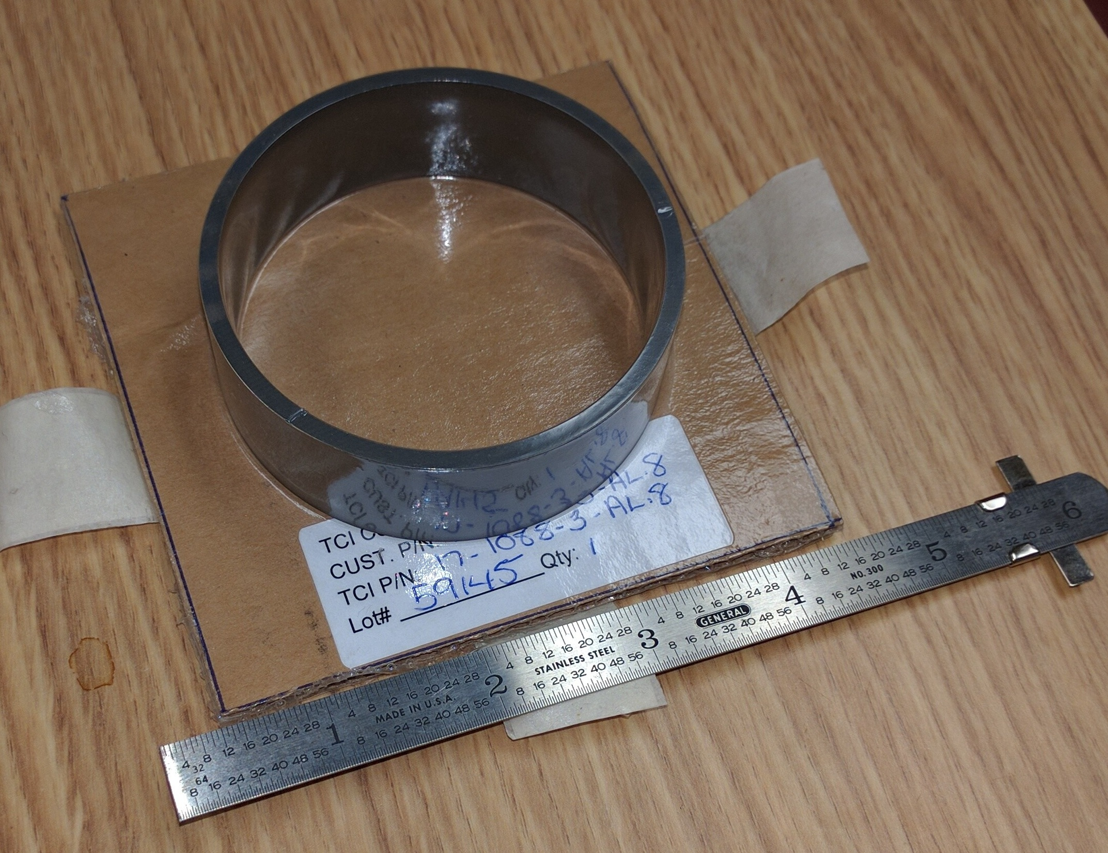
Goal
Develop a method and experimental apparatus to measure the BvH curve for sample ring of AL-800.

Slide 3
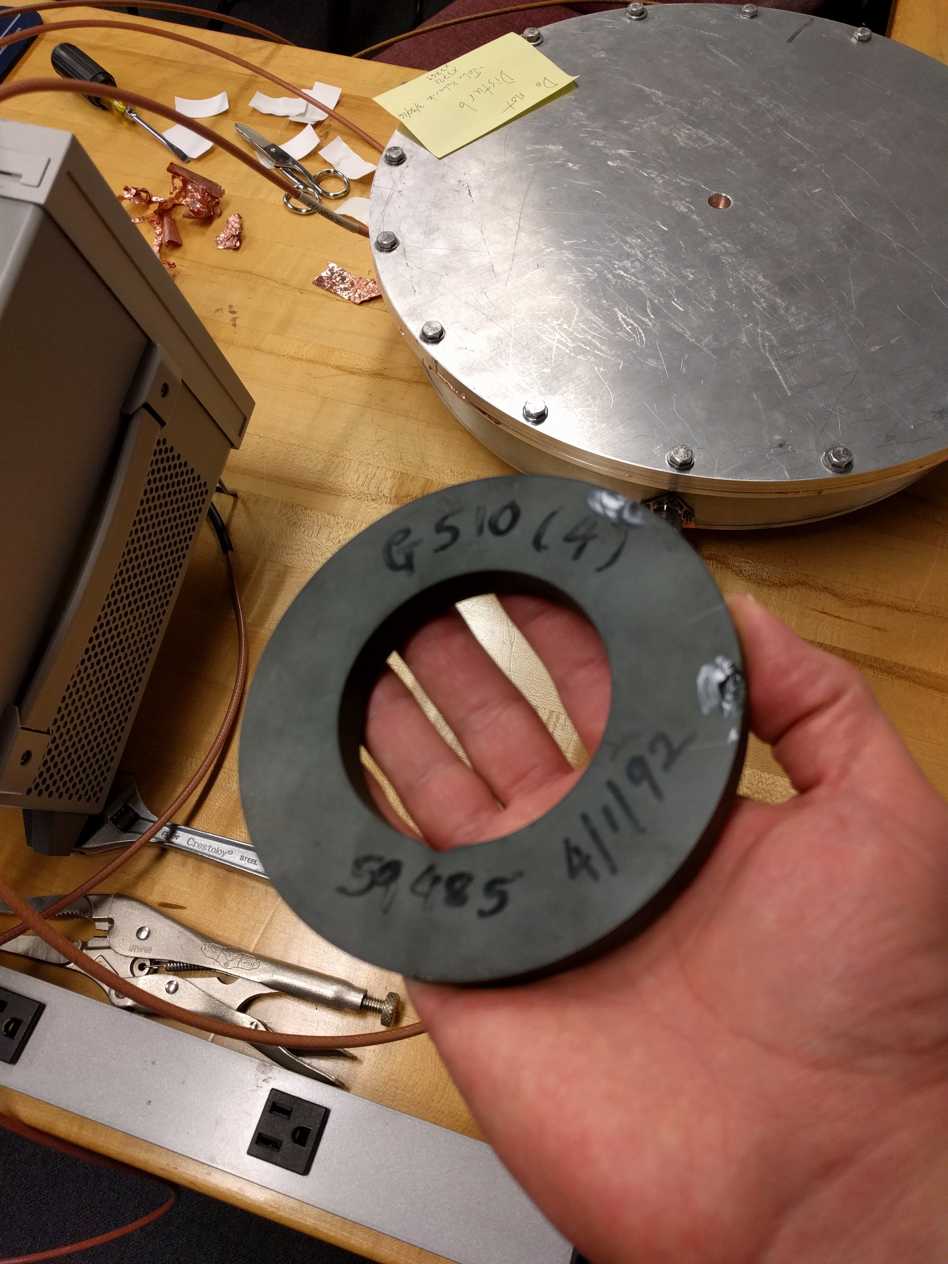
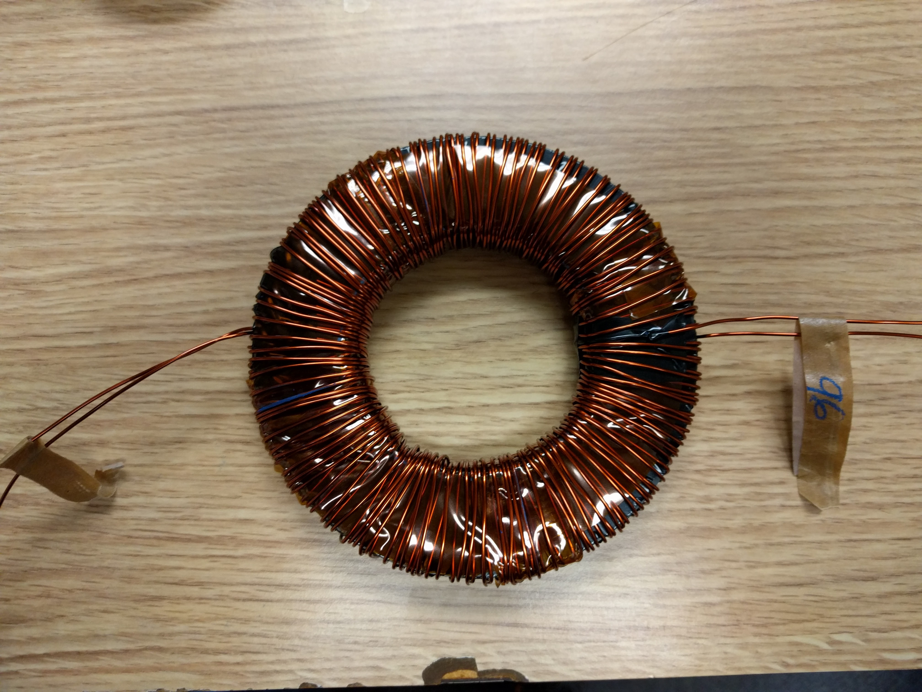
G510 Ferrite Ring

Slide 4
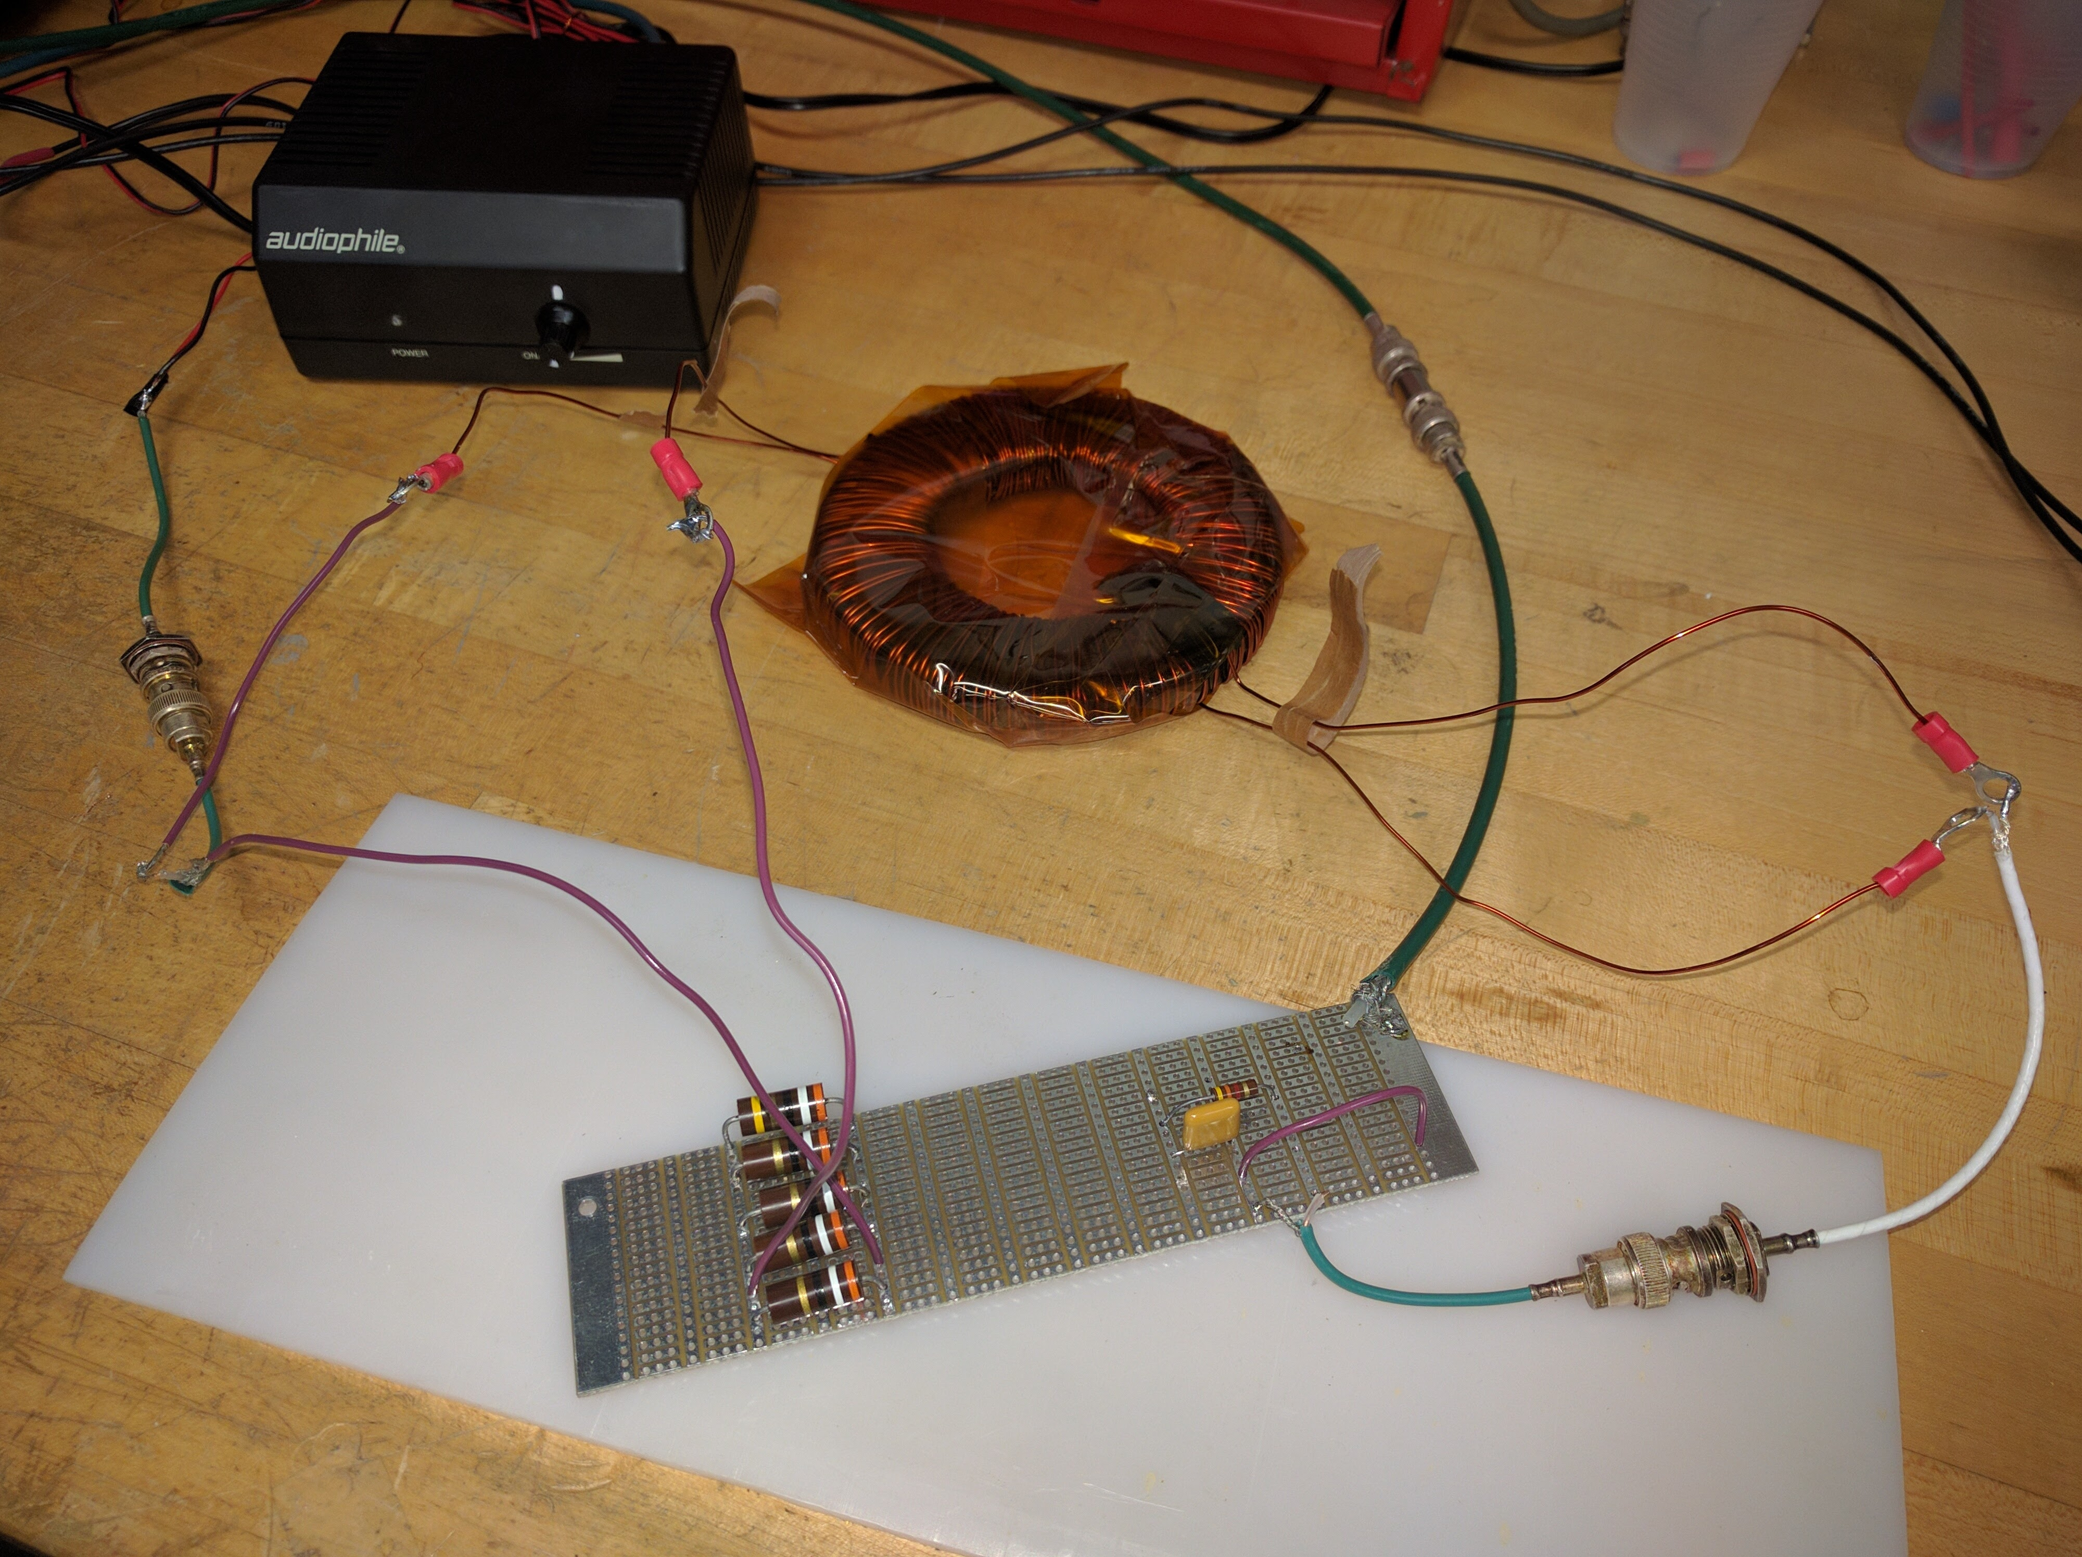
Circuit Design

Slide 5
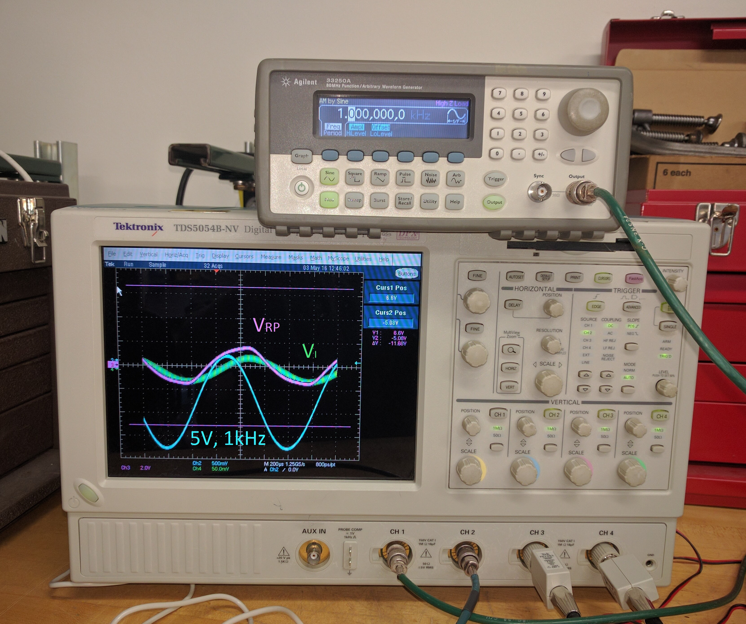
Circuit Design

Slide 6
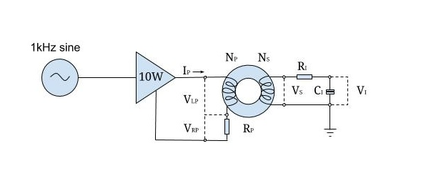
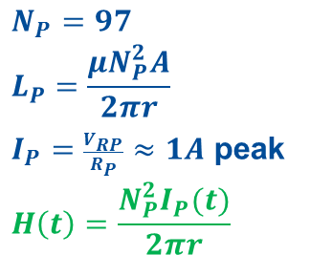
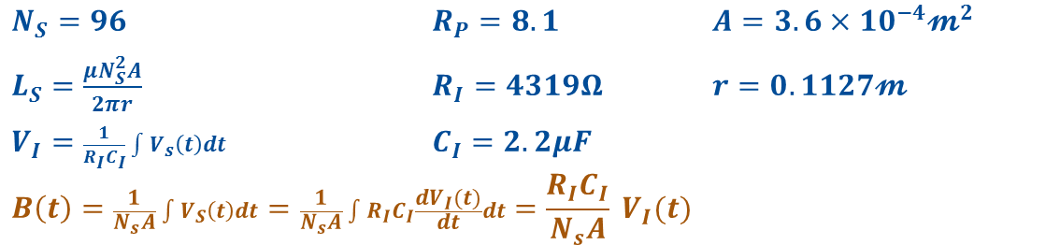
Circuit Design
$$N_{P}=97$$
$$L_{P}=\frac{μN_{P}^{2}A}{2πr}$$
$I_{P}=\frac{V_{RP}}{R_{P}}≈1A$ peak
$$H\left(t\right)=\frac{N_{P}^{2}I_{P}(t)}{2πr}$$
$N_{S}=96$ $R_{P}=8.1$ $A=3.6×{10}^{−4}𝓶^{2}$
$L_{S}=\frac{μN_{S}^{2}A}{2πr}$ $R_{I}=4319Ω$ $r=0.1127𝓶$
$V_{I}=\frac{1}{R_{I}C_{I}}\int{V_{s}\left(t\right)dt}$ $C_{I}=2.2μF$
$$B\left(t\right)=\frac{1}{N_{s}A}\int{V_{S}\left(t\right)dt}=\frac{1}{N_{s}A}\int{R_{I}C_{I}\frac{dV_{I}(t)}{dt}dt}=\frac{R_{I}C_{I}}{N_{s}A} V_{I}(t)$$

Slide 7
Results

Slide 8
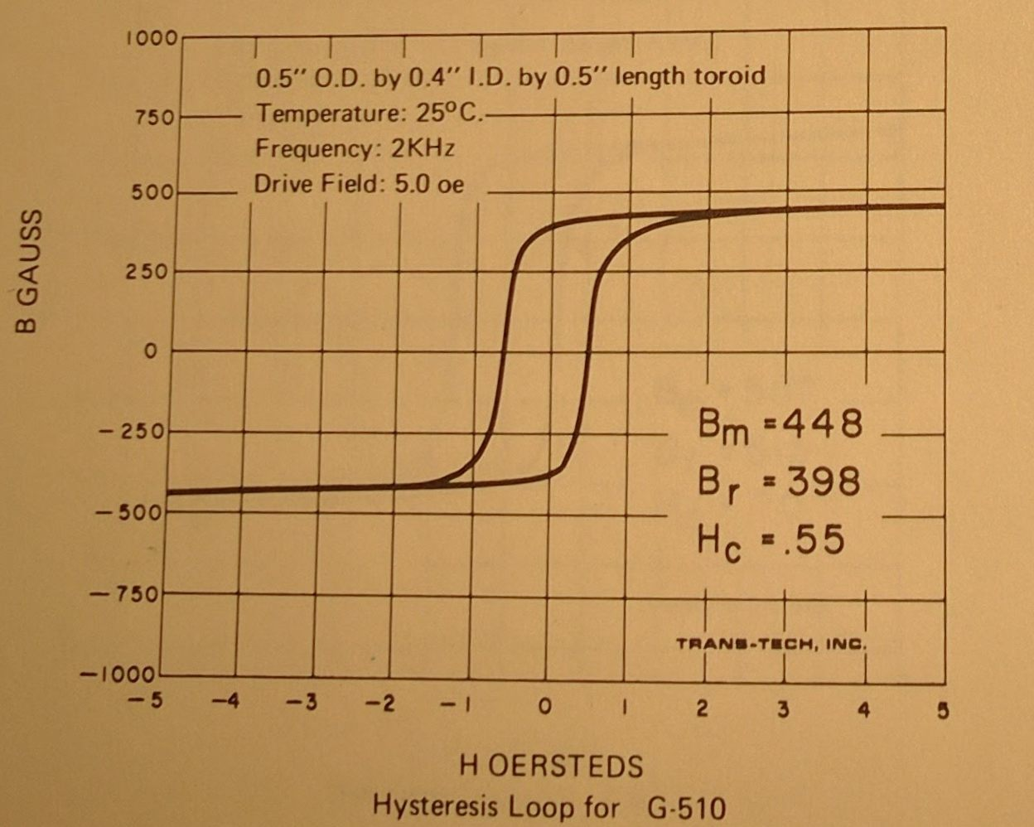
Published Data from Trans-Tech Inc.

Slide 9
Going Forward
The test was successful on the ferrite ring, but the setup only delivered H = 2 Oe in the sample.
Next steps:
  Measure BvH on Al-800 ring with 200+ Oe.
  Better amplifier, 60W available
  More turns on the windings, 500

