Slide 1
Impedance (Presented to Anode) of Cavities
Ding Sun
2nd Harmonic Cavity Meeting
06/16/2015

Slide 2
1. Where is this impedance (presented to or seen by anode)
2. Check simulation results with some measured data (booster cavity)
3. Impedance of 2nd harmonic cavity
4. Impedance of resonators for PA test

Slide 3
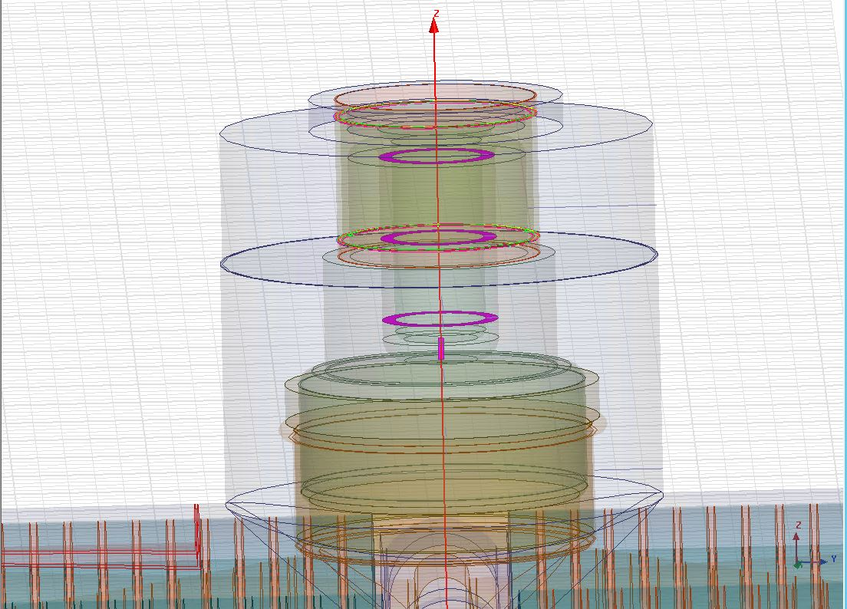
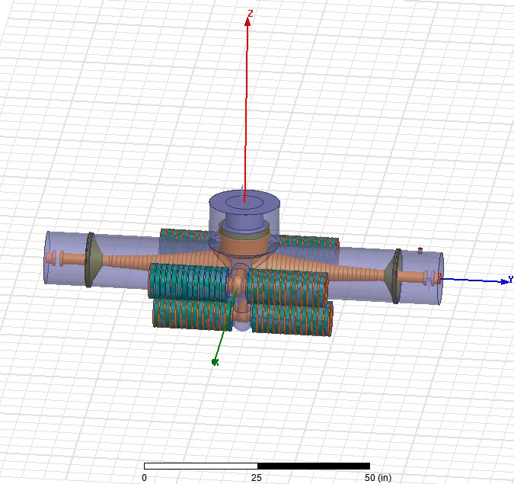
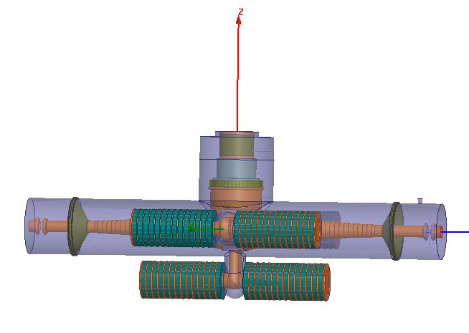
Where is this impedance (presented to the anode)?
Location 2
Location 1
Not This Plane
Location 3
Location 4
Without PA
With PA

Slide 4
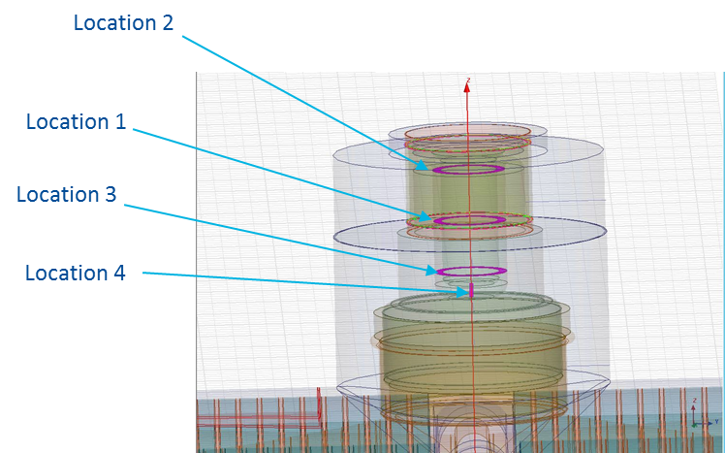
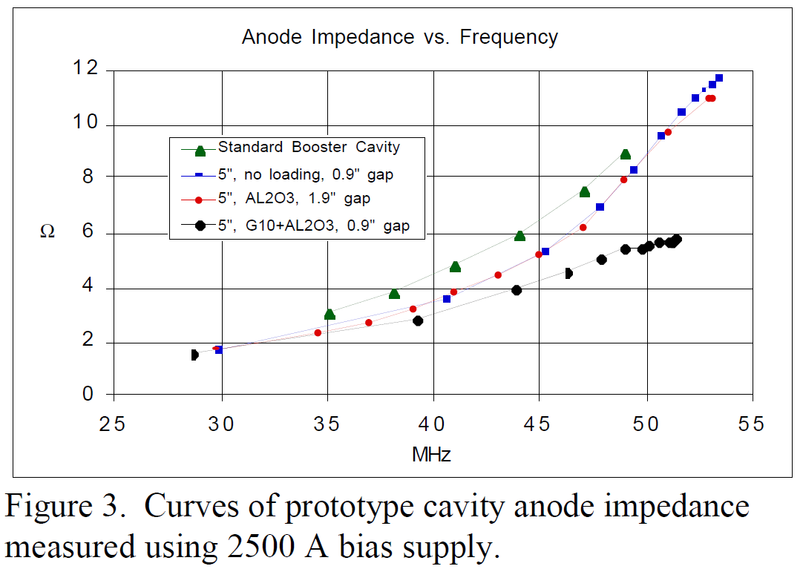
Simulation results vs. measured data (Booster Cavity)
Simulation results (Booster Cavity):
With PA, 1 Local port at anode Location1 35.419 MHz 3100 Ohm
With PA, 1 Local port at anode Location2 35.419 MHz 3000 Ohm
With PA, 1 Local port at anode Location3 35.419 MHz 3100 Ohm
With PA, 1 Local port at anode Location4 35.410 MHz 3100 Ohm
With PA, 1 Local port at anode Location1 52.082 MHz 10200 Ohm
With PA, 1 Local port at anode Location4 52.097 MHz 10200 Ohm
Measured data (Mark Champion)
The simulation results are close to the measured data
-> validated. Now other cavities can be evaluated in
the same way.

Slide 5
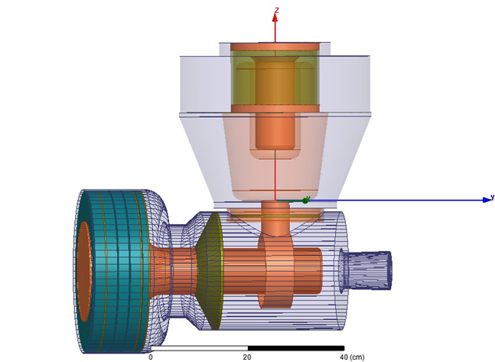
Impedance (presented to anode) of 2nd Harmonic Cavity
With PA, 1 Local port at anode Location1 74.720 MHz 1900 Ohm
With PA, 1 Local port at anode Location4 74.735 MHz 1900 Ohm
With PA, 1 wider Local port at anode Location4 74.715 MHz 1960 Ohm
With PA, 1 Local port at anode Location1 105.790 MHz 10500 Ohm
With PA, 1 Local port at anode Location4 105.803 MHz 11000 Ohm

Slide 6
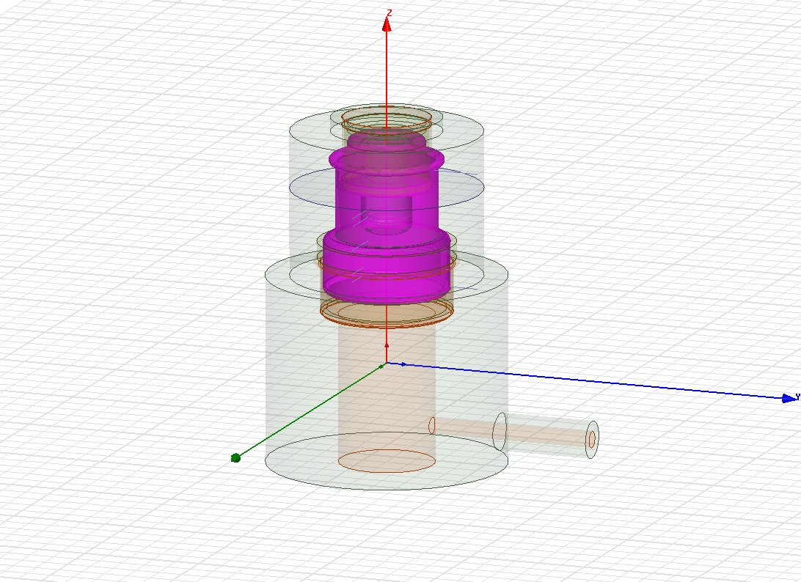
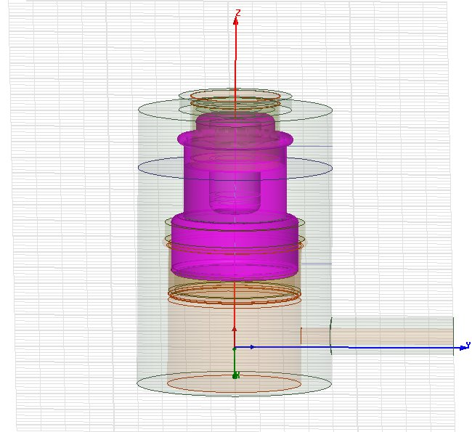
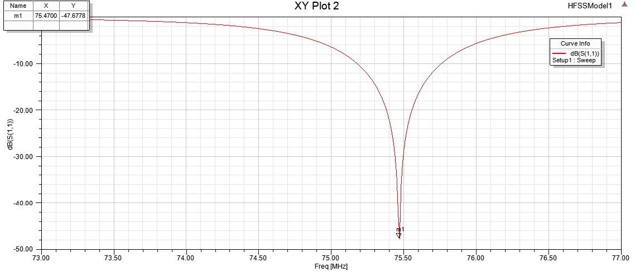
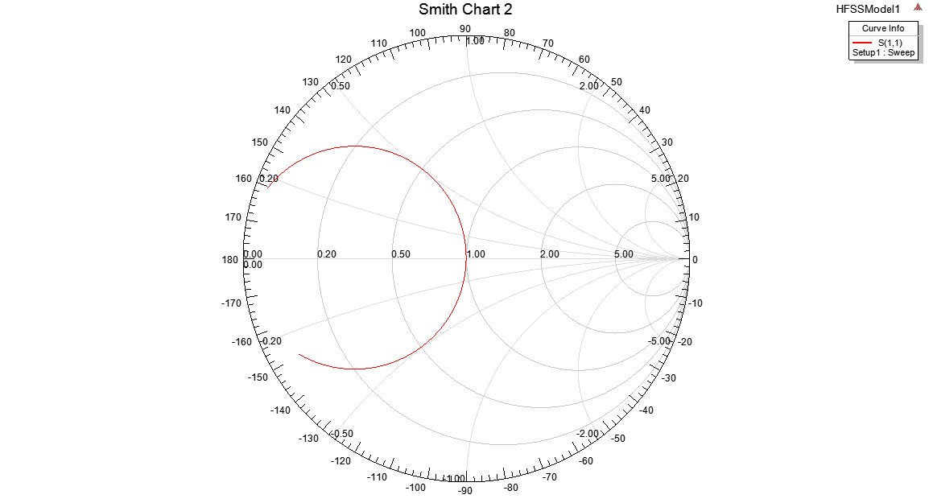
Impedance (presented to anode) of Resonators for PA test
Existing 53 MHz resonator With PA, 1 Local port at anode Location4 52.642 MHz 1950 Ohm
Robyn’s new76 MHz resonator With PA, 1 Local port at anode Location4 75.467 MHz 2400 Ohm
Existing 53 MHz resonator
Robyn’s new 76 MHz resonator
It would be interesting to check a 106 MHz PA test resonator (if any).

