Slide 1
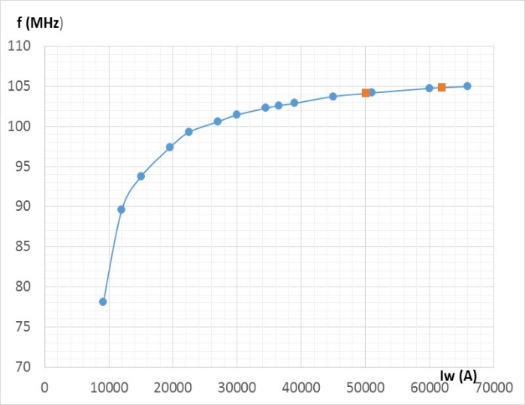
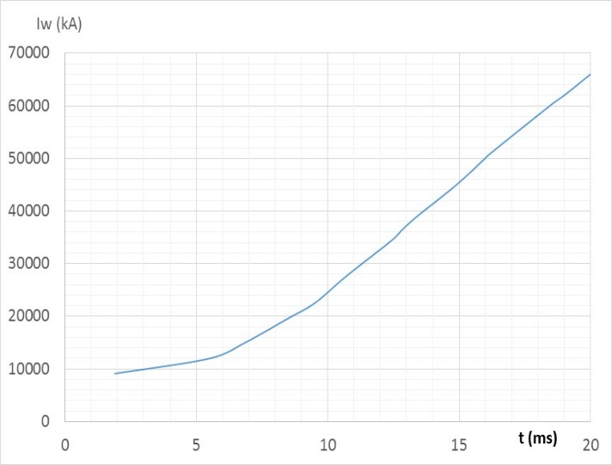
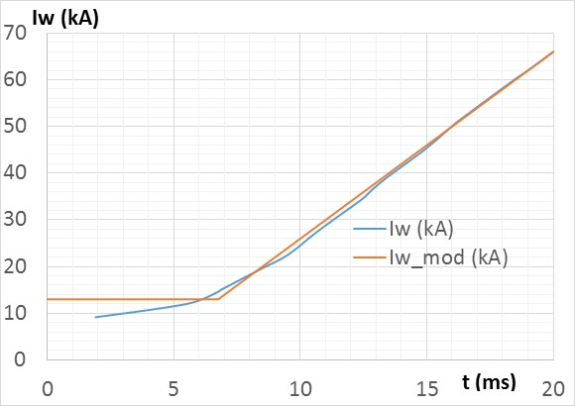
Bias Current Profile
Magnetic system update
Tuning curve (June 02, 2016)
Iw = 13 kA at t < 6.75 ms
Iw (kA) = 13[kA] + 4[kA/ms]*(t[ms]-6.75) at 6.75 ms < t < 20 ms
dIw/dt = 4 kA/ms or 80 A/s
Maximum current at 20 ms is 1320 A
Problems:
Heat deposition in the coil
Flux return saturation

Slide 2
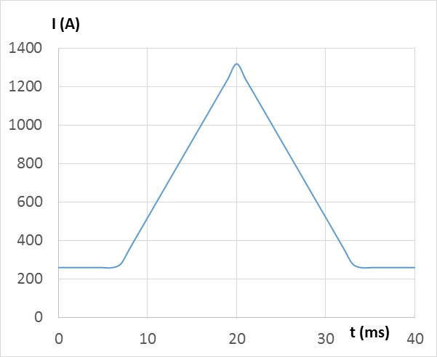
Heat deposition in the coil
R = 0.02 Ohm
Simplified current shape (N = 50)
1. Energy per cycle at the low current:
Q = 0.02 Ω * 260² A² * (66 – 2*(20- 6.75))E-3 s = 53.4 J
2. Energy per cycle during the single ramp I = 260 + 80*t
Where t changes from 0 to (20-6.75) = 13.25 ms:
Q = 0.02 Ω*10⁻³*∫dt(260 + 80*t)² = 2E-5*{260²*13.25 + 2*260*80*13.25²/2 + 80²*13.25³/3} =
2E-5*{895700 + 3651700 + 4962566.7} = 2E-5*9.51E6 = 190 J
For two ramps per cycle, the energy in the coil is 380 J
3. Total energy per cycle is Q = 434 J
5. At 15 Hz, P = 6510 W
This power exceeds current capabilities of the coil → the cooling circuit design needs to be modified
What happens if we have four cooling circuits?
Velocity of water with ΔT = 10°C – Q = 0.24*1750/10 = 0.042 l/s → 2.52 l/min
Water velocity v = 1.6 m/s
The lengths of the longest circuit is ~22 m
Δp = 1.6²∙22/20.7 = 2.7 kG/cm² or ~40 PSI.
This is realistic → the 6.5 kW power in the coil can be handled.

Slide 3
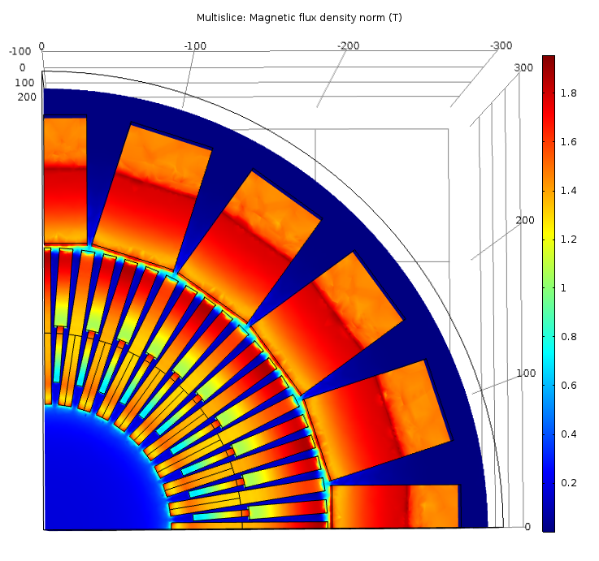
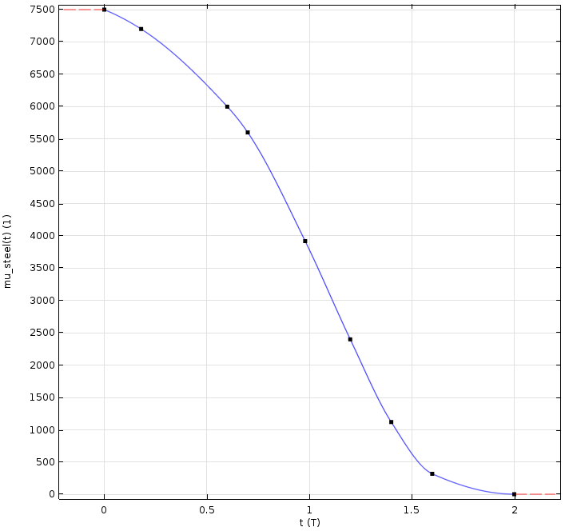
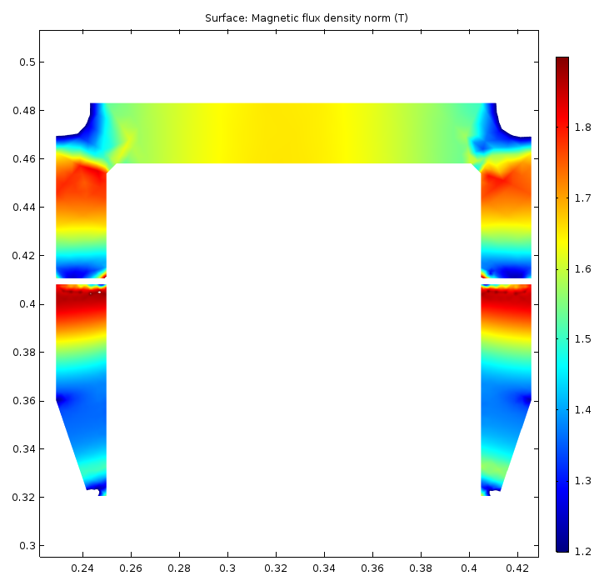
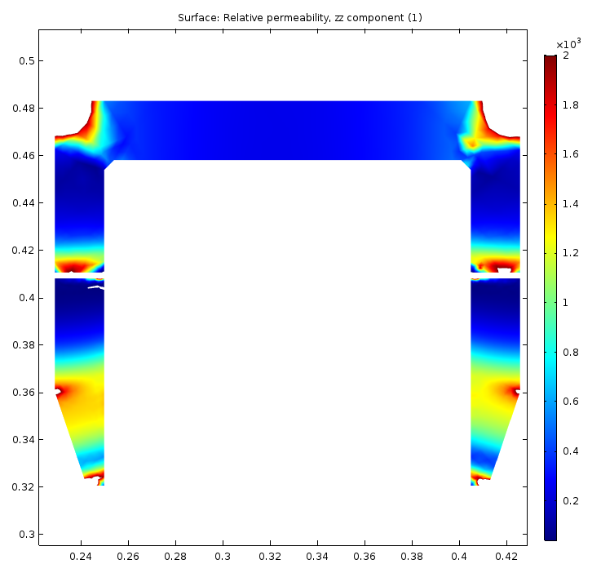
Flux return saturation at the 62.5 kA excitation current
Simplified magnetization curve for the electric Silicon Steel
Material is in the highly saturated condition →
1. Better filling density: fill all gaps tighter.
2. Better material: use low silicon content grades of steel, e.g. M47.
3. Thicker pole parts
B > 1.2 T
B < 1.9 T
μ > 40
μ < 2000

Slide 4
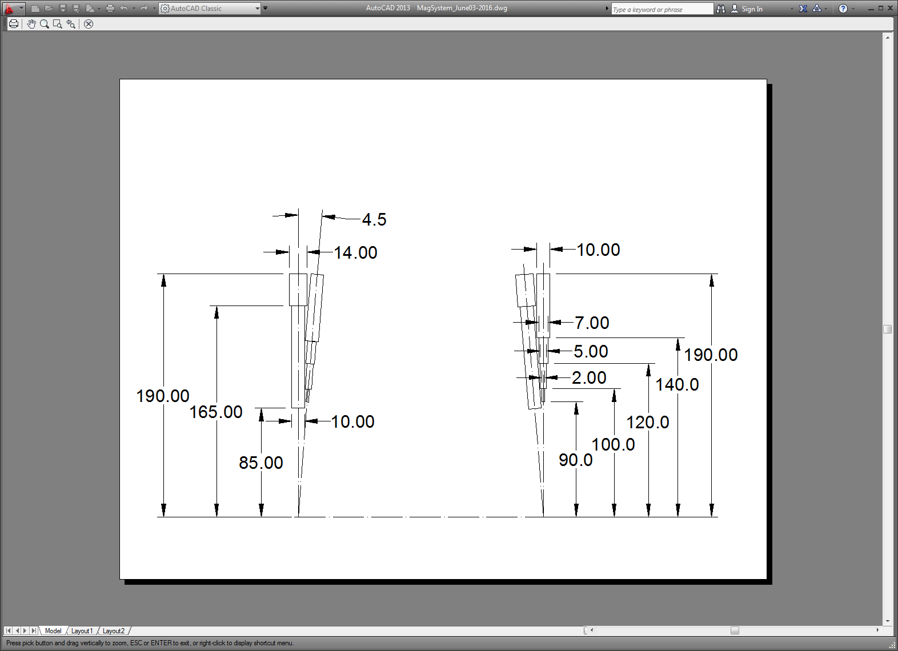
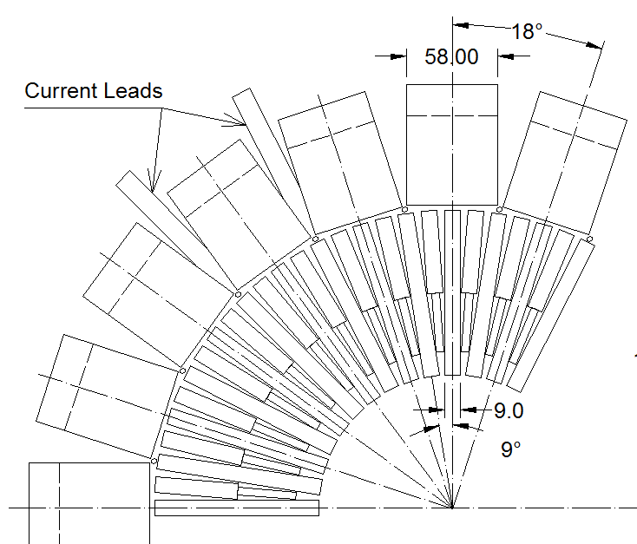
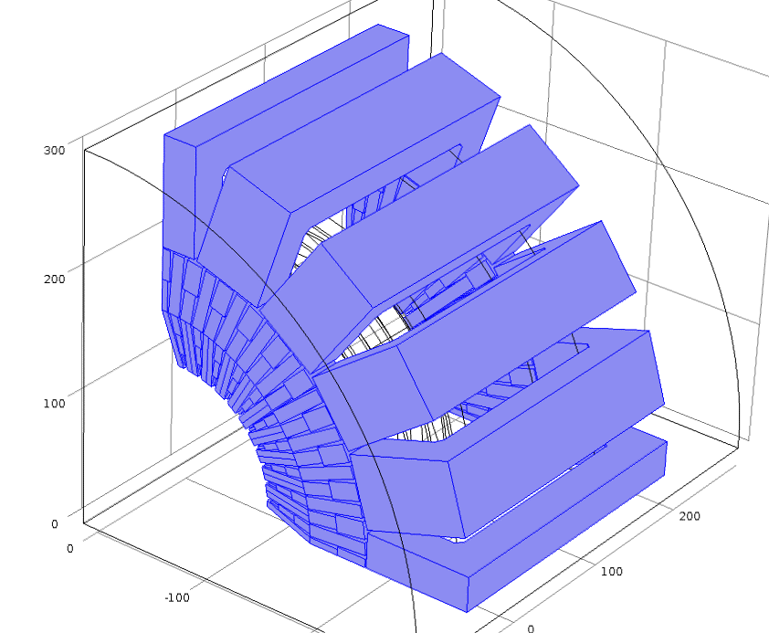
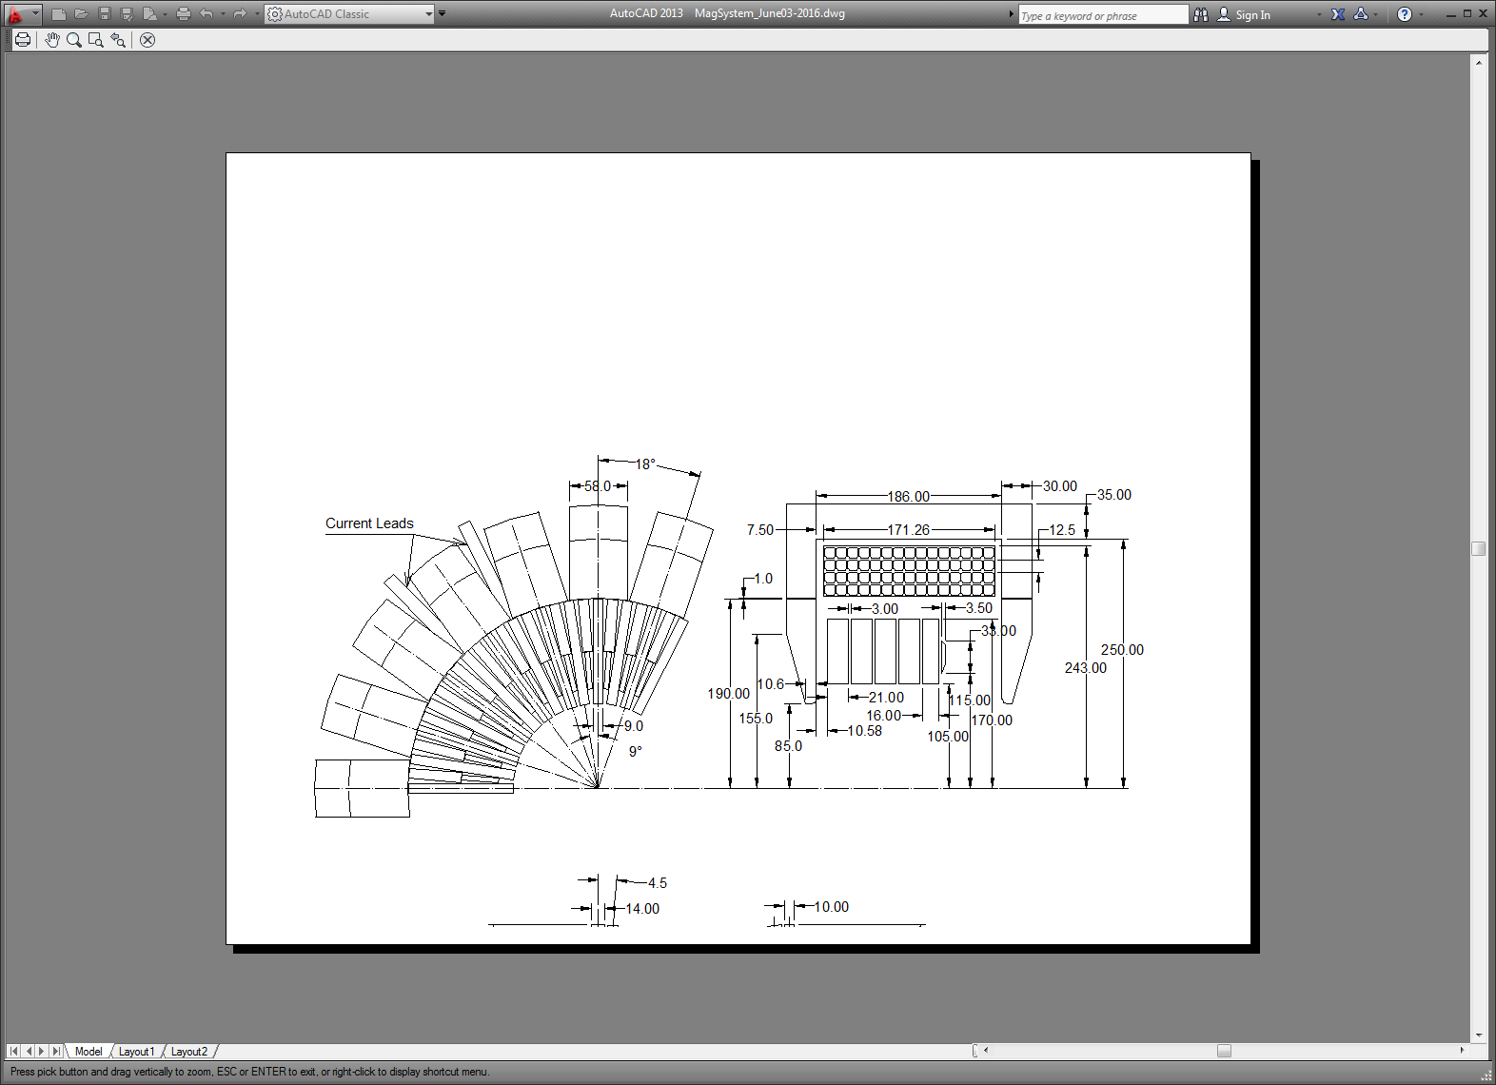
Flux Return Saturation
1. Increased filling factor in the poles
2. Increased thickness of the FR

Slide 5
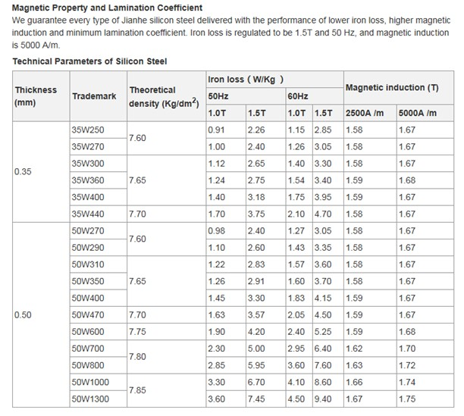
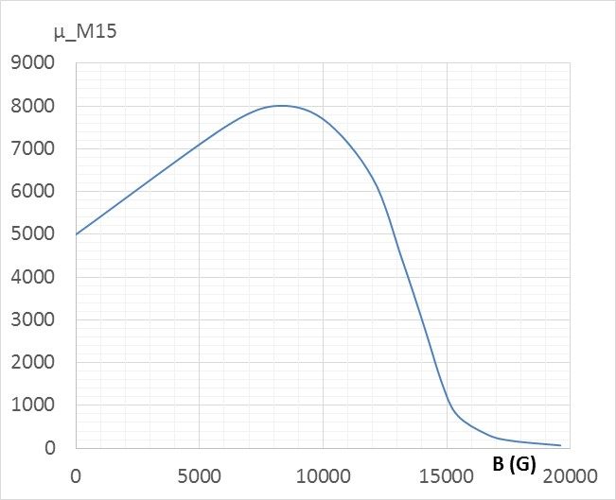
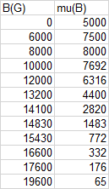
FR Material
M15 Silicon Steel
Using M15 silicon steel seems adequate for the goal

Slide 6
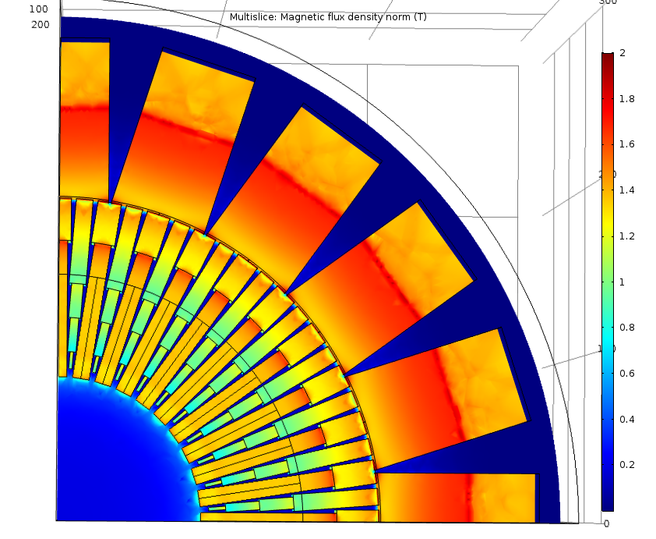
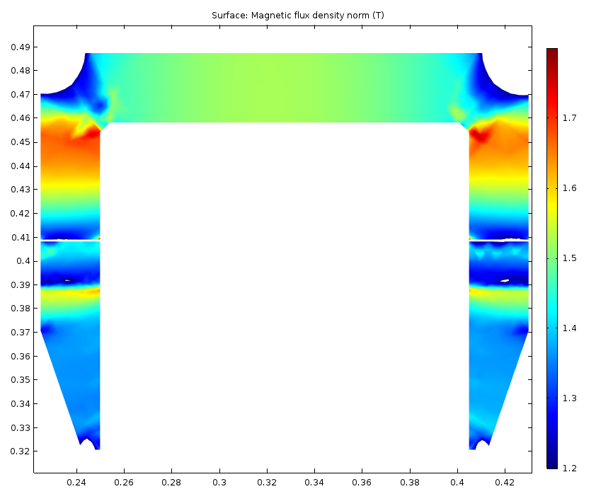
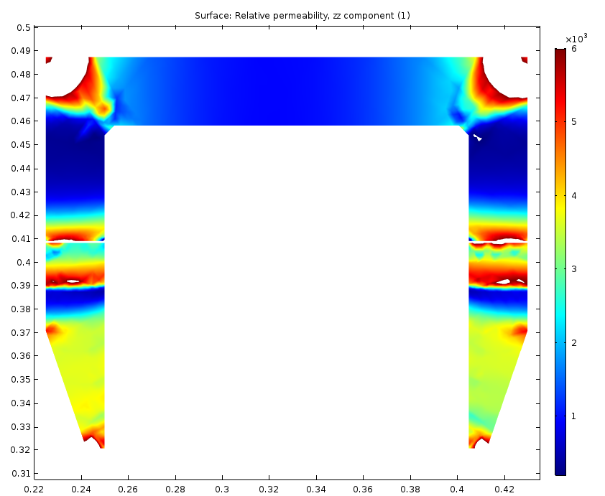
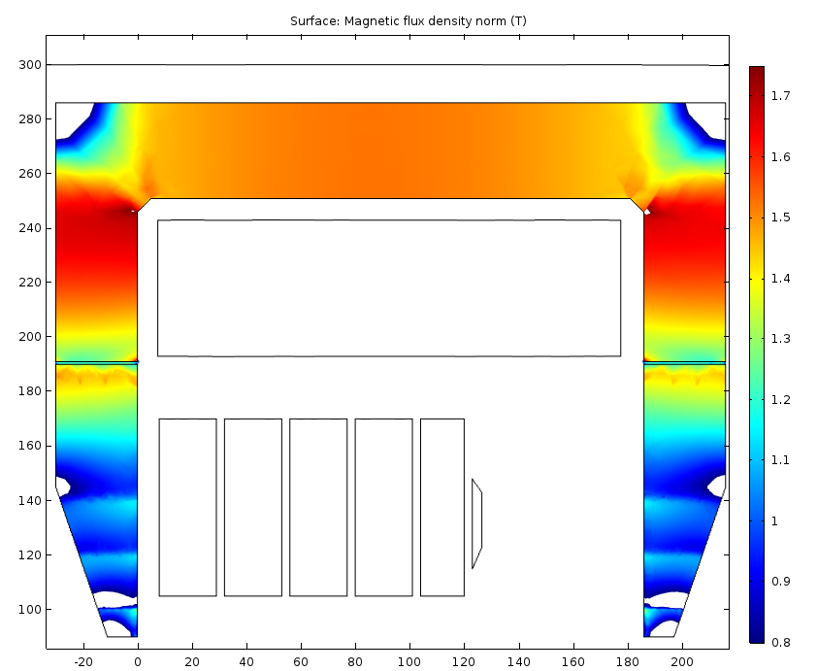
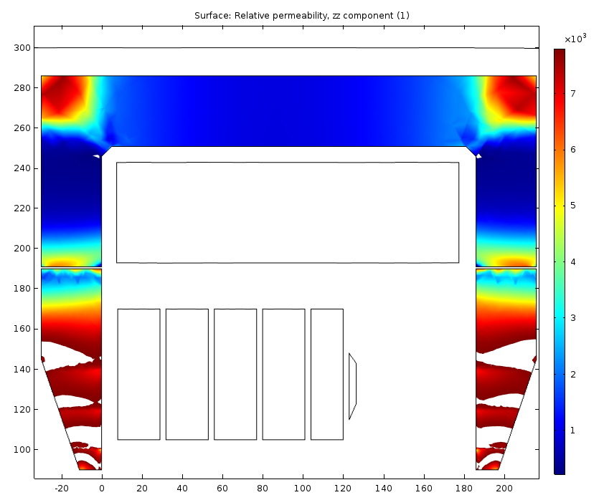
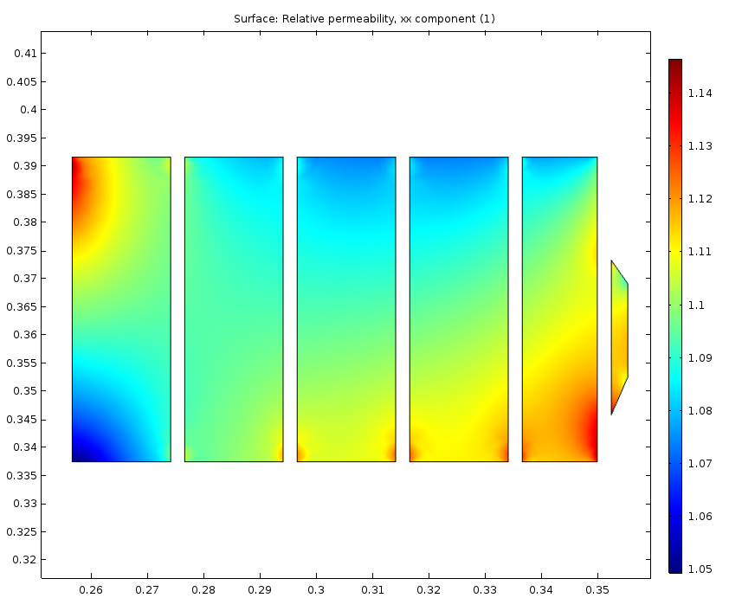
Updated FR Saturation Data (62.5 kA)
Changes made:
Gap between the pole and the FR is now almost uniform (1 mm)
Thickness of the FR is made 35 mm (it was 30 mm).
Material of the FR is M15
0⁰ plane: B → 1.2 – 1.8 T; μ → 200 - 6000
4.5⁰ plane: B → range 0.8 – 1.75 T; μ → 220 - 7800
Garnet permeability

Slide 7

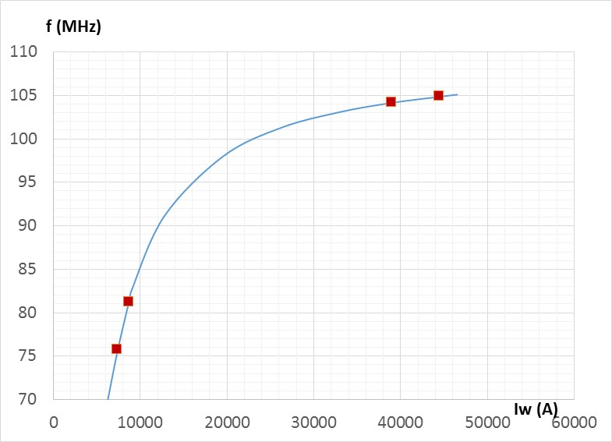
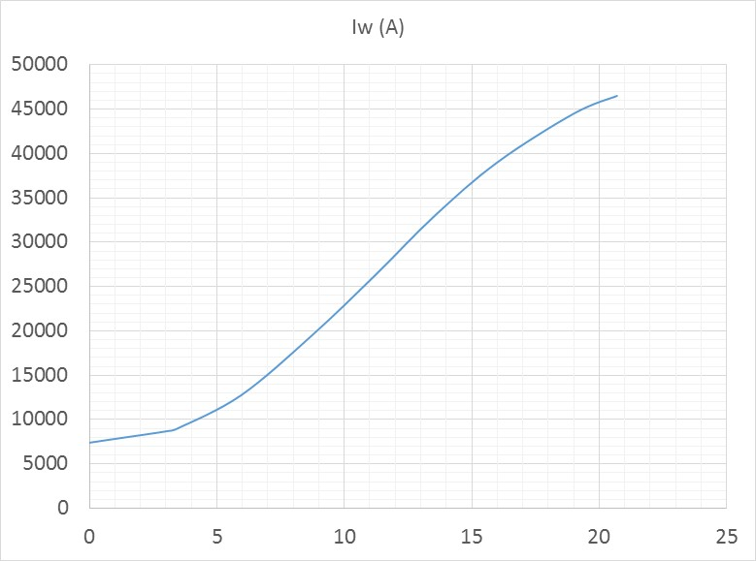
Updated Tuning Curve (June 10)
The lowest frequency of 75.73 MHz corresponds to the total current of 7400 A.
This corresponds to the 148 A current in the coil.
Field and permeability in the garnet at the lowest current is a concern

Slide 8
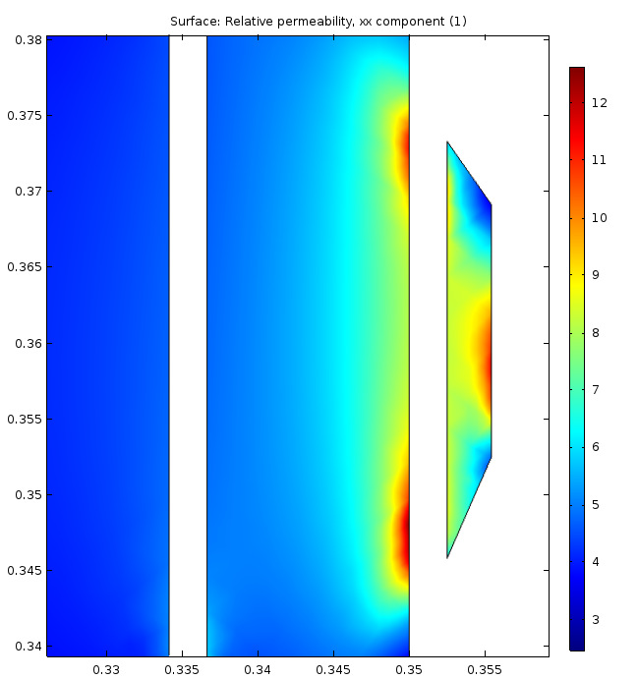
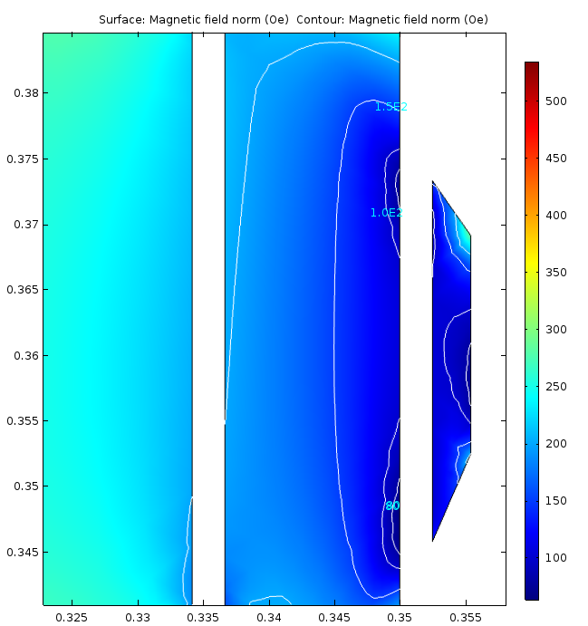
Magnetic Field and Permeability in the Garnet at the Lowest Bias
Permeability in the garnet
Magnetic field in the garnet (80, 100, 150, 200 Oe)
Gyromagnetic resonance field at 75 MHz (32 Oe) → the field seems sufficiently far from the resonance

Slide 9
Next steps
According to the latest tuning curve, we have some reserves in handling the heating
Integration efforts by Kevin will show availability of additional space for the pole material (if needed)
2D flux penetration stays the same. Feasibility of the chosen cavity wall thickness needs to be verified.
4. 3D model of flux penetration (slotted RF shell) needs to be set
Additional activities:
SSC LEB cavity failure analysis
Setup for the QC of the AL-800 garnet rings from NMG

