Slide 1
Presentation Title — one line or two lines
Presenter’s Name
Meeting Title
Day Month Year

Slide 2
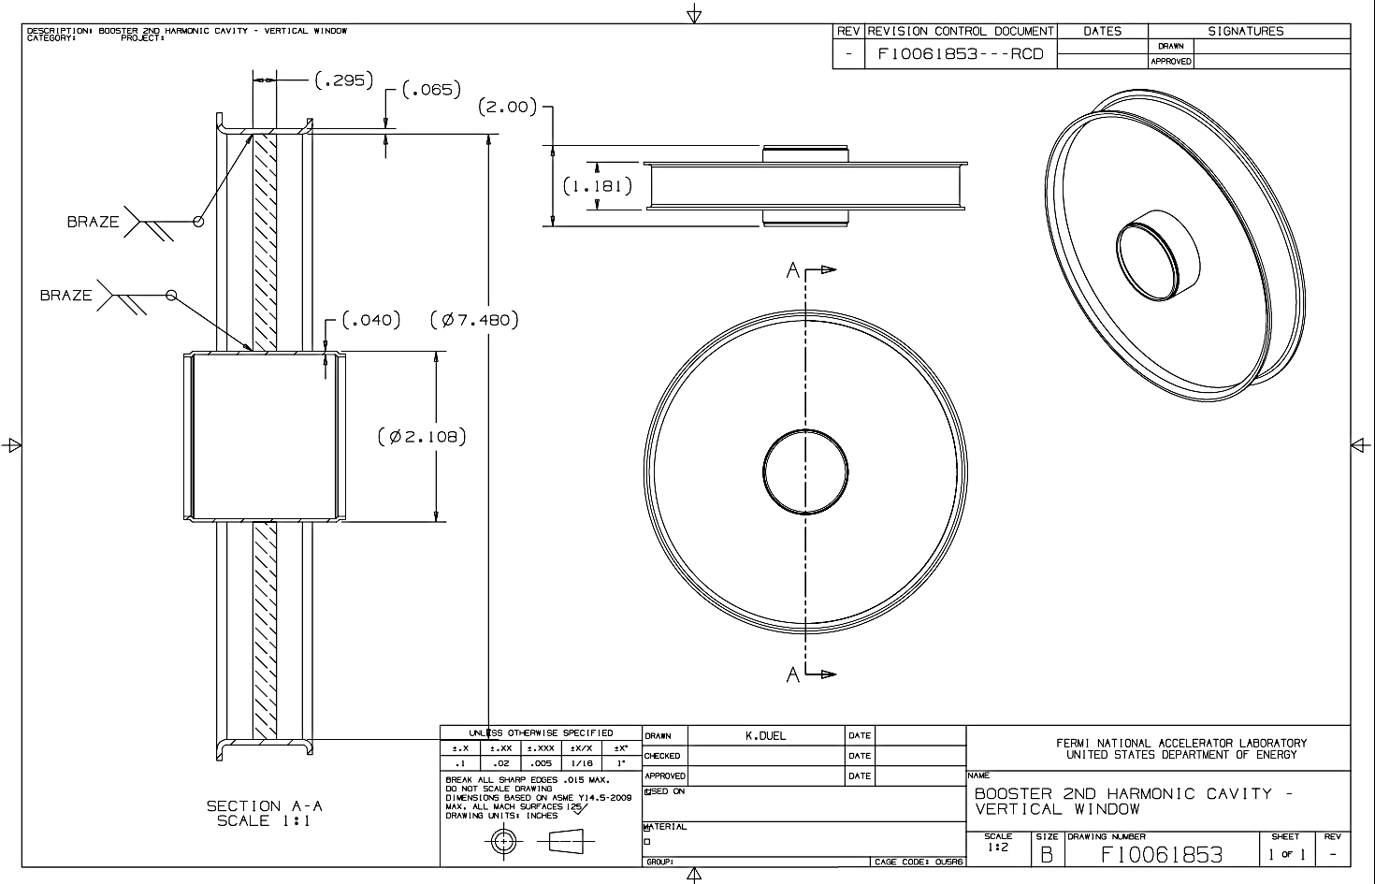

Slide 3
