Slide 1
Current Pulse Shape of the 2-nd Harmonic Booster Cavity at Injection
I. Terechkine
2-nd Harmonic Cavity Meeting
12 July 2016

Slide 2
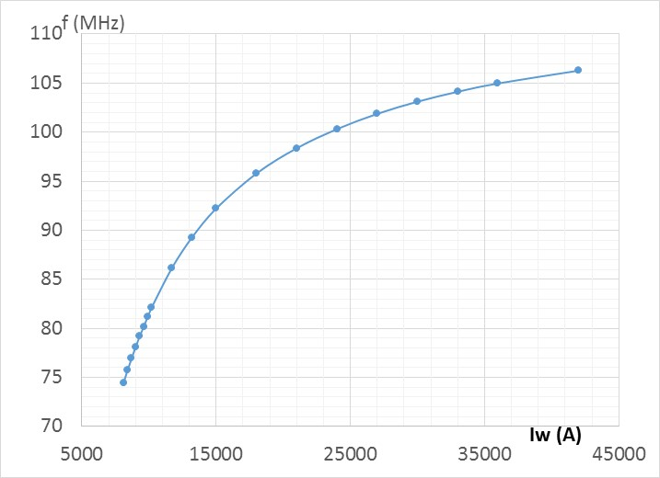
Frequency Ramp and Tuning Curve

Slide 3
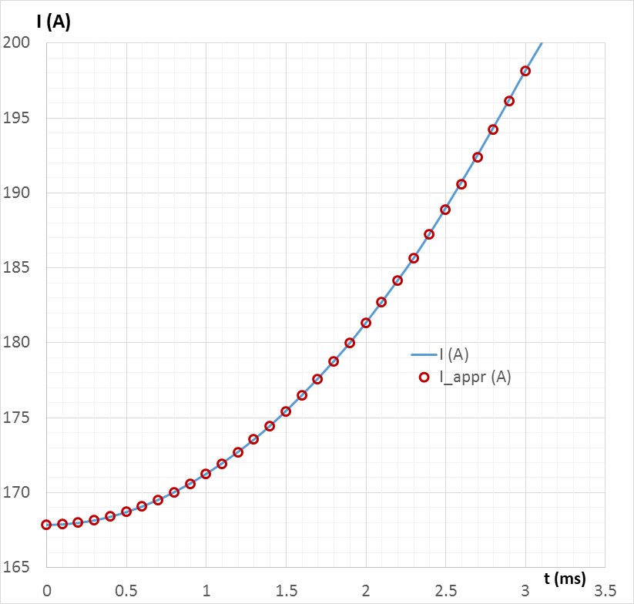
Bias Current Ramp (N = 50)
I(t) [A] = 167.855 + 3.36∙t² [ms]

Slide 4
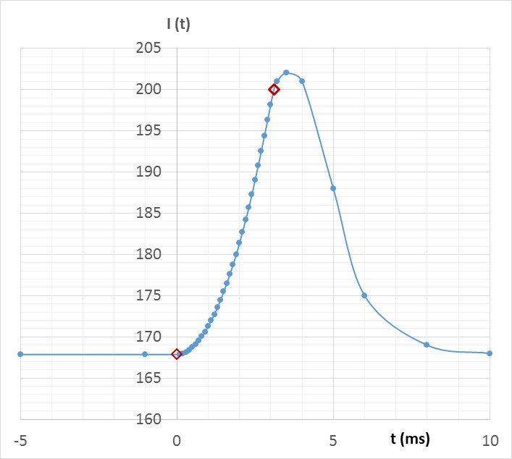
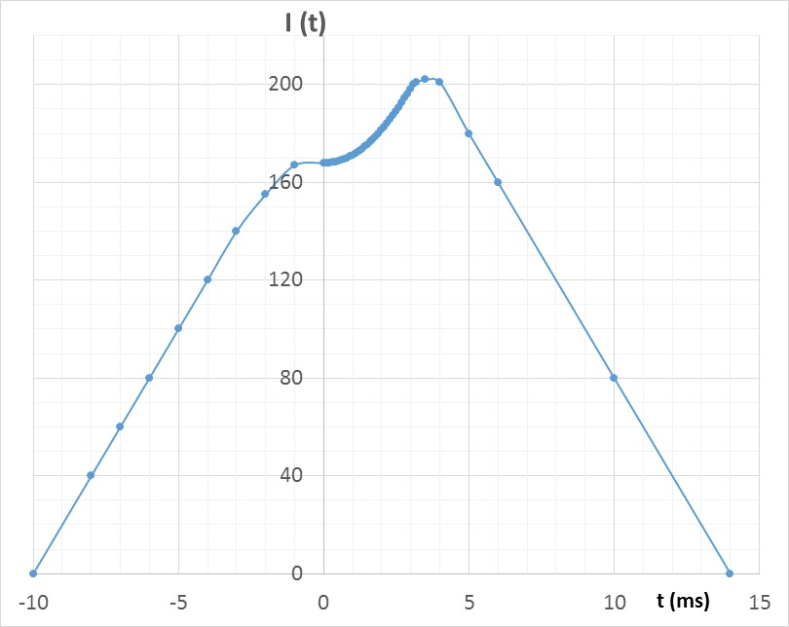
DC Power Supply
Pulsed Power Supply
Maximum DC power is 200²*0.02 = 800 W
Max dI/dt = 20 A/s →
Max U_{ind} = 3.5*10⁻³ * 20 = 0.07 V.
Average Power = Energy per cycle*Repetition rate
P_{AV} = 200²[A²] * 0.02[s] * 0.5*30∙10⁻³[s] * 15[Hz] = 180 W
Volt-Amperes: 200 A * 4 V = 800 VA
U_{DC} = 200 * 0.02 = 4 V

