Slide 1
Accelerator Physics and Technology: Lecture 2
Vladimir SHILTSEV (Fermilab*, USA)
Hadron Collider Physics Summer School
Fermilab, August 2016
* Operated by Fermi Research Alliance, LLC under Contract No. De-AC02-07CH11359 with the United States Department of Energy

Slide 2
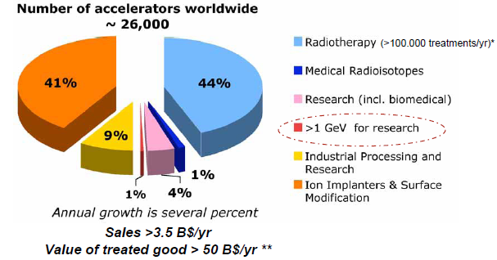
Research Machines: Just the Tip of the Iceberg

Slide 3
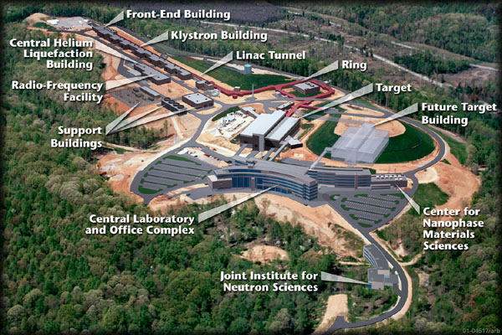
Example: Spallation Neutron Source
(Oak Ridge, TN)
A 1 GeV Linac loads 1.5E14 protons into a non-accelerating synchrotron ring.
These are fast extracted onto a Mercury target
This happens at 60 Hz -> 1.4 MW
Neutrons are used for biophysics, materials science, industry, etc…

Slide 4
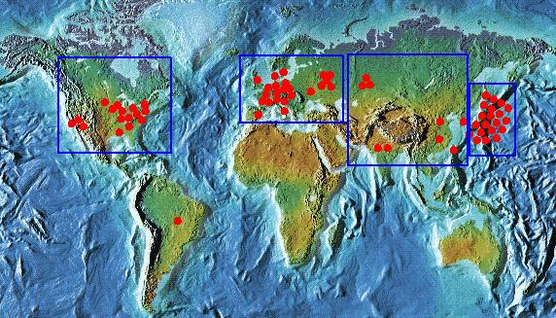
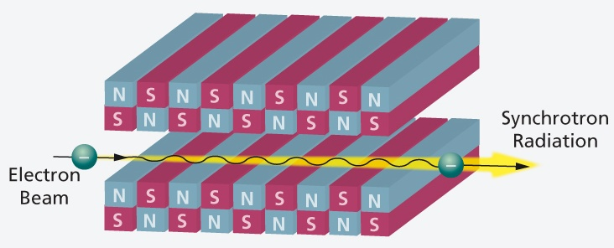
Light sources: too many to count
Put circulating electron beam through an “undulator” to create synchrotron radiation (typically X-ray)
Many applications in biophysics,
materials science, industry.
New proposed machines will use
very short bunches to create coherent
light.

Slide 5
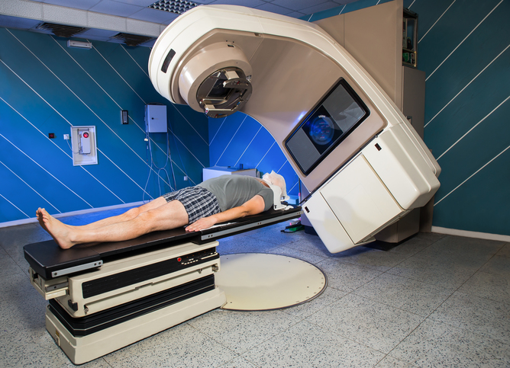
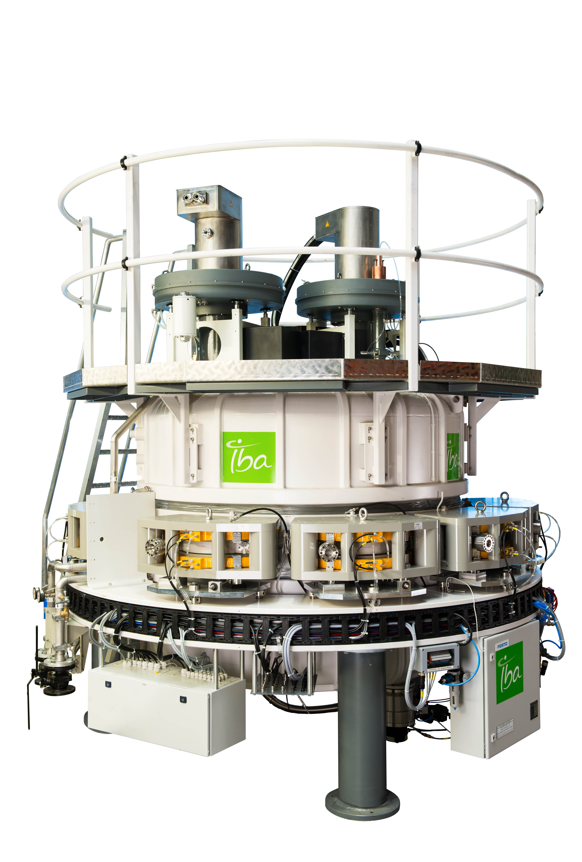
Industrial accelerators
Radioisotope production
Medical treatment
Electron welding
Food sterilization
Catalyzed polymerization
Waste treatment

Slide 6
Accelerator Technologies (“Show and Tell”)
Impregnated W cathode
RF cavity copper (warm)
RF cavity Nb (cold)
RF tube
Magnet: permanent SmCo
Magnet: superconducting NbTi
Vacuum pipe: FNAL Main Injector, LHC

Slide 7
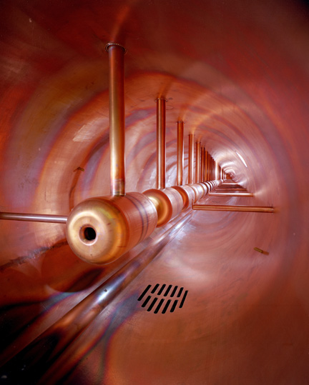
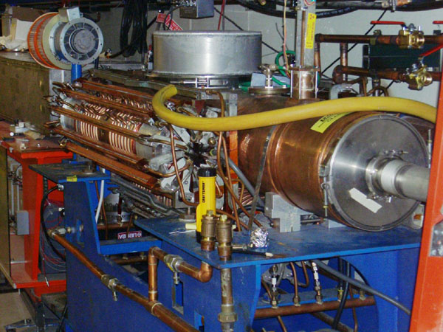
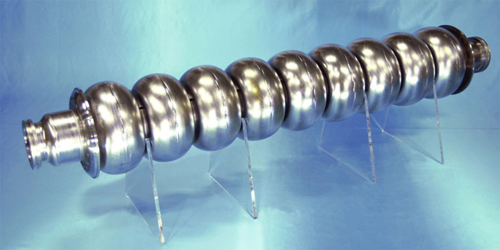
Examples of Accelerating RF Structures
37->53MHz Fermilab Booster cavity
Biased ferrite frequency tuner
Fermilab Drift Tube Linac (200MHz): oscillating field uniform along length
ILC prototype elipical cell “π-cavity” (1.3 GHz): field alternates with each cell

Slide 8
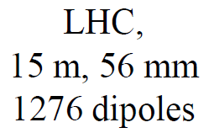
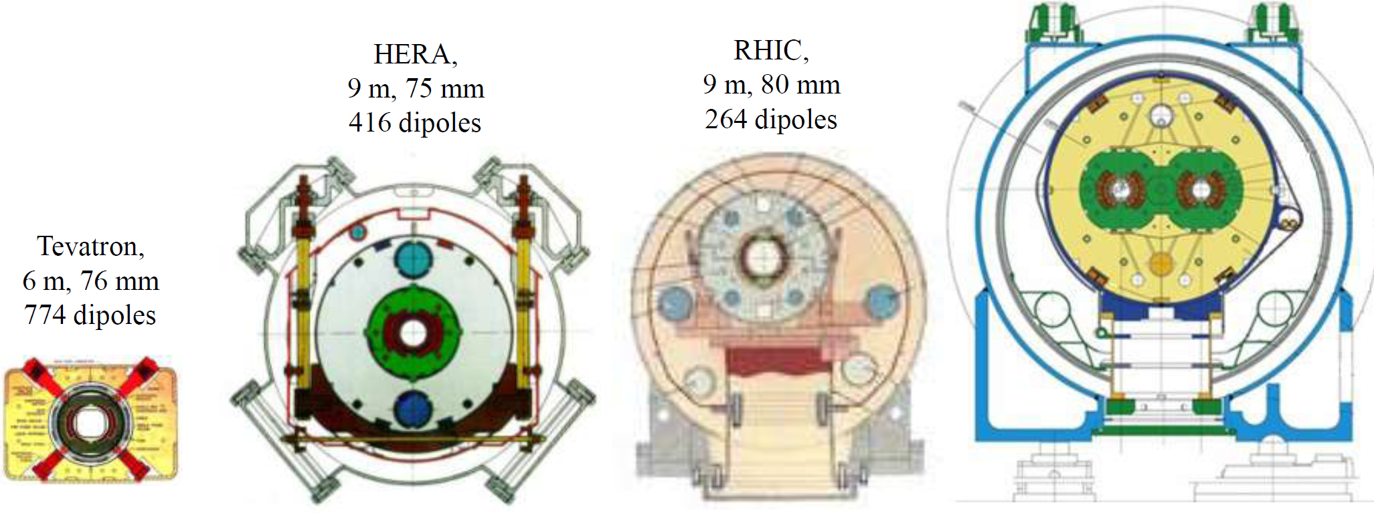
State of the Art SC Magnets: 3 Decades
1232 bending magnets 15 m long →
NbTi cables, 13 кА@1.9 К 10 GJ
8.3T
4.5T
5.3T
3.5T
4.5 K He, NbTi
+ warm iron small He-plant
NbTi cable
cold iron
Al collar
NbTi cable
simple &
cheap
NbTi cable
2K He
two bores

Slide 9
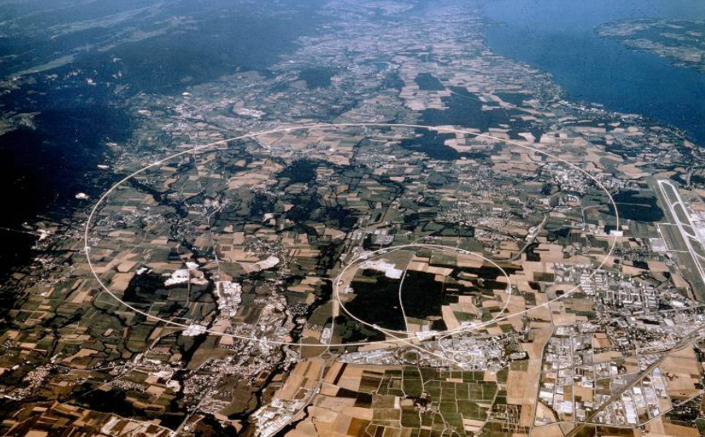
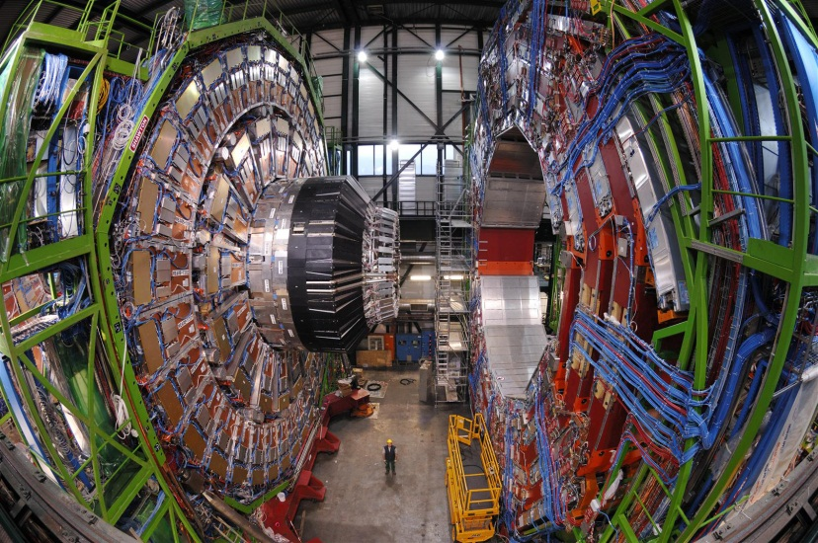
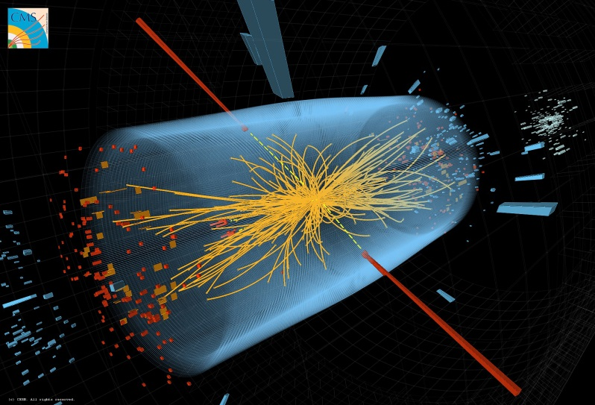
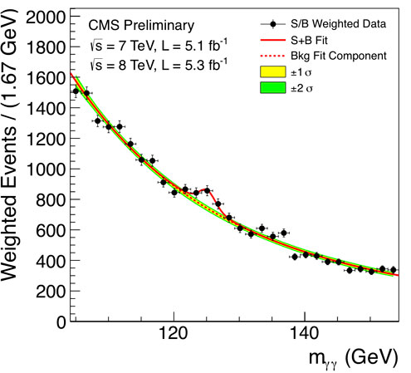


26 658.883 m
6.5 TeV x 2

Slide 10
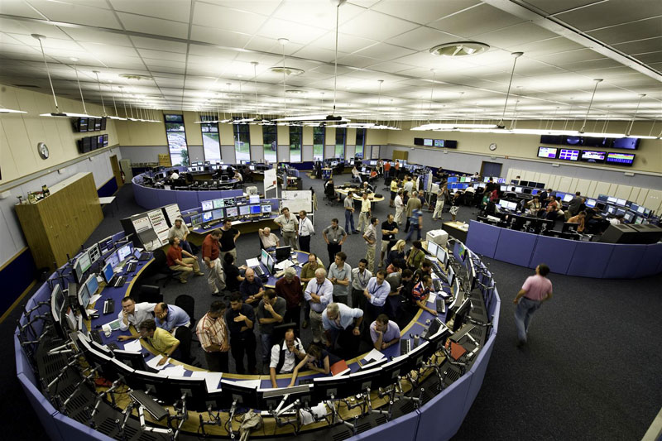

LHC Accelerator Operations
What are they doing there !?

Slide 11
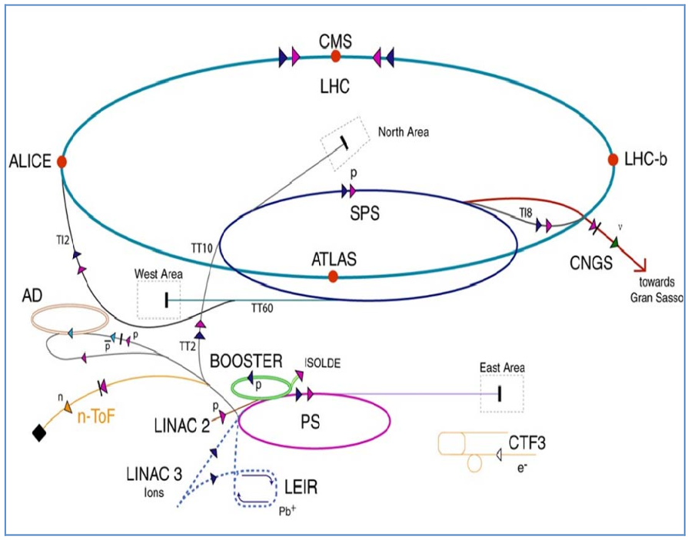
6500 GeV
450 GeV
1.4 GeV
50 MeV
25 GeV

Slide 12
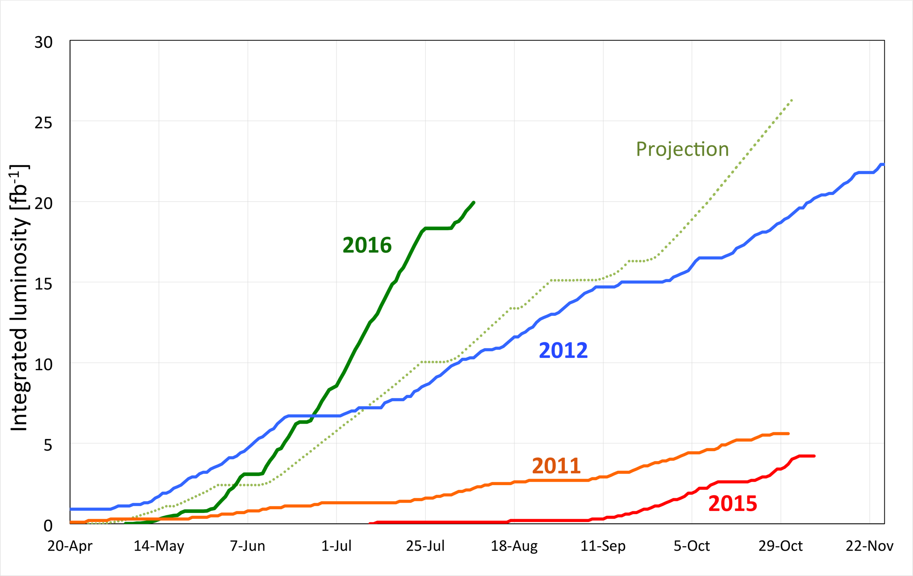
Bottom line: Integrated Luminosity
Receipe : a) peak luminosity; b) max availability; c) short turnaround time
~20 fb⁻¹ delivered to ATLAS & CMS
3 fb⁻¹/very good week

Slide 13
Themes and Topics
“Level 0” Issues: Make machines run
  T1: Fix splices
  T2: Train magnets
  T3: Clean beampipes
“Level 1” Issues: Make them run reliably
  T4: Cryogenics trips, other issues
  T5: UFOs
  T6: Turnaround time, ramp
“Level 2” Issues: Performance (luminosity)
  T7: Proton’s life and death in LHC
  T8: Halo collimation
  T9: Upgrades

Slide 14
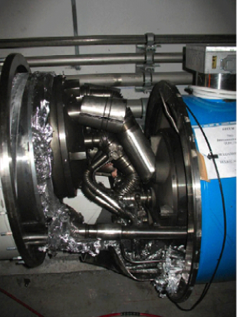
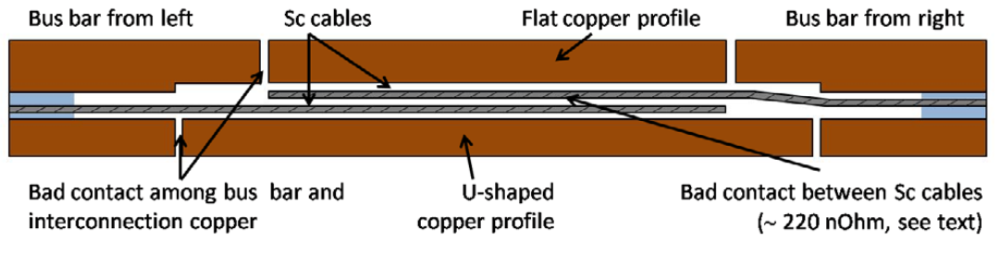
T1: Splices… all began Sept 19 2008
A splice with bad thermal and electrical contact between the superconductor and the copper produced sufficient resistive heating to lead to thermal runaway.
This provoked the melting of the material surro-unding the splice, and subsequently an electric arc developed between two exposed cable ends.
This arc melted through the helium line in which the cable travels, releasing Helium into the insulation vacuum of the interconnect.
The rapid and voluminous expansion of the Helium caused a pressure wave that propagated along the insulation vacuum causing extensive damage

Slide 15
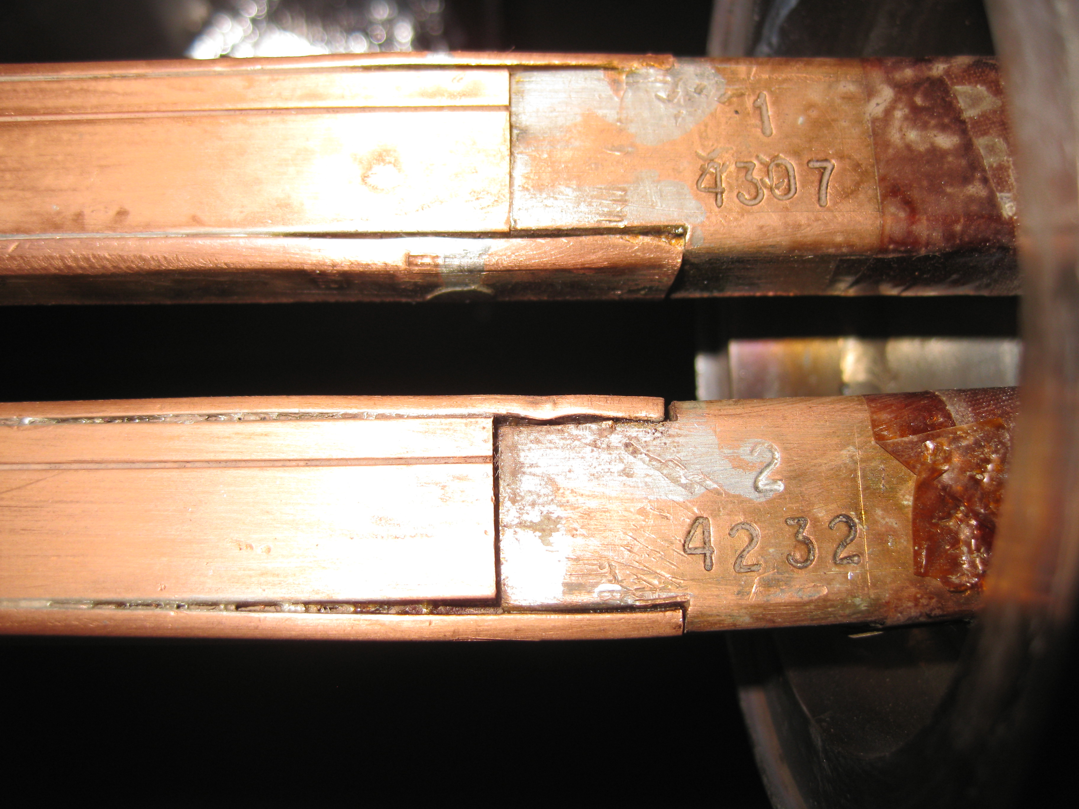
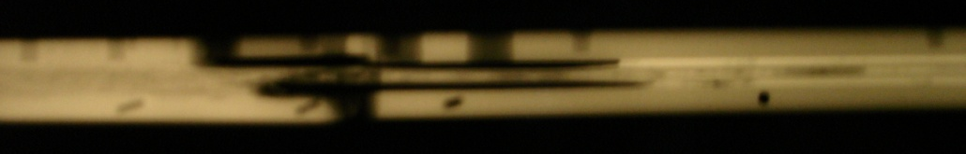
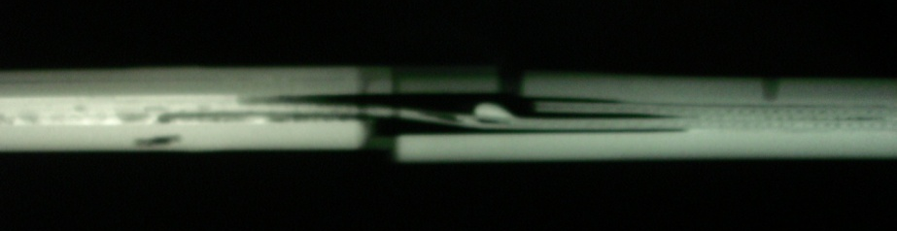
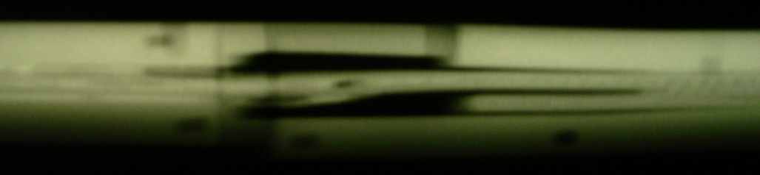
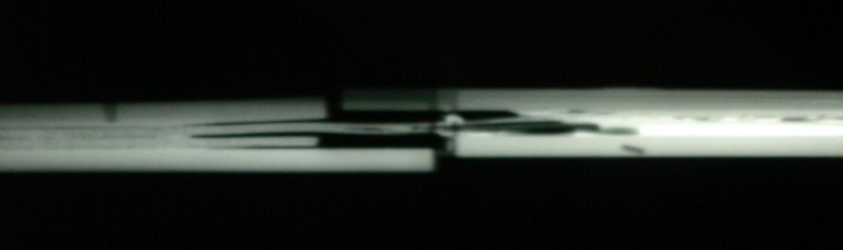
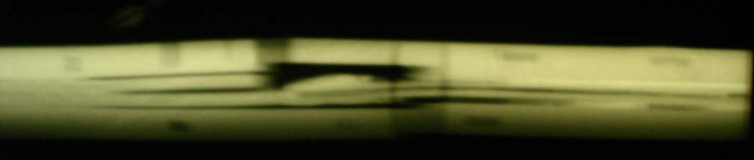
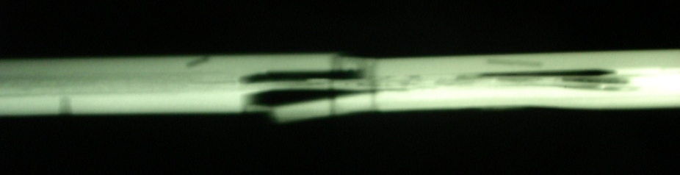
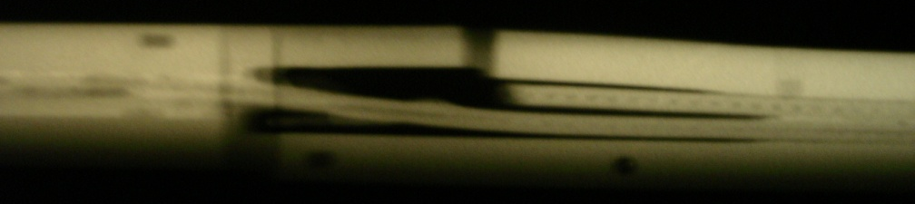
Sample Joint X-Rays
Sample 1 (61 μΩ)
Sample 3A left (26 μΩ)
Sample 3A right (43 μΩ)
Sample 2A right (43 μΩ)
Sample 3B (21 μΩ)
Pictures by J.-M. Dalin
Sample 2B (42 μΩ)

Slide 16
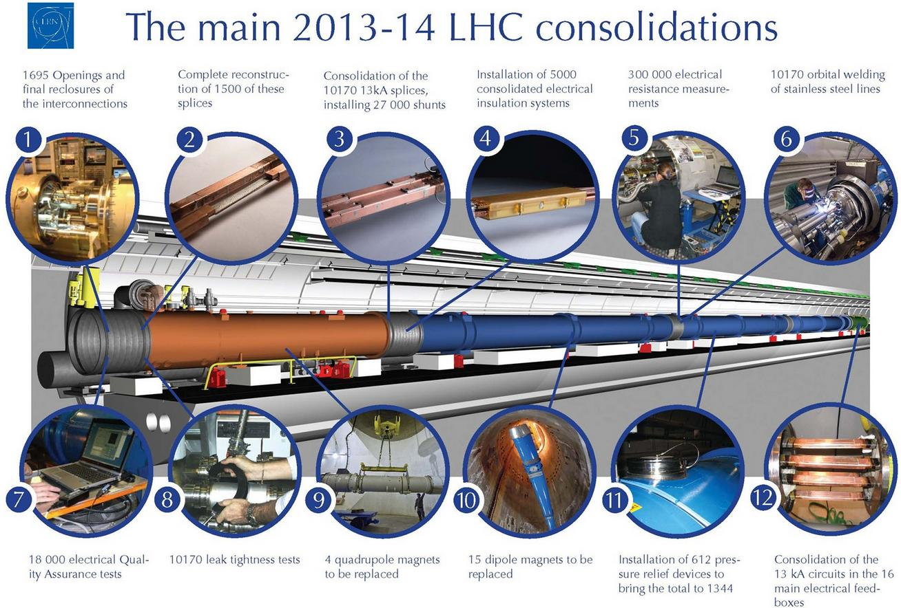
A 13kA splice has a resistance of about 300 pΩ, which can be measured with a precision ~20pΩ. The acceptance criteria is 10 nΩ. Any splice does not meet this criteria is replaced/repaired. The resistance acceptance criteria at the Cu - superconducting splice joints was 5 μΩ. Any joint does not meet this criteria is replaced or repaired.

Slide 17
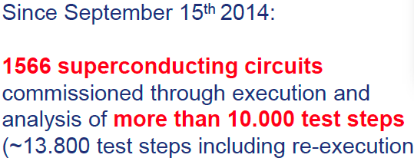
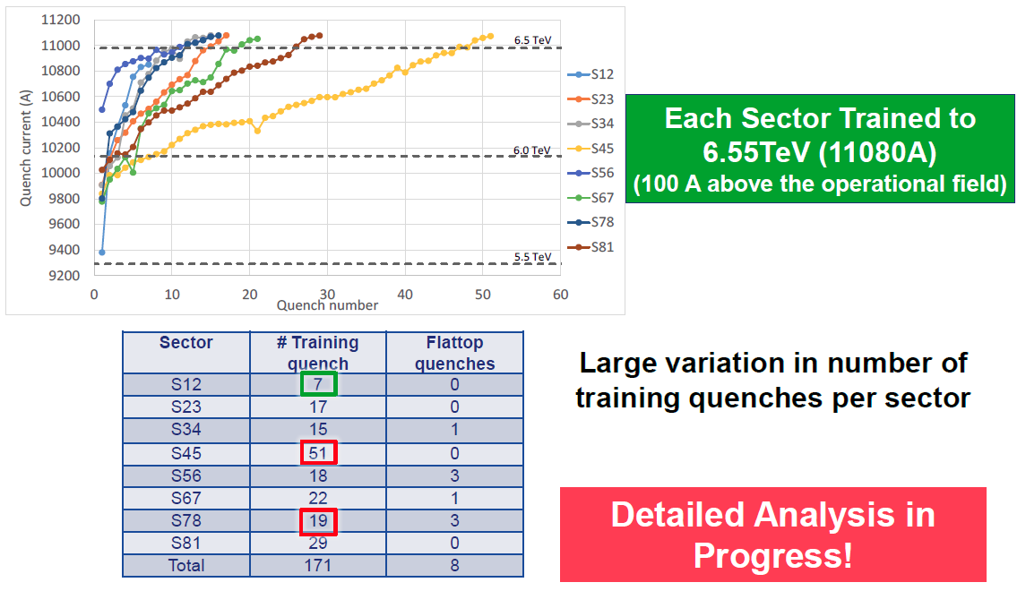
T2: Train All the Magnets: Sep 2015 – April 2015

Slide 18
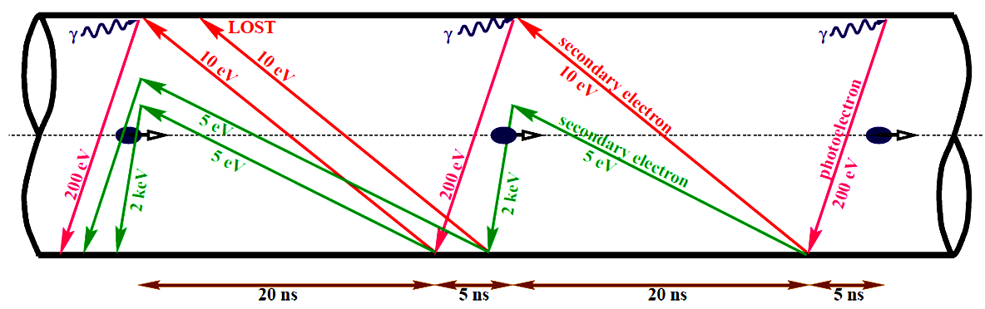
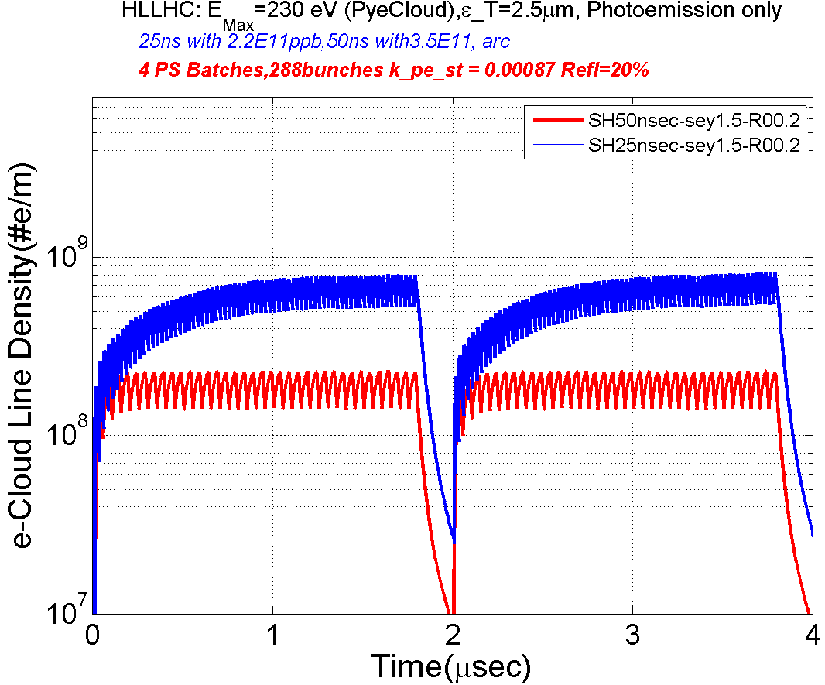
T3: Electron Cloud & Need of Scrubbing
The critical energy of the photons at
7 TeV ~ 44 eV
Primary sources of electrons in the LHC
  At Injection (450 GeV) gas ionization
  At 7 TeV Synchrotron Radiation
E_{max}=239.5 eV
ε_{T} =2.5 μm
72x 2.2E11ppb(25ns)
Consequences:
  - instabilities, emittance growth, desorption ←bad vacuum, beam loss
  - excessive energy deposition in the cold sectors
36x 3.5E11ppb(50ns)

Slide 19
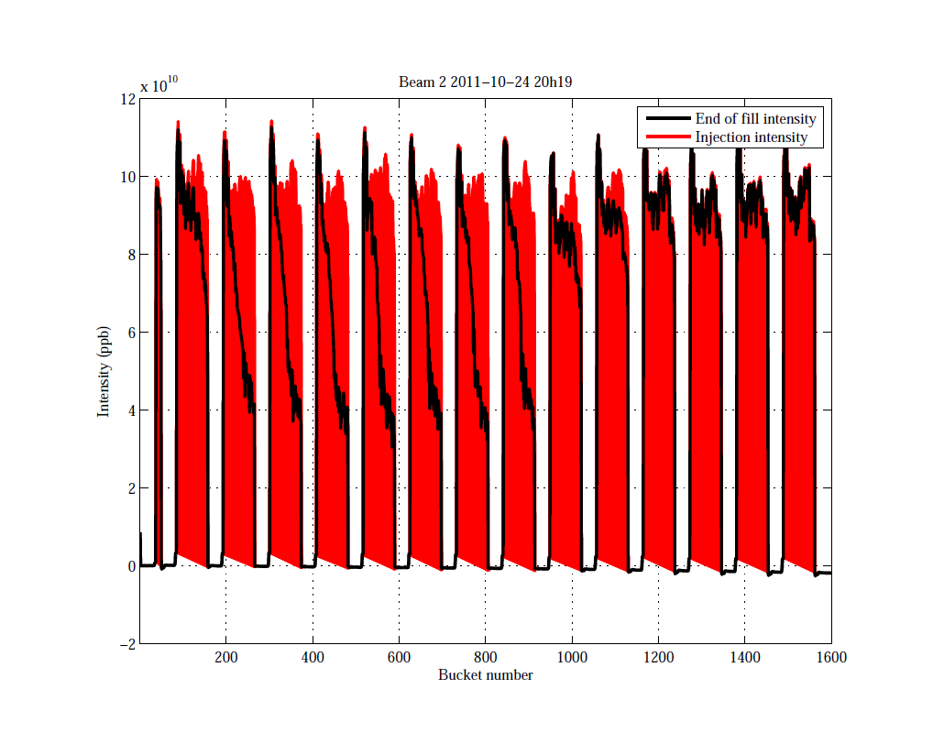
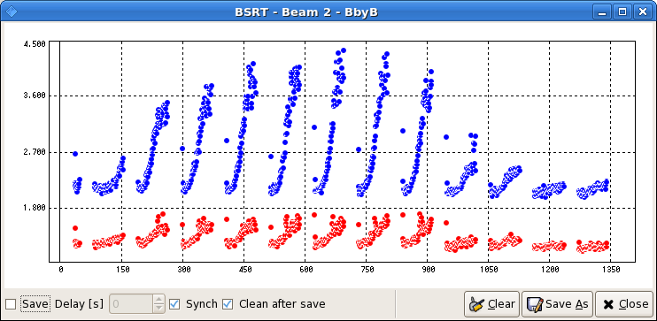
What e-cloud can do to the Beam?
Fill: 2249 (2011)
25 ns Bunch Spacing
Energy = 450 GeV
Time between Injection to End ~10 min
Dumped by BPM
1020 Bunches
Intensity
Bunch #
Injection Intensity
End of fill Intensity
Measured Emittance Growth
~33% Horizontal
~110% Vertical
Associated beam loss

Slide 20
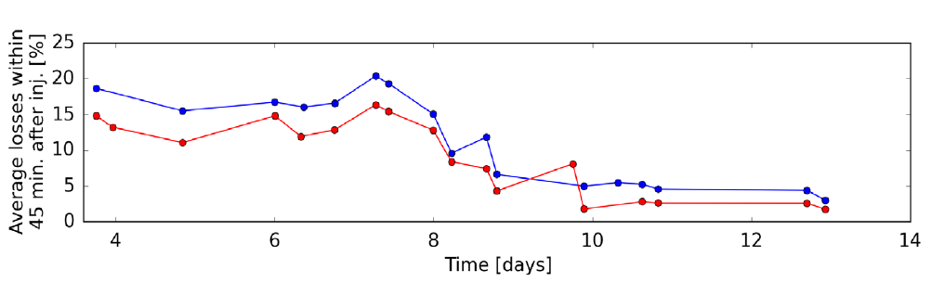
Scrubbing @ 25 ns bunch spacing
So far it is the only cure in the LHC….Takes time to clean the surface and reduce SEY (secondary electron yield) from ~2.2 to ~1.5
Scrubbing “memory” kept while running with 25 ns beams - deconditioning was observed after few weeks of low e-cloud operation

Slide 21
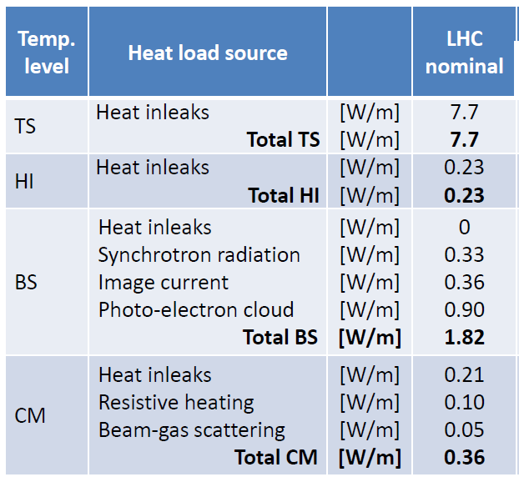
T4: Cryogenics , Trips
LHC: 8 cryoplants total 35 MW wall plug; 130 tons of LHe to keep 36,000 tons at 1.9K
Efficiency ~250 W wall plug power per Watt at 4.5 K
  CERN cryocapacity of 150 kW @4.5K and 20kW at 1.9K
Three Temperatures:
  50-70 T-shield
  4.6 K Heat Intercept
  4.6-20 K Beam Screen
  1.9K cold mass
Safety factor 1.6 (design)
Reality: ~none (1.1?)

Slide 22
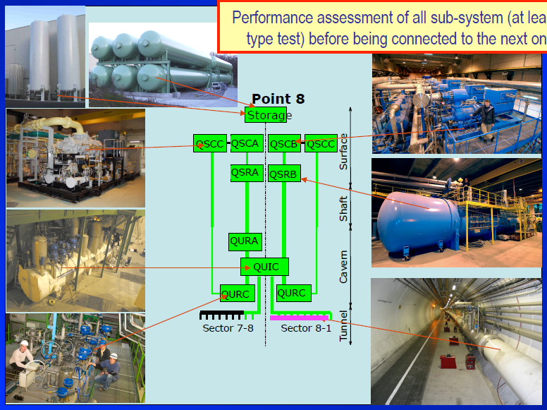

Slide 23
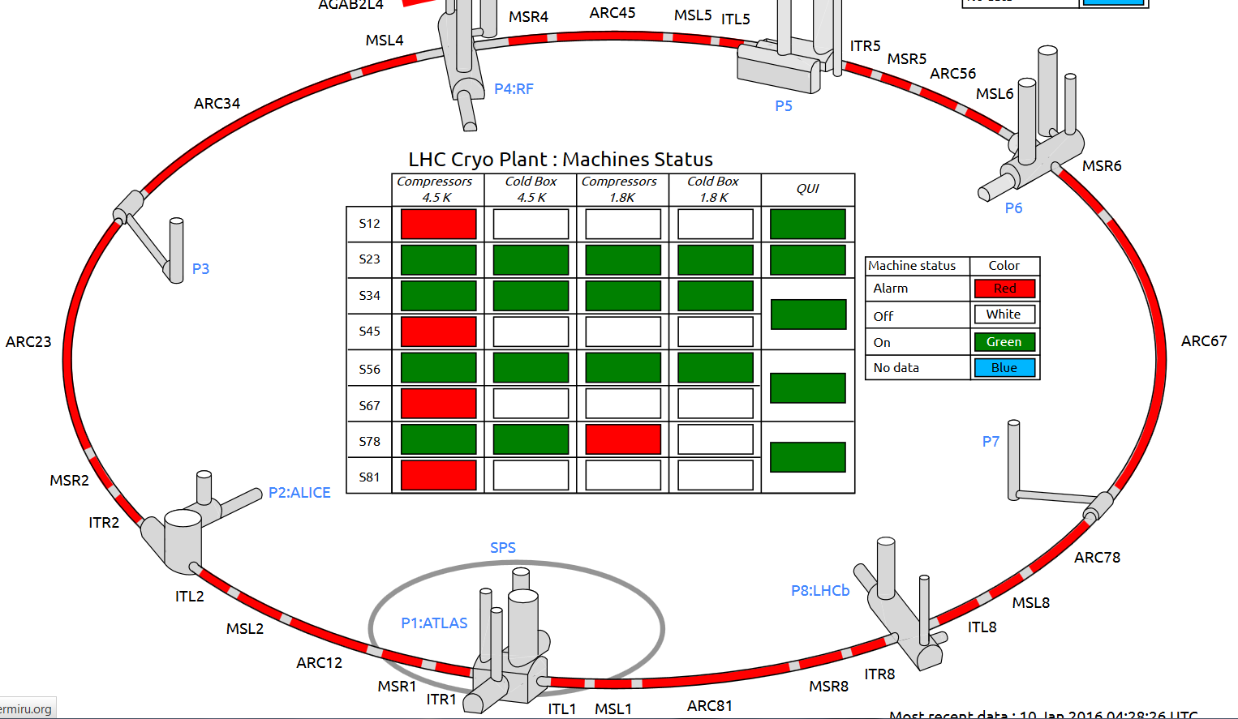
Cryo: Complex and Large Machinery

Slide 24
2015 LHC Machine availability
Statistics for 25 ns run from September 7 to November 3

Slide 25
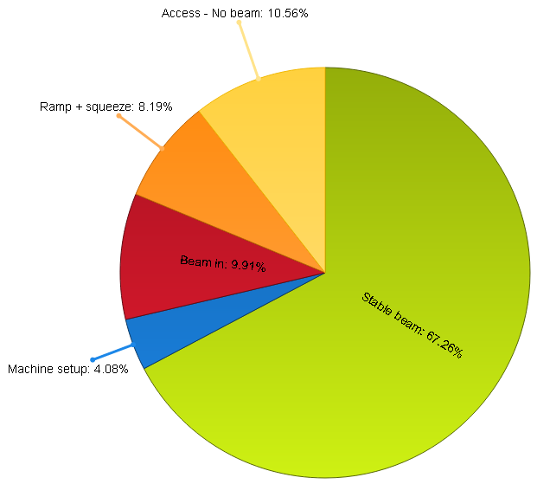
Availability: 11th June – 23rd July, 2016
From 32% to 67%
In one year!
Stable Beams 67%

Slide 26
T5: UFOs
‘Unidentified Falling Objects’

Slide 27
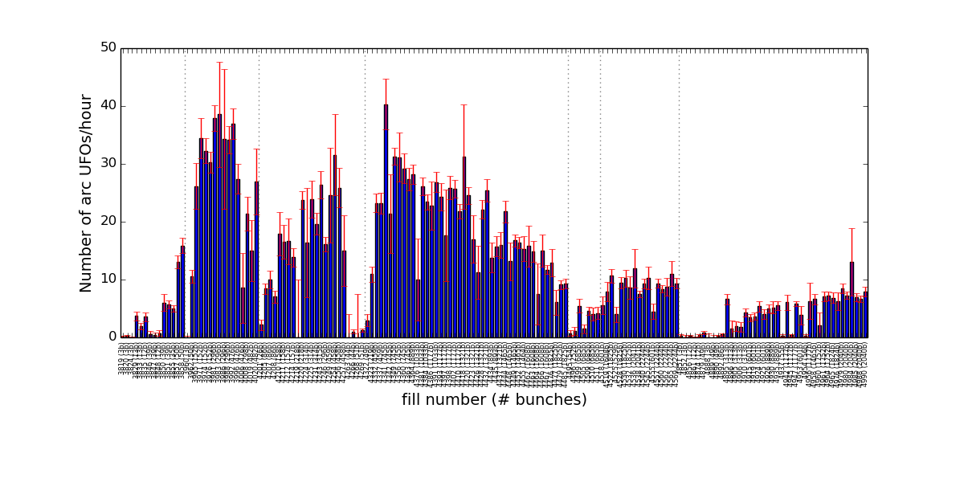
UFOs: there are many of them, they are frequent !
UFO events observed quite often during operation at 6.5 TeV
Conditioning is observed on the UFO rate in spite of the increasing number of bunches
BLM thresholds being optimize to find a good compromise between availability and quench protection
2015
2016
arc UFOs (cell >11): rates similar to end of 2015
  did not lose conditioning over the Xmas stop

Slide 28
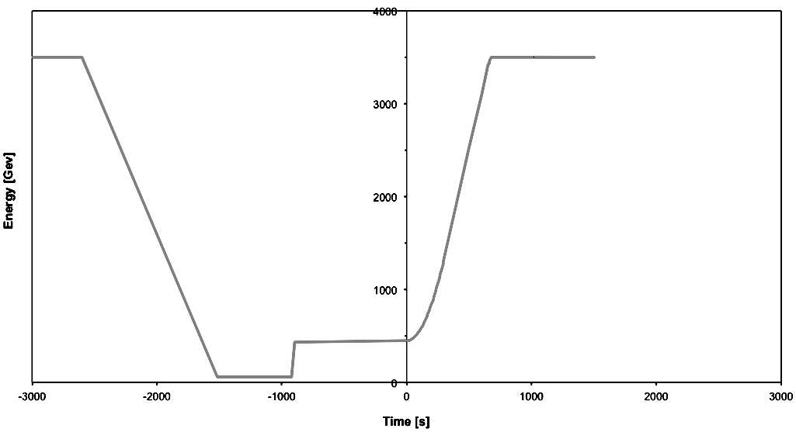
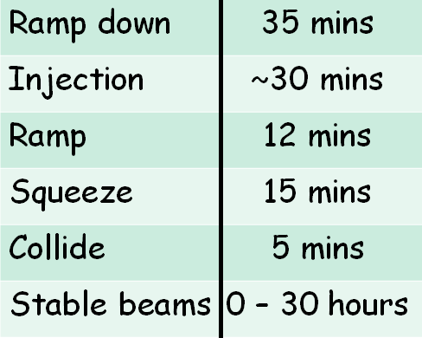
A Schematic of LHC Operational Cycle at half nominal energy
T6: Turnaround times, ramps, etc
Collide
Beam dump
3.5 TeV
Squeeze
Stable beams
Beam loss during
squeeze
12-SPS batch Injection
Ramp down/precycle
Ramp
450 GeV
Injection
The fastest turnaround in 2012 was 2 hours 8 minutes. This was close to the theo- retical minimum for 4 TeV operation. The average for the year was around 5 hours 30 minutes.

Slide 29
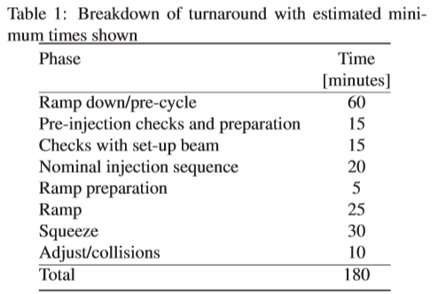
T7: Turnaround @ 13 TeV - longer
Additional delays:
• Transfer and injection optimi-zation and general wrestling with the injection process (respecting tight demands on beam quality etc.).
• controls and data acquisition problems; kicker overheating; problems in the injectors; etc.
• access recovery, precycle faults
• Fills lost in the ramp and squeeze to beam induced problems (instabilities) or, feedback system faults

Slide 30
T7: Proton’s Life in LHC
design 2800
2100 bunches/beam x ~1.2e11/bunch = 2.5e14 /beam
11,000 revolutions/s x 12 hrs = 0.5 billion turns
  Only ~ 1 billion protons die in collisions per second
Transverse betatron oscillations ~60 times/revolution:
  Also called betatron oscillations
  Rms amplitude = beam size
  200-300 micron in arcs, 13 micron at IPs
  Angular divergence : ~2 microrad in arcs, 30 microrads at IPs
Longitudinal oscillations – slow – 23 Hz:
  Also called synchrotron oscillations
  Particles change positions in the bunch, rms bunch length ~8 cm
  Particle’s energies vary, too – rms 1 GeV (dE/E_rms=1.1e-4)

Slide 31
T7: Proton’s Death in LHC (Luminosity)
The relationship of the beam to the rate of observed physics processes is given by the “Luminosity”
Rate
Cross-section (“physics”)
“Luminosity”
Standard unit for Luminosity is cm⁻²s⁻¹
Example: total p-p inelastic+elastic cross section at 13 TeV cme is ~110 mbarn (58 inel+ 12 ssd+40 el not seen)→
~30 interactions per crossing (NB: pile up is only ~20! ) x
40,000,000 collision/sec= 1.1B protons leave each beam every second
Beam lifetime due to such “Burn up” T=N/(dN/dt)= 2.5e14 protons/(1.1e9/s) =63 hours

Slide 32
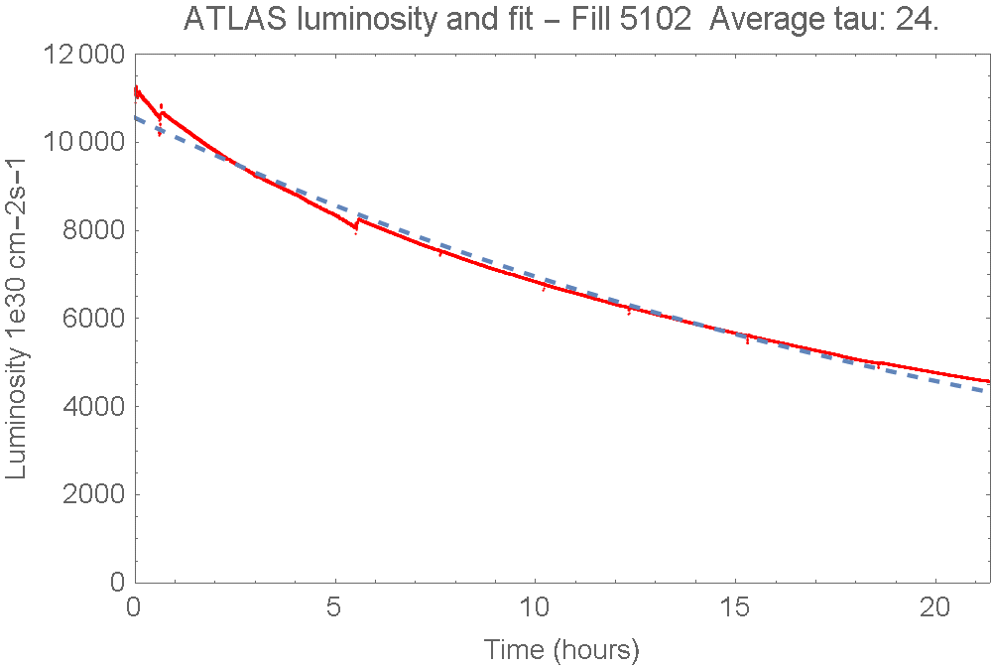
Luminosity lifetime
Take into account two IPs (ATLAS, CMS and 3% LHCb) 1/64+1/64 hrs⁻¹
Take into account beam gas 1/110hrs⁻¹ and that Lumi~N^2 → x2
2x(1/64+1/64 + 1/110) hrs⁻¹
=8%/hr (12.5 hrs lifetime)

Slide 33
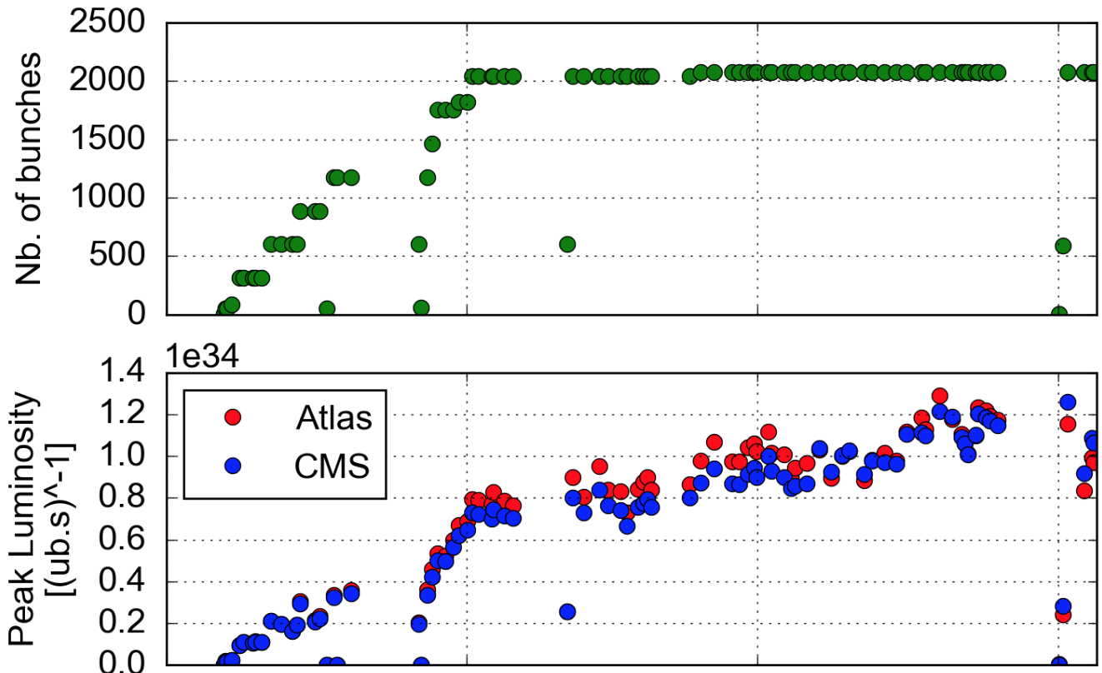

Peak luminosity: design 1e34 reached!
(8 yrs after start up, 6 yrs after 1st lumi)
  No of bunches ~2100 due to SPS beam dump
  6.5TeV -8% off design
  25 ns beam - nominal bunches ~1.2e11 p/bunch
But: Lower emittance from injectors (2.9 vs 3.5 um)
Squeeze harder in ATLAS and CMS
  beta* = 40 cm
  cf. 80 cm in 2015, 55 cm design
10³⁴
LHCb and ALICE: levelled operation at
~3x10³² and ~2x10³⁰ cm⁻²s⁻¹ respectively

Slide 34
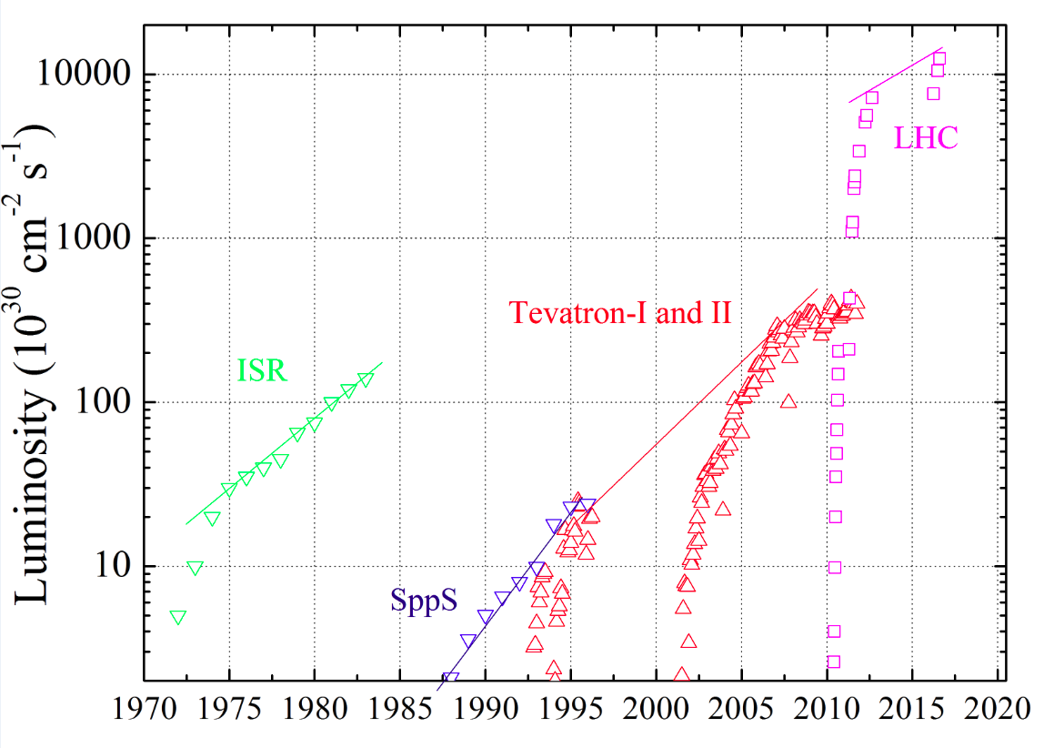

Slide 35
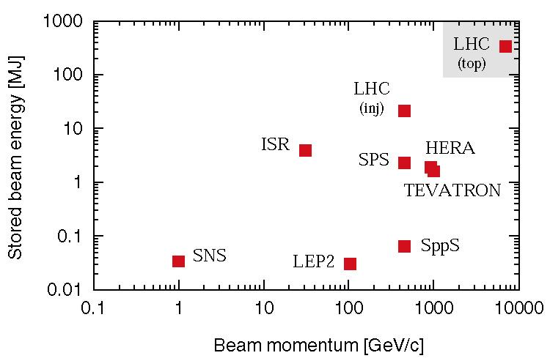
The power of the LHC beams
T8: Halo Collimation
LHC particles are not 100% contained! They diffuse! – need control !
The LHC beam energy is 350 MJ. Already at injection the beam can damage a magnet.

Slide 36
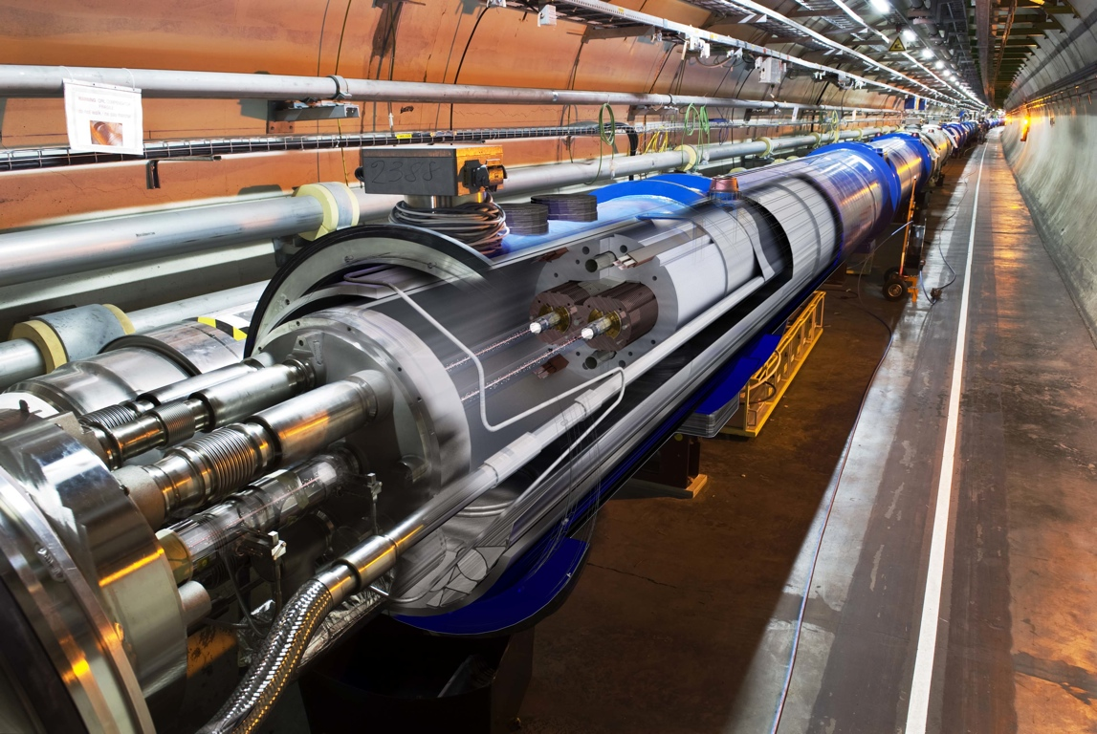
Superconducting coil:
T = 1.9 K, quench limit ~ 15mJ/cm³
Factor 9.7 x 10 ⁹
Aperture: r = 17/22 mm
Proton beam: 145 MJ
(design: 362 MJ)
LHC “Run 1” 2010-2013: No quench with circulating beam, with stored energies up to 70 times of previous state-of-the-art!

Slide 37
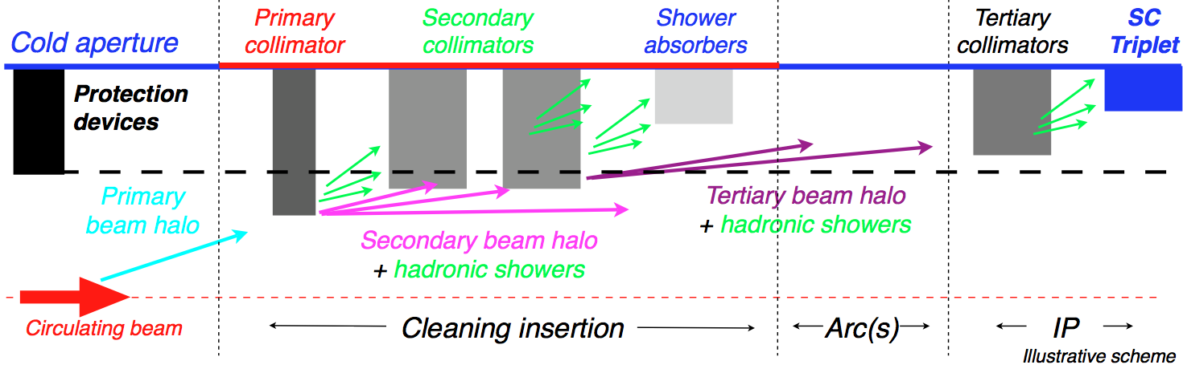

LHC collimation system
LHC has complex and distributed collimation system of >100 collimators
→ several stages to protects LHC components as well as detectors
Collimation is designed to provide cleaning efficiencies > 99.99%
→ need good statistical accuracy at limiting loss locations;
→ simulate only halo particles that interact with collimators, not the core.

Slide 38

The LHC collimator
1.0m+0.2m tapering
BEAM

Slide 39

LHC Collimation System Layout
Two warm cleaning insertions, 3 collimation planes
IR3: Momentum cleaning
1 primary (H)
4 secondary (H)
4 shower abs. (H,V)
IR7: Betatron cleaning
3 primary (H,V,S)
11 secondary (H,V,S)
5 shower abs. (H,V)
Local cleaning at triplets
8 tertiary (2 per IP)
Momentum
cleaning
IR3
Betatron
cleaning
IR7
Passive absorbers for warm
magnets
Physics debris absorbers
Transfer lines (13 collimators)
Injection and dump protection (10)
Total of 108 collimators
(100 movable).
Two jaws (4 motors) per collimator!

Slide 40

Super-Effective Halo Cleaning in LHC
2015

Slide 41
T9: Upgrades
The main objective of HiLumi-LHC Upgrade (2022-2024) is to install new hardware and guarantee beam parameters that will allow the LHC to reach the following targets:
  Prepare machine for operation beyond 2025 and up to 2035-37
  Devise beam parameters and operation scenarios for:
    enabling a total integrated luminosity of 3000 fb-1
    implying an integrated luminosity of 250-300 fb-1 per year,
    design for μ ∼ 140 (∼ 200)
    (peak luminosity of 5 (7) e34 cm-2 s-1)
  Design equipment for ‘ultimate’ performance of 7.5 1034 cm-2 s-1 and 4000 fb-1 => Ten times the luminosity reach of first 10 years of LHC operation

Slide 42

LHC Luminosity Upgrade : Machine Goals

Slide 43

HL-LHC Scale: Hardware and Cost
976MCHF (-142 +208)
~2,500 man-years

Slide 44


Slide 45
Acknowledgements
  Thanks for Your Attention !
Questions !?
  Materials and slides used here come from many sources, including the USPAS lectures, Eric Prebys, Mike Lamont, various conferences, workshops, LHC and LARP reviews, etc

Slide 46
Backup

Slide 47


Radio Frequency Accelerating Cavities
Normal Conducting (“Warm RF”) -
Muon Cooling RF Cell
SuperConducting
ILC RF Cryomodule

Slide 48



Accelerator Technology: Permanent Magnets
Sr-Fe + iron poles
B_max=1.45T
combined function
T-compensation
dB/B~0.01%

Slide 49

Recycler Ring
E_kin=8 GeV fixed
Shares tunnel with 150 GeV fast cycling Main Injector
C=3.32km
344 Permanent magnets (344, 1.45T, Sr-Fe
combined function)
Stores and cools antiprotons
Build by the US Congressman
Recycler
Main
Injector
Gerry
Jackson
Bill Foster

Slide 50





Accelerator Elements : Present
Tevatron
SC magnet
VLHC Super- ferric magnet
LHC SC magnets

Slide 51

Quench : МRI magnet* (~1/30,000 of LHC)
№1 how LHC was fixed
№2 LHC vacuum chamber
*pulled off the web. We recover our Helium.

Slide 52


Exit Run 1(2010 – 2012)
Foundations well proven at 4 TeV
  Magnets, vacuum, cryogenics, RF, powering, instrumentation, collimation, beam dumps etc.
Huge amount of experience gained
  Operations, optics, collimation…
Healthy respect for machine protection
Main bend power converters: tracking error between sector 12 & 23 in ramp to 1.1 TeV

Slide 53









2013 - 2015
28th October
Physics with record number of bunches
Peak luminosity 5 x 10³³ cm⁻²s⁻¹
April ‘13 to Sep. ‘14
3rd June
First Stable Beams
5th April
1st B E A M
13-14
Aug 14-Apr 15
2015
Struggle
IONS
10th April
Beam at 6.5 TeV
Dipole training campaign

Slide 54



2015: re-commissioning year, relaxed parameters, some issues…
Electron cloud
Anticipated
Significant head load to cryogenics
UFOs
8 UFO dumps within 2 weeks (Sep 20 to Oct 5)
Conditioning observed
Radiation to electronics
Mitigation measures (shielding, relocation…)
Non-rad hard components used in LS1 upgrade

Slide 55



Overcome a few problems
WEASEL
PS MAIN POWER SUPPLY
SPS BEAM DUMP
Limited to 96 bunches per injection
2076 bunches per beam cf. 2750

Slide 56

Then enjoy some remarkable availability
Heartbeat
Things that can go wrong
6 weeks

Slide 57



Stored energy per beam
B1 collimators IP7
Beam 1
2.2 mm gap

Slide 58


Beam from injectors
Lower than nominal emittance taken a step further
BCMS
(Batch Compression, Merging & Splitting)
Standard 25 ns scheme
PS circumference
Lower intensity, smaller bunches from PSB

Slide 59


Dipole training 2/2
Training: frictional energy released during conductor motion
Campaign summary
All magnets have been trained to well over 7 TeV in SM18 before installation
Extensive re-training in situ was not expected

