Slide 1
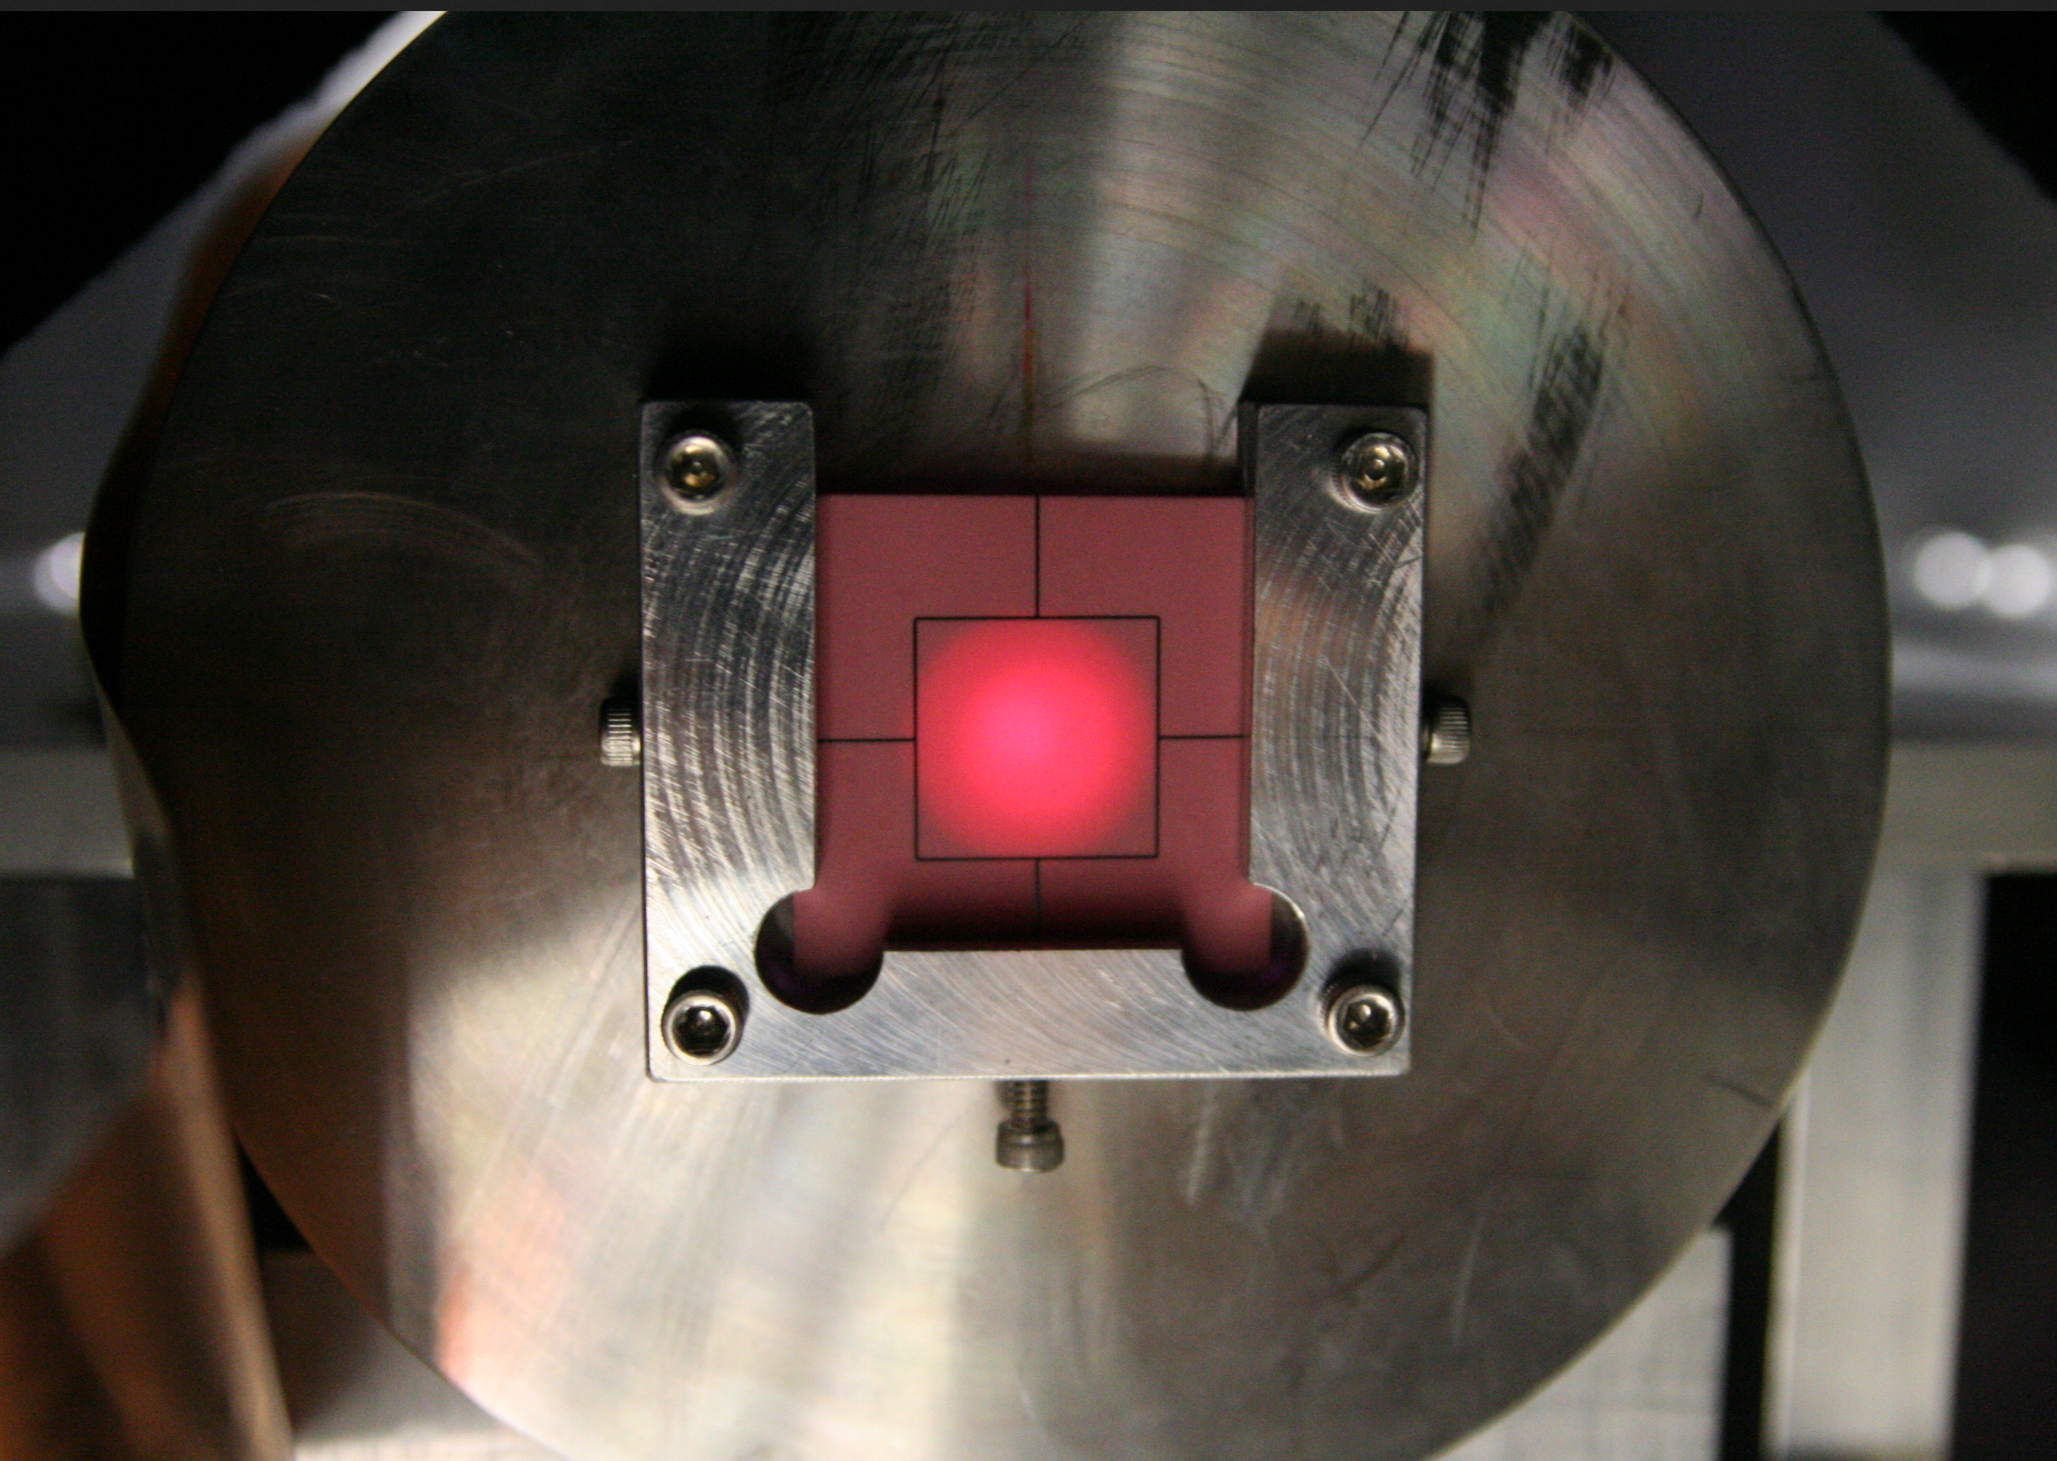
Pressurized Gas Beam Monitor for Extremely Intense Beam Line
Katsuya Yonehara
APT Seminar
08/30/2016

Slide 2
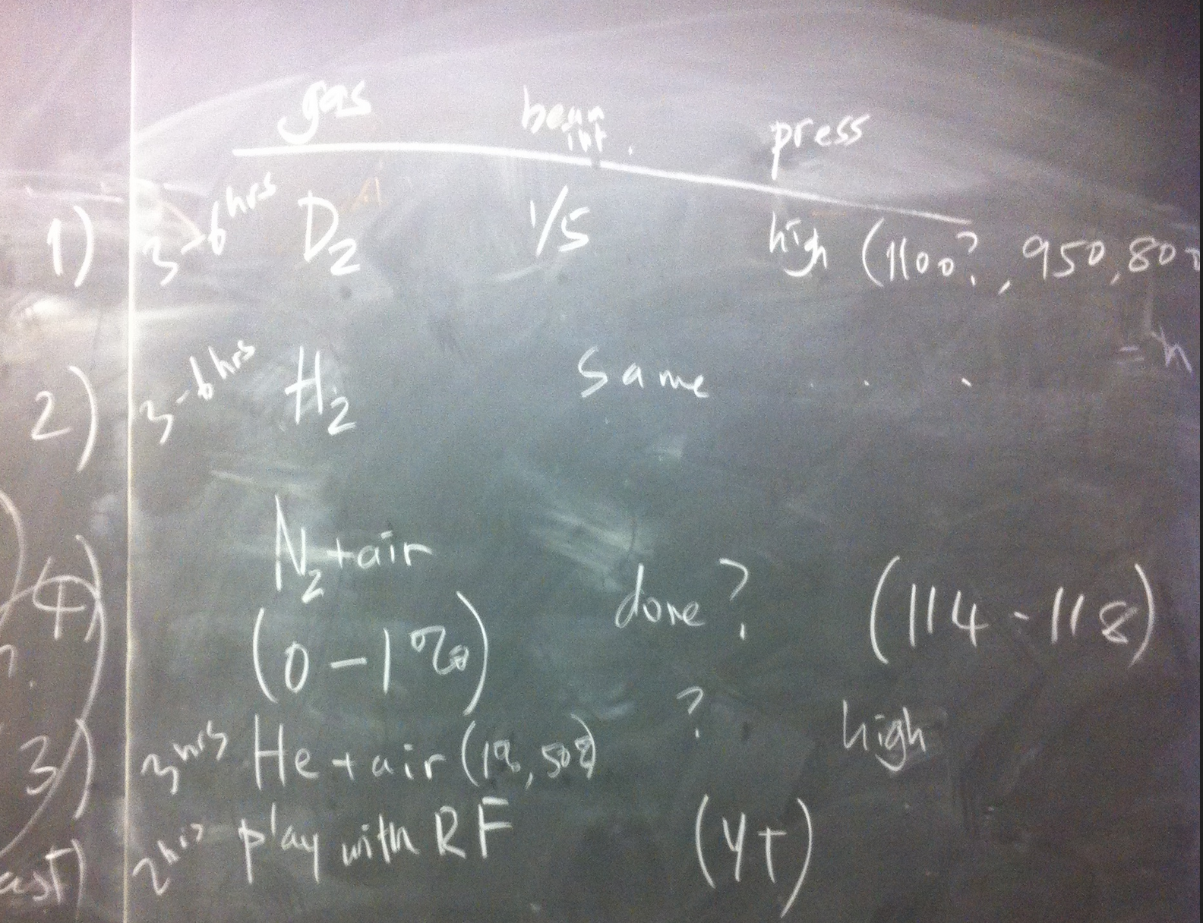
Contents
Part I
Concept of gas-filled RF cavity
Plasma dynamics in the cavity
Part II
Apply gas-filled RF hadron monitor for LBNF
Assess the monitor for LBNF
Plan for demonstration test

Slide 3
Concept of gas-filled RF cavity (I)
Original concept of the gas-filled RF cavity derived from the study of muon ionization cooling (IC)
  Muon IC requires high gradient RF fields (Designed peak RF gradient: 20 MV/m, RF accelerating gradient: 10-15 MV/m) and strong magnetic fields (10-15 Tesla)
To reach cooling factor, ε_{6D,n}/ε_{6D,0} = 10⁻⁶ in an
ionization cooling channel, the total length of
IC is shown in the left plot.
Assume dE/dz = RF accelerating grad.
Goal RF
accel.
gradient
E = 120 MeV

Slide 4

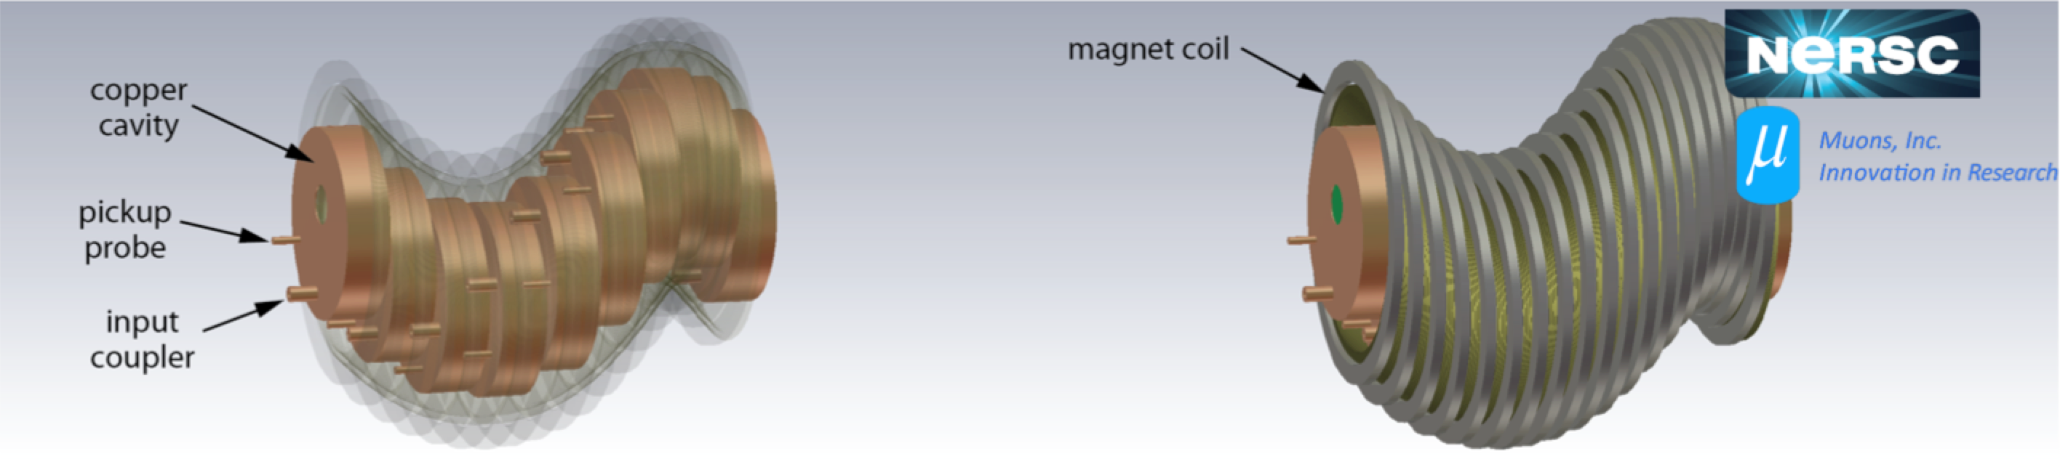
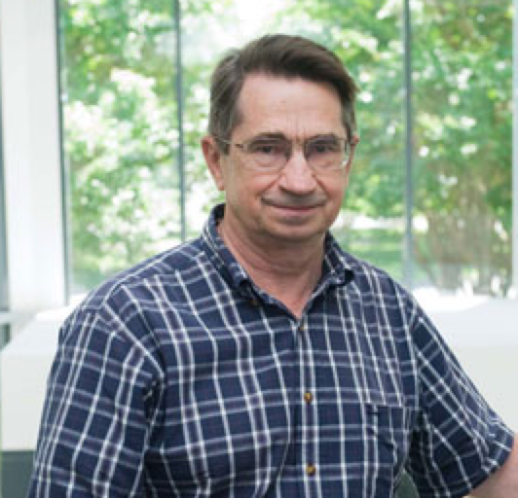
Concept of gas-filled RF cavity (II)
We have tackled against an RF electric breakdown (BD) in a vacuum RF cavity to gain high RF gradients
  Surface emission currents from electrodes in the cavity are concentrated by magnetic fields, which induces BD at low RF gradients
Rolland Johnson invented a pressurized hydrogen gas-filled RF cavity
  Pressurized gases suppress such current conductions
    No RF degradation in multi-tesla fields (experimentally verified)!
  Hydrogen also serves as an ionization material
Design concept of helical 6D muon ionization cooling channel
To find more features of a helical cooling channel,
Y. Derbenev and R.P. Johnson, PRSTAB 8, 041002 (2005)

Slide 5
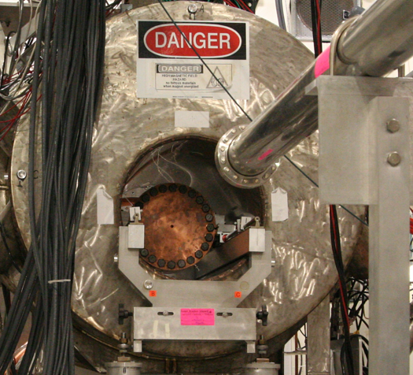
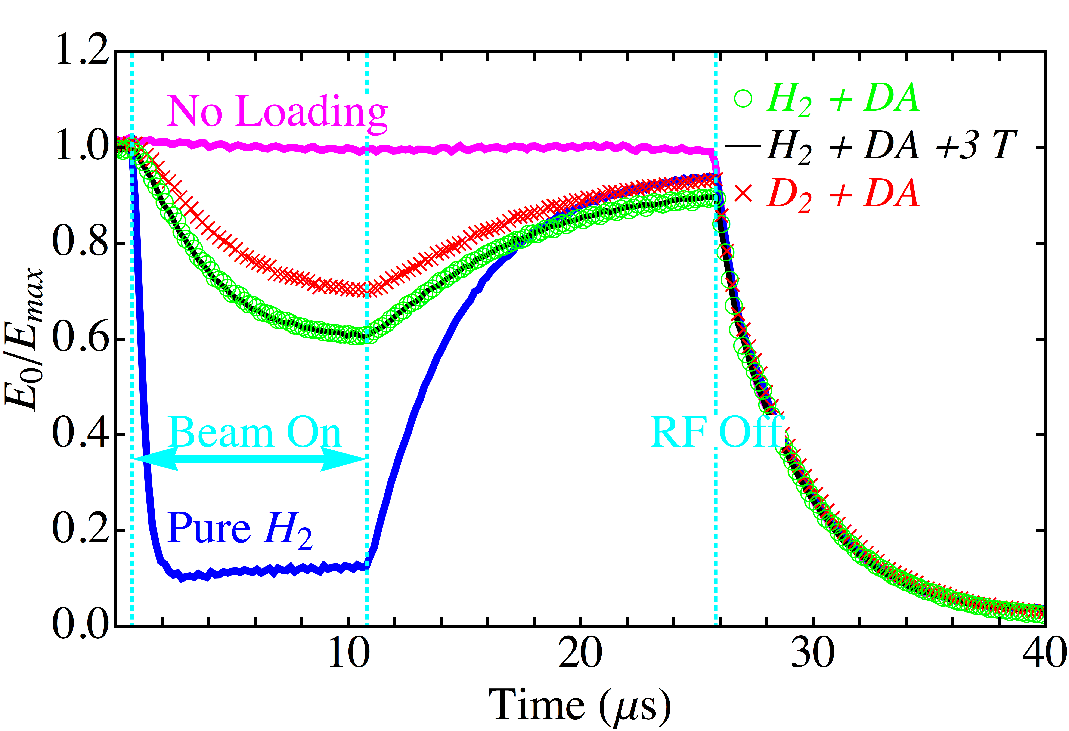
Study beam induced plasma in gas-filled RF cavity
Tested a gas-filled RF cavity with intense proton beams
Proton beam test at MTA
Gas pressure = 100 atm
DA: Dry Air
Multi-Tesla
solenoid
E_{max} = 50 MV/m
400 MeV
H⁻ Beam
Gas-Filled 800 MHz RF cell
Proton beam energy → 400 MeV
Protons per bunch → O(10⁹/2 mm diameter beam)
Bunch gap/length → 5 nsec/10 μsec
RF responses with proton beams
M. Chung et al., PRL 111, 184802 (2013)
B. Freemire et al., PRAB 19, 062004 (2016)
What do we learn from the experiment?

Slide 6
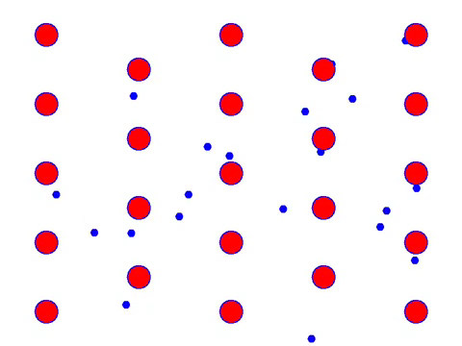
Plasma dynamics in dense gas with RF field
Charged particles passing through the cavity produce ionized plasma (Ex. p + A₂ → p + A₂⁺ + e⁻, A₂ = H₂, N₂, He, etc)
Electron/Ion dynamics can be explained by the Drude model
In RF fields, the plasma changes a permittivity of gas
The change is proportional to the number of incident particles
electron flow
Electron motions
in a DC field
Electron motion obeys
Maxwell distribution

Slide 7
Drude model with RF field
K. Yonehara et al., IPAC2015, 1189 (2015)
& IPAC2016, 2733 (2016)
Equation of motion of electron
ν: Electron collision frequency with gas
m: Electron mass
ω_{rf}: Frequency of driving RF
Energy gain term
Drag force term
Displacement of electron
Polarization
Permittivity

Slide 8
Permittivity change
n_{e} and ν are functions of a gas pressure and a RF gradient
Resonant frequency shift
Plasma loading
RF power consumed by plasma
Formulae tell us:
Permittivity change is proportional to n_{e}
Real part is enhanced at a low ν → Low RF gradient & Low pressure
Imaginary part is enhanced at a high ν → High RF gradient & High pressure

Slide 9
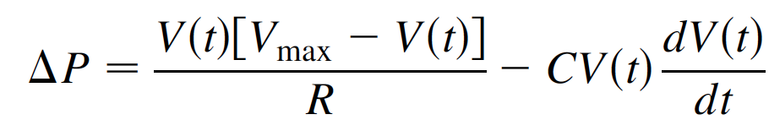
Interpret RF signal
Gas pressure = 100 atm
DA: Dry Air
Ion pair production rate
Plasma loading
Recombination process
Electron capture process
E_{max} = 50 MV/m
dN/dt → Ο(10 pairs/cm) @ p_{gas}= 1 atm
μ_{e}E₀² → O(10⁻¹⁷) Joules/RF cycle
μ⁻_{i}E₀² ≈ μ⁺_{i}E₀² → O(10⁻¹⁹) Joules/RF
RF amplitude with a plasma loading
Time constant β⁻¹ρ_{i} → Ο(μsec)
RF source term
Power consumption term
Time constant τ → Ο(nsec)

Slide 10
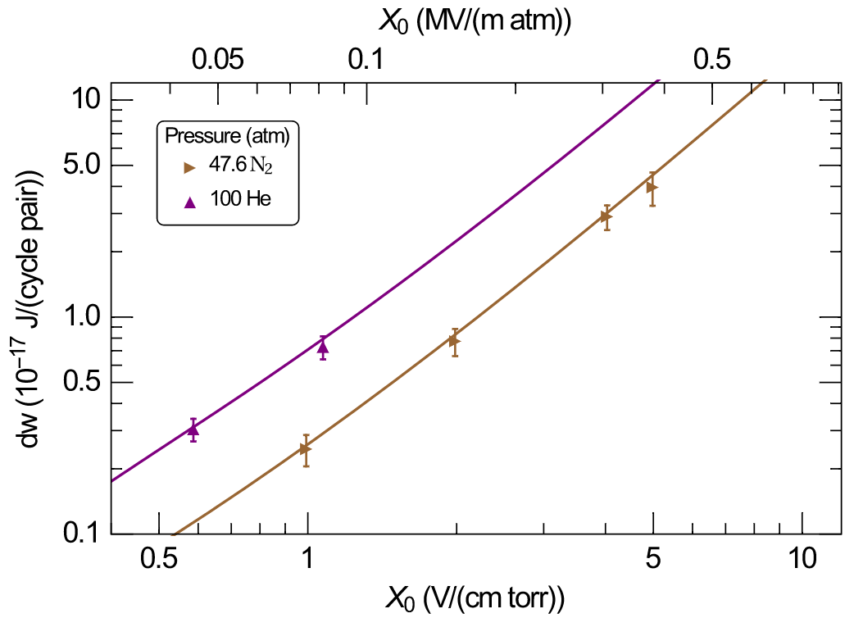
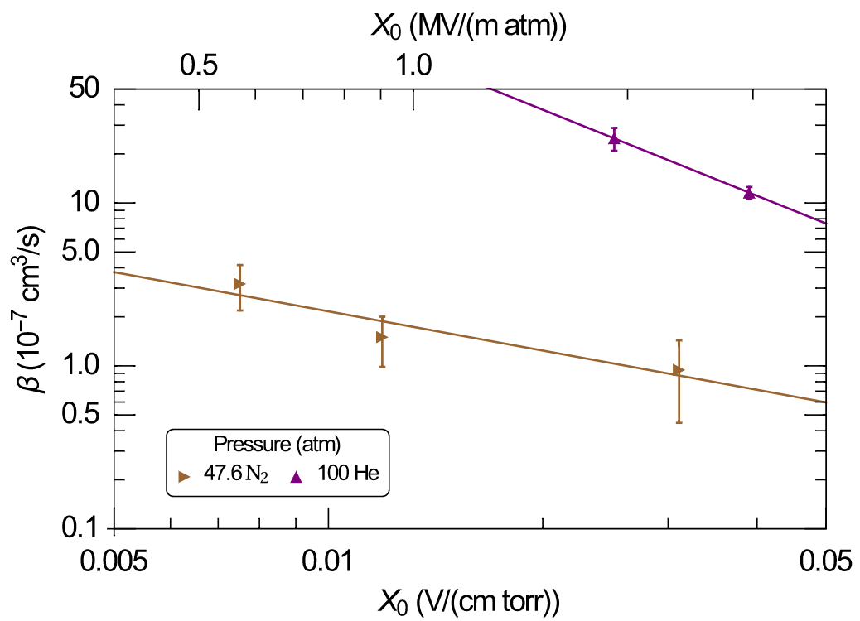
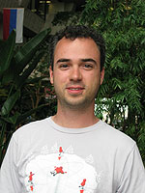
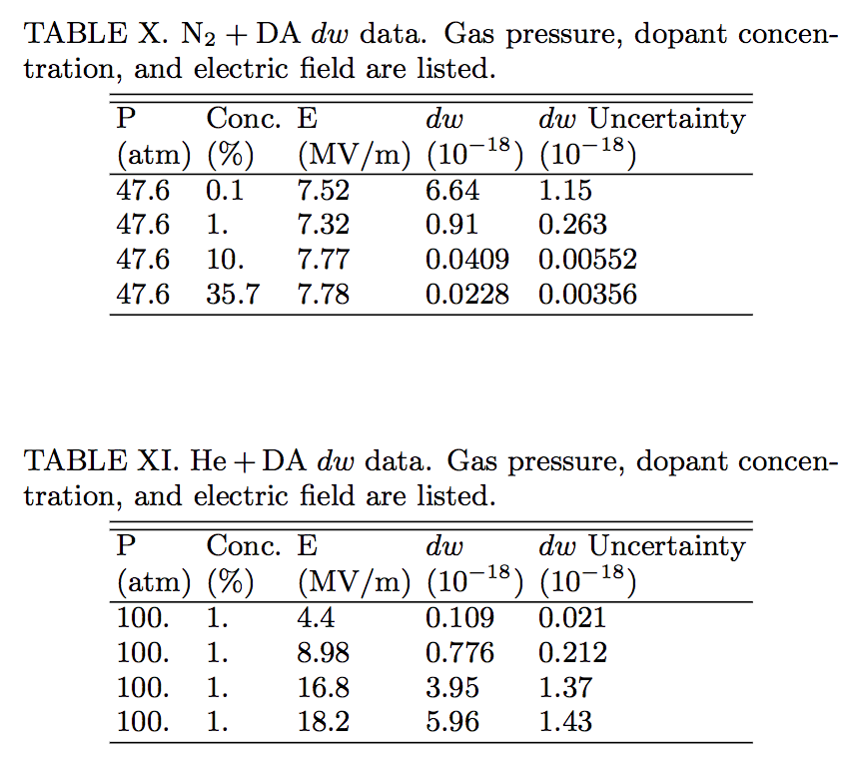
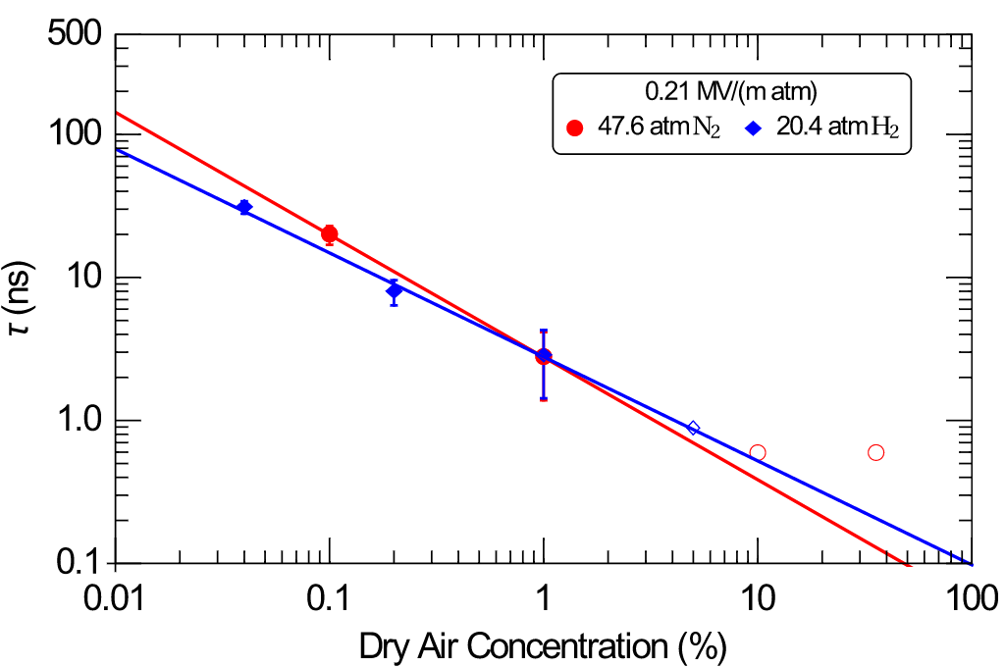
Evaluated Plasma Parameter
B. Freemire et al.,
PRAB 19, 062004 (2016)
X₀ ≡ E₀/p_{gas}
800 MHz RF operation →
Achievable time resolution ∼ 1 ns

Slide 11
Apply Gas-Filled RF Hadron Monitor
for LBNF/DUNE

Slide 12
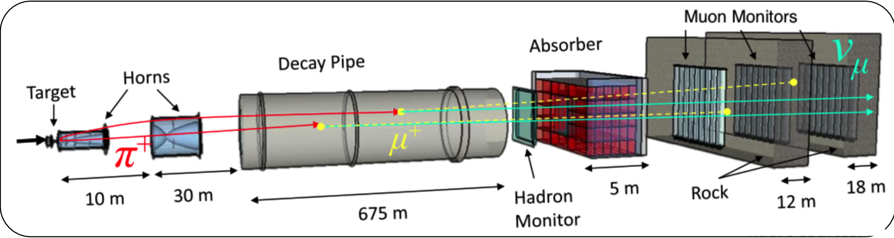
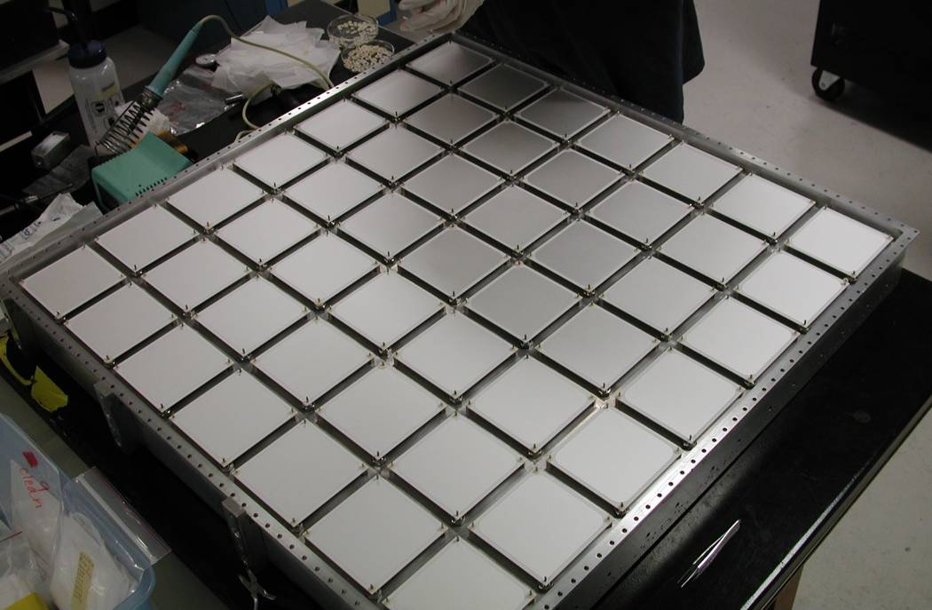
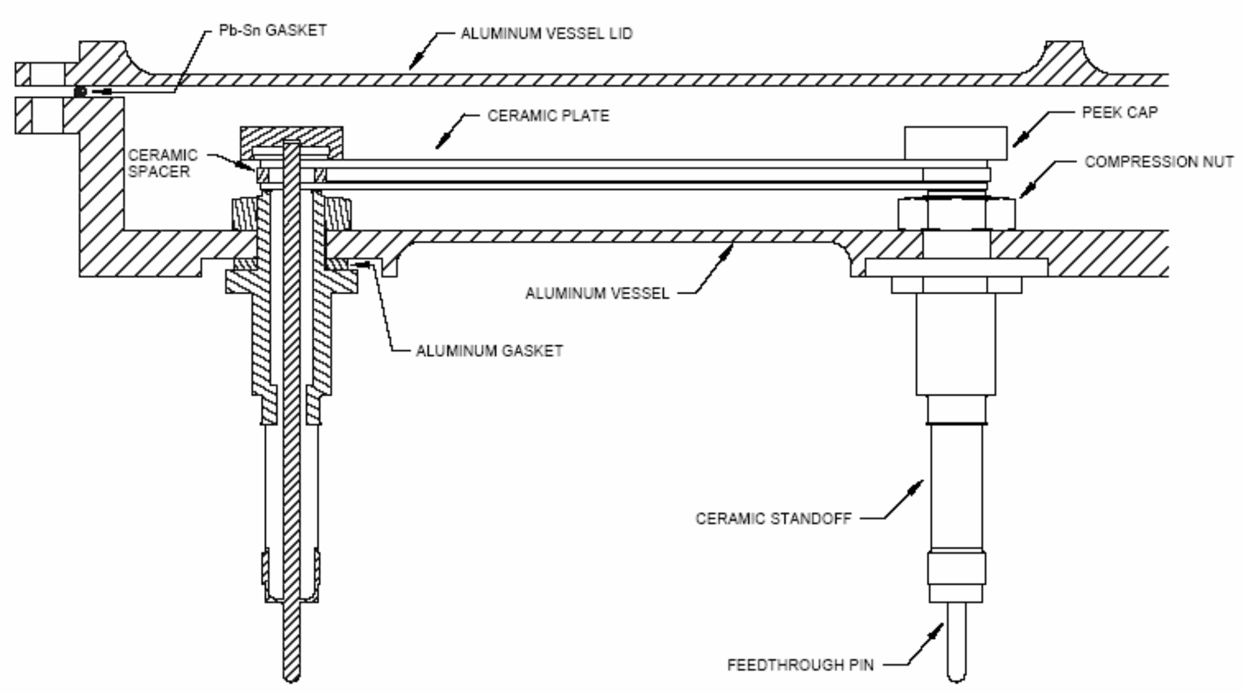
Present Hadron Monitor in NuMI Beam Line
NuMI Front end
Hadron monitor ion chamber
Primary/Secondary beam-based alignment
of target and horns
Diagnostic tool and long-term running
1 m² sense area
with 7 × 7 pixels
70 DCV in 1 mm gap
Apply He gas for ionization gas

Slide 13
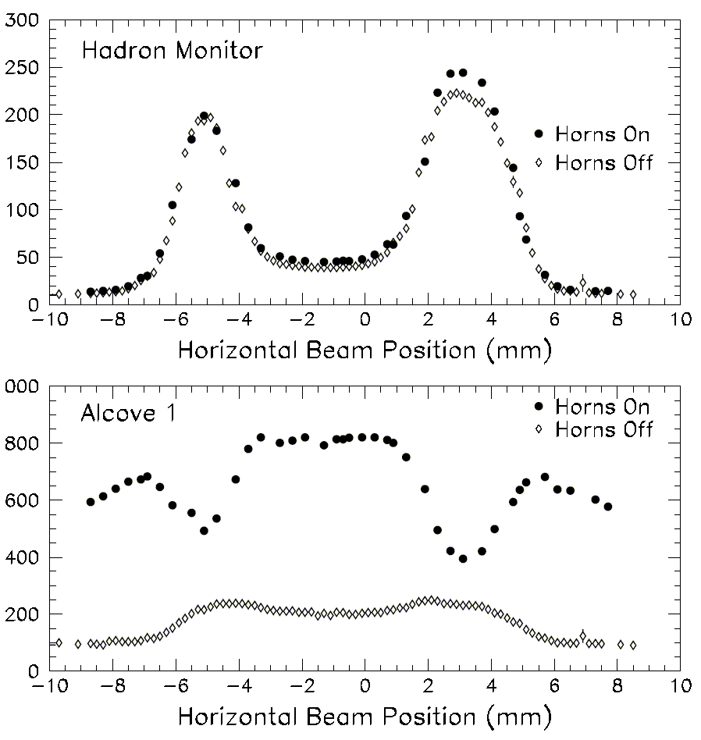
NuMI Target Alignment
Courtesy of R. Zwaska, “NuMI Hadron Monitor”
Proton beam scanned horizontally across target and protection baffle
  Also used to locate horns
Hadron Monitor and the Muon Monitors used to find the edges
Measured small (~1.2 mm) offset of target relative to primary beam instrumentation.
Baffle
Horn
p
Target
π
Graphite protection baffle
baffle
baffle
target
Water cooling line
Horizontal Fin
Pulse Height in Chamber (arb.)
21.4 mm
15.0 mm
11.0 mm
baffle
baffle
target
6.4 mm
Graphite target

Slide 14
Possible issues on Ion Chamber for LBNF/DUNE
Courtesy of R. Zwaska, “NuMI Hadron Monitor”
& “Beam Tests of Ionization Chambers for the NuMI Neutrino Beam”
Lifetime
  Degradation of the hadron monitor observed almost from the start for the NuMI application
    Certain number of damaged pixels at start
    Gradual increase in leakage voltage on HV
    Gains become variable
    Lifetime is 2-4 years in recent operations
Linearity of output signal
  Found non-linear response at > 2 10¹¹ protons/5 cm²/1.56 μs
    Linearity test has been done at the Booster ring
    Space charge effect activates recombination (confirmed by simulation)
LBNF/DUNE situation will be a factor of 10-20 worse
  Questions of temperature, robustness, and signal response

Slide 15
Consider Gas-Filled RF Hadron Monitor for LBNF
Long lifetime
  Simple structure, less material in a beam enclosure
Linearity
  No non-linear effect found with 2 10¹²/12 mm²/10 μsec from past beam test
Need R&D
  Vary driving frequency
  Low gas pressure
  Validate plasma model

Slide 16
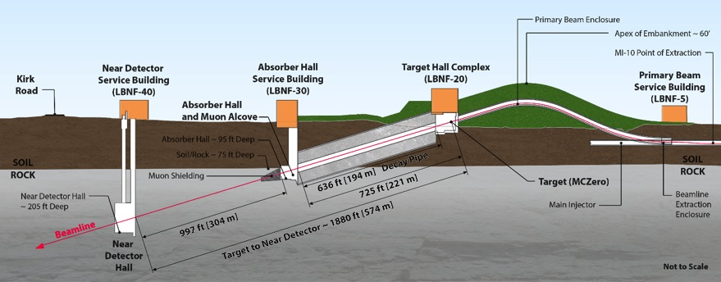
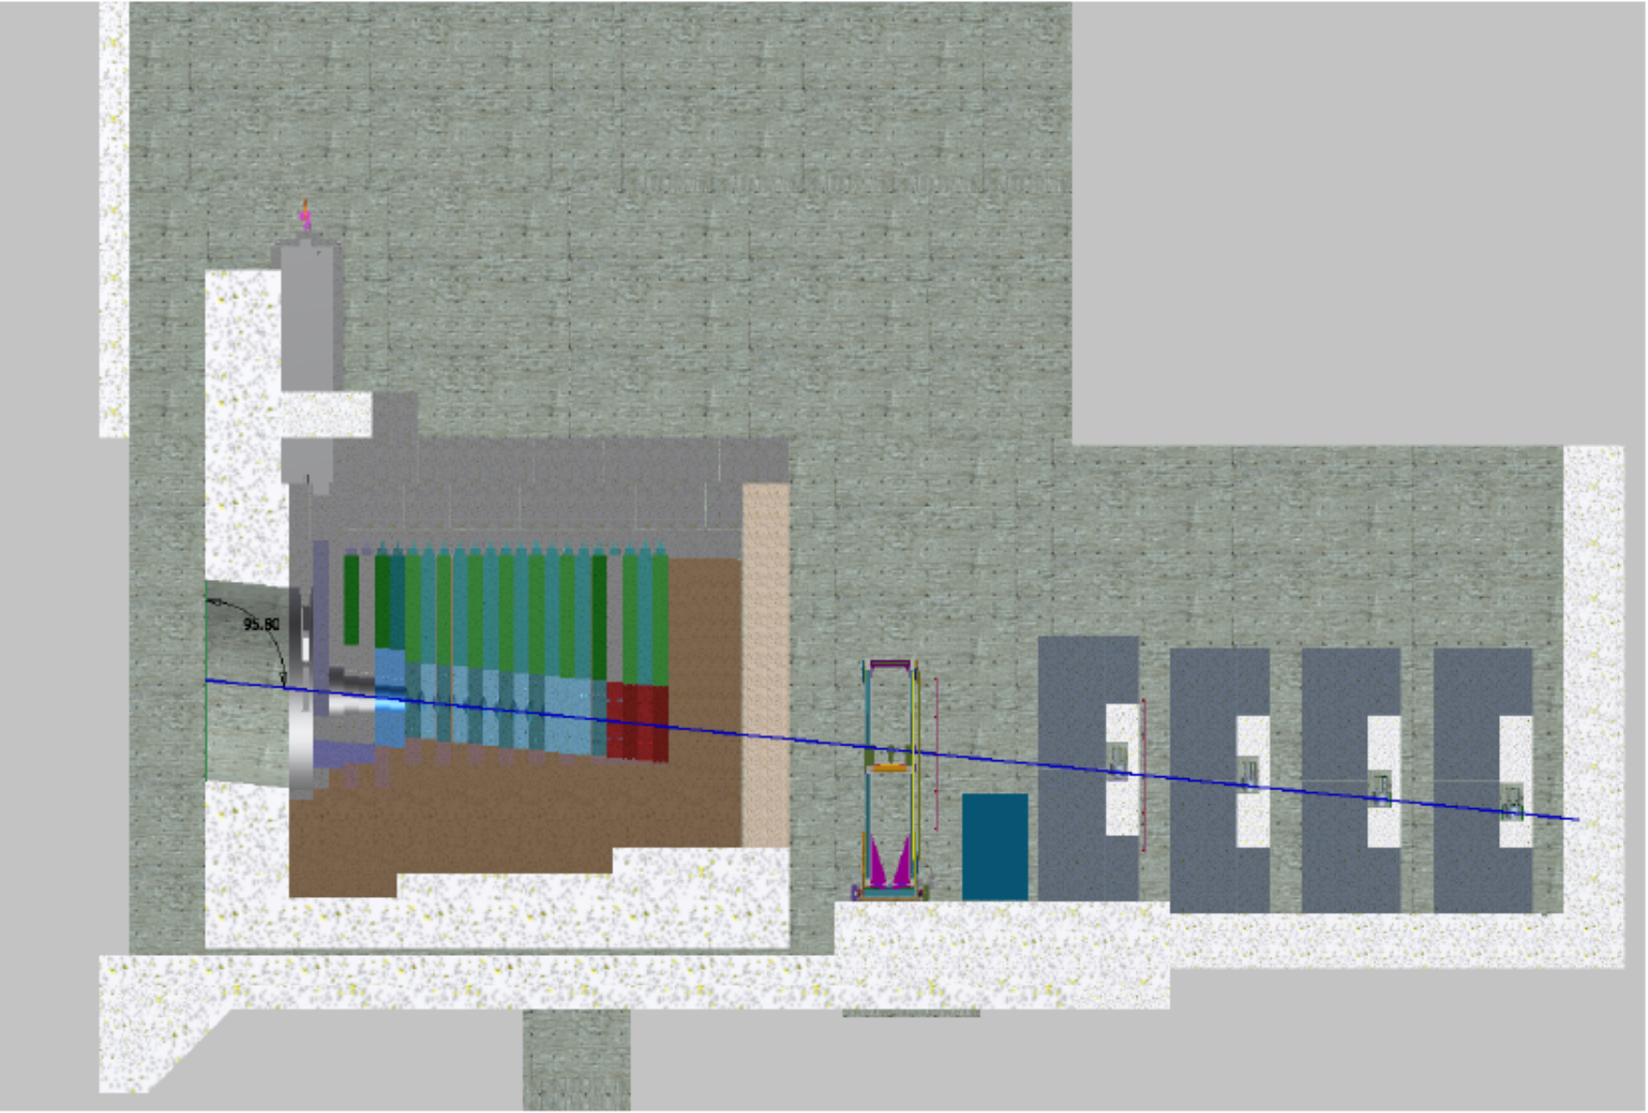
LBNF Beam line
Hadron monitor
Distance from the target
to the hadron monitor is
200 m (700 m for NuMI).
Beam power is > 2 MW
(up to 0.7 MW for NuMI).
Absorber
Muon monitor

Slide 17
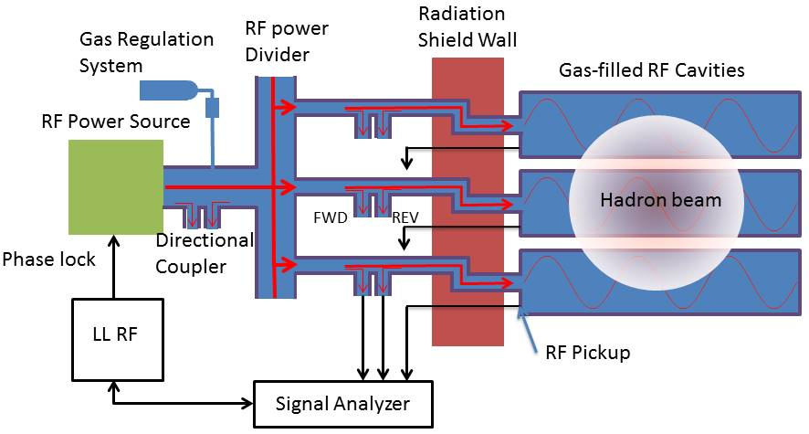
Schematic of proposed RF hadron monitor
RF cavity/waveguide
made of aluminum
(Optional: Diagnose the cavity)
・Entire size of the sense area is
0.36 x 0.36 m² (1 x 1 m² for NuMI)
・12 x 12 pixels or 12 + 12 bins for x and y
planes, hence the size of each pixel is
0.03 × 0.03 m² (0.1 x 0.1 m² for NuMI)
・RMS hadron beam radius at the monitor is
8 cm by using a 1-m-long C target
DAQ & Analyzer

Slide 18
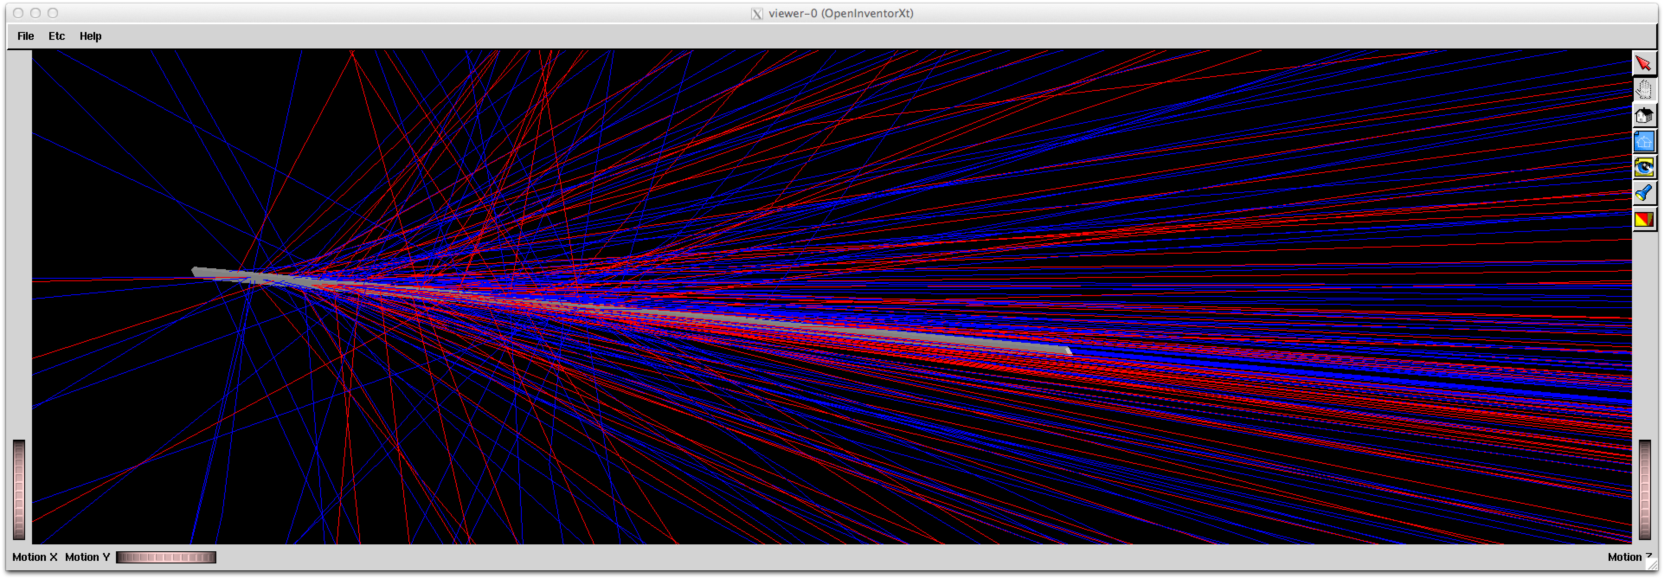
Performance Test in simulation
Use G4Beamline (Geant4 based single tracker program) for event generator
  No horn
  Just look at proton at hadron monitor
“Long-Baseline Neutrino Experiment”
Conceptual Design Report Vol.2 (2012)
with some arrangements referred from
the recent optimization study
Carbon target @ z = 0 m
15 x 6.4 x 1000 mm
120 GeV proton
Secondary particles
size = 1.5 mm
cycle time = 1.33 s
Pulse duration = 10 μs
84 bunches (20 ns bunch gap)
1.2 10¹⁴ ppp, Transverse beam emittance = 30π μm 99 %
Hadron monitor
@ z = 200 m
Snapshot of simulation events around target
(Blue) positive charged particle
(Red) negative charged particle
(Grey) target

Slide 19
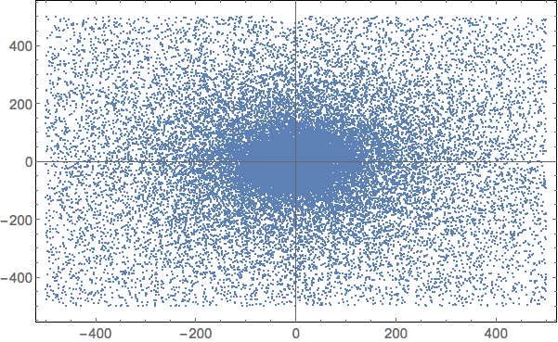
Monitor signal with 1 m carbon target
• Raw x-y beam profile at monitor
• Unit is mm
• Signal from gas-filled RF monitor
- RF amplitude E₀ = 0.1 MV/m
- N₂ gas pressure p_{gas} = 1 atm
• Vertical shows the plasma
loading
• RF cavity size 30 mm x 30 mm
• 12 x 12 RF cavity cells

Slide 20
Resonant Frequency Change
Collision frequency of electron in 1-atm N₂ ν (Hz)
Important fact
ν² ⨠ ω²_{rf} to apply for the Drude model
Dynamic range of
hadron monitor
Electron temperature [E, p_{gas}] (K)
300 K = Room Temp
E₀ ≤ 1 kV/m, p_{gas} = 1 atm
E₀ = 0.1 MV/m, p_{gas} = 1atm
Frequency change [Hz]
f = 10 GHz
E = 0.001 MV/m
[cm]

Slide 21
Temperature Dependence
Courtesy of Q. Liu
• Equilibrium temperature per
Single RF cell vs. incident beam
intensity
• 1.2 10¹⁴ protons/spill/sec
is the worst case
• Time constant: 243 sec
• Frequency detuning by the
temperature change is
/Kelvin for Al
• RF Quality factor vs Temperature
• Temperature increment make an
influence on the time constant

Slide 22
2-meter-long C target
W_{inst} [J]
• Beam is distributed wider than the 1-m-long-C target
• Output signal from 20 × 20 pixels monitor
• RMS beam size is 15.0 ± 1.3 cm
◆ It is 21.6 ± 7.9 cm in a 12 × 12 monitor
◆ Centroid of beam position in the 12 × 12 is the same as the 20 × 20

Slide 23
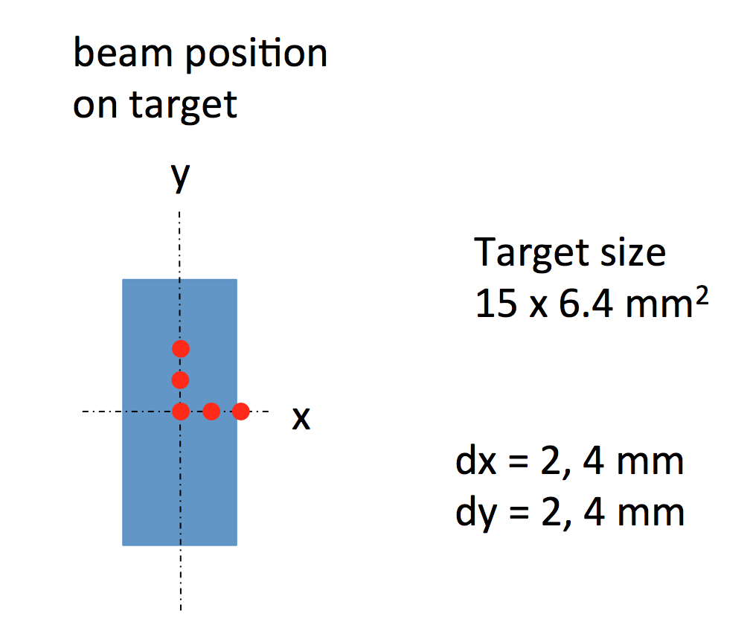
Beam Alignment
Estimated beam center
dy = 1.6 ± 0.5 mm
Estimated beam center
dy = 4.1 ± 1.1 mm
• Add beam position offset
• y-offset is reconstructed
with the absolute error
less than 0.5 mm
• Swept beam position in
x plane that is the same
procedure as for NuMI
beam alignment
• Find transvers profile of
baffle and target
Baffle
Target
Baffle

Slide 24
Monitor Target Quality and Beam Size
RMS beam size
1.6 mm
1.8 mm
2.1 mm
2.4 mm
Target density dependence
• 2 % density reduction corresponds
to 5 % signal increment
Beam size dependence
• 0.2 mm beam size difference
looks visible

Slide 25
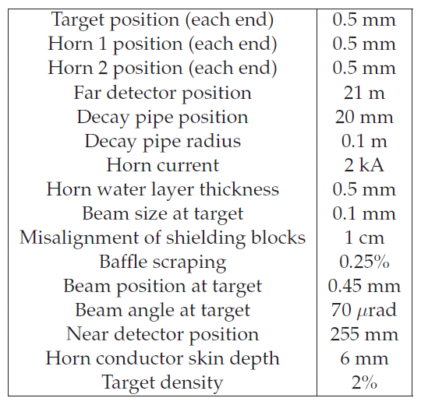
Hadron Monitor Sensitivity
Courtesy of R. Zwaska, “NuMI Hadron Monitor”
Has broad sensitivity to tolerances as it sits in remnant primary and secondary beams
Most relevant parameters:
  Intensity
  Position
  Width
Most useful only in conjunction with other instrumentation and the features of beam devices
✔︎
✔︎
✔︎
✔︎
✔︎
✔︎

Slide 26
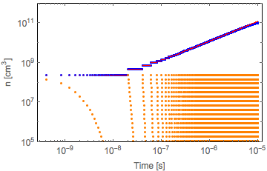
Increase acceptable beam intensity
• Reduce the number of electrons
to reduce plasma loading
• Dope electronegative
atom/molecule to control plasma
(Red) Pure N₂, assume no e-N₂⁺
recombination
(Blue) Pure N₂, recombination on
(Orange) N₂ + 1 % Oxygen dopant
• Single RF cavity can accept 10¹³
protons by using dopant
• Bottom left plot shows the ratio
between the stored energy (U) vs
plasma loading (W) as a function
of time in the RF cell which receives
the highest intensity in the monitor
Population of electrons in RF cavity
with bunched beam (Bunch gap = 20 ns)
τ = 10⁻⁹ sec
protons/bunch
N = 5 10¹² protons/spill/RF cell
τ = ∞

Slide 27
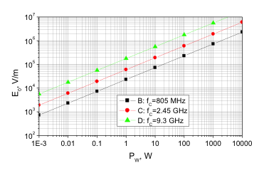
Required RF power for single RF cavity
Required peak power for single RF cavity
0.3 or 3 W for 9.3 or 2.45 GHz @ E₀ = 0.1 MV/m

Slide 28
Benefit of Gas-Filled RF Monitor
Radiation robust
  Much less material in the sense area
Wide dynamics range
  Accept 10⁶ to 10¹³ protons
  No non-linear response

Slide 29
Disadvantage of gas-filled RF monitor
Expensive
  Possibly $1M
    RF power source is a major cost driver
    Use Fermilab standard frequency, e.g. 1.3, 2.45, 3.9 GHz to reduce the cost
Need R&D
  Require R&D to make a practical device
    Several demonstration tests needed for performance check
    Establish algorithm for DAQ & Analyzer & Calibration
Funding support
  STTR budget ($1M/2 years) to support R&D
  Need additional support to fabricate the practical device for LBNF

Slide 30
Two-years Demonstration Plan
Two demonstration stages are planed
  2.45 GHz
    Design/fabricate a high-pressure single RF cavity
    Test at the Fermilab Test Beam Facility
    Use Fermilab-owned Magnetron
      Or Fermilab-owned solid state amplifier for the first test
    Optionally, design/fabricate a multi-RF-cavity to apply for NuMI
  3.9 or 9.3 GHz
    Design/fabricate a multi-RF-cavity for LBNF
    Design/fabricate a Magnetron or a Solid State RF amp.

Slide 31
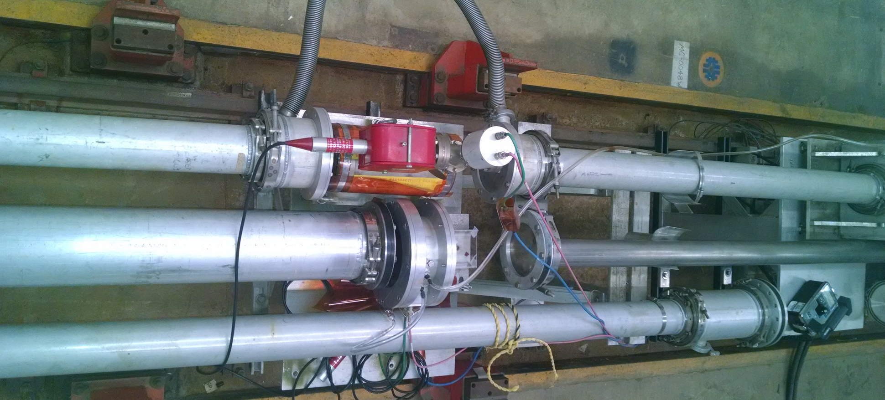
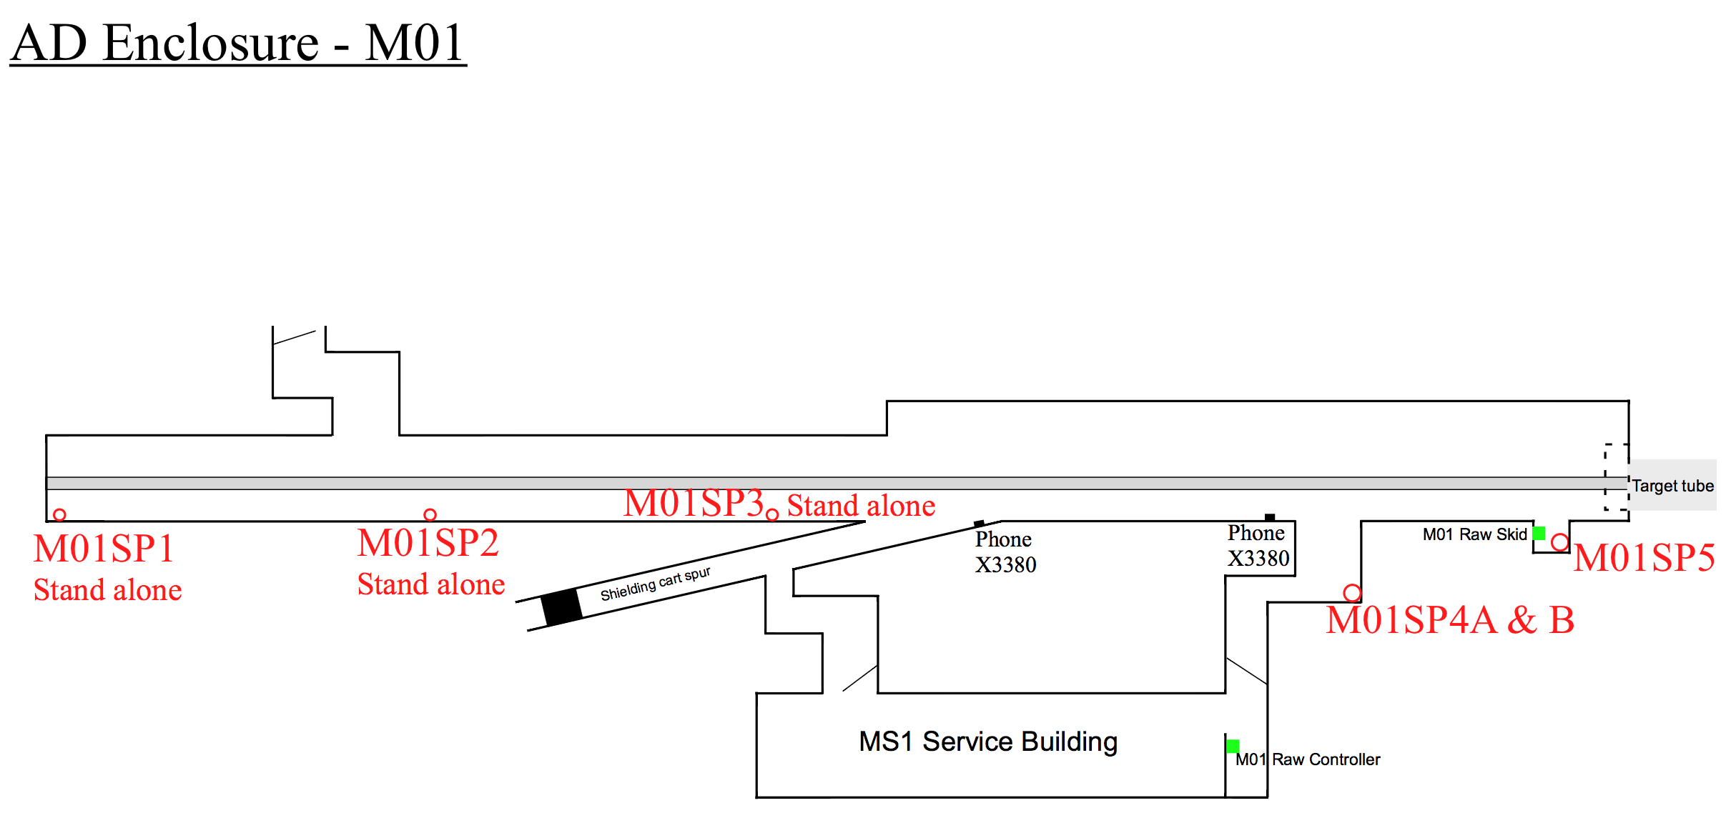
Possible beam test facility
Sufficiently a large
air gap to install
a gas-filled RF
MS1/M01
Slow extraction beam
120 GeV protons
4 10¹² protons/spill in 4 sec
Limited by the radiation safety
RF source/Gas regulation/DAQ system
will be stored in the MS1 service building

Slide 32
Summary
Propose a gas-filled RF cavity for a beam profile monitor
  Expected radiation robust and linear response for intense beams
Numerically evaluated the cavity for the LBNF application
  Demonstrated wide dynamics range, 10⁶-10¹³ protons/RF cavity
The project is funded by the DOE STTR phase II
  Plan a demonstration test
    Experimentally verify the monitor concept
    Find the best RF/plasma parameter for LBNF
    Consider FTBF and NuMI for test
  R&D will be carried out in 2016-2018
  Looking for additional funds and collaborators

Slide 33
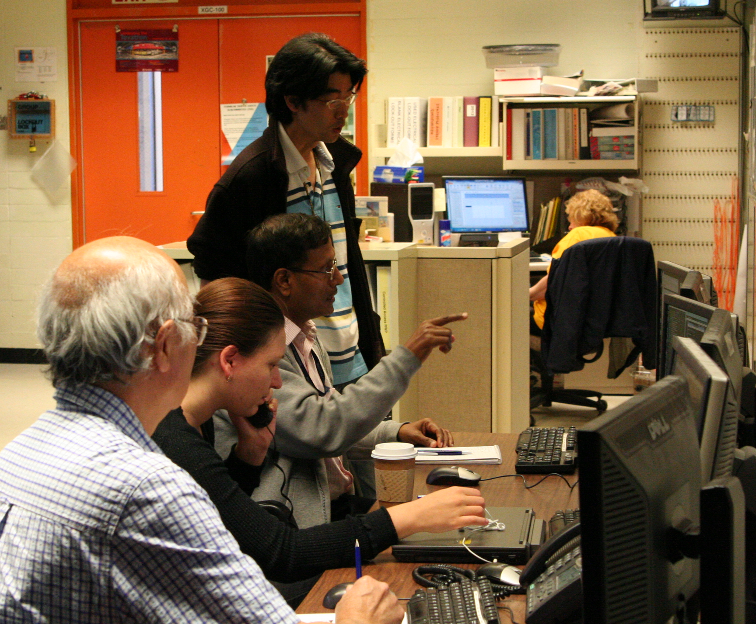
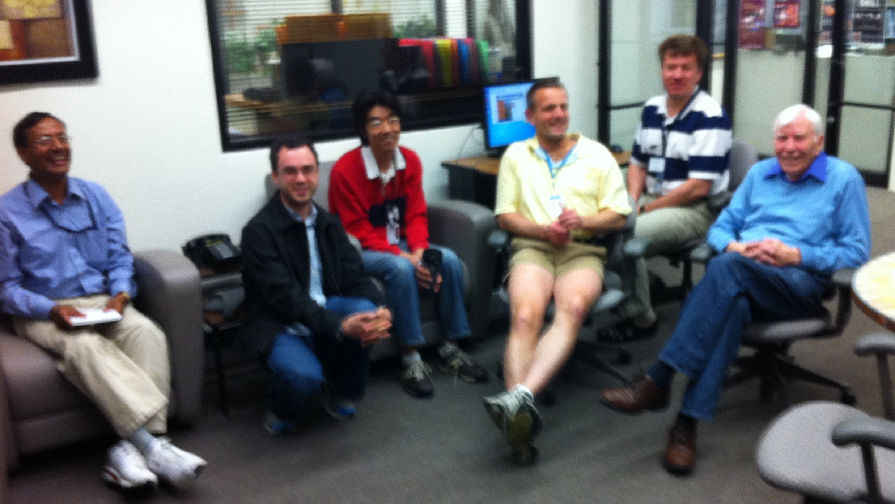
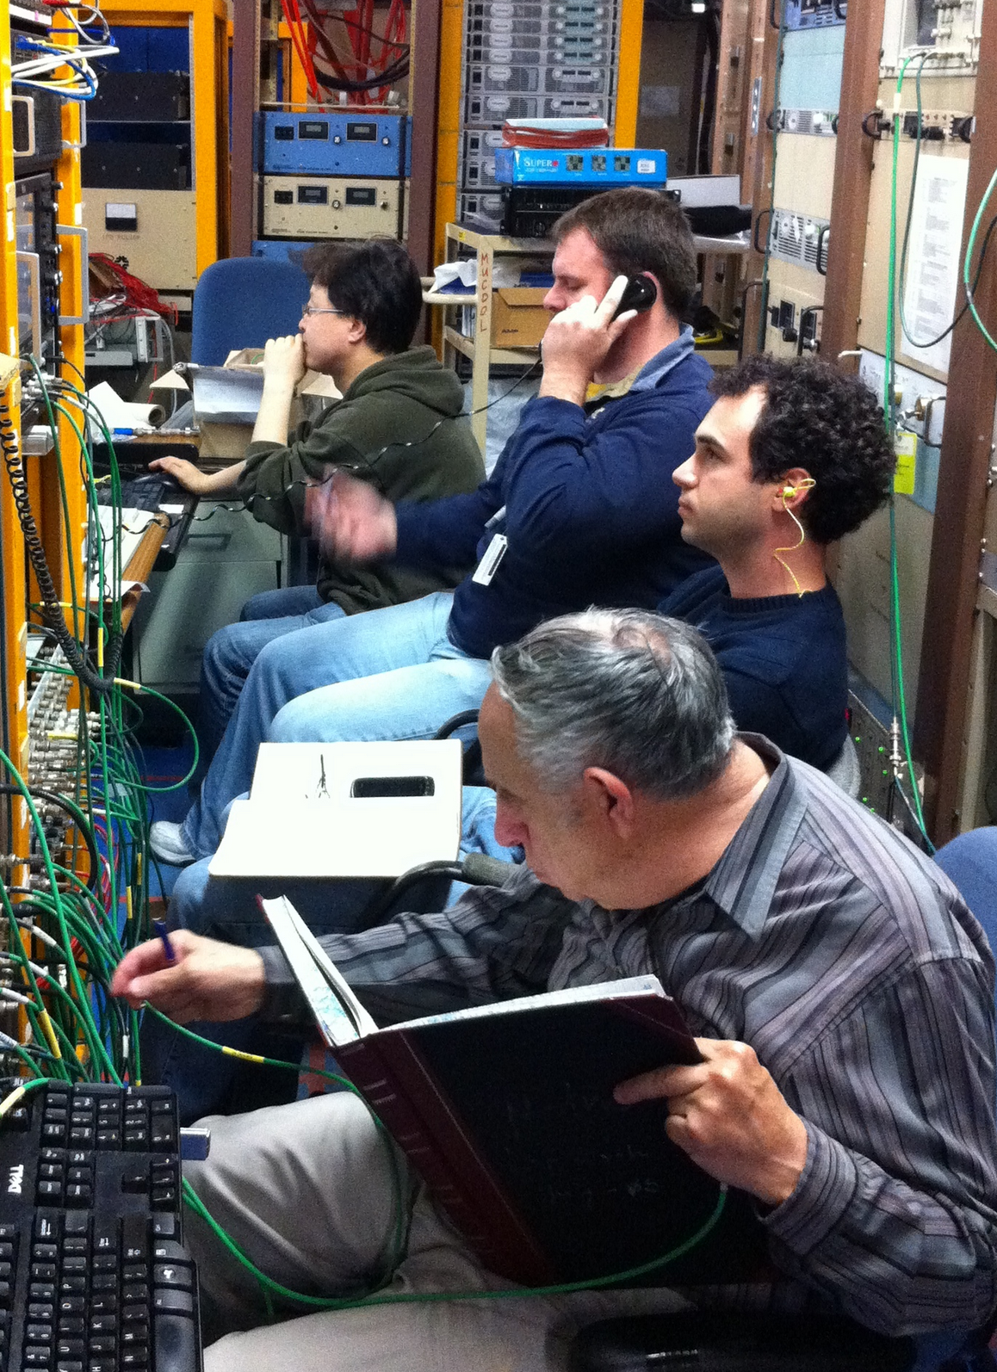
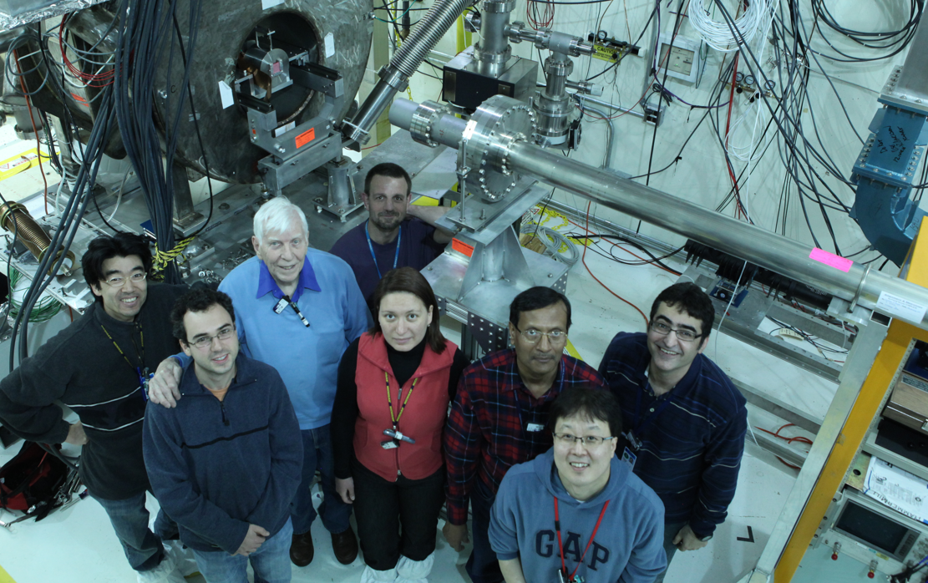
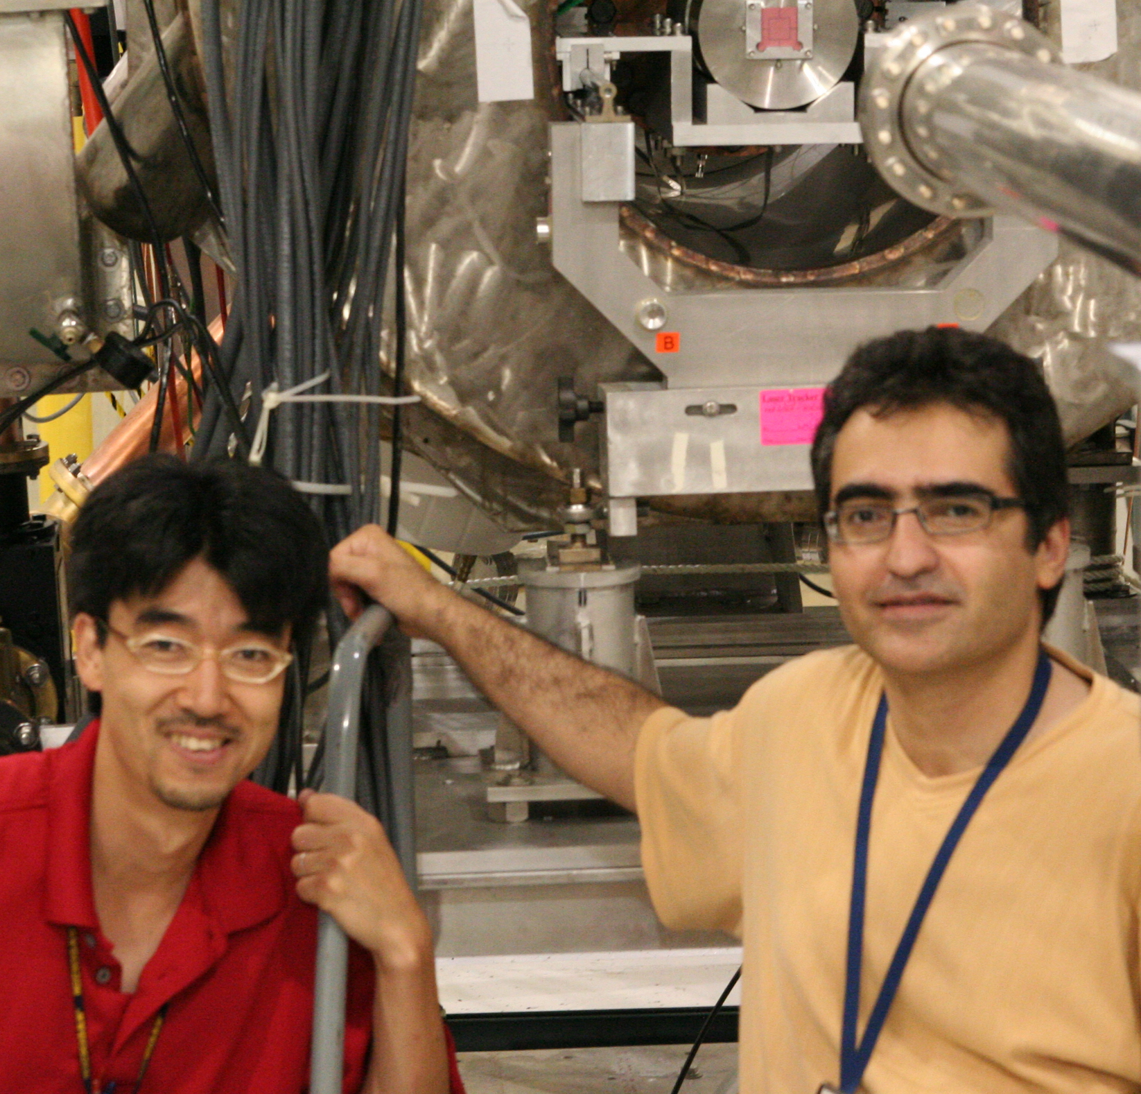
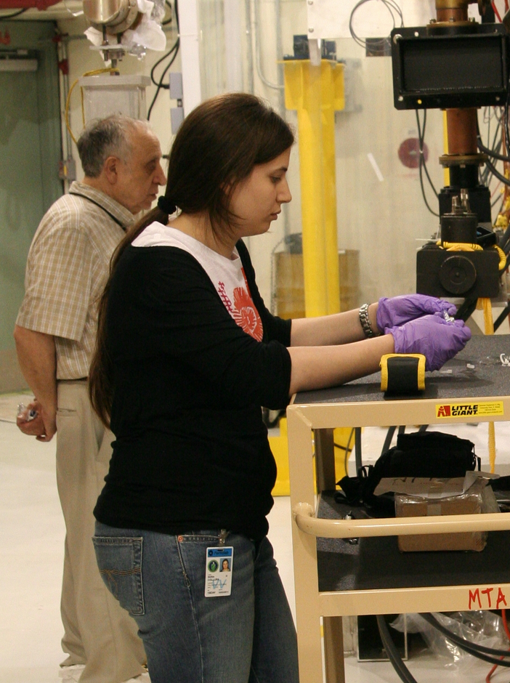
Thank you!

