Slide 1
PA drive circuit (cathode resonator)
Robyn Madrak
Booster 2nd harmonic Cavity
15 Sept 2016

Slide 2
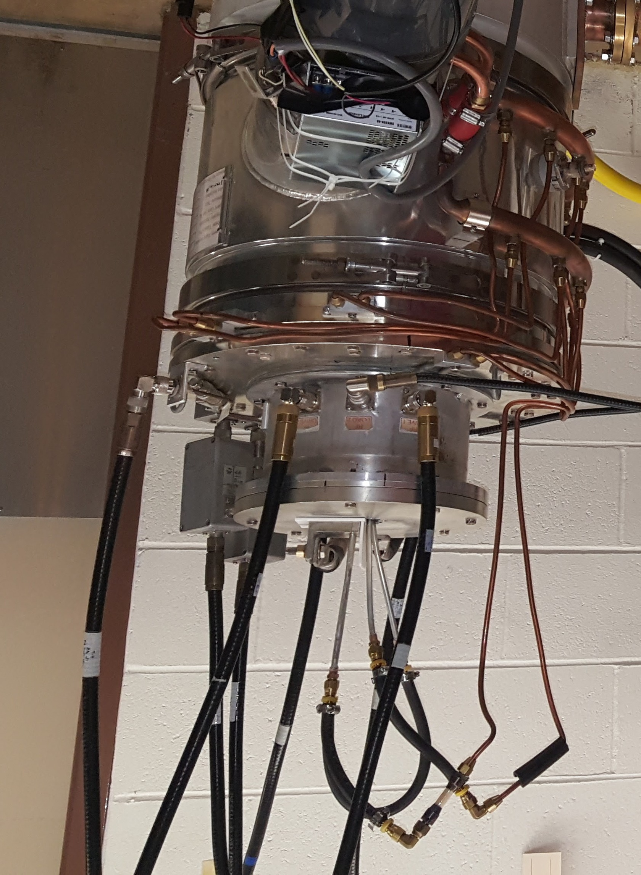
Cathode Resonator
The cathode resonator is a short, inductive, coaxial line
It is meant to cancel the capacitive part of the impedance the drive amp sees (tube input capacitance)
Two 50 ohm loads are attached in parallel in an attempt to make the response broadband enough
Werlatone output 12.5 ohm
(four 50 ohm outputs
In parallel attach to cathode circuit)
Cathode resonator

Slide 3
The problem
The circuit was modeled as a coaxial line in parallel with a lumped 250 pF (tube input impedance) and swamping resistors. This was the approach used for the Booster fundamental.
Modeling it this way, it was determined how much shorter to make the coax part so that the peak of the response was at 76 MHz. The model predicted the response would only be ~1dB lower at 106 MHz.
A prototype booster fundamental cathode resonator was made shorter…
As it turned out, the f was lower than expected and the falloff worse.

Slide 4
The problem cont’d
The lower f can be explained by a tube input capacitance that increases with frequency.
  The decay in response is (in data) accounted for in reflected power due to impedance mismatch. That is, the shape of the response curve (cathode voltage vs input power) can be gotten from the shape of the reflected power
  But in simulation cannot reproduce the falloff at higher f, even with a larger tube C value
The Tomco drive amplifier cannot operate at a high enough power at 106 MHz, given the reflected power

Slide 5
From Tomco
Reflected power hurts doubly: first it derates the allowed output power from the amp; it also decreases transmitted power

Slide 6
Needed drive power
Given Gennady’s CST shunt impedances of 192k, 361k at 76,106 MHz, for 100 kV
  76 MHz: need 52 kW
  106 MHz: need 28 kW
For drive power
  76 MHz: need 1.3 kW drive
  106 MHz: not sure how to extrapolate this fit. Probably should assume ~ 1kW, especially since we do not know its response at higher f
Bad fit
extrapolation

Slide 7
Reflected power vs. f
At 76 MHz we are fine
At 106 MHz, ~75% reflected
Tomco can only operate with 31% of 8 kW out = 2.5 kW
Then 75% of that is reflected so only 0.62 kW forward.
Try to do better: move the peak to 91 MHz to “split the difference”, by changing the coax resonator (inductive line)

Slide 8
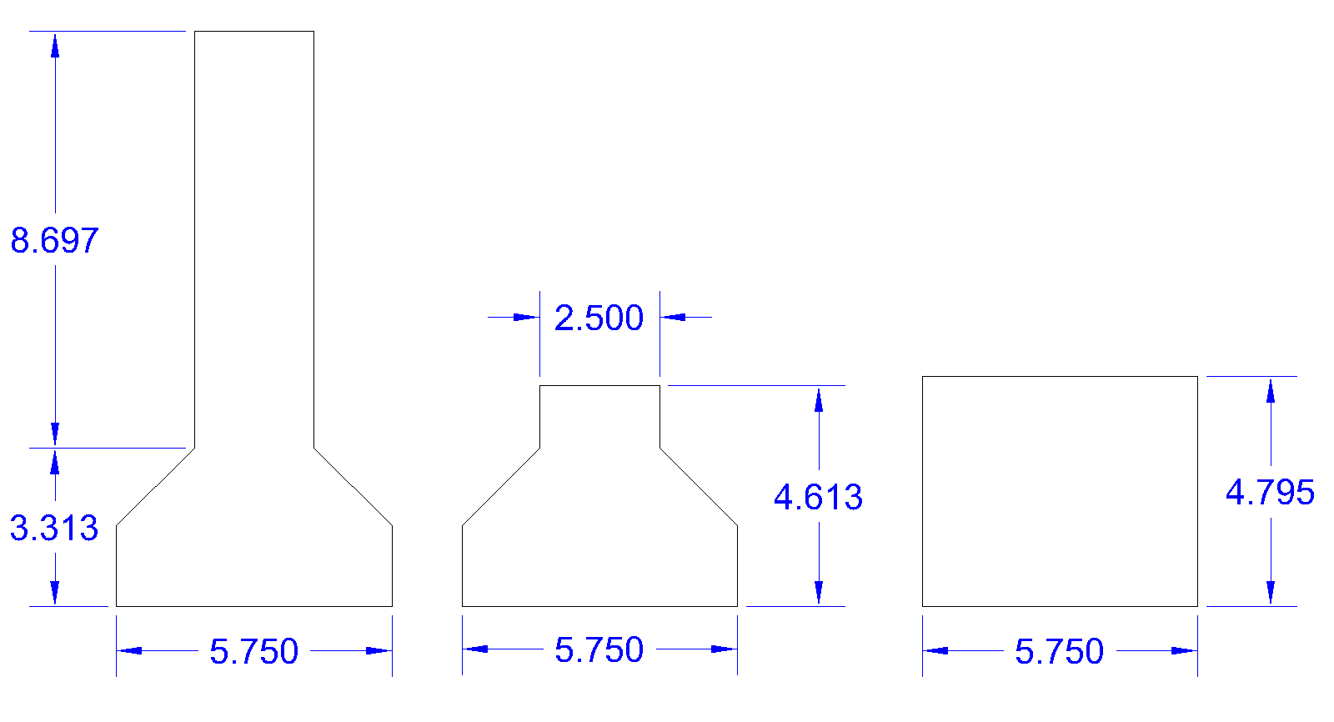
Resonators…
1) Booster fundamental
Prototype cath. Res.
Sometimes a blind squirrel gets a nut…
We can kludge the new design 3) up with sheet metal since it’s the same length as 2)
2) Existing harmonic
cath. res. made from
Booster prototype (1)
3) New design for harmonic cath. res.
f = 91 MHz

Slide 9
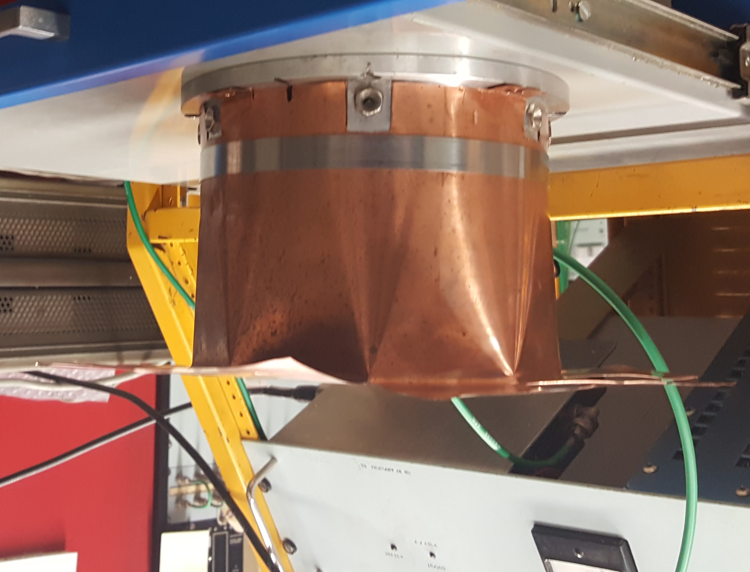
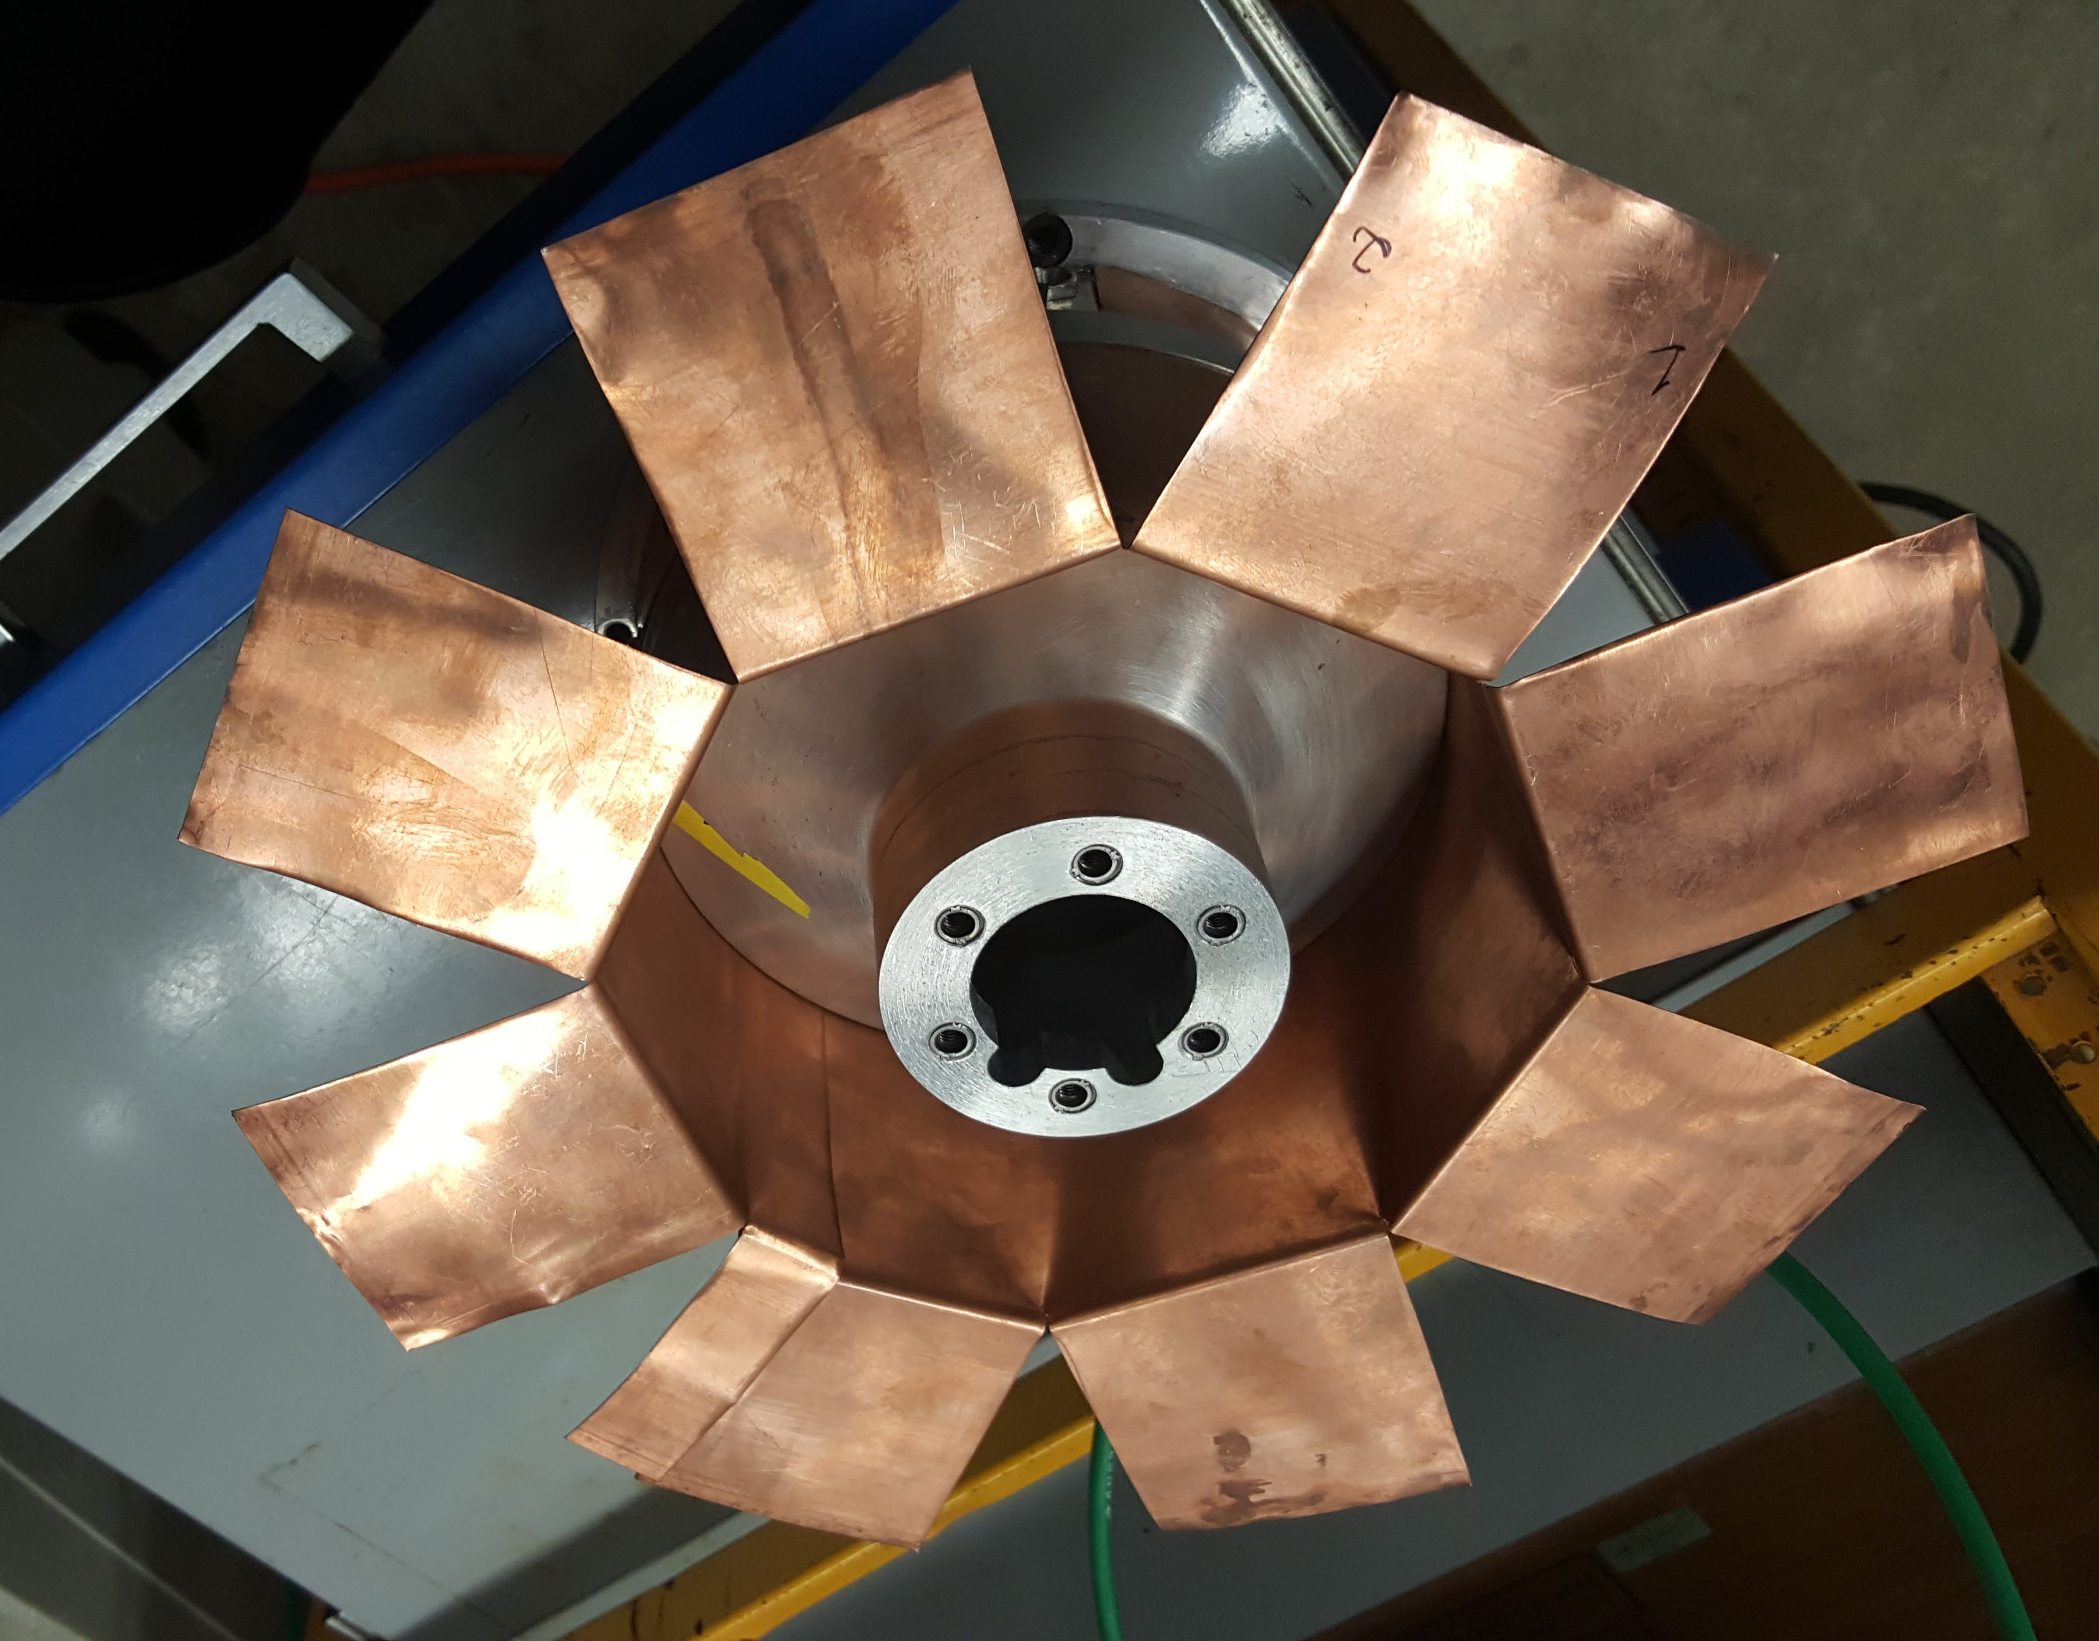
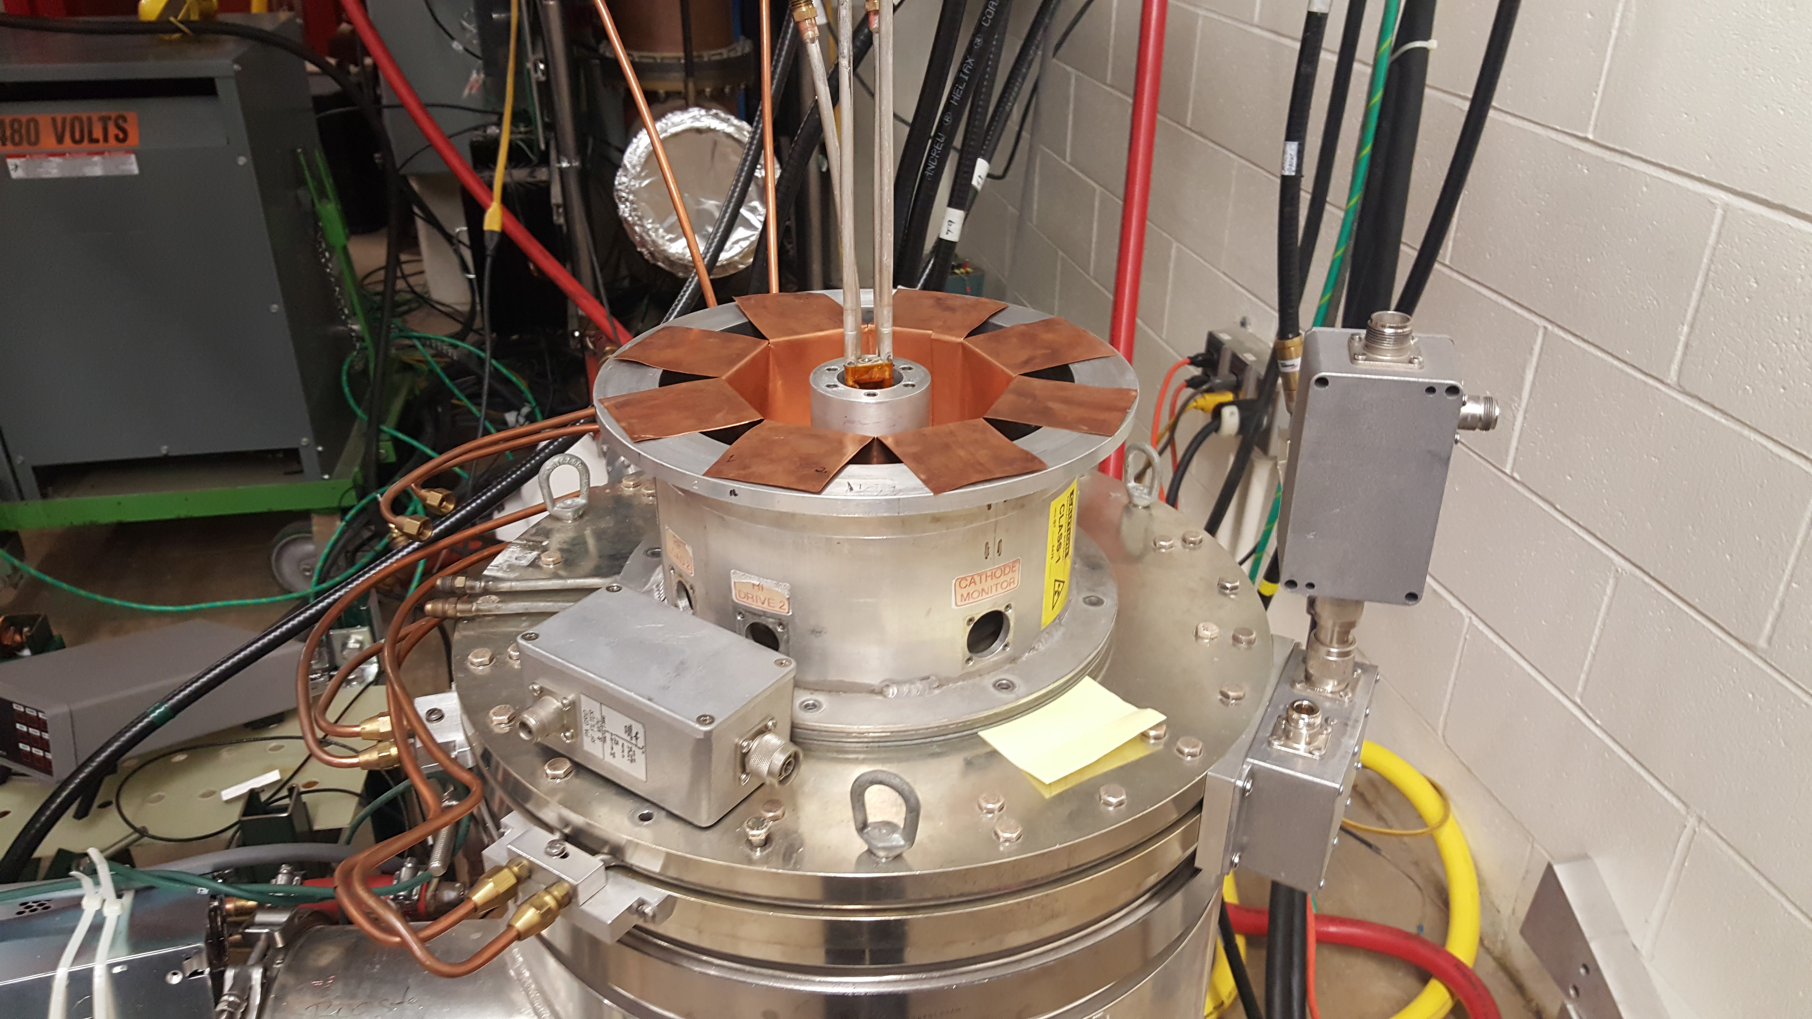
Kludged Resonator
Put Cu tape across gaps,
Then a shorting plate is added on top

Slide 10
What we were aiming for..
If we take the data for reflected power with resonator 2) and assume we can just shift the whole curve up in frequency but keep the same shape:
This is very good but probably not realistic because we know that the response falls off faster as we go up in frequency
 |  |  |  | Total Allowed
 |  |  | Frac Allowed | Output P | Actual Forward
 | f(MHz) | Frac Reflected | Output Power | (kW) | P (kW)
f0 | 70.05 | 0.022 | 1.000 | 8.00 | 7.82
f0-15 | 55.05 | 0.361 | 0.462 | 3.70 | 2.36
f0+15 | 85.05 | 0.333 | 0.493 | 3.94 | 2.63

Slide 11
Actual results with kludged resonator #3
f0 will still need to be moved up, but with these results we are just on the edge of what we need (also as f goes up things get worse)
Likely Rsh will be less than the model predicts so we need to do better…
 |  |  |  | Total Allowed
 |  |  | Frac Allowed | Output P | Actual Forward
 | f(MHz) | Frac Reflected | Output Power | (kW) | P (kW)
f0 | 88 | 0.01 | 1.000 | 8.00 | 7.92
f0-15 | 73 | 0.52 | 0.339 | 2.71 | 1.30
f0+15 | 103 | 0.59 | 0.313 | 2.50 | 1.02

Slide 12
To do better
Tried changing swamping loads but this does not help, because reflection is due mainly to the imaginary part of the impedance when away from the peak
Initially tried adjusting length of drive cables – it helped by a few % and this is something we can explore more…
Circulator: can’t find any available with this bandwidth
Joe Dey’s idea: use a tuning stub without the combiner

Slide 13
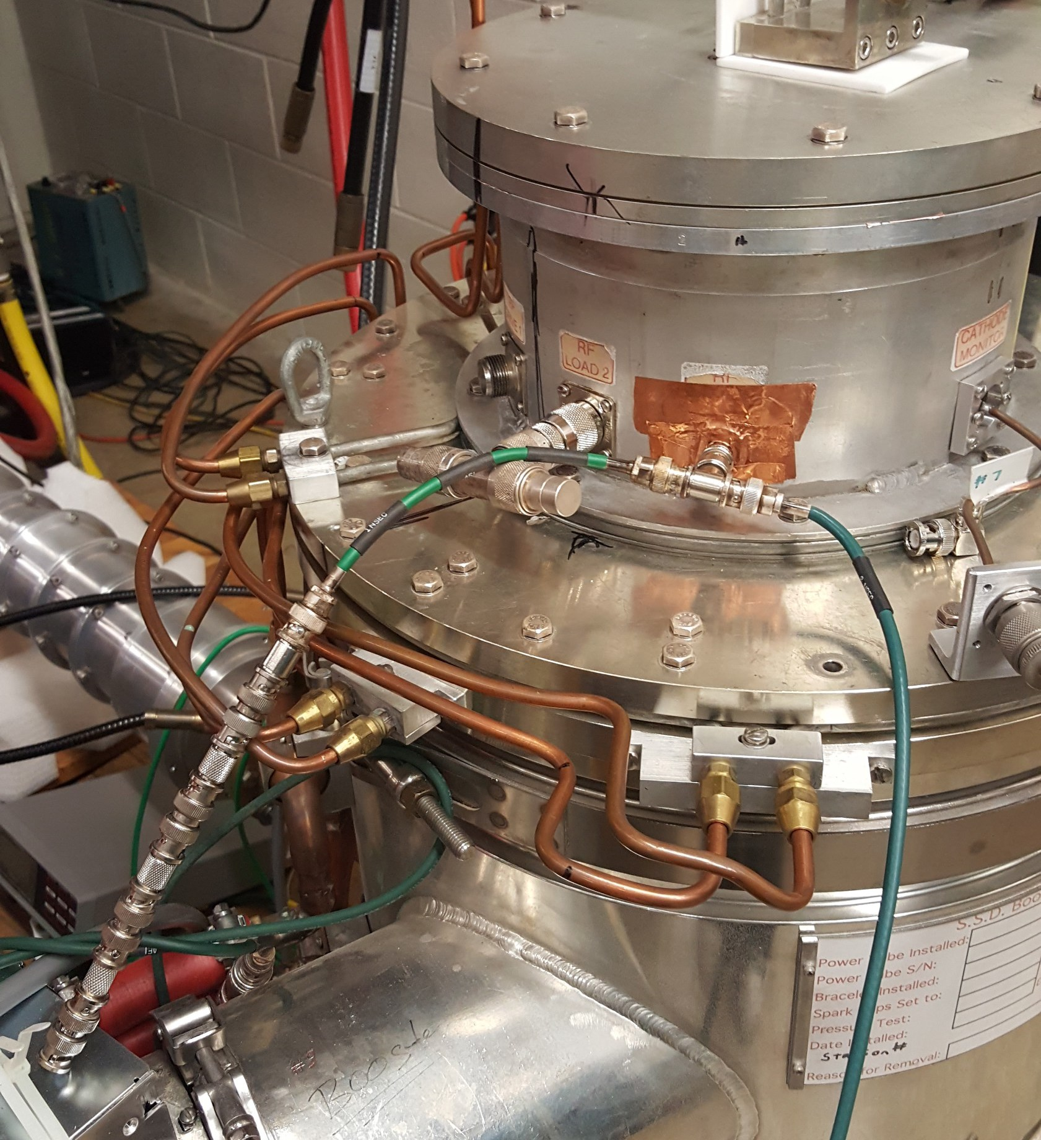
Joe’s Tuning Stub (low power only)
Input: only 1 now instead of 4
Removed HN adapter to
Decrease L (this was important for the bandwidth)
Open tuning stub: Joe calculated and adjusted (1ns + 4 bullets + 4 barrels)
Also 12.5 ohms (instead of 25) loading is optimal.
Input from network analyzer

Slide 14
SWR with tuning stub

Slide 15
Kludged resonator low power with tuning stub
At 78.7 MHz and 109.6 MHz (Δ = 31 MHz)
  VSWR is 4 -> 36% reflected power (compared to ~50 - 60% before)
This corresponds to ~2.3 kW forward power, which is great!
The next task will be to implement this with heliax and connectors which can take the power
The central frequency must be adjusted too
Need to make a real version of the kludged resonator

Slide 16
Other interesting things
We now have three resonators where we can measure f0 (with weakly coupled probes). L of the resonator is calculable.
This gives us tube input C as a function of f
 | f0(MHz) | Z/(Calculated) | L(from Z/i) | C=1/ω²L (pF)
old Booster | 37.844 | 15.672 | 6.59094E-08 | 268.3 | filaments off - PA on dolly
new fund | 65.138 | 7.245 | 1.77021E-08 | 337.2 | filaments on
kludge | 84 | 4.983 | 9.4413E-09 | 380.2 | filaments on

Slide 17
Conclusion
If we can get the tuning stub to work with high power modifications, the problem is solved.

