Slide 1
Laser Notcher Status
David Johnson & Todd Johnson
PIP Weekly Meeting
10-19-2016

Slide 2
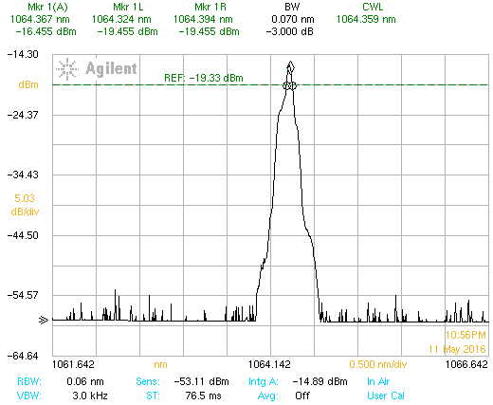
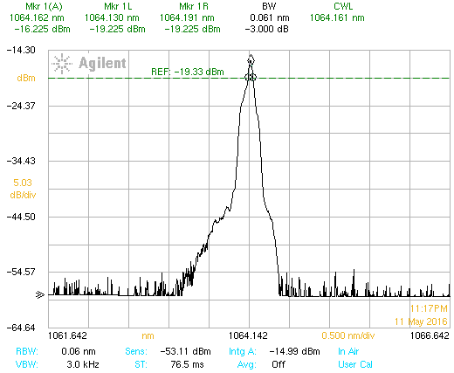
Add TEC to seed diode FBG
We have been testing cooling down the FBG with a TEC. Can get about 20 deg C cooling to bring the FBG temperature to around 8 deg. This will shift the peak wavelength of the seed from about 1064.36 nm to 1064.16 nm (Δ =0.01 nm /deg C)
However, we will not need to do this as we are getting a new seed diode without an external FBG.

Slide 3
Fiber amplifier Optimization – P.O. approved and in process of placement with Dr. Rudiger Poschotta of RP-photonics. He will model our two CW fiber amplifiers independently and as a system for current performance and perform optimization for the amplifiers and provide suggestions. At issue
Length of the LMA gain fiber – to be optimized for gain and output and move the SBS threshold to higher powers (we may be at optimization – don’t know)
Length of the pre-amp gain fiber … fiber used has very high doping level which provides for a very high pump absorption… the current gain fiber is much longer than simple scaling of pump absorption… want to understand the ramifications… can this be optimized
Replace LMA isolator –
Isolator has come in – scheduling the replacement
If we can get results from simulation for LMA amplifier want to fold into the modifications when adding the isolator.

Slide 4
Replace tap coupler in OEA with 2x2 tap coupler to monitor Rev power –
This will allow us to monitor the reverse power being generated in the Optical Engines amplifier so we can confidently increase pump power while monitoring reverse power.
Tap coupler in hand will schedule replacement when we remove the PriTYel amplifier for modification.

Slide 5
Add Pockels cell to FSA
We need a half-wave cell for our system
Tested optical operation (single pass) of quarter wave cell in our system to gain experience
Pockels cell on order expect first of November delivery,
Pockels call mount in hand
Driver (we’re using an existing driver from Analog Modules). Need to order a spare (however it uses a bit different voltages which will require a bit of adaption)
Estimate a week to install, implement and tune to implement and tune.

Slide 6
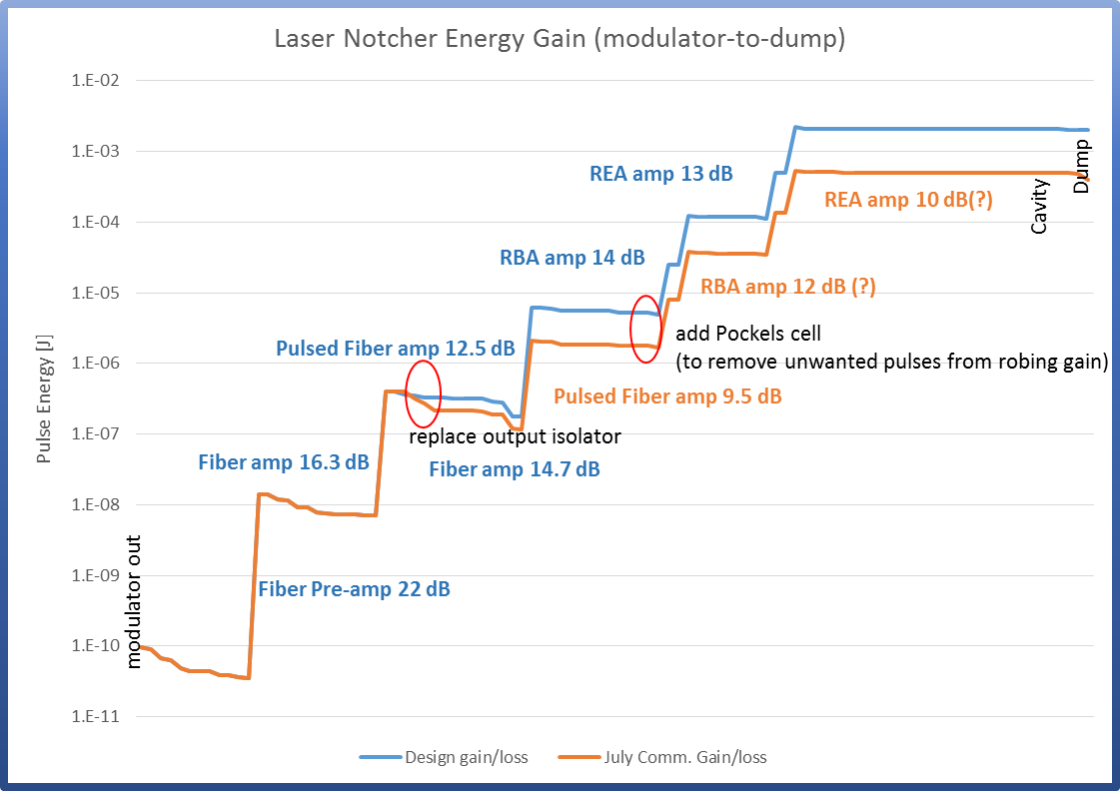

Slide 7
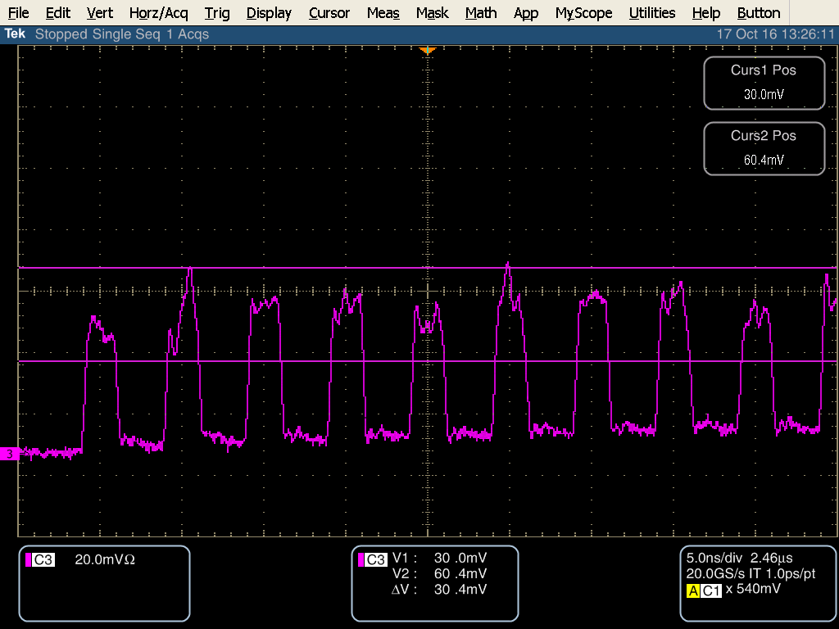
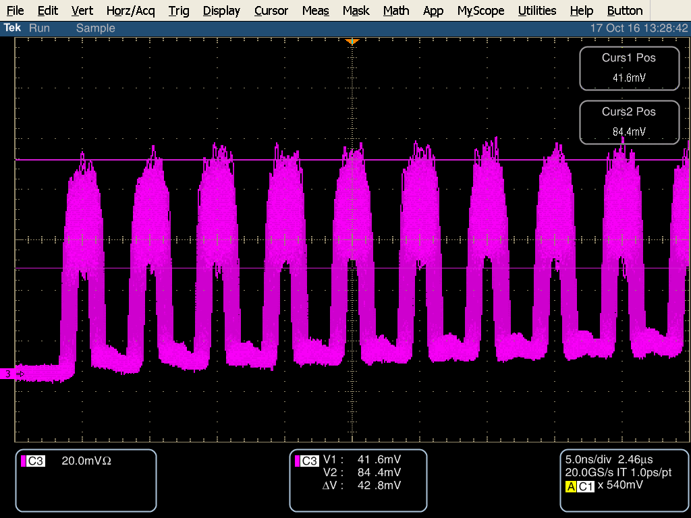
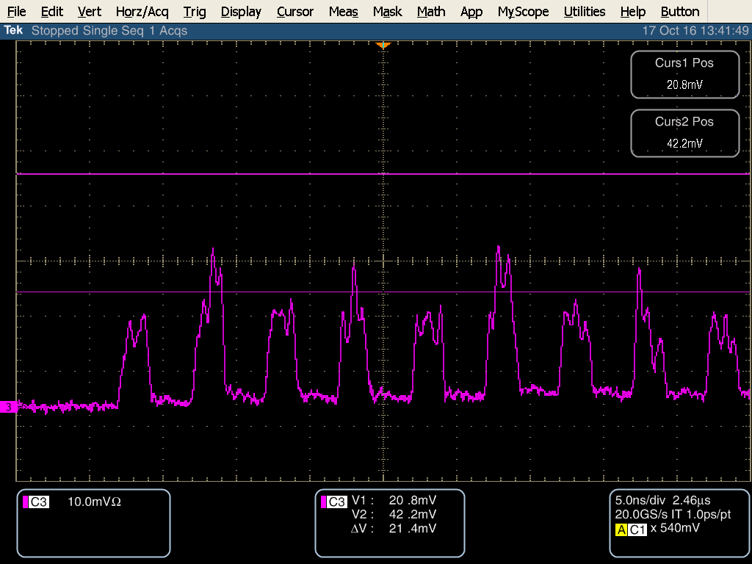
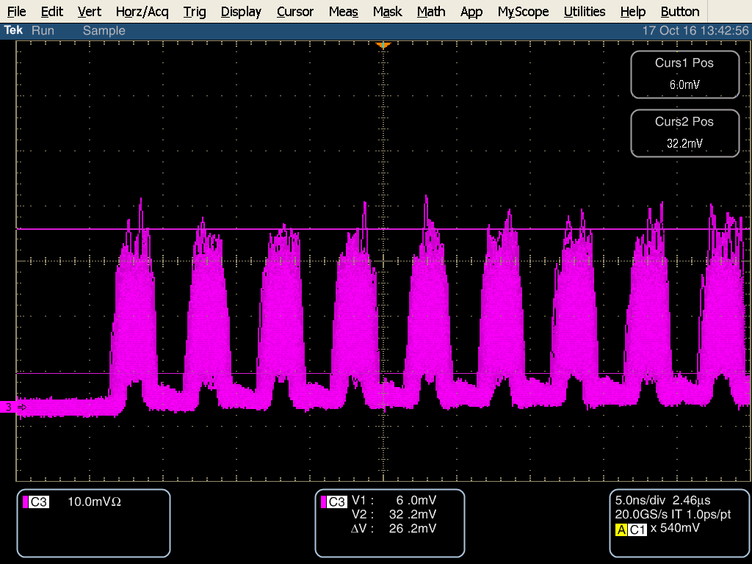
Cure high frequency instability in Grumman modules –
Experts thought we had some sort of parasitic cavity or spatial mode issues in the DPSS system or had no idea.
Our investigations showed the instability was NOT because of some parasitic cavity in our DPSS system, NOT some spatial mode matching, NOT coming from ASE or other instability from the upstream pulsed fiber amplifier, and NOT from some instability in the PriTel amplifier, or inter-pulse power from modulator extinction.
Single pass thru RBA
Two pass thru RBA

Slide 8
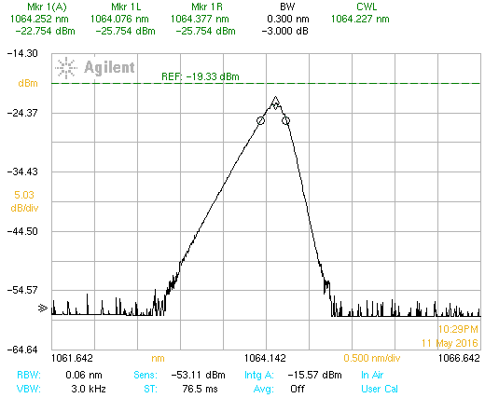
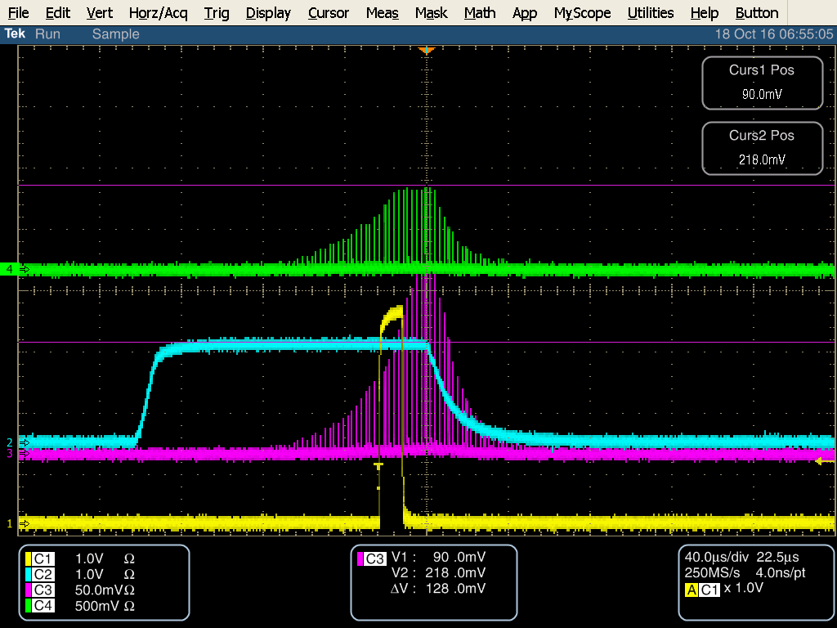
GOOD NEWS: We found the instability was coming from our SEED source
TEC 8 deg
TEC 40 deg
TEC 40 deg
FBG 8 deg
PriTel LMA pump 4A / OE pump 0
RBA & REA pump 130A
REA
RBA
These diode parameters are good for the Free-space
amplifiers, but not good for the fiber amplifiers

Slide 9
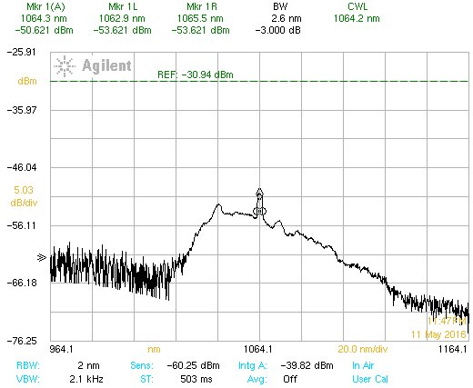
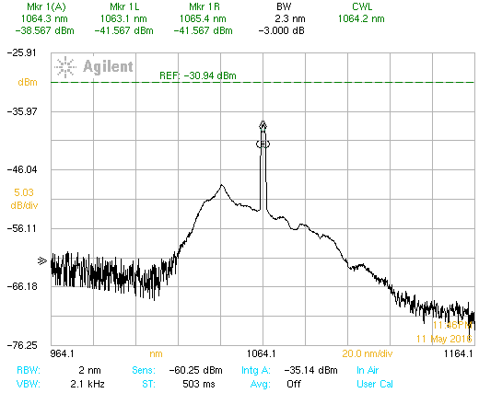
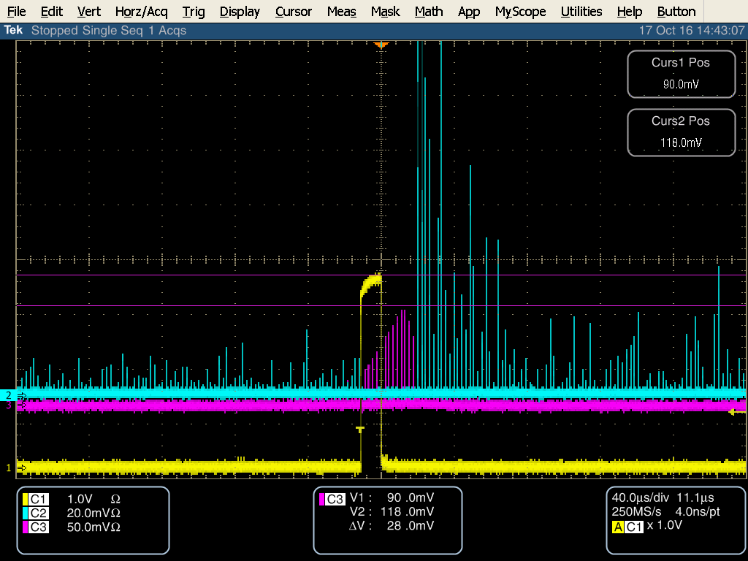
BAD NEWS: We can’t use our seed source
Seed source not stable at 40 deg C (oscillates between the 1st two
spectra on previous slide)
Impact of running Lumics Diode at 40 deg C. and the LMA amplifier
PriTel pump 5A
PriTel pump 5A
PriTel pump 4A

Slide 10
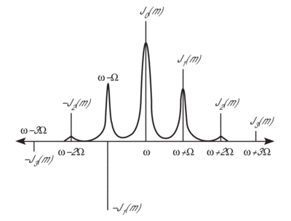
The requirements for our seed diode get tighter
Spectral content & power must not generate SBS
Can’t be operated in a regime of coherent collapse or
Gain competition amongst longitudinal modes where the energy is transferred between modes not shared amongst modes.
The center wavelength must match the peak of the ND:YAG gain spectrum and be within the 3 dB bandwidth or better.
Solution: use a single frequency seed diode and phase modulate the output such that the power in each line is shared amongst the sidebands
Brillion gain bandwidth 100 MHz
Modulation frequency larger than 100 MHz (500 MHz – 1 GHz)
Should generate a spectral comb ~ 80 GHz (corresponds to 0.3 nm)
Seed diode laser – in purchasing 2-3 weeks ARO
Phase modulator – REQ in purchasing – ship upon ARO
Modulation source – borrow then make (?)
Instrumentation issues
The OSA has a resolution bandwidth of 0.6 nm ( only see the envelop of individual longitudinal modes)
Need something like a scanning Fabry Perot cavity interferometer

Slide 11
99:1
Modulator
95:5
99:1
Seed
Pulse output to amplifier chain
~320 uW
VDRIVE
RF Amp
MDC Bias Control
Osc. Keep Alive
DA12000 AWG
Notch Trigger
<P> <100 mW
Fermi OPG
Ext. clock sync to RFQ
Phase
Modulator
99:1
Modulator
95:5
99:1
Seed
Pulse output to amplifier chain
MDC Bias Control
~120 uW
VDRIVE
RF Amp
Modulation
source
Osc. Keep Alive
DA12000 AWG
Notch Trigger
<P> <100 mW
Fermi OPG
Ext. clock sync to RFQ

Slide 12
Implication of adding phase modulator:
Maximum average power input from seed diode 100 mW
Added insertion loss of < 3.5 dB (special ultra low insertion loss unit ~2 dB)
Reduces input in to EOM from about 96 mW to somewhere between 30 and 45 mW depending on insertion loss.
Reduces input into pre-amp from 320 -400 uW to 120 uW
With pre-amp at max gain the pre-amp output (LAM amp input) down to 20 mW- below the input threshold for the LMA amplifier.
Two options
pulse seed diode
Reduces average power into phase modulator (pulse duty factor ~100 ns/2.2 us) while keeping peak power
Unknown impact on spectral quality and unknown peak power
Requires new pulsed diode driver (new interface to safety system and controls)
Added complications interfacing keep alive
Once we understand the full impacts considering making spare OPG module with pulsed seed
Add booster amplifier
MW- Technologies (Portugal) YDFA-SPM-1 for 100 uW input 17 dB gain -> 6 mW output
3.5x4.5x1 inch , easily integrated, < $6K
Delivery 6-8 weeks (can we install once we are operational?)

Slide 13
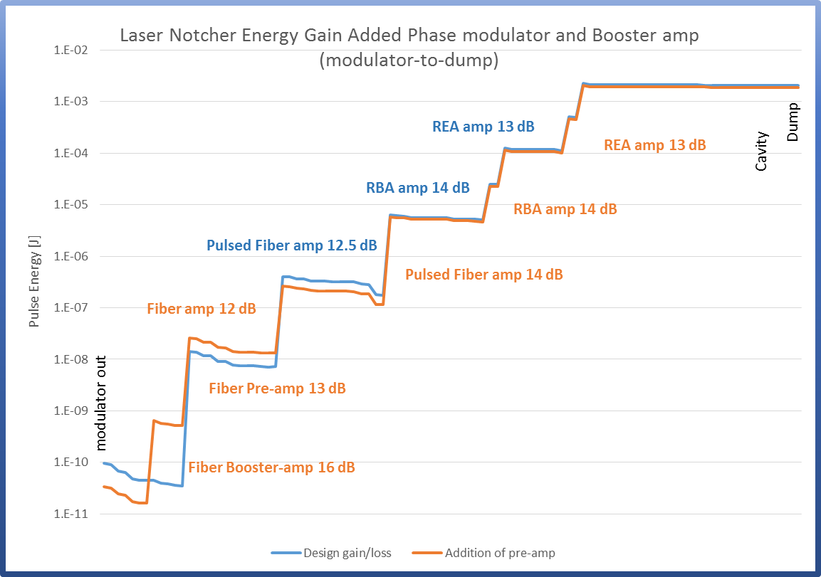

Slide 14
Construct photodiode monitor module – under construction
Construct integrating spheres - components on hand
Build 2 new vacuum flanges & 1 optical cavity
Optical cavity complete (being cleaned)
Viewport/mirror blanks delivered –
send out for coating ( approx. 2 weeks)
Vacuum flanges being manufactured
Once we have all parts and put one together, we can test new cavity with expanded input viewport
Implement real-time video camera into Transport enclosure to monitor bounces on the fixed mirror
Replace wheels on rack/add anti-vibration feet
Add protective front panel(door)/water shield OE
Parts on hand

Slide 15
Stiffen steel floor plate
Additional bolts added to hold it to the floor
Add cooling to electronics rack –
In process – a 2 inch smooth interior tube will be run under floor and come out under RFQ to connect to the front door to provide cooling for the rack
Create N2 atmosphere in optics box-
Working with Matt Alvarez
External Review: Under construction - Tentative date week of Nov 14th

