Slide 1
Summary of DC studies held between 12 Oct to 14 Oct 2016
C.Y. Tan (on behalf of studiers, K. Seiya, C. Bhat & S. Chaurize)
PIP Meeting
26 Oct 2016

Slide 2
Goals
We wanted to check the lattice that was measured with LOCO with independent methods
Use dipole method and quad method to measure lattice.
Requires good tune measurement.
Requires feedback like RPOS be turned off.
Check that Dogleg model is correct in MADX.
Tune scans for different dogleg settings.
Measure the RF voltage using synchrotron frequency.
Measure momentum acceptance.
Aperture at the absorber (last minute addition)
All the above had to be completed in 2 days!
Had to cancel ½ integer studies.

Slide 3
Studiers
C.Y. Tan & K. Seiya on lattice measurements.
LOCO & beta function measurements.
Tune scans.
Dogleg measurements.
C. Bhat
Calibration of RF voltage using synchrotron frequency.
Momentum acceptance.
K. Seiya & S. Chaurize
Aperture scans at absorber.
Thanks to B. Pellico, K. Triplett for getting Booster into DC state.

Slide 4
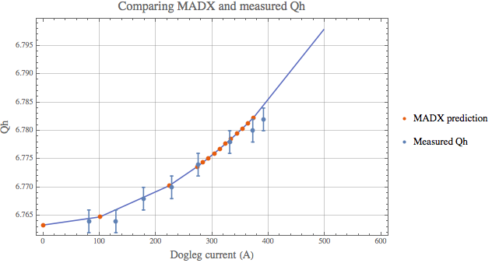
Dogleg measurement vs MADX model
This shows the predicted Qh from MADX compared to measurement. It is very good!
Dogleg only affects Qh and not Qv.

Slide 5
Check BPMs for LOCO and independent β measurements
5 ms
7 ms
9 ms
In DC studies, we can compare the response of the BPM measurements.

Slide 6
However 3 ms does not reach current setting
3 ms
-0.56 vs -0.37 ~ 67% difference
5 ms
The dipole currents cannot slew by > 1A in 0.6 ms. We have to be careful when we do LOCO during the ramp. Scripts have to be changed to read actual current if possible.

Slide 7
Measuring lattice using dipole excitation
Since we are measuring the beam response anyway Δx/Δθ, the approximate beta function at the BPM (assuming the dipole corrector and BPM are at the same location) is:
The above is model independent, but assumes that all bpm’s and dipoles are ideal. (LOCO is model dependent).
Have to measure tunes to get β.
DC conditons:
All feedback is OFF.
All QL’s have the same constant value. QS’s also.
Dipoles have the same value that they had at injection.

Slide 8
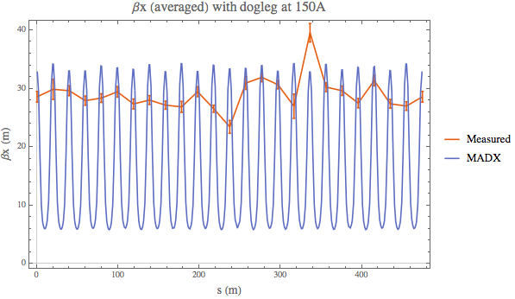
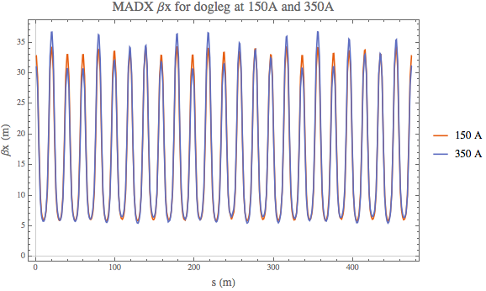
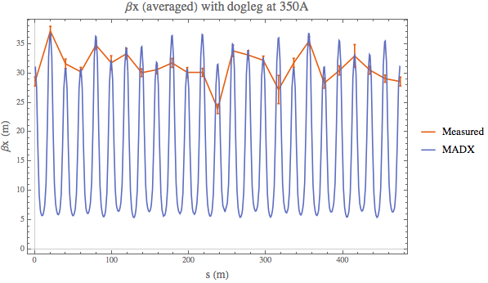
Comparing MADX and dipole excitation β’s
Measurements show a much larger change in lattice than model! Also measured lattice is smaller than what is in the model for 150A. Is lattice correct? Or Q is not right for the dipole excitation measurement? Or dipole calibrations?

Slide 9
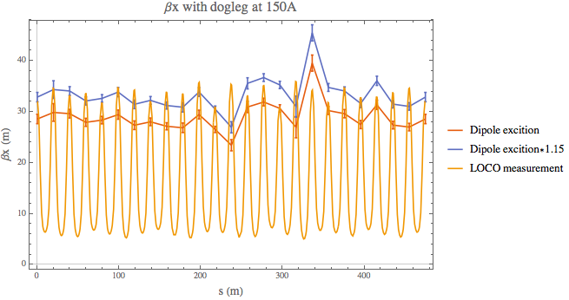
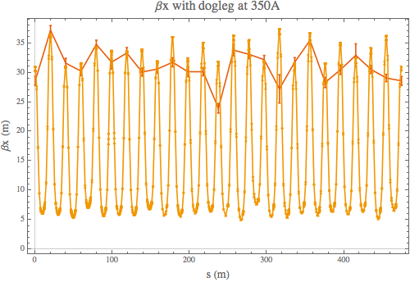
Comparing LOCO and dipole excitation β’s
Comparison with LOCO and measurements.
Since LOCO depends on the MADX model, it also shows that at dogleg at 150 A does not match dipole measurements.
Rescaling dipole excitation measurement for 150A data by 1.15 gives approximately the same behaviour as LOCO.

Slide 10
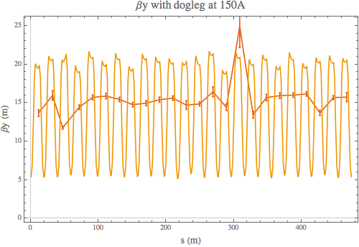
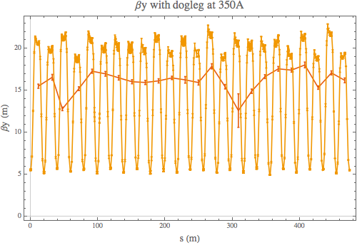
Comparing βy
Problem persists with βy measurements. Dipole excitation method gives lattice that is about 25% too small!
Lattice is wrong?

Slide 11
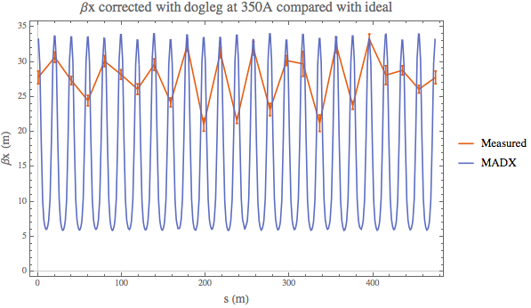
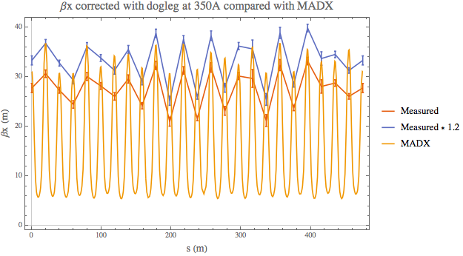
After “correction”
Clearly, I made things worse!!!
There is problem with my “fix”. More investigation is needed.
I think the way forward is to trust the model and check new settings with MADX first before sending out to Booster.

Slide 12
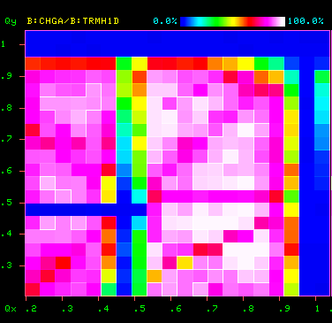
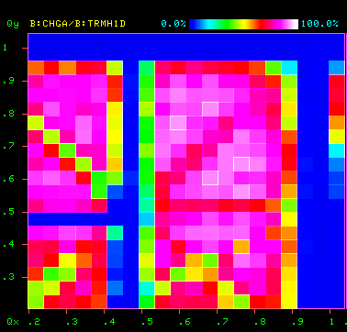
Tune scans
B:DOGL3 = 150A
B:DOGL3 = 350A
Clearly shows that higher dogleg current increases the width of the Qx = 0.5 resonance.

Slide 13
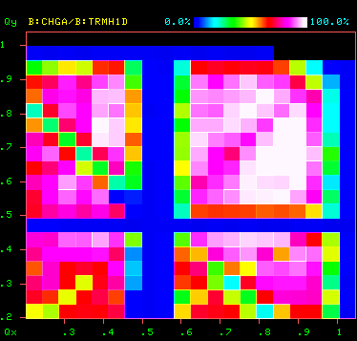
After applying LOCO “correction”
½ integer really got enhanced with bad correction! Seems to have a better lifetime in a region of the tune plane.
However, take this with a grain of salt right now. Corrections are being checked.

Slide 14
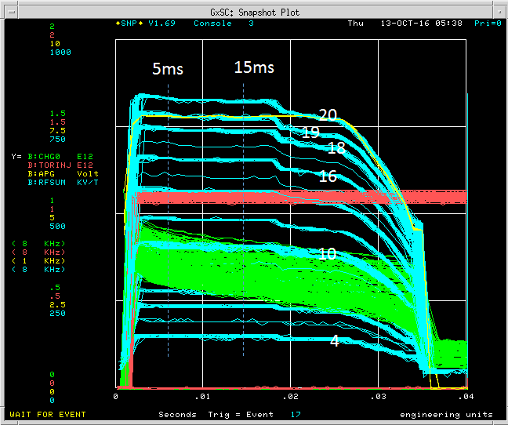
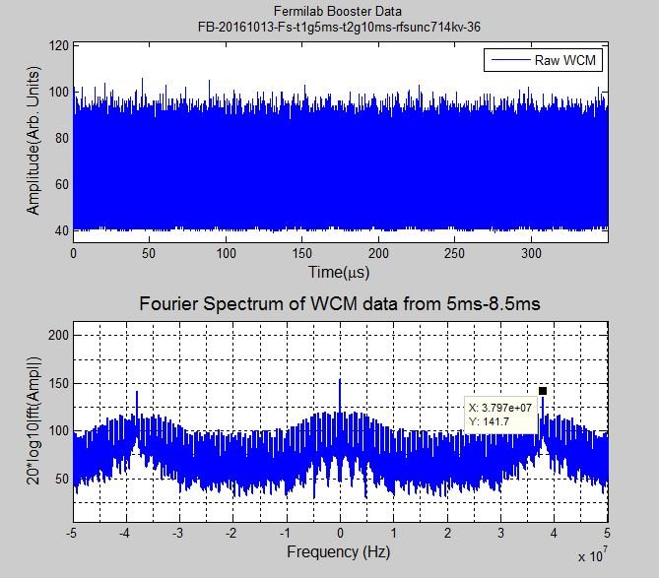
RF voltage calibration
WCM data for 350us at 15ms on the cycle
Measurement were made at 5, 10 or 15 ms after the beam injection and capture.
Procedure:
Injected about 1E12pbc (5BT)
2) Beam captured iso adiabatically using 4 rf stations
Collected WCM data for 400us at two timings
4) Repeated the steps 2 and 3 for turning on two
stations (A and B) at a time.
Fourier Spectrum
(Preliminary)
Analyses are in progress

Slide 15
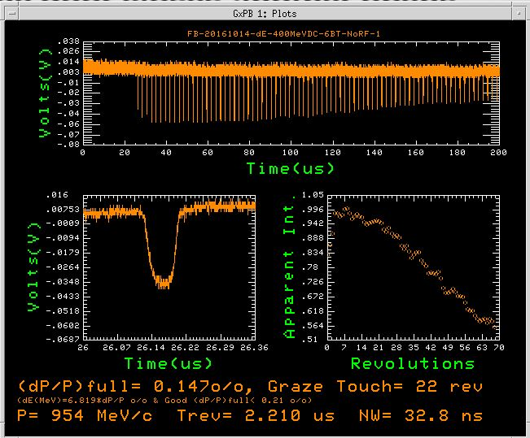
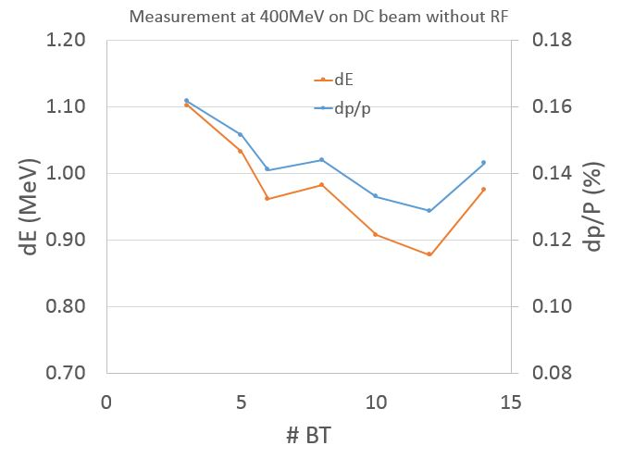
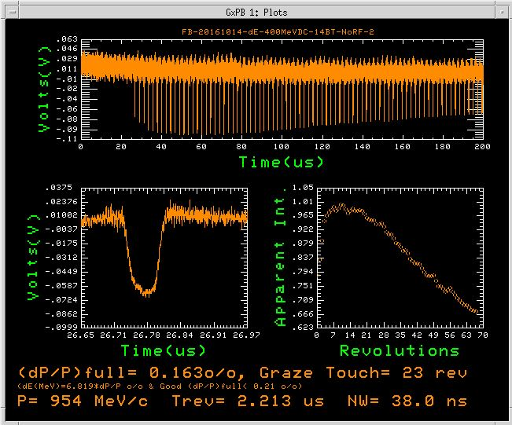
Energy spread from Linac
6BT Beam
WCM Data
14BT Beam
1st Notch
Evolution of Notch Depth
< dE> _{95%} = 0.98±0.08 MeV
<dp/p> _{95%} = 0.14±0.01 (%)
(Beam Energy spread from the LINAC is better than it used to be before 2016 shutdown)

Slide 16
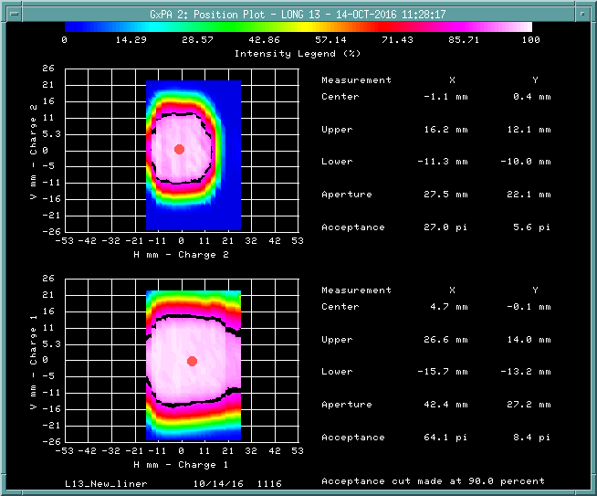
Aperture scans around absorber region (L13)
Aperture scan to see whether the aperture is impacted after the insert was removed and a new liner was installed.
Data is very clean.

Slide 17
Conclusion
DC studies were very successful!
Lattice measurements calculated by LOCO were cross checked with model independent measurements.
Bugs will be fixed ☺
LOCO “corrections” have to be checked further.
Dogleg measurements show that the MADX model is correct.
Tune scans show that the Dogleg does have a large effect on the width of the ½ integer resonances.
Aperture scans look good at the absorber.
RF calibration measurements still under investigation.
Energy spread at 400 MeV is better than before shutdown.
Must do this again in 6 months:
Collimators
½ integer corrections.

