Slide 1
Garnet Ring Test Setup
Verification of the mechanical design per TC #F10067736

Slide 2
Geometry
Initial proposal (July 2016)
Suggested design (Oct. 2016)

Slide 3
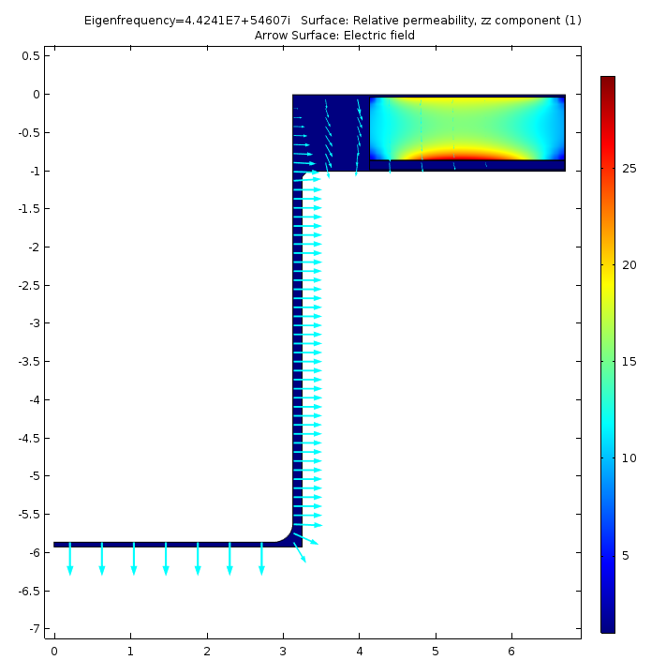
2D Modeling
1. Geometry input from the drawing in inches.
2. Garnet static permeability as we have measured.
3. Garnet RF permeability – theoretical with the measured loss coefficient α = 0.033.
4. Permittivity and dielectric loss tangent:
Garnet ε = 14 tg(δ) = 0.0001
Alumina ε = 9 tg(δ) = 0.0001
Glue (0.1 mmm) ε = 5 tg(δ) = 0.02
5. Magnetic Properties of low carbon steel 1010 (non-linear)
6. No “small 3D” design features included
Mode of oscillation
For the empty cavity:
f = 138.26 MHz
Q = 2265
CST with uniform garnet:
135.72 MHz
Q = 2154

Slide 4
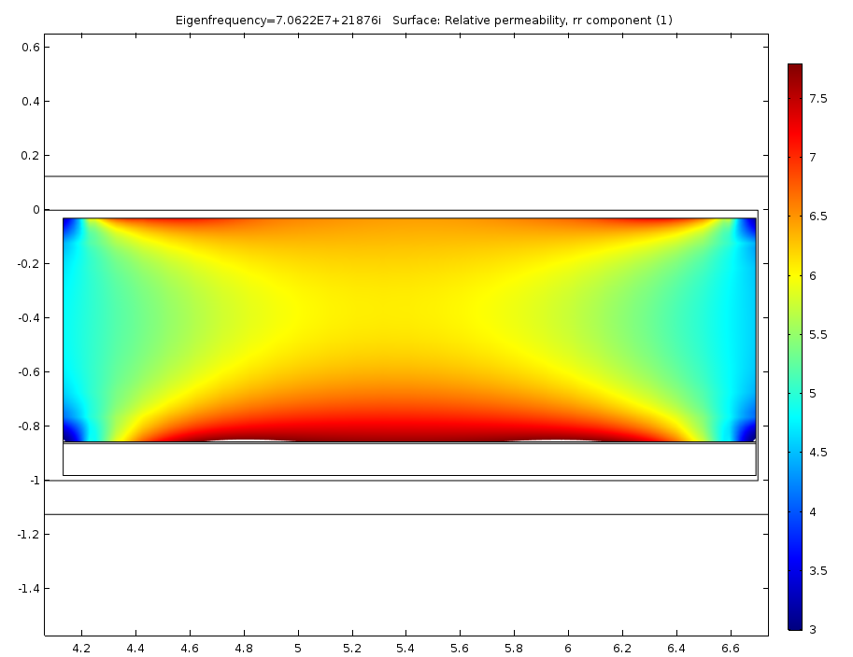
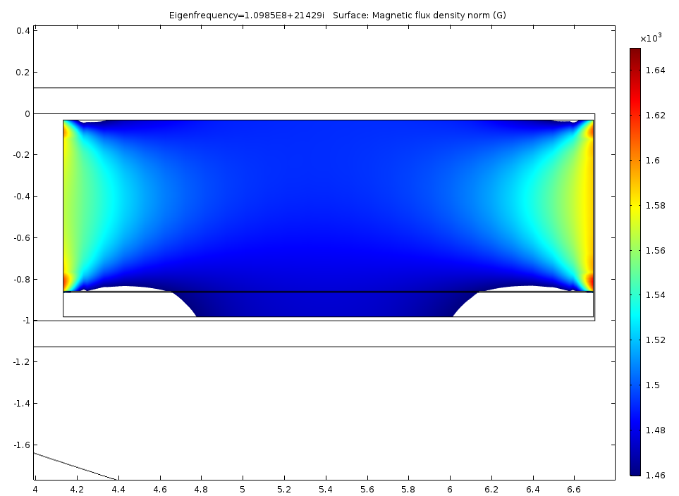
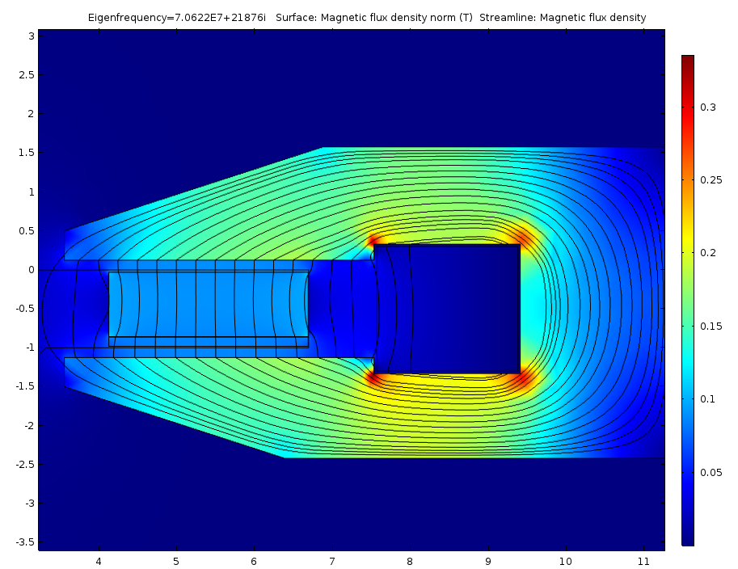
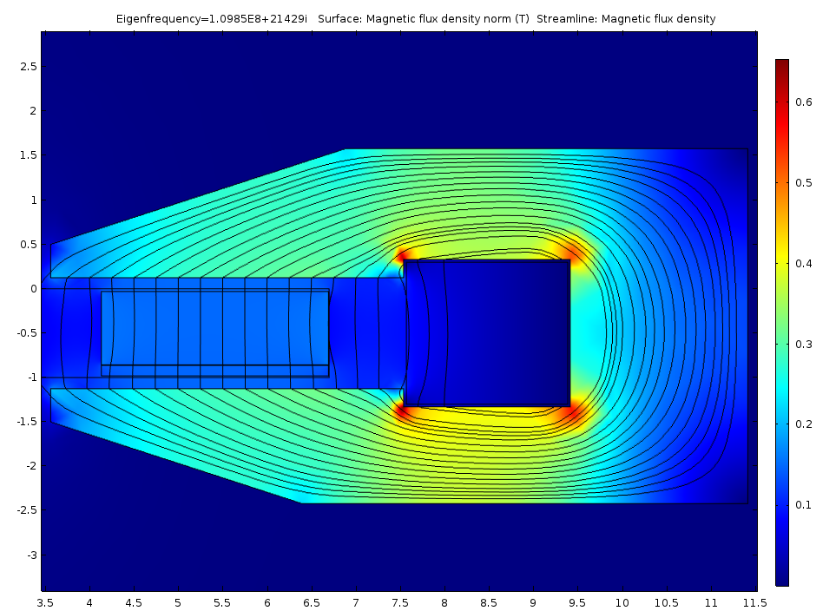
Frequency Scan
Iw = 1 kA → f = 70.626 MHz, Q = 1614
Iw = 2.5 kA → f = 109.85 MHz, Q = 2563
Permeability: average static – 5.94; RF – 6.38
Permeability: average static – 2.04; RF – 2.09
Flux return: B_max = 0.36 T
Flux return: B_max = 0.65 T
Flux return is far from being optimal
Suggested modification

Slide 5
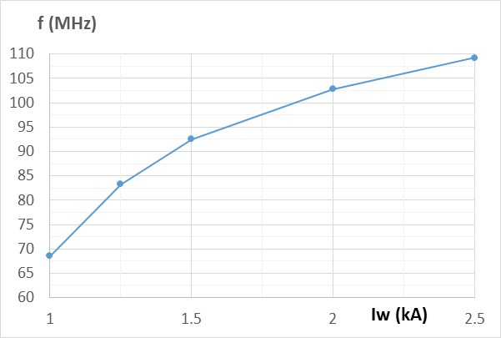
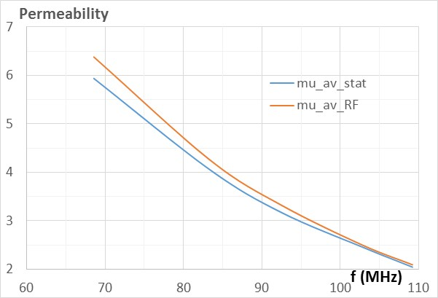
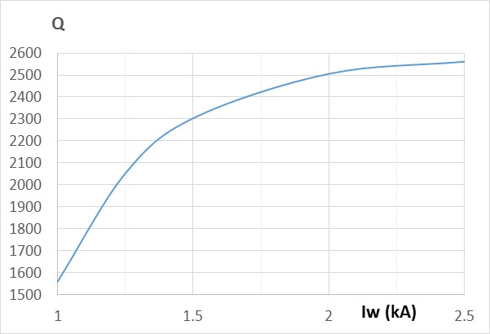
Updated Magnet Geometry
Magnet weight is ~40 kG now

Slide 6
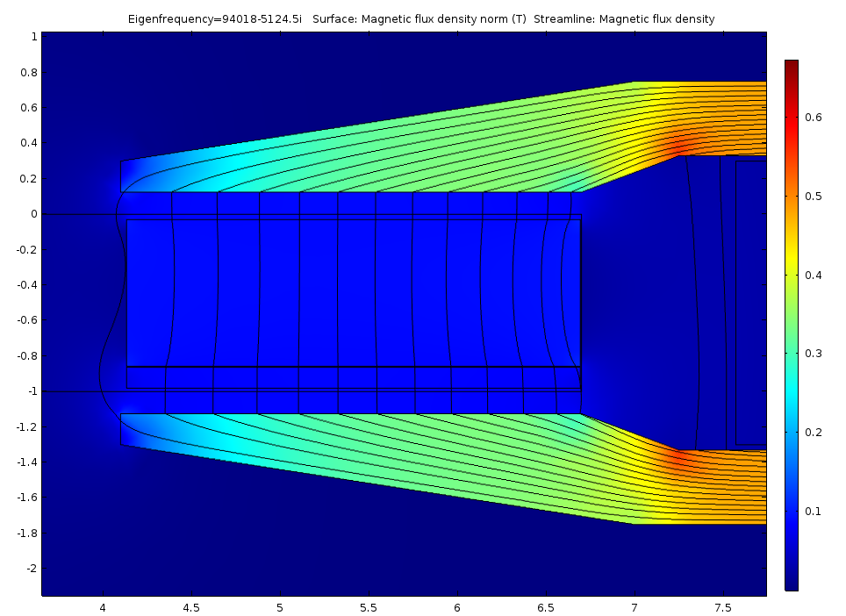
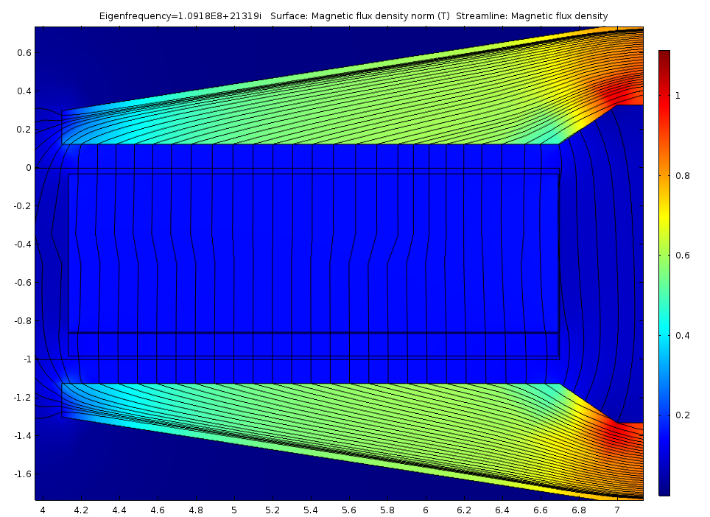
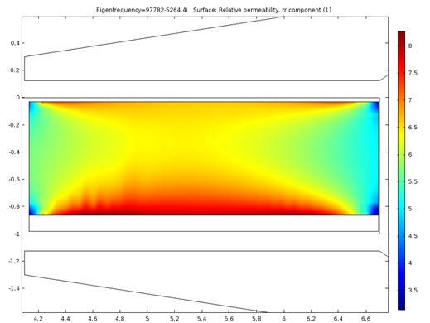
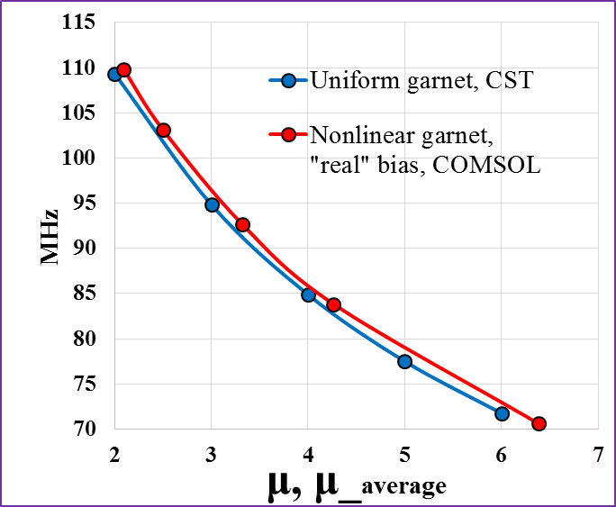
Expected Field Quality
Iw = 1 kA
Iw = 2.5 kA

