Slide 1
Pulse Formation and the Fiber System
David E. Johnson, Todd Johnson, David Slimmer, Robert Santucci
Laser Notcher External Review
14-15 November 2016
Notes:
First of all I would like to thank the Organizers for allowing me to share this unique and interesting Proton Improvement Plan task called the Linac Laser Notcher.

Slide 2
Topics (Pulse Formation and Fiber System)
Pulse Formation
  Required Pulse structure
  Optical Pattern Generator
  Creation of the waveform
  Keep-Alive pulses (what & how)
Fiber Amplifiers
  CW pre-amplifier
  CW fiber amplifier 1
    Power instabilities
  External amplifier tests
  Pulsed pumped fiber amplifier
Fiber amplifier modeling

Slide 3
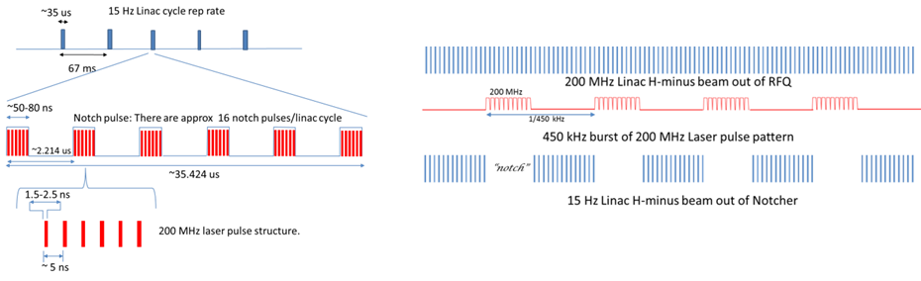
Required Pulse Structure
We must match the H- ion 200 MHz bunch structure exiting RFQ.
The width of the 200 MHz burst must be at least 60 ns to allow for rise time of the Booster extraction kicker (we will use 80 ns).
Number of notches = Number of injected turns in Booster – 1.
Each pulse must match H- bunch length out of the RFQ.
Want variable pulse length and roughly uniform spatial and temporal profiles.

Slide 4
Where and how do we create bunch structure?
Several Options:
  Amplify DC beam and then create bunches at high energy
  Create and amplify a CW 200 MHz pulse structure and pulse pick later
  Create final pulse pattern at low energy and amplify
    MOPA configuration
    Use 10 GHz modulator

Slide 5
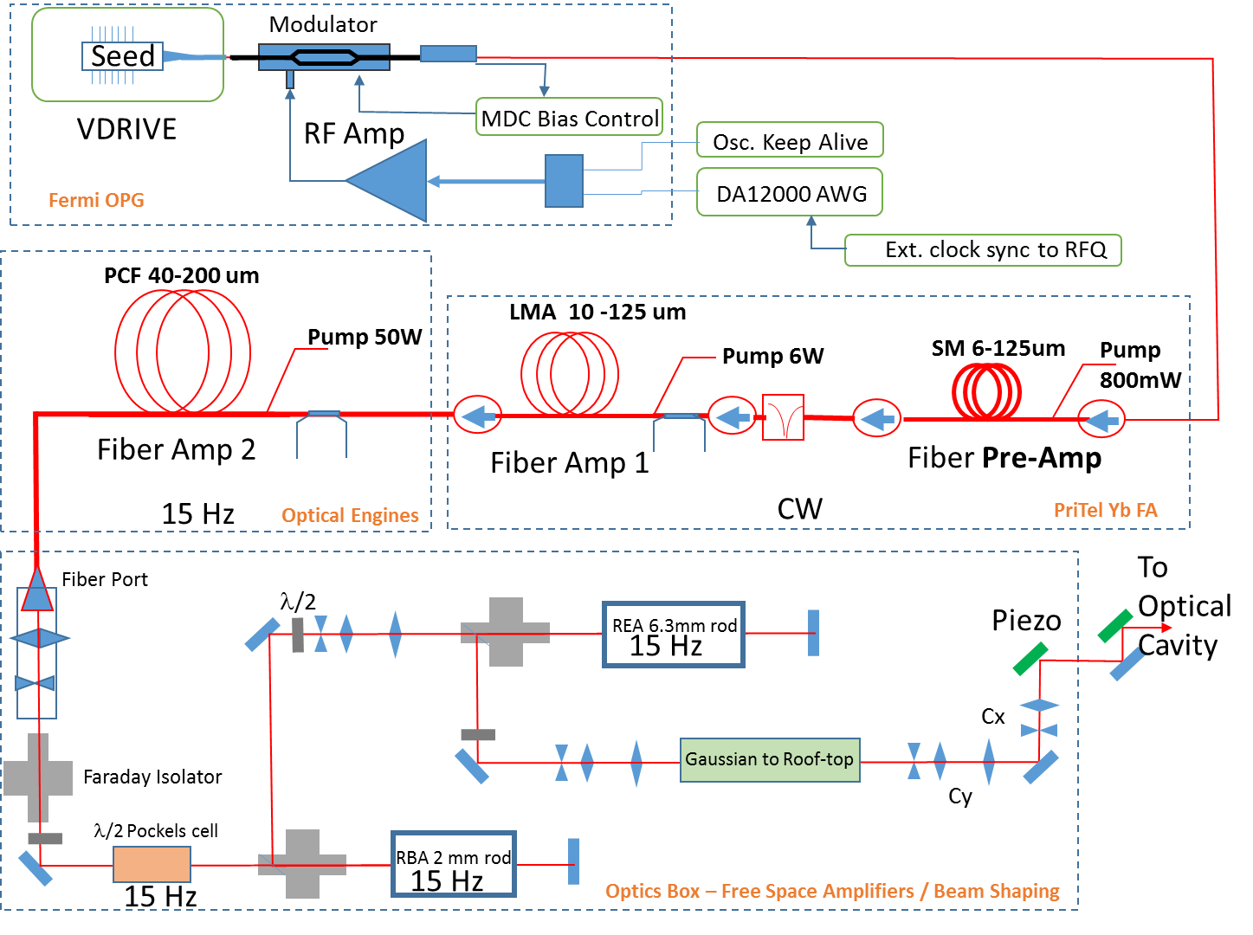
Overall Laser System Layout
*

Slide 6
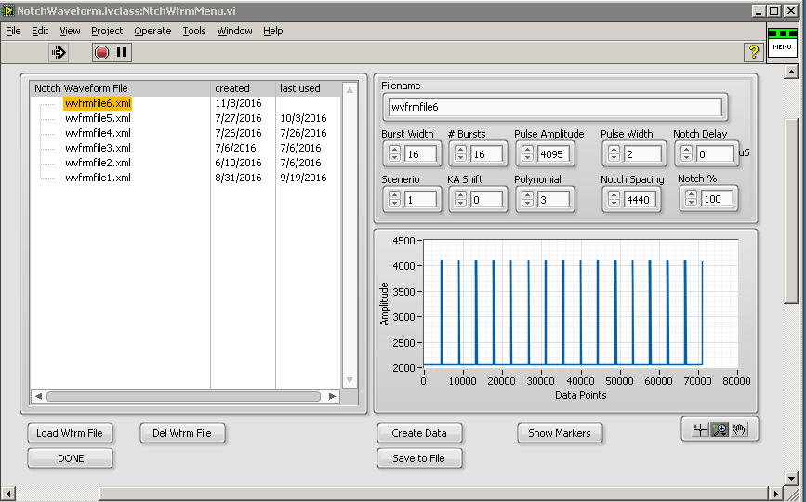
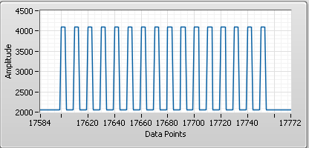
Creation of the notch pulses

Slide 7
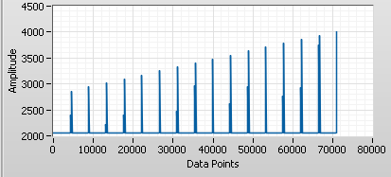

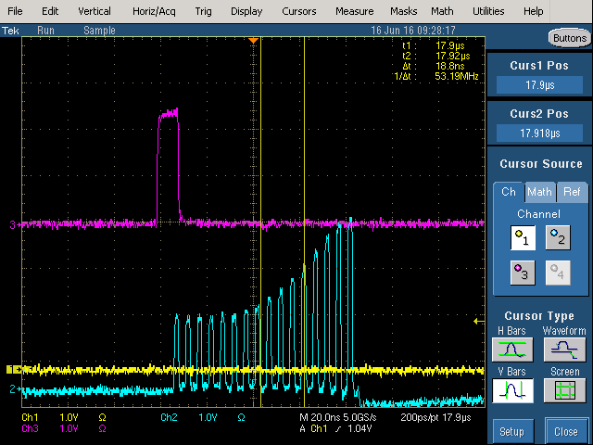
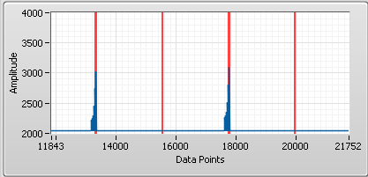
Additional Functionality
Pre-distort 200 MHz pulses within a notch
linear, quadratic, cubic (increasing or decreasing)
Pre-distort each set of notch pulses
Add MARKERS into the waveform (to disable the Keep-Alive)

Slide 8
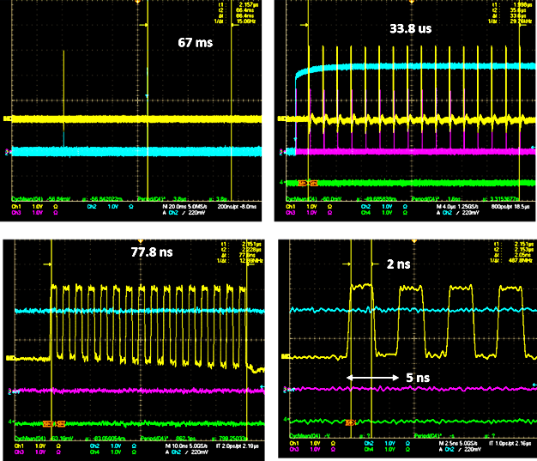
Notch trigger and notch pulses

Slide 9
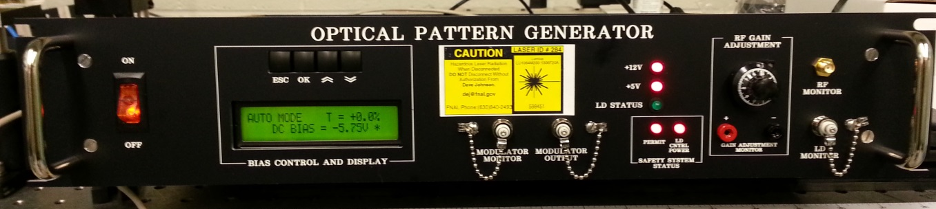
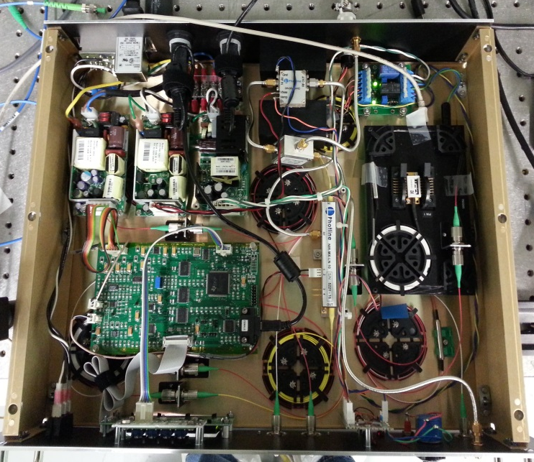
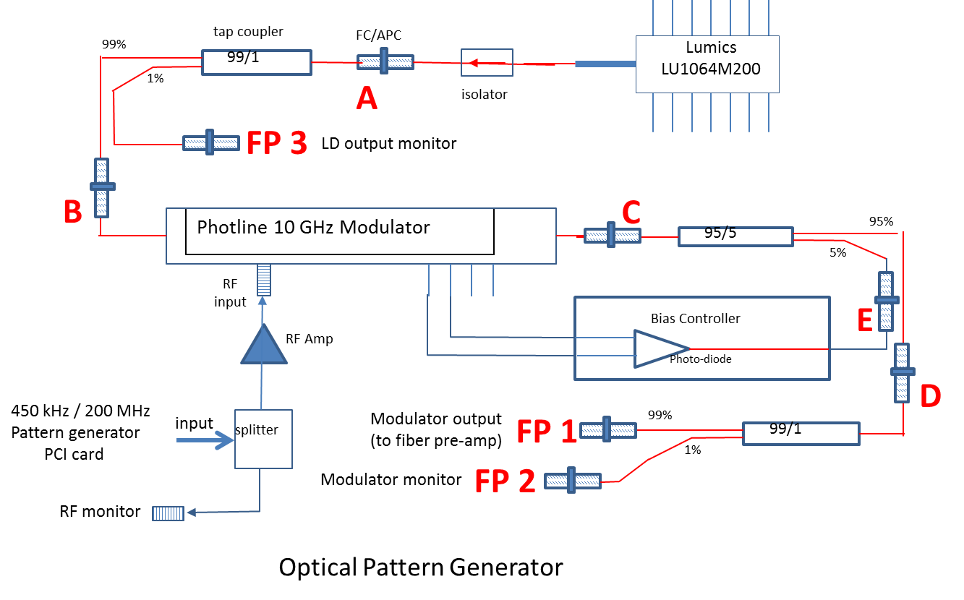
Optical Pattern Generator
TP 5
D
TP 2
A
B
TP 1
TP 6
E
TP 4
C
FP 2
FP 1
FP 3
TP 8
TP 7
TP 3

Slide 10
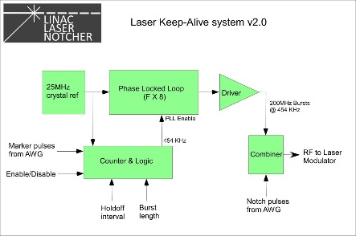
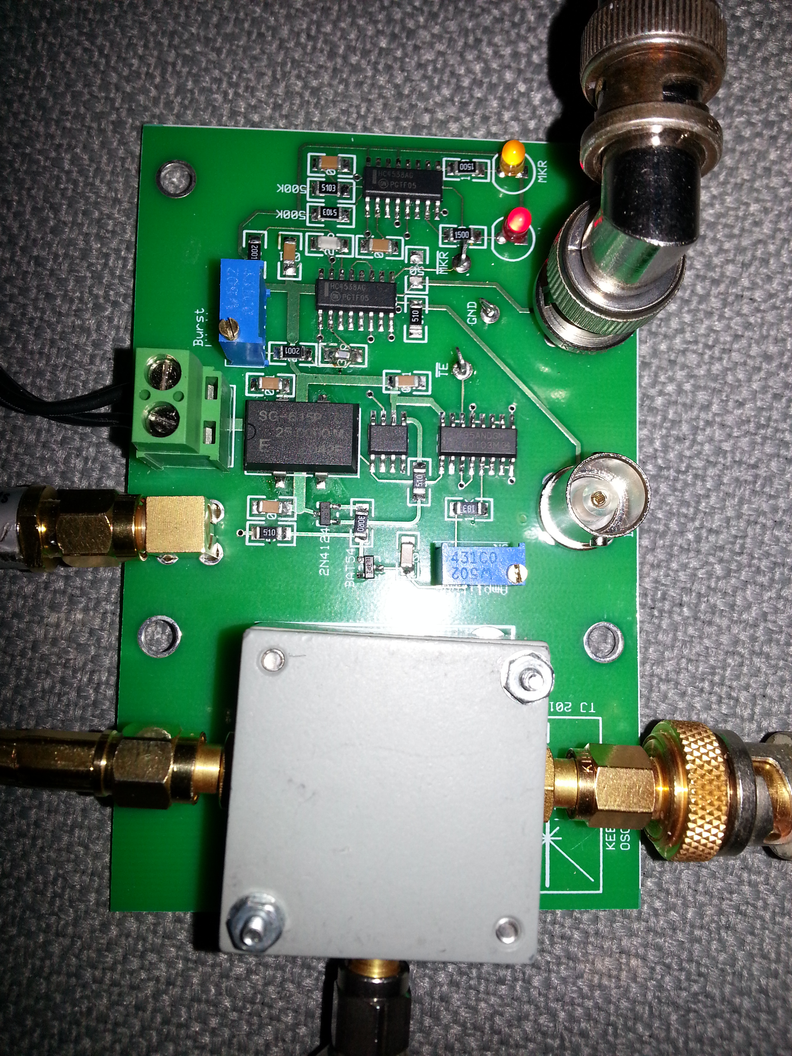
Keep-Alive
Designed by Todd Johnson
CW pumped fiber amplifiers need continuous seed.
CW pumped amplifiers require continuous
signal input to avoid over pumping gain fiber.
Create a continuous 500 MHz burst of 200 MHz pulses
which are suspended by a marker signal generated by AWG.
When the marker signal is absent for 2.2 us, the KA resumes output.

Slide 11
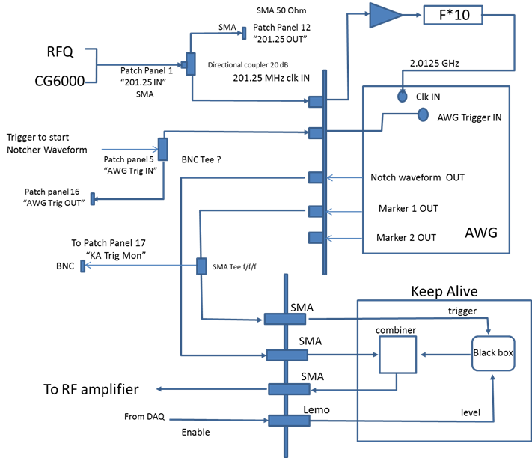
Integrating the AWG and Keep-Alive
Chase Scientific DG12000 AWG
PCI based AWG
12 bit resolution
In triggered mode only 11 bits
Output AC coupled
Internal/External clock
  2.0125 GHz from RFQ reference
2 Marker outputs encoded in data array
External Trigger
  Will be triggered by Einzel lens

Slide 12
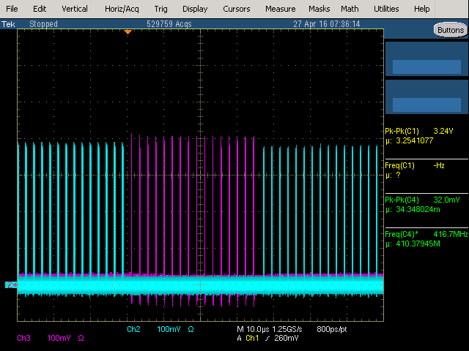
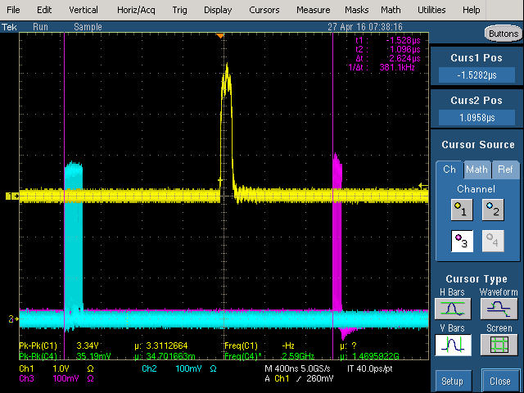
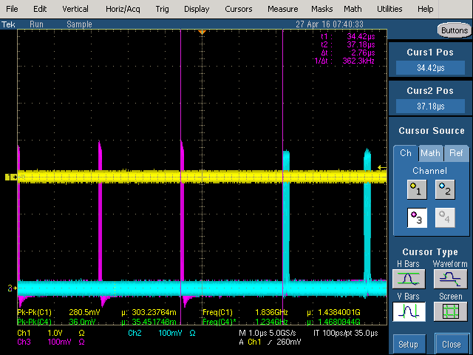
Keep-Alive and Notch Pulses

Slide 13
Fiber Amplifiers
The fiber system (both CW and Pulsed) increases the pulse energy from roughly 60 pJ to 6 uJ for a net gain of about 50 dB!
The average power during the linac pulse (35 us) out of the pulsed amplifier is ~ 45W ( real average power 54 mW).

Slide 14
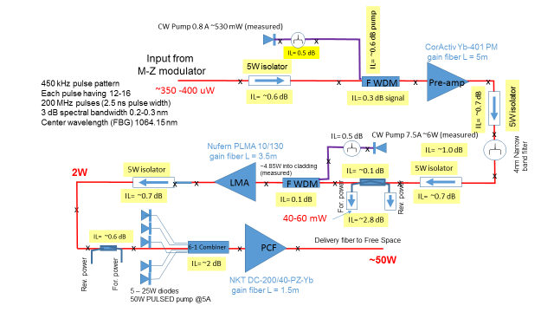
Existing Fiber System (CW & pulsed pumped)
How?

Slide 15
PriTel (CW) Amplifier Configuration
FP: Pre-Amp
Input
Pump: 800 mA (534 mW)
6 um SM
CorActive YB-401-PM
~ 5m Gain fiber
976nm pass
1020-1100 nm block
Pump filter
4nm band pass filter
Center 1064 (ASE block)
Seed
450 uW
3W 1064 nm isolator
6 um core
3W 1064 nm isolator
6 um core
External amp
FP: Power-Amp Input Monitor
50 mW
Power Monitor & ASD Control
Pump: 7.5A (6W)
PM
FP: SBS Monitor
2.1 GHz PD to scope
PLMA 10/130 Yb
gain fiber
L=3.5 m
2W
Back Panel
976nm pass
1020-1100 nm block
Pump filter
spliced
Fused TC 99/1
Fiber port to free space
1064 nm isolator
6 um core
3W 1064 nm isolator
6 um core
4.85W
Power Meter
Pump dump
Miss-match fiber sizes !

Slide 16
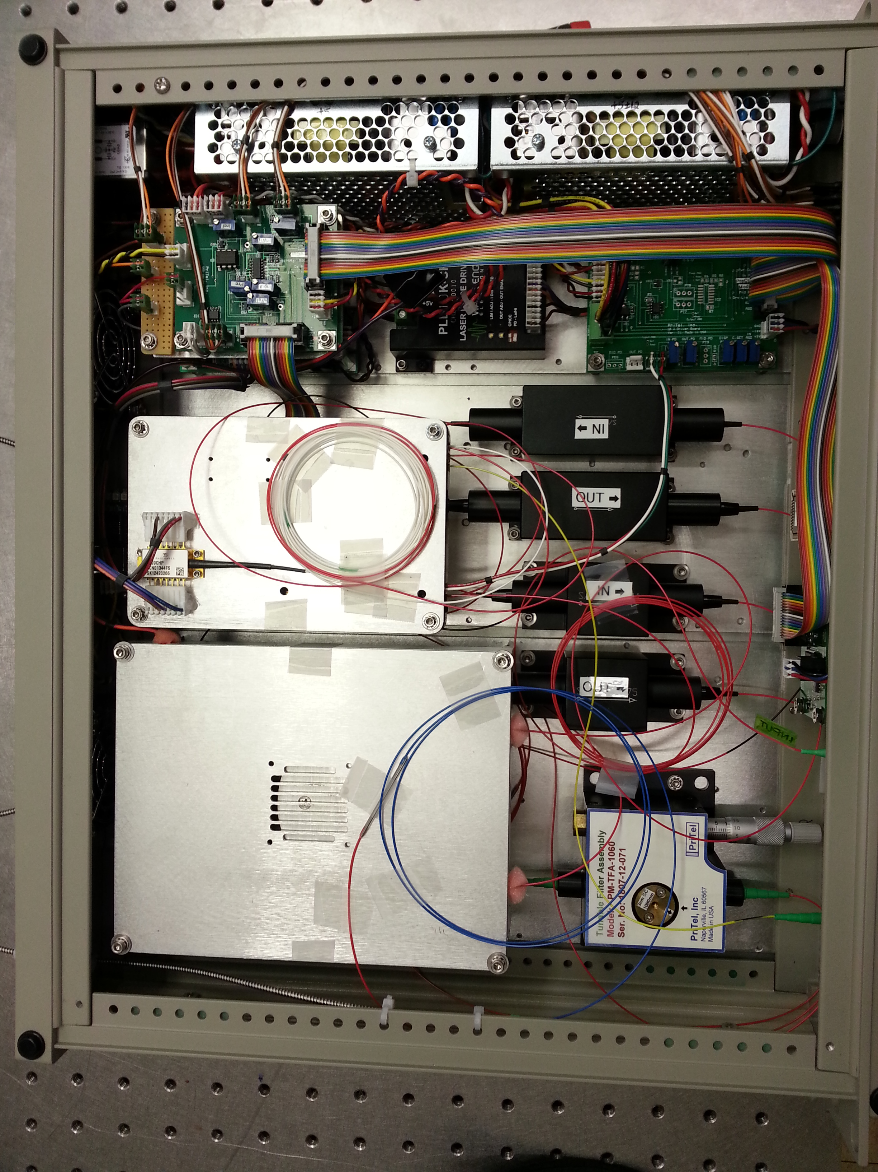
PriTel CW Pre-amplifier & fiber amplifier

Slide 17
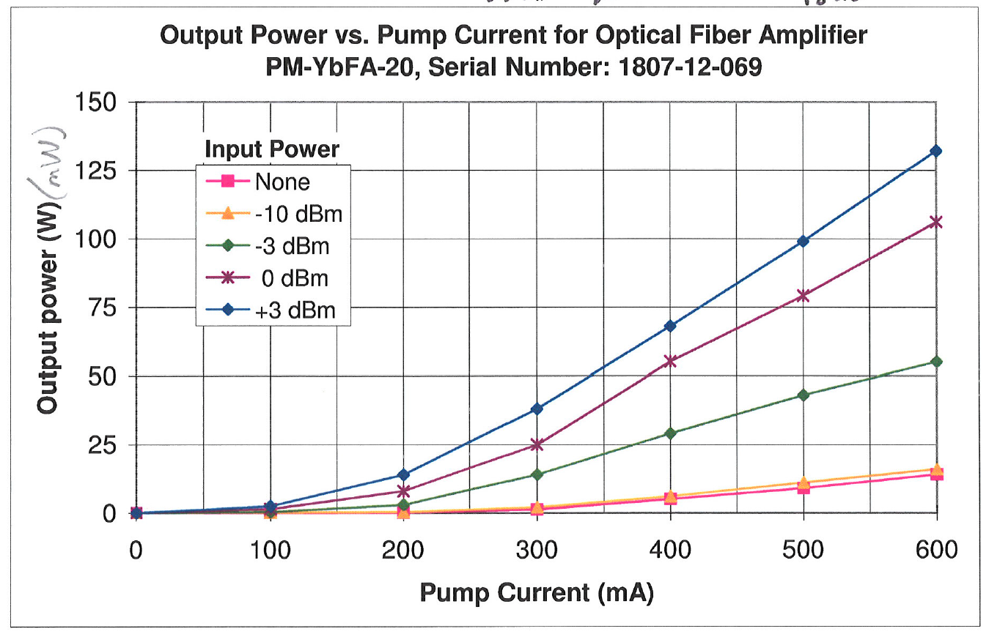
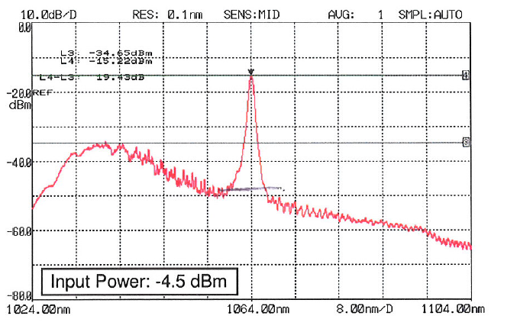
Pre-amp Initial performance
Pump diode capable of 1.1A current for 725 mW power
Initial limit set at 600 mA for 400 mW pump power
Current limit set to 800 mA for 534 mW pump power
Design gain of 24 dB at -10 dBm (100 uW) input power
Gain fiber 5 m CorActiv Yb-401 with very high pump absorption

Slide 18
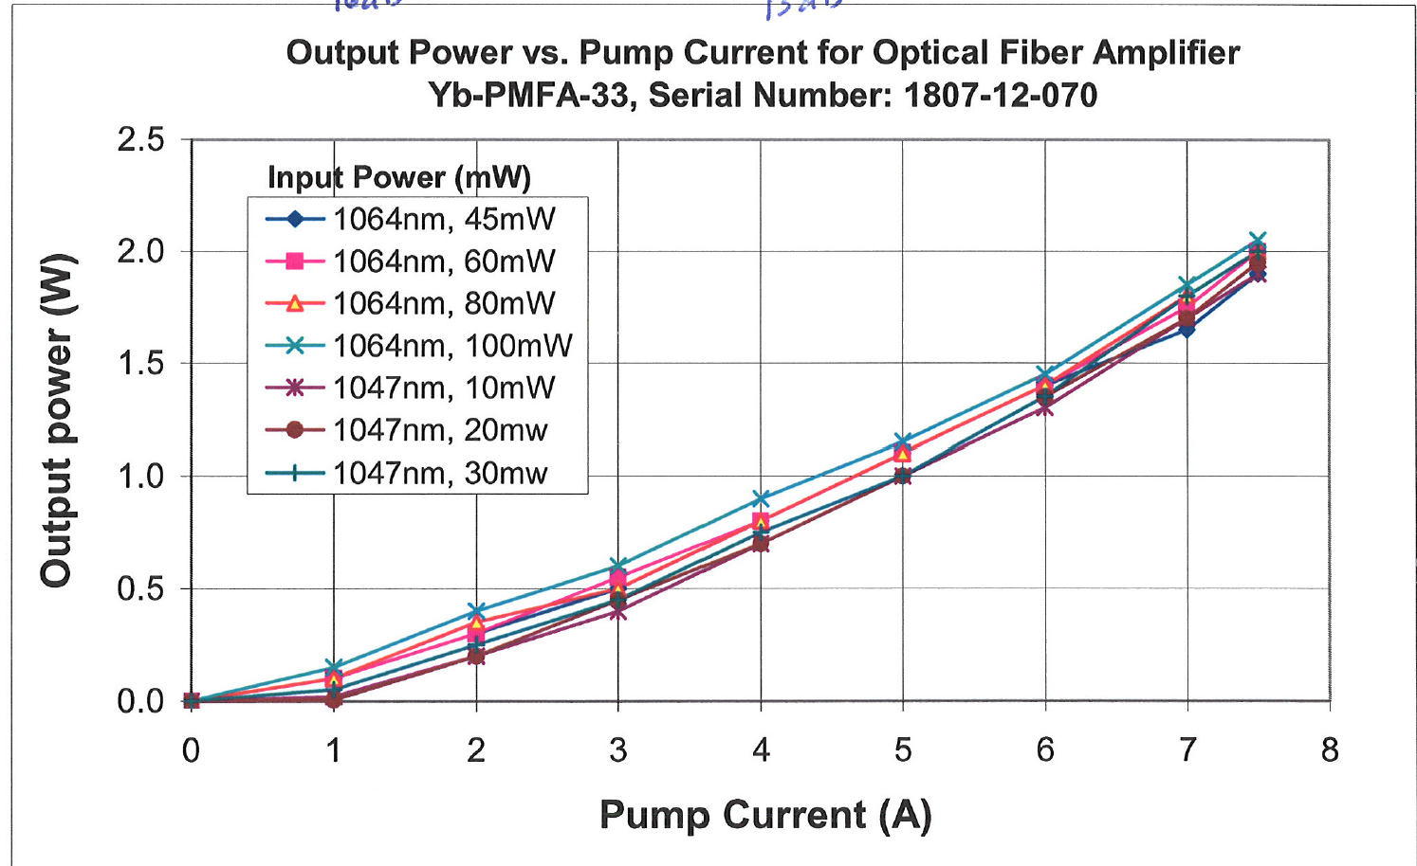
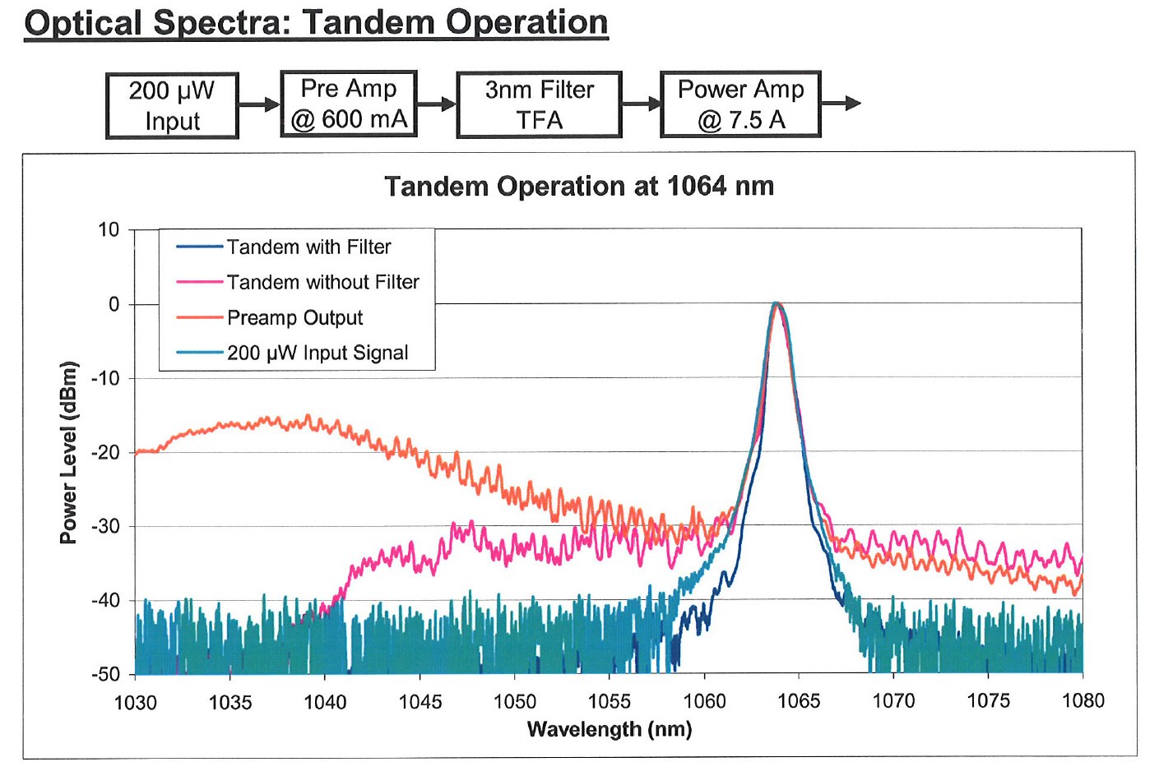
PriTel Power Amp (2W)
Initial Design with 6um SM gain fiber…
Changed to LMA 10/125 gain fiber to increase SBS threshold

Slide 19
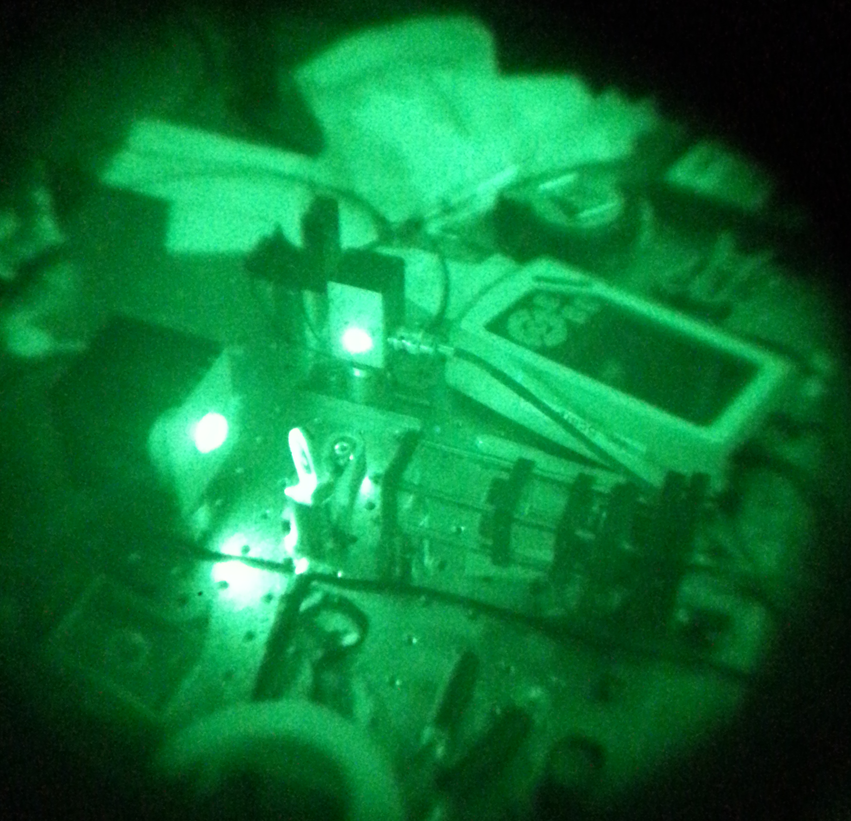
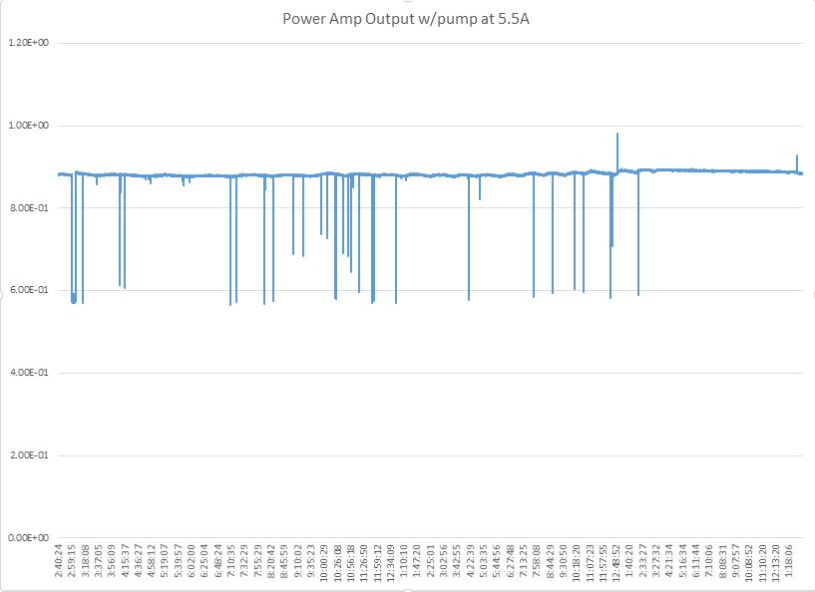
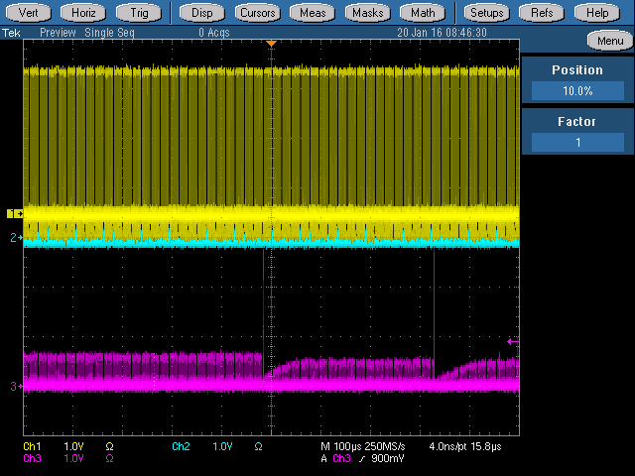
Test set up looking at PriTel Pwr Amp
Power drop out ?
Prior to having a backward tap we were seeing large spikes in output which was depleting gain—What’s happening?
This can kill downstream amplifiers/components… and it did !
Installed a backward tap coupler (2x2)

Slide 20
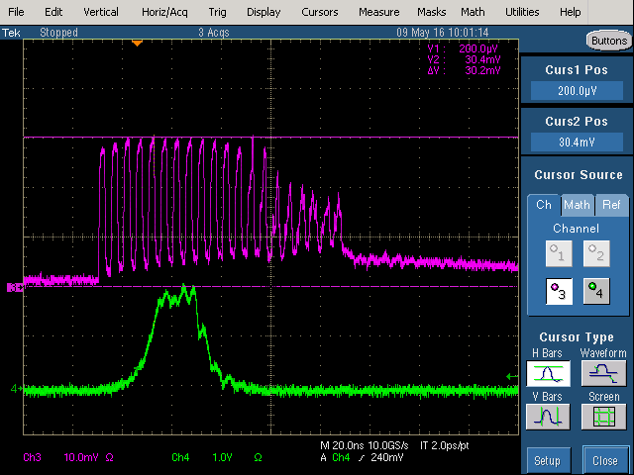
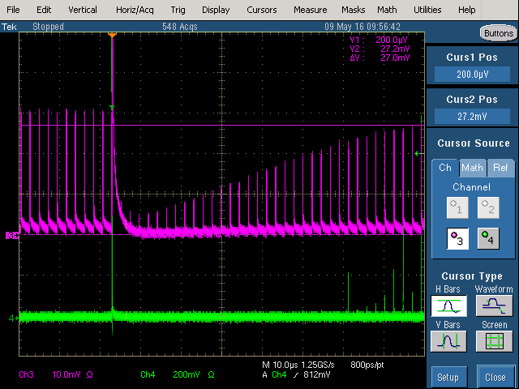
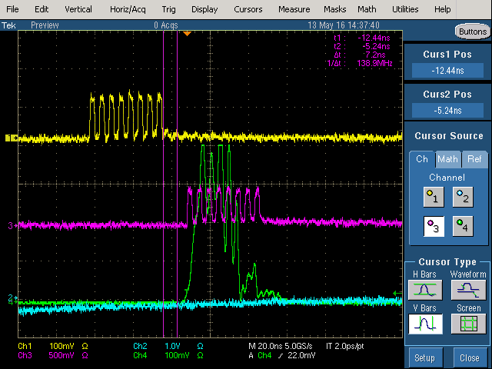
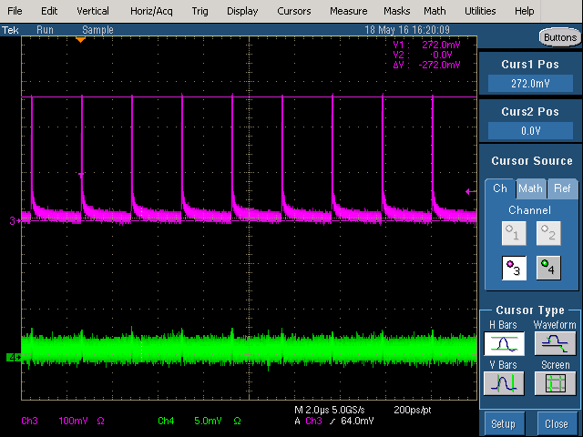
Observations of SBS out of the PriTel Power Amp
Changed seed diode

Slide 21
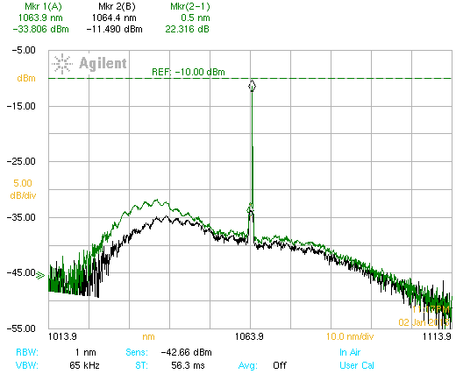
What does ASE and SBS look like
Spectrum looking at the reverse power tap
SBS spike
Broad Spectrum ASE
Generated in LMA amplifier

Slide 22
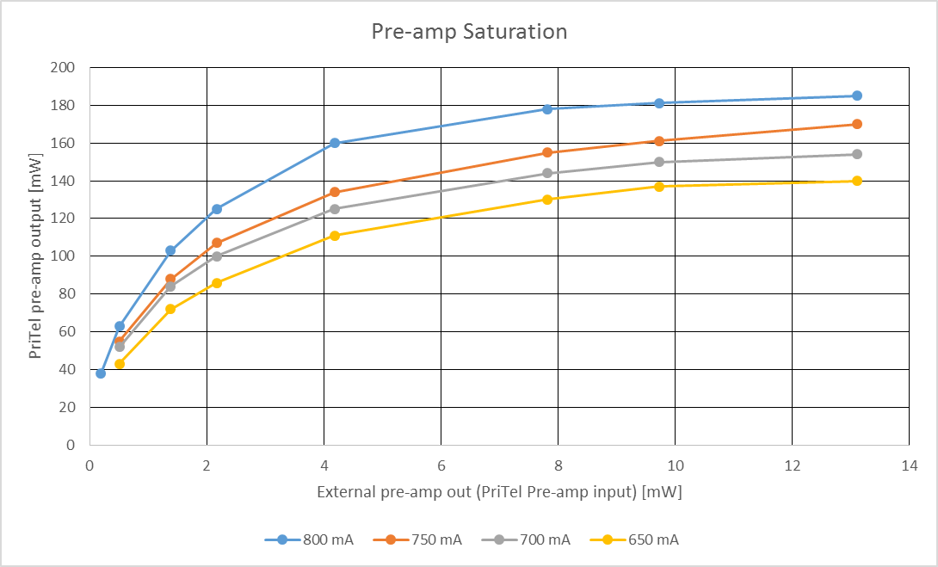
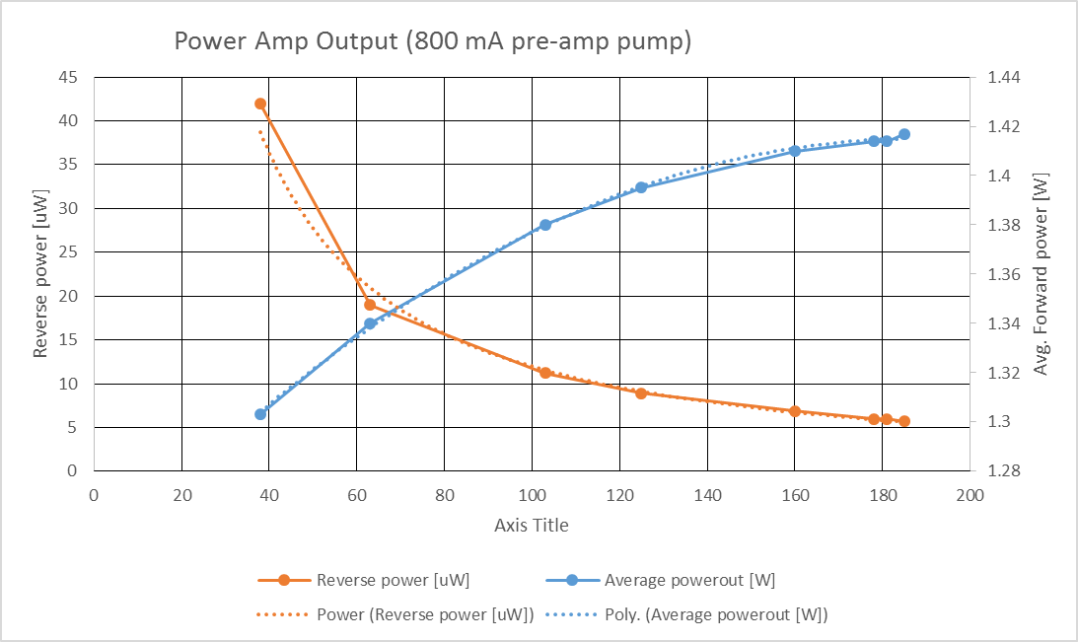
External Amplifier Tests
Used external amplifier between modulator & pre-amp
  Increase seed into pre-amp and hence power amp
  Amplifiers run further in saturation
  Don’t get much more output from power amp. But Reverse power (ASE) reduced dramatically
Region of interest

Slide 24
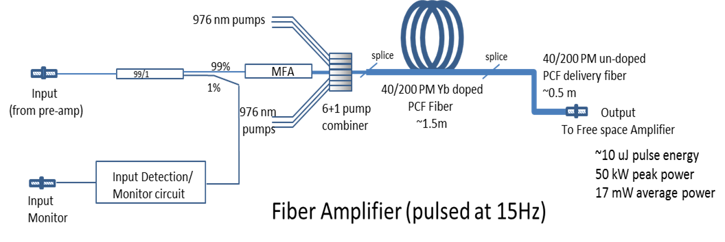
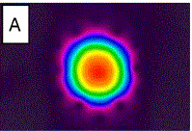
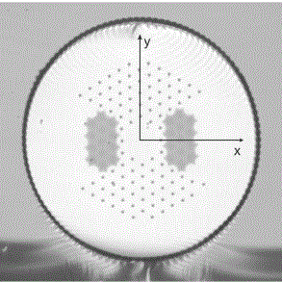
Optical Engines Pulsed Fiber Amplifier
Input 363 nJ 1.96 W
Gain: 14.5 dB
Output to include mode
stripper (to remove any pump
light) and optics to match
into first FS amp.
Single mode, single polarization
Small NA (~0.03)
Large mode area
High peak power levels
High pump absorption (~10 dB/m)
High reliability
Unique feature: can only bend in the plane of the
Stress rods→ must mount vertically below optics box
Micrograph of PCF fiber

Slide 25
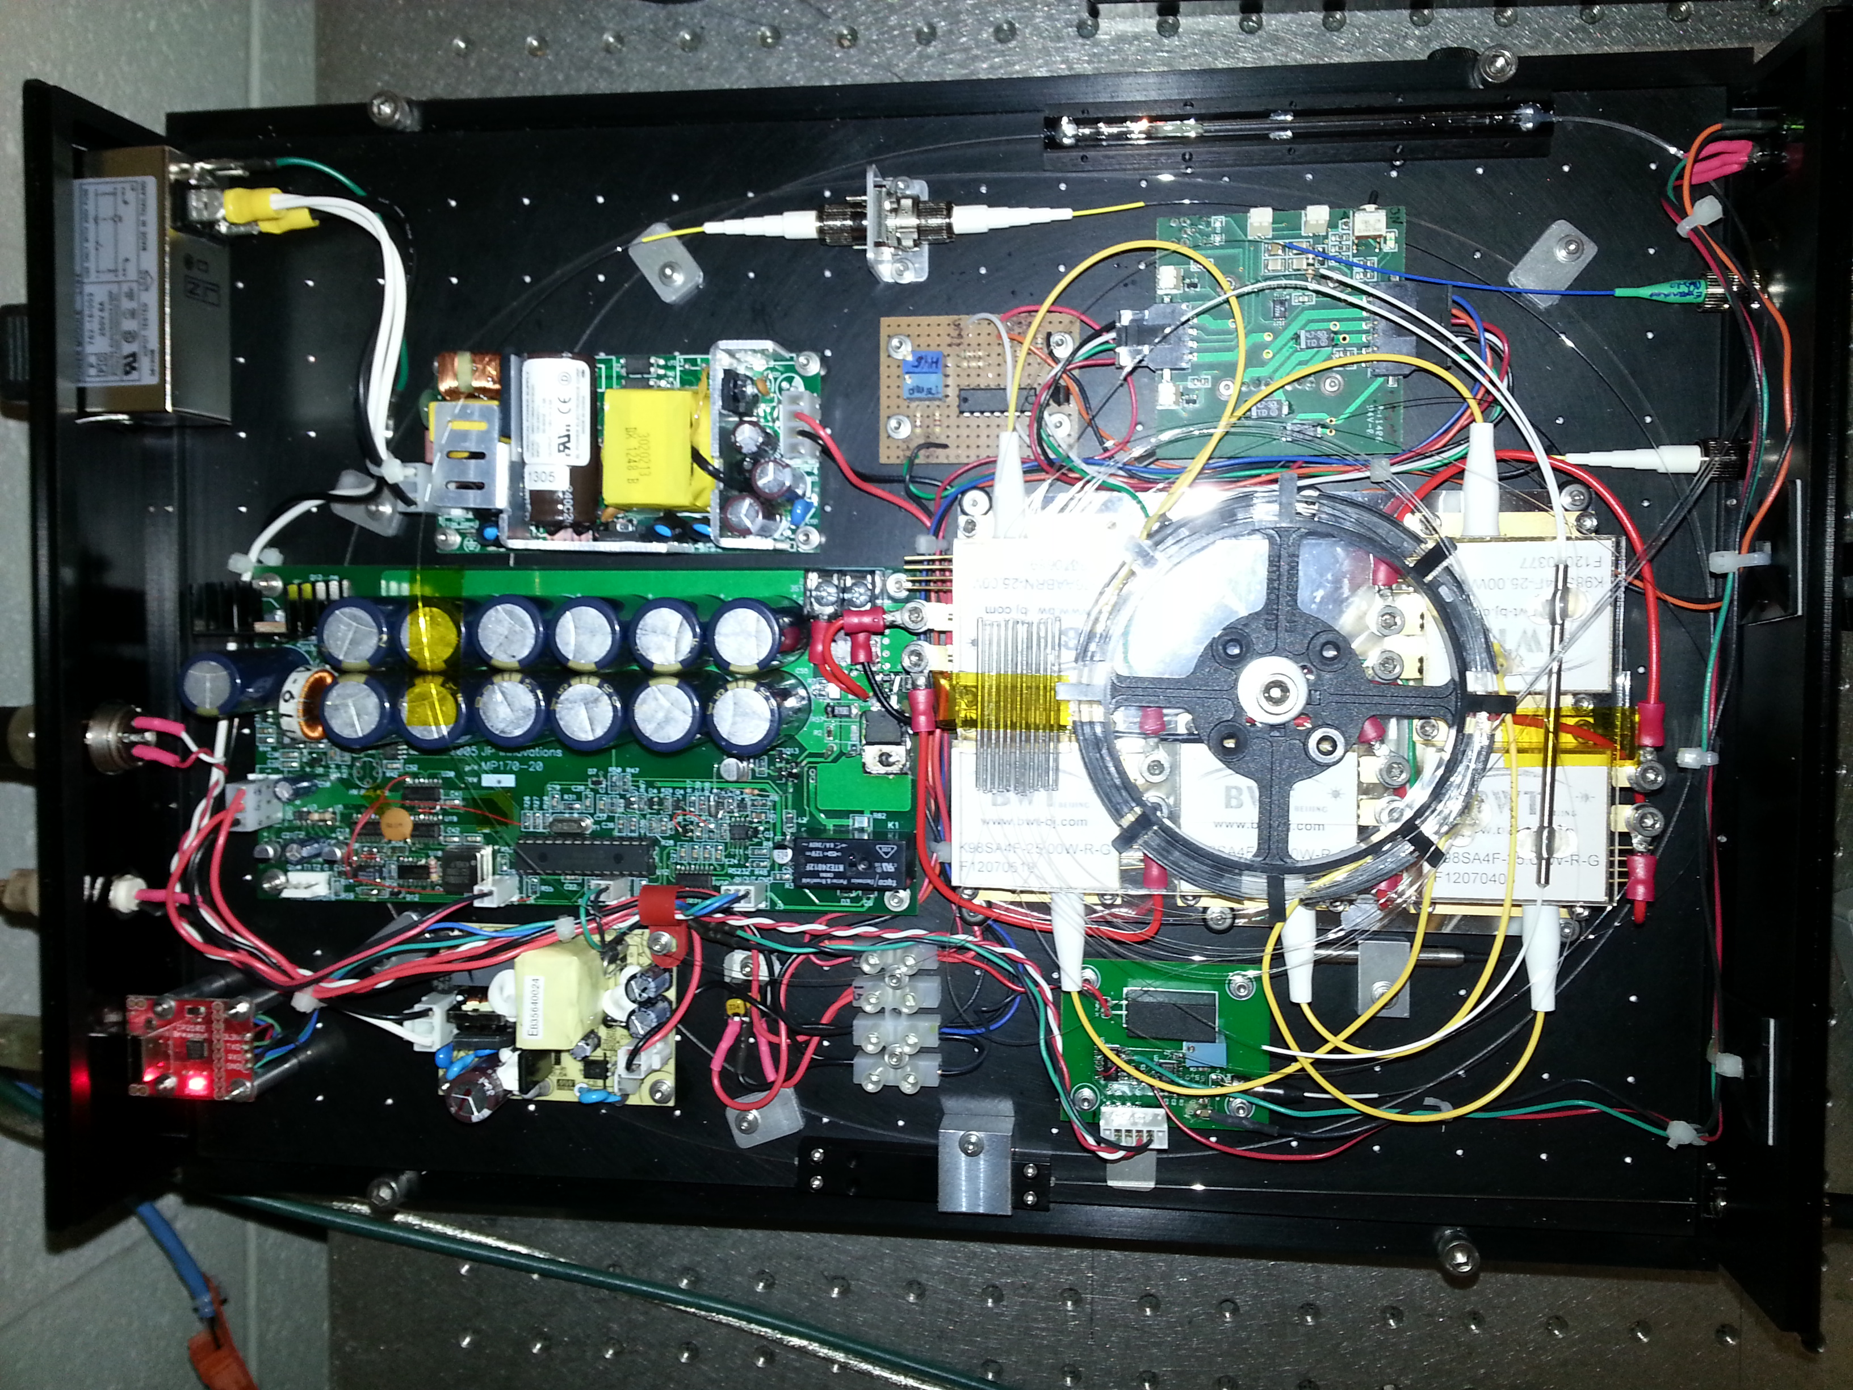
Optical Engines Pulsed Amplifier

Slide 26
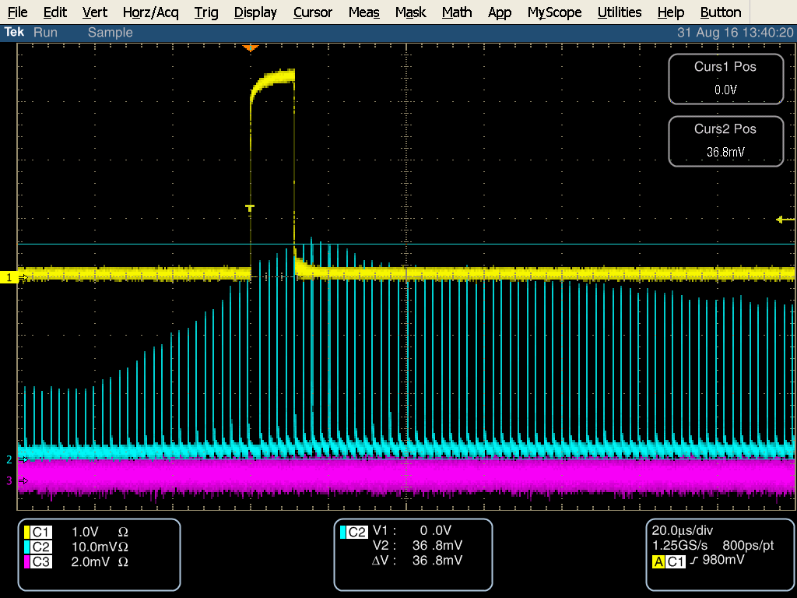
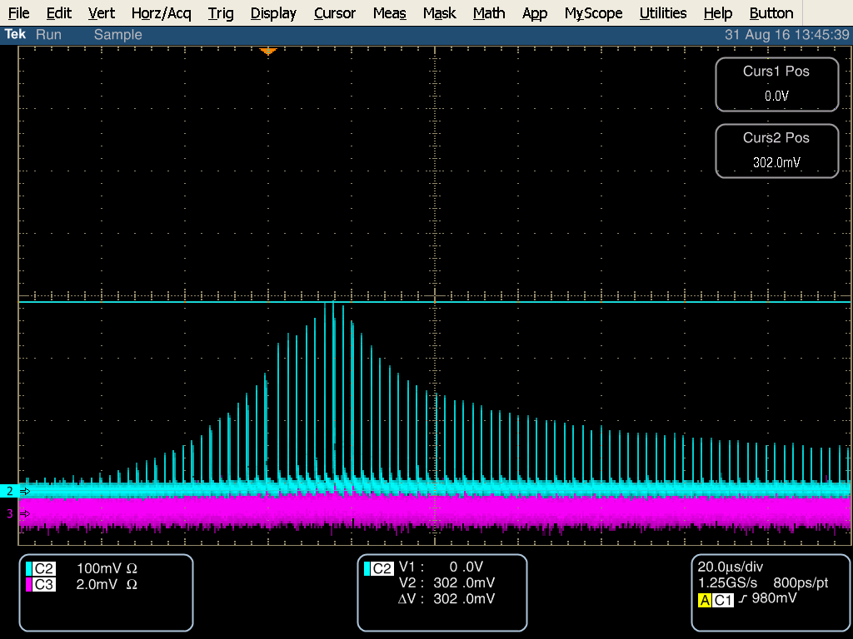
Measured Gain of Pulsed Optical Engines
Set pulse width to 60 us Baseline pulse amplitude 12 mV
Left at 2A pulse height 64-81 mV
Right at 5A pulse height 236 to 302 mV for gain of 13-14 dB
Clearly pulses aren’t extracting all energy, could increase input energy

Slide 27
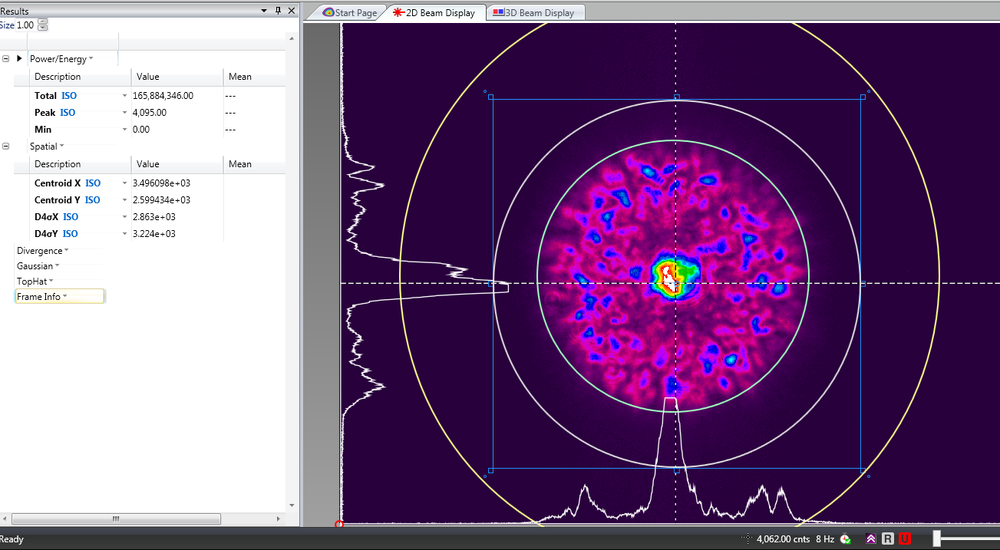
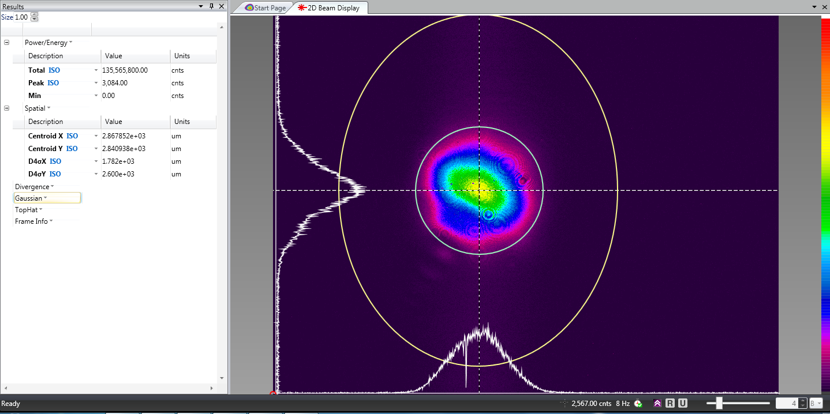
First Light Optical Engines
New PCF delivery fiber out of Optical Engines Amplifier –
FUD matched to DC-200/40 DZ Yb gain fiber to inherently strip out
cladding light ( aperture no required after fiber port)
Previous delivery fiber (shown after fiber port)
New delivery fiber (shown after fiber port & lens)

Slide 28
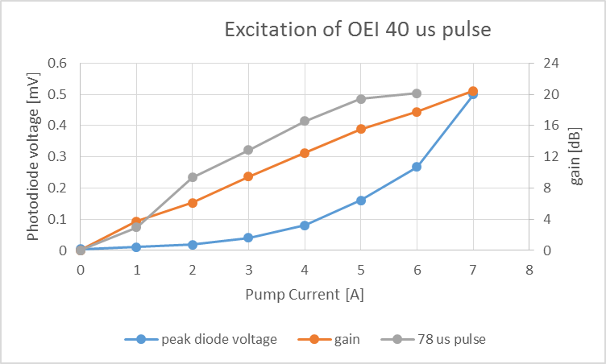
Measured gain from Optical Engines Amplifier
Current pump current 5 A

Slide 29
Fiber Amplifier Design Consultation
Motivation
  Pre-amplifier gain fiber has high absorption and long length
  LMA amplifier – want to verify operation conditions, reduce sensitivity to SBS
Contracted with Dr. Rudiger Paschotta (rp-photonics)
  Create a model of our CW pumped fiber amplifiers
  Provide suggestions on optimizing output
  Gain understanding on the design parameters for fiber amplifiers

Slide 30
Model for Existing Pre-Amplifier
Gain Fiber:
CorActive YB-401
Input:
411 mW pump
325 mW signal
Pump is absorbed in first .7 m fiber.
Due to low input signal significant ASE generated forward and backward.
Forward is absorbed and acts as a pump source for the signal

Slide 31
Pre-Amplifier with shortened gain fiber
Same input conditions
Shorten gain fiber to 2.5m.
Signal output 137 mW
Backward ASE of 133 mW while
forward ASE is only 8 mW
  Several ways to mitigate ASE problems investigated
    backwards pumping for 3.3m gain fiber output would be 170 mW, however, higher noise figure
    Pump with a longer wavelength (1010 nm obtain 243 mW
    Increase input signal power from the current 325 uW to 4.7 mW raise output to 280 mW while strongly reducing ASE

Slide 32
Pre-Amplifier with input signal raised to 4.7 mW
Same gain fiber
Same 411 mW pump
Increased signal
Output signal 280 mW
Strongly reducing ASE
Don’t need 5 m of gain fiber as needed for low input signal

Slide 33
Pre-Amplifier with increased signal and reduced length
Shortening the gain fiber to 0.55 m with increased signal improves the output power to 306 mW
Small ASE
Complete, efficient pump absorption → optimized solution

Slide 34
Pre-Amplifier Output/Gain vs signal input
5 m gain fiber
0.55 m gain fiber
With 5 m gain fiber and 5 mW input signal
  Signal gain ~ 17 dB
  Output ~ 280 mW
With 0.55 m gain fiber and 5 mW input signal
  Signal gain ~ 17 dB
  Output ~310 mW

Slide 35
Model of existing Fiber Amp 1
Gain Fiber:
Nufern PLMA-YDF-10/125-VIII
Fiber length 3.5m
Cladding pumped
Pump: 4.85 W @ 976 nm
Signal: 53 mW @ 1064.15 nm
Pump and signal [W] ASE [mW]
Signal gain 18.8 dB
Actual output power less than predicted by model could be due to lower pump absorption due to mode-dependent absorption.
Fiber length has to be limited in order to avoid SBS problems

Slide 36
Fiber Amp 1 operation vs input signal
now
By increasing input signal reduce ASE, only small increase in output

Slide 37
(Preliminary) Take-Away from Amplifier modeling
Consultation is on-going
Provided a snapshot of existing pre-amplifier and amplifier 1 performance
Concurred that increasing signal into pre-amplifier will improve performance
Better to shorten gain fiber , but don’t lose much if we keep it at 5 m.
Fiber amplifier 1:
  well into saturation.
  ASE cannot significantly degrade performance
  May be incomplete pump absorption due to mode-dependent absorption… lengthening fiber not good due to reduce SBS threshold… shortening would increase SBS threshold but leave more residual pump.
  For now leave as is…

