Slide 1
July Commissioning of the Laser Notcher and Shutdown Plans
David E. Johnson, Todd Johnson, Kevin Duel, David Slimmer
Laser Notcher External Review
14-15 November 2016
Notes:
First of all I would like to thank the Organizers for allowing me to share this unique and interesting Proton Improvement Plan task called the Linac Laser Notcher.

Slide 2
Topics (July Commissioning)
Goals for Commissioning period
Steering into cavity
Notches in Linac beam
Comparison with theoretical estimate
Notches in Booster
Loss Budget for July commissioning
Shutdown Plans and Improvements
  New vacuum flanges & cavity + new alignment fixture
  Investigate and cure high frequency instability
  Fiber Amplifier Optimization/upgrade
  Addition of Pockels cell
  Add cooling to electronics rack
Current status

Slide 3
Goals for the Commissioning Period
Gain experience in steering the laser into and through the cavity (we can’t see what happens in the cavity)
Adjust timing to match laser pulses to ions and to match Booster revolution frequency
Measure neutralization efficiency as a function of laser energy
Measure longitudinal bunch length
Investigate what is needed in Booster to keep notches formed in Linac clean
Gain experience in operating laser system in an electrical noisy & harsh (compared to the lab) environment
Gain experience in remote operation

Slide 4
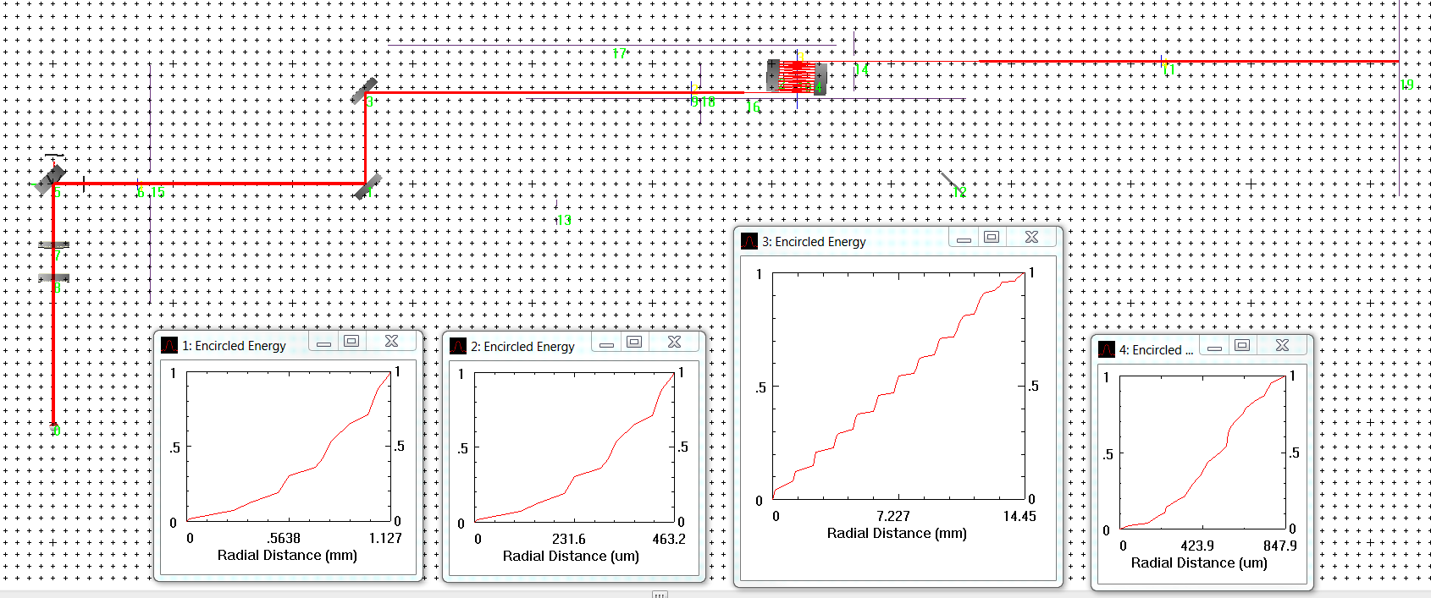
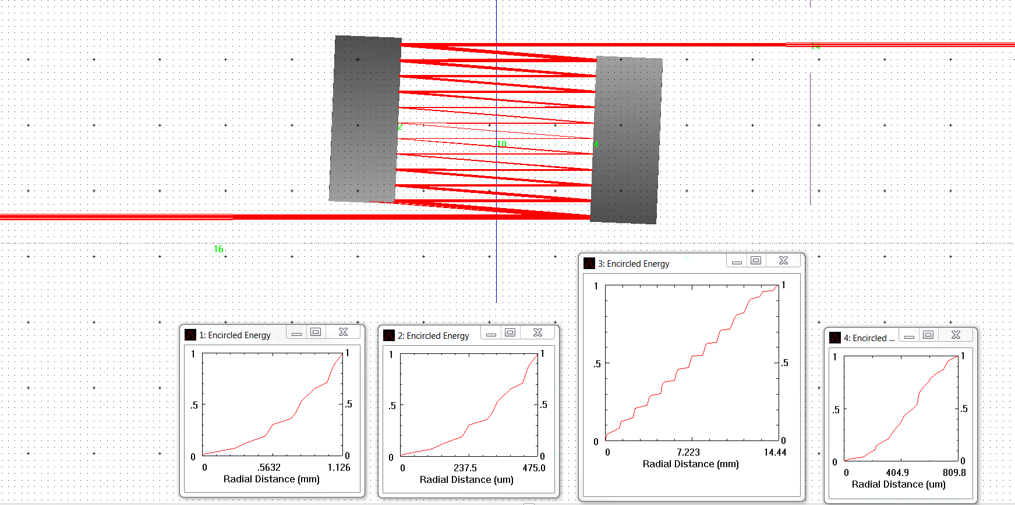
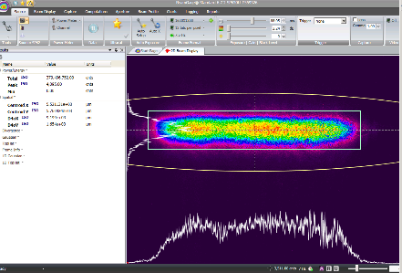
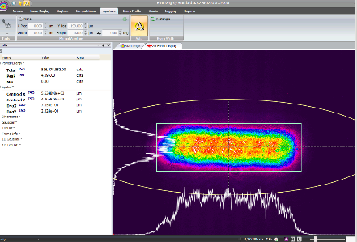
Laser Path and horizontal size thru cavity
23 interactions
Match profile Dump
Match profile Optics Box
Wanted to optimize transmission thru cavity
Best we saw was about 85-90% from optics box to dump

Slide 5
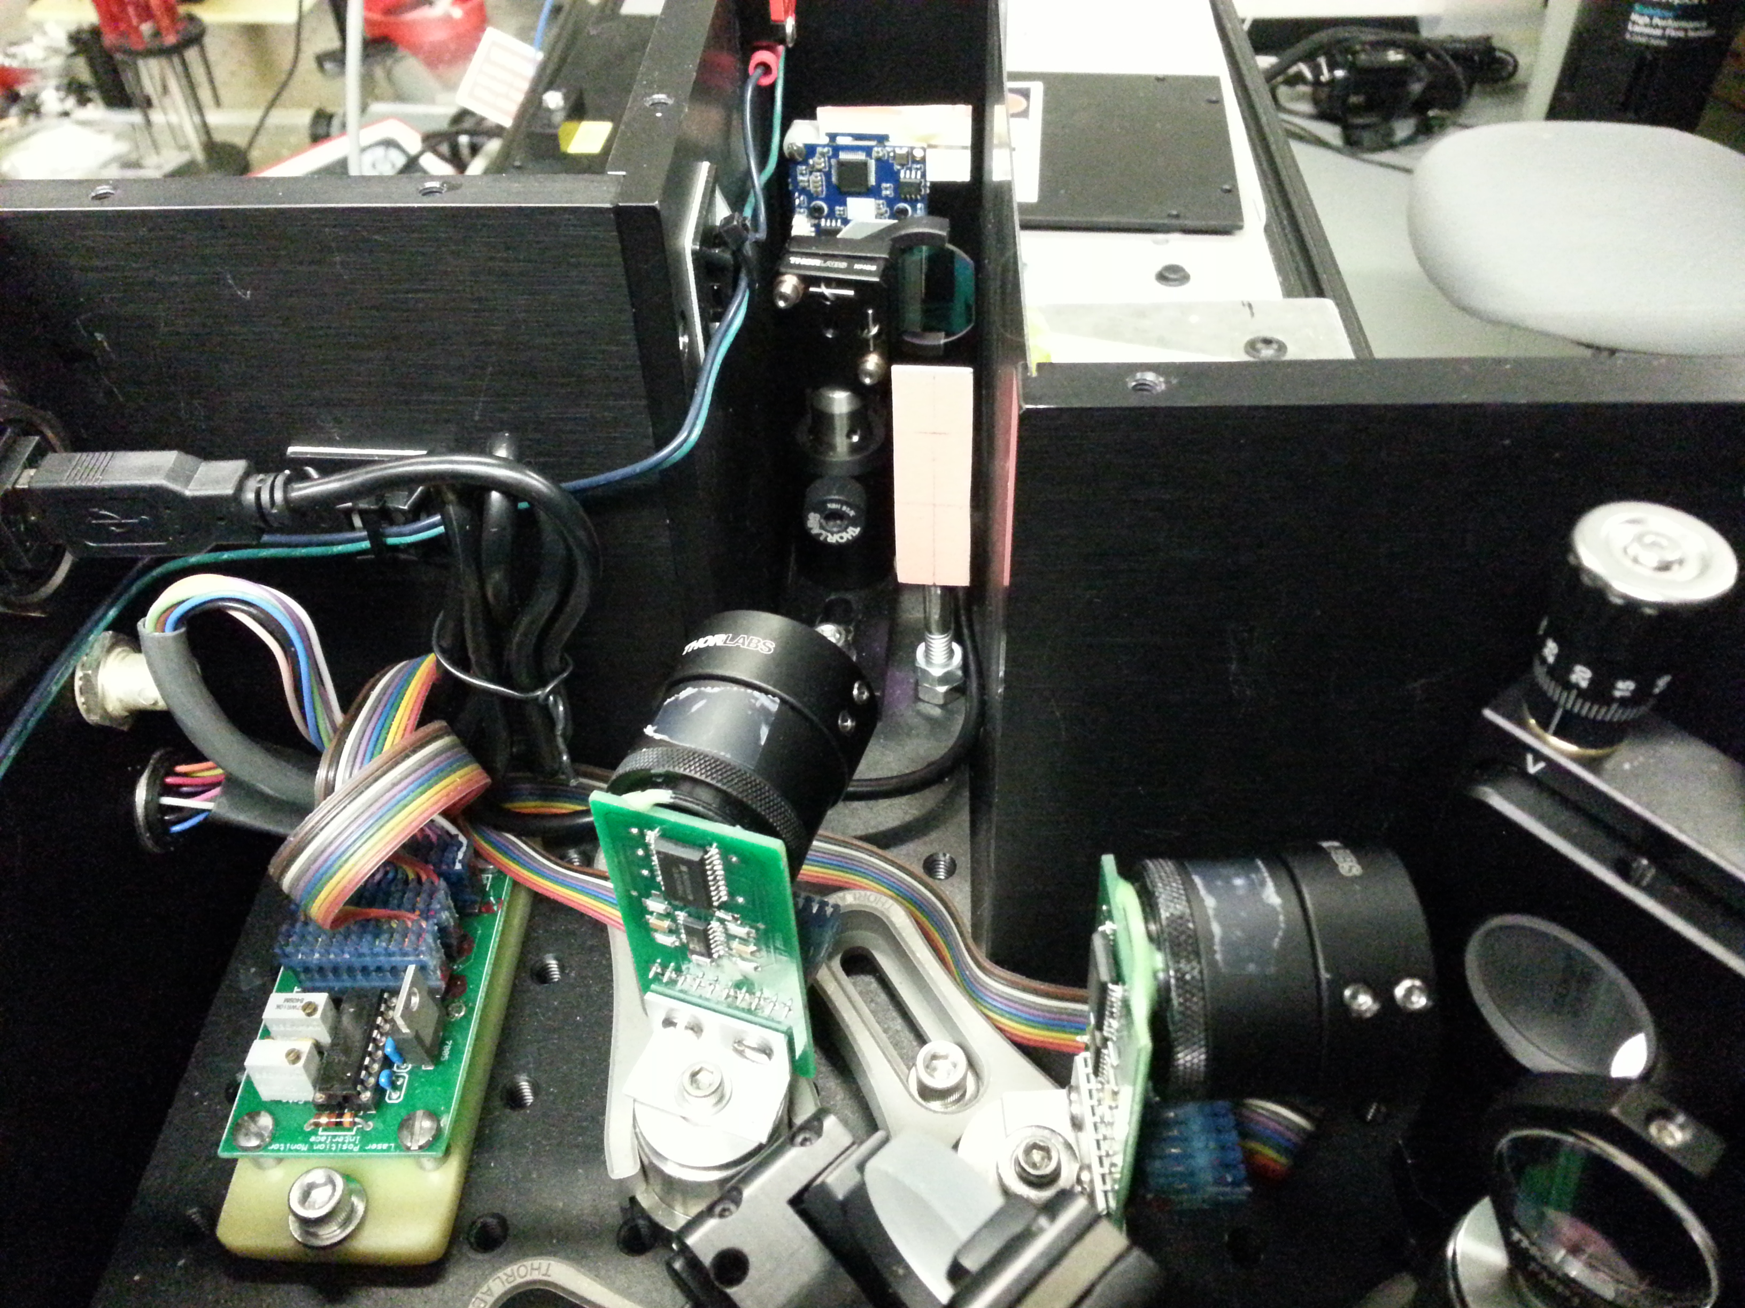
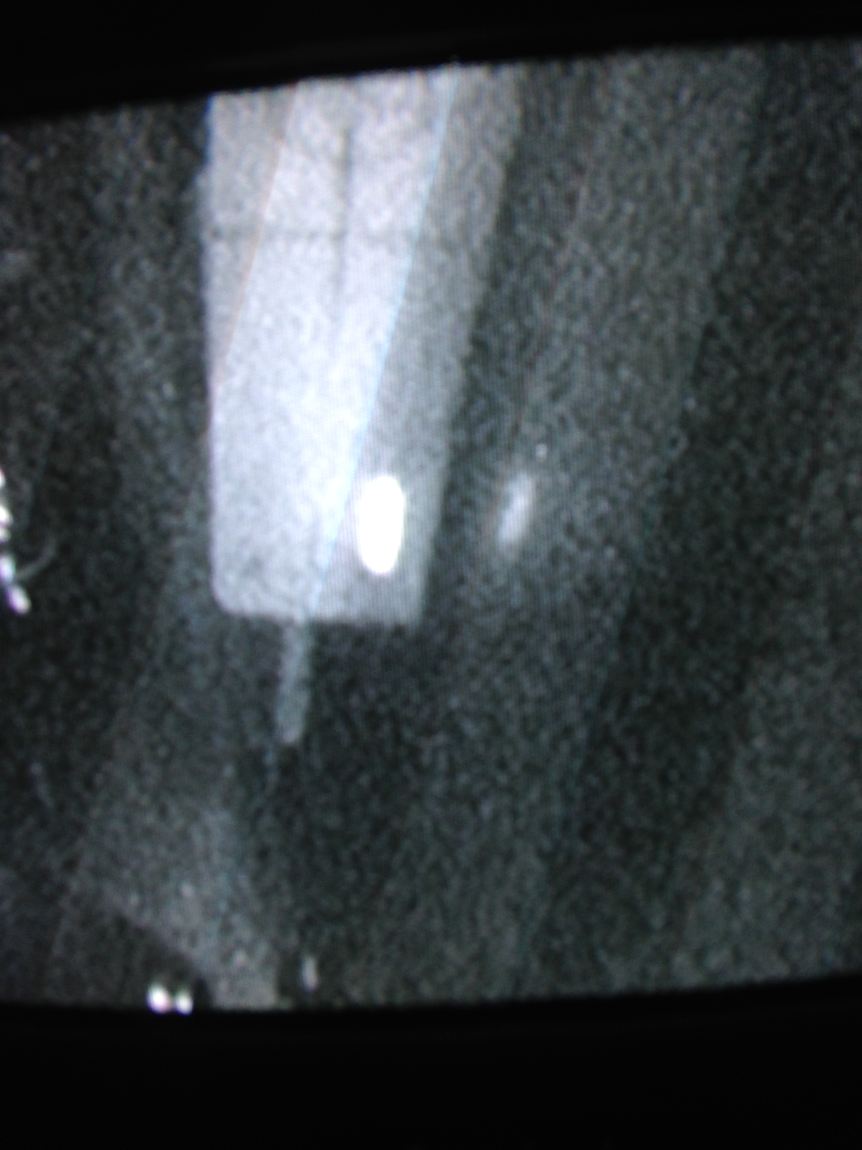
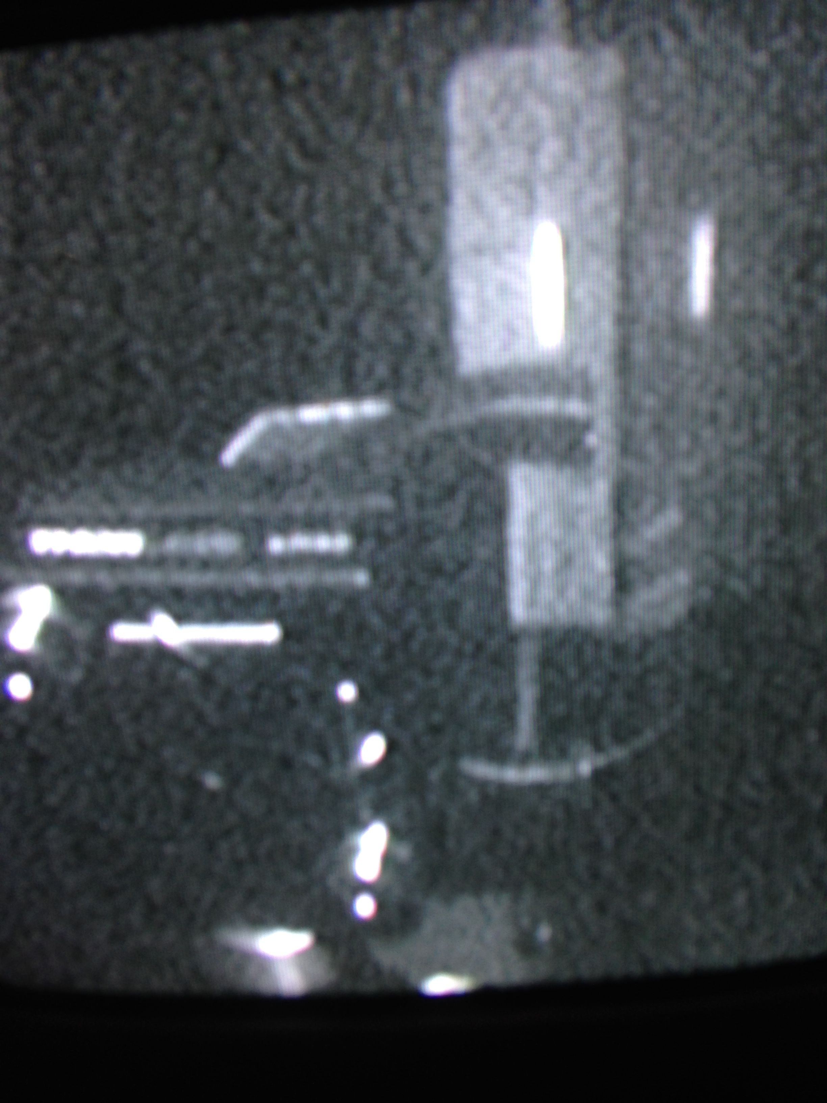
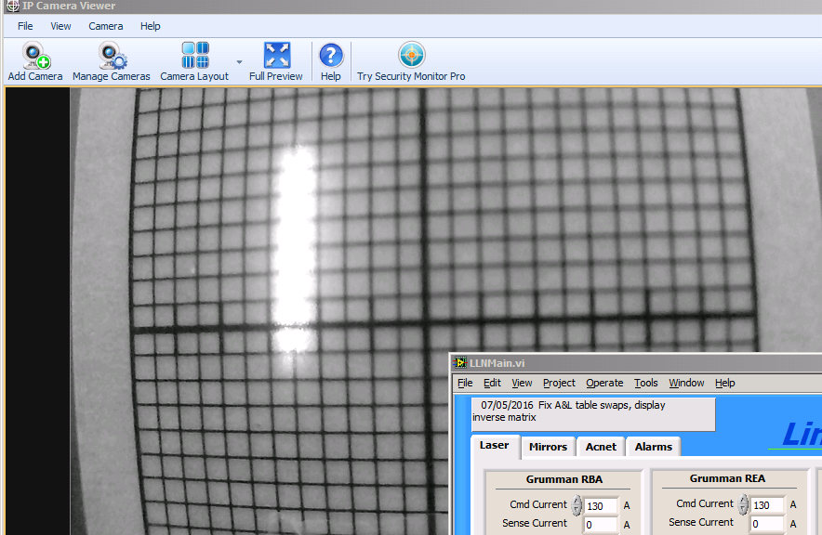
Aligning the laser into the cavity
Target monitored by video camera
in Dump enclosure

Slide 6
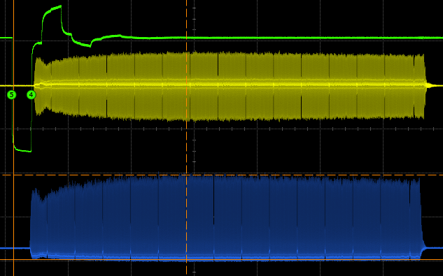
First Observation of Multiple Notches in Linac Pulse
Linac Griffin Det.
Notch
trigger
Linac WCM

Slide 7
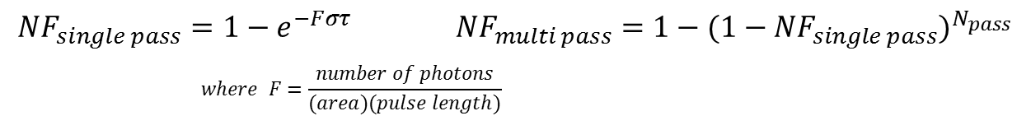
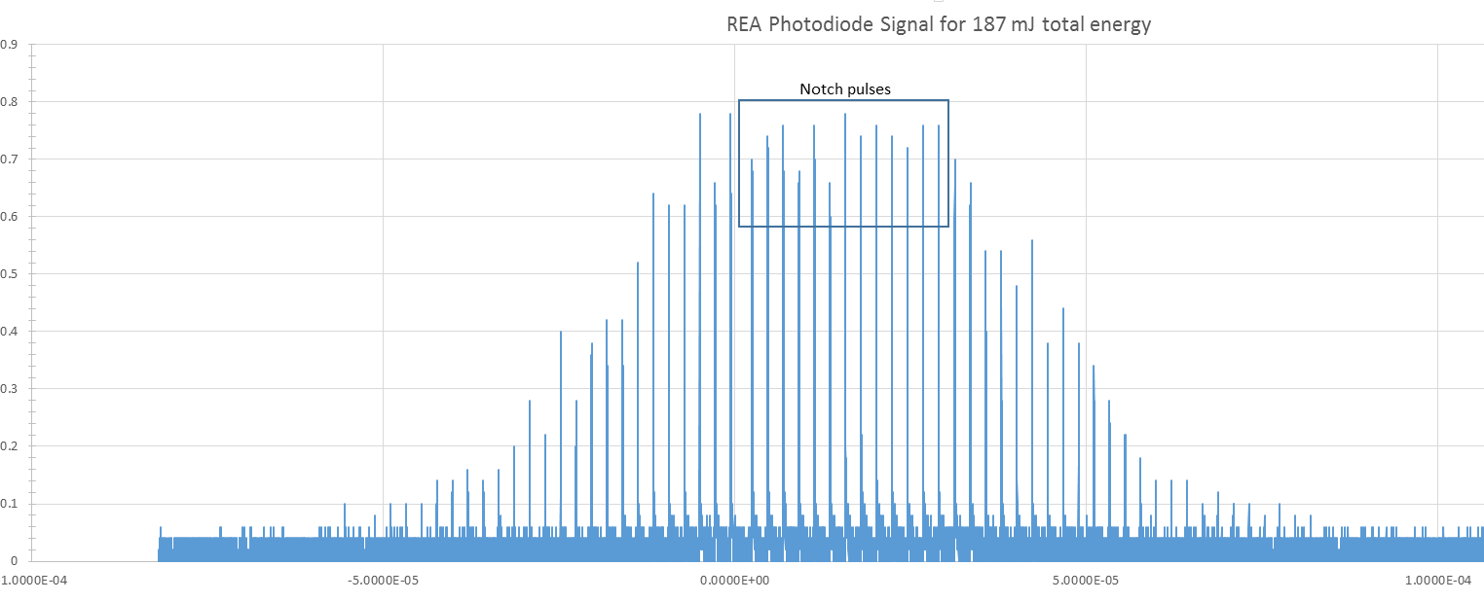
Estimate neutralization based upon laser parameters
Take neutralization data as a function of pulse energy
Recall
The parameters of interest are laser pulse energy, pulse length, transverse laser dimensions thru the cavity, and the number of interactions in cavity
Laser pulse energy
Laser pulse length
  Set to 2 ns in waveform tables
Transverse laser dimensions
(previousslide)
Notch Pulses
About 39% of total energy seen in dump
participates in neutralization process
These pulses do not interact with Linac pulse
Only add to total power to free space optics
May be removed w/ Pockels cell after OEA…

Slide 8
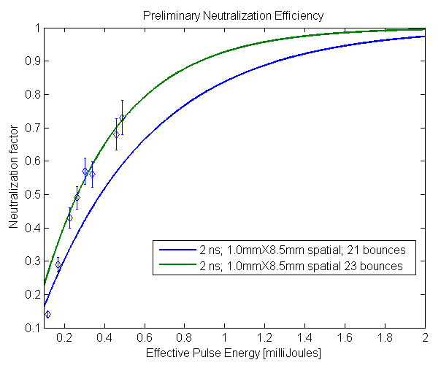
Preliminary Neutralization efficiency
Vary laser pulse energy
Compare with estimation
Design goal is 2 mJ/pulse

Slide 9
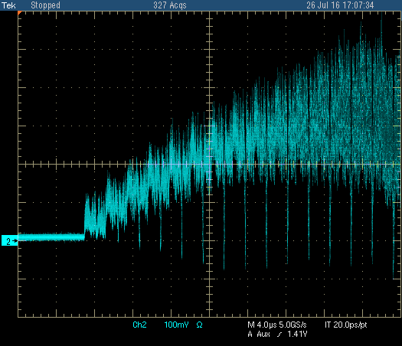
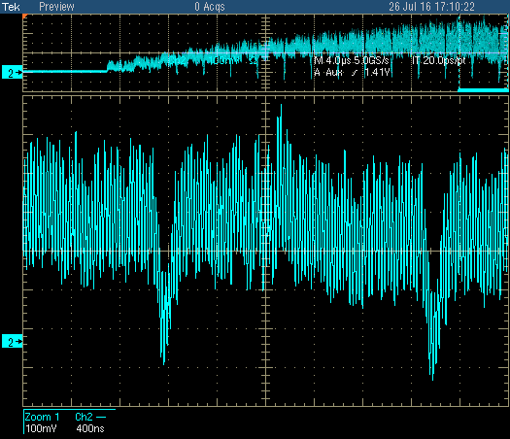
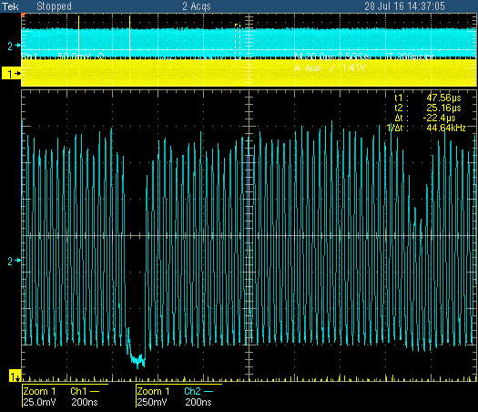
Notches in Booster(1)
Booster phase detector during injection showing notch
formation from linac
Notch in the14th and 15th turn showing a bottom width
with 38 Mhz on (little phase slippage)
(width at bottom ~ 60 ns)
c) A few ms into cycle showing notch created in Booster
(left) and notch created in linac (right). Capture set at
the nominal100-200 us after end of injection
~70%
~85%
~40%

Slide 10
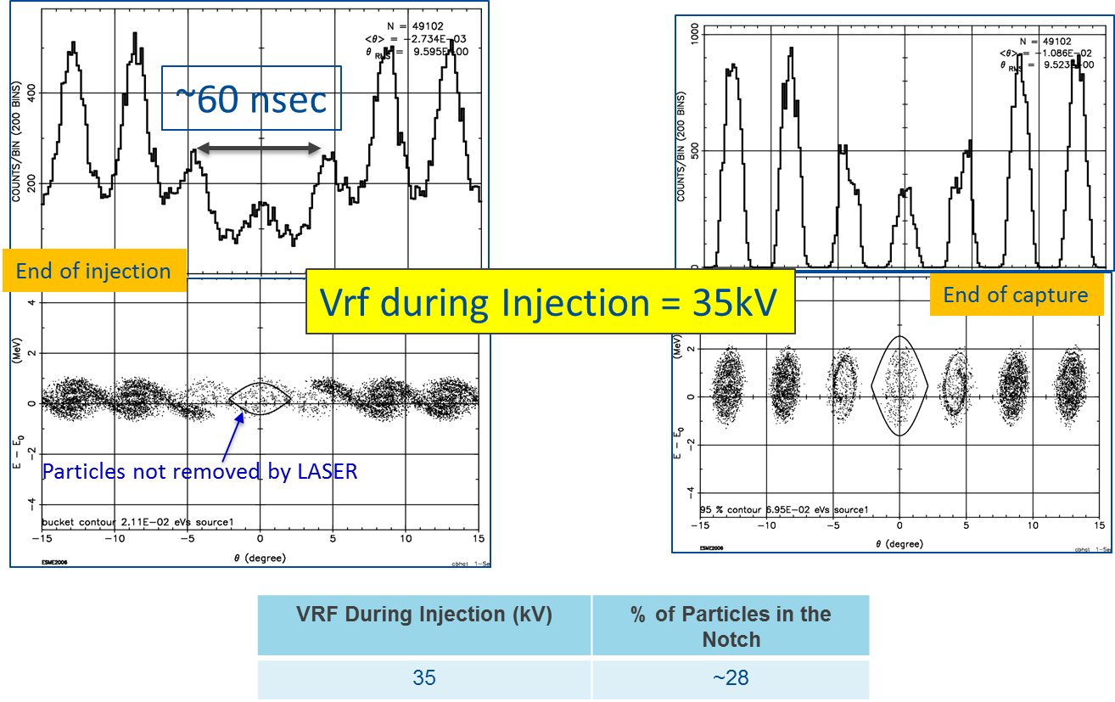
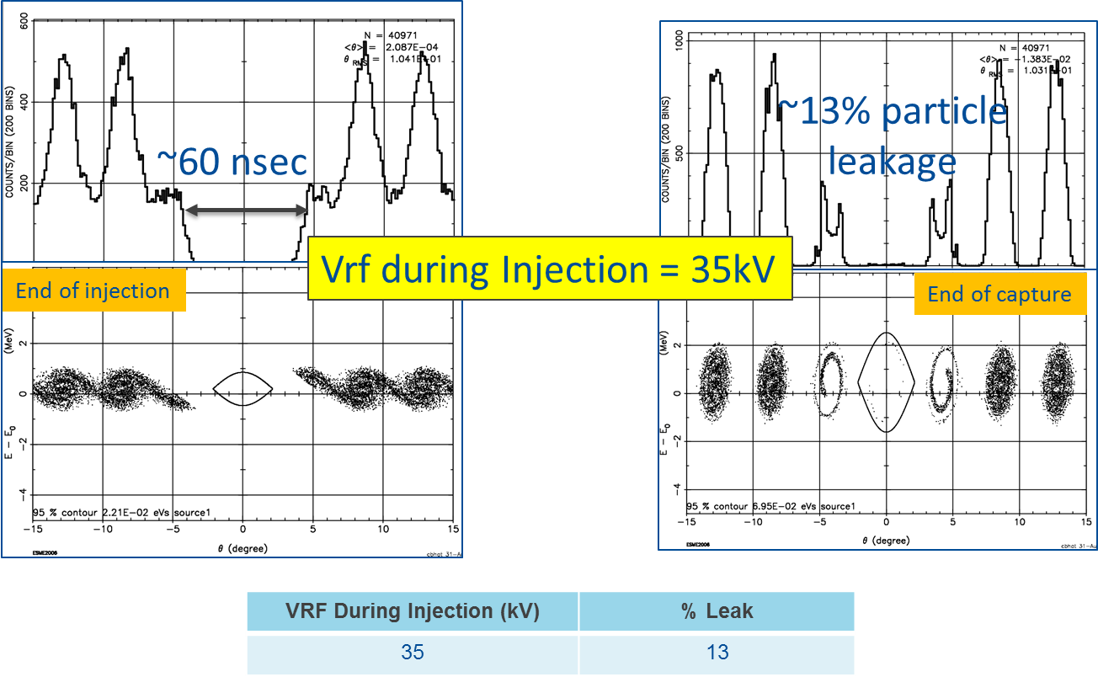
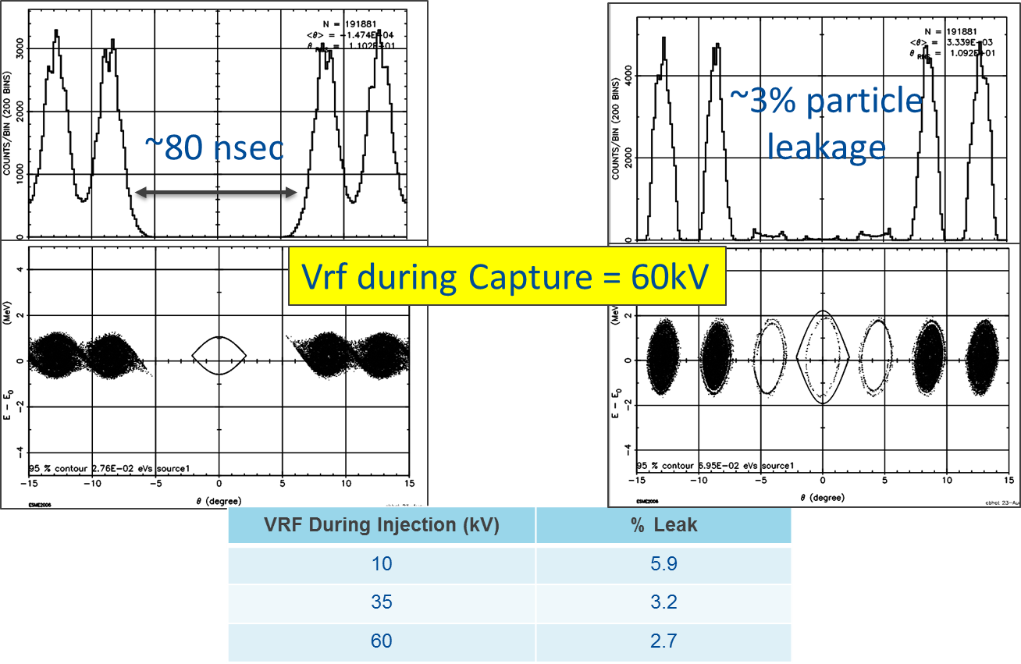
Notches in Booster (2)
Simulations from Chandra Bhat for 14 turn beam injection with Laser Notch formed in Linac and at end of capture.
  Want three 38MHz bucket notch.
  Notch centered on central bucket
  Capture starts a few (?) turns before end of injection
Top left: notch depth 70% in linac beam- not much change at end of capture (similar to current measurements)
Top right: 60ns notch in Linac 10% leak into satellite bunches
Bottom right: 80 ns notch in Linac (16 -200 MHz linac bunches)~ 3% leak into satellite bunches
Results are encouraging- additional effort is needed to Keep notches clean in Booster
Plan: start capture 1-2 turns before the end of injection

Slide 11
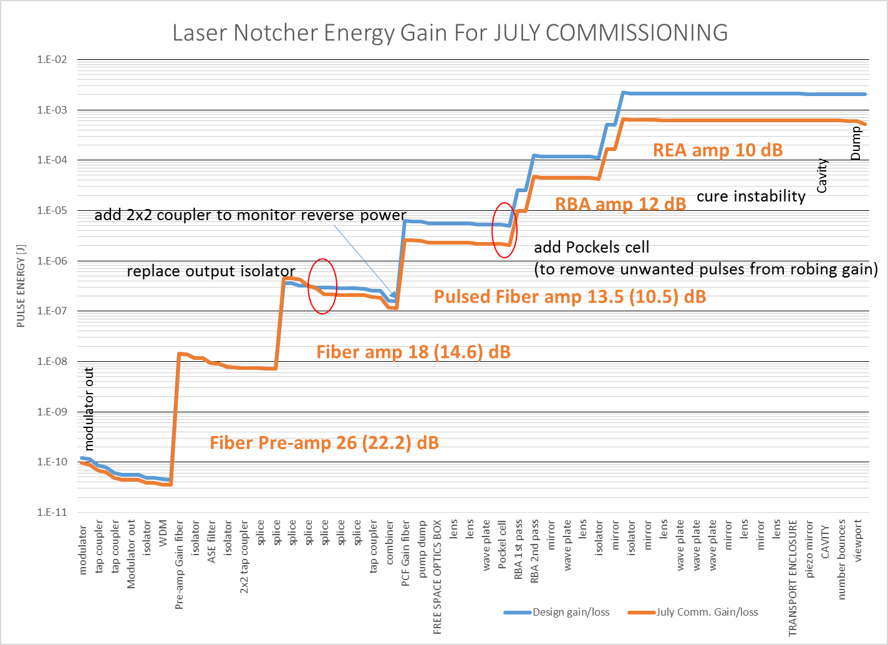
Loss Budget for July Commissioning

Slide 12
Conclusions/Take Away
We successfully demonstrated “for the first time anywhere” the ability to neutralize multiple sections (at the Booster revolution period) of a 200 MHz H- ion bunch structure out of the RFQ utilizing a burst mode fiber/solid state MOPA laser system combined with an optical zig-zag interaction cavity.
Although the laser system was not at design intensity (0.5 mJ/pulse) we demonstrated ~70% neutralization in the Linac pulse train.
The fiber and free space amplifiers worked as expected at the time.
We learned a great deal about operation of the laser system in the Linac environment and developed a good list of modifications and improvements.
We have a lot of work to accomplish during the shutdown and could use additional manpower to accomplish the tasks at hand.
We need to have a better scope to aid in commissioning
Although we saw survival of the notch ms after injection, it is clear that we need to address the survival of the notch in Booster when we turn back on… but, we think we know how to accomplish the survival of the notch

Slide 13
Shutdown Plans
Improve alignment capability and steering into cavity (need to see bounces in cavity)
  Build new vacuum flange and cavity to monitor laser bounces inside cavity. (need to assemble, align and test video camera)
  Build new alignment tool
Cure instability seen in the Grumman modules
Replace output isolator on PriTel 2W amplifier
Add reverse power tap to Optical Engines Amplifier
Add Pockels cell in front of free space amplifier module
Finish Photodiode monitor unit
Finish integrating spheres
Replace consumer USB hub with industrial unit
Install front door to electronics rack with provision for cooling

Slide 14
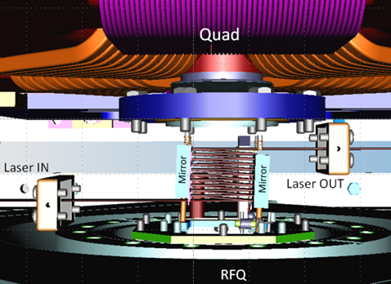
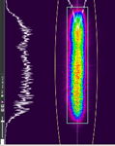

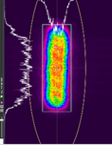
Optical Cavity
Notes:
Shows: trajectory/ steering /profiles
Designed to fit in available space
2) Expand to see cavity mirror
Diameter and angle chosen to match laser TOF to ion velocity form multiple crossings
3) 3D model

Slide 15
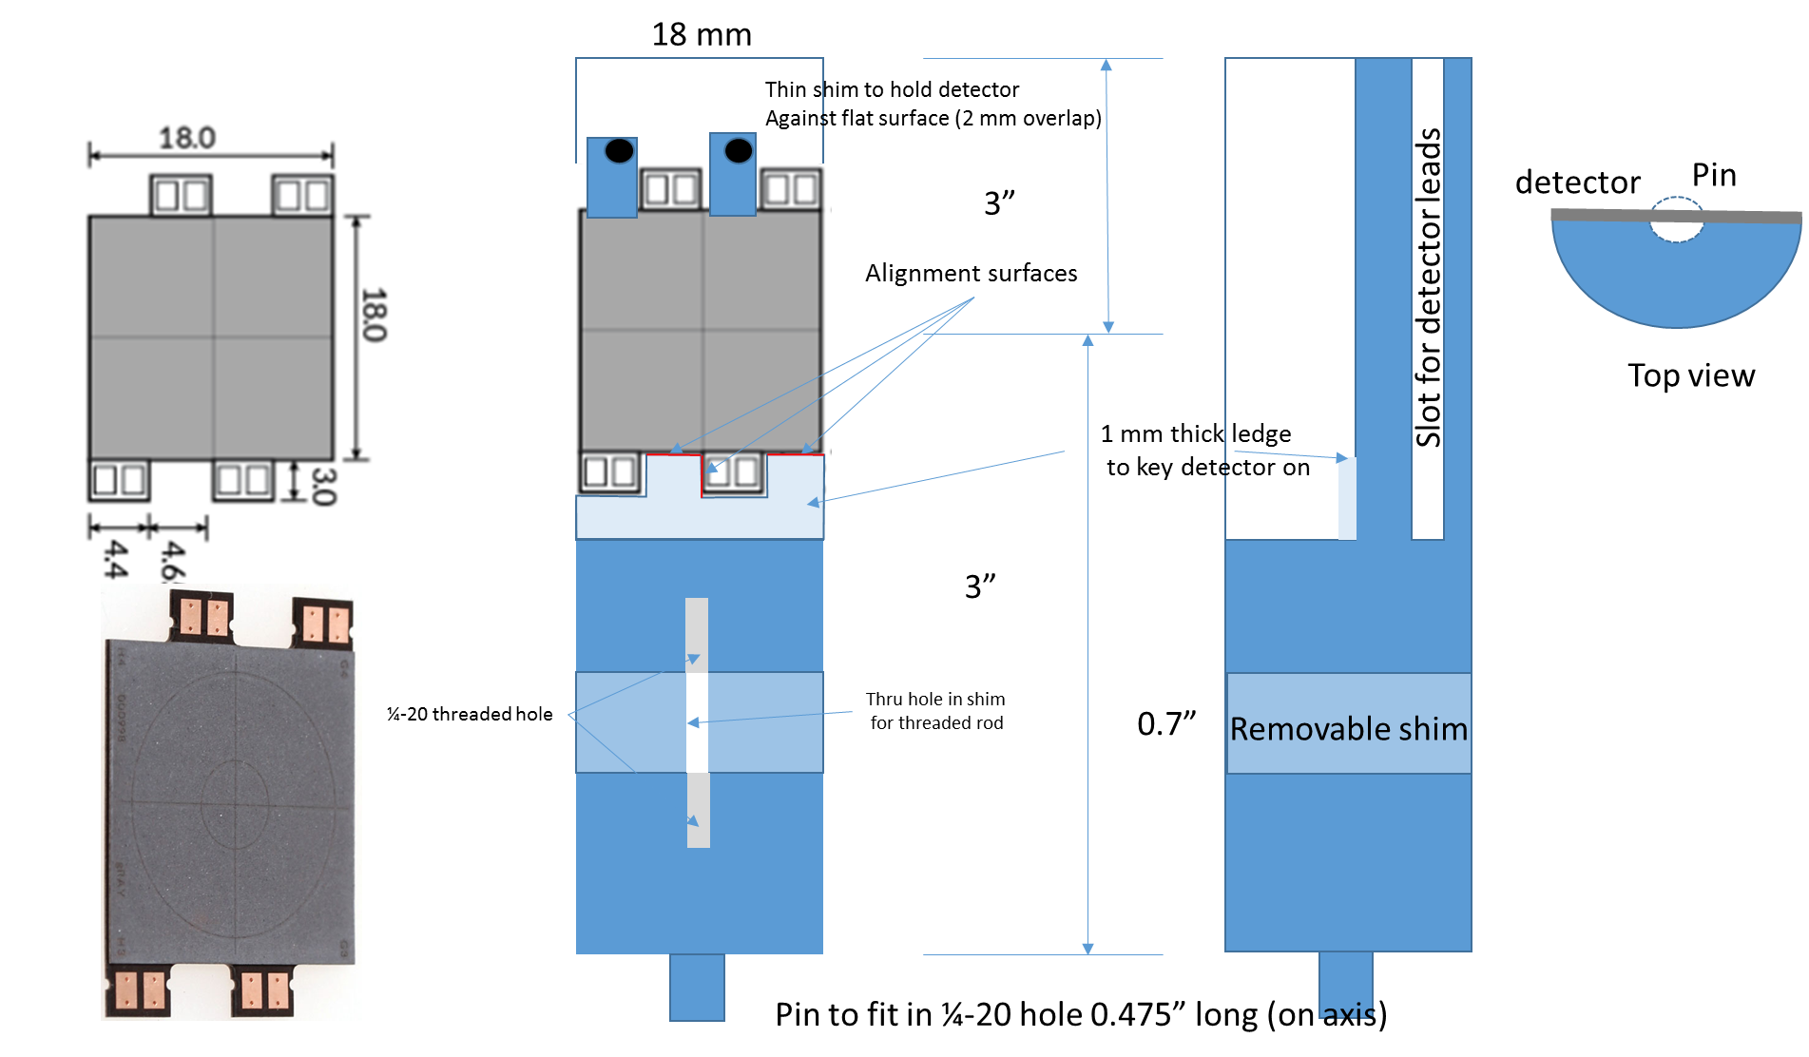
Alternate to phosphor card on a stick
Use a greenTEG thermal PSD on a precision mounting fixture. Readout through lab view. → Much more accurate than phosphor card
Can be used in optics box & Transport/Dump Enclosures
We have the PSD, fixture in shop (almost done)… will need to make a 4 channel amplifier and LabView vi.

Slide 16
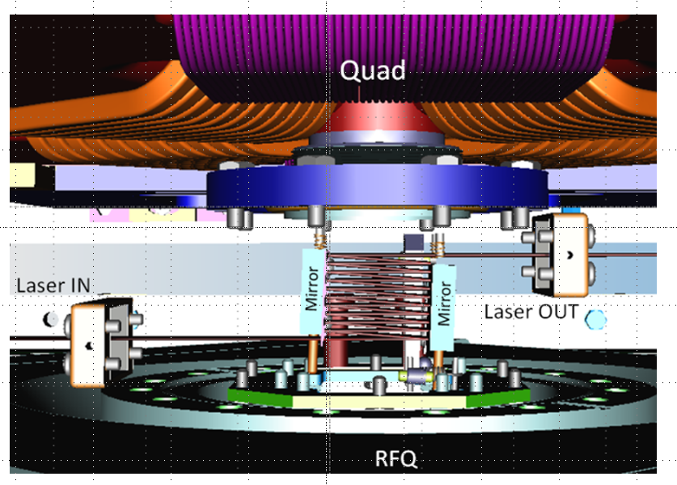
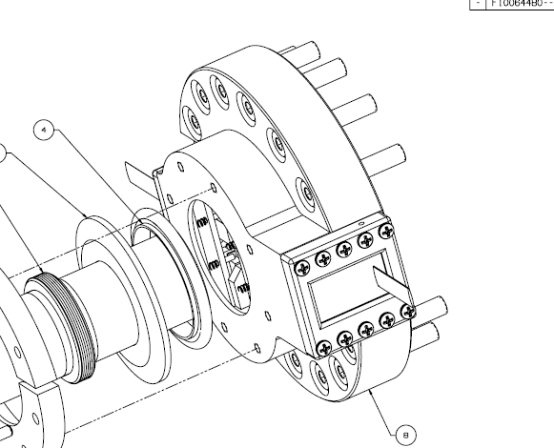
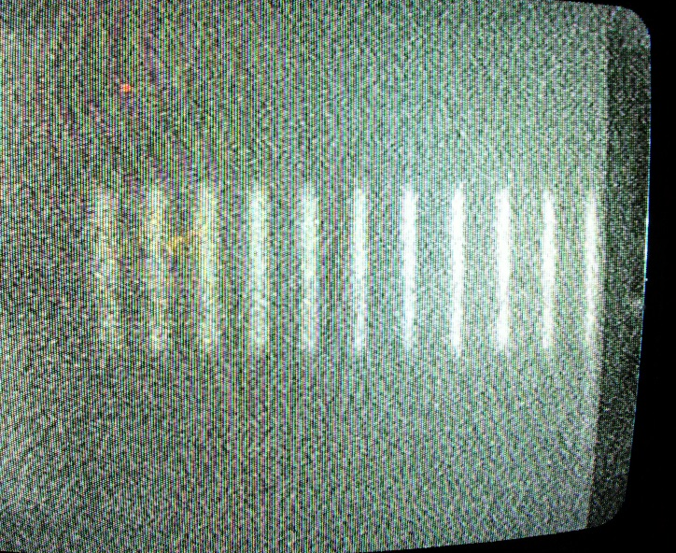
Vacuum flange modification
New input viewport
Very exciting !
Enlarged viewport will allow us to
“look” into the cavity and see the
leakage through the fixed mirror !
Video camera looking at the back of
the fixed mirror

Slide 17
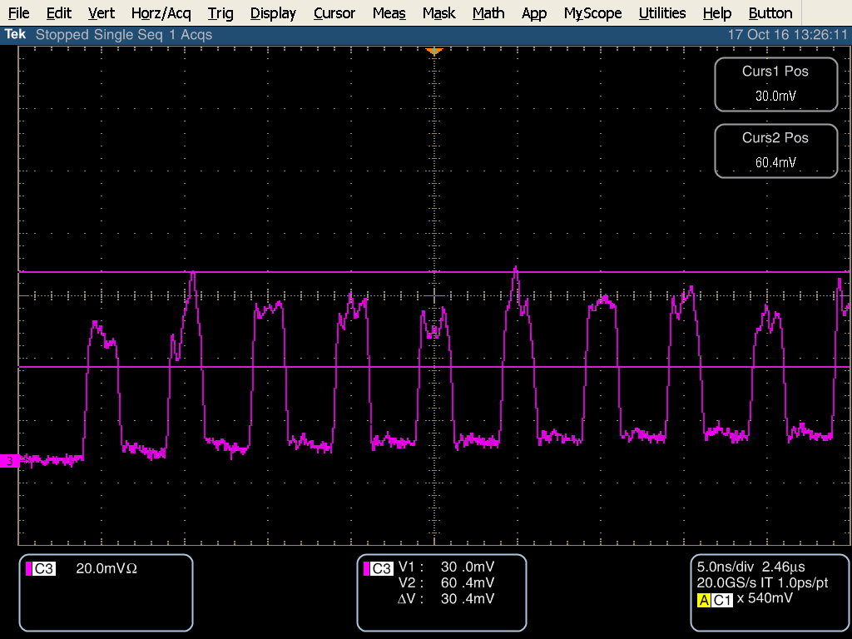
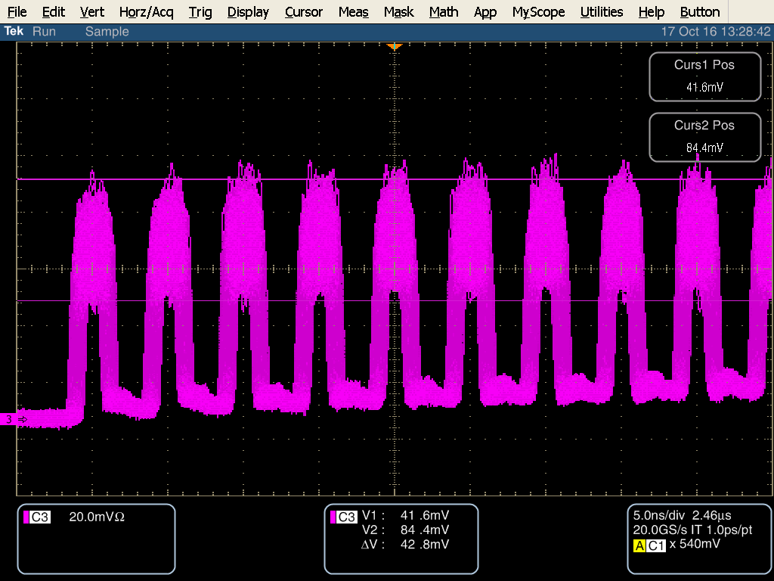
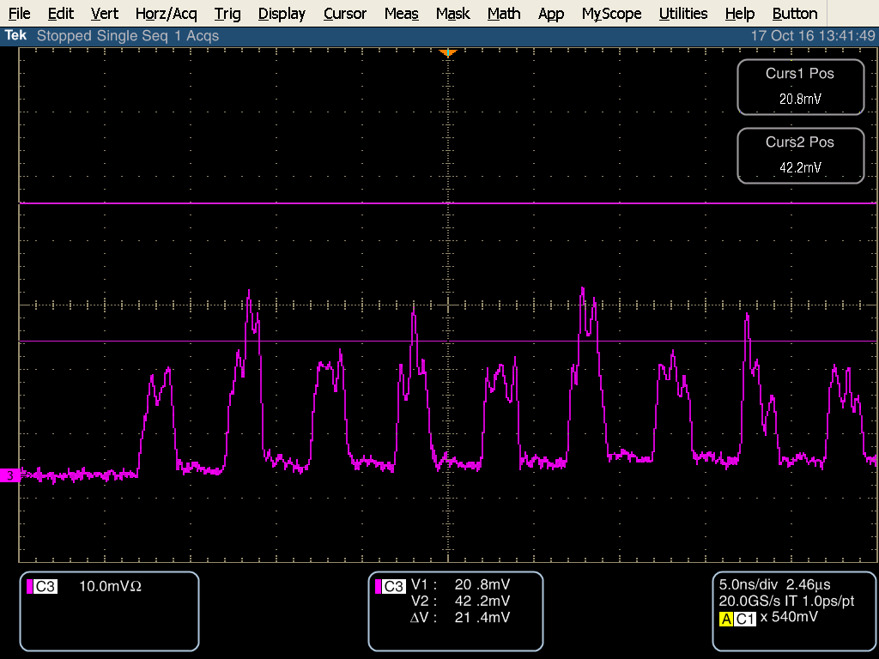
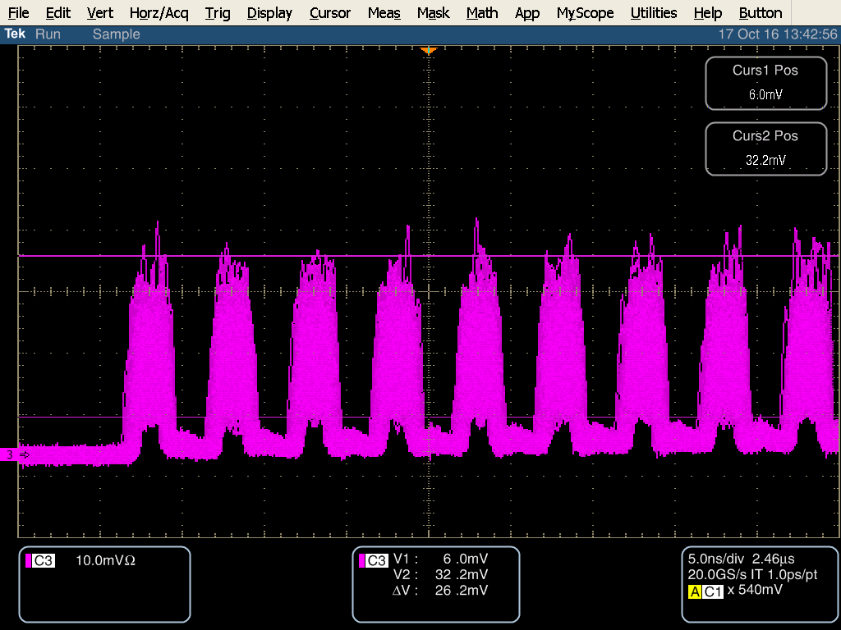
Grumman amplifier module high frequency instability
Cure high frequency instability in Grumman modules –
  Experts thought we had some sort of parasitic cavity or spatial mode issues in the DPSS system or had no idea.
  Our investigations showed the instability was NOT because of some parasitic cavity in our DPSS system, NOT some spatial mode matching, NOT coming from ASE or other instability from the upstream pulsed fiber amplifier, and NOT from some instability in the PriTel amplifier, or inter-pulse power from modulator extinction.
Single pass thru RBA
Two pass thru RBA

Slide 18
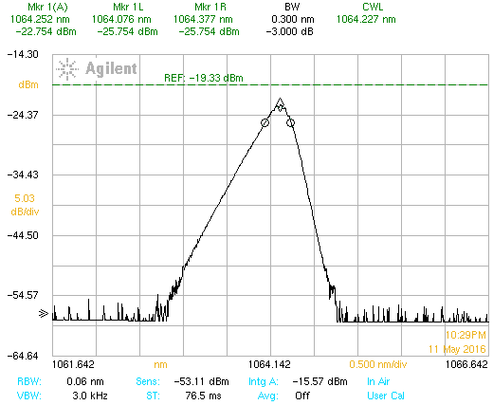
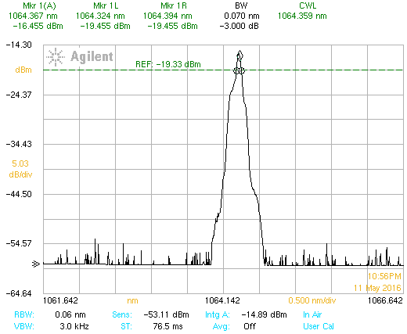
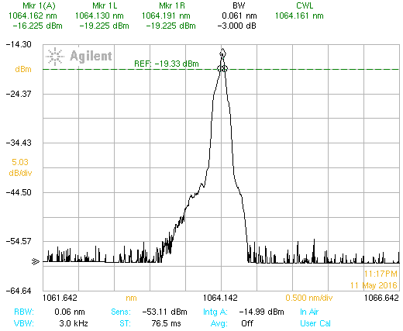
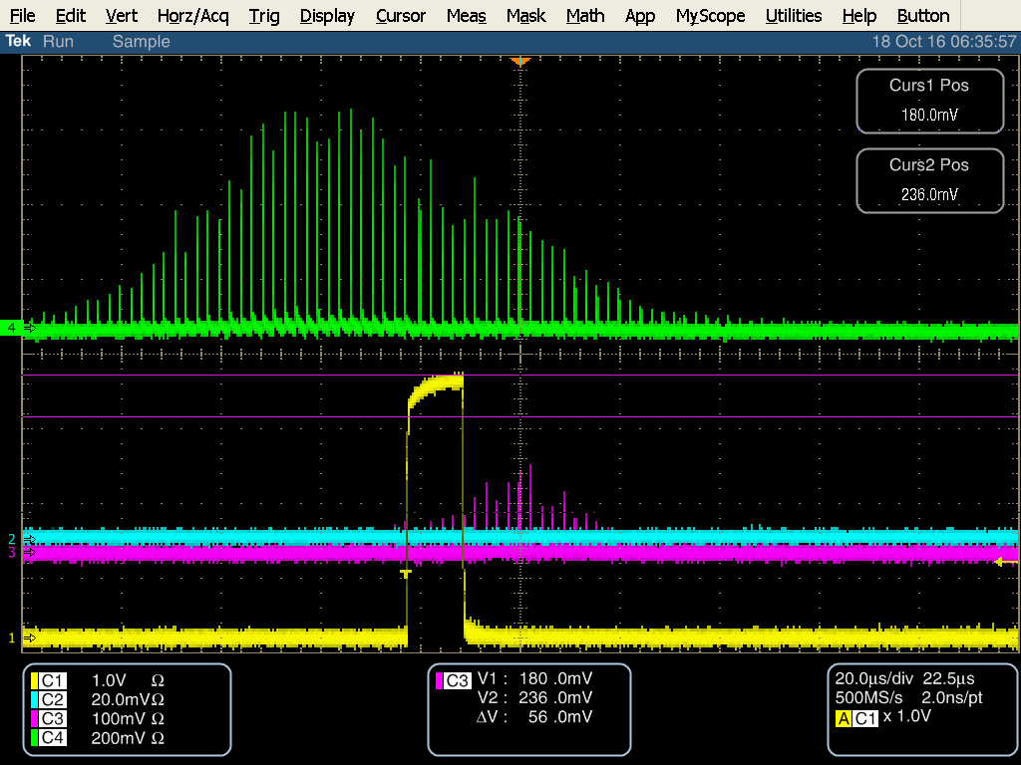
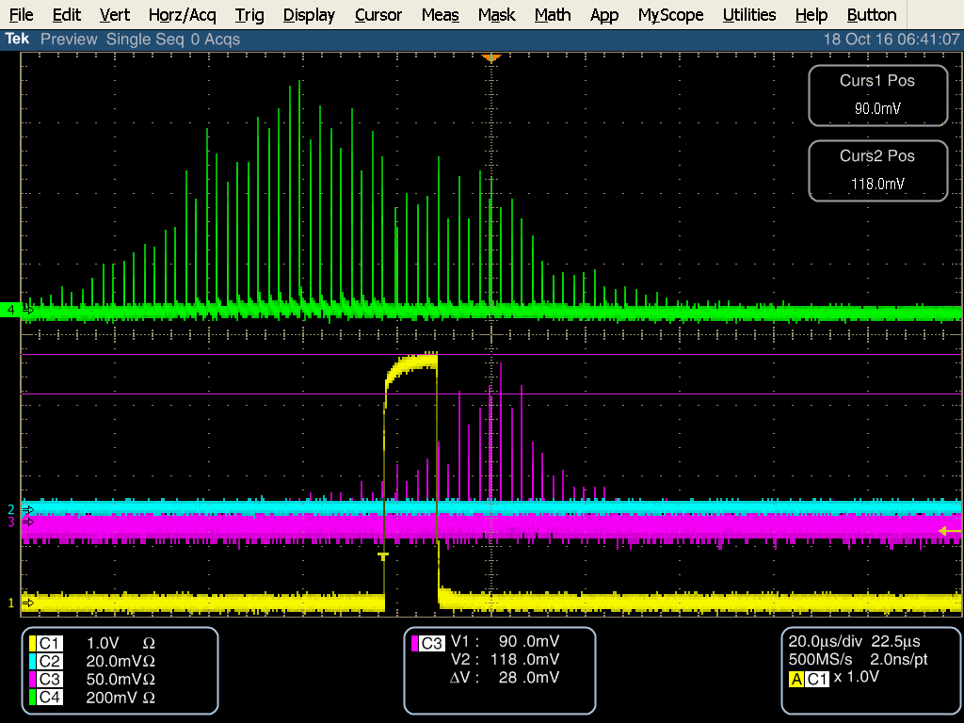
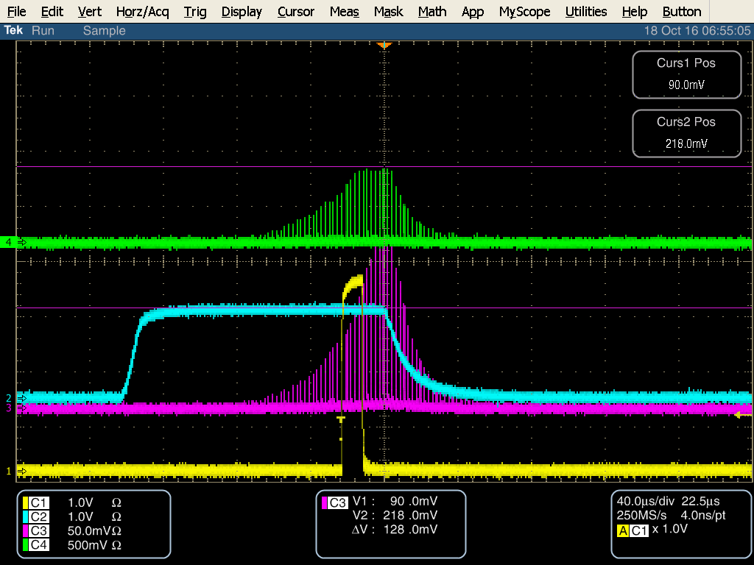
Grumman amplifier module high frequency instability
  GOOD NEWS: We found the instability was coming from our SEED source
TEC 8 deg
TEC 40 deg
TEC 40 deg
FBG 8 deg
PriTel LMA pump 4A / OE pump 0
RBA & REA pump 130A
REA
RBA
Seed 8 deg
Seed 40 deg
Seed 40 deg/FBG 8deg
These diode parameters are good for the Free-space
amplifiers, but not good for the fiber amplifiers

Slide 19
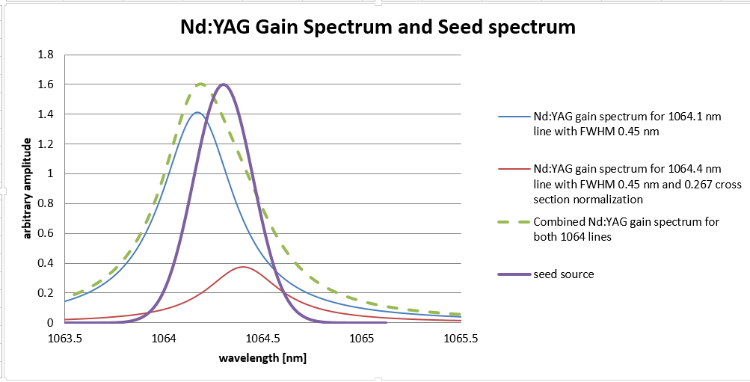
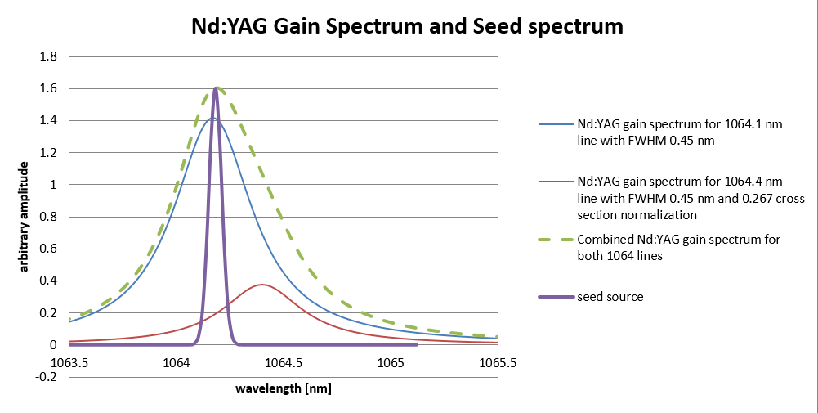
Nd:YAG Gain Spectrum and seed spectrum

Slide 20
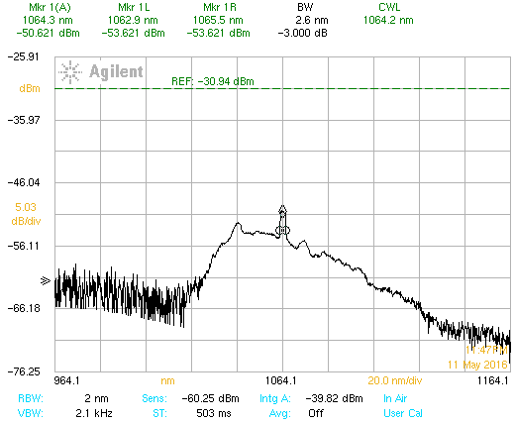
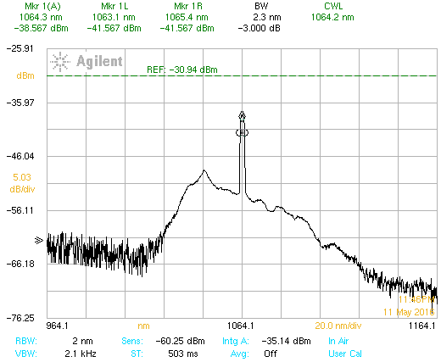
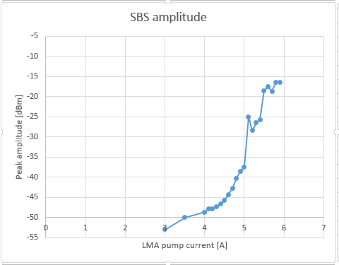
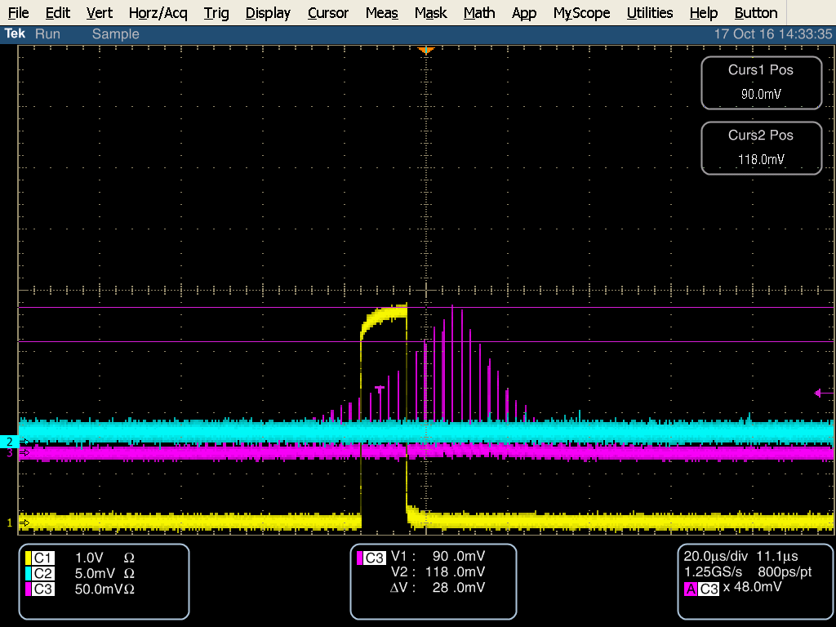
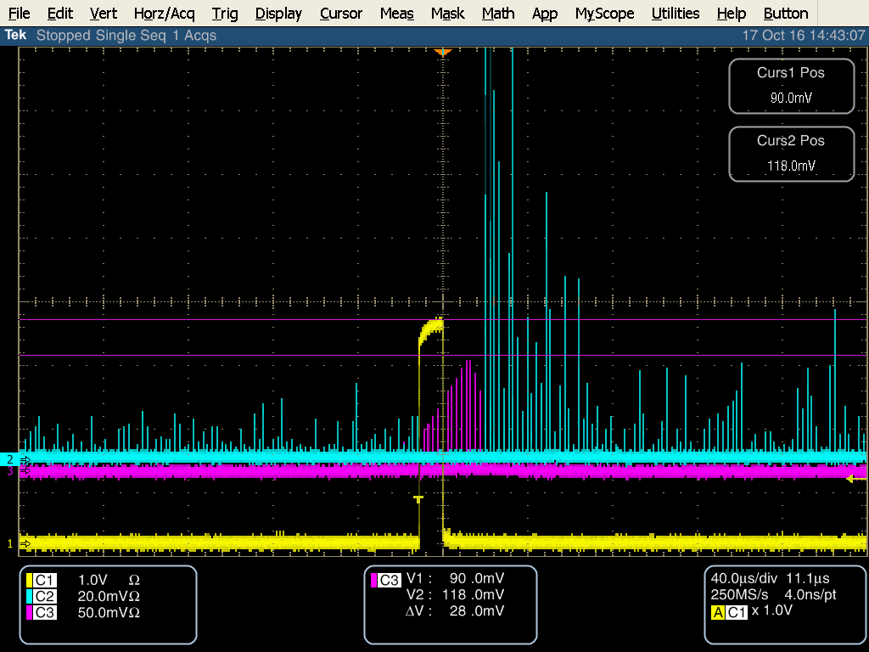
Grumman amplifier module high frequency instability
BAD NEWS: We can’t use our seed source
Seed source not stable at 40 deg C (oscillates between the 1st two
spectra on previous slide)
Impact of running Lumics Diode at 40 deg C. and the LMA amplifier
PriTel pump 5A
PriTel pump 4A
PriTel pump 4A
PriTel pump 5A

Slide 21
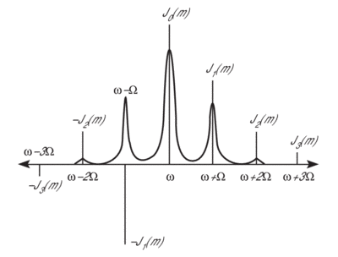
New Seed diode and phase modulation
The requirements for our seed diode get tighter
  Spectral content & power must not generate SBS
    Can’t be operated in a regime of coherent collapse or
    Gain competition amongst longitudinal modes where the energy is transferred between modes not shared amongst modes.
  The center wavelength must match the peak of the ND:YAG gain spectrum and be within the 3 dB bandwidth or better.
Solution: use a single frequency seed diode and phase modulate the output such that the power in each line is shared amongst the sidebands
  Brillion gain bandwidth 100 MHz
  Modulation frequency larger than 100 MHz (500 MHz – 1 GHz)
  Should generate a spectral comb ~ 16-80 GHz (corresponds to 0.06-0.3 nm)
Seed diode laser – Innovative Photonics Solutions 100 kHz line 1064.4nm (12/2/16)
Phase modulator – EO Space phase modulator
Modulation source – borrow then make (?)
Instrumentation issues
  The OSA has a resolution bandwidth of 0.6 nm ( only see the envelop of individual longitudinal modes)
  Need something like a scanning Fabry Perot supercavity spectrum anayzer, or monocrometer (?)
  Suggestions

Slide 22
Implication of adding phase modulator
Maximum average power input from seed diode 100 mW
Added insertion loss of < 3.5 dB (special ultra low insertion loss unit ~2 dB)
Reduces input in to EOM from about 96 mW to somewhere between 30 and 45 mW depending on insertion loss.
  Reduces input into pre-amp from 320 -400 uW to 120 uW
  With pre-amp at max gain the pre-amp output (LAM amp input) down to 20 mW- below the input threshold for the LMA amplifier.
Two options
  pulse seed diode
    Reduces average power into phase modulator (pulse duty factor ~100 ns/2.2 us) while keeping peak power
    Unknown impact on spectral quality and unknown peak power
    Requires new pulsed diode driver (new interface to safety system and controls)
    Added complications interfacing keep alive
    Once we understand the full impacts considering making spare OPG module with pulsed seed
  Add booster amplifier
    MW- Technologies (Portugal) YDFA-SPM-1 for 100 uW input 17 dB gain -> 6 mW output
    3.5x4.5x1 inch , easily integrated, < $6K
    Delivery 6-8 weeks (can we install once we are operational?)

Slide 23
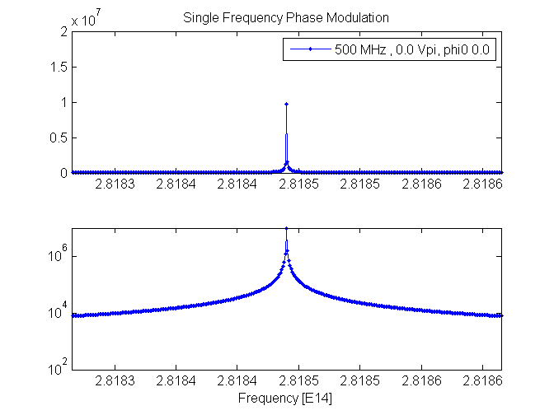
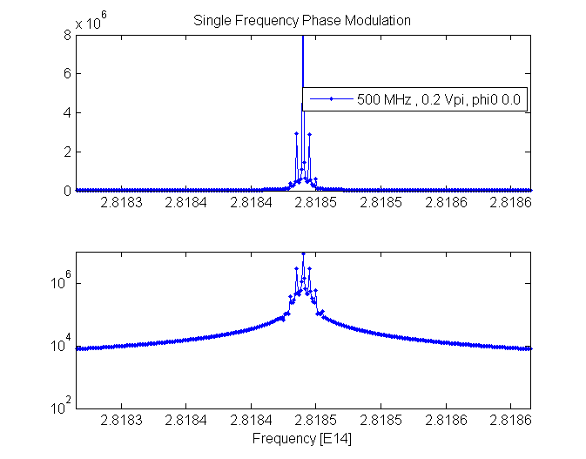
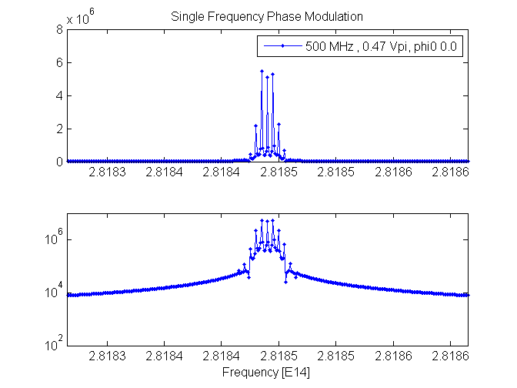
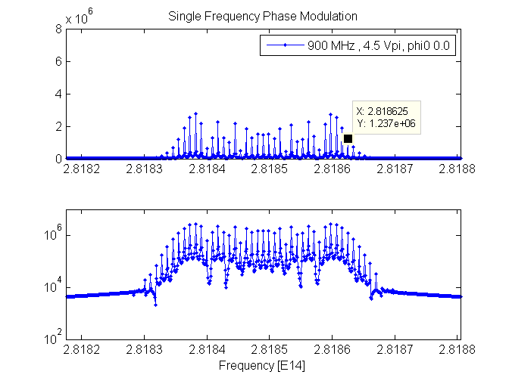
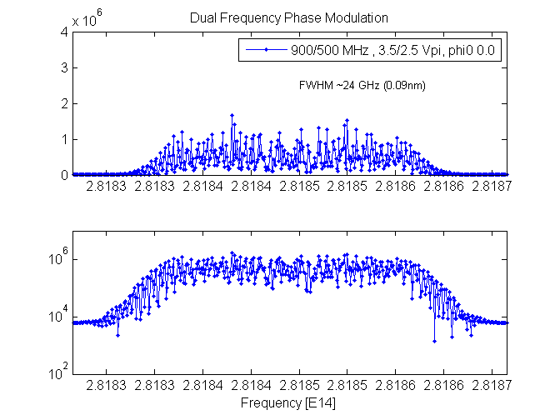
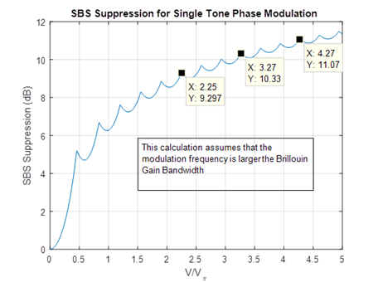

Phase Modulation Options
We have phase modulator (low Vpi =2.4V & low 2 dB insertion loss)
Single frequency seed source on order (due 12/2)
Set up RF source and amplifier
Currently the only way to tune is to look at the envelop with our OSA.

Slide 24
Implementation of new seed source and phase modulator
99:1
Modulator
95:5
99:1
Seed
Pulse output to amplifier chain
~320 uW
VDRIVE
RF Amp
MDC Bias Control
Osc. Keep Alive
DA12000 AWG
Notch Trigger
<P> <100 mW
Fermi OPG
Ext. clock sync to RFQ
Phase
Modulator
99:1
Modulator
95:5
99:1
Seed
Pulse output to amplifier chain
MDC Bias Control
~120 uW
VDRIVE
RF Amp
Modulation
source
Osc. Keep Alive
<P> <100 mW
DA12000 AWG
Notch Trigger
Fermi OPG
Ext. clock sync to RFQ
Clearly with the reduction of seed power out of the modulator we need to add an additional amplifier stage to boost the input into the pre-amplifier.

Slide 25

Expected performance after upgrades

Slide 26
Current Status
Seed source/modulator:
  Have EO Space modulator
  Seed source IPS hybrid ECL due 12/2/16
  Borrow IPS diode 100MHz line width
  Borrowed RF generator/amplifier system for tests
Fiber amplifier modifications
  PriTel isolator change (at vendor)
  Optical Engines 2x2 tap coupler added and returned to FNAL
Booster amplifier – ordered expect 3 wk delivery.
Pockels cell – Leysop, 2 crystal longitudinal cell, liquid filled angled windows, 99%transmission, 1000:1 contrast, Vpi 3.5 kV.
  I we have cell, mounting/adjustment, and pulsar in hand
Photodiode module – being constructed
Alignment tool – we have thermal PSD, fixture in shop
Vacuum flange- we have flange, optical cavity parts, and viewports/windows
Need to work on integrating spheres
Finish electronics rack door
Miscellaneous other tasks

Slide 27
Summary/Conclusions
We had a successful commission period and identified a number of issues limiting the pulse energy.
The major upgrades that are underway are:
  New seed source and phase modulator
  New booster amplifier
  Pockels cell
  Replacement fiber amp 1 output isolator
  Addition of 2x2 tap coupler in fiber amp 2 (OEA)
We believe these upgrades will allow us to reach the goals of the laser notcher.

