Slide 1
More measurements of tanδ in Stycast
Robyn Madrak
2nd Harmonic Cavity Meeting
17 Nov 2016

Slide 2
Previous Measurements - Summary
1st attempt - we tried to extract tanδ for the Stycast 2850FT with Catalyst 9 by adding thin layers (0.1mm) to the garnet test setup
This had various uncertainties and a lot of scatter, much due to the garnet/B field, however the setup was close to what will be reality in the cavity
Gave a very large value of tanδ ~ 0.2
2nd measurement - took garnet out of the picture. Made a sturdy quarter wave cavity out of 3-1/8” transmission line.
Made a 2” thick ring of epoxy to fit inside of the line
Measure Q with and without the epoxy: from this extracted tanδ ~ 0.017 @ ~66 MHz, a bit less than manufacturer value of 0.03 @ 1MHz.
3rd measurement – as a cross check. Just like 2nd measurement except made a ½ wave resonator which avoids unpredictable losses at the shorting joint. Less scaling of conductivity of Cu in sim to match. Got same result for tand as in 2nd meas.

Slide 3
Next
The following idea was proposed: could the Stycast have an effectively larger value of tanδ in thin layers? This seems very unlikely, but could explain why the first measurement yielded such a large value.
Though it was unlikely, we decided to investigate this further because
We can
It is very important that the epoxy isn’t as lossy as the first measurement indicated
4th measurement
Again use a half wave resonator
Take garnet/bias out of the picture to eliminate uncertainty
Use thin layers of Stycast
Put the thin layers of Stycast in between some samples of material which have ε similar to that of garnet. AlN was chosen because
ε = 9
We have some samples of it that will fit in the resonator and that we have no immediate use for

Slide 4
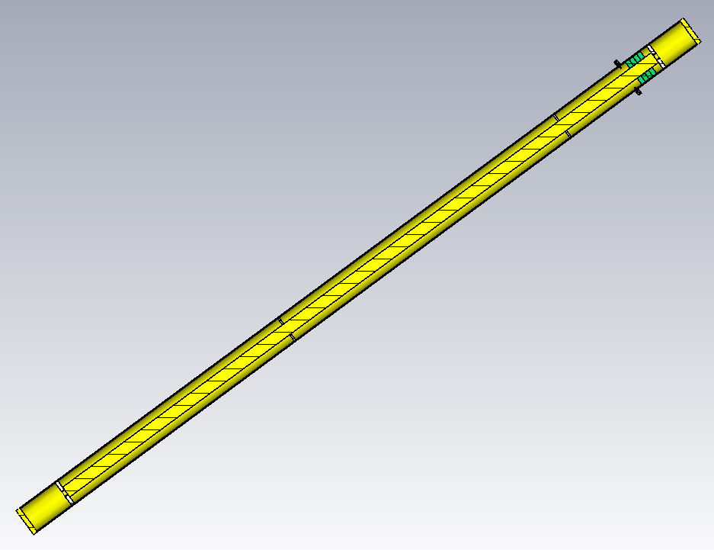
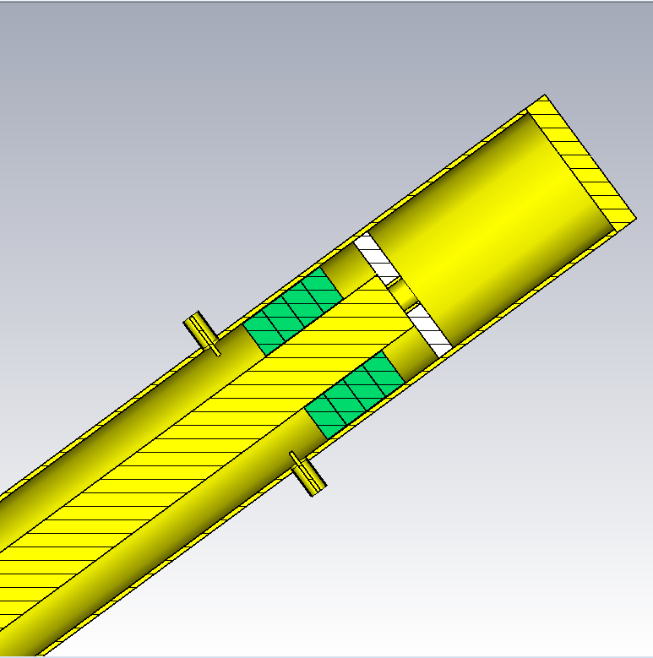
Model
4 AlN rings
0.5” thick
w/ and w/o Stycast
open
teflon support,
1 of 4
Zoomed in on end
open

Slide 5
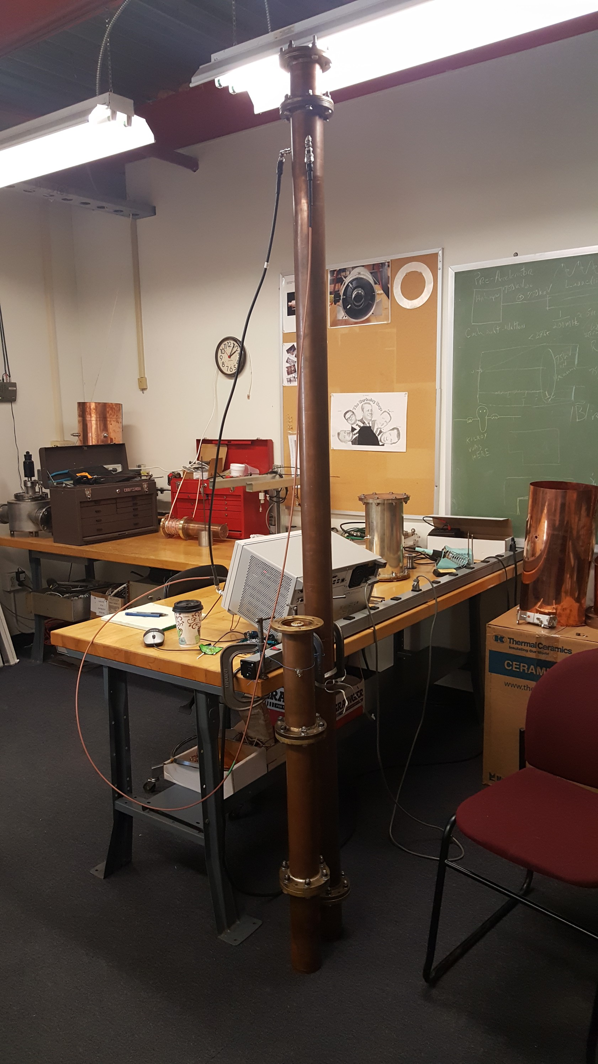
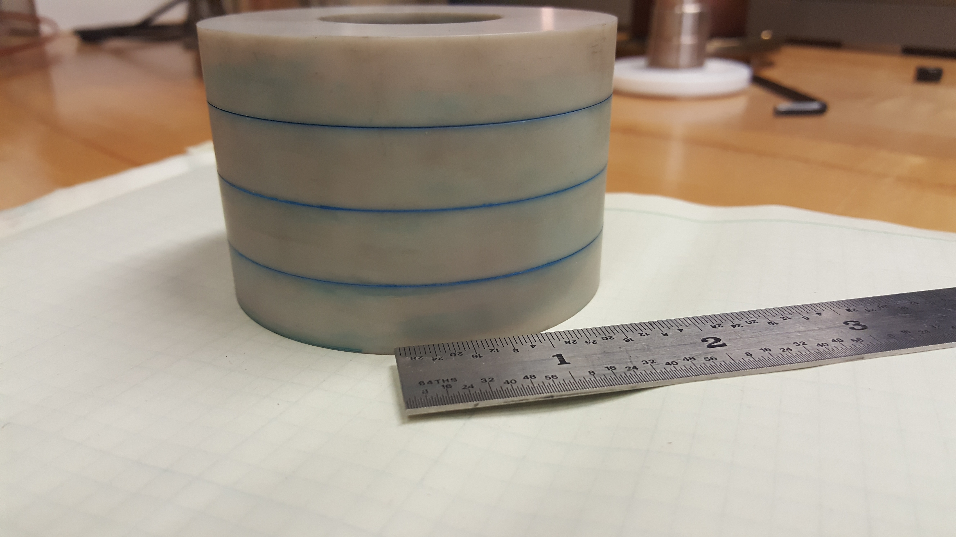
Pictures
4 pieces of AlN epoxied together
Average Stycast thickness = 0.0027”
New ½ wave fixture
Old ¼ wave fixture

Slide 6
Procedure
Measure Q with no epoxy
Q(meas) =2401, Q(sim) = 2462
This measurement was extremely repeatable, to < 0.3%
Adjust resistive losses in simulation until Q(sim) ~ Q(meas)
Initial σ = 5.8E07 S/m, final 5.64E07 S/m
Measure Q with AlN but no epoxy
Q = 2146
Adjust tanδ(AlN) in sim so it matches Q data
This gives tanδ(AlN) = 2.3E-04 @ ~66 MHz.
Manufacturer specs 2E-04 @ 1MHz
Epoxy together the rings and measure Q with AlN.
Adjust tanδ(Stycast) in sim so Q matches data

Slide 7
Measurements
Can evaluate tanδ in two ways:
Use average Q for AlN only, and AlN + Stycast, using all data
This gives tanδ = 0.002
Do the same as above but exclude two low data points for AlN only
This gives tanδ = 0.006

Slide 8
Another evaluation
The simulation of such a thin sample may not be trustworthy.
Instead of simulating Stycast, simulate AlN with an effectively larger tand to account for presence of epoxy
If we know the dimensions, this allows us to calculate (approximatey) tand of the Stycast:
An example:
Ratio of losses = tand(Stycast)/tand(AlN) = 0.2/2E-04=1000
Ratio of volume = thickness AlN/thickness Stycast = 2”/0.0081” = 1/247
1000/247 = 4 so if tand(Stycast) = 0.2, its presence would be equivalent to increasing the losses in AlN by 400%. I.e. from 0.0002 to 0.001.
Going through this exercise with more realistic numbers, the results are consistent with those where the Stycast was simulated directly

Slide 9
Conclusion
It is frustrating that the last results are not consistent with the previous, however, this result certainly indicates that this epoxy is not a problem as far as dielectric losses go.
Still, the most trustworthy experiment (thick ring of epoxy) gives a number close to the manufacturer quoted value, which is acceptable for the cavity.

