Slide 1
Particle Accelerators at the Intensity and Energy Frontiers for High Energy Physics Research
Dr. Chandra Bhat
Fermi National Accelerator Laboratory, Illinois, USA
Jnana Bharathi, Bangalore University, India
November 30, 2016
Joint sponsors:
KAAS + IPS(BC) and Dept. of Physics, Bangalore University
Outline
Modern Accelerators – An introduction
Intensity Frontier Accelerators
Energy Frontier Accelerators

Slide 2
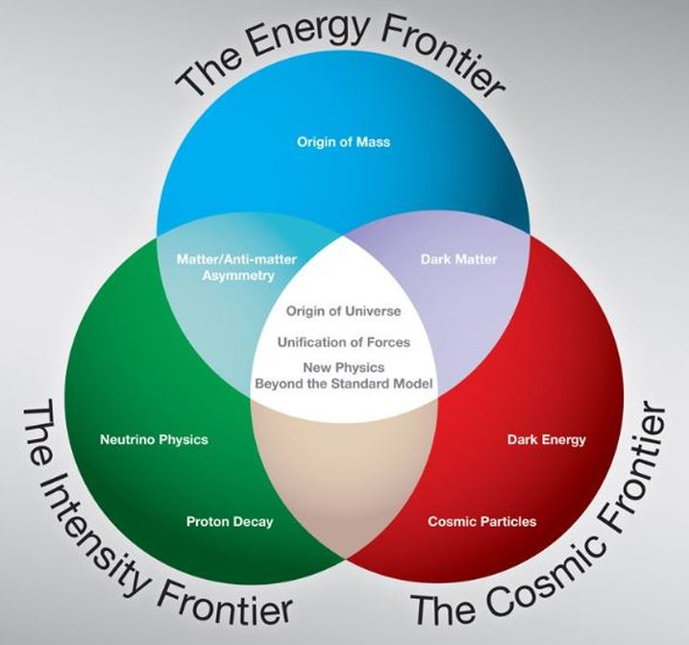
Why we do need High Intensity & High Energy Particle Accelerators?
Curiosity Driven Fundamental Science Research
Energy Frontier Colliders:
In pp collider, available
Center of Mass Energy=$2E_{p}$
At $E_{p}$=100 GeV available Energy =200 GeV
Intensity Frontier
Fixed Target Experiments:
Target
If Target is Hydrogen then available
Center of Mass Energy= $\sqrt{2E_{p}m_{p}}$
At $E_{p}$=100 GeV available Energy ≈ 14.1GeV

Slide 3
The Types of Accelerators for High Energy Physics Research
Linear Accelerators
Circular Accelerators
Combo
Most of the modern High Energy Physics Accelerators belong to the last category

Slide 4
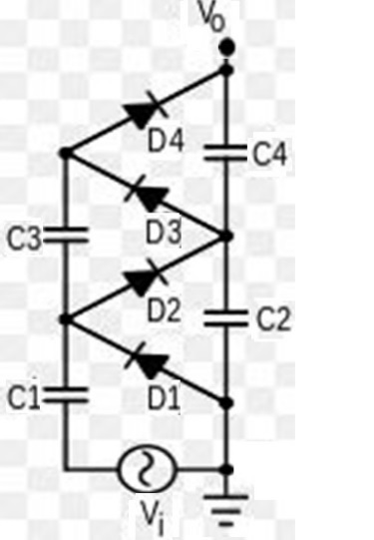
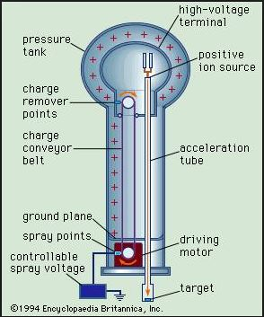
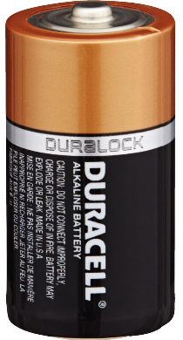
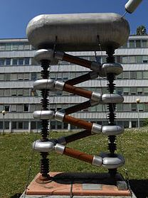
Concepts of Linear Accelerators
Two Conducting Parallel Plates
Cockcroft-Walton
Van de Graaff
4V_{peak}
A Charged particle Gains an additional Energy of ≈1.5 eV
This is the Principle of Electro-Static Accelerators
Examples: Cockcroft-Walton Accelerator,
Van de Graff (of BARC, Bombay)
Pelletron (IUAC(Delhi) and TIFR )
Used for Nuclear
Physics Research

Slide 5
Concepts of Linear Accelerators
RF Cavity
+V
RF Source of
Appropriate Frequency
-V

Slide 6
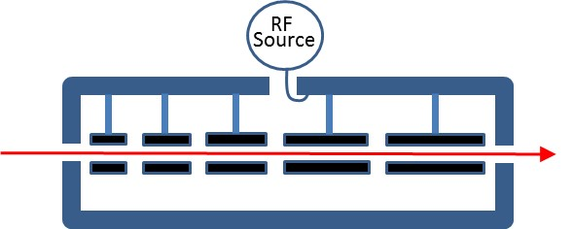
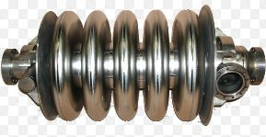
Concepts of Linear Accelerators
RF Cavity
Drift Tube
+V
-V
This idea led to
Alvarez Drift Tube LINAC
Superconducting Niobium RF Cavity
RF Source
Beam

Slide 7
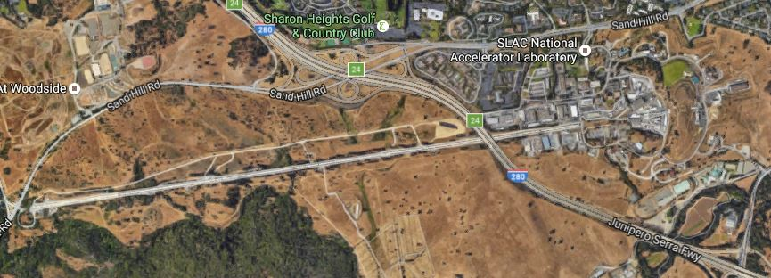
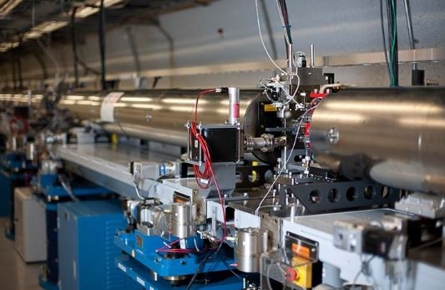
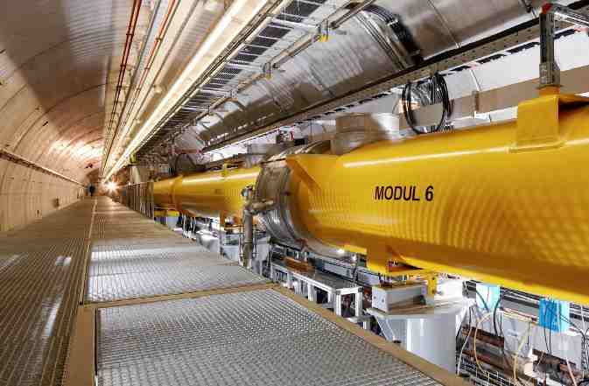
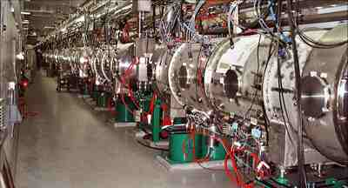
Examples of Linear Accelerators
SLAC(length=3.2km)
50 GeV ee+ collider
SNS: Front-end of 1 GeV LINAC
DESY 1.5 GeV
Free-electron Laser

Slide 8
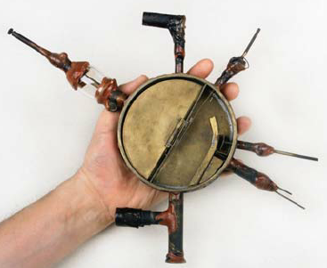
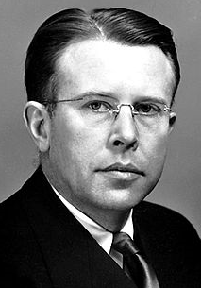
Concepts Circular Accelerators
Cyclotron (1929)
E. Lawrence
Viewed from the Top
Charged Particles
Side View
Ds
N
Vacuum
(~1μTorr
S
RF
RF
Examples: Cyclotron, Panjab University
VECC in Kolkota & 14 Others for
Medical Applications, in India

Slide 9
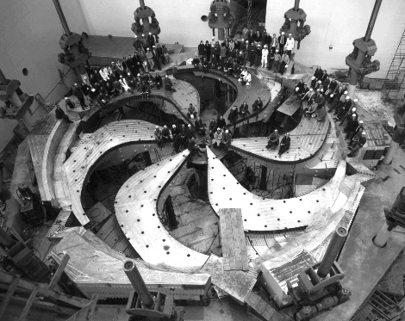
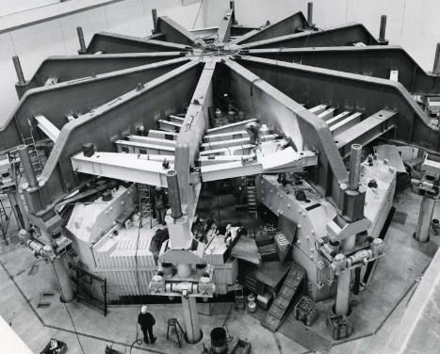
Beyond Cyclotrons
As the speed of the particles approach speed of light the path length will not change in proportion to the gain in momentum. So, the conventional cyclotrons have limited scope for higher energy. Maximum energy one can achieve is about 30 MeV/nucleon
Sector Focused Cyclotrons
World’s Highest Energy Cyclotron at TRIUMF operates at 520 MeV

Slide 10
Synchrotrons, Circular Accelerators for Relativistic Particles
Examples: 2.5 GeV Synch Light
Source, RRCAT,
Indore
Beam
Envelope
Dipoles
Beam Injection Line
Vacuum
Beam-pipe
F O D O
Cell
Principle of Synchrotrons:
RF Phase Focusing
RF
Source
Beam
Extraction Line
Focusing &
Defocusing
Quadrupoles
RF
Cavity

Slide 11
Importance of RF system in Synchrotrons
Coasting Beam with Energy E₀±ΔE
Bunch Compression
Closed Orbit
Beam Acceleration
Beam
Storage Ring
Beam Pipe &
the Beam
Ω
Ω
Bunched Beam
Phase-space Area of a Bunch is
Longitudinal Emittance
Measured in eVs
RF Cavity
Buckets of higher harmonic RF system
RF
Buckets
AC
RF Buckets
AC
Accelerating RF Buckets
and
Accelerating Beam Bunches
Sinusoidal
AC
Sinusoidal
AC
Vrf
RF Bucket
Boundary
Sinusoidal
Sinusoidal
Vrf
Vrf
Vrf
Vrf
ΔE
ΔE
ΔE
t
ΔE
t
t
ΔΕ
Beam
t
t
ω_{rf}= hω_{rev}
harmonic number h=2
ω_{rf}= hω_{rev}
harmonic number h=2
t
ω_{rf}= hω_{rev}
harmonic number h=1
ω_{rf}= hω_{rev}
harmonic number h=2
Accel. /turn=ΔE_{Acc}=V₀sin ϕ
Vrf
A contour of
constant Hamiltonian
Synchronous Particle
WCM Data
WCM Data
WCM Data
WCM Data

Slide 12
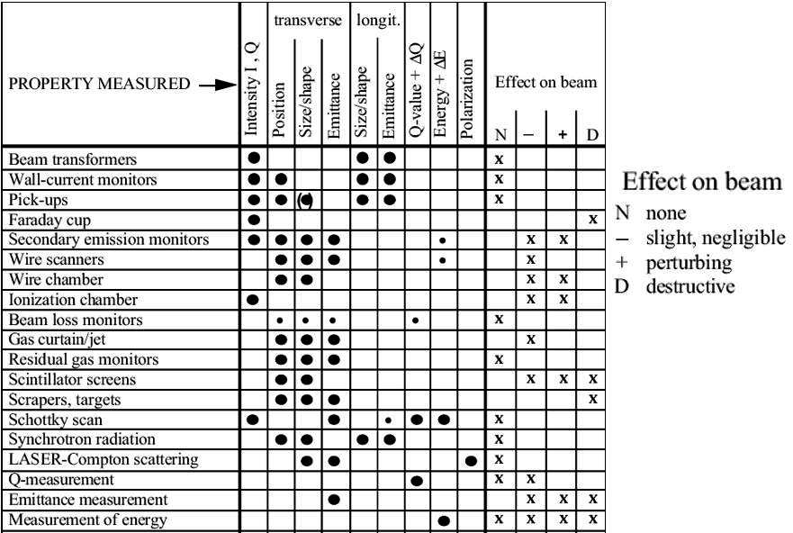
What Else are Needed? Beam Diagnostics are key Tools

Slide 13
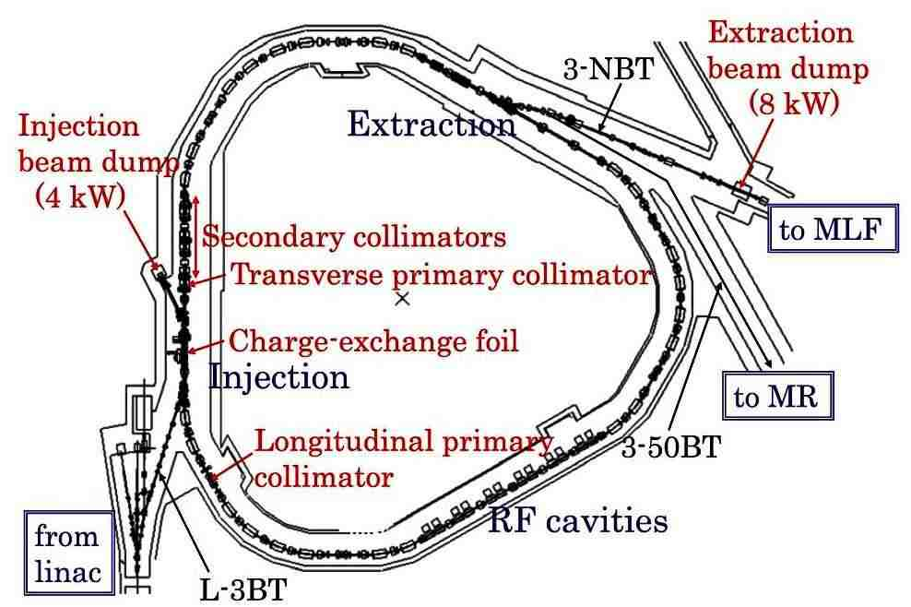
An example of 3GeV RCS JPARC (Japan)
Material & Life
Science
Experimental
Facility
Main Ring
H⁻ from LINAC

Slide 14
Intensity Frontier LaBs

Slide 15
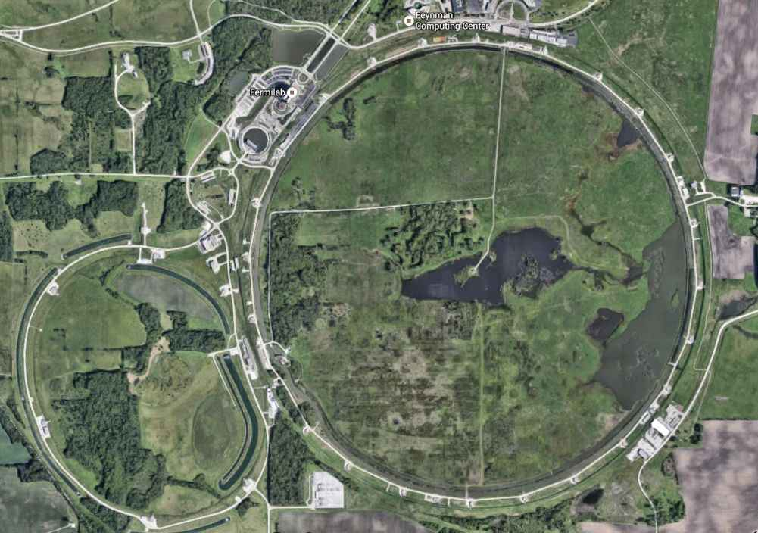
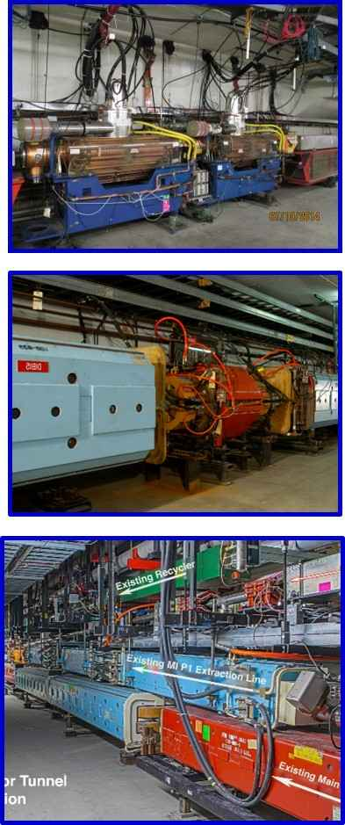
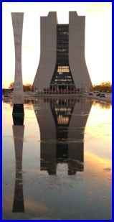
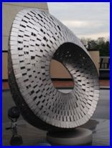
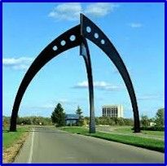
Fermilab, World’s Intensity Frontier Lab
NuMI:
MINOS+
MINERvA
NOvA
LINAC
MIPP
Test Beam
SeaQuest
M-Center
Booster:
0.4-8 GeV Accelerator
Muon:
g-2
Mu2e
MicroBooNE
Aerial
view of Fermilab
Site
Booster
LBNF
Debuncher/
(Muon-ring)
Recycler
&
Main Injector
Debuncher/
Muon-Ring
Recycler
Accelerators
are 4m-8m deep
underground!
Tevatron
Main Injector:
8 -120 GeV Accelerator

Slide 16
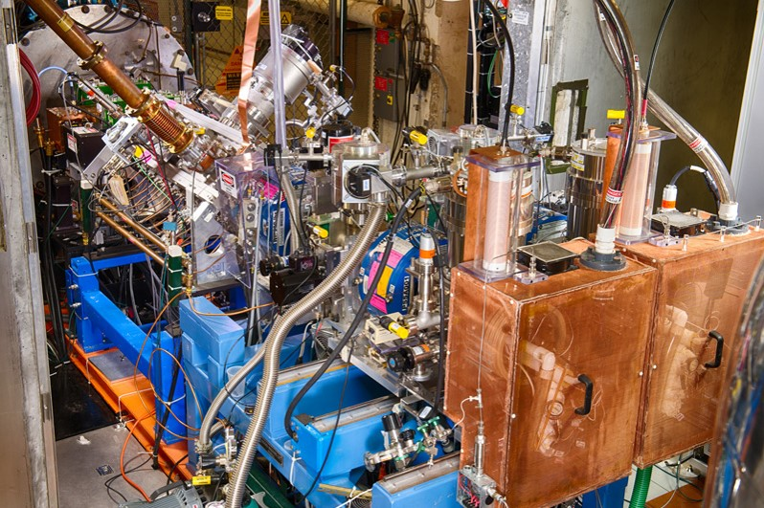
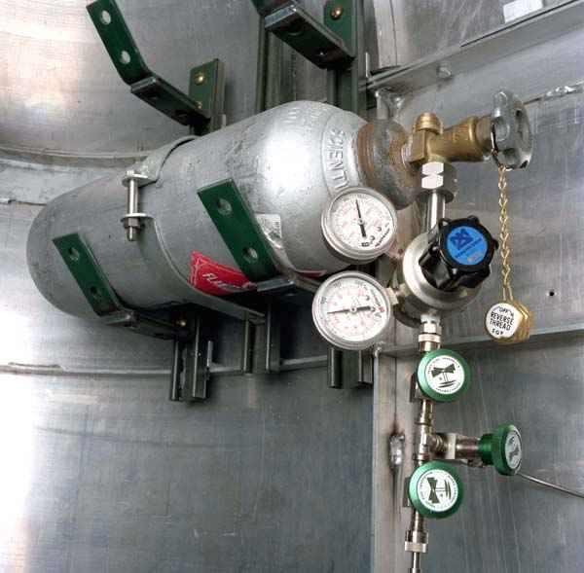
Protons Start from a Hydrogen Bottle
This idea led to

Slide 17
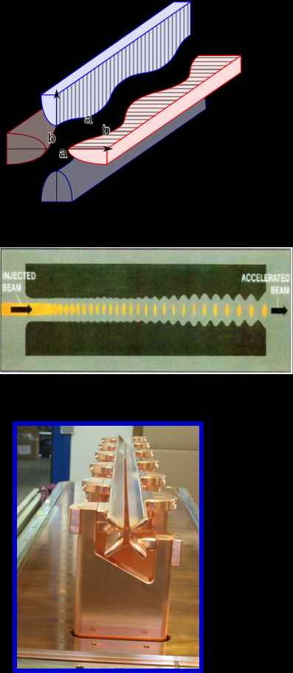
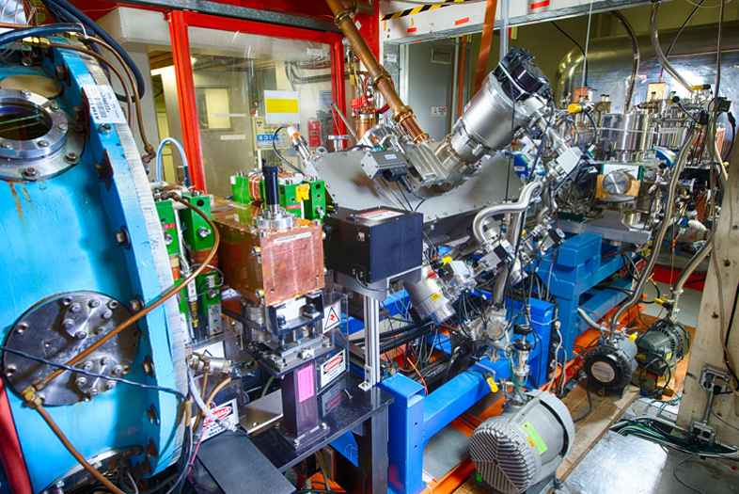
Radio-Frequency Quadrupoles (RFQ)
It is a very interesting device invented by
I.M. Kapchinsky and V.A. Tepliakov in 1970.
Schematic of RFQ
RFQ at Fermilab
Fermilab pre-accelerator Region
Drift-tube LINAC

Slide 18
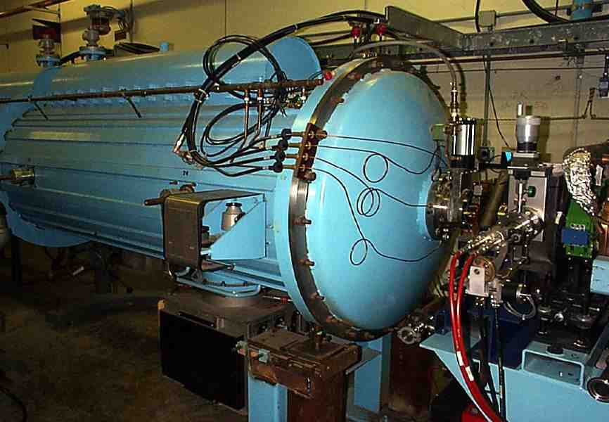
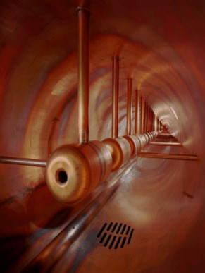
Drift-Tube LINAC 750KeV to 116 MeV
RF
Source
Beam
Alvarez Drift Tube LINAC
TM₀₁₀
Inside this tank

Slide 19
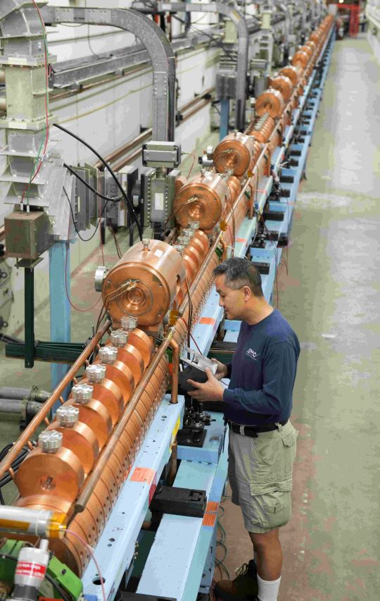
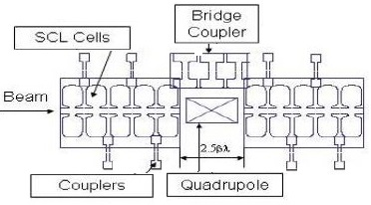
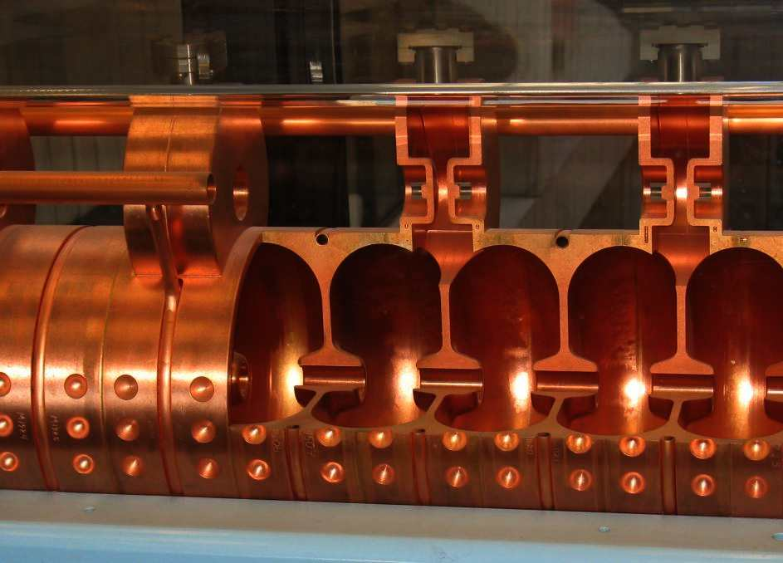
Side-Coupled Linear Accelerator for 116 MeV to 400 MeV
Schematic of Side Coupled RF structure
Coupling
Cells
Each one of cavities are hand-tuned

Slide 20
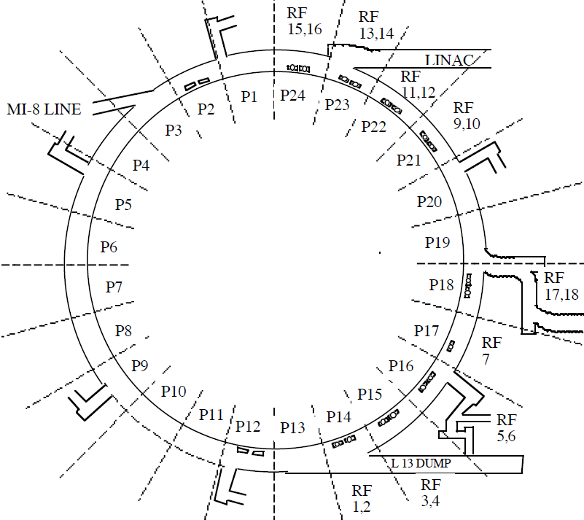
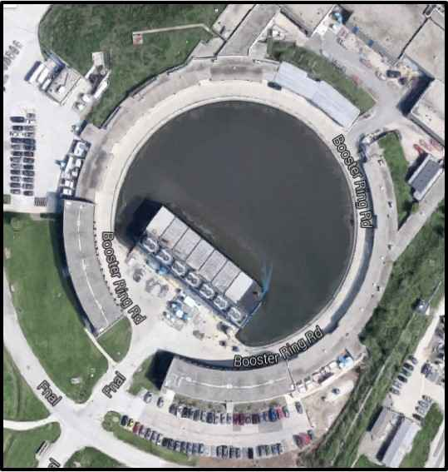
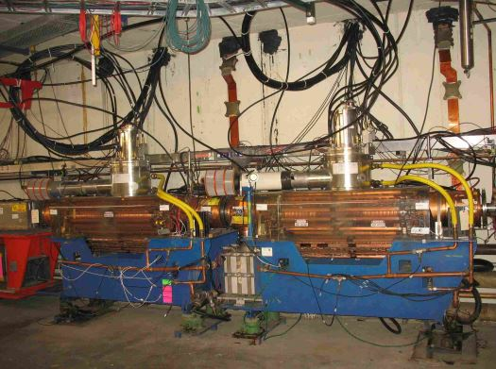
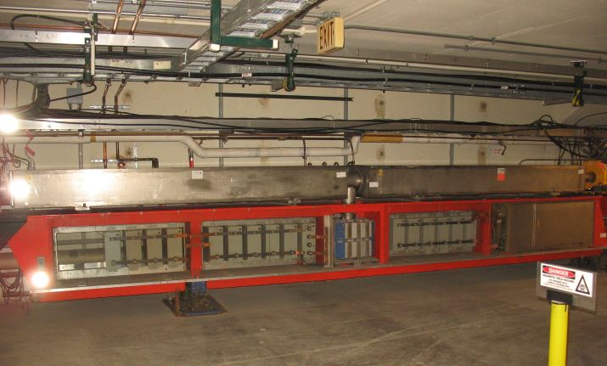
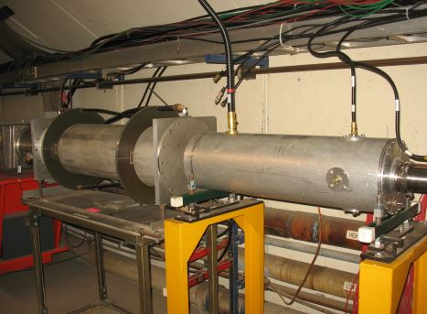
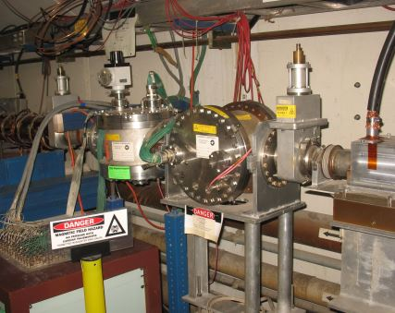
Fermilab Booster 15Hz RCS Synchrotron
400 MeV
H⁻ Injection
with 200 MHz
RF structure
8 GeV Extraction 53MHz RF structure
Two of 20 RF Cavities
Frequency Swing: 37 MHz-53 MHz
Built as an injector to the Fermilab Main Ring with 1-2E12p/cycle
Two of 96 Dipole
magnets
R = 75 meters
Cycle Time = 1/15 sec
96 Combined Function Dipoles
Bend Magnets/cell = 4
Cell type: FOFDOOD (DOODFOF)
Harmonic number h=84
Transverse Tune ν_{X}= ν_{Y}≈ 6.7
Dampers to control Beam
Beam Diagnostic Device- IPM

Slide 21
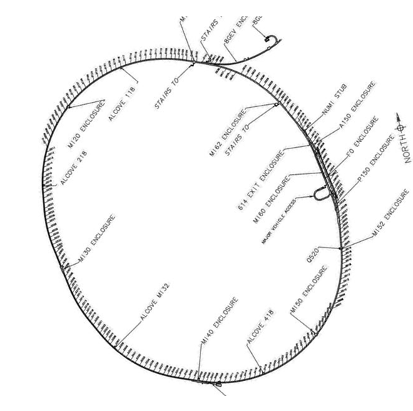
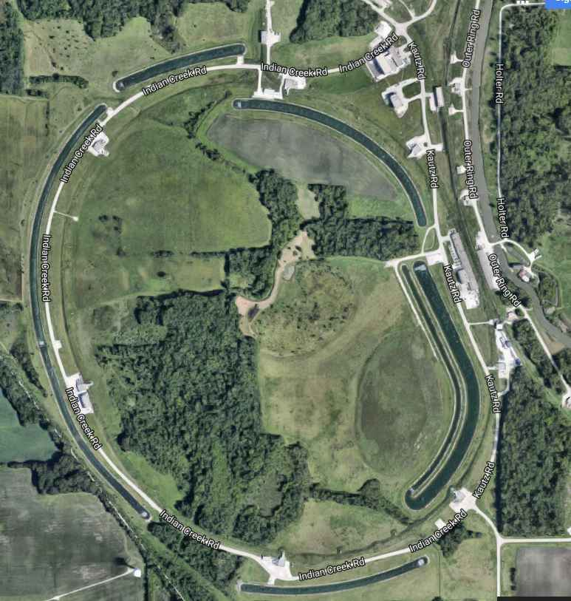
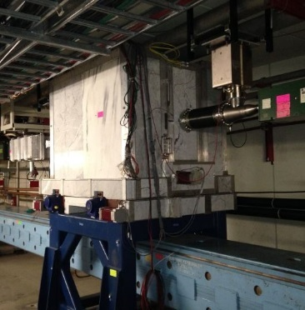
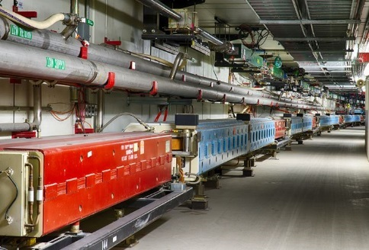
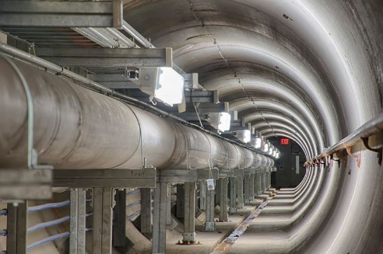
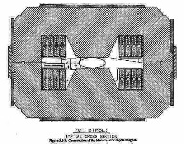
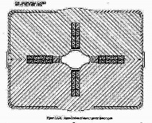
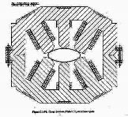
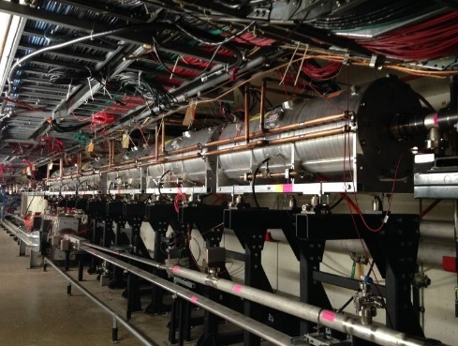
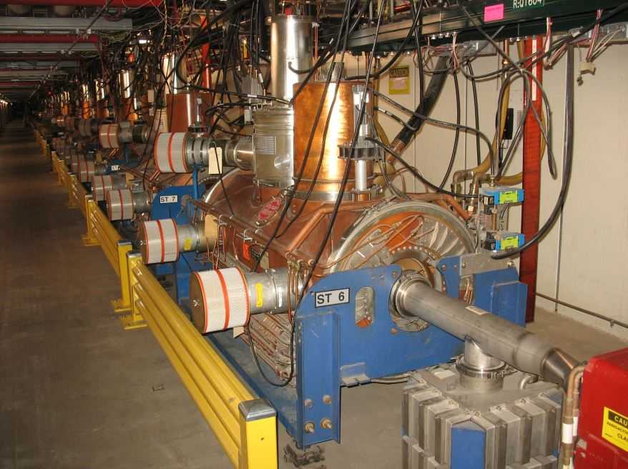
8 GeV Recycler (Beam Stacker) 8-120GeV (150 GeV) Main Injector
← LBNF (Future)
Micro-BooNe
RR-collimator
NuMI
Switch Yard
g-2 & Mu2e
MI/RR Tunnel
Main Injector Ring
Circumference=3300 m
Beam Delivery Rate =1pulse/1.3sec
Number of p/pulse=4.7E13@120GeV
Harmonic Number= 588
# of Dipoles=507 (L=240”-120”)
# of Quadrupoles=266 (L=116-17”)
# of Sextupoles= 108 (L=18”)
Transverse Tune ν_{X}≈26.425 ν_{Y}≈ 25.415
Beam Power Target=700kW
NuMI Beam line
Aerial view of the Main Injector
Dipoles
Quad
Sextupole
RR RF Cavities for g-2
Recycler Ring
20 Accelerating MI-RFs
Beam Abort

Slide 22
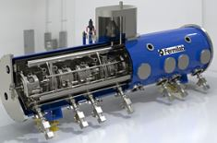
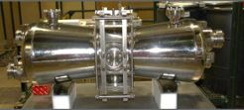
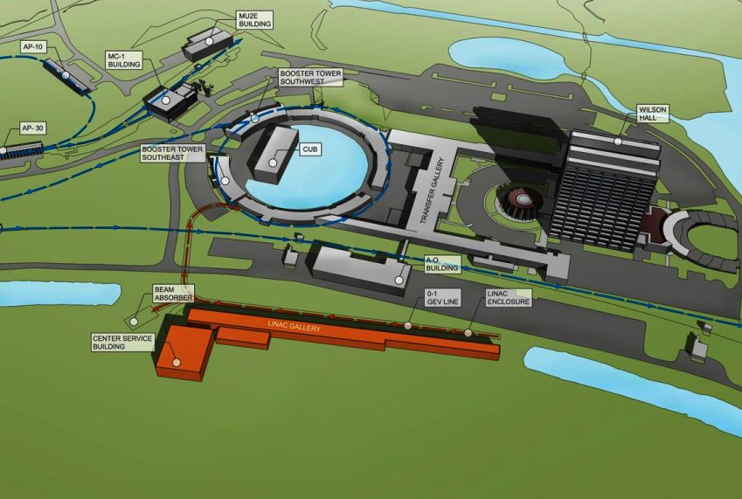
PIP-II, MW Beam Power
β=0.9
β=0.61
β=0.51
β=0.22
β=0.11
MEBT
RFQ
LEBT
IS
Superconducting
Room Temp.
US & India
Collaboration
650MHz, 117-800MeV
325MHz, 11-117MeV
162.5MHz, 0.3-11MeV

Slide 23
Status of Intensity Frontier HEP Accelerators
Fermilab (US):
Design Goal without PIP: 700kW beam power on target
Current Status: Demonstrated 700 kW on Neutrino production target (possibly we may go up by ~30%)
PIP-II: We are in the design stage of PIP-II, which will provide MW type of beam to the ν-Targets and many fixed target precision measurement experiments.

Slide 24
R&D to Increase Beam Intensity
New Synchrotron Concept (FNAL)
FAST/IOTA
PXIE
Photo-Cathode
Booster Cavity
1st Cryomodule tests complete

Slide 25
J-PARC Accelerator Facility
Built using more recent Accelerator Technology
3GeV Synch: 1010kW
50GeV (30GeV) Synch: Beam on ν-target 420kW
Michikazu Kinsho Nov. 2015

Slide 26
Energy Frontier LaB

Slide 27
World’s
Energy Frontier Lab
CERN World’s
Energy Frontier Lab
France
Switzerland
Lake Geneva
CMS (IP5)
Crossing in
H-plane
Jura Mountain
Fermilab Tevatron
was Energy Frontier
Accelerator from
1985-2011
LHC Ring
These Accelerators
are 5m-175m deep
underground!
P4: 400MHz
RF system
LHC-B
RF: 200 &
800MHz
SPS
ATLAS(IP1)
ALICE
Crossing in
V-plane
PS
RF: 2.8-10, 20, 40,
80 and 160MHz

Slide 28
CERN Accelerators
LHC (Lum. upgrade) I worked on these
SPS (single bn. Instability) accelerators
PS (bn. Int. & e-cloud) during my sabbatical
at CERN
from 2010-2013
450-7000 GeV
450 GeV
2808 bpc
LHC 7 TeV
SPS 450 GeV
PS 26 GeV
PSB 1.4 GeV
LINAC-2 50 MeV
450 GeV
288 bpc
36,48,72 bpc
26 GeV
1 bn/ring, 4bn
50 MeV
28

Slide 29
LHC PP/Heavy Ion collider (Schematic) Two beams
45
56
LHC SC Dipoles magnets (1232)
34
67
LHC SC Quad
23
78
12
81

Slide 30
The Large Hadron Collider
A scientific & technological marvel!
~ 27 km circumference
>10,000 Magnets
Largest cryogenic system in the world
SC Magnets cooled by superfluid helium to 1.9ºK (523ºF below RT)
Total beam power at 7TeV: 362MJ/beam

Slide 31
LHC from 2008-10 – Bright Startup
2008: Accelerator complete. Ring cold and under vacuum.
Sept. 10th 2008 by 14:59 hr
First beam around the ring
Some times things will not go smoothly
Sept. 19th 2008 around noon: A DISASTER STRUCK while attempting 3-4 to 5.5TeV
2008–2009: 14 months of major repairs
LHC back on track by early 2010
However, uncertainties existed about the splice quality through out the 2010-2013 runs
Because of this Risk
Decision: Limit the beam energy =4 TeV
“This is HISTORY & we learned a lot”
Public display of the
Dipole magnet
SC splices at the joints
Complex connections
between two dipoles
~4km of the LHC Ring was badly damaged
2012: Discovery of Higgs Boson

Slide 32
Current Status and HL-LHC
From 2013-2014 major repair to fix the problems
Since 2015, LHC is running at CM energy of 13TeV
Goal for HL-LHC(2018 and beyond): ☹_{total} =3000fb⁻¹
Lots of effort is going on; New high field magnets are being built
Crab-cavity- a special types of RF cavities to use at interaction points are being built.
Many more.
Instantaneous Luminosity
in units of (/cm²/sec)
Goal: By the End of 2017
provide ☹_{total} =100-200fb⁻¹

Slide 33
LHC (and HL-LHC) Schedule
Run 1
Run 2
Run 3
Run 4
7-8 TeV
13-14 TeV
<PU>≅ 140
<PU>≅ 60
<PU>≅ 40
<PU>≅ 21
25ns
bunch spacing
HL-LHC
Run 2: pp @ 13 TeV, 25 ns bunch spacing
Peak Luminosity goal ~ 1.3 x 10³⁴ cm⁻²s⁻¹
Integrated Luminosity goal ~100 -120 fb⁻¹
Run 2+3: 300 fb⁻¹
2015 Goal: ~10 fb⁻¹

Slide 34
Issues and Operational Complexity in High Energy Accelerators
Transition crossing in synchrotrons
When a beam propagates in an accelerator, it interacts with both the external fields and the self-generated electromagnetic fields which induce Beam Instabilities
Space Charge Effect ← Self Induced fields
Microwave instability: transverse and longitudinal microwave instability
Single bunch instability, multi-bunch instability
Beamloading ← RF cavity impedances
Coherent Synchrotron Radiation (CSR) instability
Electron Cloud effects
So on …
Initial Dist.
Final Dist.
Quadrupole mode
Stable Unstable
Wake field
Longitudinal Profiles

Slide 35
Buildup of Electron Cloud at the LHC & consequences
The critical energy of the photons at
7 TeV ~ 44 eV
Primary Source of electrons in the LHC
At Injection (450 MeV) gas ionization
At 7 TeV Synchrotron Radiation
Possible consequences:
- instabilities, emittance growth, desorption ←bad vacuum
- excessive energy deposition in the cold sectors
Evolution of e-cloud
Mitigation:
Scrubbing,
2) Coating with low SEM materials,
3) Shape inner surface of beam pipe
e-cloud induced
beam instability

Slide 36
CERN, Then and Now

Slide 37
I should not give up
How wonderful will
it be to go to A

Slide 38
Dream Machine: International Linear Collider
ILC or International Linear Collider is an e⁺e⁻ linear collider with the following main parameters
Center of mass energy ~500 GeV
Luminosity >10³⁴ cm⁻²s⁻¹
No synchrotron radiation, but long tunnel to accelerate to ~250 GeV/beam
Excellent Higgs factory with many Higgs production and decay channels accessible

Slide 39
Dream Machines: VLHC/VLEP, 100TeV collider
Pushpa Bhat
SC Magnet Research is going on at Fermilab/CERN
SCRF Research is going on at Fermilab, CERN and elsewhere
http://arxiv.org/pdf/1306.2369v1.pdf

Slide 40
Dream Machine: FCC, 100TeV collider
80-100 km tunnel infrastructure in Geneva area
design driven by pp-collider requirements
with possibility of e+-e- (TLEP) and p-e (VLHeC)
CERN-hosted study performed in international collaboration
15 T ⇒ 100 TeV in 100 km
20 T ⇒ 100 TeV in 80 km
Frank Zimmermann

Slide 41
Dream Machines: Muon Factory and Muon Collider
High
Intensity
Proton
Accelerator
High
Intensity
Proton
Accelerator

Slide 42
Dream Big!
If you can dream it you can do it
–Walt Disney

Slide 43
Backup Slides

Slide 44
Muon-Collider

Slide 45
(Future) Long Baseline Neutrino Facility
The next MegaScience International project at Fermilab
40 kT LAr detector at Sanford Lab, Multi-MW beam from Fermilab

Slide 46
Luminosity Formula for a Collider
Instantaneous Luminosity
# of protons/bunch
for Beam-1 & Beam-2
Beam Revolution Frequency
Transverse Beam sizes
For Beam-1 & Beam-2
Correction term
# of Bunches/beam
Relativistic Factor
Beam Transverse
Emittance
β* @ interaction point
(Lattice parameter)

Slide 47
Luminosity
Luminosity relates the cross-section σ_{p} and event rate
For Fixed Target case depends on
Flux of Incident beam
# of target nuclei/unit area
Goal of the Accelerator is to maximize the Event Rate
L
y
v₂=β₂c
L
L_{fix-Tgt}= Φ ρ_{T} l →
s
v₁=β₁c
x
In the case of the Collider
the target is also moving. Assuming bunched beam, the L per bunch crossing is,
Time variable
N₁ and N₂ ← number of particles /bunch
Kinematic factor

Slide 48
Collider Luminosity
Assume
Head-on collision with magnitudes of velocities |v₁|=|v₂|
Densities in all coordinates are uncorrelated:
ρ(x,y,s,s0)= ρ_{x}(x)*ρ_{y} (y)* ρ_{s}(s±s₀) ; x≡ Horizontal, y≡ Vertical
Density distribution function is Gaussian in each coordinate
Transverse size: σ_{1x}# σ_{2x} and σ_{1y}# σ_{2y}, but bunch length σ_{1s}= σ_{2s}
Then
σ ²_{x,y} =ε_{x,y} β*_{x,y}
; β*_{x,y} : Lattice beta-functions at interaction points &
ε_{x,y} : Transverse Emittance of the beam
As the # of bunches increase the cross talk between in-coming and out-going bunches (beam-beam interactions) becomes an issue.
Solution: Crossing angle

Slide 49
Collider Luminosity with Crossing Angle & other corrections; the case of LHC
x
θ= θ_{C}
Beam 1
Beam 2
Instantaneous Luminosity with other Corrections:
W → Beam offset
S → Crossing angle
→ Crossing angle and beam offset
H → Hour-glass factor from bunch length
Luminosity per Crossing
For the LHC
(n_{b})_{Max}= 2808 @25 ns bunch spacing,
N₁=N₂=1.15E11ppb, fo= 11.24kHz, β*_{x}= β*_{y}=0.55m,
θc=285μr, σ*_{x}= σ*_{y}=16.6μm, σ_{s}=7.5cm
L_{Head-on} =1.2x10³⁴cm⁻²s⁻¹
L_{S} =1.01x10³⁴cm⁻²s⁻¹
L_{S&H} =1.00x10³⁴cm⁻²s⁻¹
If N=N₁=N₂ L ∝ N² and linearly with n_{b} .
L also depends on beam filling pattern

