Slide 1
Y567B PA test at 76 MHz
Robyn madrak
Booster 2nd Harmonic Cavity Meeting
19 Jan 2017

Slide 2
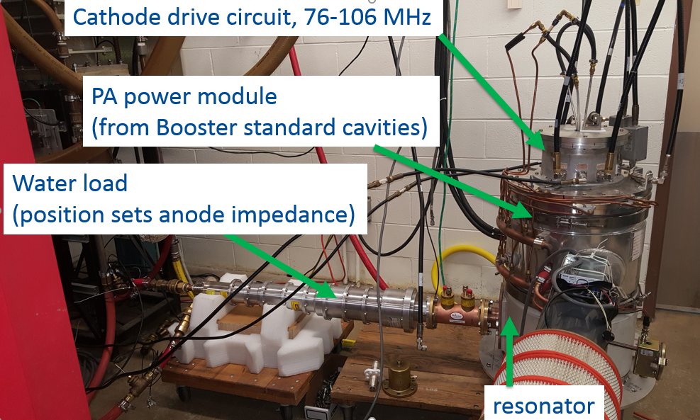
PA test at 76 MHz
Previously, had tested PA at ~71.9 MHz (anode resonator frequency)
To test at 76 MHz, added a ring to increase the frequency, and a modified jumper for the 50 ohm load connection, in order to get the optimal impedance

Slide 3
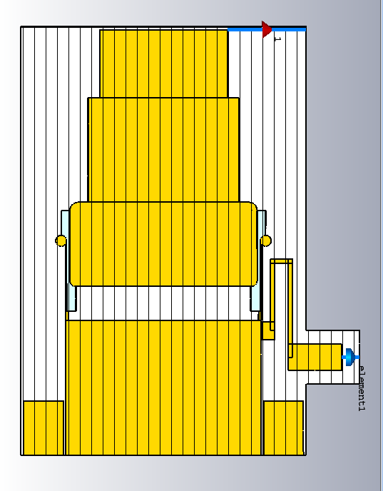
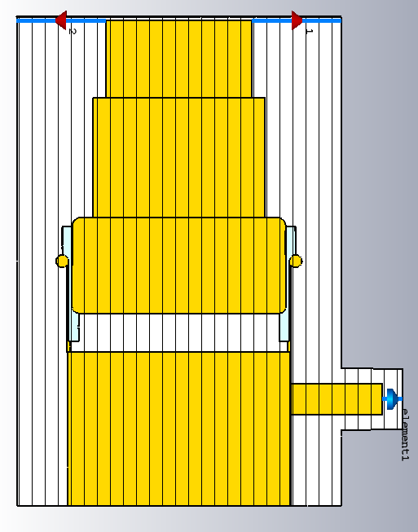
Original and Modified
tetrode
shroud
Blocking
Capacitor
(fruitbowl)
Anode
Resonator
Center conductor
ring
Position is adjustable, but not enough with ring to
get optimal impedance with straight tap, so tap has to loop around

Slide 4
Procedure
As was done last time, several data points were taken at varying DC anode voltages
The drive power from the Tomco (new this time) was set to that which produced 300 mA screen current
The duty cycle was 50% which ~40 ms wide pulses
Measured quantities: Anode DC voltage and current, output (load) power, dissipated anode power, cathode and anode response, forward and reflected drive power, reflected drive power at cathode

Slide 5
Output power and anode power

Slide 6
Drive power
Reflected power is low since drive and cathode resonator are well matched at 76 MHz

Slide 7
Plans
A new cathode resonator has been designed which should be a better compromise for matching at both 76 and 106 MHz
Matt will start working on getting this made
We will want to test this (high power) at 76 and 106 MHz since the loading (and impedance) is different when the tube is on
The 106 MHz anode resonator is being fabricated
As of last week it was in the shop.
Next: welding
Back to shop
Out for plating
Matt’s best guess: on the order of two months

