Slide 1
PEEK cooling tubes. Shroud with fingers.
Gennady Romanov
2nd Harmonic cavity meeting
February 2, 2017

Slide 2
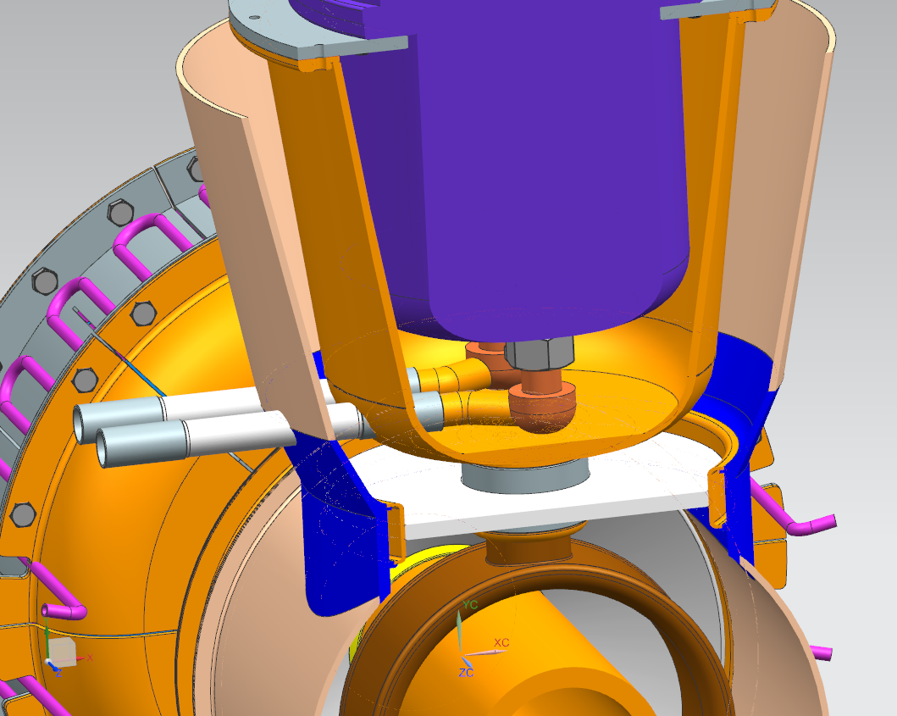
Kevin: PEEK Proposal
PEEK water tubes

Slide 3
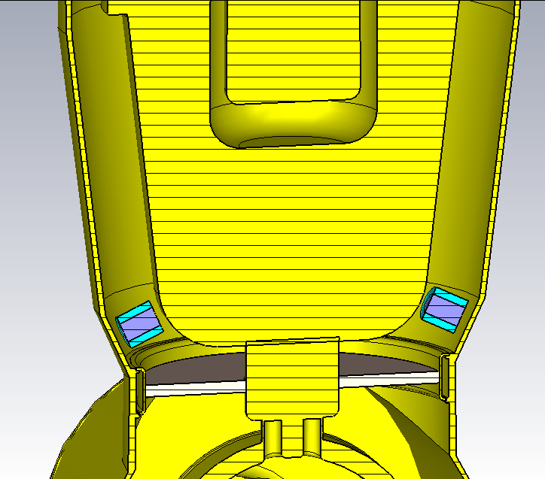
CST model of the tubes
Distilled water: ε=78.4, µ=1, tan δ = 0.005 (for 100 MHz and 25ºC).
PEEK material: ε=3.3, µ=1, tanδ = 0.003

Slide 4
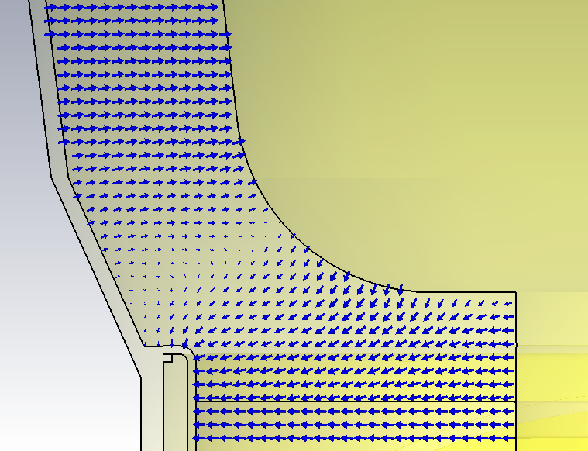
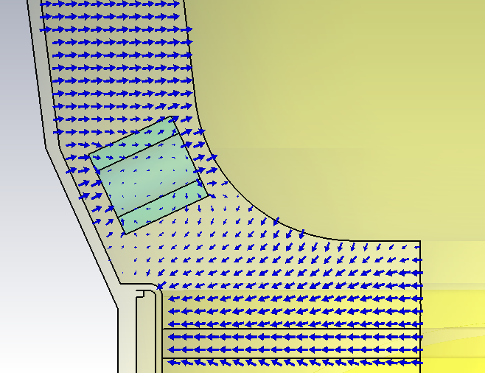
Fields
The electric field is very weak in the tube location.
The field component parallel to the tube dominates, so field enhancement on the ceramic and water boundaries is minimal
 |  | Thermal losses for V=100 kV and t = 3 ms, W
 | f, MHz | Copper | Alumina | Garnet | PEEK | Water
No tubes | 103.92 | 945 | 58 | 4369 | 0 | 0
Tubes | 103.92 | 945 | 60 | 4367 | 0.003 | 0.006
PEEK tubes look acceptable.
Loss tangent of distilled water must be confirmed.
NB For garnet it was tan δ =0.001 instead of 0.000206

Slide 5
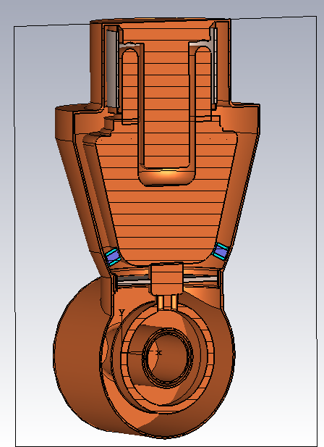
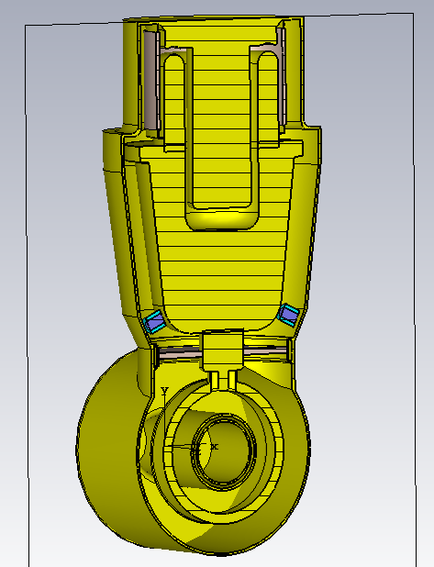
Kevin: New shroud shape to place finger contacts
Yellow – current CST shape
Proposed shape
Current CST shape
Tuning range is slightly smaller. Other parameters are not checked yet, but expected to be OK.
Concern: possible pressure on the ceramic window.

