Slide 1

Booster Vrf by f_{sy} Measurements at Injection Energy (400MeV-DC Mode) (data of 20161013)
Chandra Bhat
20170308
Synchrotron Oscillations
Goal:
Vrf by the measuring the small angle synchrotron frequency, f_{sy} of the beam in the rf bucket by imposing the Booster magnetic at 400 MeV.
or
frev = Revolution frequency of the beam
= 0.713, Relativistic velocity
Es = 1338 MeV (kE=400MeV)
η= -0.458
h = 84, Harmonic number
fsy = Measured synchrotron frequency
$$f_{sy}=f_{rev}\sqrt{\frac{V_{rf}h\left|η\right|}{2πβ^{2}E_{s}}}$$
$$V_{rf}={\left\{\frac{f_{sy}}{f_{rev}}\right\}}^{2}\frac{2πβ^{2}E_{s}}{h\left|η\right|}$$
±60⁰
60⁰

Slide 2
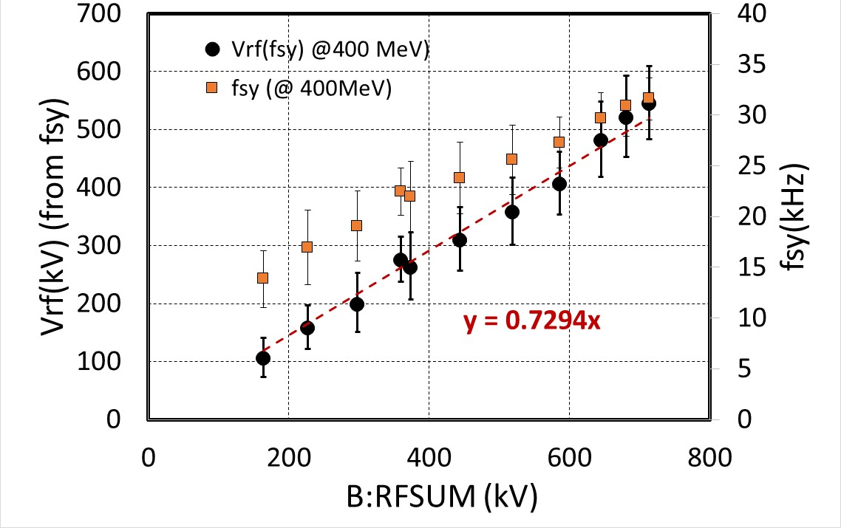
Vrf(fsy) from the Measurements on captured beam at 400 MeV (DC-mode) in the Booster
Vrf(kV)=0.73×B:RFSUM

Slide 3
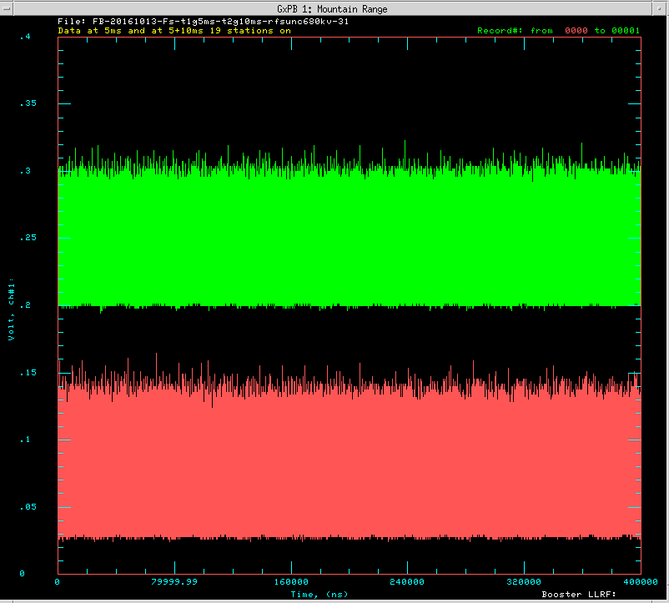
Measurement Technique
Inject low intensity 400 MeV beam (~1E12ppBc) while Booster is being operated in DC –mode (at 400 MeV).
Capture the beam in the 38MHz main rf system just like that in normal operation with different number of RF cavities ON.
Collect the WCM data for several synchrotron period at about 5 ms and at about 10 ms into the cycle.
400 μsec
Trace from 15-15.4ms
Trace from 5-5.4ms

Slide 4
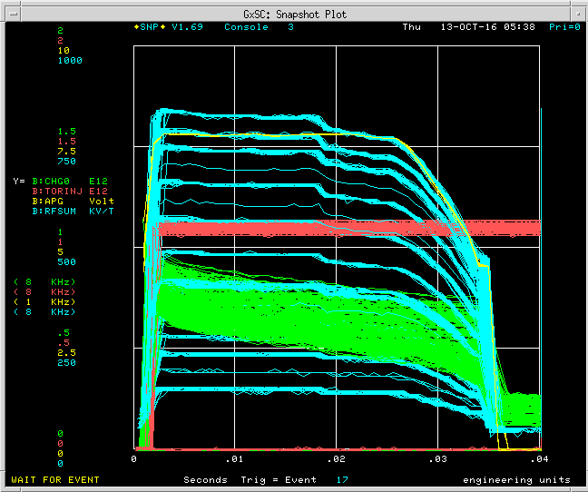
RF turn on sequence & WCM trigger times
Used Operational B:PARAT & ~1E12ppBc
5ms
15ms
+(10A,10B)
20
+(9A,9B)
18
19
+(8A,8B)
16
+(7A,7B)
14
+(6A,6B)
12
+(5A,5B)
10
+(4A,4B)
8
+(3A,3B)
6
(1A,1B)+(2A,2B)
4

Slide 5
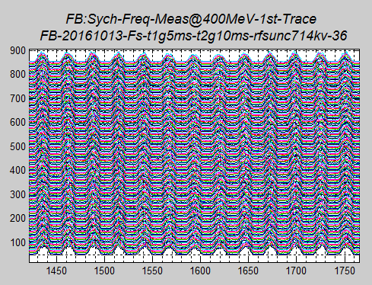
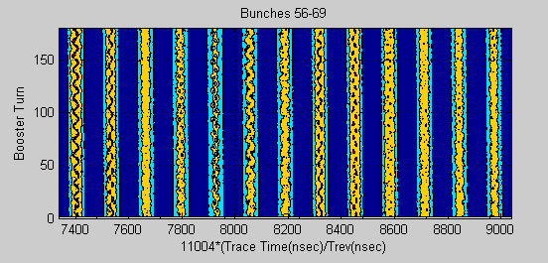
Typical MR of the data
Beam with almost uniform distribution
WCM
Beam with non-uniform distribution
WCM

Slide 6
Result from FFT on Raw Data
RF Frequency
Appears to be
Straight forward! &
Very simple Analysis!
Analysis for different data sets found to be ambiguous
?
?
?
?
Can not get
anything out of this???
Ambiguous???

Slide 7
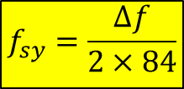
fft on a single bunch to look for synchrotron frequency
Also look for small angle oscillations for Vrf(fsy) measurements.
Number of Turns
0
Concatenated WCM data for bunch # 83
MR and Contour plot
for bunch # 83
Upper and Lower
synchrotron side bands
$$f_{sy}=\frac{∆f}{2×84}$$
Δf

Slide 8
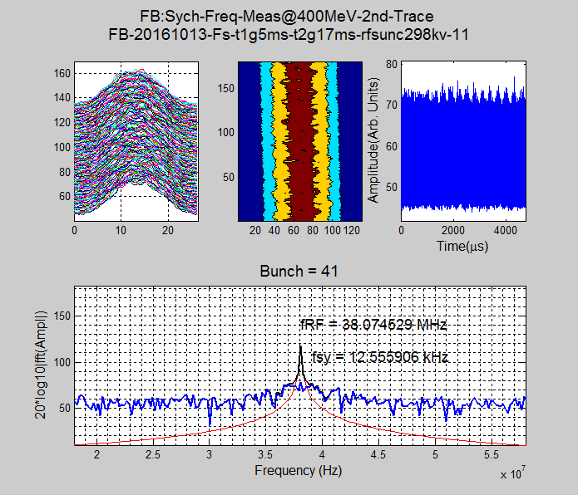
Outliers
Average of most of other bunches give <fsy> = 19.31 kHz

Slide 9
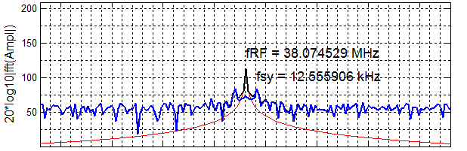
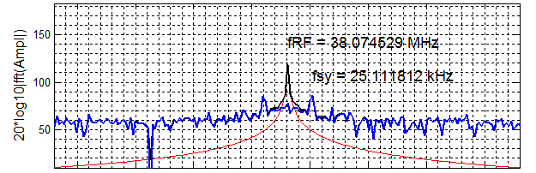
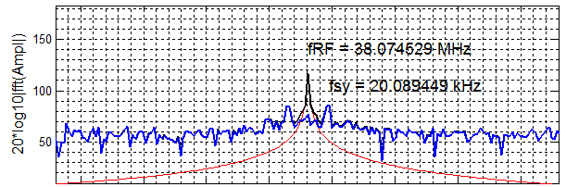
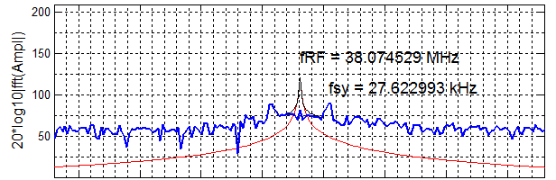
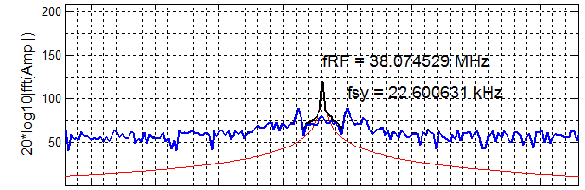
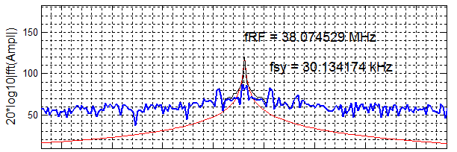
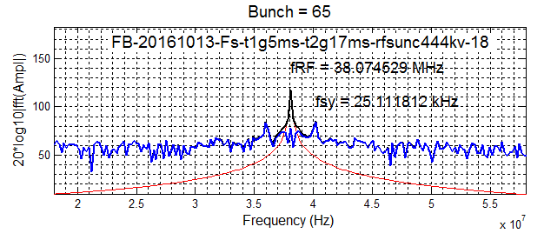
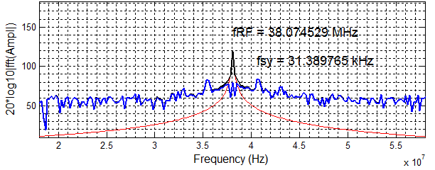
Illustrations of fft on single bunch
B:RFSUM=164kV
B:RFSUM=519kV
B:RFSUM=298kV
B:RFSUM=586kV
B:RFSUM=374kV
B:RFSUM=680kV
B:RFSUM=444kV
B:RFSUM=714kV

Slide 10
Vrf from fsy at 400 MeV in the Booster
Vrf(kV)=0.73×B:RFSUM

Slide 11
Error in the Measured fsy and Conclusions from the 400 MeV DC Data
fsy(Total Error)=
±3.5% (Systematic)
±9.3% (Statistical)_{Ave}
±3.5%
For example, with 20 RF cavities ON
B:RFSUM=714kV
VRF(fsy) = 544 kV+76 kV (+ve error only)
(620/714) ≈ 0.87
We have lower Vrf by about 13%
60⁰
Conclusions:
We find that Vrf(fsy) is at least 13%
smaller than Vrf (B:RFSUM). This might need further investigation.

Slide 12
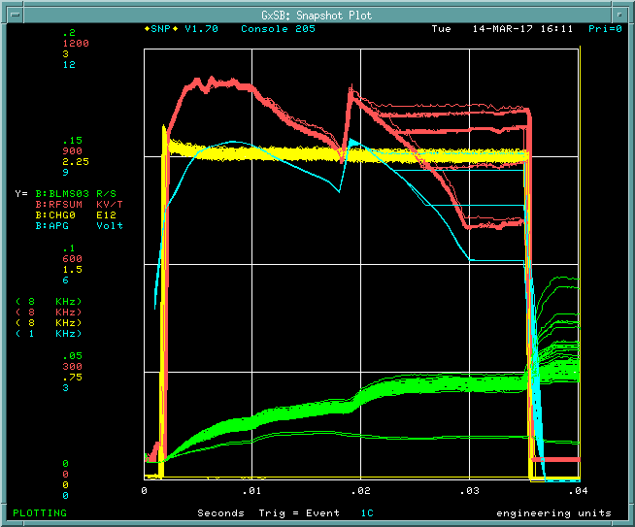
What Next?
Can we measure the Vrf(fsy) @8GeV in a Stationary Bucket?
B:RFSUM
B:APG

Slide 13
Backup

Slide 14
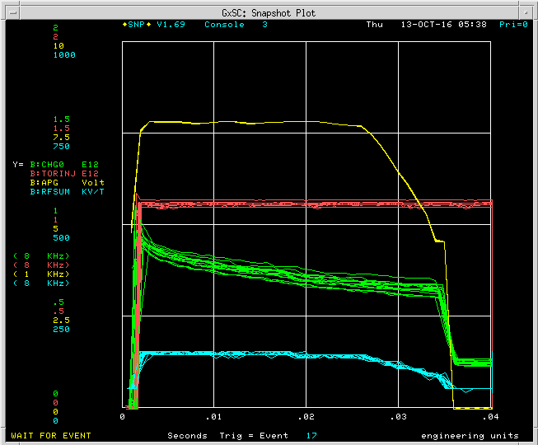
B:APGT Curve
Used Operational B:PARAT & 6BT Beam
(1A,1B)+(2A+2B)
B:APG

