Slide 1


Slide 2
The Sinuous Target
Robert Zwaska
LDRD-Fest
31 March 2017

Slide 3
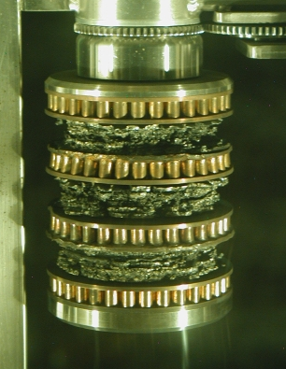
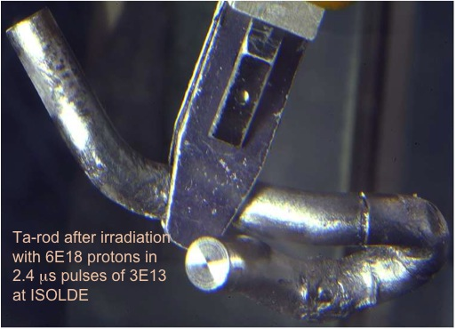
New Approaches for High-Power Targets
Many accelerator facilities world-wide are limited by the capabilities of their targets
  Compromised in physics performance are sometimes made
Future facilities will use higher powers and have higher demands for performance

Slide 4
Breaking a Target - Fundamentally
Non-uniform heating leads to stress in target
Axisymmetric case:
  Max compressive stress at center
  Max tensile stress near edge
Proportional to:
  Energy deposition
  Coefficient of thermal expansion
  Modulus of elasticity
Inversely proportional to:
  Specific heat
  Beam spot area

Slide 5
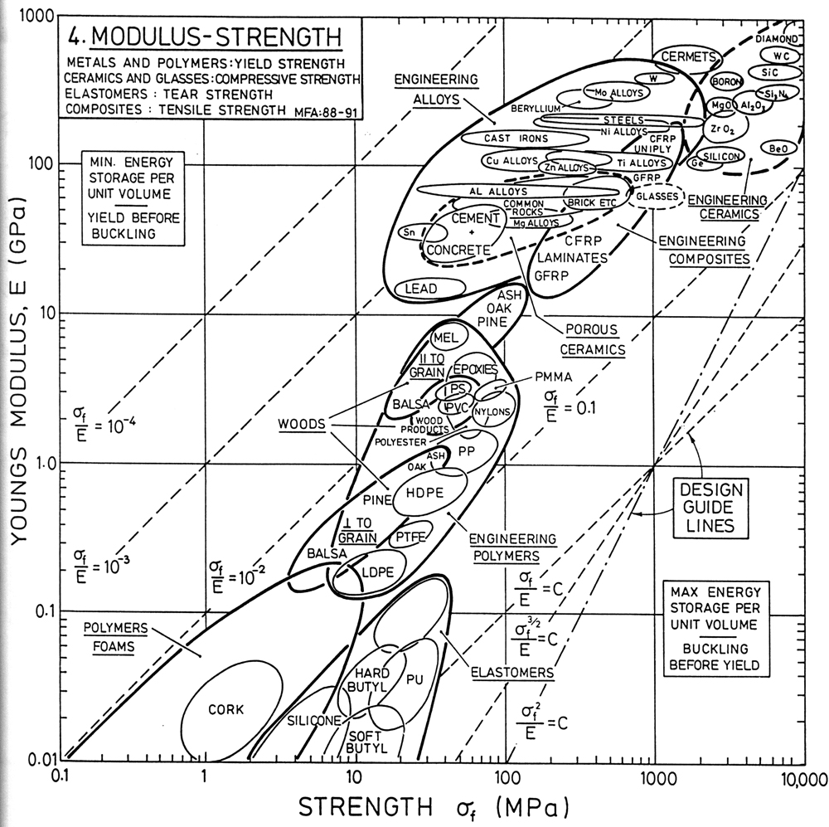
Strong Materials have High Elastic Modulus
We already use the best of available materials
  Stronger materials are stiffer, so there is little to be gained.
Can we engineer a material to have low elastic modulus, but have high strength?
  At least strong on the micro-scale? Overall strength is not generally important.
"Materials Selection in Mechanical Design" M.. Ashby

Slide 6
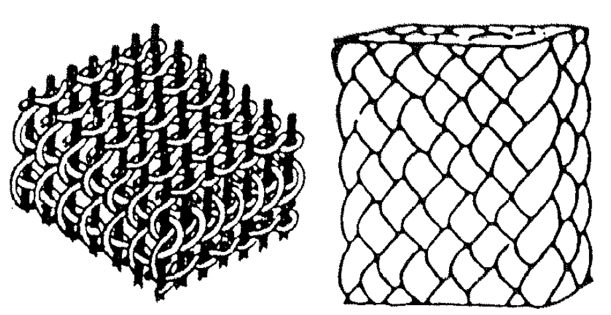
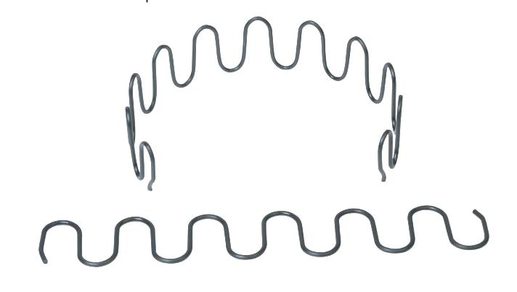
The Sinuous Target
  Engineer a target material that can sustain the high-beam powers we anticipate in the future
  Conceptual material is composed of an interlaced matrix of wires or strings of a high-strength material
  Project Scope:
    Produce a microstructure scheme
    Model thermo-mechanical response
    Fabricate scaled prototypes
    Test and compare to analogues
    Develop fabrication techniques

Slide 7
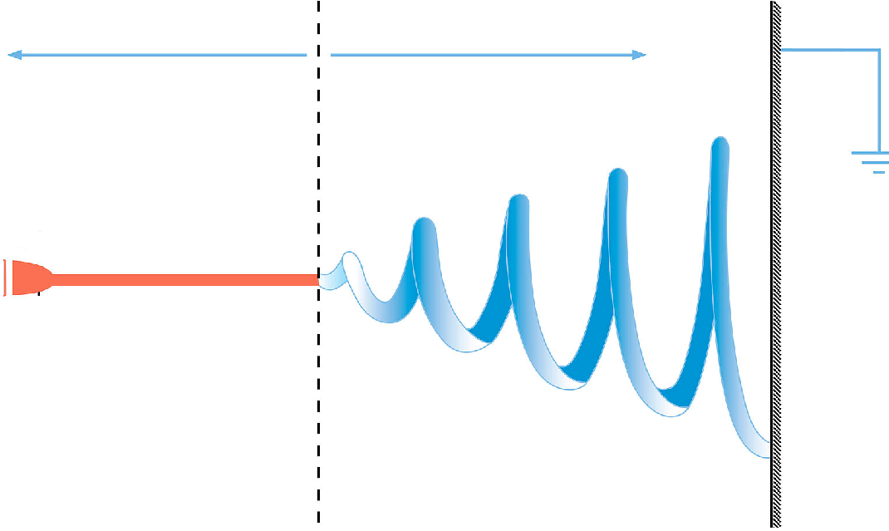
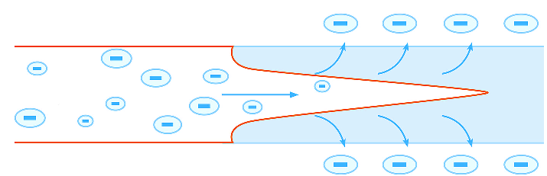
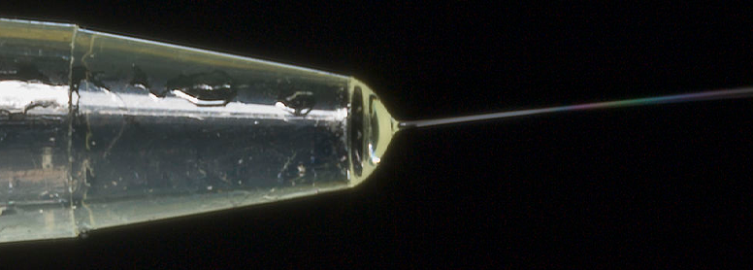
Electrospinning Fabrication Technique
Ohmic flow
Convective flow
Electrostatic repulsion > surface tension
Droplet is stretched
Jet elongated by whipping action
  (hosing instability)
Slow acceleration
Rapid acceleration
Flat needle
Collector plate
+/- KV
Transition liquid to solid
Taylor cone
Liquid
Solid
Flow direction

Slide 8
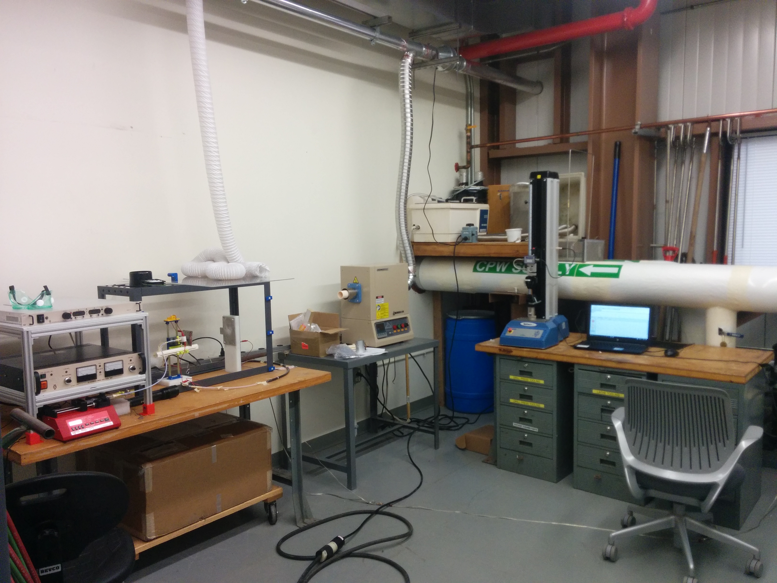
Electrospin Lab – MI-8 Cage area
Multi force tester
Furnace
E-spin set up

Slide 9

Electrospinning in Action

Slide 10
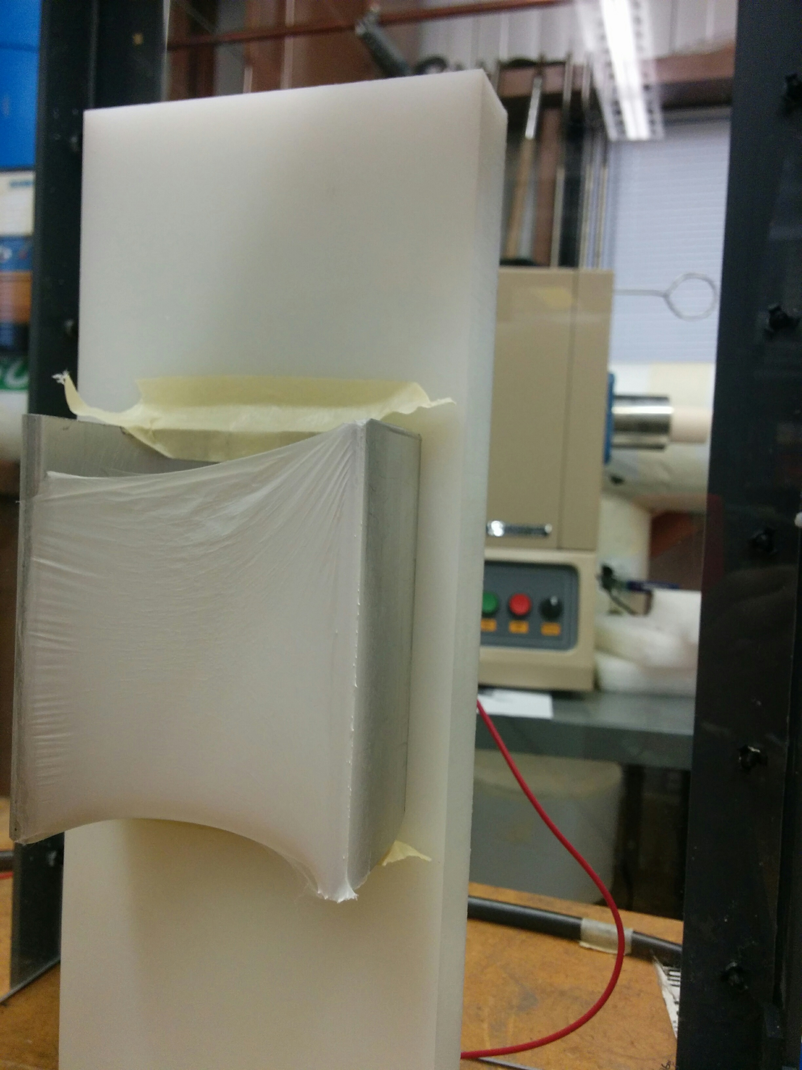
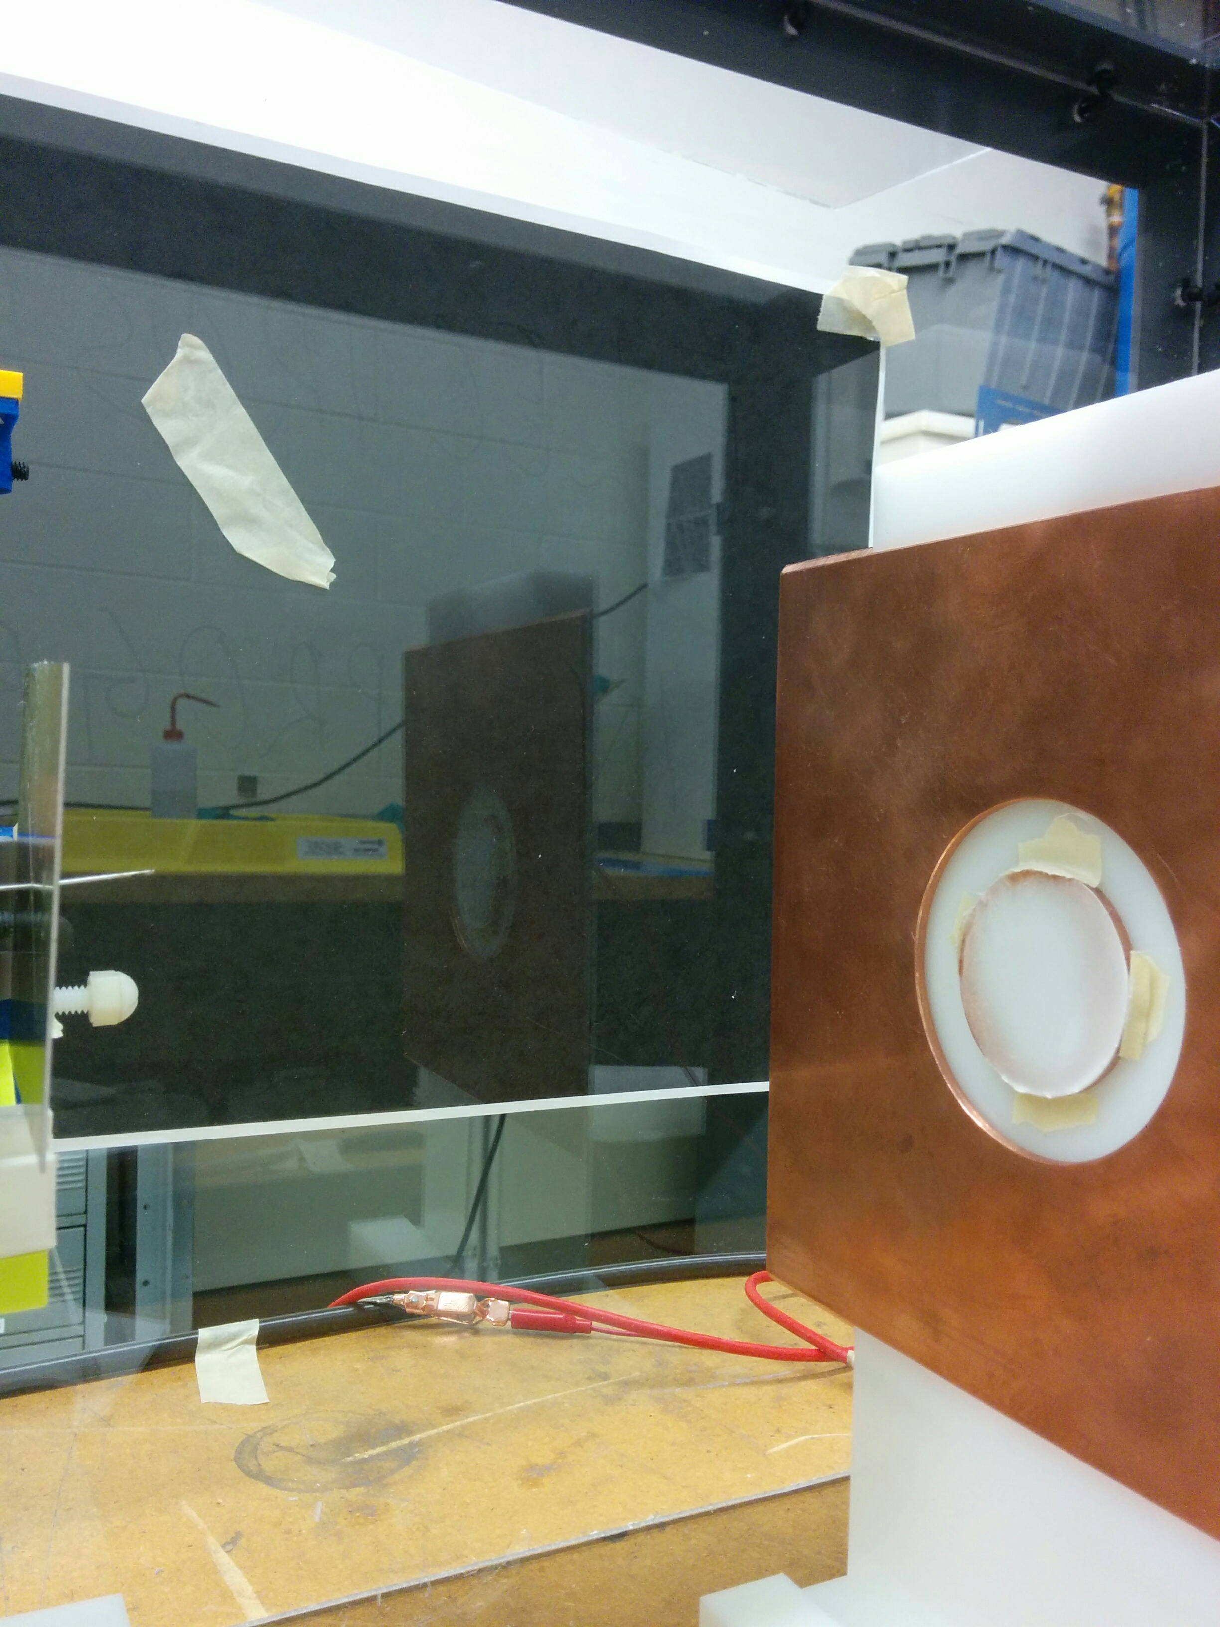
Electrospinning Accumulation

Slide 11
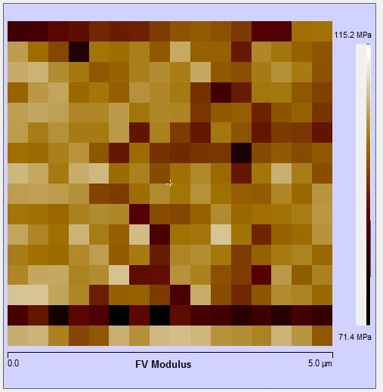
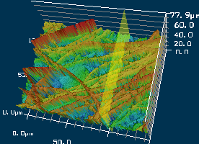
As spun nanofiber- Microanalysis
Alumina+PVP
Tungsten+PVP

Slide 12
Potential Benefits of Nanofibrous Target
Improved Thermal Shock Resistance
  Fundamental limit for solid materials
  Suppress stress wave generation and interference
  Elongated crystal grains may have superior performance
Alternate cooling approaches
  Very high surface area -to- volume ratio
  Nanfibrous material provides relatively low resistance to gaseous coolant flow
Improved radiation damage
  Material defects and gaseous transmutation products can diffuse to the surface
  For isotope production targets, rapid diffusion is also an advantage

Slide 13
Future Work
Produce a variety of thicker materials
Produce pure ceramics and metals
  Incorporate carbon nanotubes
Perform macro- and micro-mechanical testing
  Compare to bulk and analogue materials
Perform thermal testing
Compare with mechanical simulations
➩ Establish Sinuous Materials as a serious avenue
Later research (beyond this LDRD) may include radiation and beam testing

Slide 14
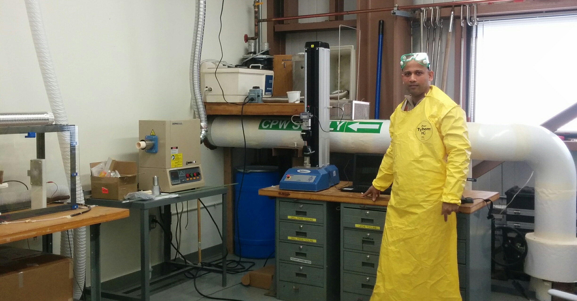
Acknowledgements
Sujit Bidhar
Josh Kubicek
MI-8 Technical Crew
  Henry Schram, Paul Schild, Hiep Le, Chris Kelly, …
ESH&Q
Marty Murphy & Denton Morris
Technical Division Material Science Laboratory
Valerie Goss (Chicago State University)
LDRD Program & Committee

Slide 15
Conclusion
Some future accelerator facilities and HEP experiments will be limited by the capabilities of targets (and their materials)
We are investigating an exotic, engineered material as a replacement for bulk target materials
  Electrospun, sinuous materials
  Material properties of electrospun materials is a sparsely-researched topic
Goal is to overcome the strength-stiffness limit
  Other potential benefits of cooling, radiation hardness
Other “engineered” approaches may prove beneficial as well

Slide 17
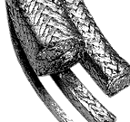
Array of analogue materials
Exfoliated materials
  Exfoliated graphite
  Vermiculite
Reticulated Vitreous carbon
  “Glassy” carbon, in 3-D foam-like shape
Silicon Carbide
  Material of interest for defense and aerospace applications
  Solid and foam
HfC and HfN foams

Slide 18
Raw material for electrospinning solution
Polymer
Solvent
Asphaltene
Nylon
Polyacrylonitrile
(PAN)
Polyvinylepyrrolidone
(PVP)
Toluene
Formic acid
N-N,dimethyle-
formamide
Ethanol
Salt additives
(surfactants)
Fiber diameter
Stable jet length
Morphology
Inorganic precursor
Ceramics
TiO₂
WO₃
Zirconia
Precursors
Titanium(IV) propoxide
Ammonium Metatungstate Hydrate
Zirconium Carbonate

Slide 19
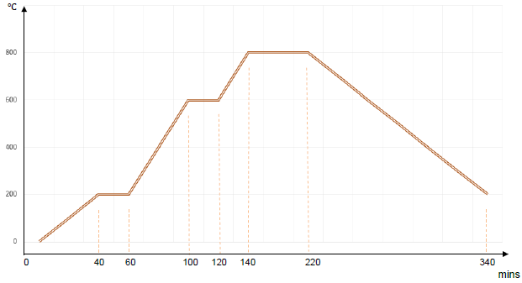
Ceramics nanofiber fabrication
Inorganic precursor(ceramic+precursor solution)
Polymer solution(polymer+solvent)
Salt additives (surfactants)
Solution for electrospinning→polymer-ceramic nanofiber
Calcination (Heat treatment)
Vaporize polymer
Promotes crystal growth
Bonding
Representative heating profile

Slide 20
Candidate electrospin nanofiber
Polymer (for Starter)
Nylon 6
Metal/Ceramic
Alumina
Zirconia
WO₃
Titania
Graphite
Carbon-nanotube Composite(Ultimate)
CNT-Alumina
CNT-Zirconium

Slide 21
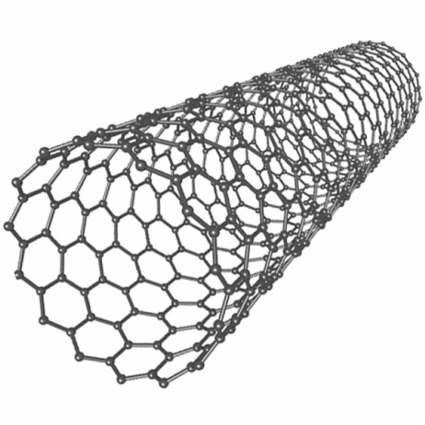
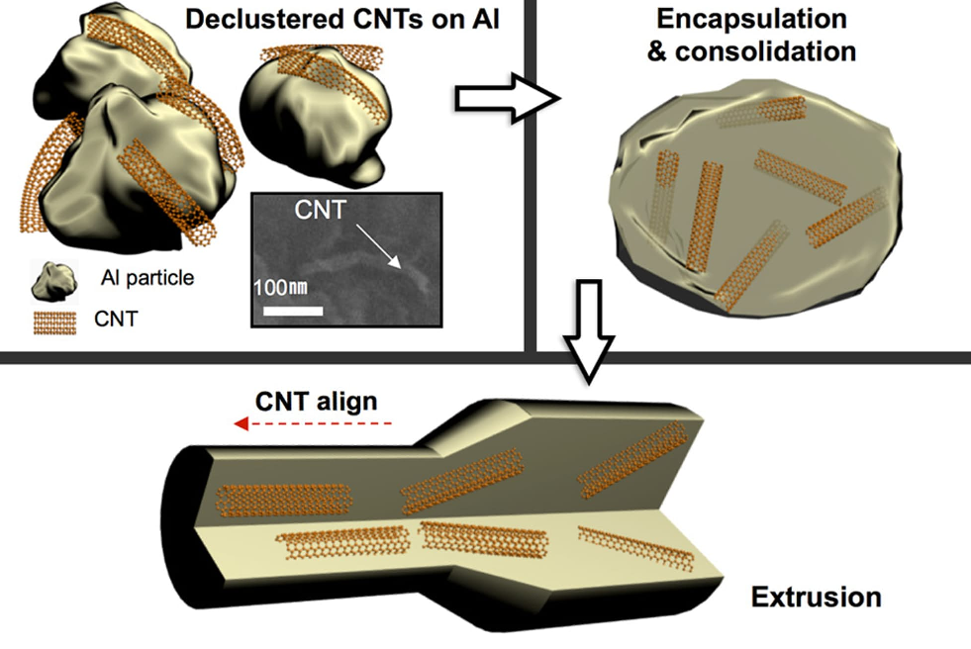
CNT-ceramics nanofiber composites-advantage
Excellent mechanical properties
E : 1~5 Tpa
Tensile strength : 15-50 Gpa
Elongation % : 16%
High thermal conductivity (axial), insulator lateral
1-3 nm
µm-mm
SWNT
1~2 Vol% CNT
Protects Aluminum metal against
radiation damage
1-D transport network for He to escape
Bulk not nanofiber!!
MIT-research

Slide 22
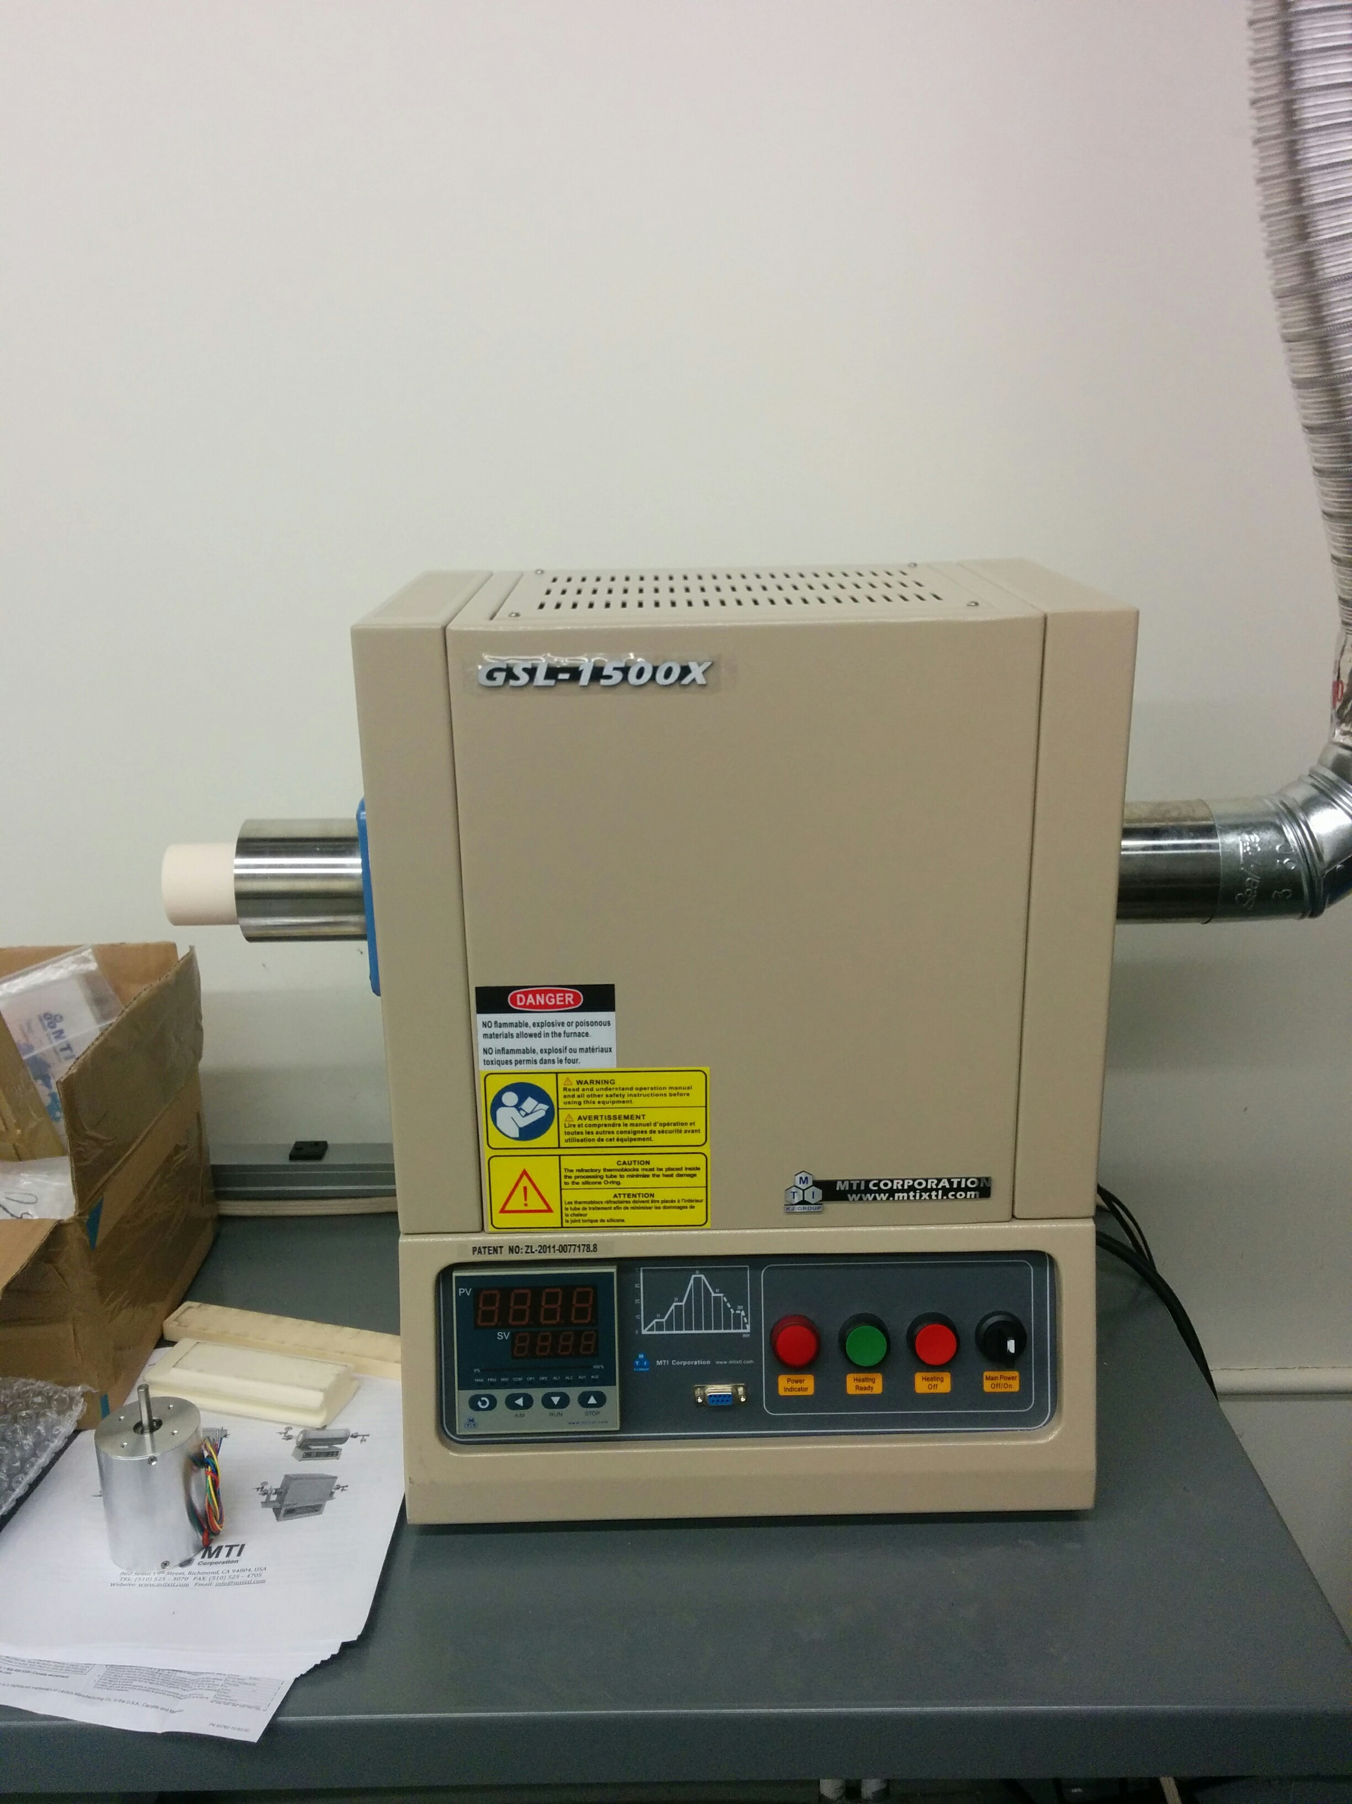
Heat treatment – High temperature furnace
Programmable temperature control up to 1500C
To vaporize polymer part and to allow recrystallization, grain growth of metallic ceramic part in as-spun nanofiber

Slide 23
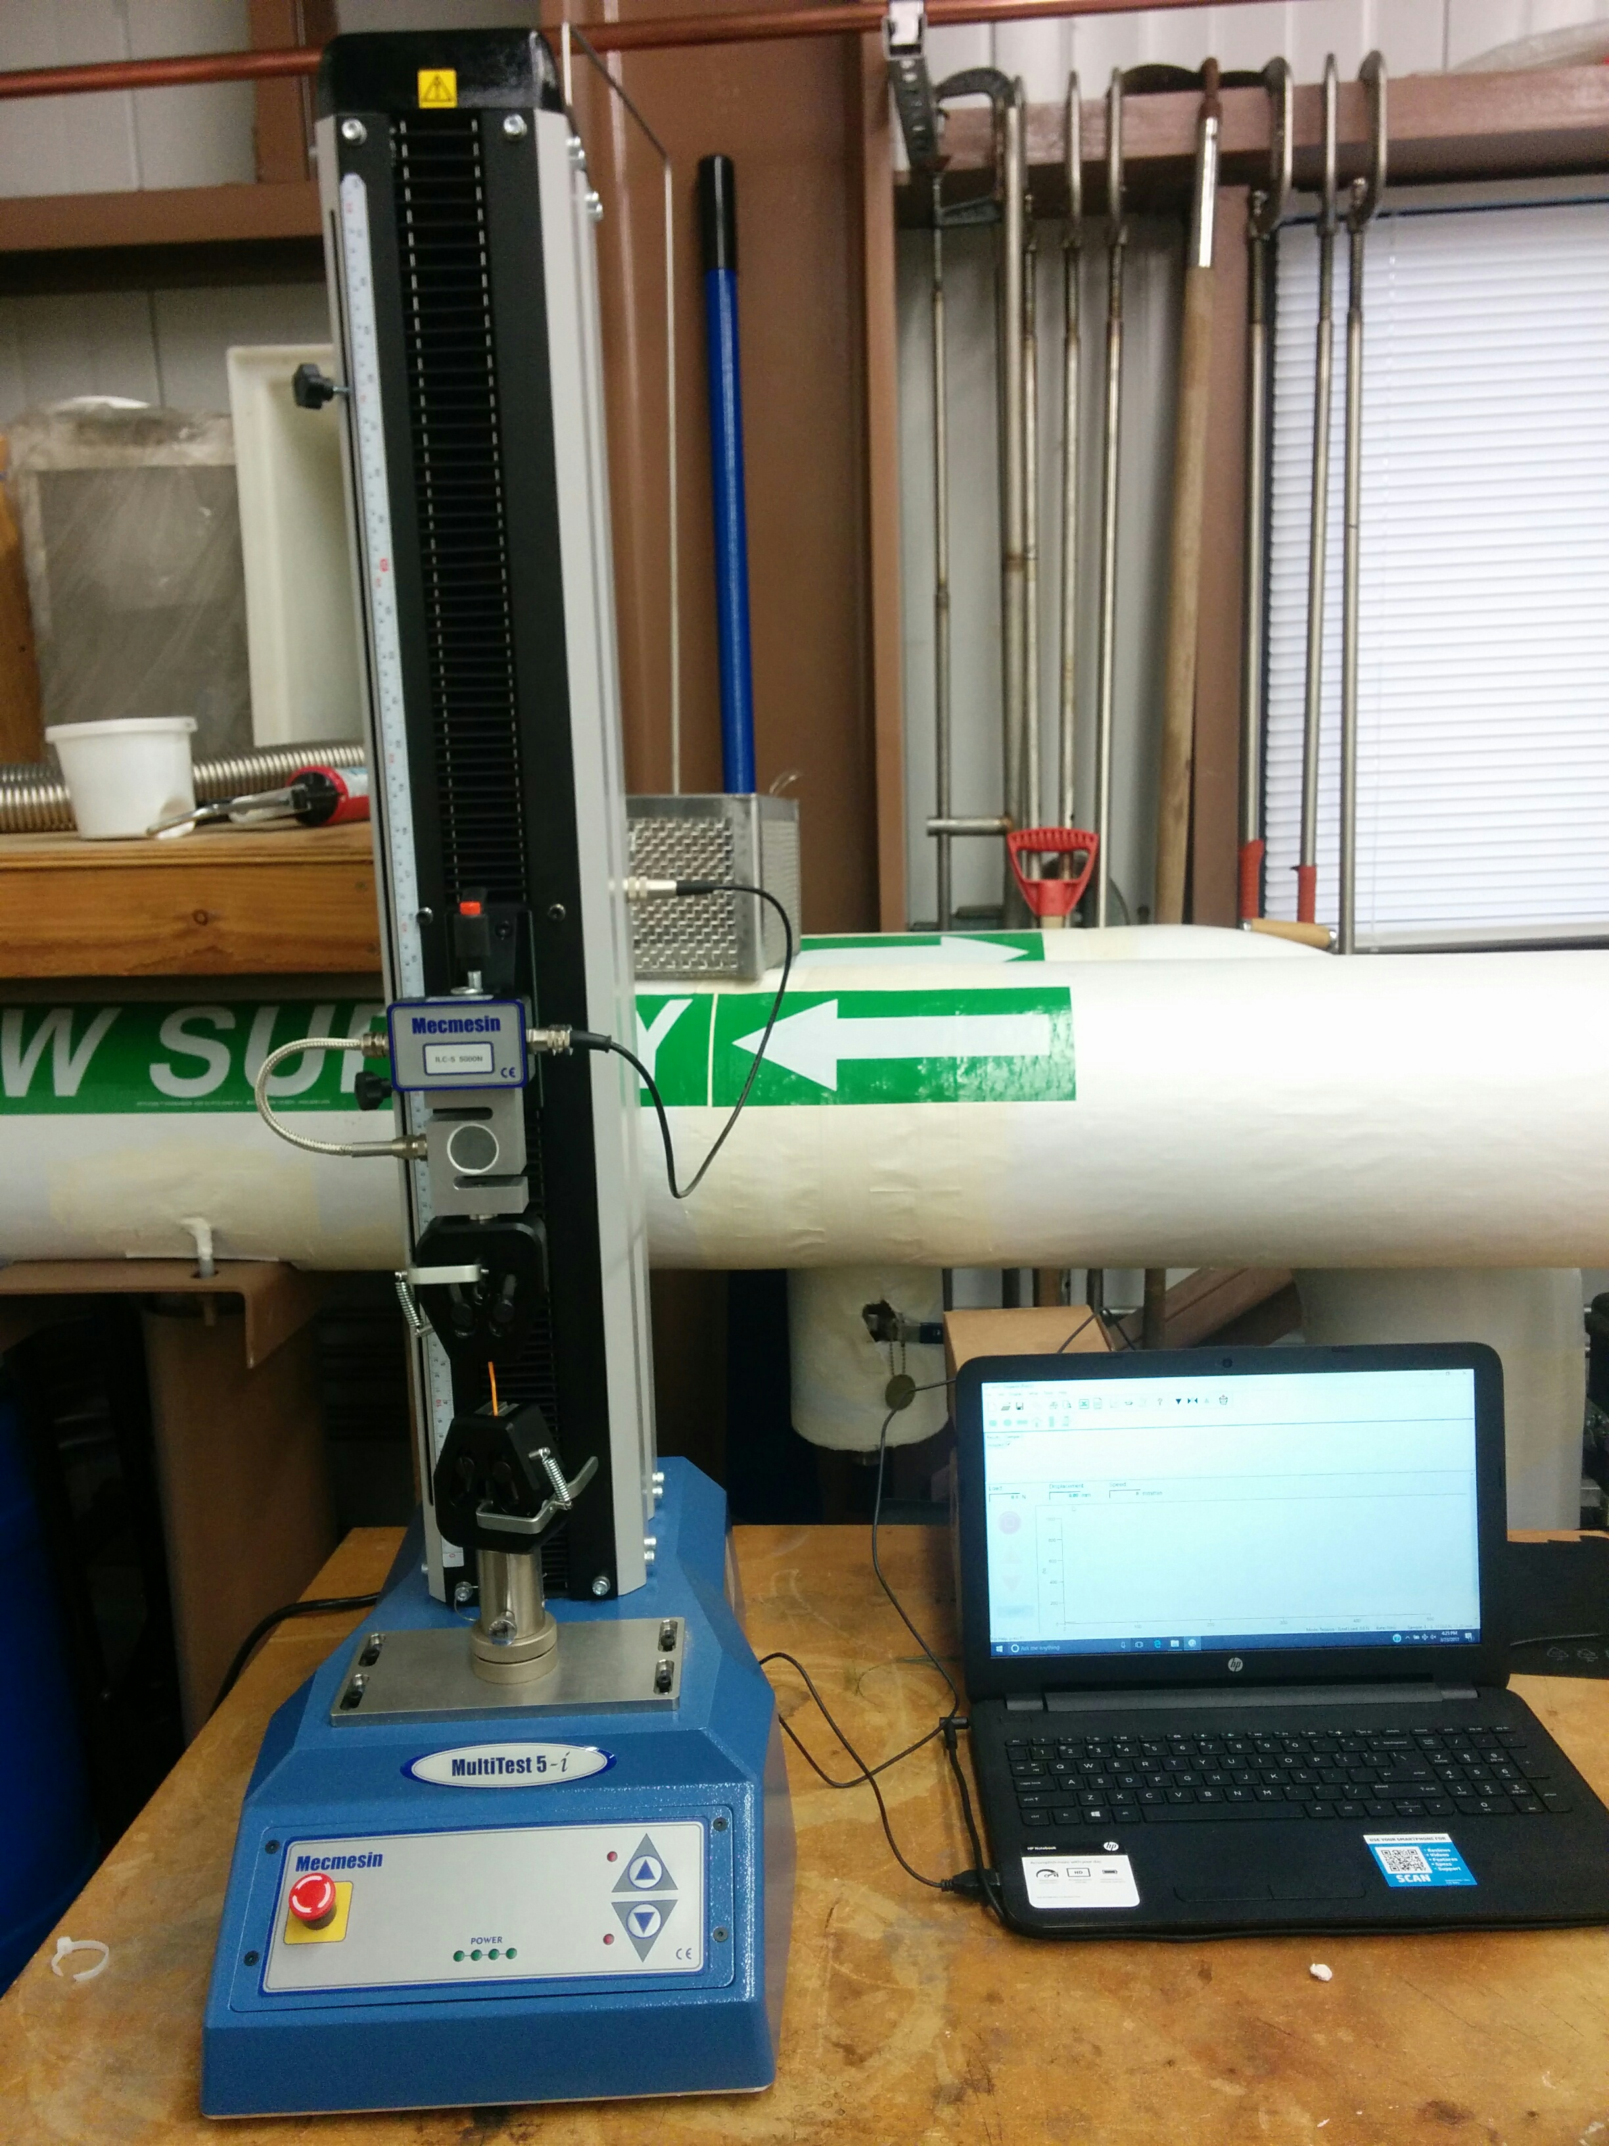
Mechanical testing of nanofiber mat
Universal force tester to evaluate mechanical strength
High precision testing using 2N load cell.
Wide range of test piece testing with 5kN load cell.

