Slide 1

Booster Vrf by f_{sy} Measurements at Extraction Energy (8 GeV) (data of 20170228-0318)
Chandra Bhat and Nathan Eddy
20170328
Synchrotron Oscillations
Goal:
Measure Vrf by the measuring the small angle synchrotron frequency, f_{sy} of the beam in rf bucket at extraction.
or
frev = Revolution frequency of the beam
= 0.994, Relativistic velocity
Es = 8.938 GeV (kE=400MeV)
η= 0.223
h = 84, Harmonic number
fsy = Measured synchrotron frequency
±60⁰
$$f_{sy}=f_{rev}\sqrt{\frac{V_{rf}h\left|η\right|}{2πβ^{2}E_{s}}}$$
$$V_{rf}={\left\{\frac{f_{sy}}{f_{rev}}\right\}}^{2}\frac{2πβ^{2}E_{s}}{h\left|η\right|}$$
60⁰

Slide 2
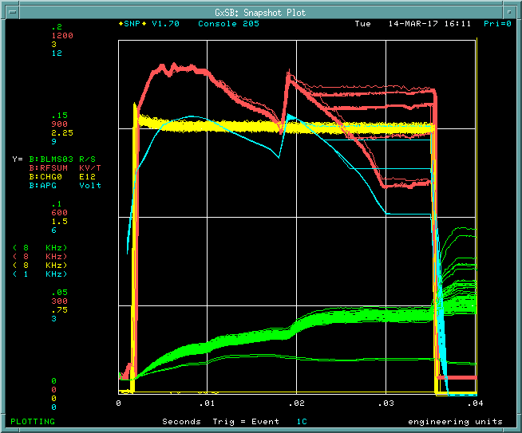
Measurement Technique -1 ($1C)
Settings:
Turn off the bunch rotation (B:BRRMP) for beam to Recycler ($1C).
Turn off Acceleration feedback 3 ms of the cycle (standard procedure).
f(RF) held constant for last 3ms of the cycle (standard procedure)
Load RF voltage curve with constant B:APGT for at least 3 msec before the beam extraction.
Inject ~1E12ppBc on the beam to and accelerate the beam to the extraction energy.
Give a longitudinal kick (phase kick) to the beam at about 2.5 ms before beam extraction by turning OFF mode 50 and turning ON Nathan’s Vernier rf cavity.
Collect the WCM data for at least 3-synchrotron oscillations before the end of the cycle.
Notice that the rf frequency is changing during this last 3 ms, because it is locked to the RR.
B:RFSUM
Constant
RF Voltage
B:APG

Slide 3
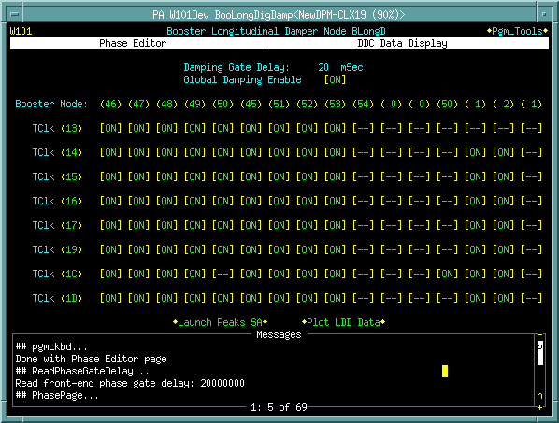
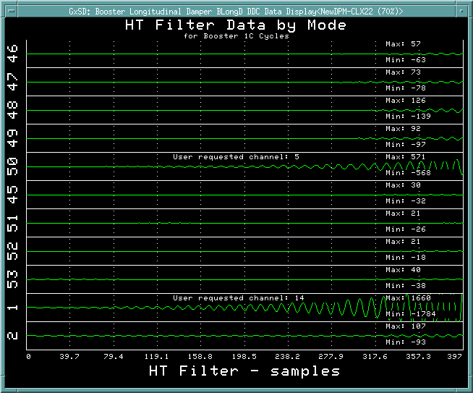
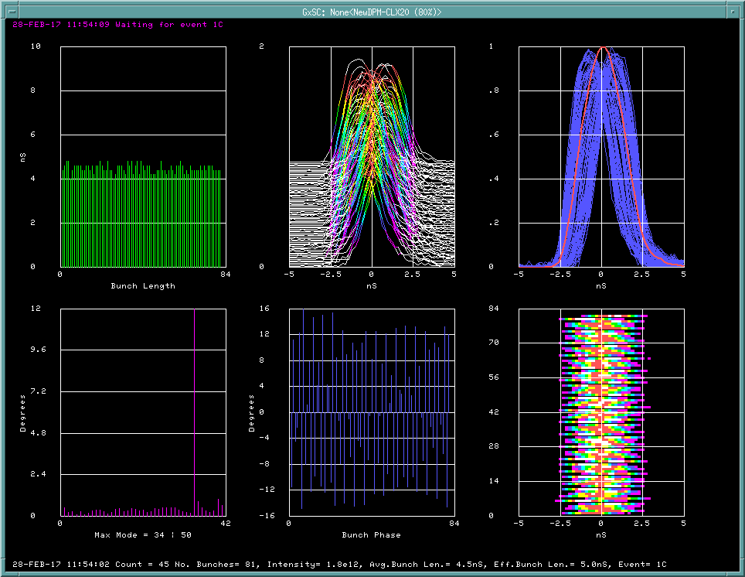
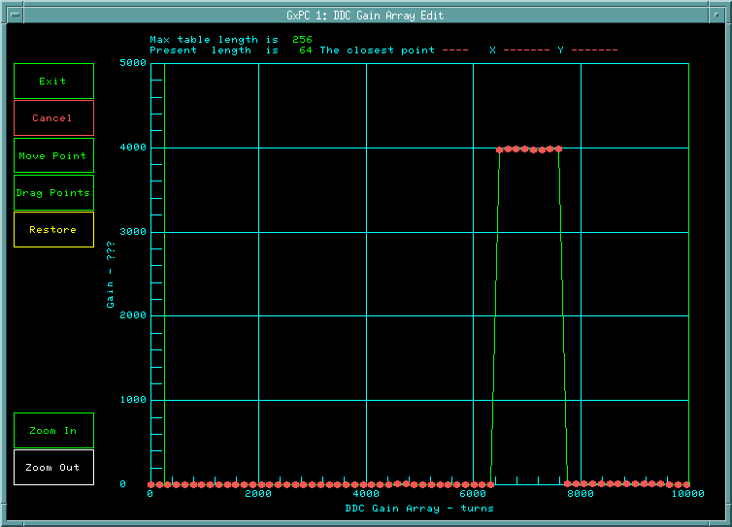
Damper Configuration Set Up (Nathan Eddy)

Slide 4
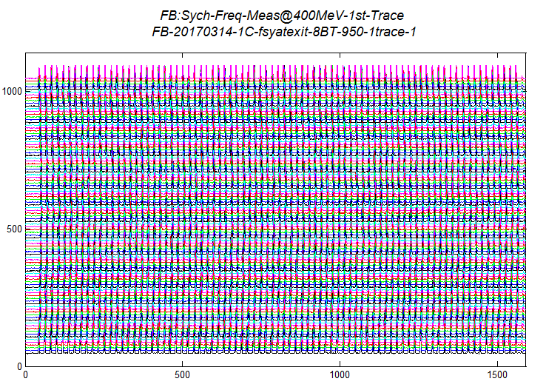
Mountain Range
Turn Number
Time (nsec)

Slide 5
Mountain Range Data for the last 1.6 ms
APG held at 4.74 V
APG held at 9.76 V
1.6ms
18.9nsec
18.9nsec
The position of the bunch centroid has two components
1. Oscillation of the bunch about the bucket centroid (fsy)
2. In absence of radial feedback bunch moves in accordance with B-field

Slide 6
fsy from Fit to the Peak Position
F$\left(t\right)=b_{1}sin(2πb_{2}t+b_{3}$)+$b_{4}+b_{5}sin(2πb_{6}t+b\text{)+}b_{8}$
Back Ground (changing magnetic field)
Synchrotron Oscillations
APGT=4.74
APGT=9.76
18.9nsec
1.6ms
1.6ms

Slide 7
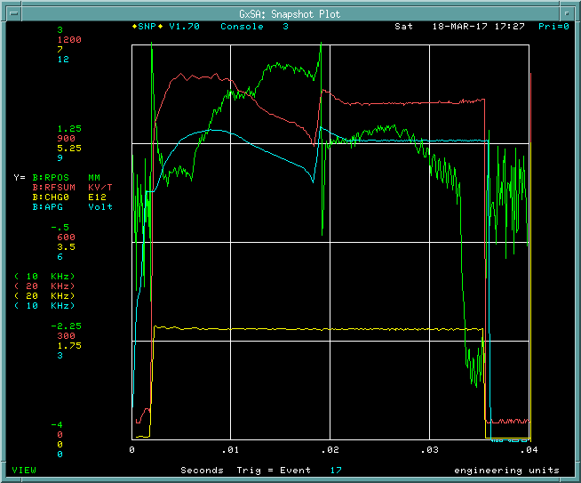
Measurement Technique -2 ($17) (20170318)
Settings:
Turn off the bunch rotation (B:BRRMP) in the Booster on the study cycle ($17).
B:RAGT =0 for the last 3 ms of the beam cycle
f(RF) held constant for last 3ms of the cycle
Load RF voltage curve with constant B:APGT for at least 3 msec before the beam extraction.
Inject ~1E12ppBc on the beam to and accelerate the beam and extract.
Give a longitudinal kick (phase kick) to the beam at about 2.5 ms before beam extraction by “turning OFF mode 50 and turning ON Nathan’s Vernier rf cavity” or “turning off mode-1 damper”.
Collect the WCM data for at least 3 synchrotron oscillations.
B:RFSUM
Constant
RF Voltage
1035kV
B:APG
B:RPOS
R:RAG=0
for the last 3ms

Slide 8
Mountain Range Data for the last 1.6 ms
APG held at 6.38 V
APG held at 9.50 V
1.6ms
18.9nsec
18.9nsec
The position of the bunch centroid has two components
1. Oscillation of the bunch about the bucket centroid (fsy)
2. In absence of radial feedback and at fixed frequency bunch
moves in accordance with B-field

Slide 9
fsy from Fit to the Peak Position
F$\left(t\right)=b_{1}sin(2πb_{2}t+b_{3}$)+$b_{4}+b_{5}sin(2πb_{6}t+b\text{)+}b_{8}$
Back Ground (changing magnetic field)
Synchrotron Oscillations
APGT=6.38
APGT=9.50
18.9nsec
1.24ms
1.24ms

Slide 10
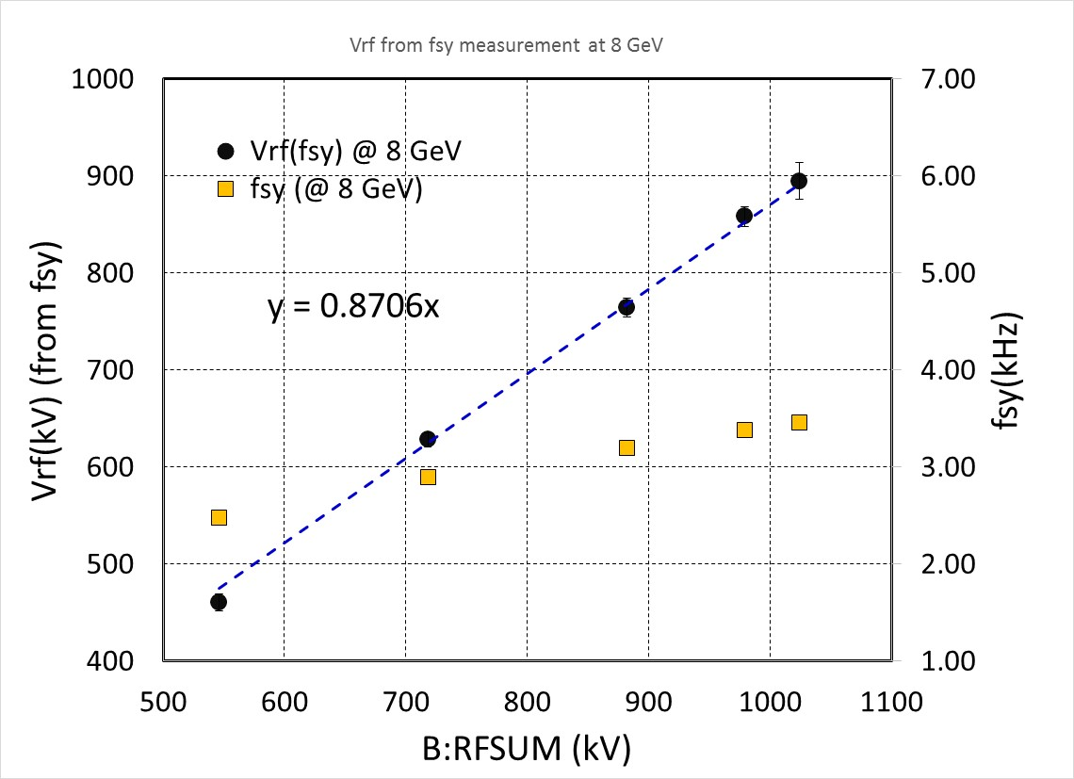
Vrf from fsy at 8 GeV in the Booster
Vrf(kV)=0.87×B:RFSUM

Slide 11
B:RFSUM –SNP data
Offset in
B:RFSUM ??

Slide 12
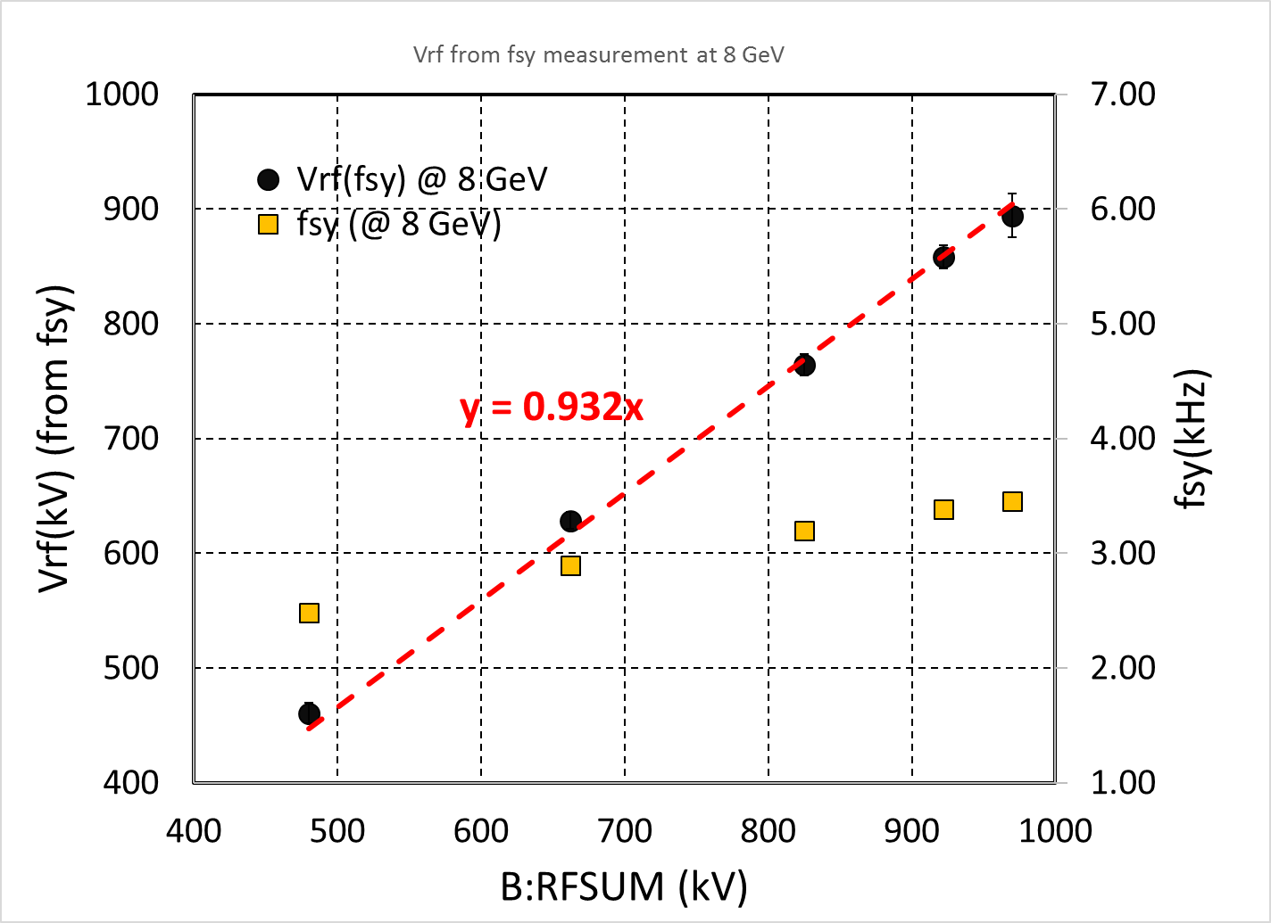
Vrf from fsy at 8 GeV in the Booster
Vrf(kV)=0.932×B:RFSUM

Slide 13
Error in the Measured Vrf(fsy) and Conclusions
fsy(Total Error)=
±2% (Systematic)
±.5% (Statistical)_{Ave}
±2%
For example, with 20 RF cavities
B:RFSUM=1035kV
VRF(fsy) = 900 kV+40 kV (+ve error only)
(900/1036) ≈ 0.93
We have lower Vrf by about 13%
30⁰
Conclusions:
We find that the Vrf seen by the beam is about 7% smaller than B:RFSUM. This needs to be taken into account in future efforts.

Slide 14
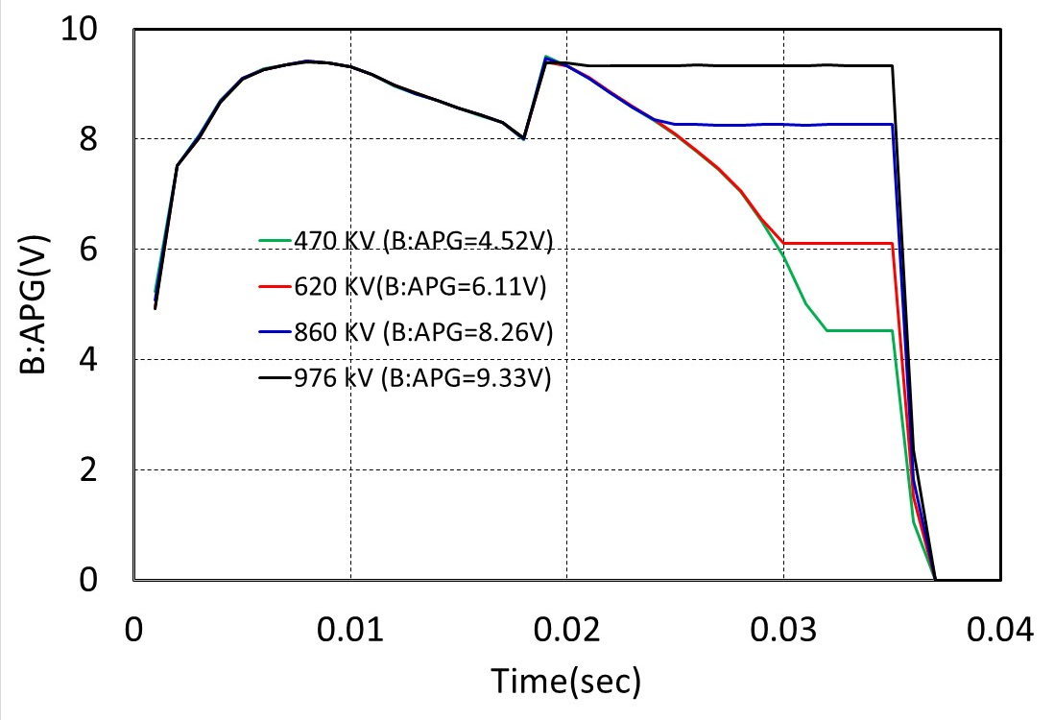
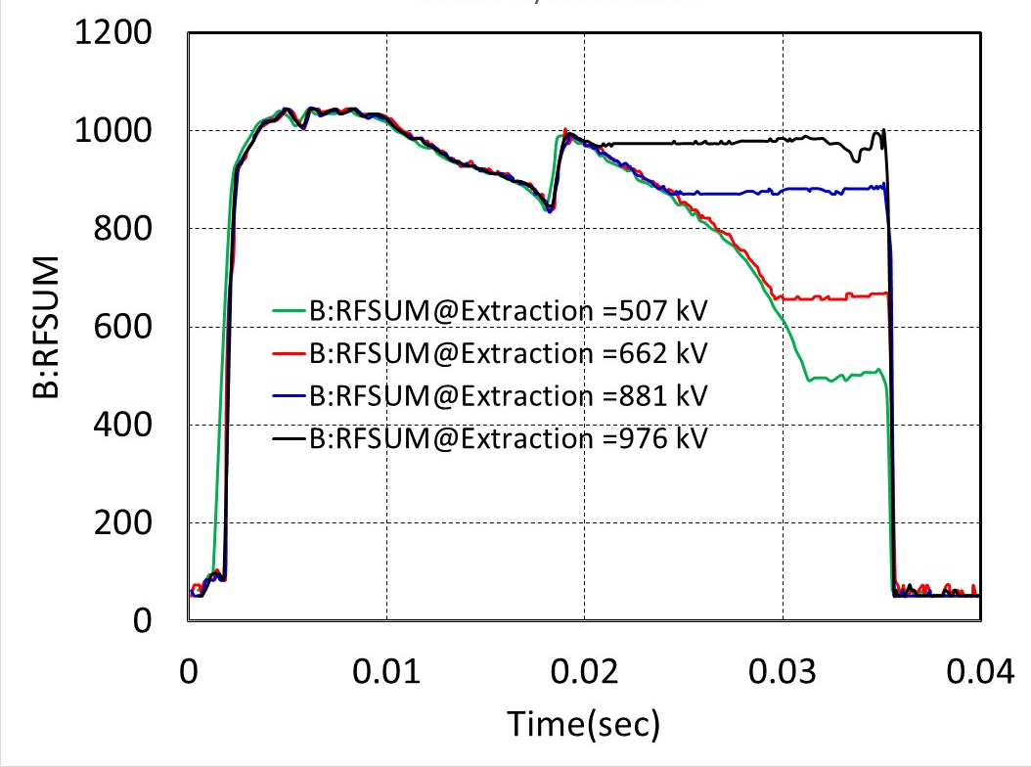
Measured APG and B:RFSUM
B:APG
B:RFSUM

