Slide 1
The Energy Efficiency of High Intensity Proton Driver Concepts
Vyacheslav P. Yakovlev
APT Seminar, Contribution to 8th International Particle Accelerator Conference (IPAC 2017)
20 April 2017

Slide 2
  On behalf of the Working Group Eucard² Workshop on Proton Driver Efficiency :
  J. K. Grillenberger, Paul Scherrer Institut, 5232 Villigen, Switzerland,
  S-H. Kim, Oak Ridge National Laboratory, Oak Ridge, TN 37831, USA
  M. Yoshii, KEK and JAEA J-PARC Center, 2-4 Shirakata-Shirane, Tokai, Ibaraki 319-1195, Japan
  M. Seidel, Paul Scherrer Institut, 5232 Villigen, Switzerland

Slide 3
Outline
Motivation
PSI Cyclotron of the High Intensity Proton Accelerator Facility
Superconducting Pulsed Linac of the Spallation Neutron Source (SNS).
Japan Proton Accelerator Research Complex (J-PARC)
Summary

Slide 4
Motivation
High power proton driver accelerators are used to generate secondary particles at high intensities, such as pions, muons, neutrons and ultra-cold neutrons or neutrinos.
The applications of these facilities have a broad spectrum in the fields of particle physics and condensed matter physics. Another industrial application under discussion is transmutation with accelerator driven systems.
The production of megawatt-class proton beams implies the consumption of electrical power on a large scale.

Slide 5
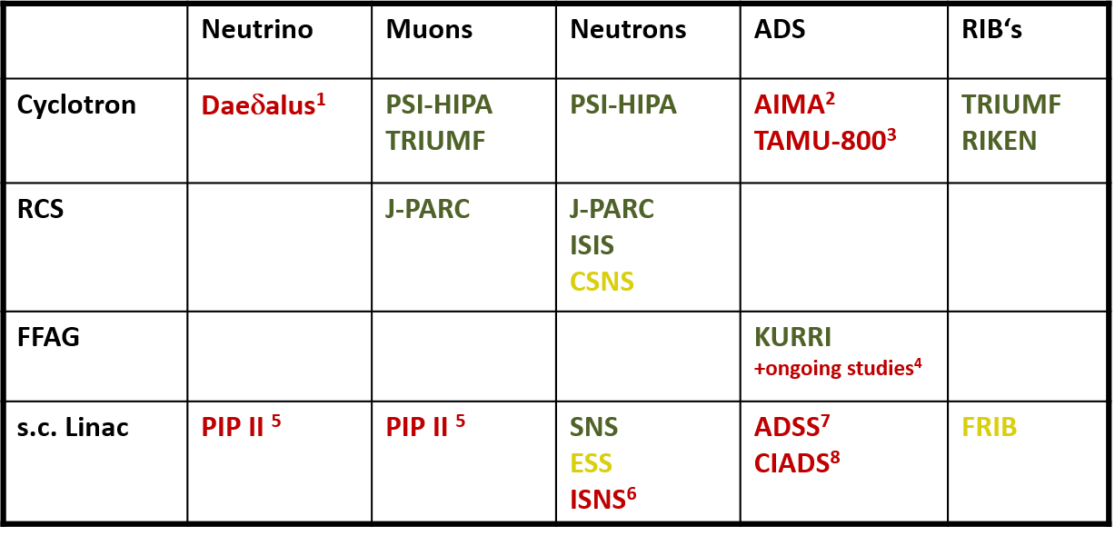
Operating and planned facilities that utilize a high intensity proton driver accelerator.
operating
in construction
concept study
1 Decay-at-Rest Experiment for δcp studies At the Laboratory for Underground Science, MIT/INFN-Cat. et al
2 Accelerators for Industrial & med. Applications, reverse bend cyclotron, AIMA company
3 Cyclotron 800MeV, flux coupled stacked magnets, s.c. cavities, strong focusing channels, Texas A&M Univ.
4 FFAG studies, e.g. STFC
5 SRF linac, Proton Improvement Plan-II (PIP-II), Fermilab, Batavia
6 Indian Spallation Neutron Source, Raja Ramanna Centre of Advanced Technology, Indore, India
7 Accelerator Driven Sub-critical System at Bhaba Atomic Research Centre (BARC), Mumbai,India
8 China Initiative Accelerator Driven System, Huizhou, Guangdong Prov. & IMP, Lanzhou, China

Slide 6
For each new generation of accelerator facilities we want better flux, rate, brightness, luminosity.
→ typically needs more power!
Acceptance of these projects by authorities and the public becomes increasingly difficult.
Thus, one needs to work on that:
  Improve efficiency of accelerators
  Demonstrate efforts to improve efficiency to funding organizations / to public
  Adapt our facilities to new sustainable energy production
  New projects and operating facilities must focus on improving the energy efficiency with a higher priority.
  This is especially true for linacs suggested for ADS-type applications, which may have to deliver >10 MW beams.

Slide 7
(generic) Powerflow in Accelerators
conversion to secondary radiation (beam collisions, targets, undulators …)
efficiency?
public GRID
Accelerator
Radio Frequency
Magnets
Vacuum etc.
beam
secondary radiation
brightness, effective utilisation?
neutrons
muons
neutrinos etc.
exotic particles, e.g. Higgs, B-mesons
synchrotron radiation
direct beam application:
p-therapy
isotope production
Auxiliary systems
cryogenics
conv. cooling, AC etc.
Instruments
e.g. particle detectors
finally all converted to waste heat !
figure of merit:
secondary particles, X-rays on sample per KWh

Slide 8
Eucard² Workshop on Proton Driver Efficiency
Eucard² ?
EUCARD = Integrating Activity Project for coordinated Research and Development on Particle Accelerators, co-funded by European commission, 2013…2017
idea: comprehensive approach to cover the entire power chain from Grid to secondary radiation at the user.
goal: Assess state of the art and development potential for each
stage.
(comparison of potential of each link in the chain)
R&D recommendations in each field.

Slide 9
The goal :
“Efficiency drivers” for different types of the proton drivers
Wall-plug efficiency limits for the MW-range proton drivers
The ways of the efficiency improvement
New technologies should be developed for this.
Proton Drivers:
GeV-energy range
MW-power range
Applications: neutrinos, muons, neutrons, ADS.

Slide 10
Three operating accelerators for GeV- energy scale, MW beam power scale facilities are considered:
Cyclotron of the High Intensity Proton Accelerator Facility, PSI;
Superconducting RF (SRF) Pulsed Linac of the Spallation Neutron Source, ORNL ;
RCS and Main Ring of the Japan Proton Accelerator Research Complex, J-PARC .
The power consumption breakdown will be shown for three facilities, in order to understand the major energy efficiency drivers.
“Efficiency”: we consider a fraction of grid power converted to beam power, i.e., the ratio of the delivered beam power over the accelerator power consumption, including RF, magnetic system, cooling/cryogenics, but neglecting auxiliary systems and experimental facilities.
$$η=\frac{P_{beam}}{P_{magnet}+P_{RF}+P_{cooling/refrigeration}}$$

Slide 11
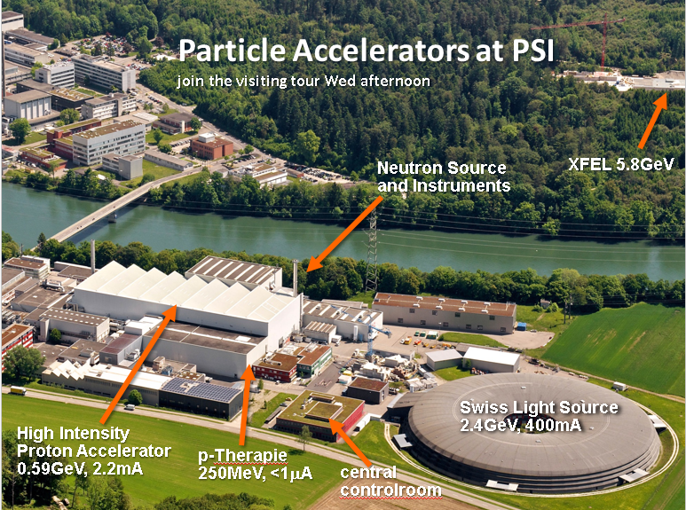
Cyclotron of the High Intensity Proton Accelerator Facility, PSI

Slide 12
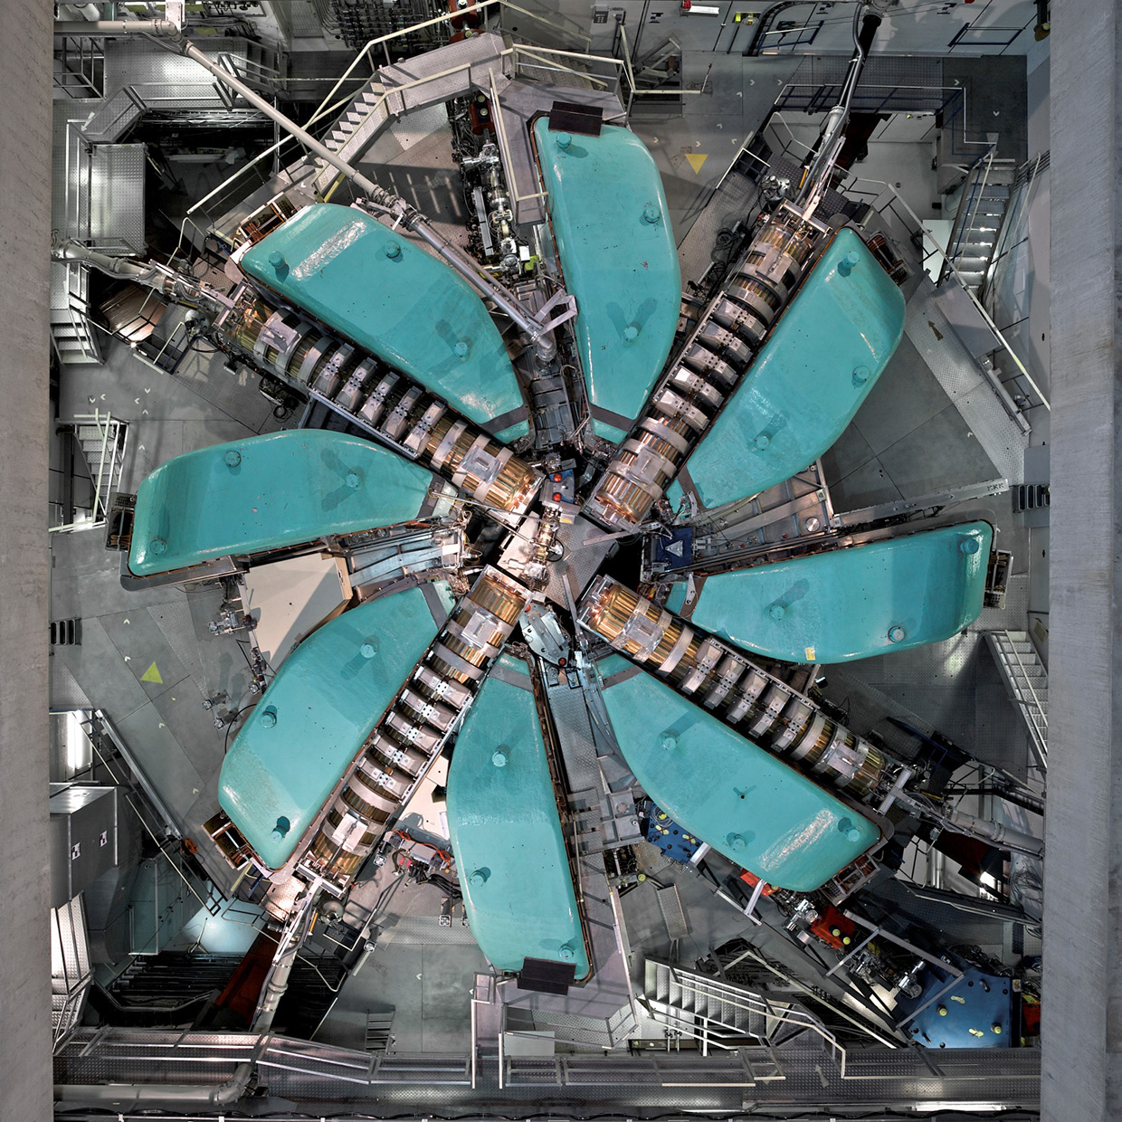
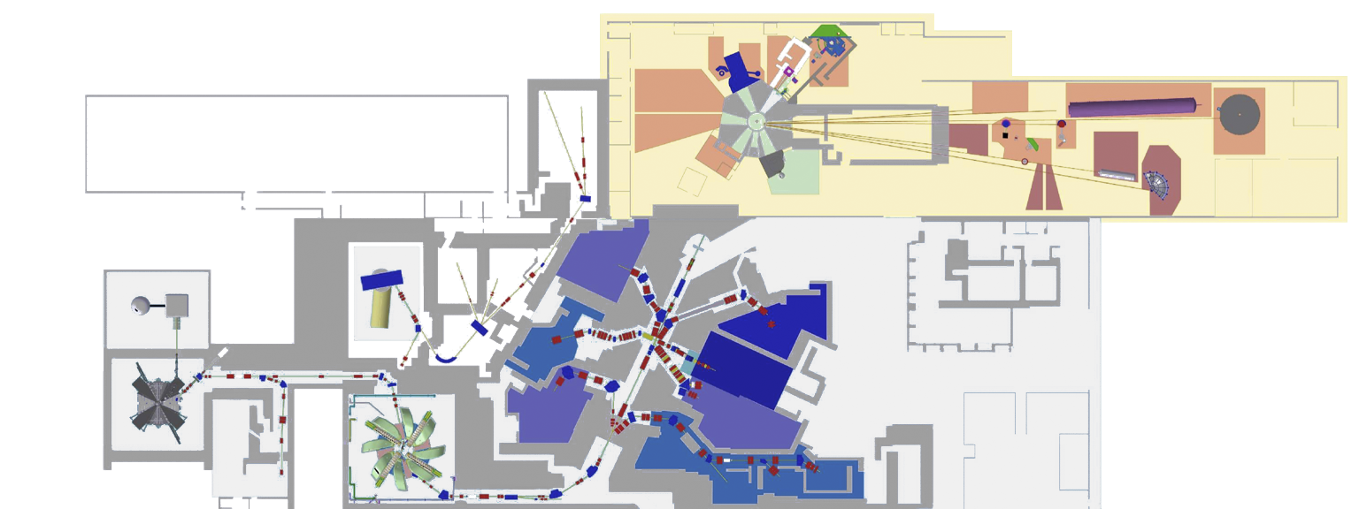
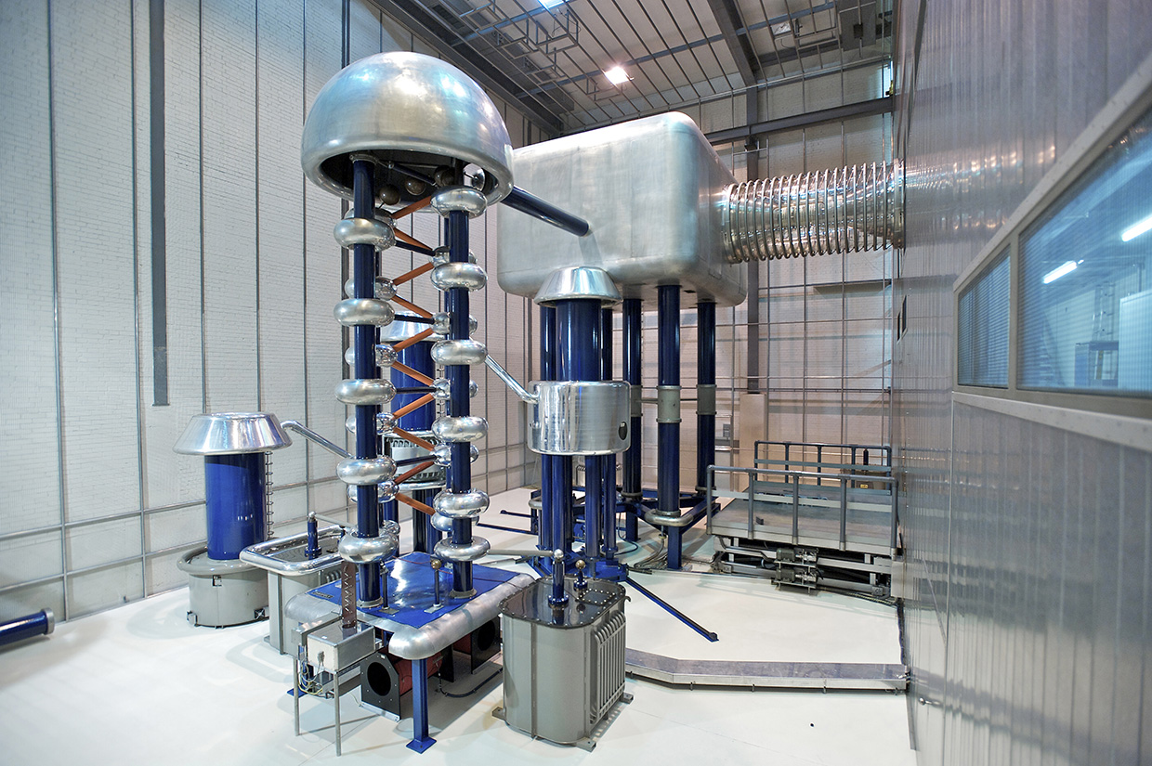
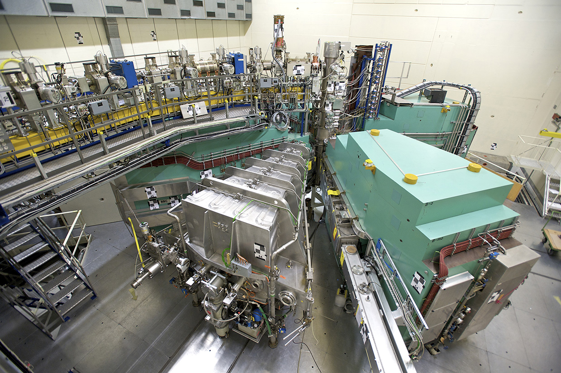
Ring Cyclotron:
590 MeV
2.4 mA
1.4 MW
186 turns
8 sector magnets
Injector 2: 2.7 mA, 72 MeV
Cockcroft-Walton: 10 mA, 870 keV

Slide 13
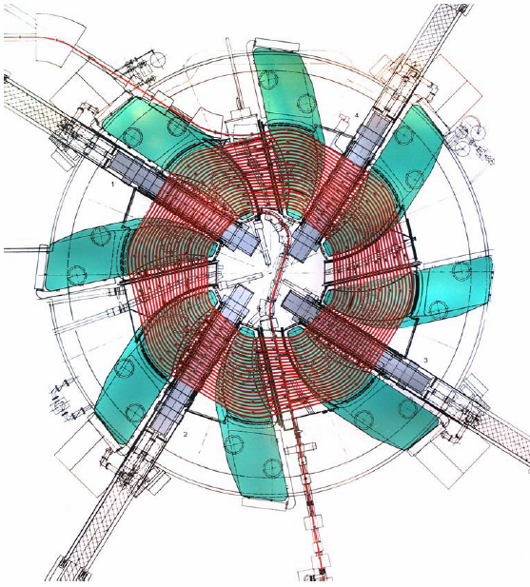
The 590MeV isochronous cyclotron at PSI with a diameter of 15m

Slide 14
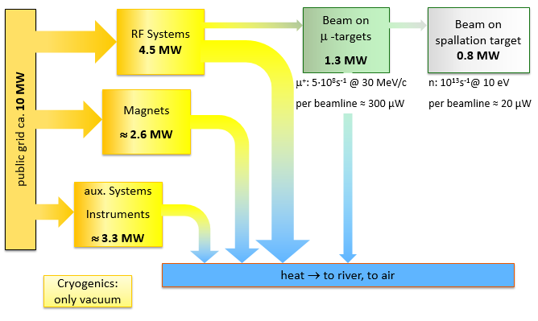
Grid to Beam Power

Slide 15
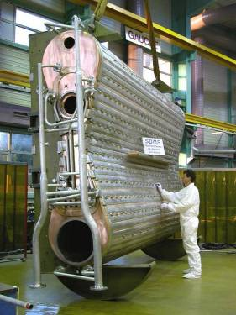
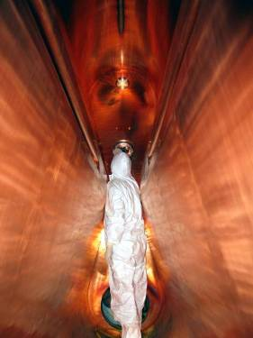
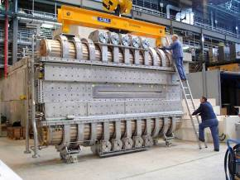
Copper Cavities at PSI
Wall plug to beam efficiency:
AC/DC: 90%
DC/RF: 64%
RF/beam: 55%
All over: 32%
f = 50.6 MHz
U_{max} = 1.2 MV (presently 0.85 MV)
Q = 4.8⋅10⁴
Transfer of up to 400 kW power
to the beam per cavity
Inside the resonator
hydraulic tuning devices (5x)

Slide 16
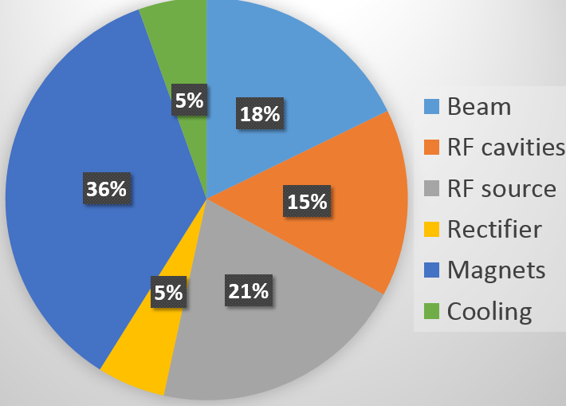
Power consumption breakdown excluding the auxiliary systems.
The magnet system consumes 2.6 MW;
The entire consumption of the RF system is 4.5 MW;
The Ohmic losses in the cavies are about 1.2 MW;
Losses in the RF sources are 1.5 MW;
Losses in the rectifier are 400 kW.
Cooling circuit efficiency is 94%.
The entire efficiency is 18%
The beam current increase up to 3 mA leads to the beam loading increase and consequently, efficiency increase up to 24%.

Slide 17
“Efficiency drivers”:
Losses in the magnets (36%)
Utilization of the superconducting sector magnets. The world’s first ring superconducting cyclotron is the 2.6 GeV cyclotron, which provides acceleration of a broad spectrum of ions up to Uranium. It is in operation at RIKEN Nishina.
Losses in RF sources (21%).
Losses in the cavities (15%).

Slide 18
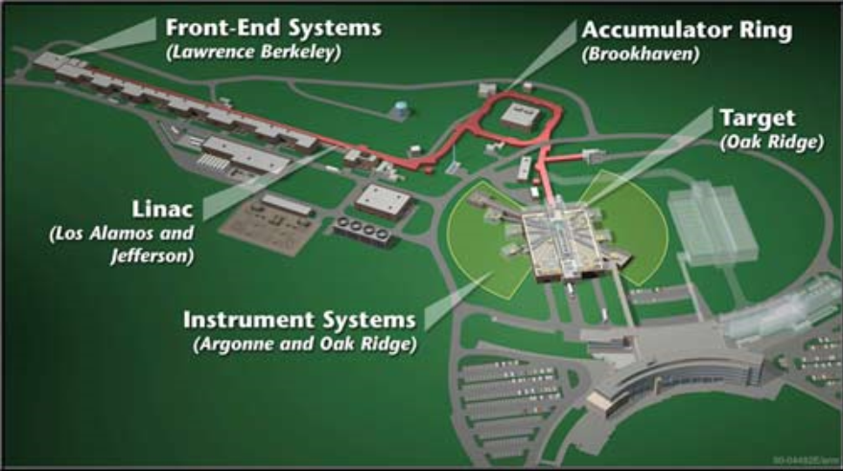
Superconducting RF (SRF) Pulsed Linac of the Spallation Neutron Source, ORNL

Slide 19
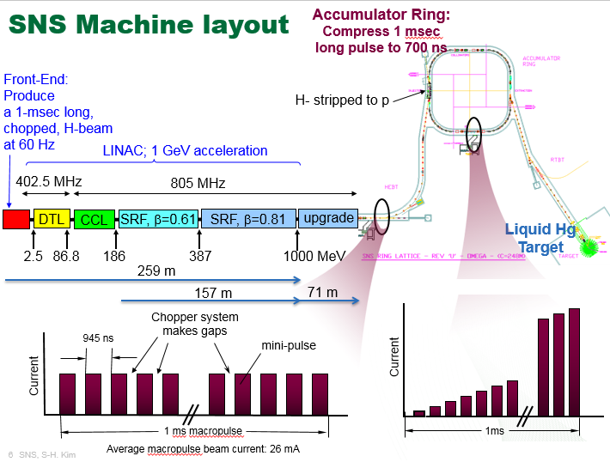

Slide 20
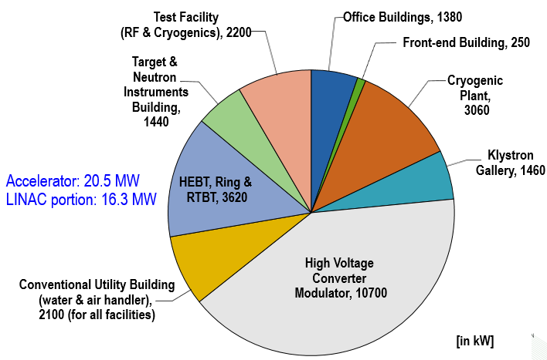
Breakdown of electric power consumption by systems during 1.4 MW operation; 26.3 MW
LINAC efficiency is 8.6%

Slide 21
Subsystems of the Linac
Front-end
  Ion source, RFQ, Medium energy beam transport
Klystron Gallery
  Transmitter, vacuum, control, magnet power supply, local pumps, local HVAC, etc.
Conventional Utility Building
  Compressed air handler, Cooling tower, Chilled water, Hot water
Accelerating Structures
High Voltage Converter Modulator (HVCM)
  Located in the Klystron Gallery, but has separate electric feeder
  15 HVCMs
Cryogenic Plant
  Warm compressors, 4K cold box, 2K cold box, etc.

Slide 22
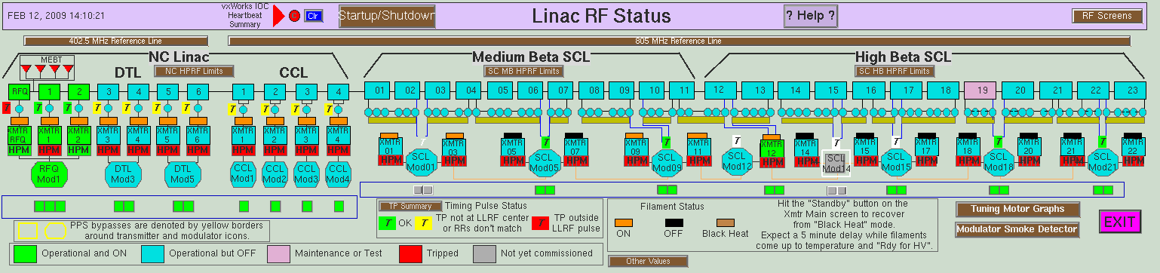
SNS High Power RF configuration
115 kV
125 kV
≤135 kV
71 kV
75 kV
RFQ, DTL
CCL
SCL
15 HVCMs
  3 HVCMs for 1 RFQ and 6 DTL (2.5 MW 402,5 MHz klystron x 7)
  4 HVCMs for 4 CCL (5 MW 805 MHz klystron x 4)
  8 HVCMs for 81 SRF cavities (0.55 MW 805 MHz klystron x 81)

Slide 23
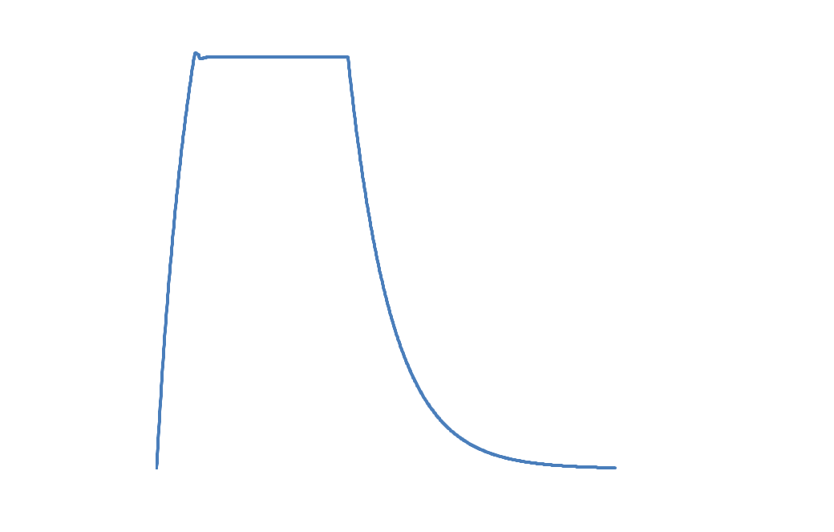
Pulse Structure at SNS
HVCM gate
RF gate
Water cooling system for NC structure and high power RF system
Max. beam gate
Cryogenic plant for cryomodules/transfer lines
Settling
& Fill
(Heating: NC case)
Mismatching
Unused
Control margin
Cavity field decay
Beam loading
HVCM
Settling time
Fill time
LLRF settling time

Slide 24
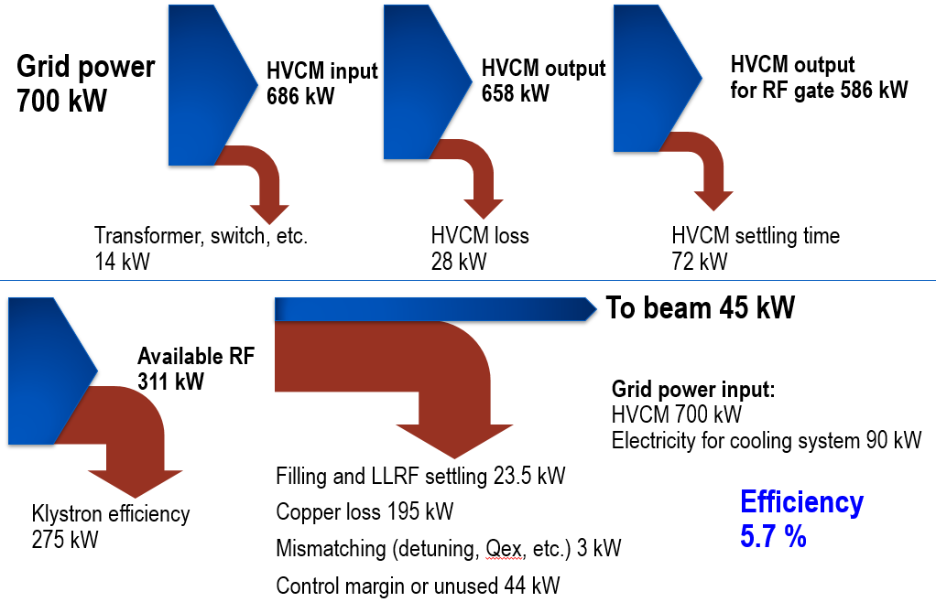
Power flow from grid to beam during 1.4 MW operation (CCL module 4)

Slide 25
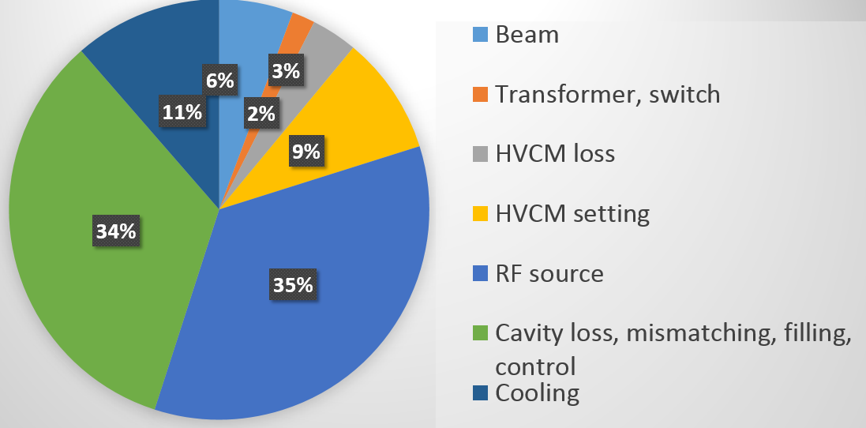
Power consumption breakdown (CCL module 4)

Slide 26
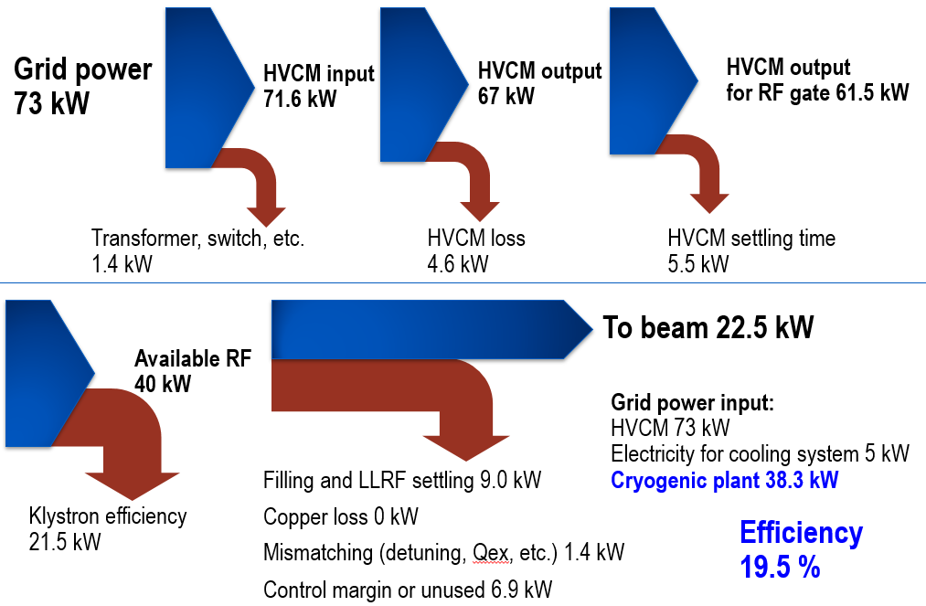
Power flow from grid to beam during 1.4 MW operation (Ex. SRF cavity; 20d)

Slide 27
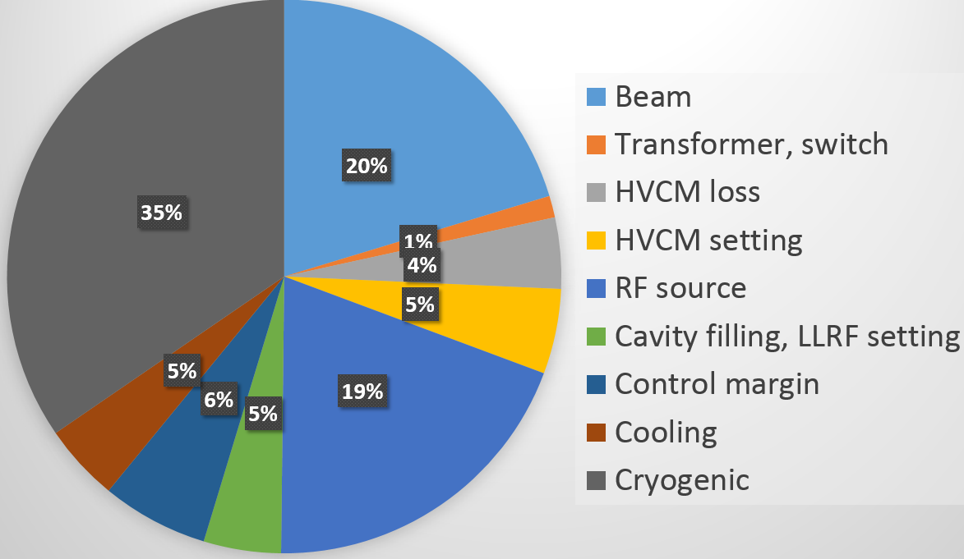
Power consumption breakdown (SRF cavity; 20d)

Slide 28
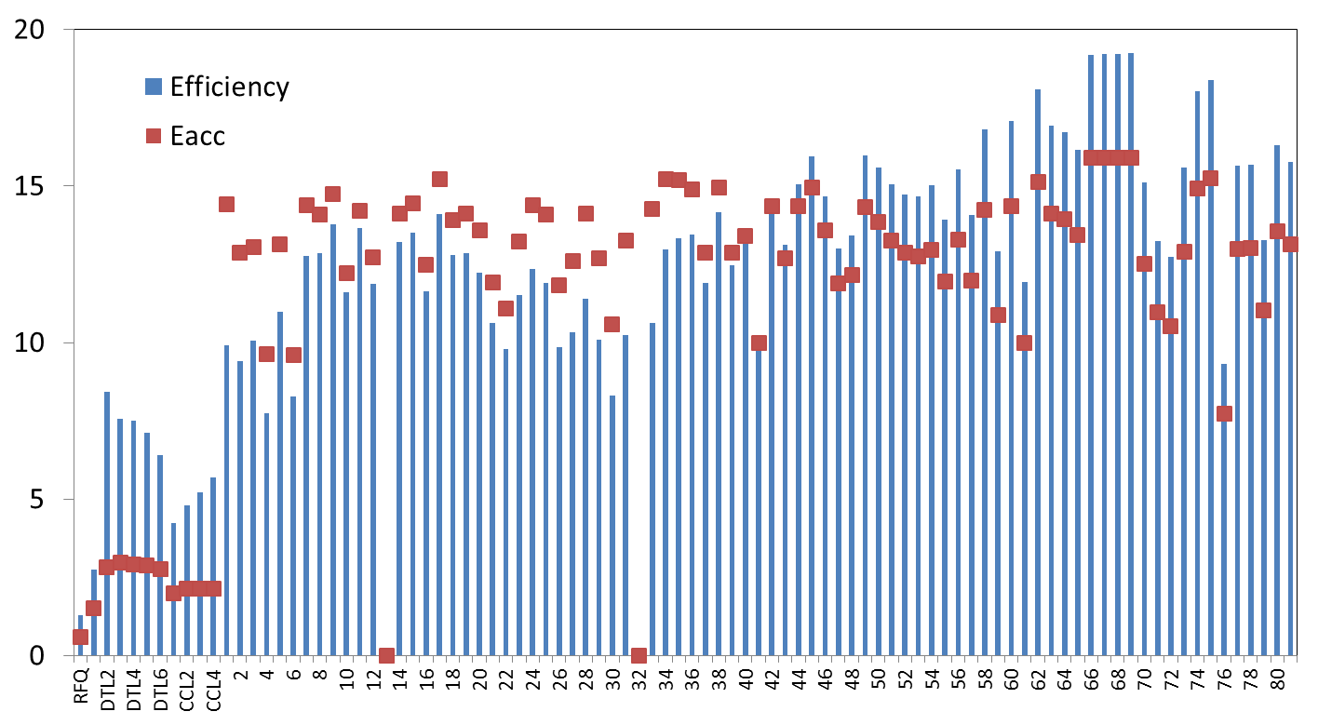
Efficiency of individual RF structures during 1.4 MW operation
Efficiency (%) or Eacc (MV/m)
Warm
structures
Cold
structures

Slide 29
Areas for further improvement
Currently SNS is working on those
RF and SRF
  Cavity performance (general)
  Settling time (high power machine)
  Control margin (general)
  Fill time (high Qex machine)
  Mismatching (low beam loading)
Cryogenic and SRF
  Turn down capability (general)
  Cryogenic efficiency (general)
  Static loss (low duty)
  Dynamic loss (high duty)
Minimize low performing cavities
Ideally inverse TTF configuration
- Eacc limited by available RF power
- Constant power/cavity
Advanced control for both HVCM/ LLRF
(ex. 50 us reduction for SNS PPU)
Should be taken into
account during design

Slide 30
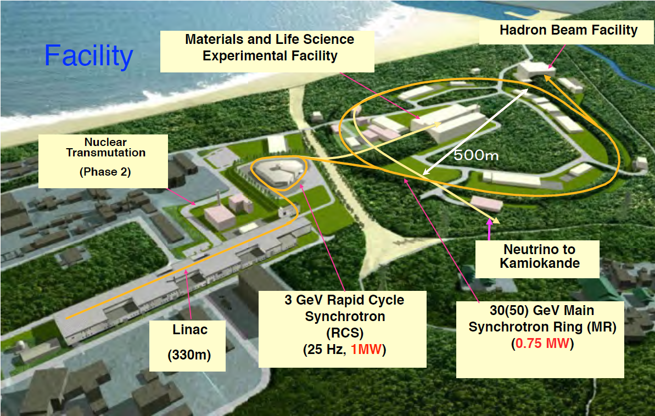
Japan Proton Accelerator Research Complex (J-PARC) Joint Project between KEK and JAEA

Slide 31
Proton Linac:
• Major Parameters
– Accelerated particles: H- (negative hydrogen)
– Energy: 400 MeV, SDTLs and ACS
– Peak current: 30 mA ~ 50 mA􁴕for 1MW at 3GeV)
– Repetition: 25 Hz (additional 25 Hz for ADS application)
– Pulse width: 0.5 ms ( beam pulse ), 0.65 ms (for RF pulse)

Slide 32
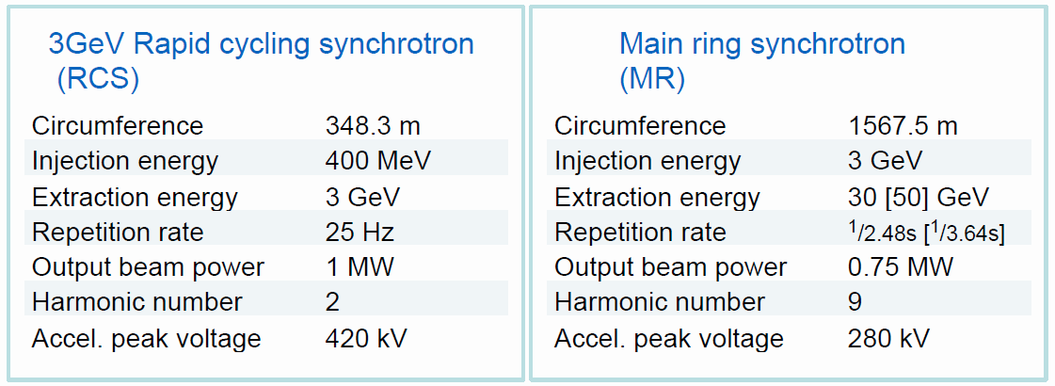
  Synchrotron Rings (RCS and MR)
Features
Magnetic alloy loaded cavity:
High field gradient > 20kV/m
Multi-harmonic forward beam-loading compensation
MR: Slow and fast extractions for nuclear and particle physics experiments

Slide 33
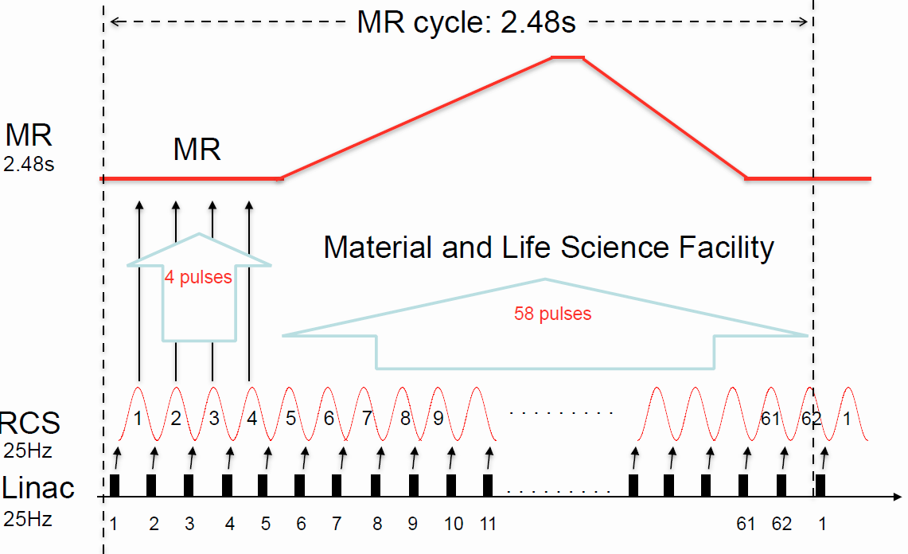
Operation cycle:

Slide 34
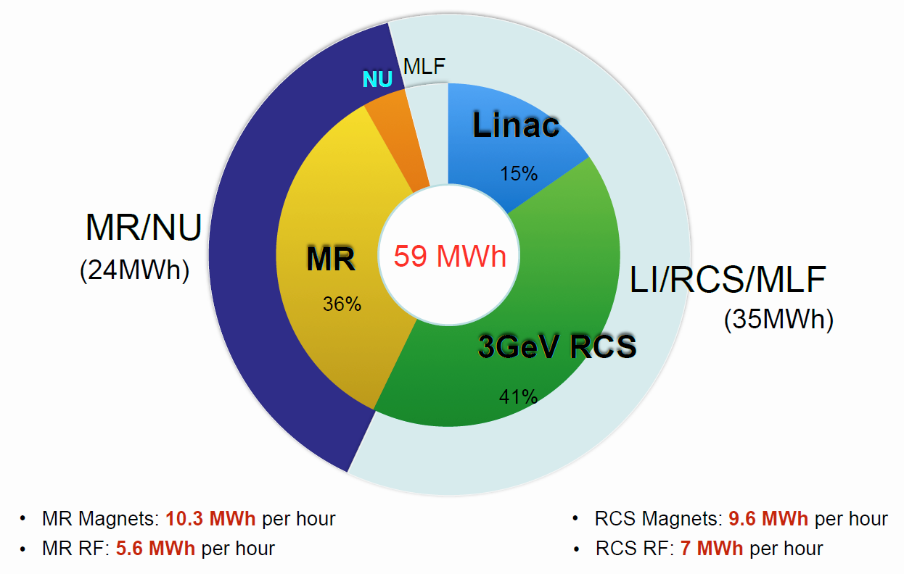
The RF power consumption breakdown for the J-PARC facility.
Linac and RCS: Power consumption: 32.6 MW; beam power: 1 MW
Efficiency ~3%

Slide 35
A number of improvements are in process of implementation:
New power supplies with capacitive energy storage for the main magnets are under development. The power variation at the electrical system keeps its present value even after the upgrade.
- High gradient RF cavities loaded with high performance magnetic alloy (FT-3L) cores started to be installed. The total loss with these cavities is half of that with existing cavities.

Slide 36
 | PSI cyclotron | SNS linac | J-PARC linac and RCS
Beam energy | 0.59 GeV | 1 GeV | 3 GeV
Beam Power | 1.4 MW | 1.4 MW | 1 MW
Power consumption | 4.5 (RF) in total 10 MW | 16.3 MW | 32.6 MW
Fraction of grid power converted to beam power | ~18-19% | ~9% | ~3%

Slide 37
 | PSI Cyclotron | SNS RT part | SNS SC part | JPARC linac | JPARC RCS | JPARC MR
Beam energy | 72-590 MeV | 186 MeV | 186-1000 MeV | 400 MeV | 0.4-3 GeV | 3-30 GeV
Beam power | 1.24 MW | 0.26 MW | 1.4 MW | 67 kW [0.133MW] | 0.5 MW [1MW] | 0.47 MW [0.75MW]
Total RF consumption from the plug | 4.5 MW | 4.8 MW | 5.9 MW | 3.6MW | 7 MW | 5.6 MW
Losses in the RF cavities | 1.4 MW | 1.2 MW | ~ 0 MW | 0.70MW (inc. WG loss+Pr) | 1.6 MW | 0.7 MW
Losses in the RF sources | 1.56 MW | 1.8 MW | 1.7 MW | 2.4MW | 4.4 MW | 3.6 MW
Losses in the HV sources | 0.3 MW | 0.2 MW | 0.3 MW | 0.4MW | 7*15% =1 MW | 5.6*15% =0.8 MW
Total Power consumption for magnets | 2.6 MW | 0.05 MW | 0.15 MW | 0.4MW (inc. cable loss) | 9.6 MW | 10.4 MW
Losses in the power sources | 0.1 | ~ 0 MW | ~ 0 MW | 0.1MW | 9.6*10% ~1MW | =10.4*10% =1 MW
Cooling (water and air) | 0.4 MW | 0.9 MW | 0.4 MW | 2.6MW | 0.9MW | 0.5 MW
Refrigeration | ~0 MW | N/A | 3.1 MW | N/A | N/A | N/A
others | 0.2 | 0.5 MW | 0.5 MW | 1.0MW | 7.4 MW | 5 MW

Slide 38
Summary
Further development of existing types of accelerators and related technology in order to reach higher efficiency:
Cyclotrons;
SRF linacs;
RSCs
Related technology:
  - SC (including HTS) and permanent magnets;
SRF and RT cavities with low losses ( especially high Q0 and resonance
control for SRF);
- Capacity energy storage for synchrotron magnets.
New or alternative ideas and approaches should be developed for both new and explored basic accelerator parameters
  FFAG;
  Other new ideas.
RF is an important efficiency driver for all the considered accelerators. New high efficiency RF sources and operation techniques should be developed:
  high-efficiency klystrons magnetrons,
  magnetrons,
  resonance control for SRF linacs

