Slide 1

R&D of Gas-Filled RF Beam Profile Monitor for Intense Neutrino Experiments
Katsuya Yonehara
Accelerator Seminar
4/25/2017

Slide 2
Collaboration list
Fermilab, Batavia, IL 60510, USA
  K. Yonehara, M. Backfish, A. Moretti, A. V. Tollestrup, A. Watts, R. M. Zwaska,
Muons, Inc., Batavia, IL 60510, USA
  R. Abrams, M.A. Cummings, A. Dudas, R. P. Johnson, G. Kazakevich, M. Neubauer,
Case Western Reserve University, Cleveland, OH 44106, USA
  Q. Liu

Slide 3
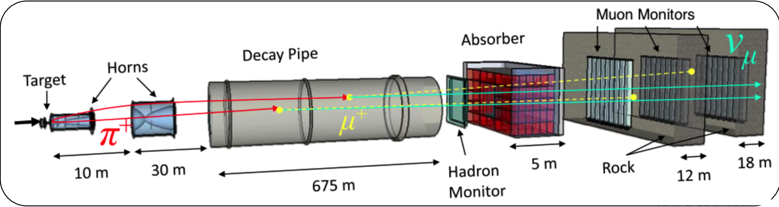
Beam Profile Monitor in Neutrino Beam Line
NuMI Front end
Beam profile monitor in a front end of a neutrino beam
  Combination of hadron and muon monitors
  Monitor beam centroid
Hadron monitor is exposed to severe radiation
  It locates at the end of a decay pipe without shielding
  Radiation hardness is a potential issue for multi-MW beam
  Unexplored beam power!! What kind of device can survive?

Slide 4
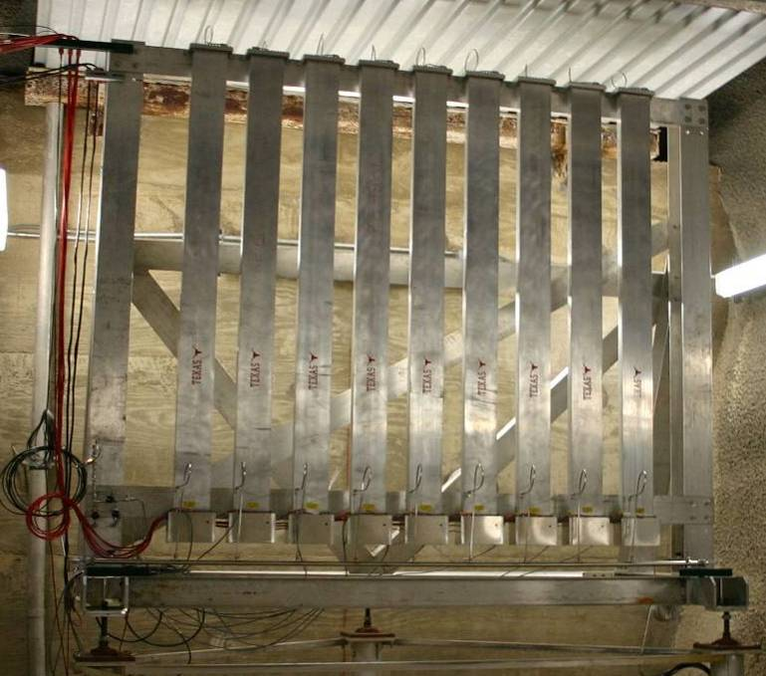
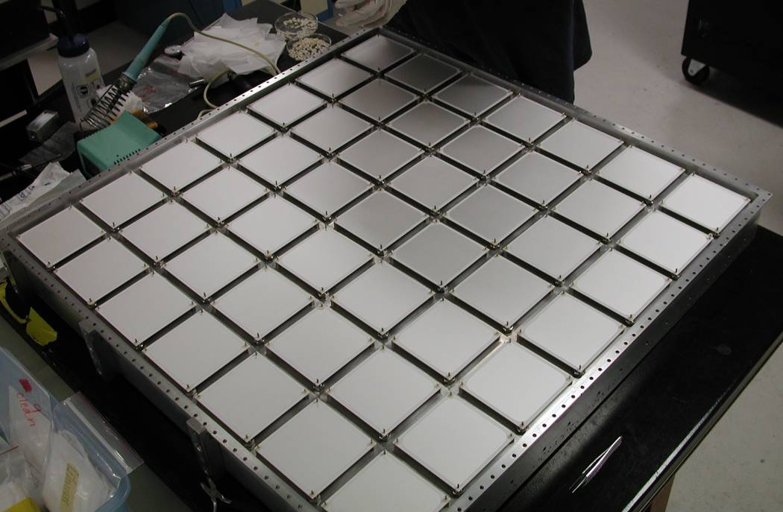
Current System Design lots of ion chambers
Hadron Monitor
  7x7 grid → 1x1 m²
    1 mm gap chambers
  Radiation Hard design
    ~ 10 Grad exposure
  Mass minimized for residual activation
    57 Rem/hr
Muon Monitors
  9 tubes of 9 chambers each → 2.2x2.2 m²
    3 mm gap chambers
  Tube design allows repair
High Voltage (100-500 V) applied over He gas
  Signal acquired with charge-integrating amplifiers
Hadron Monitor
Muon Monitor

Slide 5
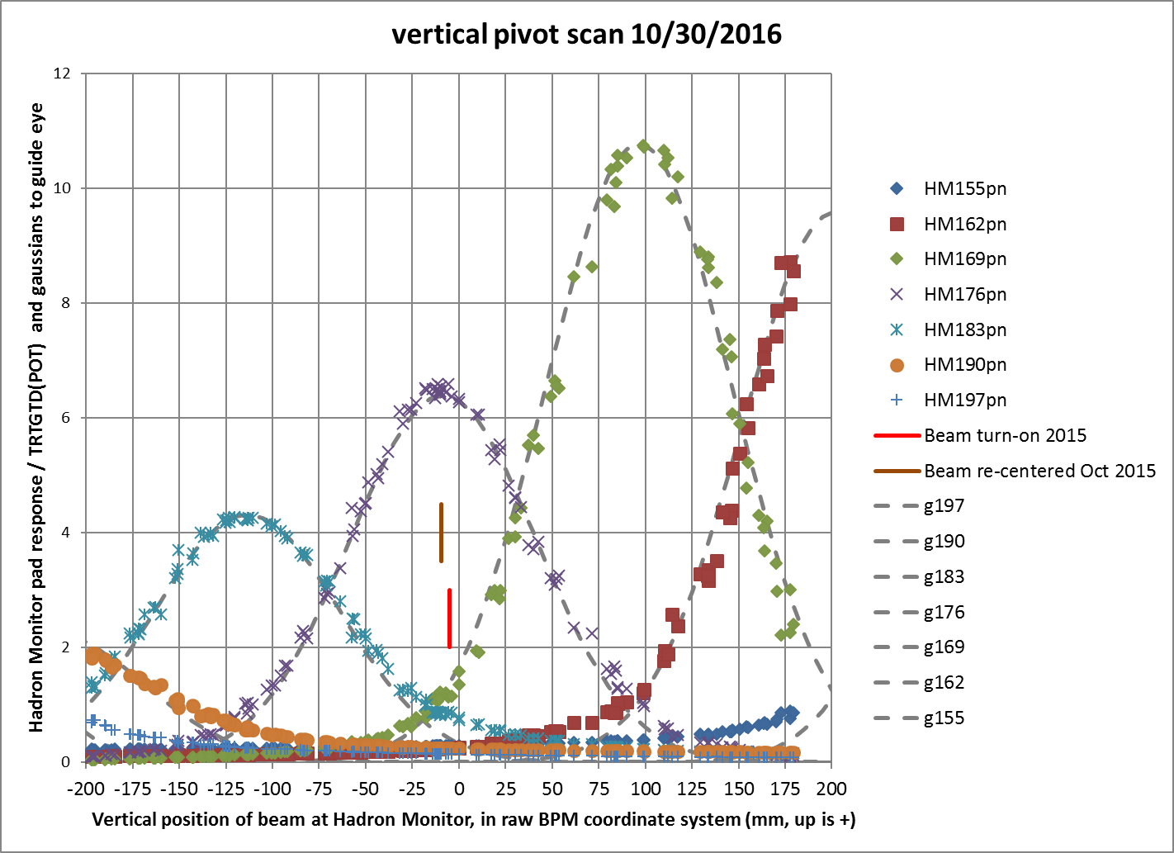
Degrade Beam Sensitivity due to Radiation Damage
Beam scanning signal
in current hadron monitor
Unequal signal height at each pixel -> Cannot use for absolute beam profile measurement
Currently, the monitor is used to find the beam centroid position

Slide 6
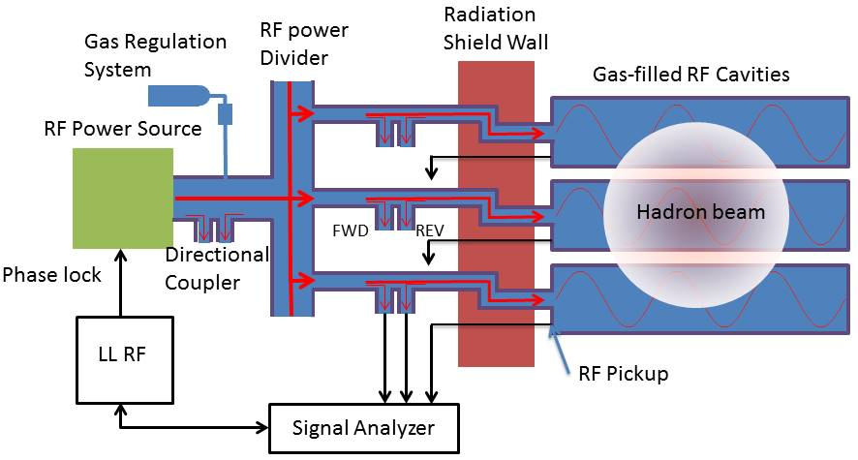
Proposed Radiation Hard Gas-Filled RF Monitor
• Measure permittivity of beam-induced
plasma in a resonator cavity
• All instruments in the beam enclosure is
made of metal
DAQ & Analyzer

Slide 7
Concept of Gas-Filled RF Monitor
Gas permittivity is measured in a microwave-resonant cavity
  Permittivity change (Δε) modulates the resonant frequency (Re(Δε)) and the quality factor (Im(Δε))
Permittivity change is proportional to the number of ion pairs in the RF cavity
  Measure the number of ion pairs to reconstruct the number of incident charged particles in the cavity
Equivalently, the quality factor change represents as the RF power loading (call plasma loading)
RF power equation is solved to evaluate the plasma loading

Slide 8
Simulated Secondary Beam Profile in LBNF
Fraction of secondary protons per single proton on target
at the end of a 200-m decay pipe (by using G4Beamline)
1-meter-long-C target
RMS size 7.2 cm
Bin size
3 × 3 cm², which is the required pixel size in the
monitor for LBNF
2-meter-long-C target
RMS size 14.4 cm
Primary proton beam for LBNF
• 120 GeV protons; 1.5E14 ppp for 2.4 MW; 20 ns bunch gap
• 10 μsec pulse length; 1.2 s cycle time
• Highest secondary proton intensity 5E10 ppp/cm²

Slide 9
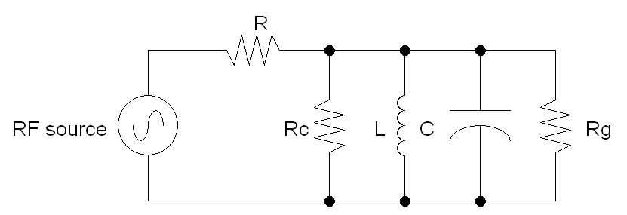
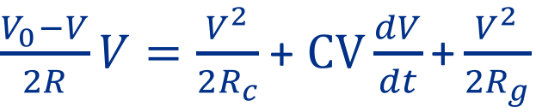


RF Equivalent Circuit
Additional resistance
generated by
beam-induced plasma
RF power equation
$\frac{V_{0}−V}{2R}V=\frac{V^{2}}{2R_{c}}$ + $CV\frac{dV}{dt}\text{+}\frac{V^{2}}{2R_{g}}$
Evaluate R_{g}
$$R_{c}=QZ_{0}$$
Q, Z₀, R_{c}, R can be calibrated
with no beam measurement
$$Z_{0}=\sqrt{L/C}$$

Slide 10
Simulate Transit RF Signal
Simulated plasma loading
in 1-atm dry air filled RF
τ_{e} = 5 ns, τ_{ion} = 2 μs, RF frequency = 2.45 GHz,
Apply LBNF beam with 2 m graphite target,
Q factor = 500, Matched to RF source
No beam
Air (20 % O₂, 80 % N₂)
1-atm
2-atm
LBNF beam on
3-atm
Average
O₂ mixed N₂ gas
Courtesy of A. Tollestrup, Mathematica notebook,
HadronCalorimeter4.nb

Slide 11
Tune Q factor to change beam sensitivity
1-atm dry air
Q = 50
Q = 500
Q = 5,000
LBNF beam
Measurement limit
LBNF beam
Design Q = 500 for LBNF application

Slide 12
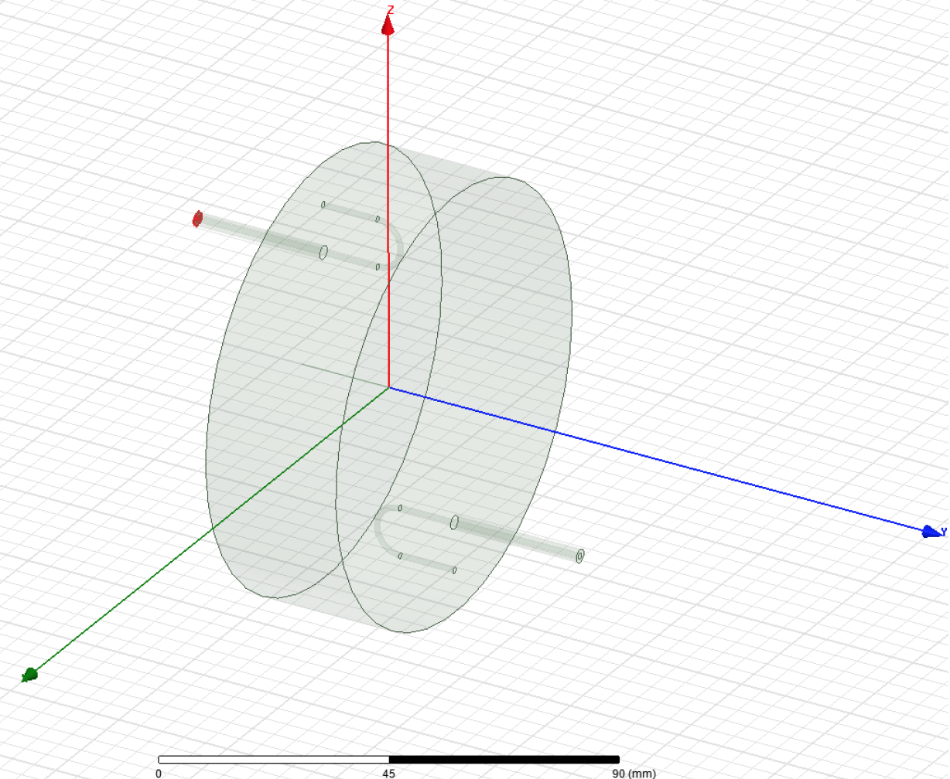
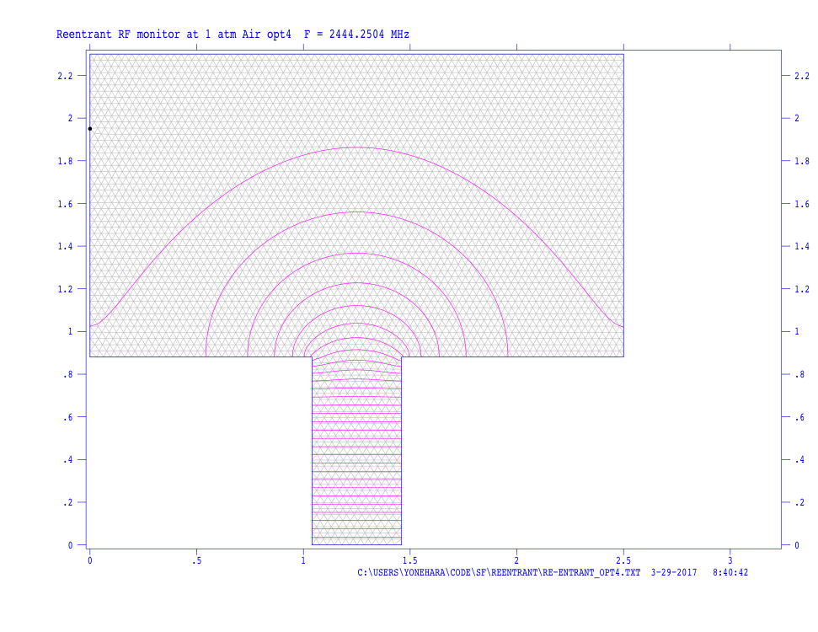
Design test cavity
Tunable Q factor pillbox cavity
Re-entrant shape RF cavity
Made of SS
Q is tuned by changing coupling
of two loading loops
Variable Q range 100 - 1,000
Investigate electron capture time
  Optimize Q
Once Q is fixed, then re-entrant
shape RF cavity will be applied
Small perturbation of coupling loop
High sensitivity

Slide 13
Time line
Summer 2017
  Carry out the table-top measurement by using the tunable Q factor RF cavity
  Develop data acquisition technique to measure low power RF signal from low Q factor cavity
Fall 2017
  Start beam test at SY120 beam dump with the tunable Q factor RF cavity
  Find out optimum Q factor
Winter 2017-Summer 2018
  Make the re-entrant shape RF cavity and test at SY120
  Meantime, make a prototype monitor and emonstrate radiation endurance at the MI beam dump
  Ready to build for real neutrino experiments
Fall 2018
  Any chance to assemble at NuMI during the shutdown? If yes, we start taking data from this time

Slide 14
Conclusion
RF equivalent circuit was solved to adjust sensitivity of gas-filled RF monitor by tuning Q-factor
First tunable Q factor RF is designed and cut a metal
  Prepare RF equipment
  Design gas manifold system
  Start engineering analysis for safety assessment
Time line is set
  R&D phase will be done by Summer 2018
  Install prototype monitor in this shutdown

