Slide 1
Of chip, shim and probe.
Gennady Romanov
2nd Harmonic cavity meeting
May 11, 2017

Slide 2
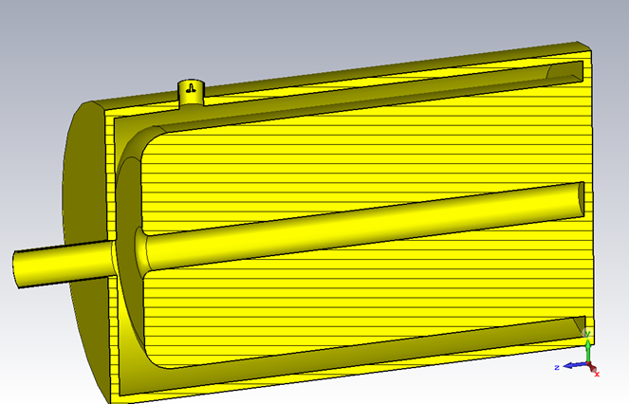
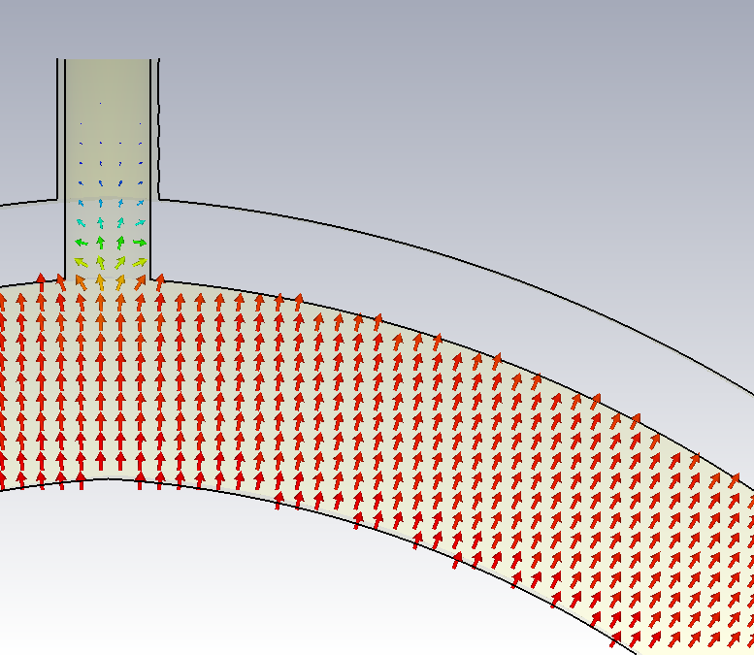
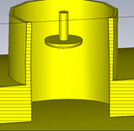
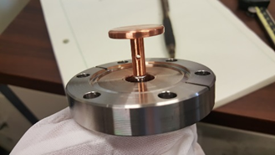
Field probes
144 kV/m
1.63 MV/m
0.44 MV/m
≈ the same for 75 and 107 MHz
Frequency shift is negligible
The outer cylinder of the window is here

Slide 3
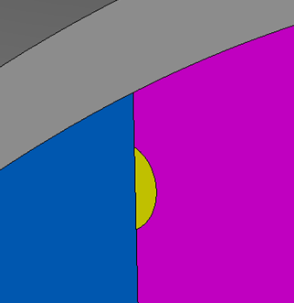
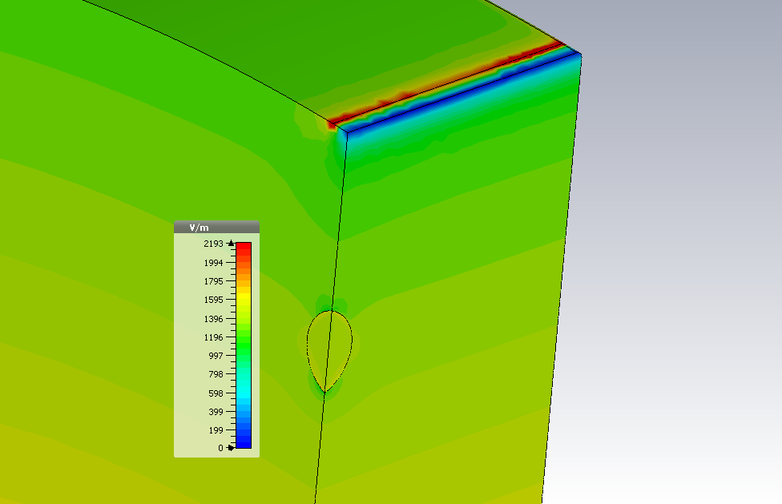
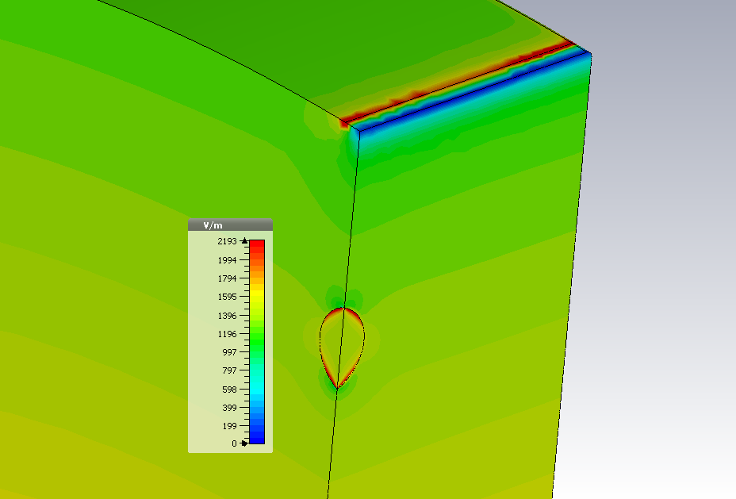
Chips in the garnet ring
|H|
.020-.025” deep ?
0.1”
0.26”
0.1”
µ=5
µ=1

Slide 4
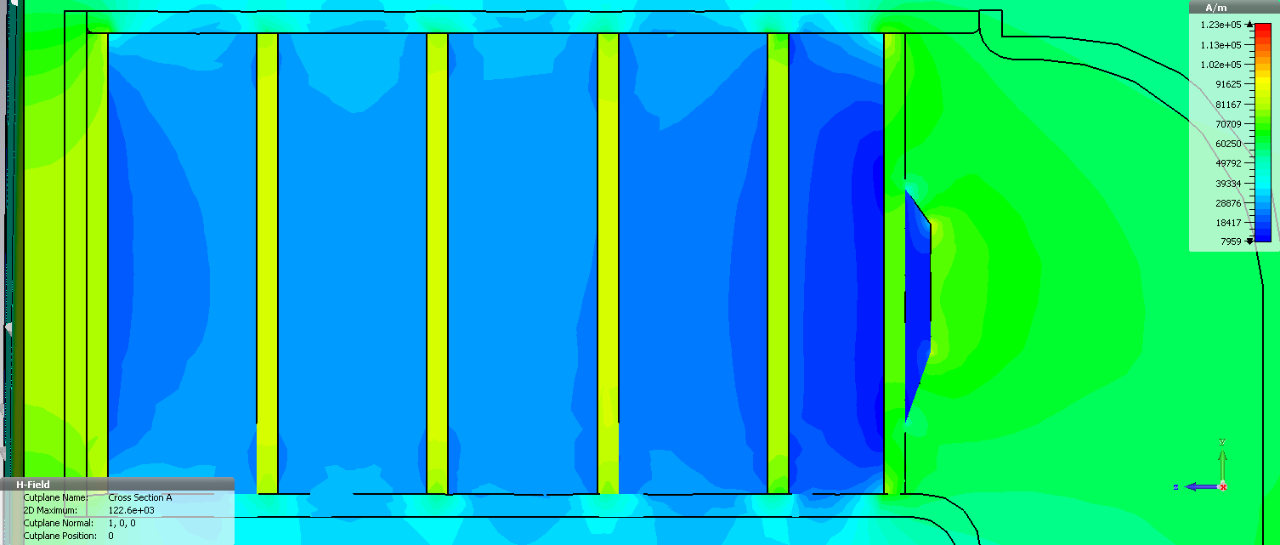
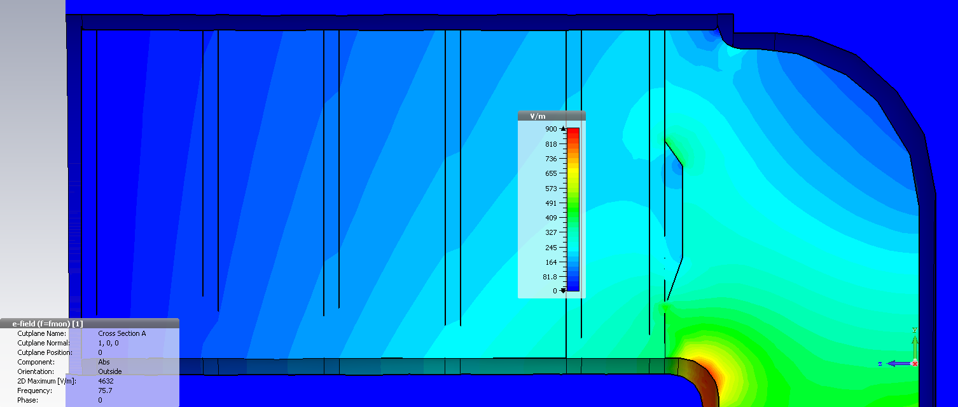
Optimized garnet shim
105 Oe
(COMSOL – 100 Oe)
|H_{bias}|, I_{stat} = 745 A
Kilpatrick limit for 77 MHz: 10.3 MV/m
|E_{rf}|, V_{acc} = 100 kV
≈ 1.3 MV/m
3.9 MV/m

