Slide 1
High Q-factor superconducting cavities as enabling technology for CW accelerators
Martina Martinello
APT Seminar, 1st July 2017

Slide 2
Outline
Introduction
The N-doping treatment
Trapped flux in SRF cavities
Best treatment for high Q-factors
Frequency-dependence study
New insights on the physics of the anti-Q-slope
Ideas for future doping @ FNAL
Conclusions

Slide 3
Outline
Introduction
The N-doping treatment
Trapped flux in SRF cavities
Best treatment for high Q-factors
Frequency-dependence study
New insights on the physics of the anti-Q-slope
Ideas for future doping @ FNAL
Conclusions

Slide 4
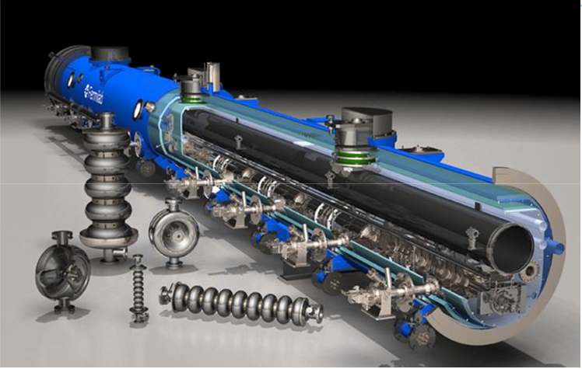
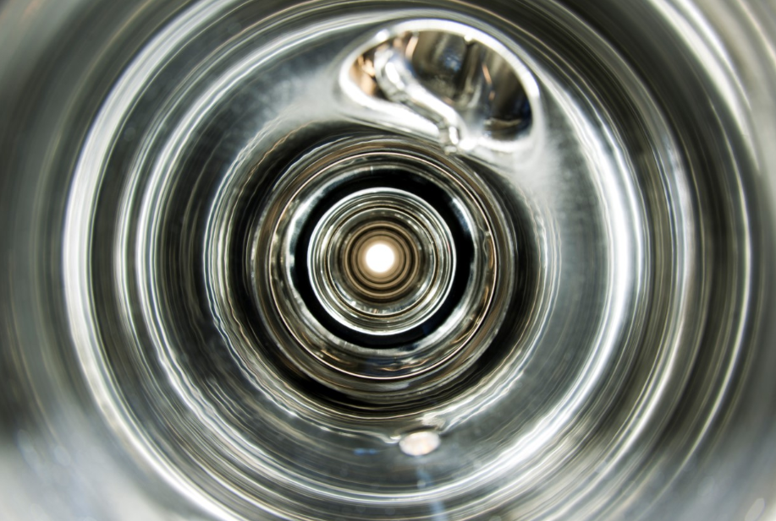
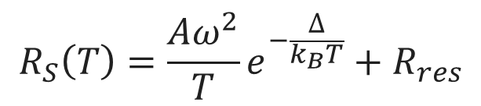
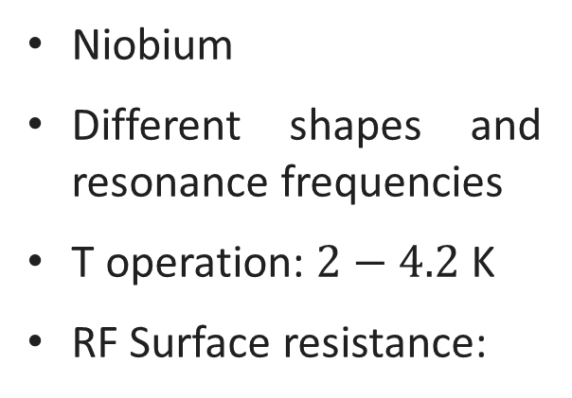
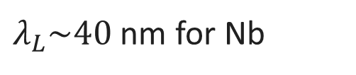

Superconducting RF Cavities
3. Criteria for Cavity Design: accelerating cells
Niobium
Different shapes and resonance frequencies
T operation: $2−4.2$ K
RF Surface resistance:
$$R_{S}\left(T\right)=\frac{Aω^{2}}{T}e^{−\frac{∆}{k_{B}T}}+R_{res}$$
Losses concentrated on the first ~100 nm of the inner surface
B_{y}(0)
$$B_{y}={B }_{0}e^{−x/λ_{L}}$$
$λ_{L}\sim 40$ nm for Nb

Slide 5
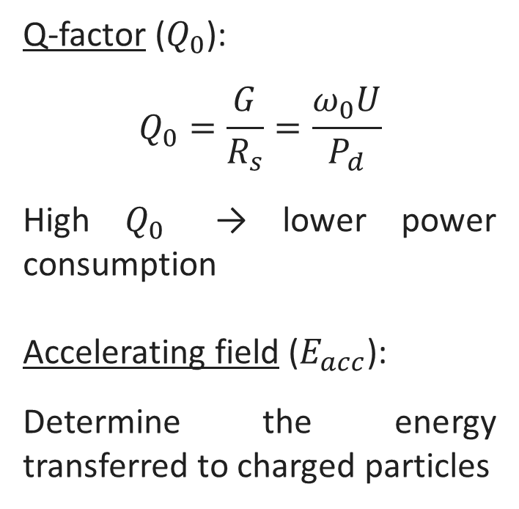
SRF Cavities Figure of Merits
SRF Cavities Figure of Merits
Q-factor ($Q_{0}$):
$$Q_{0}=\frac{G}{R_{s}}=\frac{ω_{0}U}{P_{d}}$$
High $Q_{0}$ → lower power consumption
Accelerating field ($E_{acc}$):
Determine the energy transferred to charged particles
Standard ILC cavity
High Q at large gradient may reduce both capital and operational costs of accelerators

Slide 6
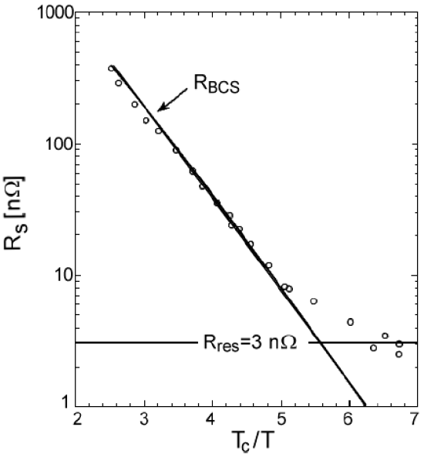


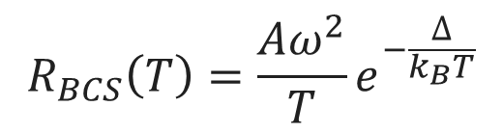
RF Superconductivity
$$R_{s}\left(T\right)=R_{BCS}\left(T\right)+R_{res}$$
$$R_{BCS}\left(T\right)=\frac{Aω^{2}}{T}e^{−\frac{∆}{k_{B}T}}$$
The BCS surface resistance is defined in Mattis-Bardeen theory, due to thermally excited quasi-particles
$$R_{res}$$
The residual resistance is due to different contributions :
Impurities/defects in the surface
Hydrides precipitates
Trapped flux (B_{trap})
...

Slide 7
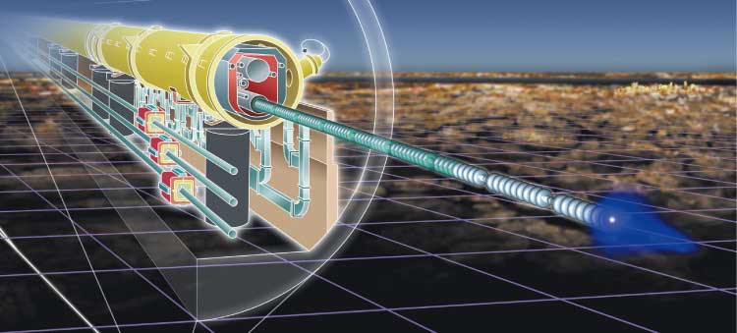
Standard Nb Surface Treatment
Conventional Nb Cavities Surface Treatment (main steps):
Cavity after Equator Welding
EP 140 um
800C UHV Bake
EP 50 um
120C bake
EP cavities
120C bake
cavities
Standard treatment for the International Linear Collider (ILC)

Slide 8
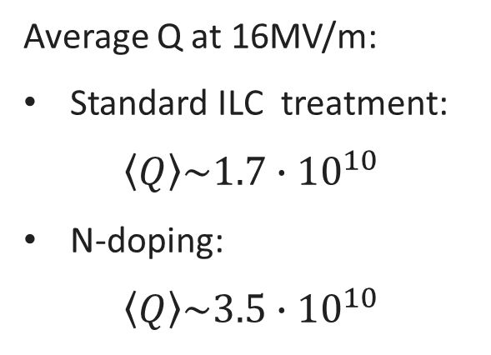
The discovery of N-doping
Q-factor improvement after N-doping – up to 4 times higher Q than standard Nb cavities
Typical Q vs Eacc curve obtained with 120C bake (standard ILC treatment)
Anti-Q-slope
Average Q at 16MV/m:
Standard ILC treatment:
$$\left\langle Q\right\rangle \sim 1.7∙{10}^{10}$$
N-doping:
$$\left\langle Q\right\rangle \sim 3.5∙{10}^{10}$$
A. Grassellino et al., Supercond. Sci. Technol. 26, 102001 (2013) – Rapid Communications
Notes:
High Q at high gradients may reduce both capital and operational cost of the accelerators

Slide 9
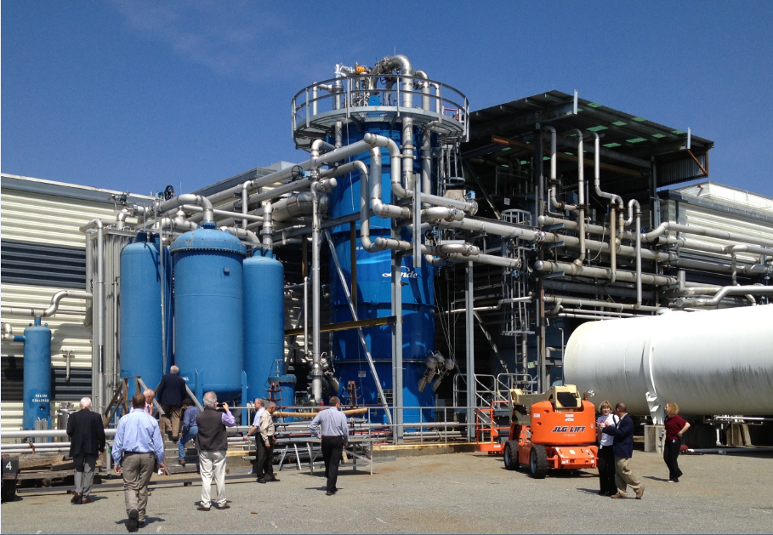
For CW accelerators the refrigeration cost is of the order of several tens of millions $
Jefferson Lab Cryoplant
(completed 2012)
→ SLAC / LCLS-II to be similar ←
Q₀ x 2 $⇒$ half cryo-power is required
Notes:
In CW machine the highest cost is usually due to refrigeration that cost several tens of millions dollar, because of the cost of every single cryoplant (In the picture). Doubling the Q-factors means cutting in half the power consumption and therefore the number of cryoplant required and the refrigeration cost

Slide 10
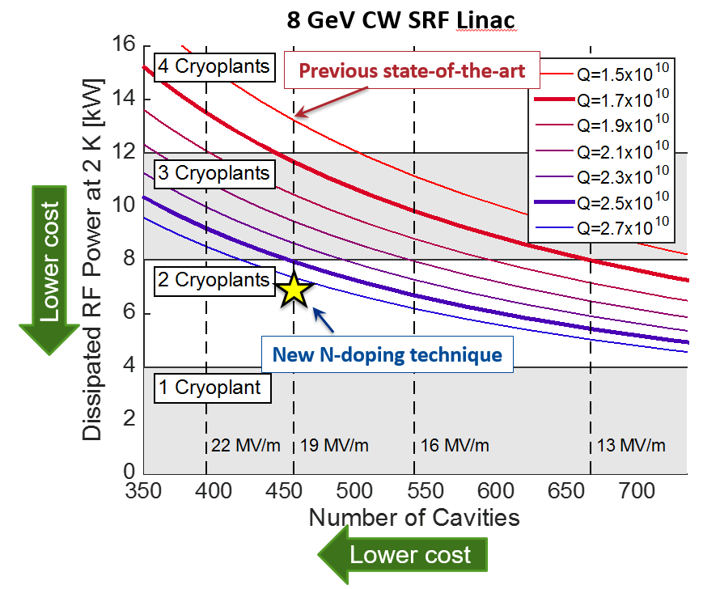
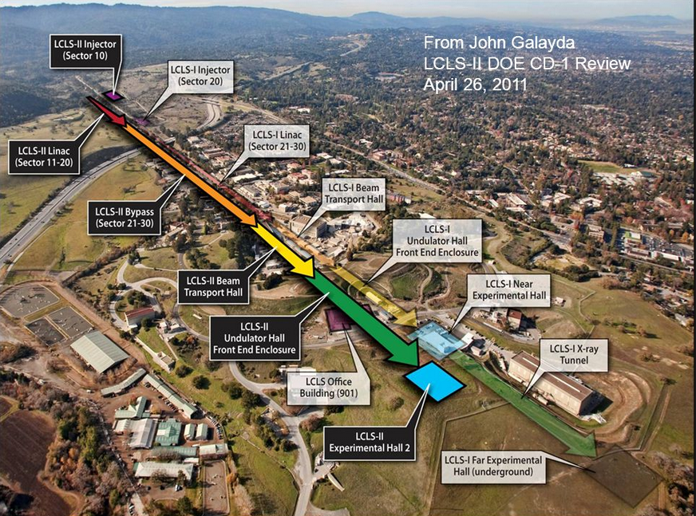
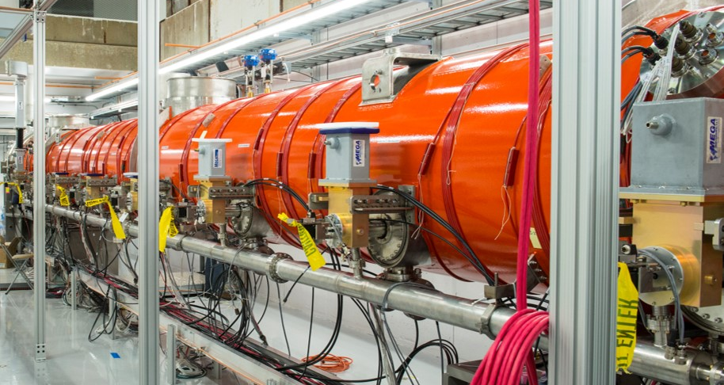
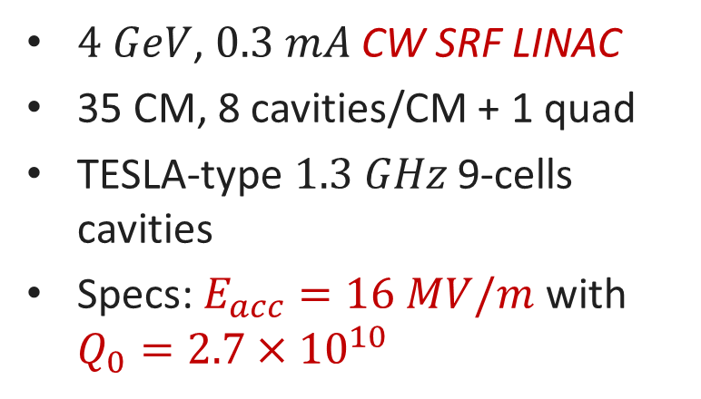
Linear Coherent Light Source-II (LCLS-II)
$4 GeV$, $0.3 mA$ CW SRF LINAC
35 CM, 8 cavities/CM + 1 quad
TESLA-type $1.3 GHz$ 9-cells cavities
Specs: $E_{acc}=16 MV/m$ with $Q_{0}=2.7×{10}^{10}$
Notes:
Indeed the construction of the LCLS-II has been possible thanks to the discovery of the N-doping, that cut in half the number of cryoplants needed to reach the desired energy. Indeed in the graph here THAT shows the case of an 8 GeV CW linac, you can see how the number of cryoplants scales by increasing the Q-factors.

Slide 11
Outline
Introduction
The N-doping treatment
Trapped flux in SRF cavities
Best treatment for high Q-factors
Frequency-dependence study
New insights on the physics of the anti-Q-slope
Ideas for future doping @ FNAL
Conclusions

Slide 12
N-doping treatment
800C UHV, 3 hours
800C N₂ injection p=25mTorr
800C N₂ 2 minutes
800C UHV, 6 minutes
UHV cooling
5 um EP
Nb

Slide 13
N-doping treatment
800C UHV, 3 hours
800C N₂ injection p=25mTorr
800C N₂ 2 minutes
800C UHV, 6 minutes
UHV cooling
5 um EP
N₂
Nb

Slide 14
N-doping treatment (example: the “2/6 recipe”)
800C UHV, 3 hours
800C N₂ injection p=25mTorr
800C N₂ 2 minutes
800C UHV, 6 minutes
UHV cooling
5 um EP
N₂
N
Nb

Slide 15
N-doping treatment (example: the “2/6 recipe”)
800C UHV, 3 hours
800C N₂ injection p=25mTorr
800C N₂ 2 minutes
800C UHV, 6 minutes
UHV cooling
5 um EP
N
Nb
N Interstitial

Slide 16
N-doping treatment (example: the “2/6 recipe”)
800C UHV, 3 hours
800C N₂ injection p=25mTorr
800C N₂ 2 minutes
800C UHV, 6 minutes
UHV cooling
5 um EP
Nb
N
N Interstitial

Slide 17
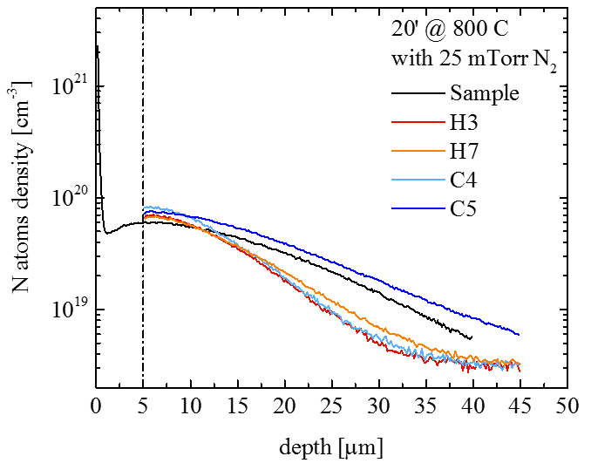
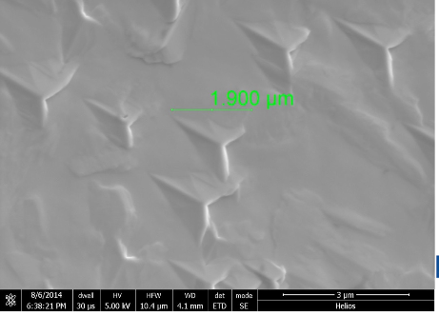
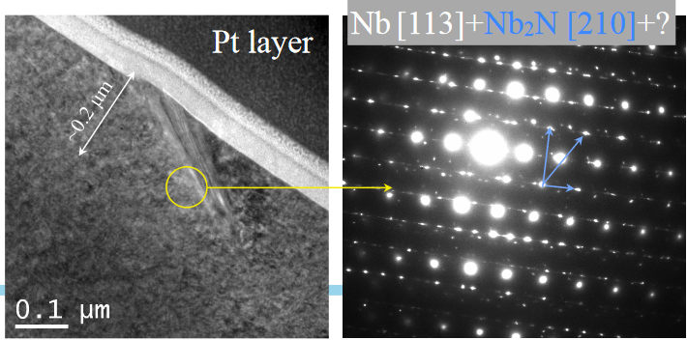
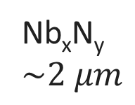
N-doping treatment (example: the “2/6 recipe”)
800C UHV, 3 hours
800C N₂ injection p=25mTorr
800C N₂ 2 minutes
800C UHV, 6 minutes
UHV cooling
5 um EP
Nb_{x}N_{y}
$\sim 2 μm$
Nb
N
N Interstitial
Y. Trenikhina et al, Proc. of SRF 2015

Slide 18
N-doping treatment (example: the “2/6 recipe”)
800C UHV, 3 hours
800C N₂ injection p=25mTorr
800C N₂ 2 minutes
800C UHV, 6 minutes
UHV cooling
5 um EP
Final RF Surface
Nb
N
N Interstitial

Slide 19
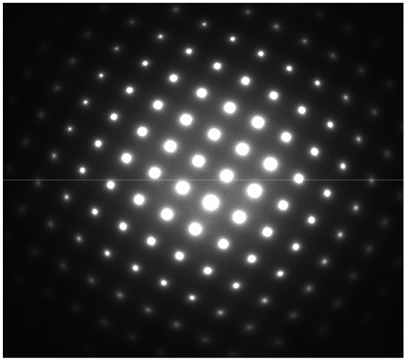
N-doping treatment (example: the “2/6 recipe”)
800C UHV, 3 hours
800C N₂ injection p=25mTorr
800C N₂ 2 minutes
800C UHV, 6 minutes
UHV cooling
5 um EP
Y. Trenikhina et Al, Proc. of SRF 2015
Only Nb from TEM spectra:
N must be interstitial
Final RF Surface
Nb
N
N Interstitial

Slide 20
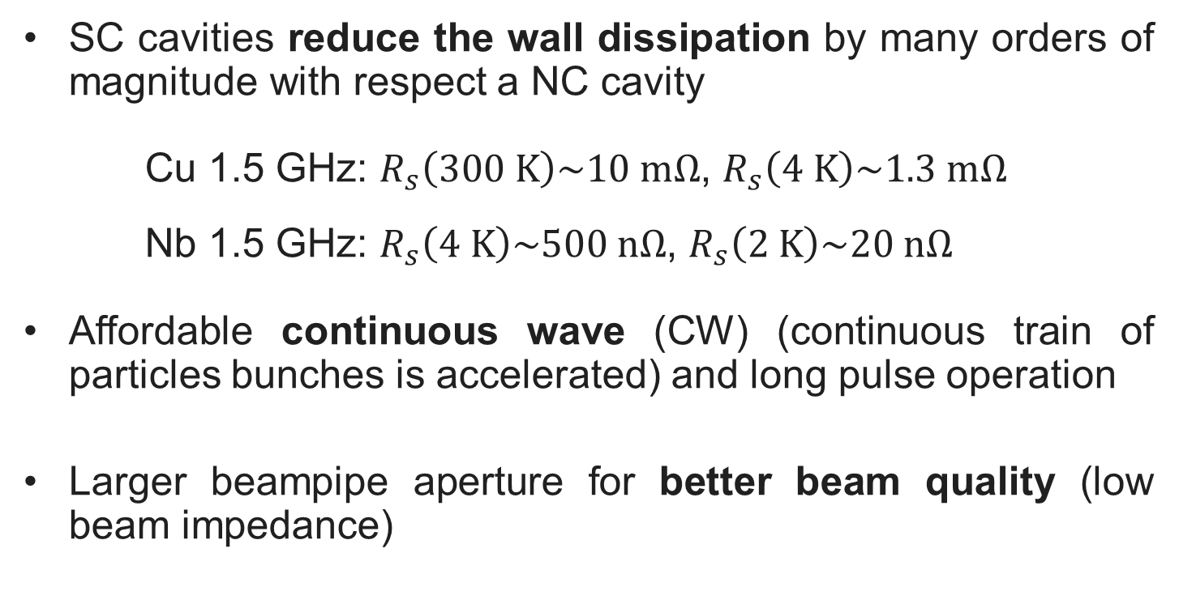
Origin of the anti-Q-slope
$$R_{S} \left( 2 K,B_{Trap} \right)={R_{BCS} \left( 2 K \right)+R}_{0}+R_{Fl} ( B_{Trap},l )$$
Anti-Q-slope
Anti-Q-slope emerges from the BCS surface resistance decreasing with field
A. Grassellino et al, Supercond. Sci. Technol. 26 102001 (2013) - Rapid Communications
A. Romanenko and A. Grassellino, Appl. Phys. Lett. 102, 252603 (2013)

Slide 21
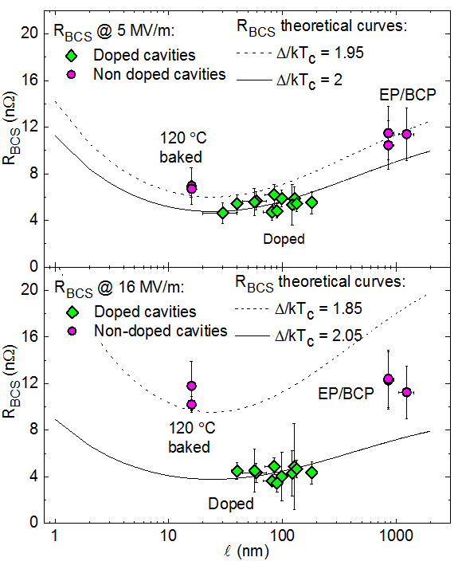
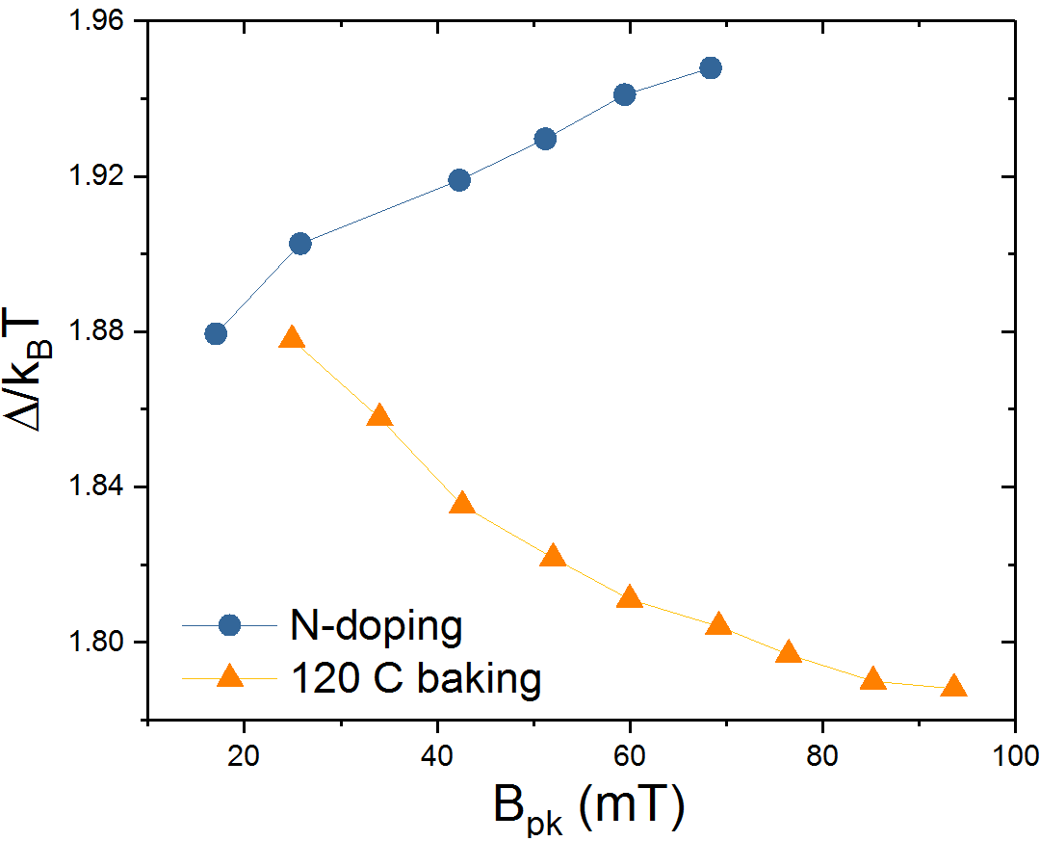
BCS surface resistance vs mfp
The reduced energy gap Δ/kTc seems to increases with Eacc for N-doped cavities causing the decreasing of Rbcs
M. Martinello et al., App. Phys. Lett. 109, 062601 (2016)

Slide 22
Outline
Introduction
The N-doping treatment
Trapped flux in SRF cavities
Best treatment for high Q-factors
Frequency-dependence study
New insights on the physics of the anti-Q-slope
Ideas for future doping @ FNAL
Conclusions

Slide 23
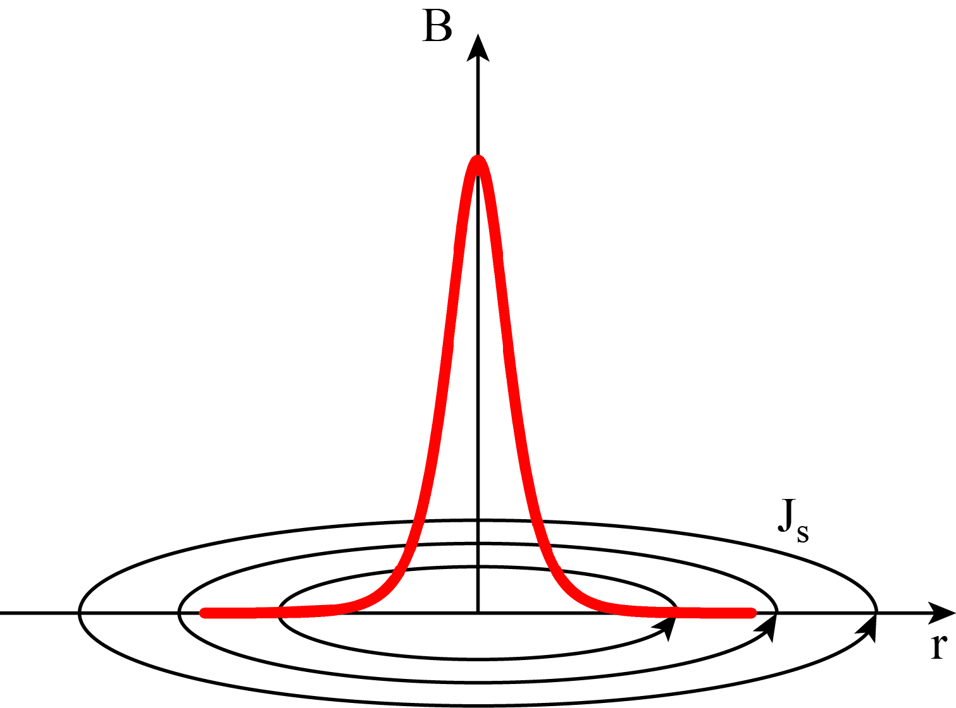
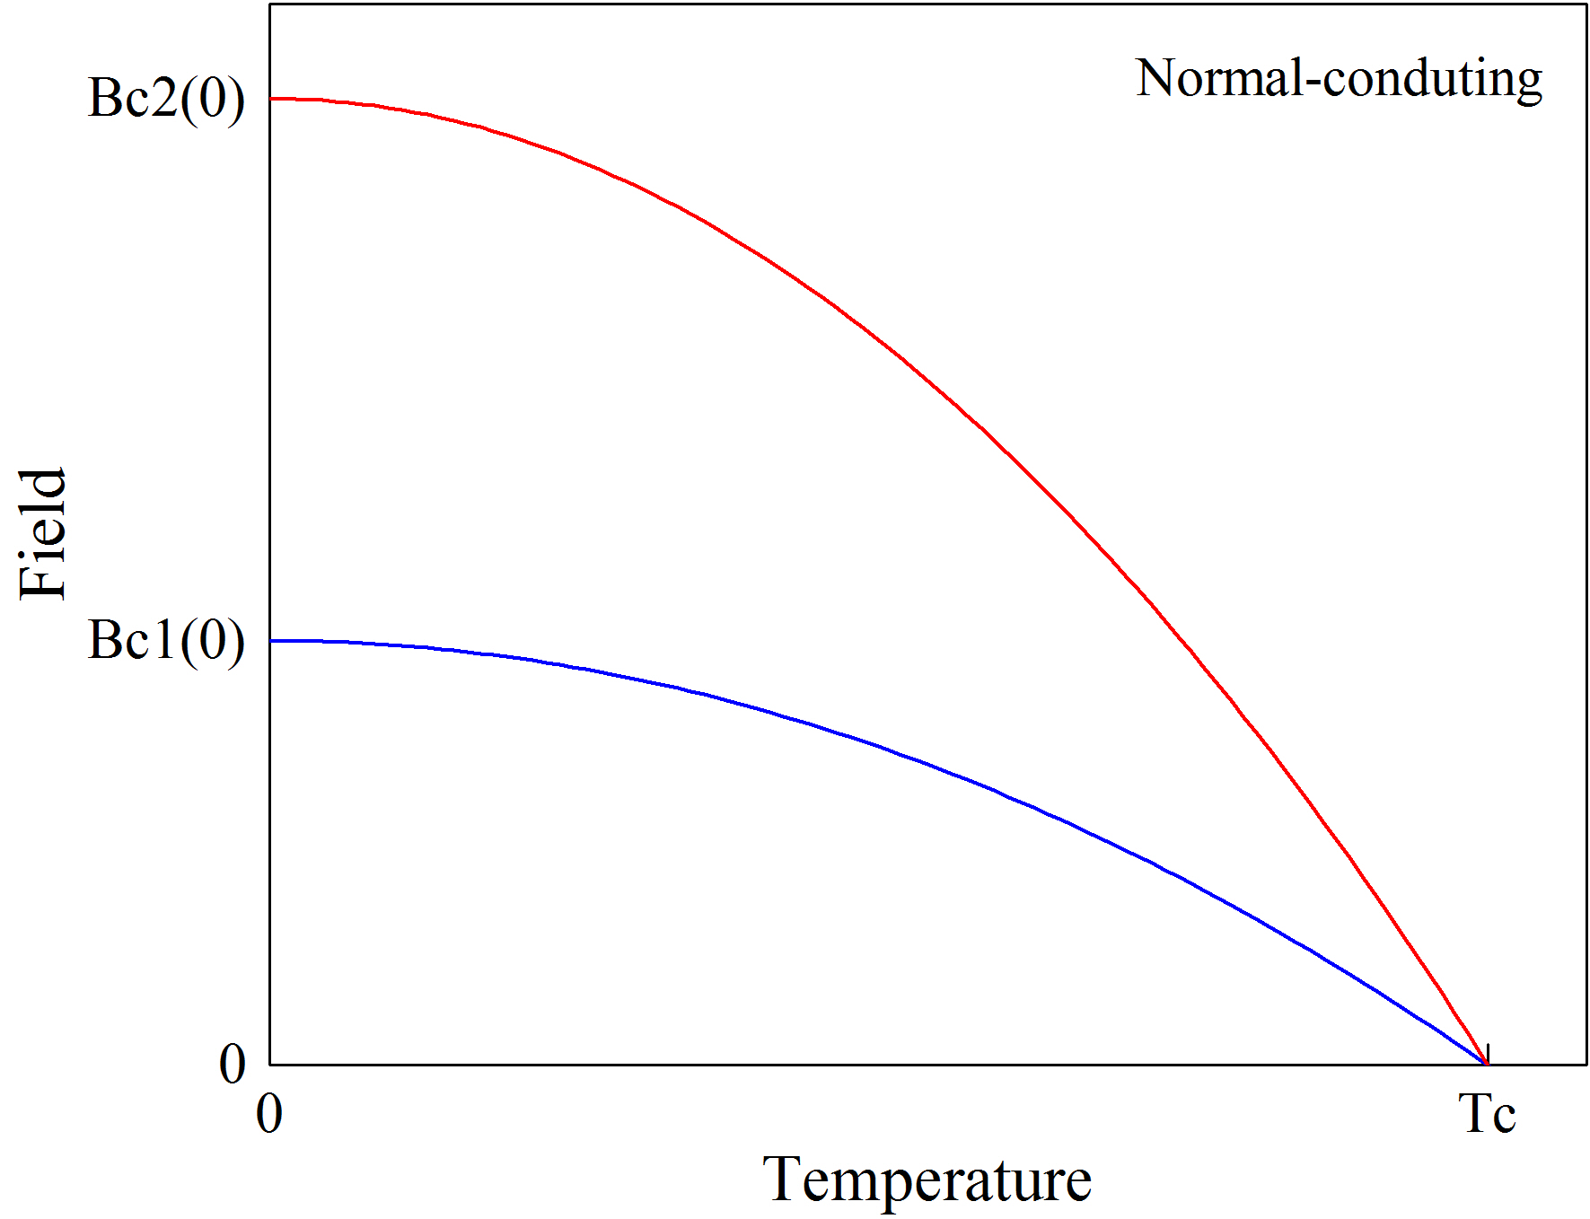
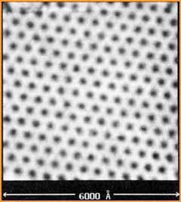


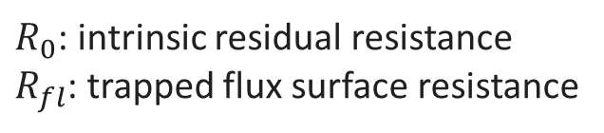
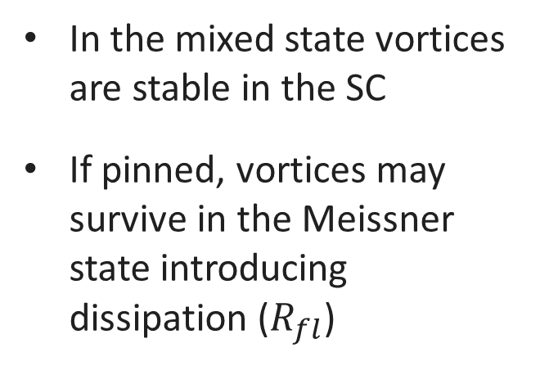
SC transition in presence of external magnetic field H
Vortex
Vortex lattice
$$R_{s}\left(T\right)=R_{BCS}\left(T\right)+R_{res}$$
In the mixed state vortices are stable in the SC
If pinned, vortices may survive in the Meissner state introducing dissipation ($R_{fl}$)
H. F. Hess et al., Phys. Rev. Lett. 62, 214 (1989)
Cooldown
$$R_{res}=R_{0}+R_{fl}(B_{trap})$$
$$B$$
Cooldown
$R_{0}$: intrinsic residual resistance
$R_{fl}$: trapped flux surface resistance

Slide 24

Trapped Flux Surface Resistance
$$R_{S} \left( 2 K,B_{Trap} \right)={R_{BCS} \left( 2 K \right)+R}_{0}+R_{Fl}$$
$$R_{Fl} =B_{ext}∙η∙S$$
These losses can be reduced by minimizing these contributions:
External Magnetic Field
$$B_{ext}$$
𝐵_𝑒𝑥𝑡
Magnetic shielding/hygiene improvement
$$η$$
𝜂
Fast Cooling
S
Optimizing mean free path
Flux Trapping Efficiency
Trapped Flux Sensitivity

Slide 25
Trapped Flux Surface Resistance
$$R_{S} \left( 2 K,B_{Trap} \right)={R_{BCS} \left( 2 K \right)+R}_{0}+R_{Fl}$$
$$R_{Fl} =B_{ext}∙η∙S$$
These losses can be reduced by minimizing these contributions:
$$B_{ext}$$
𝐵_𝑒𝑥𝑡
Magnetic shielding/hygiene improvement
$$η$$
𝜂
Fast Cooling
S
Optimizing mean free path
Flux Trapping Efficiency

Slide 26
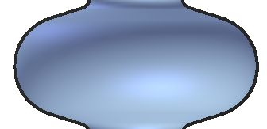
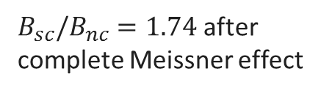
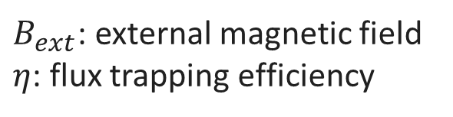
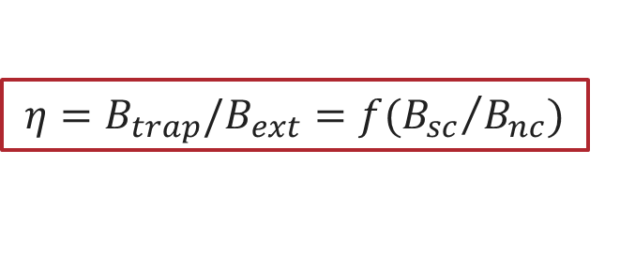
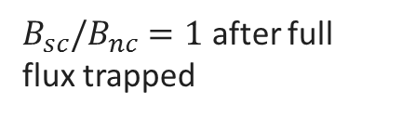
Magnetic field recombination after SC transition
$B_{ext}$: external magnetic field
$η$: flux trapping efficiency
$$η={B_{trap}/B}_{ext}=f({B_{sc}}/{B_{nc}})$$
Before the SC transition:
B_{ext}=B_{NC}
fluxgate magnetometers to measure external field
After the SC transition:
Field completely expelled
B_{SC}
$B_{sc}/B_{nc}=1.74$ after complete Meissner effect
Field completely trapped
B_{SC}
$B_{sc}/B_{nc}=1$ after full flux trapped

Slide 27
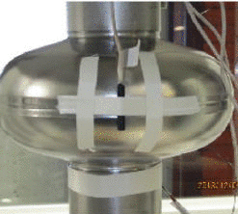
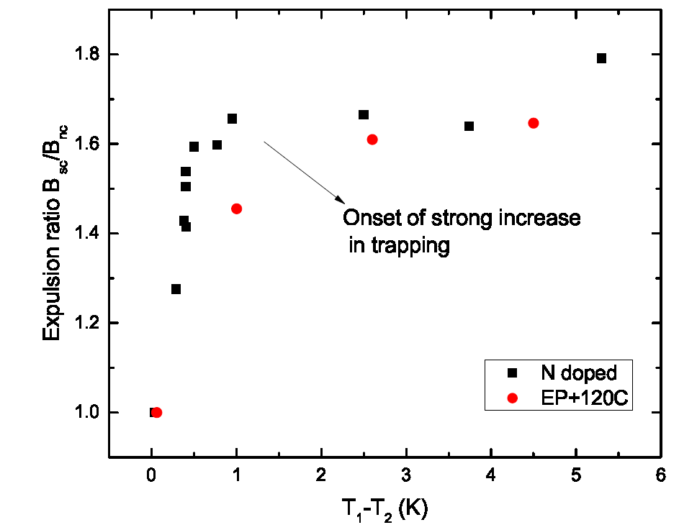
Fast cooldown helps flux expulsion
Fast cool-down lead to large thermal gradients which promote efficient flux expulsion
Slow cool-down → poor flux expulsion
T₁
T₂
B_{SC}/B_{NC}
Q₀
A. Romanenko et al., Appl. Phys. Lett. 105, 234103 (2014)
A. Romanenko et al., J. Appl. Phys. 115, 184903 (2014)
M. Martinello et al., J. Appl. Phys. 118, 044505 (2015)
S. Posen et al., J. Appl. Phys. 119, 213903 (2016)

Slide 28
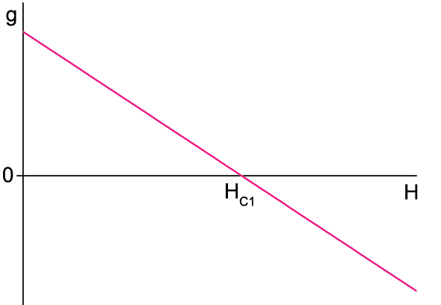




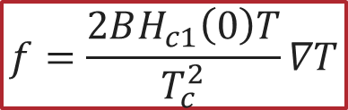

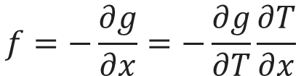

Why fast cooling help expelling vortices
The Gibbs free energy density defines the stability of vortices in the SC:
$$g=B(H_{c1}(T)−H)$$
The gradient of the Gibbs free energy defines the thermodynamic force:
$$y$$
$$g(x)$$
$$f=−\frac{∂g}{∂x}=−\frac{∂g}{∂T}\frac{∂T}{∂x}$$
$$f$$
$$f$$
$$f=\frac{2BH_{c1}\left(0\right)T}{T_{c}^{2}}∇T$$
$$x$$
Meissner State
Mixed State
The thermodynamic force pushes vortices from the Meissner to the mixed state with a force proportional to the thermal-gradient
M. Martinello, PhD Thesis (2016)

Slide 29
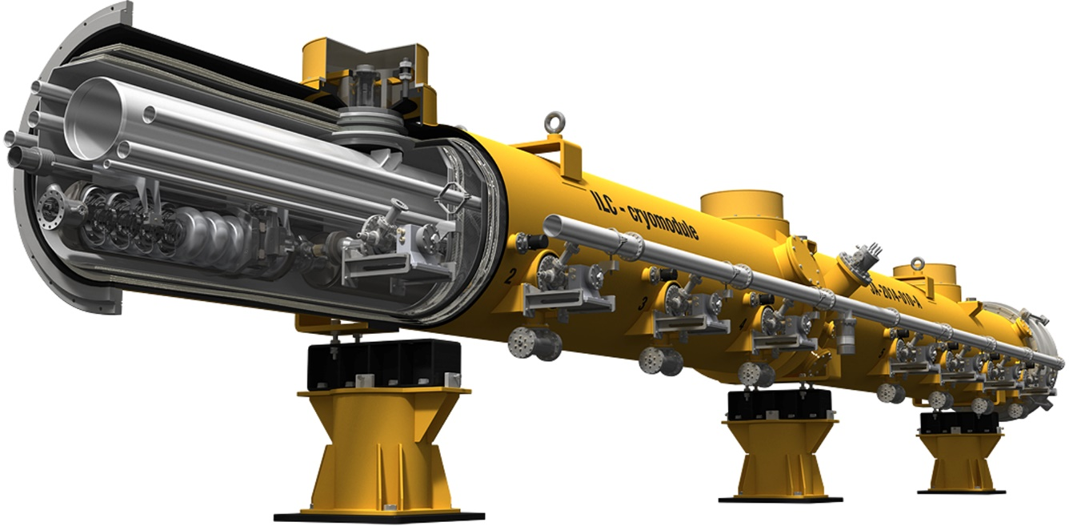
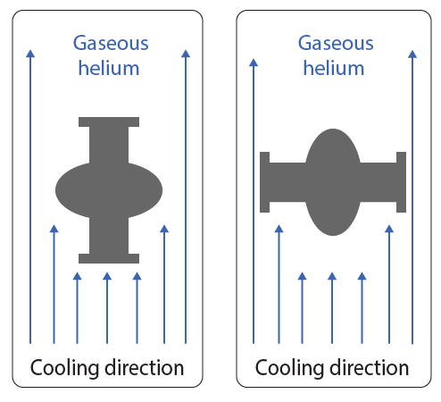
Cavity Cooling in Cryomodules
Vertical Cryostat Test (VTS)
ILC Cryomodule
Usual geometry:
vertical cooldown
New geometry:
horizontal cooldown
Vertical cooldown usually done to measure cavity performance
Inside a cryomodule cavities are horizontally cooled
Single cell cavity horizontally placed in the vertical test cryostat → resembles cavities cooling in accelerators

Slide 30
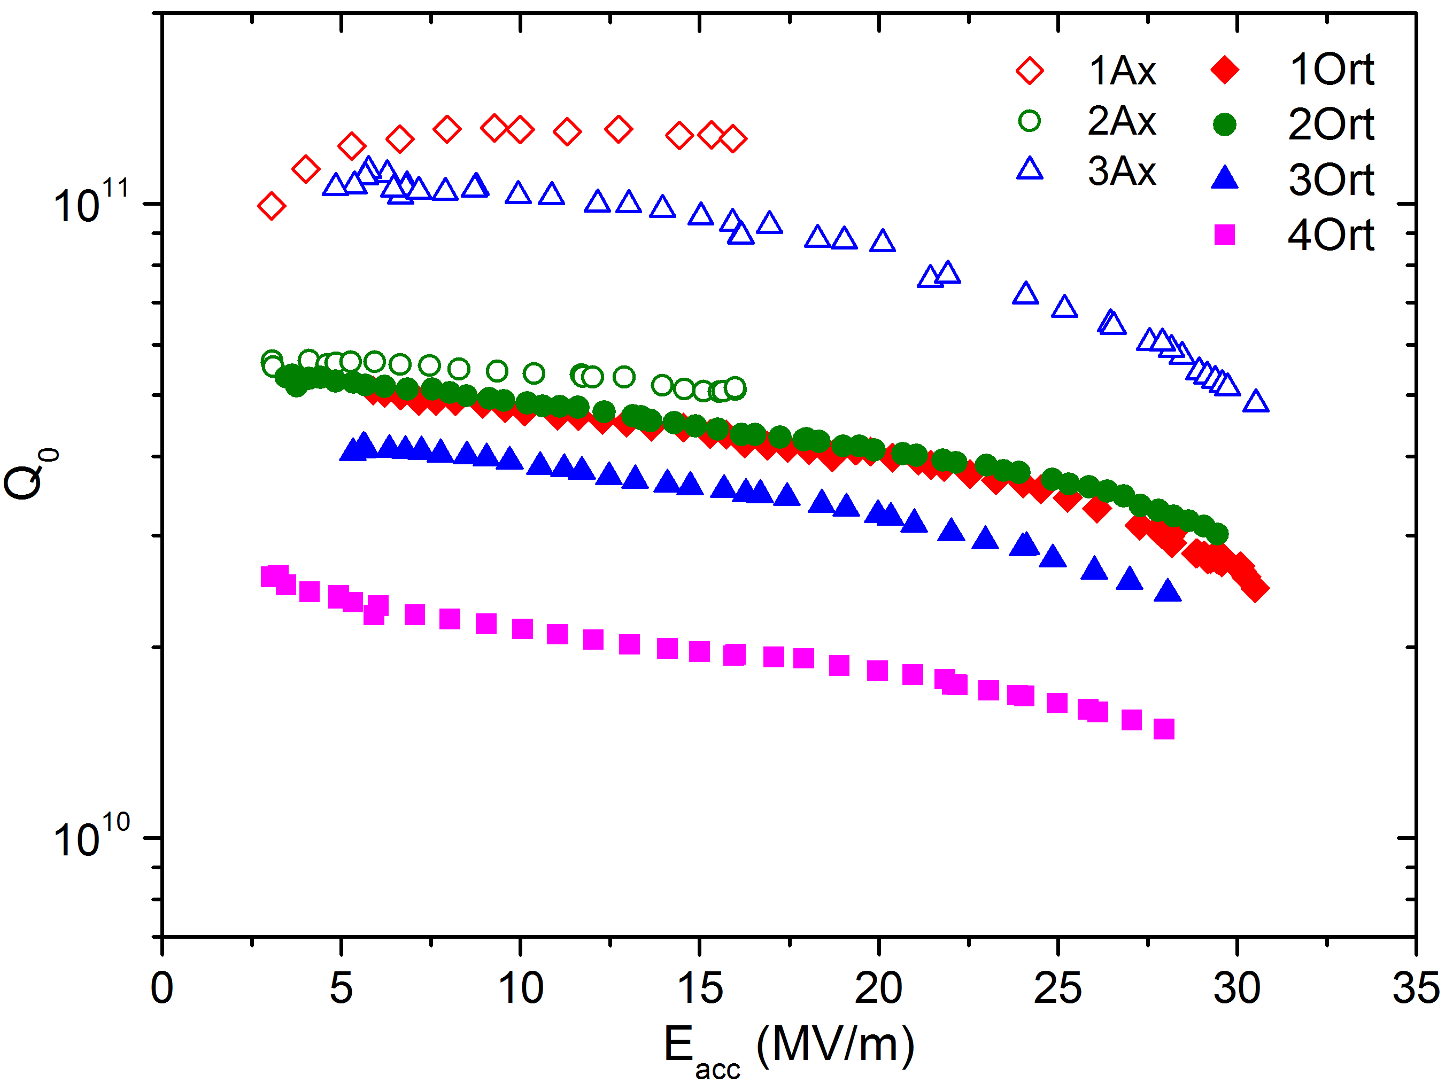
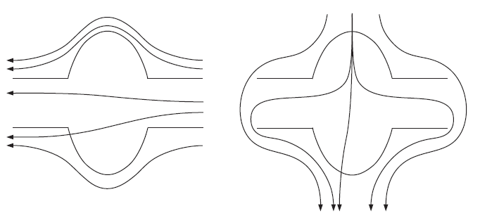
RF test result after cooldown in 10 mG
Axial magnetic field:
Orthogonal magnetic field:
Complete flux expulsion is possible during horizontal cooldown, but more difficult to achieve with orthogonal magnetic field
M. Martinello et al., J. Appl. Phys. 118, 044505 (2015)

Slide 31
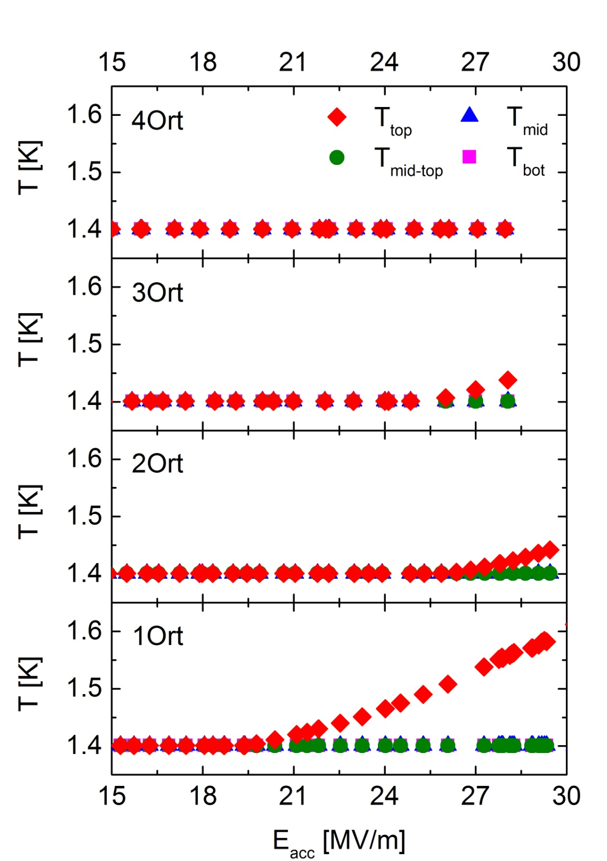
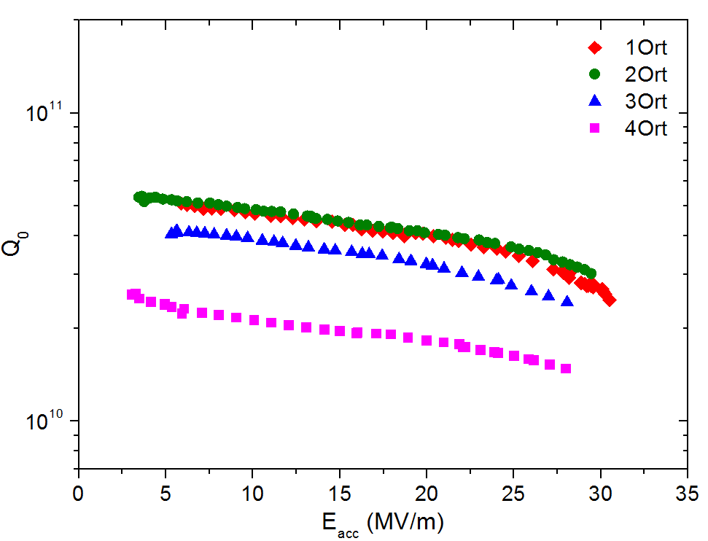
RF test result after cooldown in 10 mG
Temperature rising on top after fast cooldown in orthogonal magnetic field
M. Martinello et al., J. Appl. Phys. 118, 044505 (2015)

Slide 32
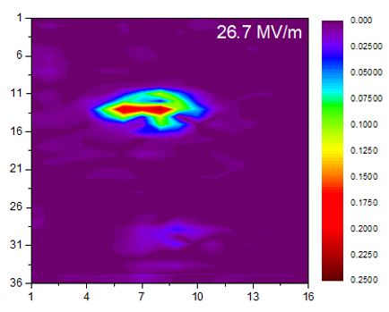
RF test result after cooldown in 10 mG
Top cavity equator
Temperature rising on top after fast cooldown in orthogonal magnetic field
M. Martinello et al., J. Appl. Phys. 118, 044505 (2015)

Slide 33
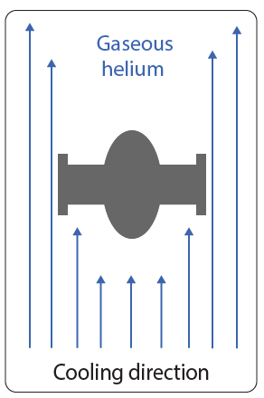
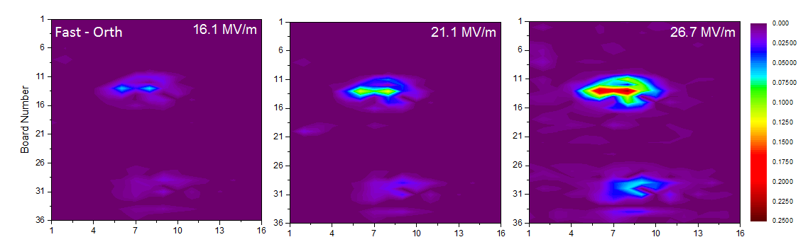

Flux-hole scenario
Orthogonal
Axial
flux-hole
9.25K
Orthogonal magnetic field concentrates on top during the cool-down
→ localized trapped flux increases dissipation and T
M. Martinello et al., J. Appl. Phys. 118, 044505 (2015)

Slide 34
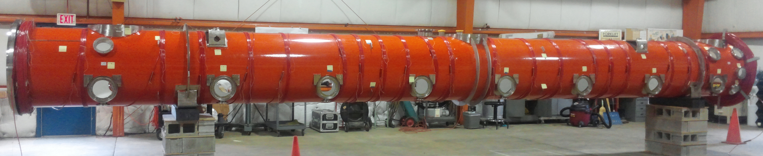
Implications for Accelerators
Coils for magnetic field demagnetization
New direction to avoid trapped flux in cryomodules:
Fast cooldown to promote flux expulsion
Minimization of external magnetic field
Minimization of orthogonal magnetic field component crucial to avoid flux trapping even during fast cooldown

Slide 35
Trapped Flux Surface Resistance
$$R_{S} \left( 2 K,B_{Trap} \right)={R_{BCS} \left( 2 K \right)+R}_{0}+R_{Fl}$$
$$R_{Fl} =B_{ext}∙η∙S$$
These losses can be reduced by minimizing these contributions:
$$B_{ext}$$
𝐵_𝑒𝑥𝑡
Magnetic shielding/hygiene improvement
$$η$$
𝜂
Fast Cooling
S
Optimizing mean free path
Trapped Flux Sensitivity

Slide 36
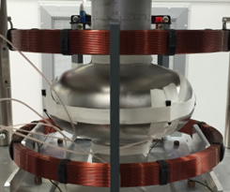
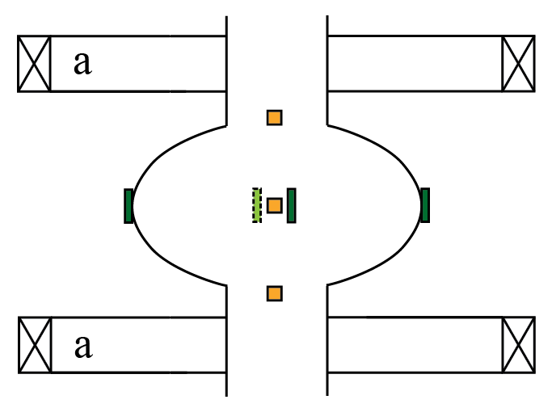



Trapped Flux Sensitivity Calculation
The trapped flux sensitivity S defines how much the cavity dissipates per amount of trapped flux
$$S=\frac{R_{Fl}}{B_{Trap}}$$
$R_{Fl}$ → trapped flux surface resistance
$B_{Trap}=B_{ext}∙η$ → trapped magnetic field
$B_{ext}$: external magnetic field
$η$: flux trapping efficiency

Slide 37

Trapped Flux Sensitivity Example

Slide 38
Trapped Flux Sensitivity Example
B_{trap}=10.8 mG
S=0.5 nΩ/mG

Slide 39
Trapped Flux Sensitivity Example
B_{trap}=10.8 mG
S=0.5 nΩ/mG
B_{trap}=10.7 mG
S=1.5 nΩ/mG

Slide 40
Sensitivity vs Mean Free Path
NEW FINDING: Bell-shaped trend of $S$ as a function of mean free path
M. Martinello et al., App. Phys. Lett. 109, 062601 (2016)

Slide 41
Outline
Introduction
The N-doping treatment
Trapped flux in SRF cavities
Best treatment for high Q-factors
Frequency-dependence study
New insights on the physics of the anti-Q-slope
Ideas for future doping @ FNAL
Conclusions

Slide 42



Surface resistance contributions
$$R_{S} \left( 2 K \right)=R_{BCS} \left( 2 K \right)+R_{fl}+R_{0}$$
Residual resistance:
4 nΩ: 120C baked cavities
2 nΩ: EP and optimally N-doped cavities
Adding together all the $R_{S}$ contributions, it is possible to predict which treatments lowers Rs, taking into account also trapped flux
Best compromise given by light N-doping treatments

Slide 43

The advantage of N-doping in condition of full flux-trapping
12
15
M. Martinello et al., App. Phys. Lett. 109, 062601 (2016)

Slide 44
The advantage of N-doping in condition of full flux-trapping
12
15
Gain in Q-factor given by the N-doping in condition of full flux trapping
M. Martinello et al., App. Phys. Lett. 109, 062601 (2016)

Slide 45
The advantage of N-doping in condition of full flux-trapping
12
15
N-doping wins over standard treatments as long as the field trapped is <10 mG
M. Martinello et al., App. Phys. Lett. 109, 062601 (2016)

Slide 46

Example with LCLS-II specifications
12
15
To reach $Q=2.7∙{10}^{10}$ LCLS-II cavities can afford 2.5 mG fully trapped
2.5
M. Martinello et al., App. Phys. Lett. 109, 062601 (2016)

Slide 47


Recipe for High Q-factors in Cryomodules
$$R_{S} \left( 2 K,B_{Trap} \right)={R_{BCS} \left( 2 K \right)+R}_{0}+R_{Fl} ( B_{Trap},l )$$
$R_{BCS}$ is minimized with N-doping, especially at medium field
$R_{0}$ is very low for both N-doped and EP cavities
$R_{Fl}$ can be minimized via:
      Efficient magnetic field shielding, especially for the orthogonal magnetic field component
      Fast cooling
      Light N-doping
2/6 N-doped cavities in a cryomodule environment with $B < 10$mG and fast cooldown led to the highest achievable Q-factors in cryomodules

Slide 48
Outline
Introduction
The N-doping treatment
Trapped flux in SRF cavities
Best treatment for high Q-factors
Frequency-dependence study
New insights on the physics of the anti-Q-slope
Ideas for future doping @ FNAL
Conclusions

Slide 49




Study of N-Doping at Different Frequencies
Elliptical-shape cavities available @ FNAL: 650 MHz, 1.3 GHz, 2.6 GHz, 3.9 GHz
New study:
How does Rs(Eacc) varies with the frequency, and for different treatments?
Is the “doping-effect” frequency dependent?
First systematic frequency-dependence study done using SRF cavities!
1.3 GHz
1.3 GHz
2.6 GHz
650 MHz
3.9 GHz
650 MHz
1.3 GHz
3.9 GHz

Slide 50

Effect of the frequency on the slope of R_{BCS}(Eacc)
M. Martinello et al., to be published

Slide 51
Effect of the frequency on the slope of R_{BCS}(Eacc)
From 650 MHz to 1.3 GHz we observe a reversal of the R_{BCS} field dependence
M. Martinello et al., to be published

Slide 52

Normalized Rbcs for different frequencies
M. Martinello et al., to be published

Slide 53
Normalized Rbcs for different frequencies
Varying the frequency we observe a strong changing in the field dependence of R_{BCS}
M. Martinello et al., to be published

Slide 54
Effect of the frequency on the slope of R_{BCS}(Eacc)
What are the implications for accelerators regarding the different field dependences?

Slide 55

More R&D to Improve Q at 650 MHz
N-doping provide higher Q-factor than 120C baking even at 650 MHz
Because of the weaker “doping-effect” Q is lower than the one expected → more R&D needed to optimize doping at 650MHz

Slide 56

High frequency cavities favorable at high field
120C baking
Less pronounced field dependence of R_{BCS}:
high frequency cavities may be a good choice for high field machines → possibility of significant cost reduction
Notes:
Regarding the high frequency cavities, they seem to be very interesting for high field applications since because of the weacker field-dependence of Rbcs with the field, the Q-factorn approaches the one of a 1.3 GHz cavity around 35 MV/m. So if we manage to increase a little bit more the Q at 35 MV/m, 2.6 GHz cavities might become the best choise for high field machine like the ILC, allowing for a significant cost reduction.

Slide 57
Outline
Introduction
The N-doping treatment
Trapped flux in SRF cavities
Best treatment for high Q-factors
Frequency-dependence study
New insights on the physics of the anti-Q-slope
Ideas for future doping @ FNAL
Conclusions

Slide 58



Gurevich’s theory of the decreasing of R_{s}(E_{acc})
A. Gurevich, Phys. Rev. Lett. 113, 087001 (2014)
Notes:
So far only one theory was developed, by Gurevich, in order to understand the anti-Q-slope of N-doped cavities. His theory takes into account that the current induced a broadening effect on the density of state and taking into account just the effect of this broadening one can easily see from this approximated formula than Rs decreases as a function of the applied field, and for this theory this is true for all superconductors in the dirty regime. In his theory the surface resistance in then calculated in a self-consisted way, taking into account the non perfect balance between the overheating of quasi-particles under the RF field and the cooling from the He bath. Therefore, depending on this quasi-particles overheating the anti-Q-slope can be more or less evident.

Slide 59

Theory prediction vs experimental data
Gurevich’s theory prediction
Experimental data
Higher f₀
Higher f₀
J. Maniscalco et al. in Proc. of IPAC 2017
Gurevich’s theory prediction of the frequency dependence of R_{BCS}(E_{acc}) is in contradiction with our new experimental findings
Notes:
Recently Maniscalco extrapolated the frequency dependence from the Gurevich’s theory, predicting that at lower frequency the anti-Q-slope effect should be more pronounced, while it becomes weacker at higher frequency. However, it is interesting that this prediction is in contradiction with our new experimental founding, meaning that part of the physics underneath the “doping-effect” is still to be uncovered.

Slide 60



Understanding the reversal of R_{BCS} with the RF field
The non-equilibrium quasiparticle distribution driven by microwave fields is shown to stimulate the superconductivity^{1,2,3}:
$→$ $Δ$ increases with the RF field amplitude (absorbed power)
$→$ $RBCS$ decreases with the RF field amplitude (absorbed power)
Δ increases driven by $Eacc$?
T. Kommers and J. Clarke,
Phys. Rev. Lett. 38, 1091 (1977)
¹ G.M. Eliashberg, ZhETF Pis. Red. 11, 186 (1970)
² J.-J. Chang and D. J. Scalapino, Phys. Rev. B 15, 2051 (1977)
³ D. J. Goldie and S. Withington, Supercond. Sci. Technol. 26, 015004 (2013)
Notes:
So to understand better what is going on, we can actually let our experimental findings guide us, because if we go back a little bit we have found that the decreasing of the BCS surface resistance contribution might be explained by an increasing of the energy gap with the field. And increasing of delta with the field was already observed in the past in superconductors exposed to high frequency fields, and the effects has been attributed to non-equilibrium superconductivity. So the same effect might actually play an important role also in the case of N-doped cavities, so lets see what non-equilibrium means.

Slide 61



Thermal equilibrium distribution of quasiparticles
$$f(E)$$
$$2∆$$
Notes:
Here illustrated is the energy levels as a function of the density of states for a superconductors: you can see Cooper pairs in the sc ground state and quasi-particles above the gap occupying the exited states.

Slide 62



Non-equilibrium distribution of quasiparticles
$$hν$$
$$hν$$
$$hν$$
$$f(E)$$
$$2∆$$
Notes:
Here is how the situation changes when quasi-particles interact with the field. So they are pushed at higher level and these level s are determined by the energy hv of the RF field.

Slide 63


Non-equilibrium distribution of quasiparticles
$$hν$$
$$τ_{ep}$$
$$hν$$
$$hν$$
$$f(E)$$
$$2∆$$
$τ_{ep}$: electron-phonons inelastic scattering time
Notes:
Once they are at this higher energy levels they can relax in two different mechanism: first is relaxation to the quasi-particles ground state via phonon inelastic scattering

Slide 64



Non-equilibrium distribution of quasiparticles
$$hν$$
$$τ_{ep}$$
$$hν$$
$$hν$$
$$f(E)$$
$$τ_{r}(E)$$
$$τ_{r}(E+nhν)$$
$$2∆$$
$τ_{ep}$: electron-phonons inelastic scattering time
$τ_{r}$: quasi-particles recombination time
Notes:
And the second is recombination in cooper pairs, and this mechanism is more favorable at higher energy. If quasi-particles recombine in cooper pairs the superconductivity is enhanced. So non-equilibrium means have enough quasi-particles in the excited state so that there will be a large number of Cooper pairs. This situation of non-equilibrium can appear only if the RF period is fastest than the relaxation/recombination times otherwise quasi-particle would have never enough time to populate the higher energy state. Consequence of this is that higher frequency favorable non-equilibrium effects.

Slide 65

Non-equilibrium distribution of quasiparticles
$$hν$$
$$τ_{ep}$$
$$hν$$
$$hν$$
$$f(E)$$
$$τ_{r}(E)$$
$$τ_{r}(E+nhν)$$
$$2∆$$
N-doping may modify $τ_{ep}$ and $τ_{r}$ enhancing the non-equilibrium effects
$τ_{ep}$: electron-phonons inelastic scattering time
$τ_{r}$: quasi-particles recombination time
Notes:
Also the presence of Nitrogen , or other impurities, modify the density of state, so can modify the relaxation and recombination times, making non-equilibrium effect more favorable.

Slide 66
Non-equilibrium effects on SRF performance
Taking into account the smearing of the DOS due to the RF field amplitude (as done by Gurevich) and non-equilibrium effects (new hypothesis) we may be able to explain the experimental results:
High frequencies favor non-equilibrium effects in superconductors
Impurities may modify the relaxation/recombination times of quasiparticles allowing non-equilibrium effects at lower frequencies
Different impurities may weight differently (120C bake vs N-doping)

Slide 67
Outline
Introduction
The N-doping treatment
Trapped flux in SRF cavities
Best treatment for high Q-factors
Frequency-dependence study
New insights on the physics of the anti-Q-slope
Ideas for future doping @ FNAL
Conclusions

Slide 68



First hint of Ti-doping
Q-factor enhancement after treatment at 1400 C
Ti contamination from flanges measured with SIMS
First evidence of Ti doping?
P. Dhakal et al., PRST-AB 16, 042001 (2013)

Slide 69


Ti-doping @ FNAL
Cavity baked at 1300 C for 112 h with NbTi flanges
Reduction of R_{BCS} observed, further hints of Ti doping
Large residual resistance prevent to see high Q-factor and strong anti-Q-slope
Ti-doping to be performed in a more controllable way

Slide 70


Possibility of Sn-doping @ FNAL
C. Toffolon et al., J. Phase Equil. 23, 134 2002
Fermilab Nb₃Sn Coating Furnace
α-Nb
Courtesy
of S. Posen
α-Nb + Nb₃SN
Fermilab has the infrastructure to evaporate Sn at high T and make it diffuse into a Nb cavity
From the Nb-Sn phase diagram the α-Nb phase can be formed
It is highly probable to form also Nb₃Sn phase

Slide 71



Possibility of doping with different metals
With the same set-up we should be able to explore different metal-doping
Crucial is to fabricate different inserts for the furnace in order to avoid cross-contaminations
Nb-Al
Nb-Ga
Nb-Ge
α-Nb
α-Nb
α-Nb
J. Flukiger et al., J. Less Comm. Metals 55, 249 (1977)/ 75, 227 (1980)/ 62, 25 (1978)

Slide 72

Possibility of doping with different elements

Slide 73
Possibility of doping with different elements
With a dedicated furnace we might be able to explore doping with different elements

Slide 74
Possibility of doping with different elements
With a dedicated furnace we might be able to explore doping with different elements
Can we improve the performance of Nb even further?

Slide 75
Outline
Introduction
The N-doping treatment
Trapped flux in SRF cavities
Best treatment for high Q-factors
Frequency-dependence study
New insights on the physics of the anti-Q-slope
Ideas for future doping @ FNAL
Conclusions

Slide 76

Conclusions
N-doping promote very high Q-factors at medium field, but larger sensitivity to trapped flux so important minimize trapped field via fast cooling
Fast cooldown helps flux expulsion, but orthogonal field can be easily trapped on top
Light N-doped cavities led to the highest achievable Q-factors in cryomodules if $B < 10$mG and they are cooled fast
The decreasing of R_{BCS} due to doping becomes weaker at lower frequencies suggesting non-equilibrium effects might be the cause of the anti-Q-slope
Doping with different elements promising, important to push to even higher Q-factor and accelerating gradients

Slide 77


Thank you for your attention!

Slide 78


Density of State Measurement with STM
Scanning Tunnel Microscopy
@ Temple University
The density of state can be measured with STM
Comparison of DOS of 120C baked vs N-doped sample should provide insight on the effect of N
The phonon spectrum can be also obtained from DOS measurement
Extrapolation of quasi-particle relaxation time might be inferred to verify which is the cut-off frequency for non-equilibrium SC in doped and non-doped niobium

Slide 79




Vortex dynamic dissipation
Dissipation due to vortex oscillation under the RF field
We can define two regimes:
Large $l$ ($p→0$) – flux flow regime:
  $⇒ρ_{1}\left(l\right)\sim \frac{1}{η}$ , decreases with $l$
Small $l$ ($η→0$) – pinning regime:
  $⇒ ρ_{1}\left(l\right)\sim \frac{ηω^{2}}{p^{2}}$ , increases with $l$
Pinning
regime
Flux-flow
regime
M. Checchin et al., SUST 2016, to be published

Slide 80











Thermodynamic force versus Pinning force
The pinning force can be defined in terms of current density $J_{c}$:
Meissner
state
Mixed
state
$$\overline{f_{p}}$$
$$\overline{f}$$
$$f_{p}=\left|{ \overline{J}}_{c}×n{\overline{Φ}}_{0}\right|=J_{c}B$$
Vortex pinned to a defect
$$\overline{∇T }$$
When the two forces balance, the critical thermal gradient ${∇T }_{c}$ is:
$$T_{c1}$$
$$f_{p}=\frac{2BH_{c1}\left(0\right)T}{T_{c}^{2}}{∇T }_{c}$$
$$f_{p}=J_{c}B$$
$${∇T }_{c}=\frac{J_{c}T_{c}^{2}}{2H_{c1}\left(0\right)T}$$

Slide 81

Uniform heating after slow cooldown
No localized heating after slow cooldown:
field uniformly trapped around the cavity
M. Martinello et al., J. Appl. Phys. 118, 044505 (2015)

Slide 82




Cooldown Summary
NC-SC transition captured with T-map during fast and slow cooldown:
$$\overline{f}$$
$$\overline{f}$$
Fast CD
Slow CD
During fast cooldown vortices are swapped up toward the top of the cavity
    Vertical cooldown: flux completely expelled from the cavity
    Horizontal cooldown: orthogonal magnetic field trapped on top at the equator -> T rising
During the slow cooldown vortices are concentrated in NC regions around the cavity where they are trapped
M. Martinello et al., Proceeding of SRF 2015

Slide 83


Accelerating Cavity
A resonant cavity is a device capable to transfer energy to a charged particle beam which pass through it
Electric field:
Magnetic field:

Slide 84




Cavity Q-factor and Accelerating field
The e.m. energy stored in the cavity decays with time:
$$U\left(t\right)=U_{0}e^{−\frac{ω_{0}t}{Q_{0}}}$$
The time constant of this decay is proportional to the quality factor or Q-factor :
$$Q_{0}=\frac{ω_{0}U}{P_{c}}=\frac{G}{R_{s}}$$
The accelerating field that the electron sees during the transit is:
$$E_{acc}=\frac{V_{acc}}{d}$$
$$d$$

Slide 85


Cooldown Dynamics Recorder with T-map
NC-SC transition captured with T-map during fast and slow cooldown:
$$\overline{f}$$
$$\overline{f}$$
Fast CD
Slow CD
During fast cooldown vortices are swapped up toward the top of the cavity
During the slow cooldown vortices are concentrated in NC regions around the cavity where they are trapped
M. Martinello et al., Proceeding of SRF 2015

Slide 86



Importance of high Q-factors
Q₀ still very important!
Baseline design
  ILC: 16,000 cavities in 31 km linac
8 cavities
~10 m
  European XFEL
Image from linearcollider.org. Tunnelflug video by European XFEL. Cost analysis by N. Solyak
Notes:
We’re doing cost savings studies to try to make the ILC more affordable and increasing the gradient has the largest impact, but Q0 also has a strong impact

Slide 87
Temperature rising on top
Temperature rising on top after fast cooldown in orthogonal magnetic field
Homogeneous heating after slow cooldown
M. Martinello et al., J. Appl. Phys. 118, 044505 (2015)

Slide 88
Temperature rising on top
Temperature rising on top after fast cooldown in orthogonal magnetic field
M. Martinello et al., J. Appl. Phys. 118, 044505 (2015)

Slide 89
Temperature rising on top
Temperature rising on top after fast cooldown in orthogonal magnetic field
M. Martinello et al., J. Appl. Phys. 118, 044505 (2015)

