Slide 1
Mechanical Update
Kevin Duel
Booster 2nd Harmonic Cavity
8 June 2017

Slide 2
Garnet Ring Orders
PO placed for alumina disks with Morgan Advanced Ceramics
8-9 week lead time
Req entered for garnet rings and waiting for PO to be issued

Slide 3
Copper Plating of Stainless
Received samples of copper plated stainless plate
1/8” thick stainless
.001” (.0254 mm) copper thickness
Next step is to test brazing copper tube to Cu plated plates
Matt Slabaugh and his techs will perform in ~1 week

Slide 4
PA Outer Shell Spool
Material preference?
Aluminum?
Plating?
Interface requirements?
RF spring fingers?
Minimum contact pressure?

Slide 5
Stem to Tetrode Shroud Connection
RF spring fingers required?

Slide 6
Outer Cooling Jacket Isolation
Need to isolate these connections?
Insulating washers? Ceramic/plastic?

Slide 7
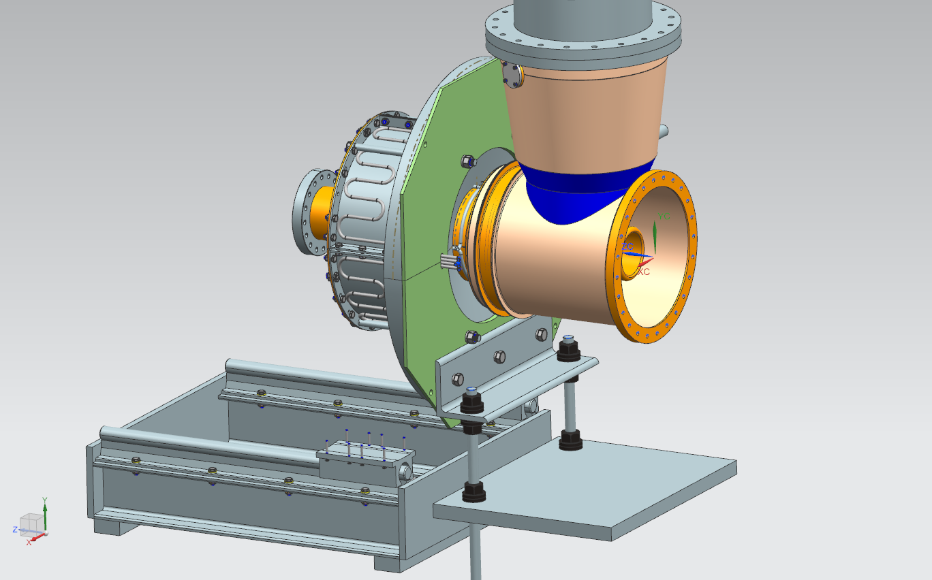
Tuner Support Concept - Rejected
Cannot screw into endplate as shown. Need to re-iterate.

Slide 8
Test Solenoid Update from Sasha
Wound the test solenoid coil and so far it is good
Trying to adapt the potting plate to a slightly new coil configuration (could not keep the wire in one layer during the winding so had to change slightly the coil and now have a lead coming from the inner layer of coil on the top of coil and need to make a slot in the potting plate)
Hope to pot the coil in the lower core next week
Have the lower core which also to be used at potting
The upper core was rejected and sent back to vendor to have it made per drawing.
1 – 2 week turnaround expected
The copper resonator is in QC now and shall be received sometime next week

