Slide 1
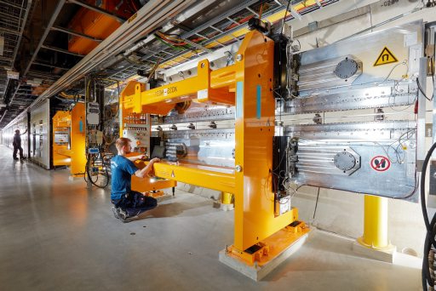
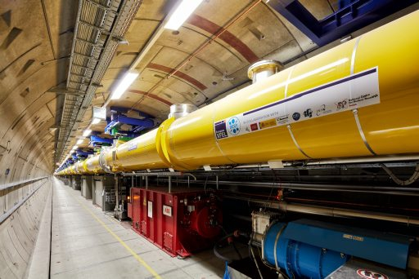
European XFEL
Alignment Work and Geodetic Control Network Adjustment
Markus Schlösser
Fermilab, June 16th, 2017

Slide 2
European XFEL, Aerial View
Facts and Figures
Total length 3.4 kilometers, tunnel length ~ 6 kilometers
Depth of tunnels is between 6 – 38 meters
Injector is located on the DESY grounds (Hamburg), as well as the cryogenic facilities
Main Linac Tunnel ~ 2km in urban area
Experimental area is located in Schenefeld (Schleswig-Holstein)

Slide 3
European XFEL
Facts and Figures
11 participating countries (DK, FR, DE, HU, IT, PL, RU, SK, ES, SE, CH)
Construction cost 1.22 billion Euro (Germany 58%, Russia 27%, others 1 – 3%), mainly as “in-kind”-contributions
Start of civil construction: 2009
Start of commissioning: 2016
First User operation: 2017
Superconducting accelerator, 101 accelerator modules
Energy: 17.5 billion electron volts
Repetition rate: 27000 flashes per second
0.05 nm < λ < 4.7 nm
Pulse length < 100 femtoseconds
Brilliance: peak 5·10³³, average 1.6·10²² (γ/s/mm²/mrad²/0.1% bandwith)

Slide 4
Alignment work
Fiducialization
Planning of monument placement on the components
Definition of component center and axis orientation together with owner
Mirror center point for MC
Center of mechanical gap for QP
Magnetic axis for HQ QP
Flange axis for VP
etc….
Creation of coordinate system (origin is located in component center)
Measurement of all fiducials in this coordinate system
Two (independent) sets of measurements to improve reliability (NOT accuracy)
Averaging data (with check for consistency of measurements)

Slide 5
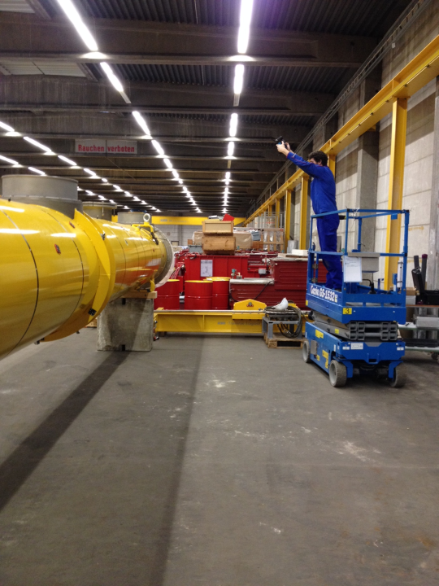
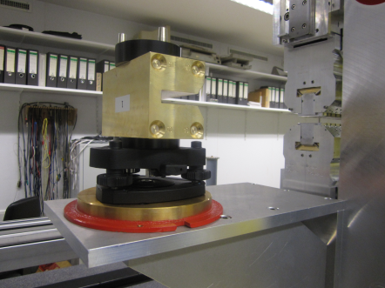
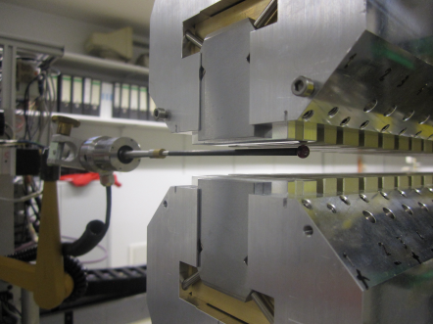
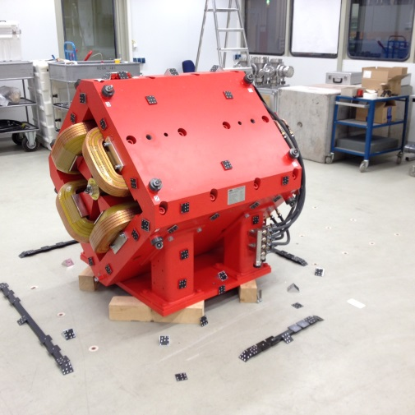
Fiducialization
Information about the inner geometry of a component is transferred to outside monuments that are accessible after installation
By laser tracker measurement
By photogrammetry
Photogrammetric measurement of quadrupole and cryo module
Axis measurement of undulator with touch probe or hall probe

Slide 6
Fiducialization
approx. 2000 components for XFEL so far (still growing)
101 cryo modules
93 undulators
~ 600 warm magnets
~ 275 corrector magnets
~ 250 ion pumps
mirror chambers / attenuators / beam shutters …
Most of them have been fiducialized by the DESY alignment group
Some are not fiducialized, because the accuracy requirement is low. Instead the relevant data has been extracted from construction drawings ⇒ this slows down the alignment process!

Slide 7
Alignment work
Stake out
Preparing nominal coordinates for every component support (boreholes)
Stake out points
Measure points staked out before (for documentation)
Coarse alignment
Preparing nominal coordinates for every component
Alignment to an accuracy of better than 1mm (required for beam pipe installation)
Measurement of aligned components (for documentation)
Fine alignment
Nominal coordinates are already available (same as for coarse alignment)
Alignment to an accuracy of 0.5 – 0.2mm (depending on component type)
Measurement of aligned components (for documentation)

Slide 8
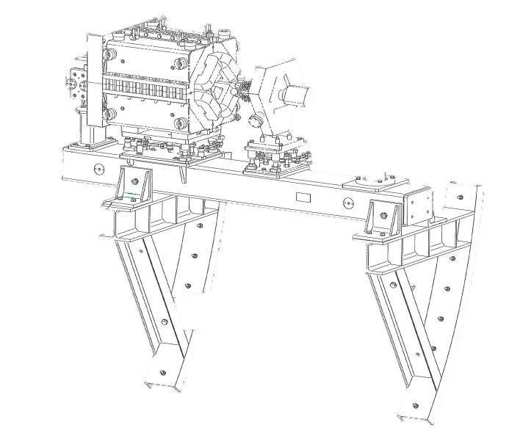
Stake out
Lattice file from physicists contains position (x,y,z) and orientation (θ,ϕ,χ) for each component ⇒ this is imported into the alignment database
Together with relative coordinates for boreholes from construction drawings (treated as “fiducialization data” here) this gives the nominal stake out coordinates for all boreholes, data is combined directly in the database
SECTION | NAME1 | GROUP | CLASS | TYPE | LENGTH | TILT | S | ST | X | Y | Z | THETA | PHI | CHI
SA3 | U68.2840.SA3 | UNDU | UNDULATO | U68 | 4.896000 | 0.000000 | 2817.309742 | 235.604721 | -5.650145 | -2.747355 | 2840.111170 | -0.000365 | 0.023007 | -0.000008
SA3 | CBX.2842.SA3 | MAGNET | HKIC | CBX | 0.025000 | 0.000000 | 2819.868942 | 238.163921 | -5.709019 | -2.748289 | 2842.669692 | -0.000365 | 0.023007 | -0.000008
SA3 | CBY.2842.SA3 | MAGNET | VKIC | CBY | 0.025000 | 0.000000 | 2819.893942 | 238.188921 | -5.709594 | -2.748298 | 2842.694686 | -0.000365 | 0.023007 | -0.000008
SA3 | ABSP.2842.SA3 | VACUUM | ABSORBER | ABSP | 0.050000 | 0.000000 | 2819.981442 | 238.276421 | -5.711607 | -2.748330 | 2842.782163 | -0.000365 | 0.023007 | -0.000008
Q(x,y,z)
Components of same type often have the same type of support, therefore this is an efficient way to produce the coordinate for stake out
(dx,dy,dz)
Q(θ,ϕ,χ)

Slide 9
Coarse / Fine alignment
Data is (almost) produced automatically
Lattice was already inserted into DB during stake out
Fiducialization data is already present in DB
Only information about individual magnets and their installation positions has to be supplied
No major difference between coarse and fine alignment from organizational point of view

Slide 10
Alignment work
Geodetic Tunnel Network
Planning
Installation and measurement
Network analysis and adjustment
SLRS (Straight Line Reference System)
Installation
Measurement
Analysis (not fully automated yet)
Integration in Tunnel Reference Network (not automated at all yet)
New network analysis and adjustment

Slide 11
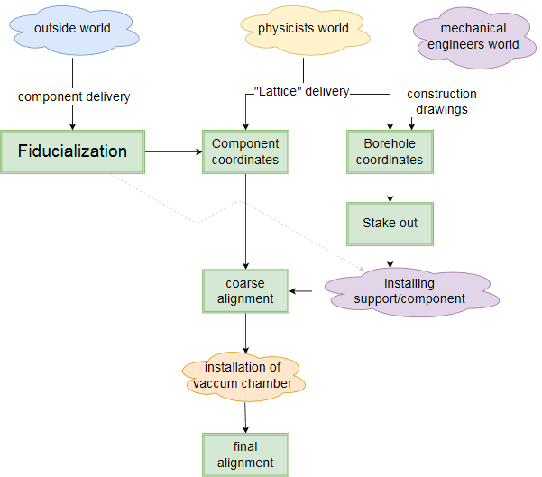
Alignment work

Slide 12
Alignment work

Slide 13
Alignment work

Slide 14
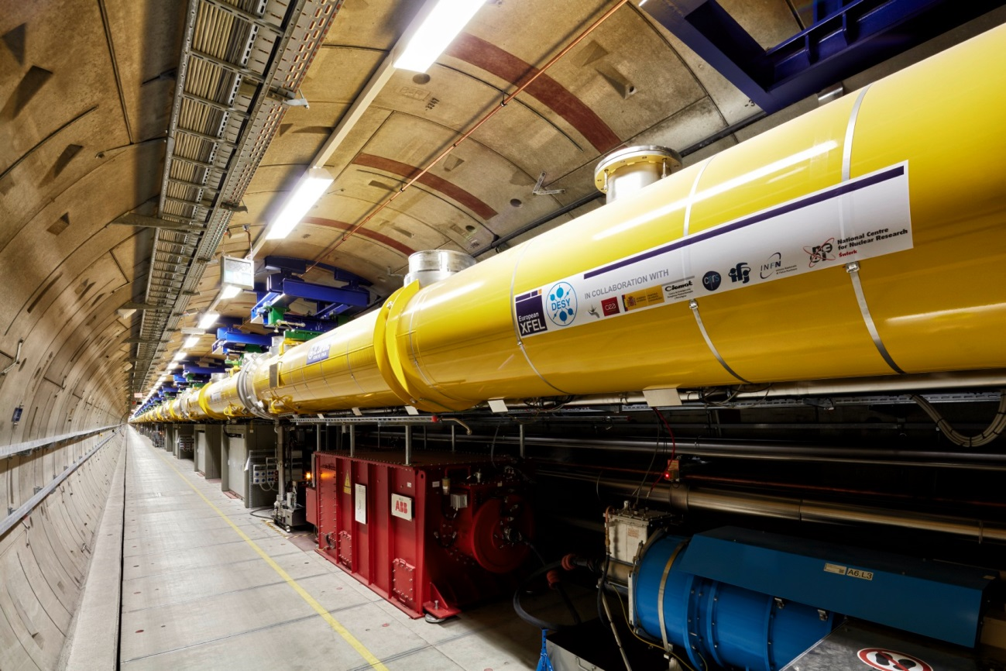
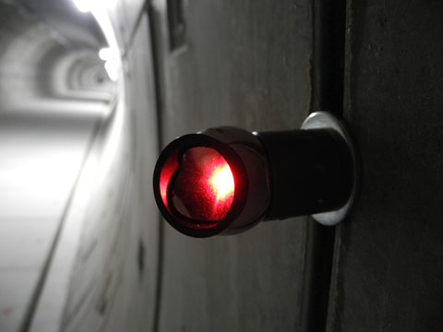
Geodetic Tunnel Reference Network - Layout
Tunnel reference network is based on “rings” of laser tracker targets, installed every ~10m in the tunnel.
rail for laser tracker car
Targets

Slide 15
Geodetic Tunnel Reference Network - Measurement
~10m
laser tracker instrument
observations
Accelerator
Accelerator
XFEL tunnel network
11400 monuments in total (1700 LINAC, 4200 Photon tunnels, injector, shafts, ExpHall)
~210000 Observations (70000 Azimuths, Zenith Angles and Distances, plus some height differences from Levelling)
PANDA would be able to adjust a network of this size, but …
the network was never measured in one go, because of external constraints
Installation was started, before all tunnels were built
workload is too high to measure all tunnels again in a short time span
LINAC tunnel and some photon tunnels are now closed due to commissioning / running accelerator

Slide 16
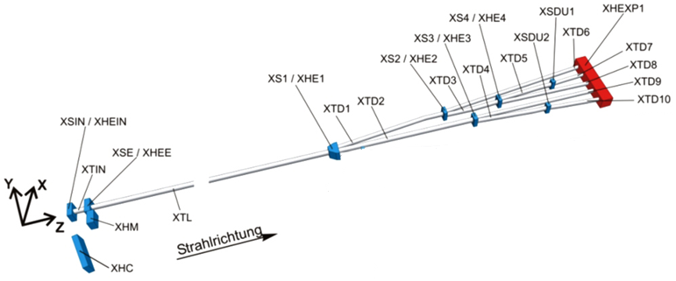
Sequence of tunnel measurements
2014
2014
2013
2013
2014
2013
2014
2013
2014
2014
2013
2013
2014
2014
2012
2013
2013
2012
2013
Different epochs have to be integrated into one homogenous network
After a year tunnels have deformed near the shafts, so the network can not be considered undisturbed in these areas
We don’t want to change coordinates in areas where the machine installation already started!

Slide 17
Adjustment of different tunnels / different epochs
XTL measured and adjusted in 2012
Free network adjustment of laser tracker data, elimination of gross errors, adopt accuracy (when needed)
Free network adjustment of levelling data, elimination of gross errors (if any)
Combining lt and lev with levelling weight set to factor 100., because number of levelling observations is low compared to laser tracker
Perform a best-fit to the nominal tunnel shape, this gives best accordance between CAD model and reality when installing the accelerator
XTD1 adjusted in 2012
Same principle as above, but only check, if the network fits to the nominal tunnel
Provisionally attach XTD1 network to XTL by quick and dirty connection measurement
2012
2013
2013
2012
2013

Slide 18
Adjustment of different tunnels / different epochs
XTL, XTD2 and XS1 measured and adjusted in 2012/2013
Free network (laser tracker)
Free network (levelling)
Combine both (levelling with high weight)
Check, if the adjusted network fits to the nominal tunnel
Correct the XTL network by new levelling campaign
Attach the networks of XS1, XTD1 and XTD2 to the XTL by over-constrained network adjustment (some XTL monuments are non-moveable)
Check, if the adjusted network still fits to the nominal shape of the tunnels
For all other networks similar approaches, however,
Lots of guessing involved engineering experience needed
Gross errors vs. wrong à priori accuracy
External influences, like ventilation
Movement of “fixed” points
Very limited time for adjustment
… some sleepless nights

Slide 19
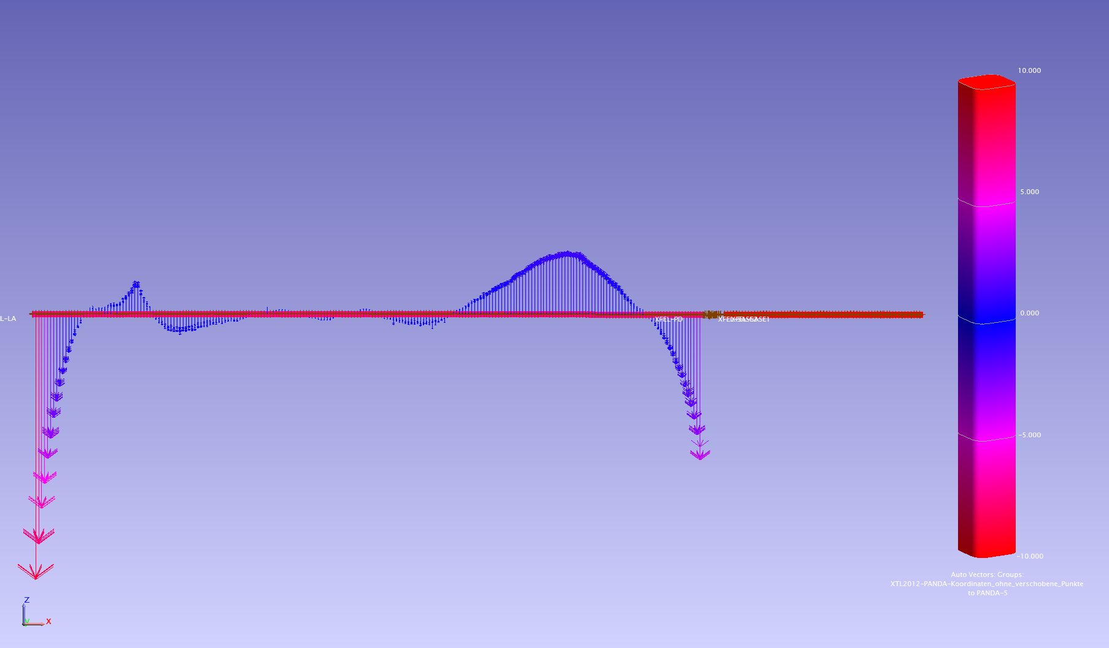
Movement of XTL between 05/2012 and 02/2013
Side view
Glacial drift area could be identified, in this area more bentonite had to be used during tunnel construction
Significant vertical movement close to the shafts – soil disturbance due to construction
Minimal horizontal movement, seems to be related to vertical movement
XS1 (Distribution shaft)
Injector shaft
glacial drift area
-8mm
-4mm
Top view
0.8mm (max)

Slide 20
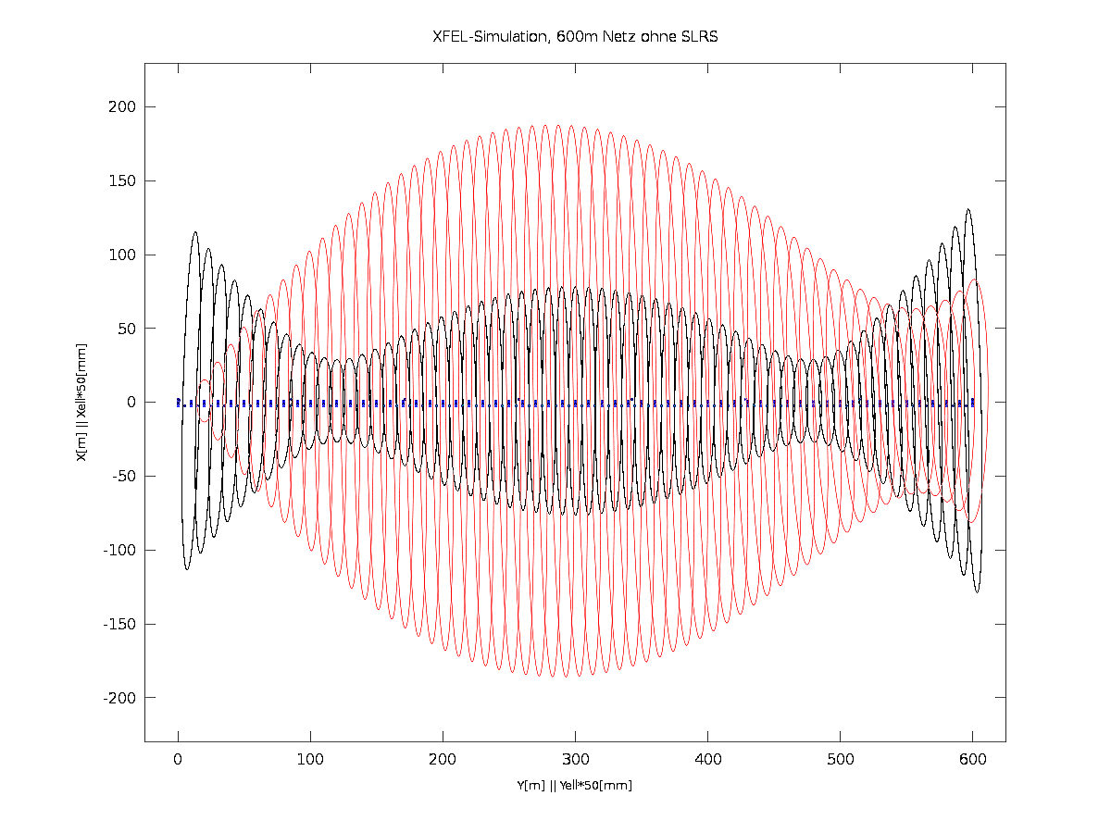
Simulation of XFEL network chunk (600m)
Undulator area (up to the first mirror) is extremely sensitive to misalignment
Accuracy requirement is 0.5mm per 600m in horizontal and height
Simulation: relative error (P=99%) is up to 4mm in horizontal
Refraction: systematic error could add up a factor of 5 with ΔT=2K
Solution: We need a refraction free measurement system ⇒ SLRS
SLRS is expensive, only installed in three critical areas
Simulation of free tunnel network L=600m, ellipses 50:1 black: point error ellipses red: relative error ellipses

Slide 21
System setup
System Integration
The SLRS (Straight Line Reference Surveyor) is a refraction free alignment system
It uses a collimated laser beam within an ISO200 vacuum tube
SLRS is used like a ruler put into the seemingly bent (refraction) tunnel network
There is no direct connection between the SLRS and machine components
SLRS provides correction parameters (dx, dz) for the geodetic network
Calibrated targets are used to connect the SLRS measurements
to the tunnel network
Δx, Δz
Δx, Δz
Δx, Δz

Slide 22
System setup
Johannes Prenting, IWAA 2016
Principle of the SLRS:
A laser light source emits coherent light
A fiber end, aperture and a plano convex lens are used to expand and collimate the beam
Spheres put into the beam along the measuring section originate a poisson spot behind the center of the sphere which can be viewed with a CCD camera
The center of the sphere and the center of its poisson spot in the image generate a straight line
A lens system focuses the expanded beam to the dimensions of the CCD sensor
Correlation algorithms are used to calculate the poisson centers in the image
CCD Camera
Plano-convex lenses
Targets
Plano-convex lens
Aperture
Laser Point Source

Slide 23
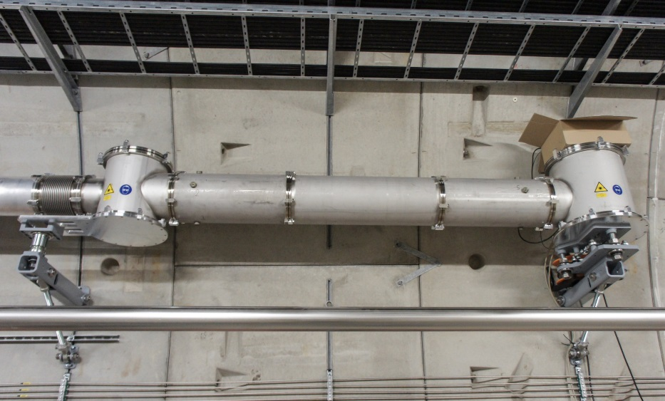
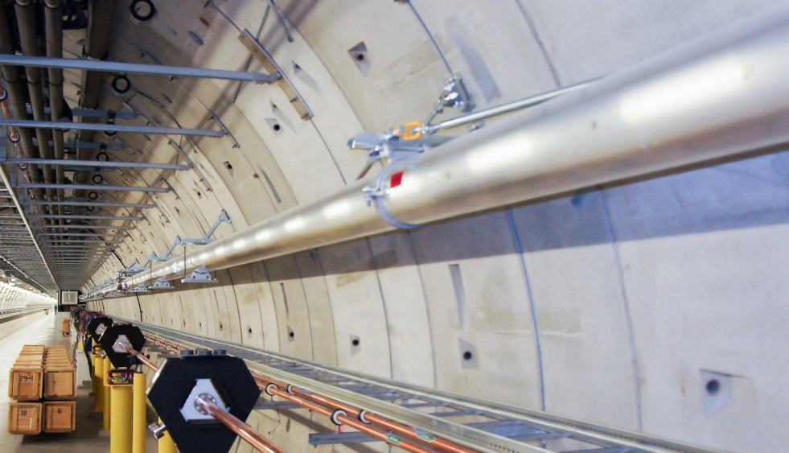
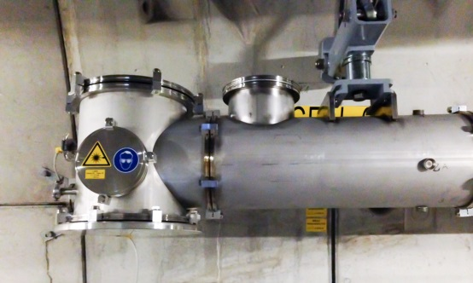
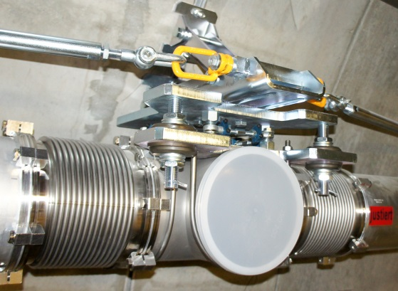
System setup
Johannes Prenting, IWAA 2016
housing for laser, aperture, lens
camera housing
SLRS@SASE1, 482m
Tee piece connector & bellows
Actual setup:
Aluminum pipes, 7.73m/3.87m long, 200mm diameter. Supports are placed every 3 to 4.5m with fixed point and floating point fixing.
special housings for (laser, aperture, lenses) and (lenses & camera)
Tee piece connector with bellows, every 24m, every 2nd is equipped with adapted measurement targets (aka target boxes)
blue laser (wavelength = 405nm) allows for small targets and provides fine interference patterns
revised plano convex lenses for minimal spherical aberration
GigE-Camera with 2048x2048 pix. resolution
Oerlikon/Leybold Trivac D 65 B Vacuum pumps

Slide 24
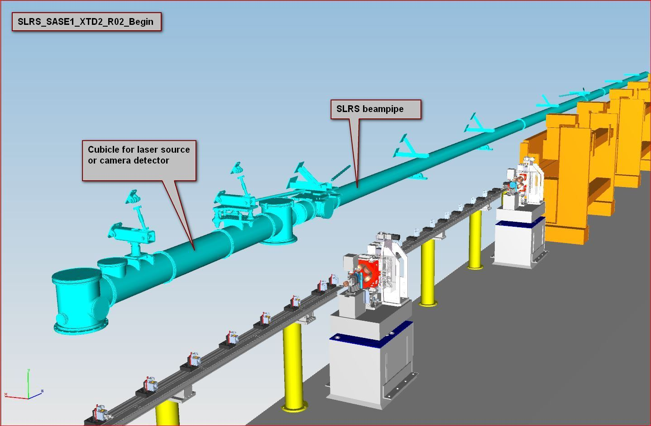
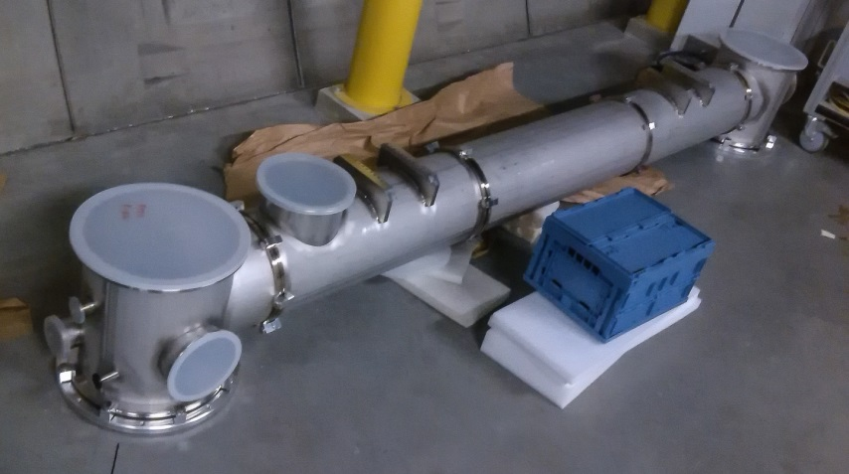
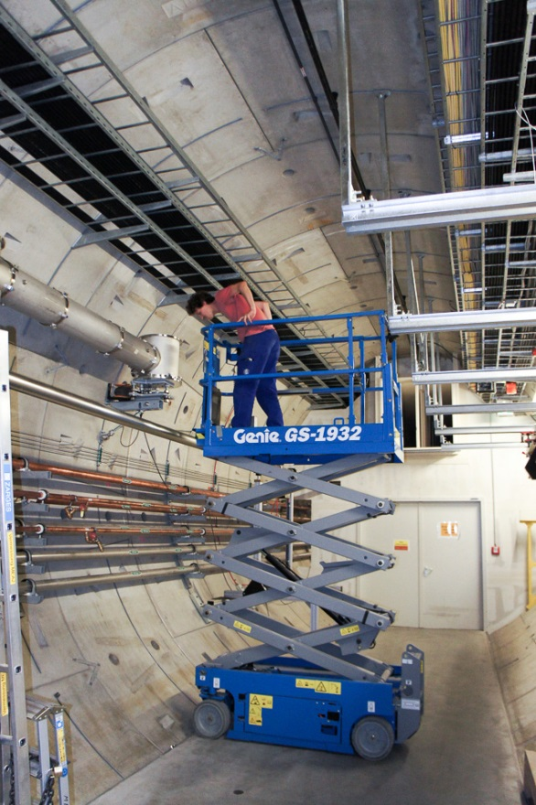
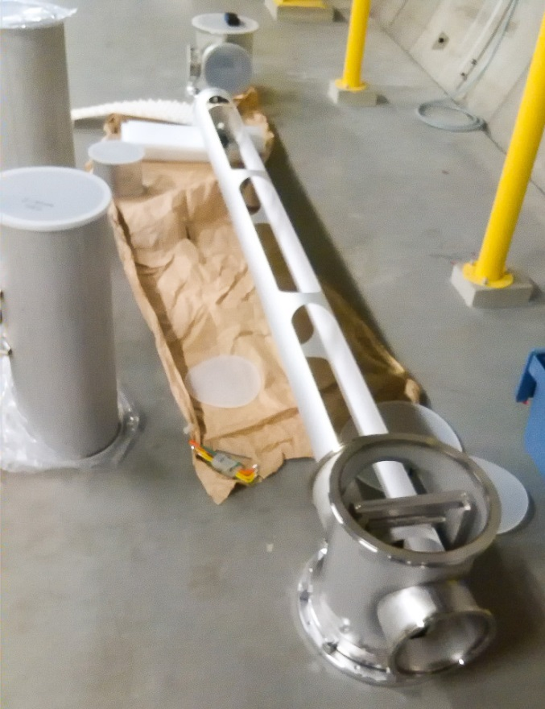
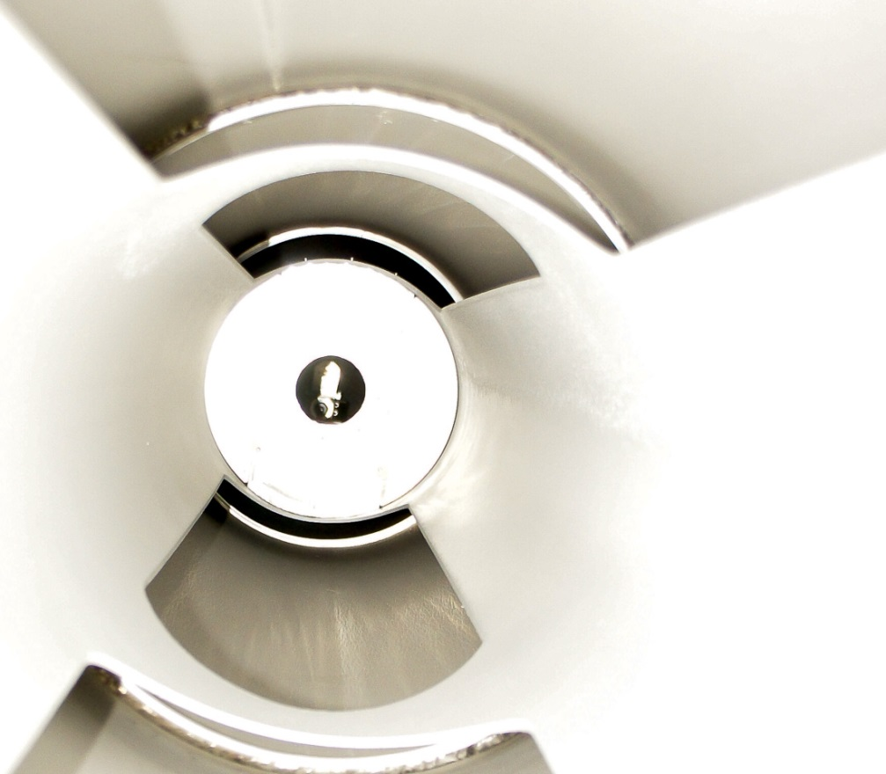
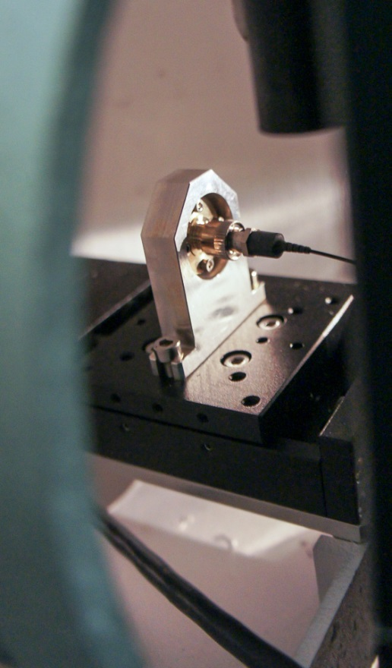
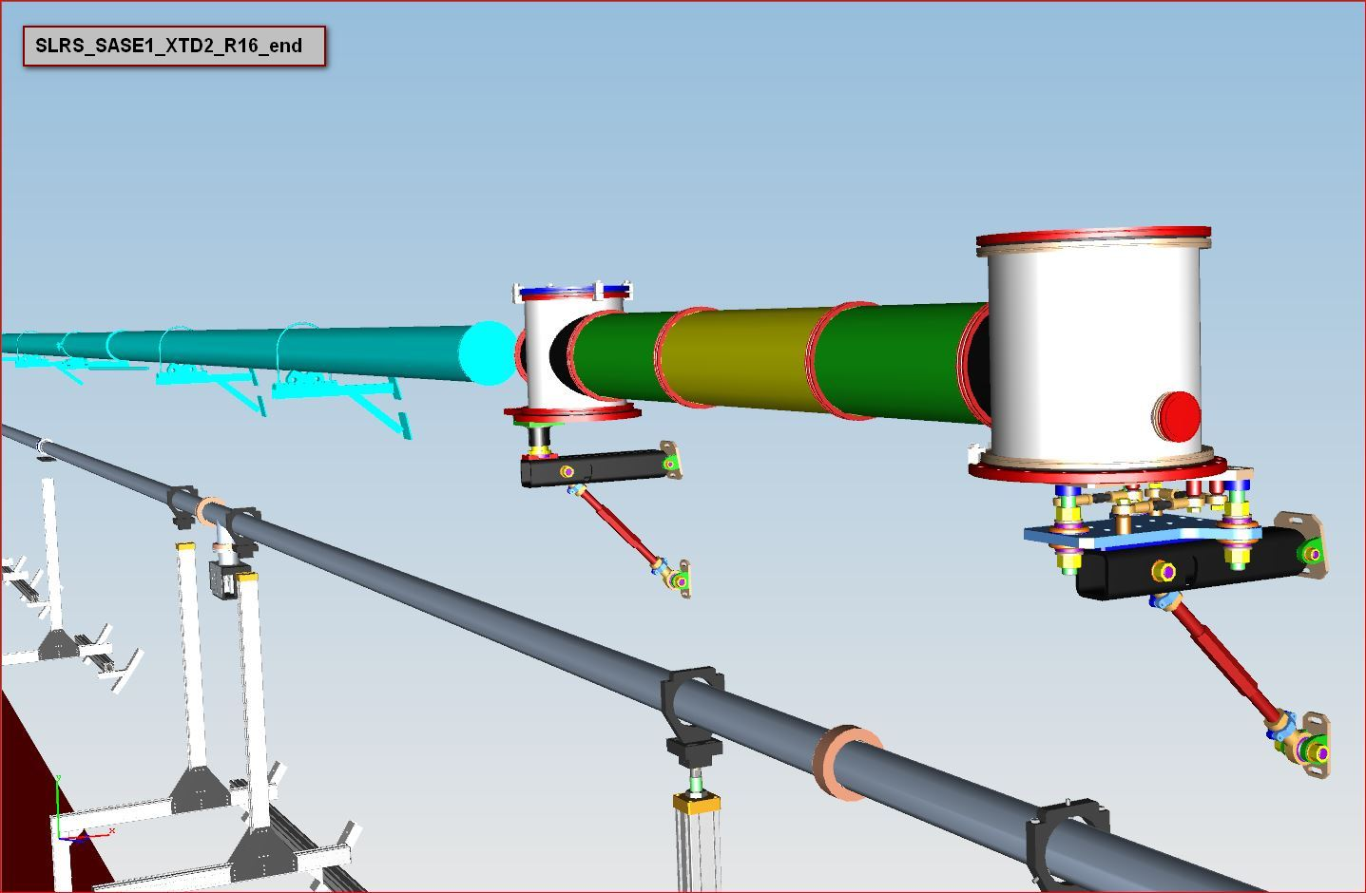
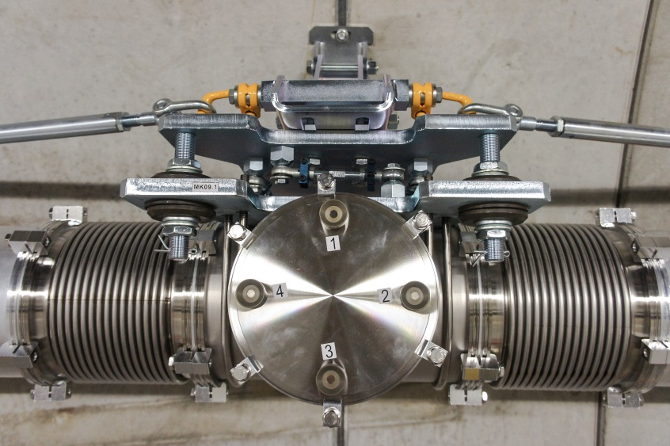
System setup, 1. SLRS, SASE1, XTD2, some impressions
Johannes Prenting, IWAA 2016
camera housing
installation of laser into laser housing
lens mount in pivot bearing
laser housing with central optics pipe
view at aperture and laser fiber from inside lens tube
fiber end of laser light source
target box

Slide 25
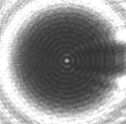
How does it work?
Johannes Prenting, IWAA 2016
The Poisson Spot
By interference a poisson spot develops behind a sphere put into coherent light
Each point at the spheres outline acts as a single lightsource
The 2D sectional view shows how the centre of the image is formed by interference of lightwaves which travel the same distance „r“
The next high intensity ring of the poisson image is formed by interference of lightwaves that travel distances „a“ and „b“ which are different by one wavelength.
A low intensity ring is formed by interference of lightwaves that travel distances that are different by 1/2 wavelength.
sectional view of interferences behind a sphere put into coherent light
poisson image of a sphere

Slide 26
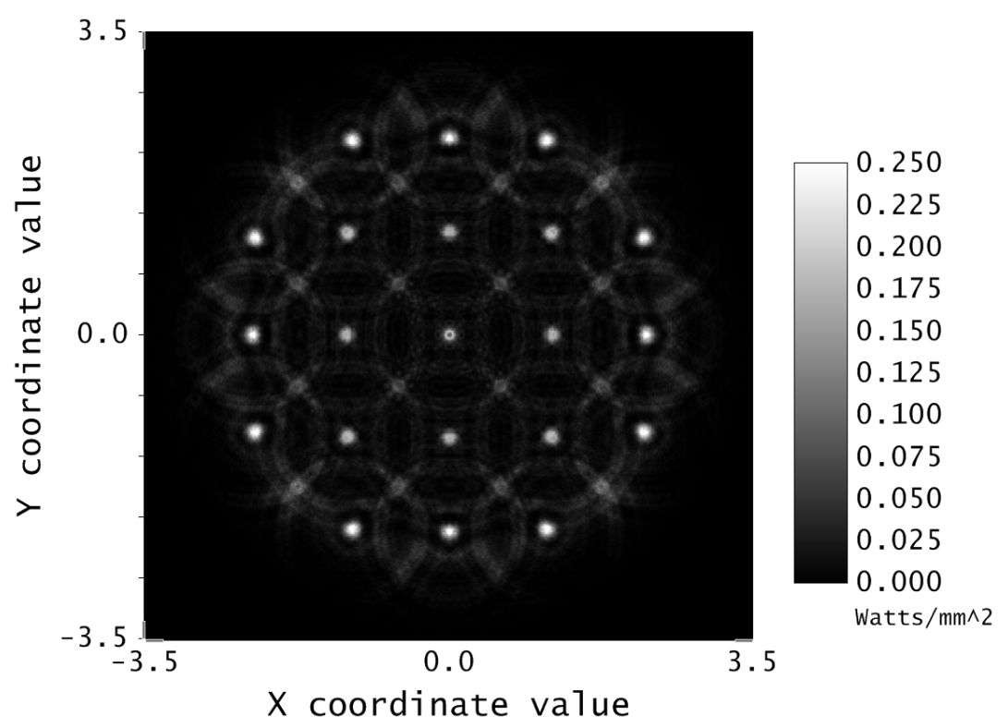
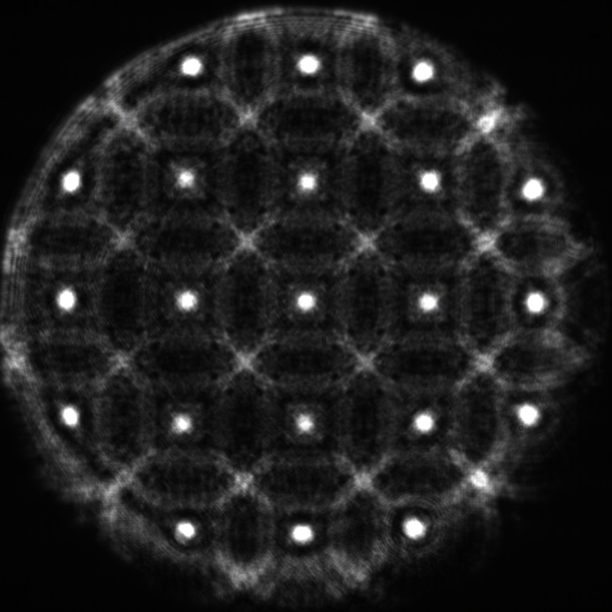
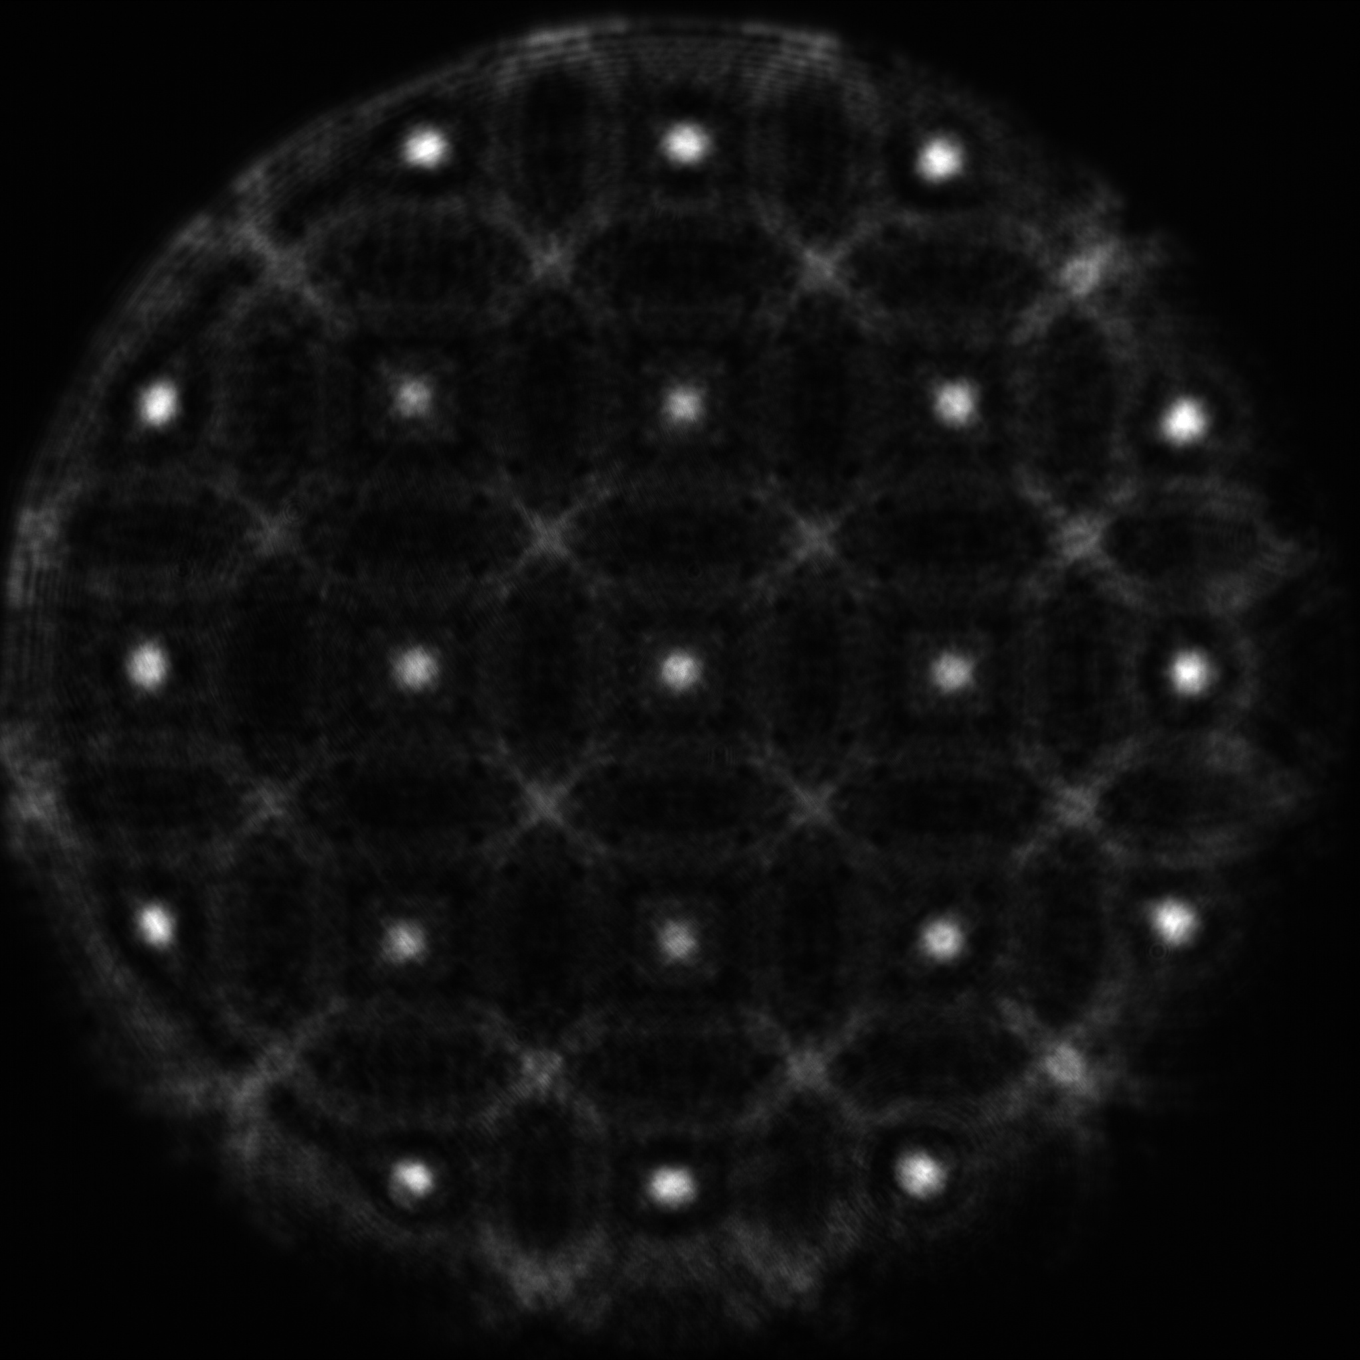
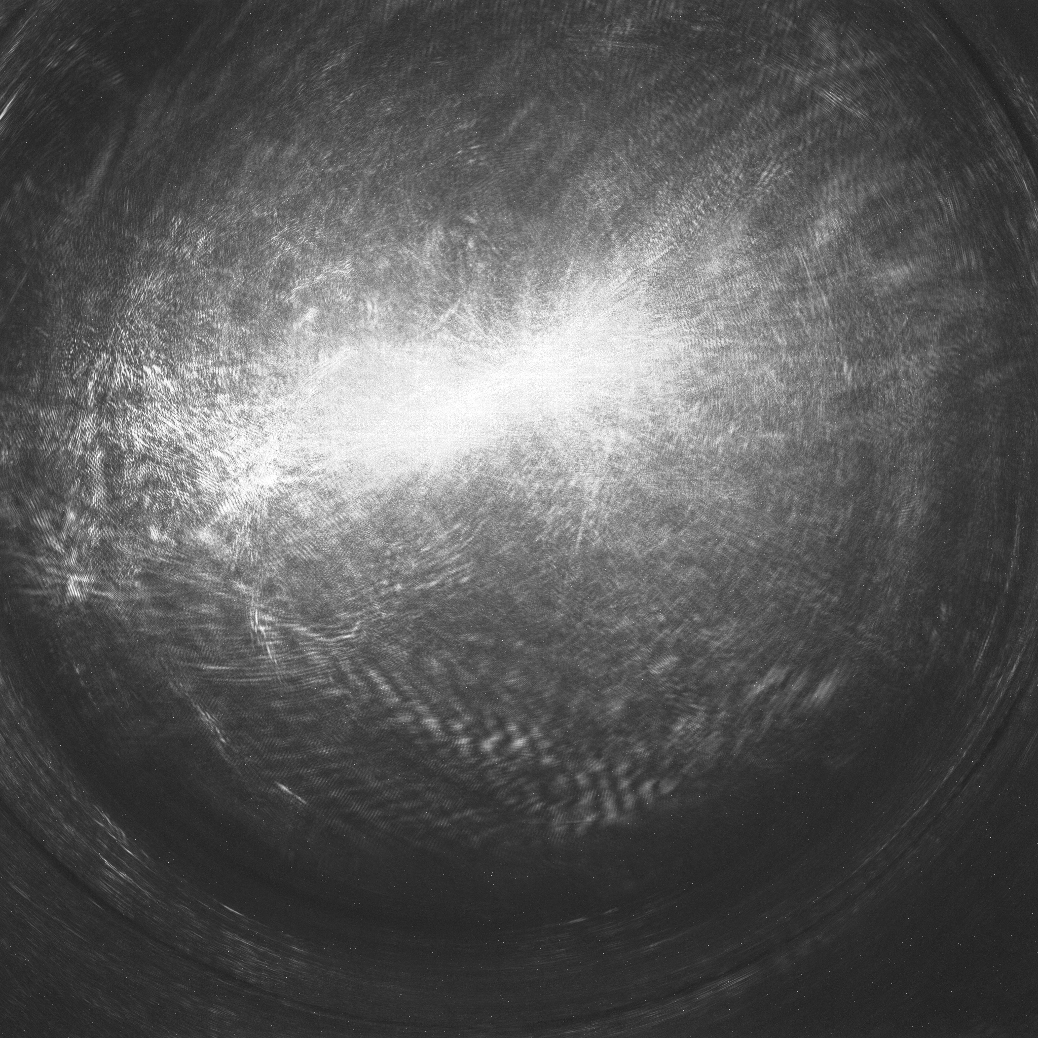
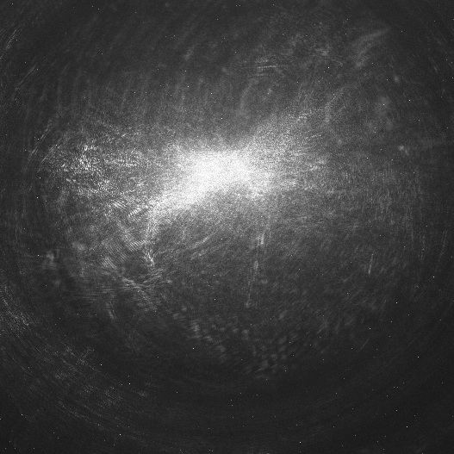
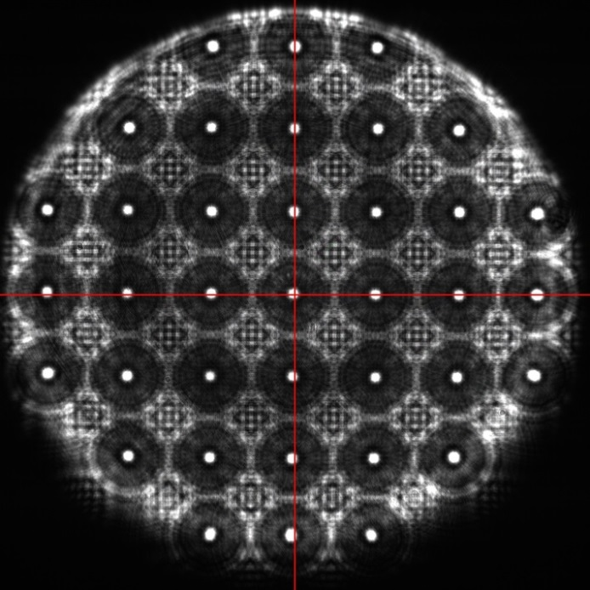
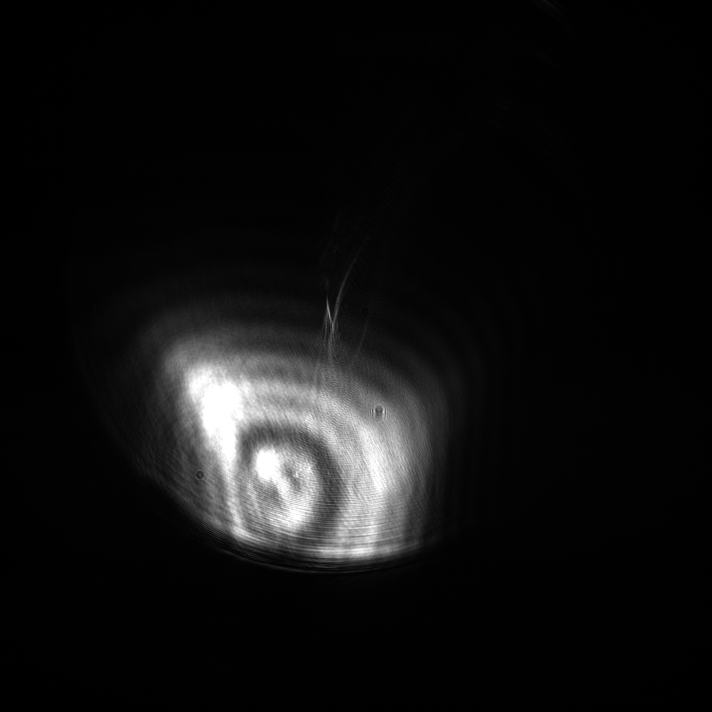
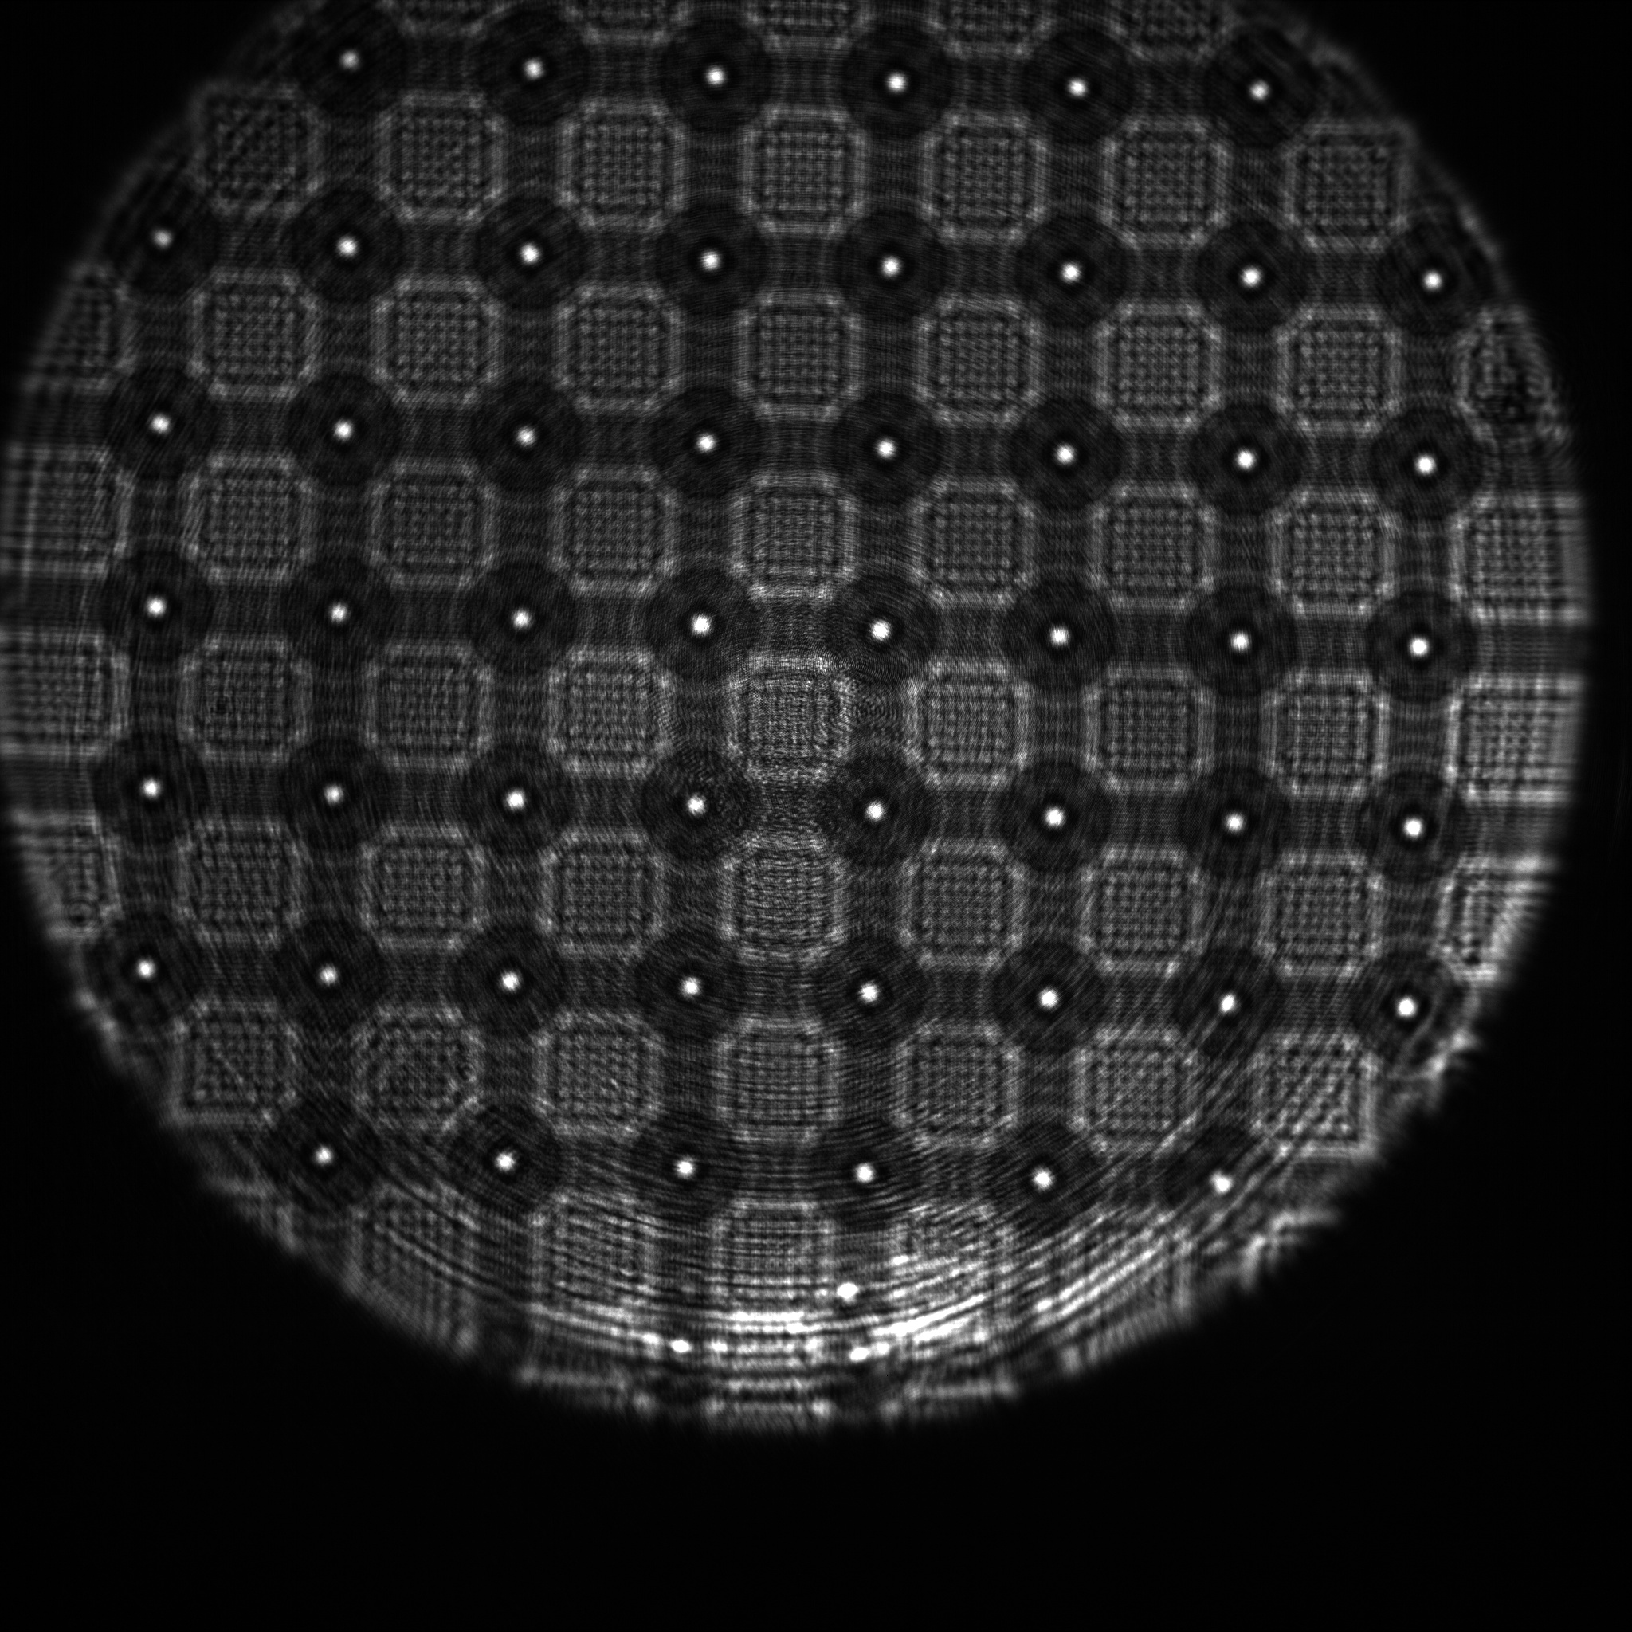
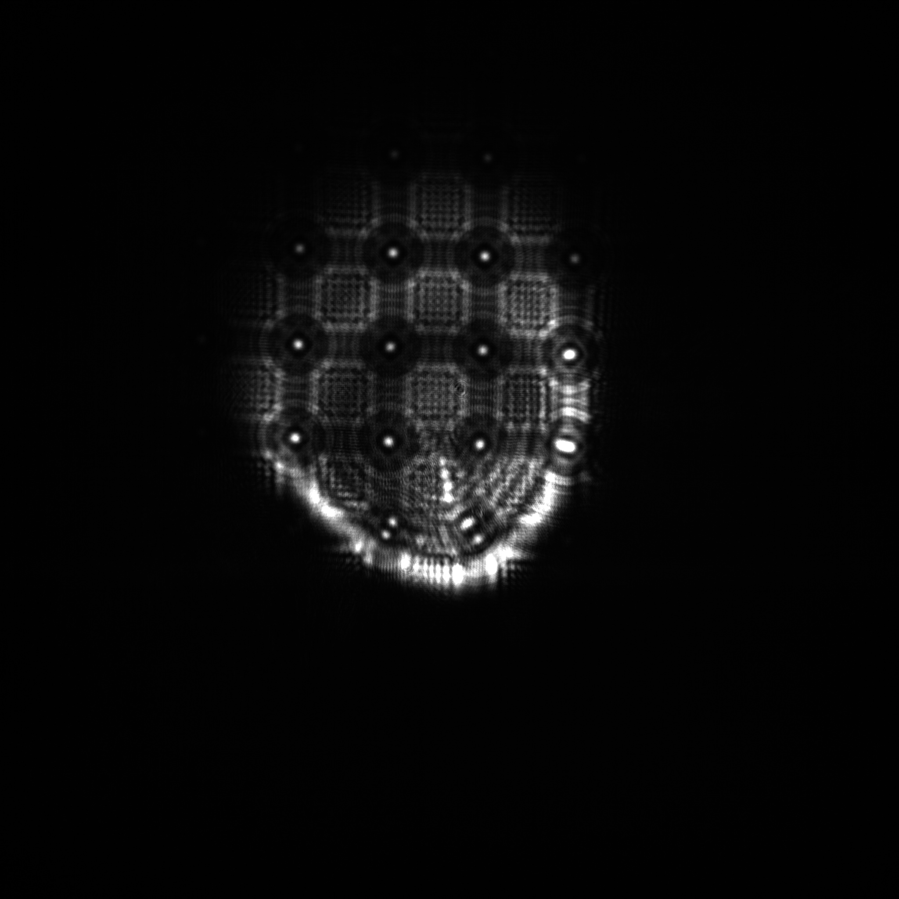
Commissioning of SLRS@SASE1: please, let there be light
Johannes Prenting, IWAA 2016
image after implementation of target frame,
(box 9), varying the exposure
simulated image of target box ‚9‘ @ 200m
Simulation vs. real thing
first image after complete installation and
adjustment from outside with lasertracker, 0823
image after complete installation and
first adjustment of laserlightsource, 0824
image after implementation of target frame,
aligning target frame with camera image
image after adjustment check @ of every single tee
piece with laser beam itself, 0831, no target installed
image after implementation of target
frame, fine aligning the laser
image after implementation of target
frame, fine alignment of laser done

Slide 27
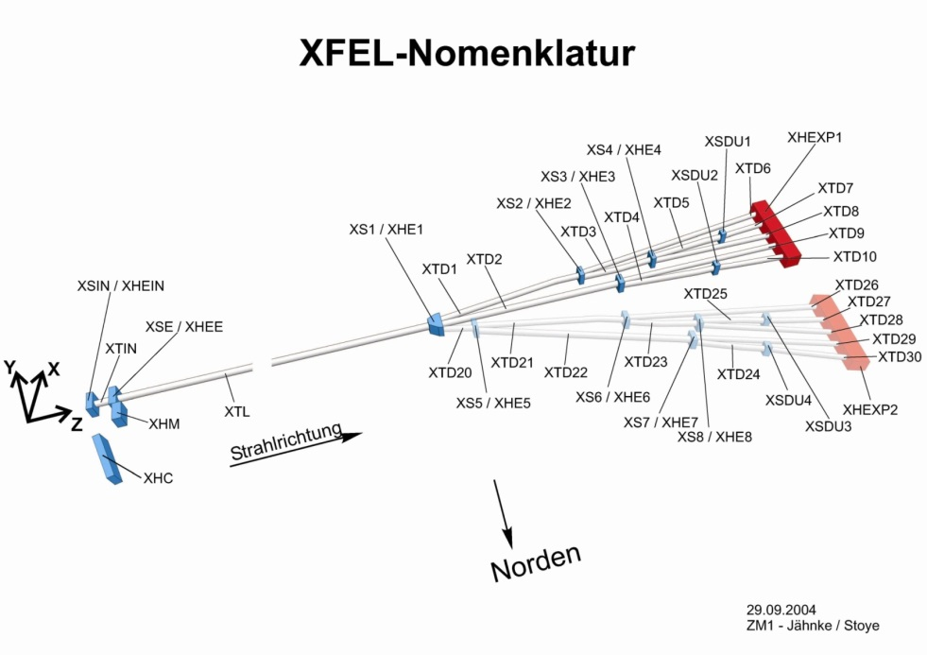
SLRS Status
Distribution of SLR-Systems in XFEL Tunnels
Distribution of SLRS systems in the XFEL
All three SLRS are operational, measurements were done
Preliminary network adjustment has been done
Lasing was achieved at SASE1 with minimal movements of quadrupoles.
SASE2: 530m
SASE3: 434m
SASE1: 482m
Tunnel network has to be re-measured while simultaneously collecting SLRS data
SLRS corrections are applied to the laser tracker and levelling network

Slide 28
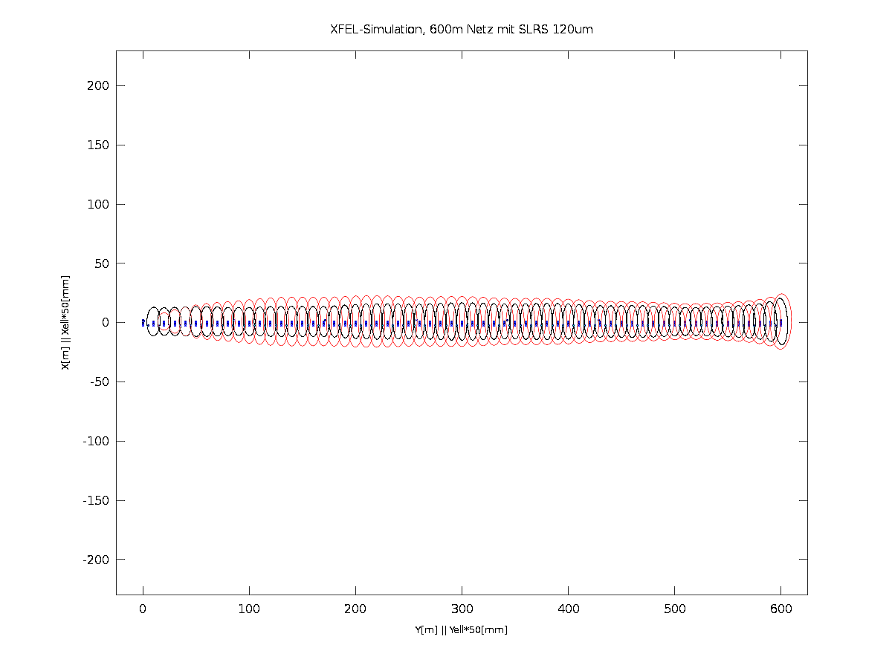
Simulation of XFEL network chunk (600m) – with SLRS
Accuracy requirement – 0.5mm per 600m in horizontal and height – is fulfilled
Simulation: relative error (P=99%) is up to 0.4mm in horizontal
Refraction: systematic error is greatly reduced due to vacuum tube (1mbar)
Simulation of free tunnel network without / with SLRS L=600m, ellipses 50:1 black: point error ellipses red: relative error ellipses

Slide 29
SLRS & network adjustment
Scheme of SLRS
P_{n-1}
P_{i}
x
x
d_{n-1}
d_{i}
x
x
P₁
d₂
P_{n}
x
P₂
n : number of SLRS measurements → n-2 constraints
$φ_{2}\left(X\right)=\left[\begin{matrix}d_{2} \\ ⋮ \\ d_{n−1}\end{matrix}\right]=\left[\begin{aligned}\frac{\left|\left({\overset{⃑}{P}}_{2}−{\overset{⃑}{P}}_{1}\right)×\left({\overset{⃑}{P}}_{n}−{\overset{⃑}{P}}_{1}\right)\right|}{\left|{\overset{⃑}{P}}_{n}−{\overset{⃑}{P}}_{1}\right|} \\ ⋮ \\ \frac{\left|\left({\overset{⃑}{P}}_{n−1}−{\overset{⃑}{P}}_{1}\right)×\left({\overset{⃑}{P}}_{n}−{\overset{⃑}{P}}_{1}\right)\right|}{\left|{\overset{⃑}{P}}_{n}−{\overset{⃑}{P}}_{1}\right|}\end{aligned}\right]=0→$ $φ_{2}\left(X\right)=\left[\begin{aligned}\left|\left({\overset{⃑}{P}}_{2}−{\overset{⃑}{P}}_{1}\right)×\left({\overset{⃑}{P}}_{n}−{\overset{⃑}{P}}_{1}\right)\right| \\ ⋮ \\ \left|\left({\overset{⃑}{P}}_{n−1}−{\overset{⃑}{P}}_{1}\right)×\left({\overset{⃑}{P}}_{n}−{\overset{⃑}{P}}_{1}\right)\right|\end{aligned}\right]=0$
Functional Model of constraints:
distances between points and line are 0

Slide 30
Gauss Markov Model
$φ\left(X\right)=L$ (Least Squares Model)
$φ\left(L,X\right)=0$ (“generalized” Least Squares Model)
$φ_{1}\left(X\right)=L ;{ φ}_{2}\left(X\right)=0$ (Least Squares Model with constraints)
$L:$ Vector of observations
$X:$ Vector of unknowns
Model with constraints is sufficient (Method of Lagrange multipliers).
n : number of SLRS measurements → n-2 constraints
$φ_{2}\left(X\right)=\left[\begin{aligned}\frac{\left|\left({\overset{⃑}{P}}_{2}−{\overset{⃑}{P}}_{1}\right)×\left({\overset{⃑}{P}}_{n}−{\overset{⃑}{P}}_{1}\right)\right|}{\left|{\overset{⃑}{P}}_{n}−{\overset{⃑}{P}}_{1}\right|} \\ ⋮ \\ \frac{\left|\left({\overset{⃑}{P}}_{n−1}−{\overset{⃑}{P}}_{1}\right)×\left({\overset{⃑}{P}}_{n}−{\overset{⃑}{P}}_{1}\right)\right|}{\left|{\overset{⃑}{P}}_{n}−{\overset{⃑}{P}}_{1}\right|}\end{aligned}\right]=0→$ $φ_{2}\left(X\right)=\left[\begin{aligned}\left|\left({\overset{⃑}{P}}_{2}−{\overset{⃑}{P}}_{1}\right)×\left({\overset{⃑}{P}}_{n}−{\overset{⃑}{P}}_{1}\right)\right| \\ ⋮ \\ \left|\left({\overset{⃑}{P}}_{n−1}−{\overset{⃑}{P}}_{1}\right)×\left({\overset{⃑}{P}}_{n}−{\overset{⃑}{P}}_{1}\right)\right|\end{aligned}\right]=0$

Slide 31
Gauss Markov Model
$$\frac{∂φ_{i}}{{∂X}_{1}}=2(P_{1}−P_{i})(P_{1}−P_{n})(2P_{1}−P_{i}−P_{n})$$
Derivatives needed for Matrix A₂
All other derivatives are 0
$$\frac{∂φ_{i}}{{∂X}_{i}}=2(P_{i}−P_{1}){(P_{1}−P_{n})}^{2}$$
$$\frac{∂φ_{i}}{{∂X}_{n}}=2(P_{n}−P_{1}){(P_{1}−P_{i})}^{2}$$
$$A_{2}=\left[\begin{matrix}\frac{∂φ_{2}}{{∂X}_{1}} & ⋯ & \frac{∂φ_{2}}{{∂X}_{n}} \\ ⋮ & ⋱ & ⋮ \\ \frac{∂φ_{n−2}}{{∂X}_{1}} & ⋯ & \frac{∂φ_{n−2}}{{∂X}_{n}}\end{matrix}\right]$$
Design matrix of constraints
$$x={\left(A^{′}PA\right)}^{−1}\left(A^{′}Pl\right)=N^{−1}n$$
Normal equations for Gauß Markov
$$\left[\begin{matrix}x \\ −k\end{matrix}\right]={\left[\begin{matrix}A_{1}^{′}PA_{1} & A_{2}^{′} \\ A_{2} & 0\end{matrix}\right]}^{−1}\left[\begin{matrix}A_{1}^{′}Pl \\ −w\end{matrix}\right]$$
Normal equations with constraints

Slide 32
Adjustment strategy
Model with constraints would give the correct solution for coordinates and statistics, but software for this model was not ready in time
PANDA is not able to integrate constraints in a convenient way
Actual approach
Free network solution (laser tracker and levelling) without SLRS
Compare actual solution of SLRS points from free network with SLRS measurement, calculate corrections
Apply corrections from SLRS to actual points from free network
Introduce corrected points into new network adjustment as fixed points, thus making it a (over-)constrained network.
Since the network was estimated as free network first, this step does not introduce any constraints but those coming from SLRS
The actual solution will be close to the correct solution, concerning the coordinates of all reference points
However, the stochastic model is wrong. This is not important for the actual work, but matters for possible analysis in the future, like deformation analysis.

Slide 33
Result of SLRS measurement, SASE1-3
Corrections from SLRS are up to 3mm
Vertical corrections are smaller, because we have à priori levelling information
“wavelength” of disturbances is much smaller than expected ⇒ too few points!

Slide 34
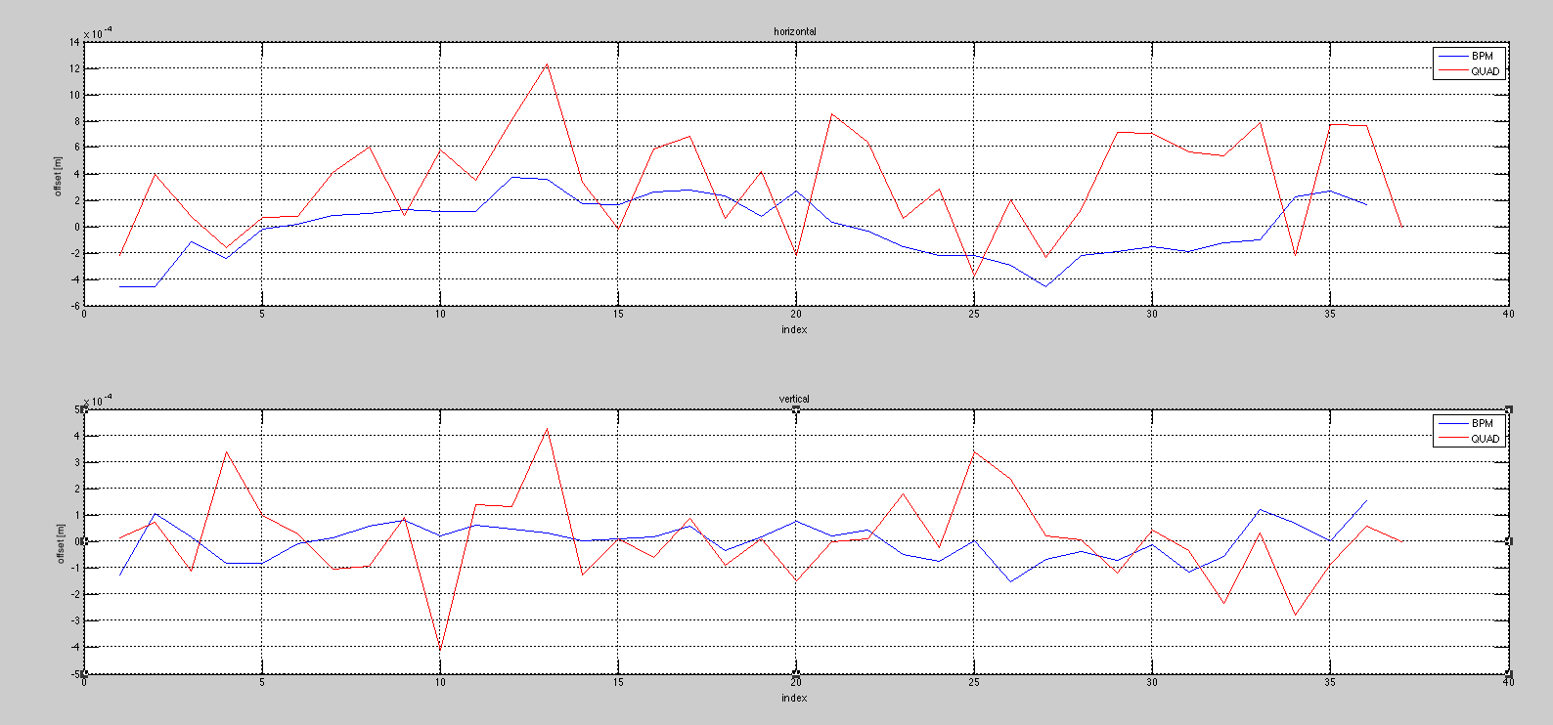
Beam based alignment results
10
horizontal
For SASE1 and SASE3 the beam went through the undulator section without steering it with the magnets, aperture of vacuum chamber is as low as ±4mm
0
[mm]
Quad
BPM
4
vertical
0
-4
For SASE1 a first beam based alignment of the intersections has been done
Results show good accuracy for BPM
Accuracy of quadrupoles is not as good as could be expected, several possible reasons (to be investigated)
Beam based alignment is wrong (don’t know, ask the experts)
Alignment is wrong (unlikely, because we are geodesists the BPM are close to the quadrupoles (~30cm))
Measurement system of the movers has been misread
Fiducialization of quadrupoles magnetic axes is inaccurate (in-kind-contribution)
Quadrupole axis changes more than expected with different current (would influence the beam based alignment)
…?

Slide 35
Thank you!
And now for the XFEL tunnel flight…

