Slide 1
Cables to go downstairs at L11
C.Y. Tan
02 Jun 2017

Slide 2
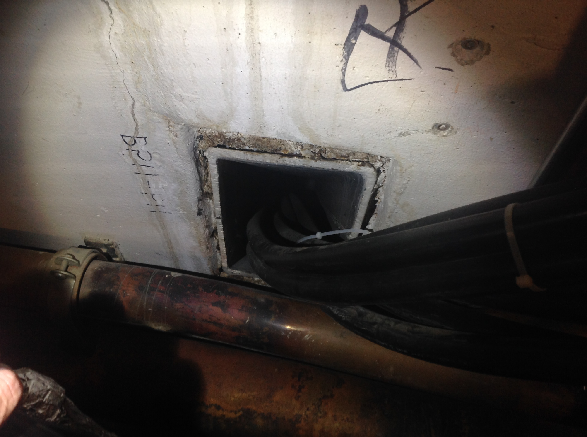
Modulator cables
This entire penetration can be cleared out. However, this is about 50 ft from the modulator which means an additional 100 ft (upstairs + downstairs) of cable is needed.
20 ft to go downstairs.
Talked to Rene (02 Jun 2017) and using this penetration is fine.

Slide 3
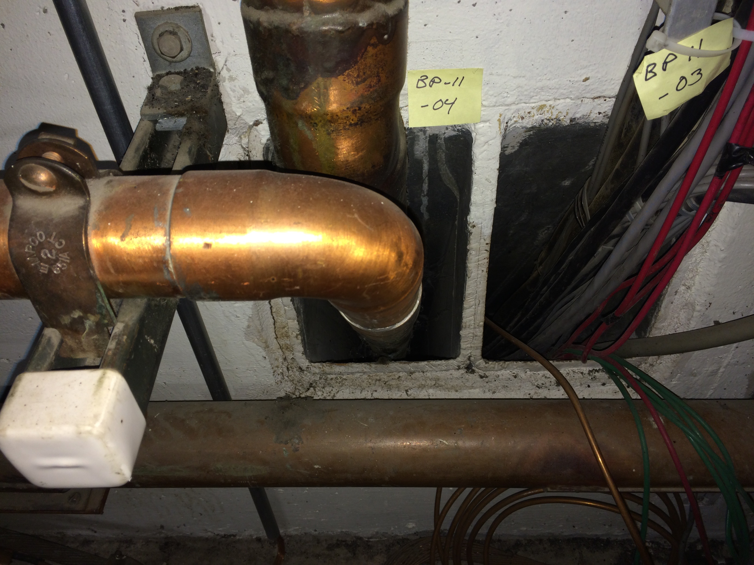
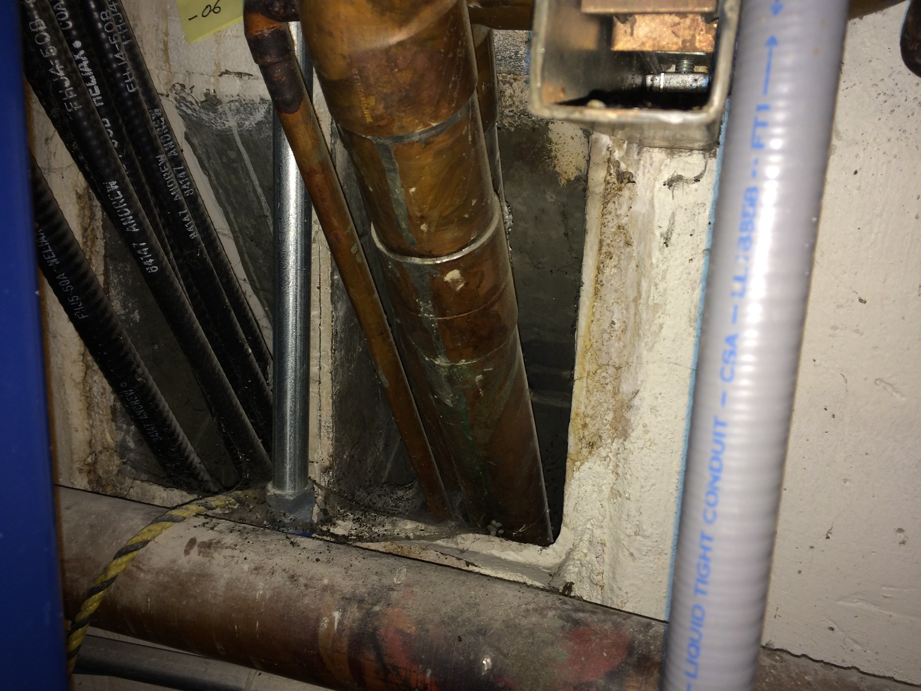
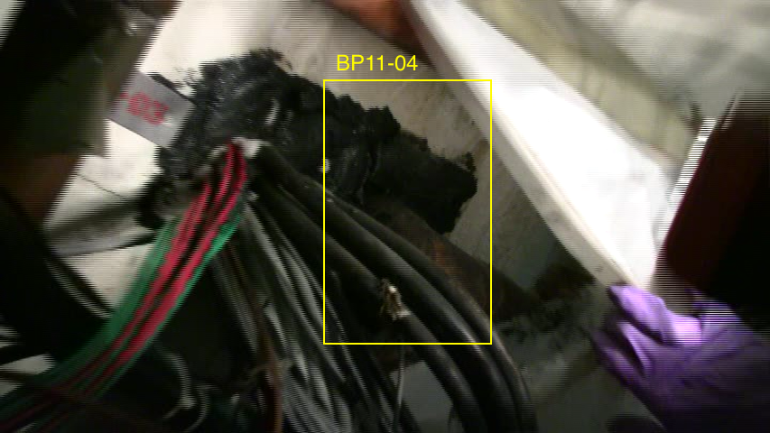
Bias supply cables
Bias supply cables will have to follow water pipes. There are 2 penetrations that are possible for doing this.
Maximum of 6 cables? Design not finalized.

Slide 4
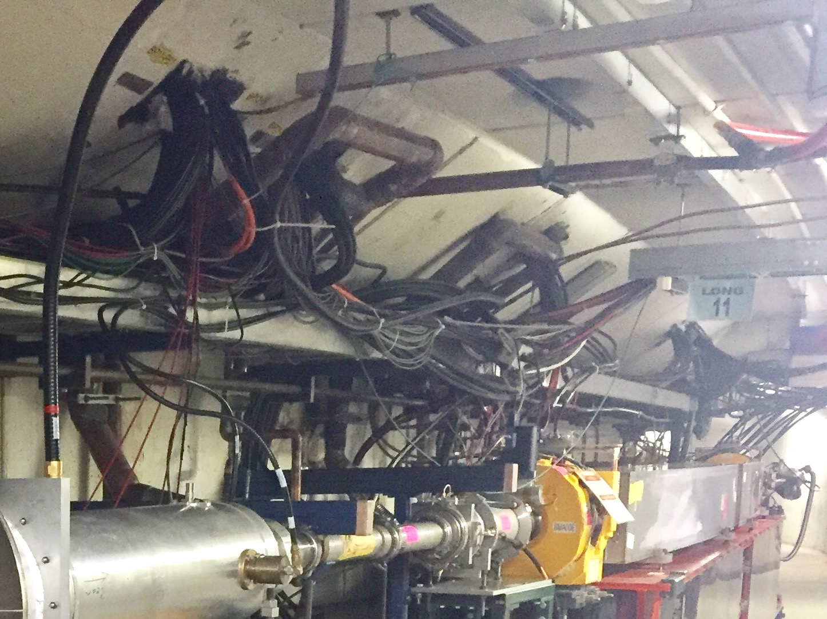
L11 downstairs

Slide 5
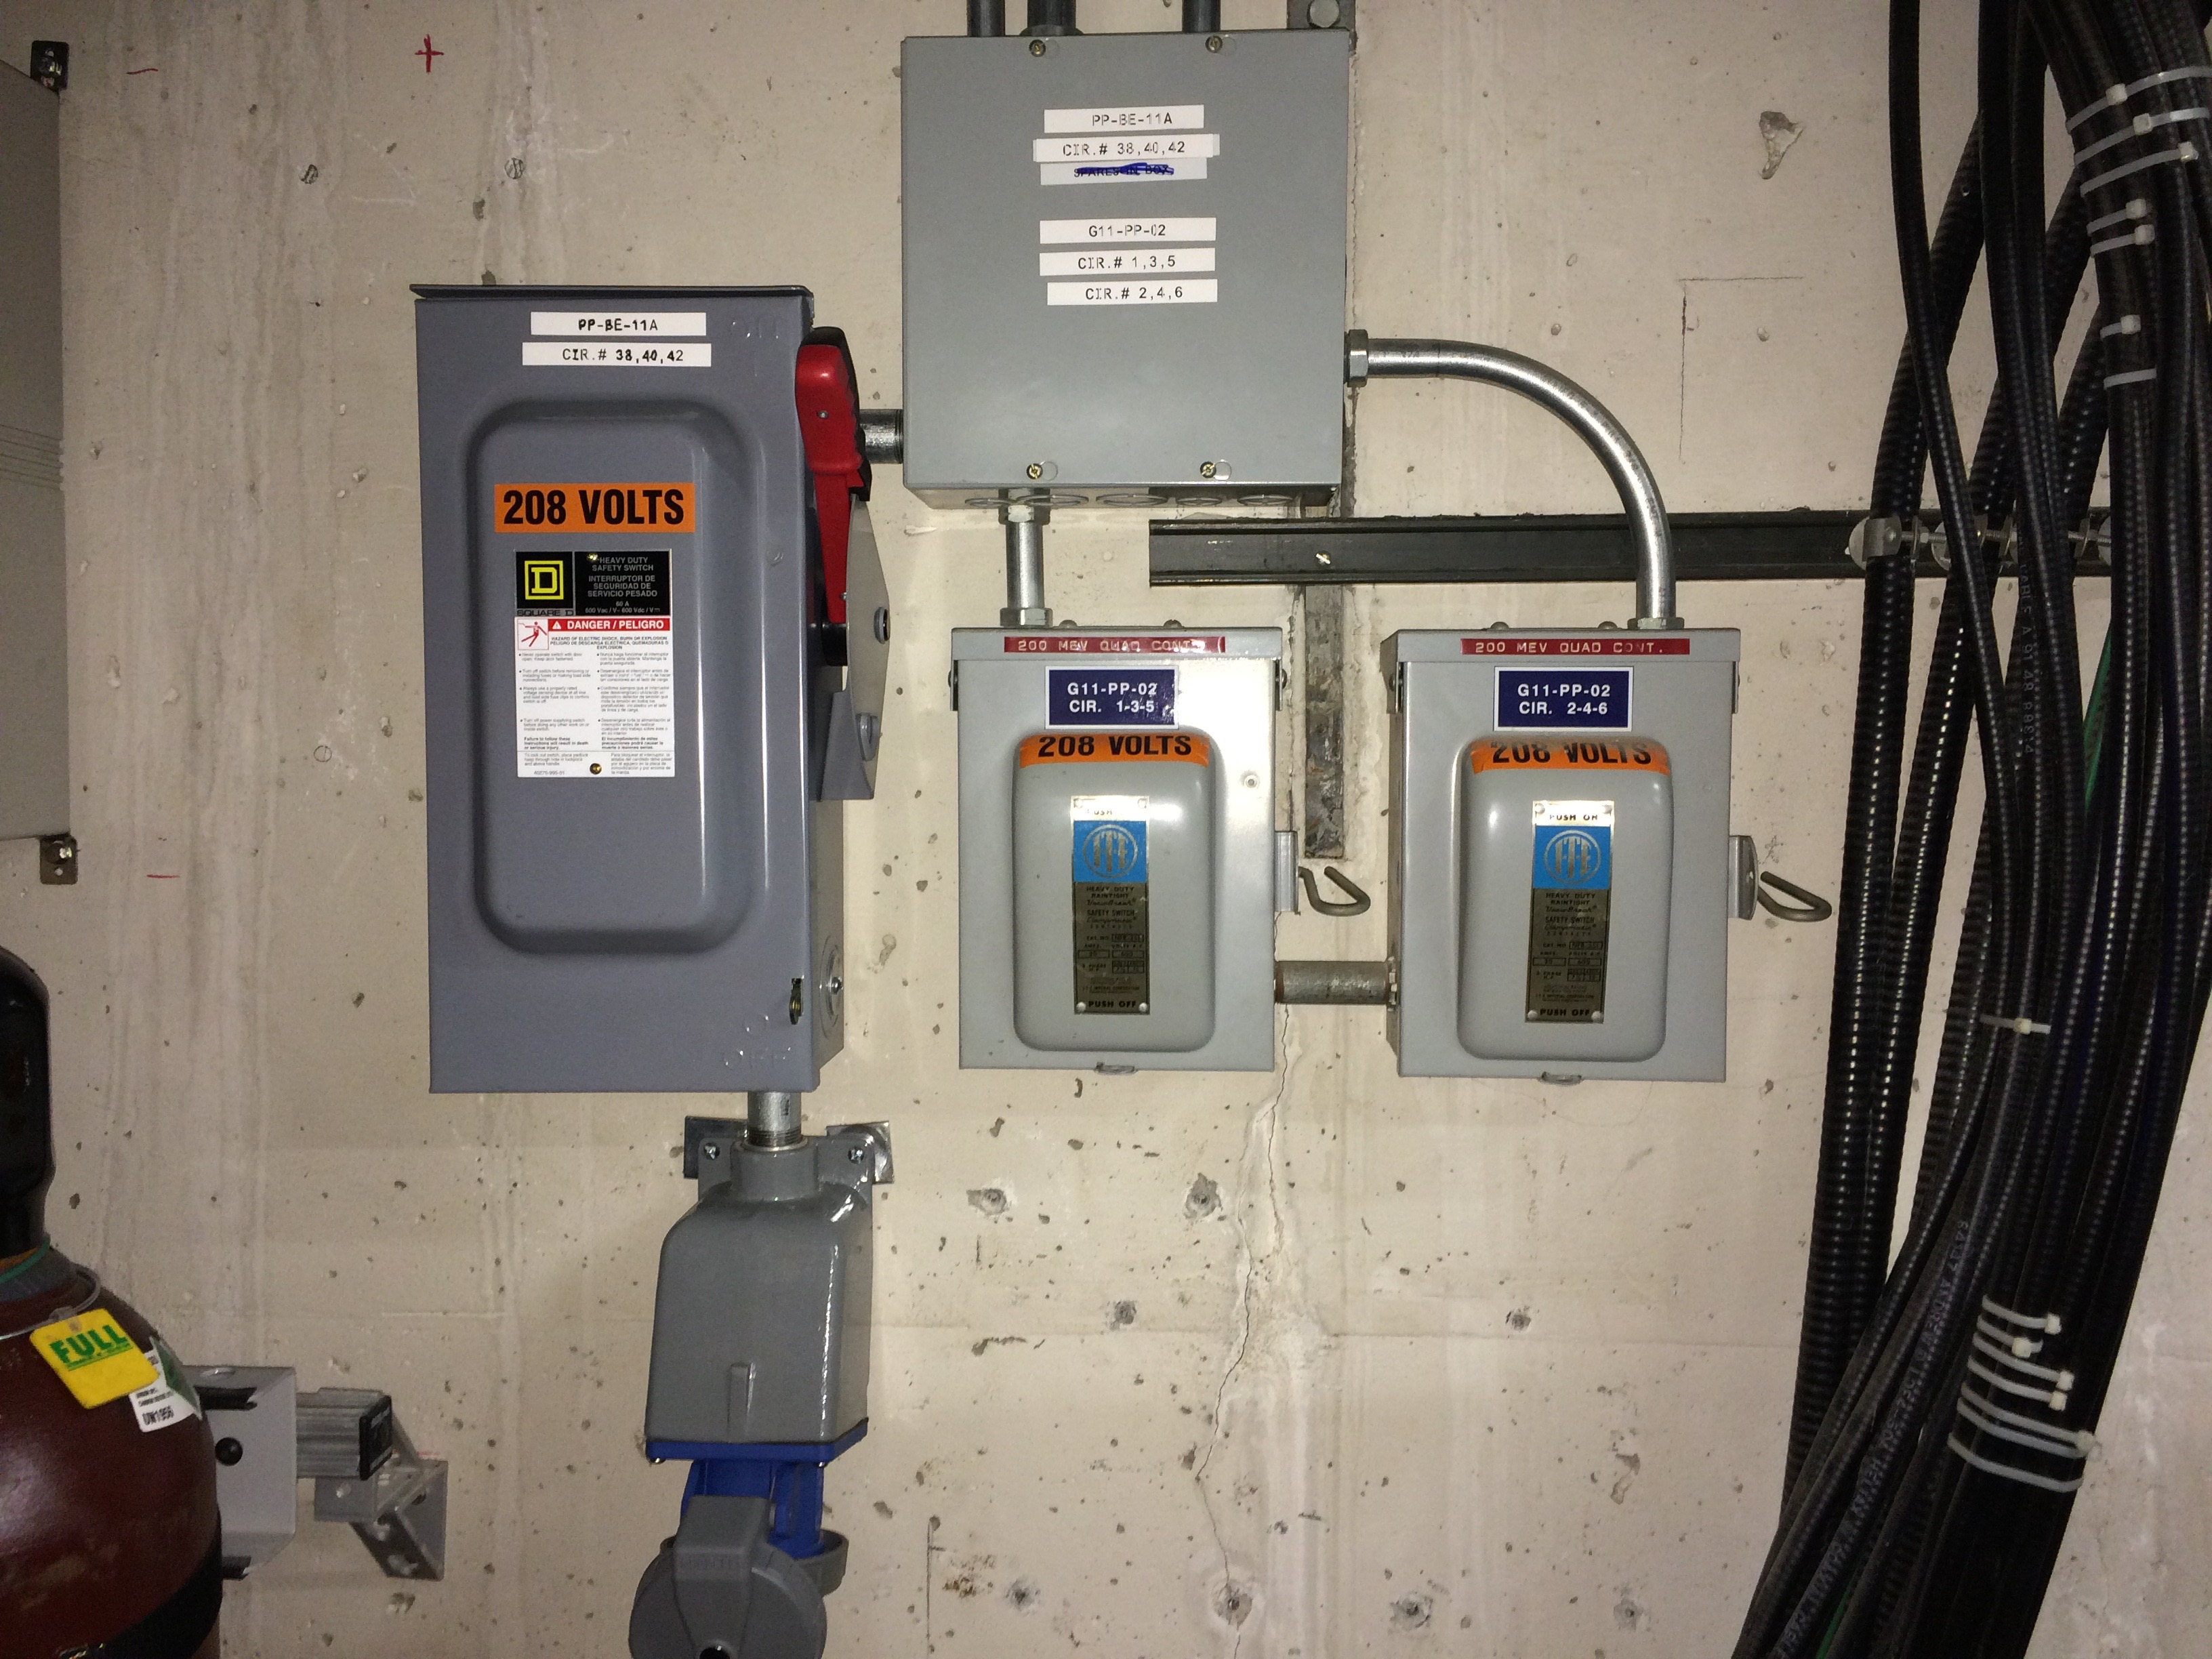
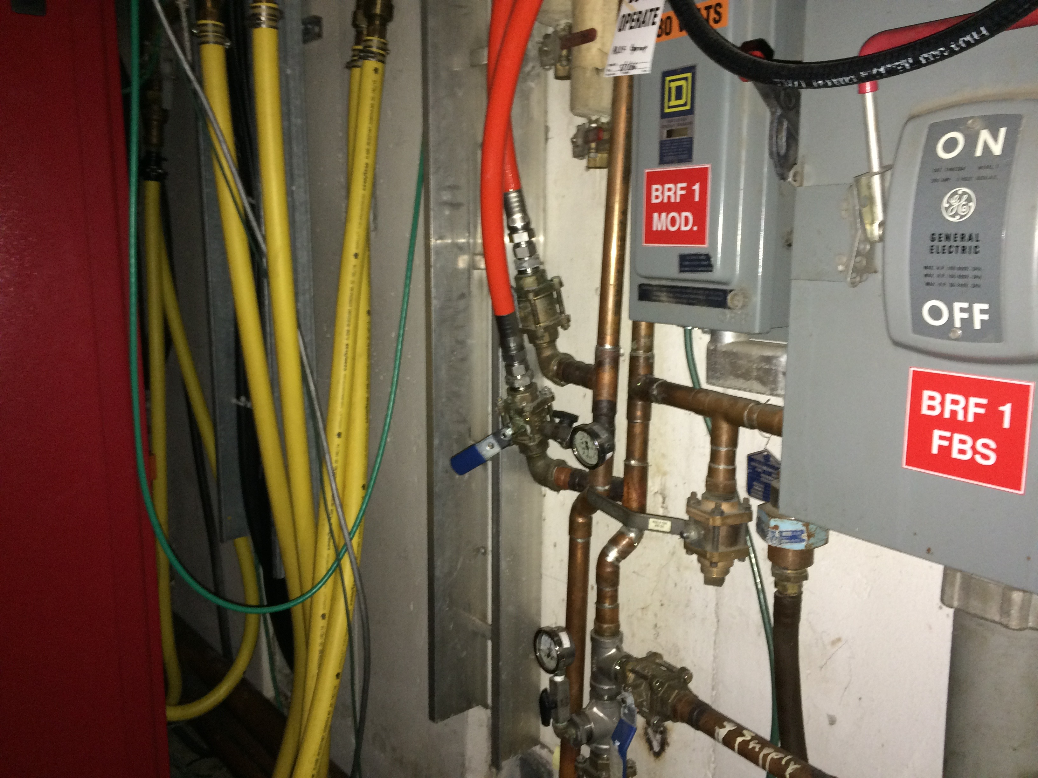
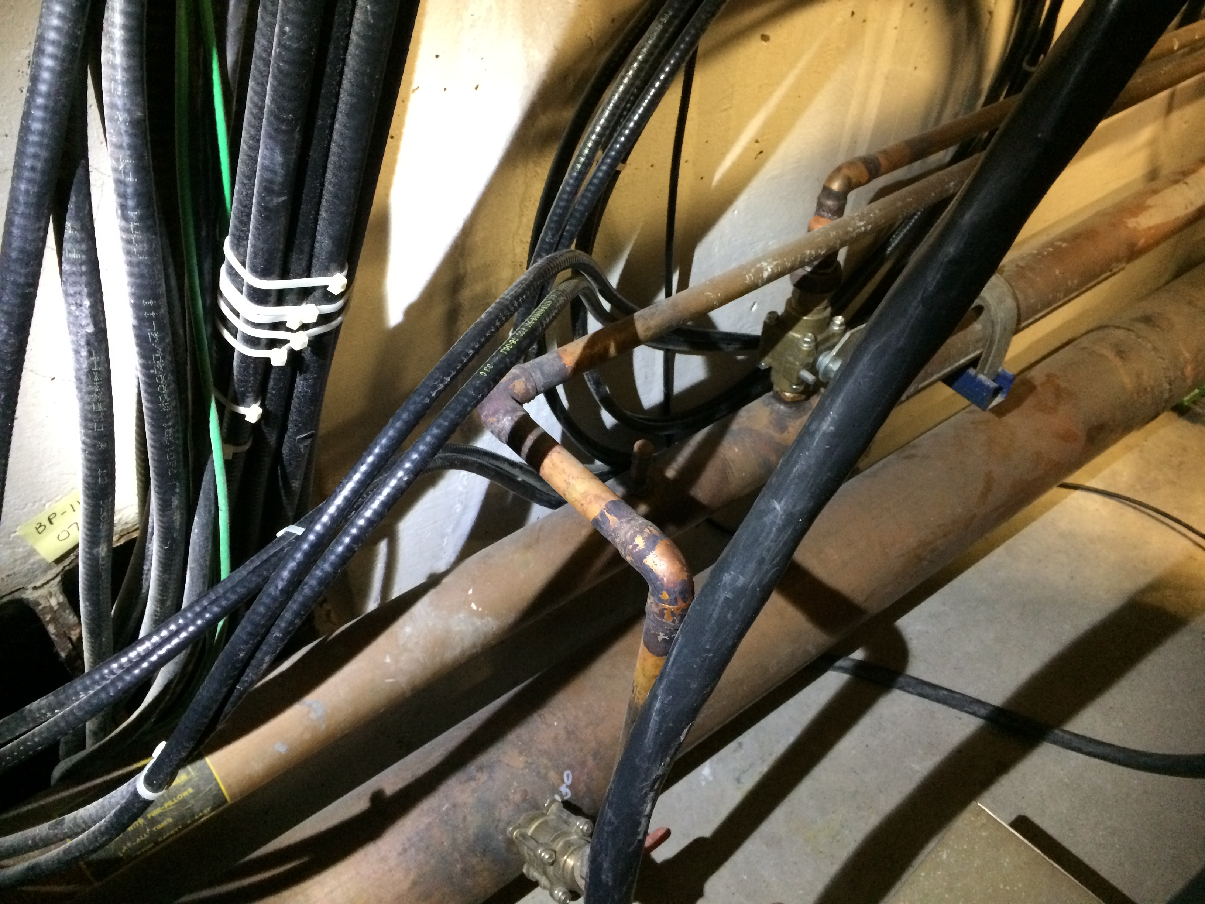
Water manifold (upstairs)
Remove these.
Replace with this.
As per Robyn’s email dated 16 Jun 2017: request ~20 g/min for the modulator.
SSA also requires water.
Recommended 20-25 l/min at 25-35 degC. (5-6 gallons/min at 77-95 F)
Bias supplies do not need water as of now. Request spare spigot just in case.

Slide 6
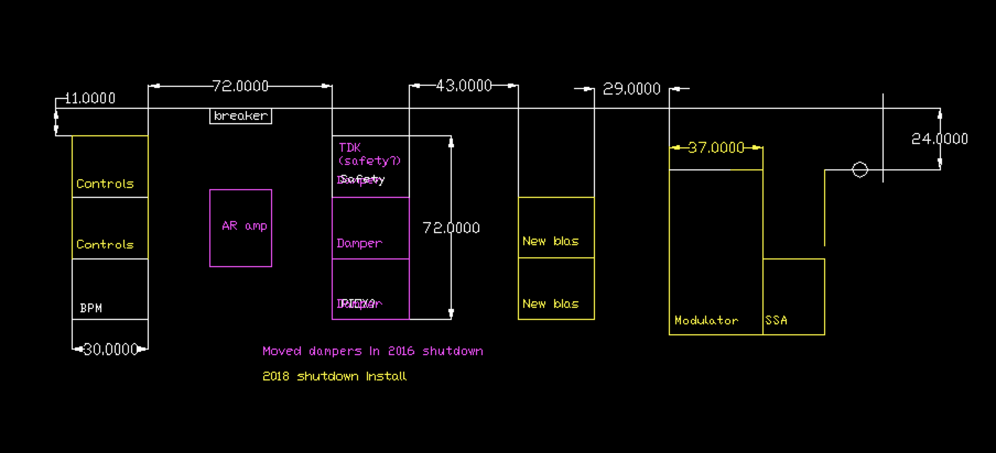
Installation map
Add new 208 outlet
Location of water

Slide 7
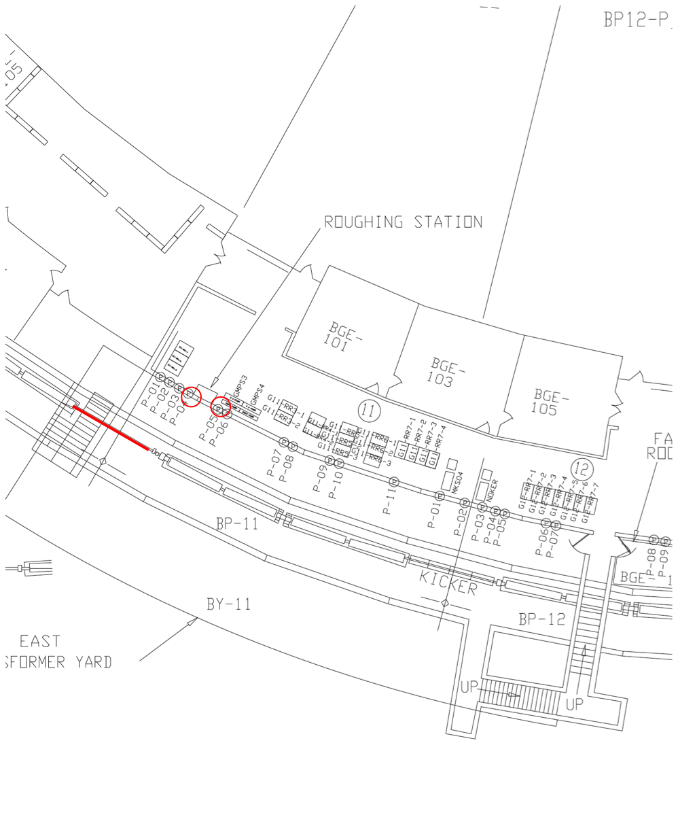
Downstairs plans

Slide 8
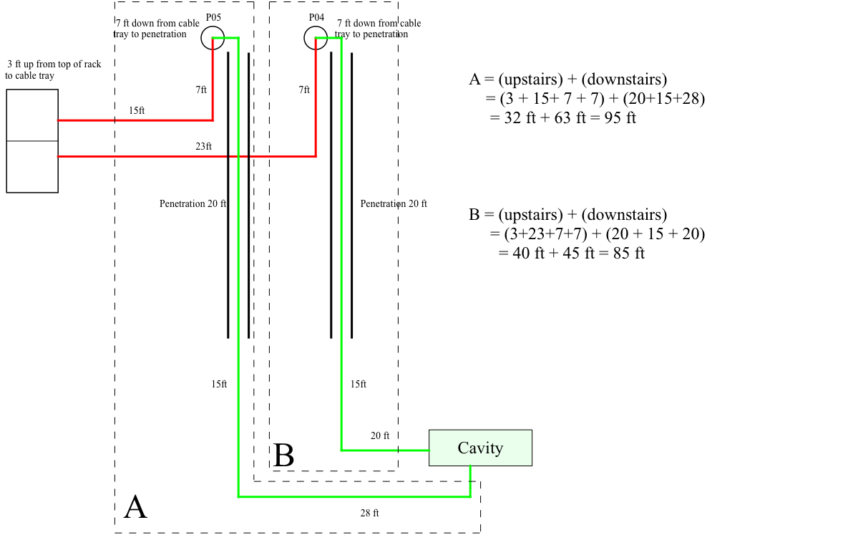
Cable lengths

Slide 9
Todo
Check modulator cable list
How much cable and what to buy. Rene will take care of this.
Check with Robyn about the size of the driver cables and number.
Check with Matt Kufer about the number of bias supply cables.
Number of signal cables. Looks like taken are of in bundle.
Talk to Mike Kucera about IRM.
Talk to Drew Wallace and Dave Hixson about water.
Talk to Salah about putting all of this into electronic worklist.
Have to check penetrations downstairs.
Talk to Ryan about cable pulls.
Talk to John or Joe about water pressure for modulator.
Check with Matt Kufer about water for bias supplies.

Slide 10
Deprecated slides

Slide 11
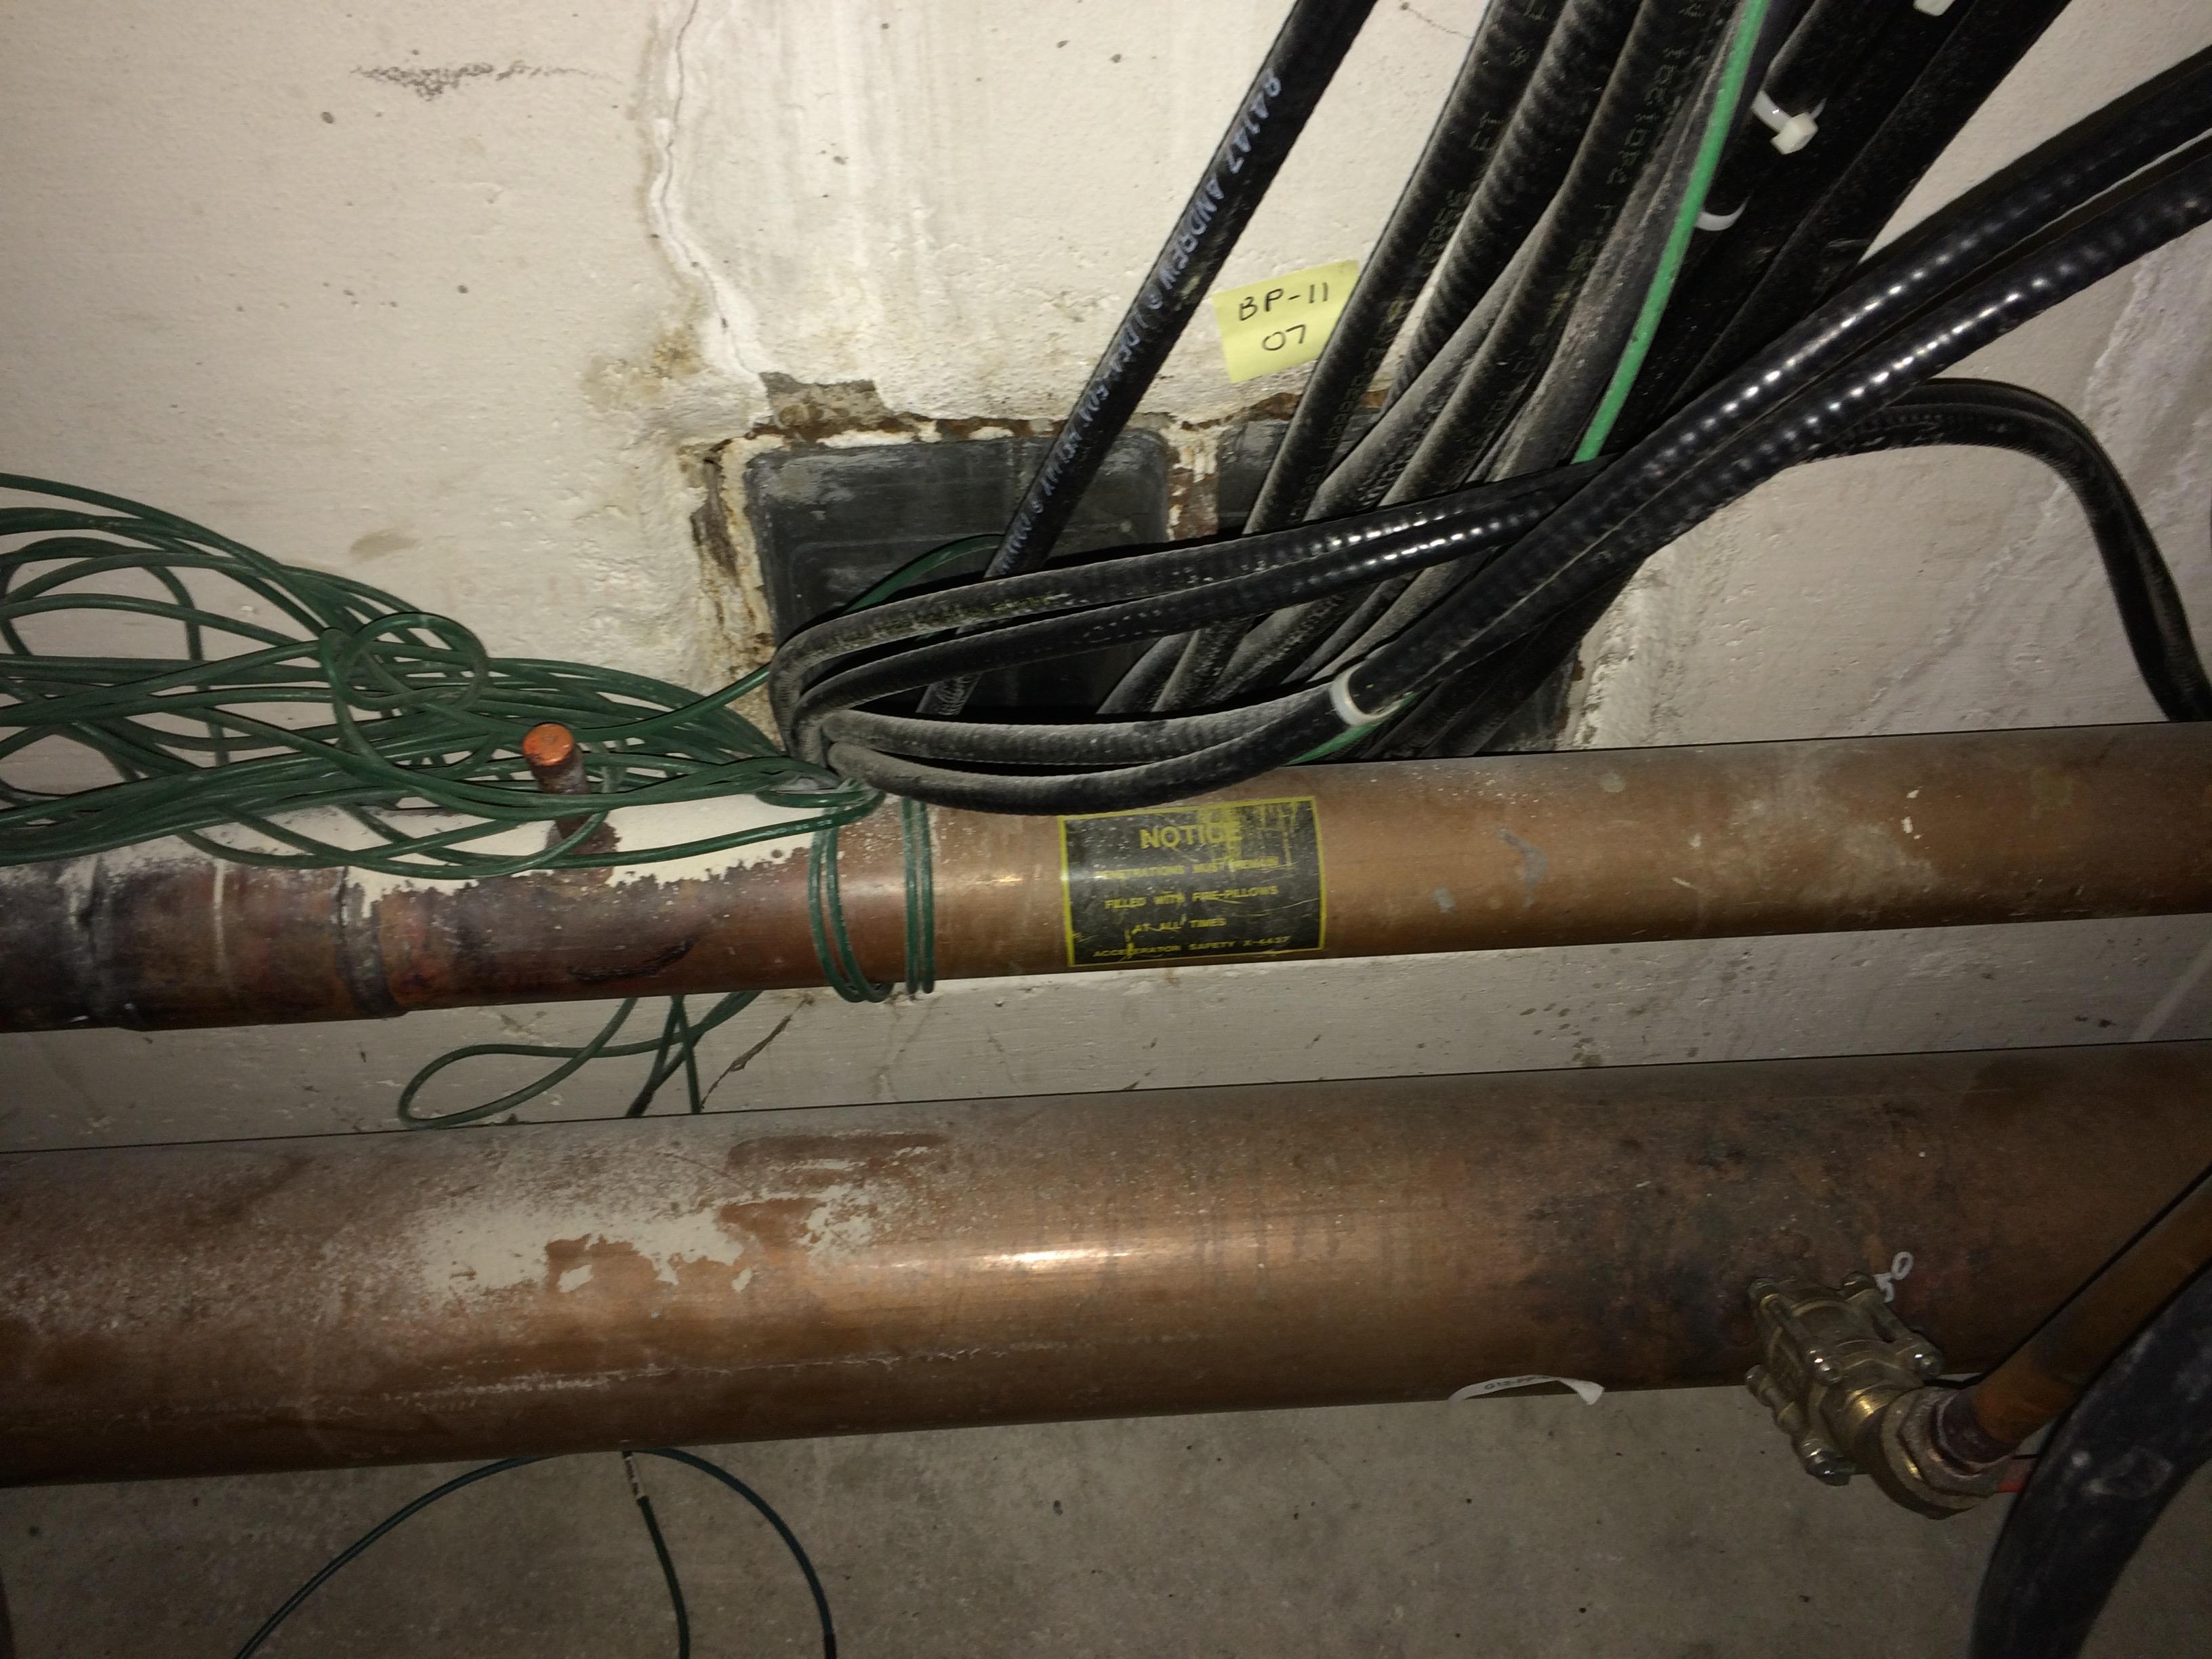
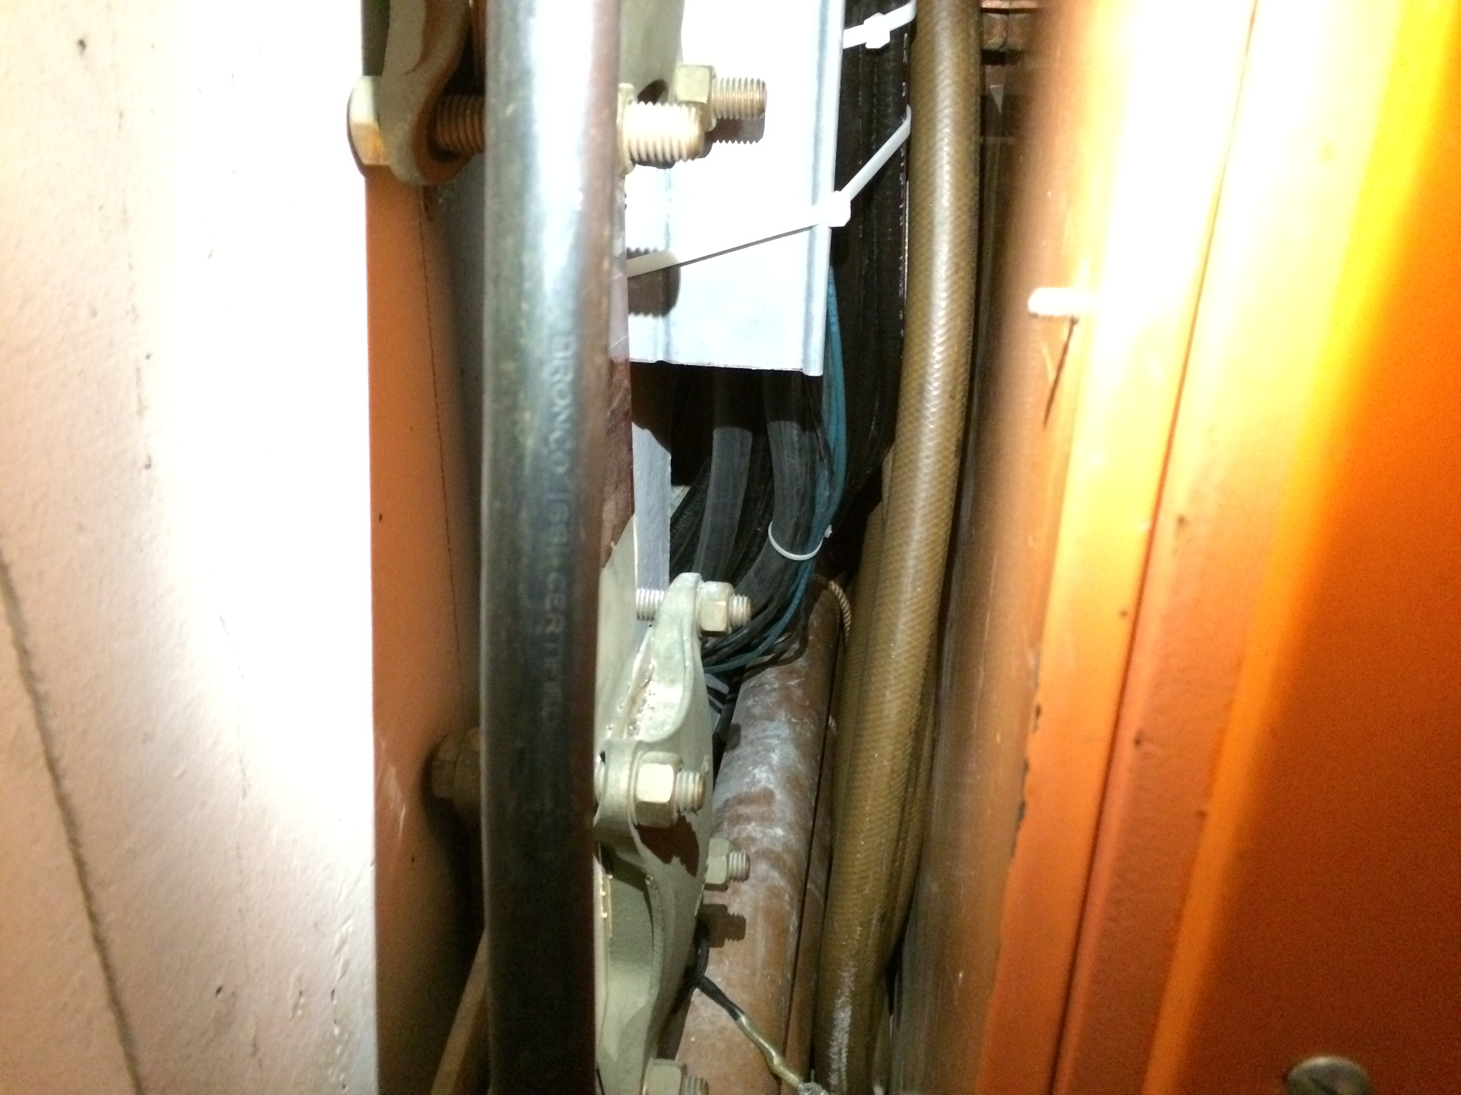
Modulator cables (option 1)
All cables must be removed from this penetration. Some moved to adjacent penetration
Typical modulator cable bundle.
Can this bundle include SSD cables?
Can I also have signal cables? Or put in adjacent penetration?
Pipe has to be moved out to unblock the pentration

