Slide 1
Witness Samples Remeasured
John Kuharik
July 6, 2017

Slide 2
Witness Samples Remeasured:
Remeasured all 16 of the samples from Lot 1.
7 measurements each
Used the same waveform as previous
Same signal generator, amplifier, scope
Same coils
Replaced both the bad and good scope probes with alligator clips
Added rubber supports under the excitation coil to give consistent horizontal and vertical alignment
Marked coils, samples, and ferrite pieces to maintain rotational alignment
Used the same scaling on all scope channels

Slide 3
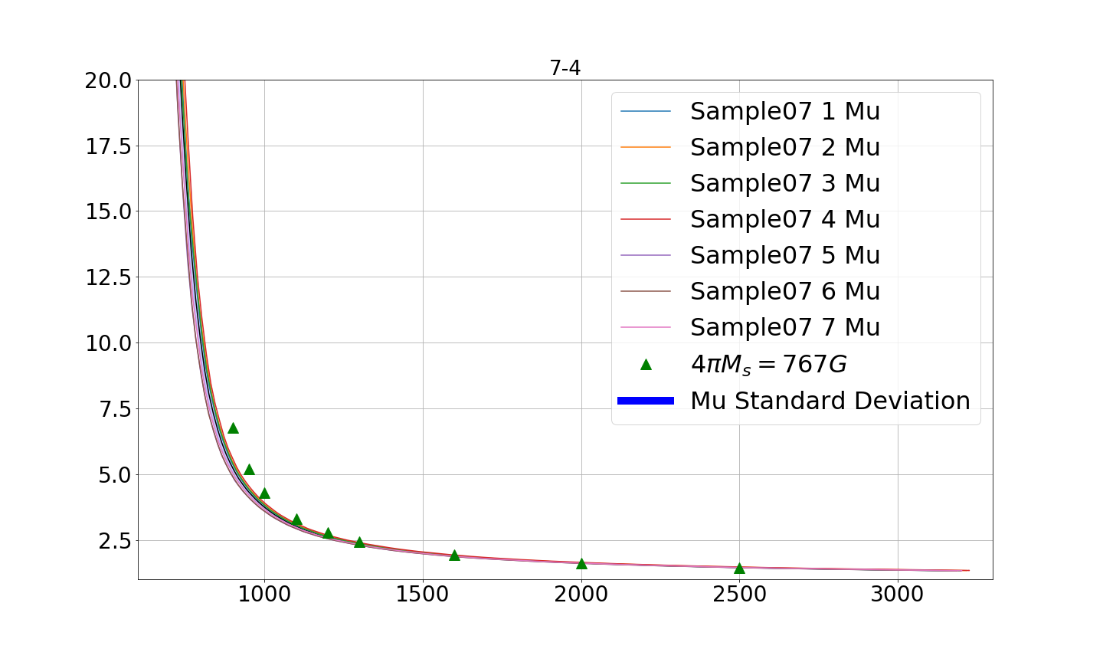
Results Sample 7

Slide 4
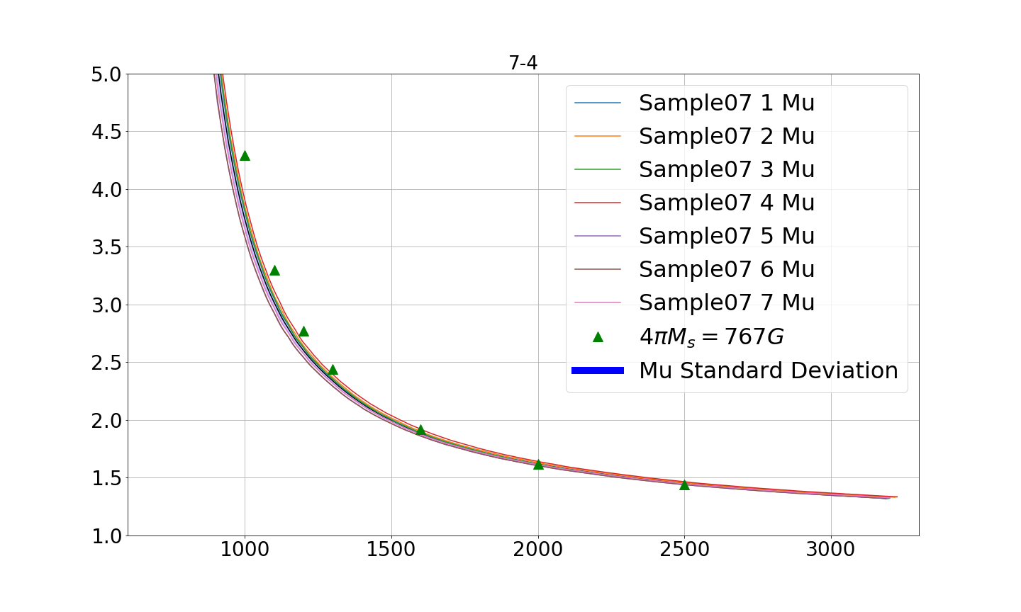
Results Sample 7

Slide 5
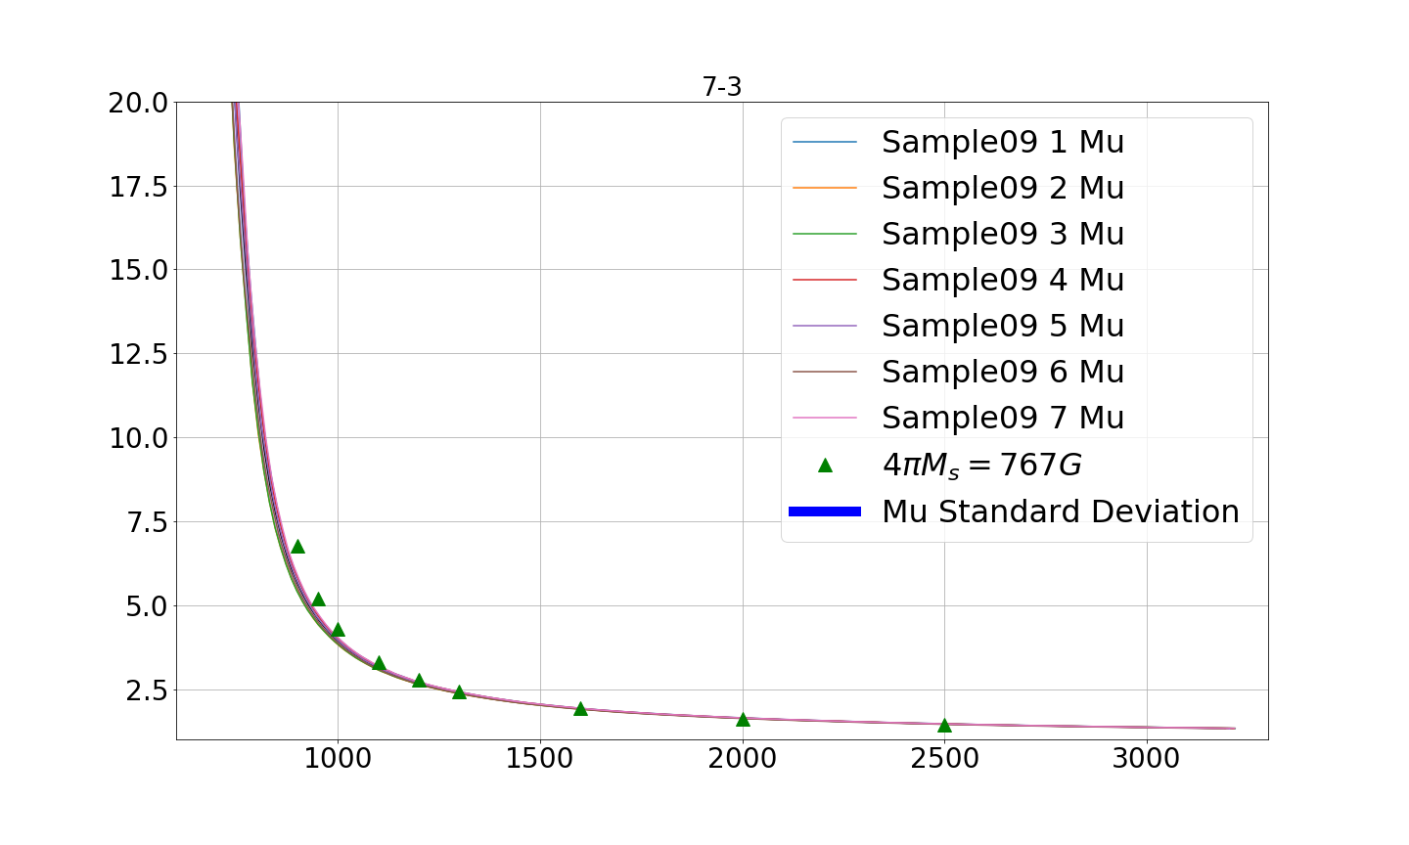
Results Sample 9

Slide 6
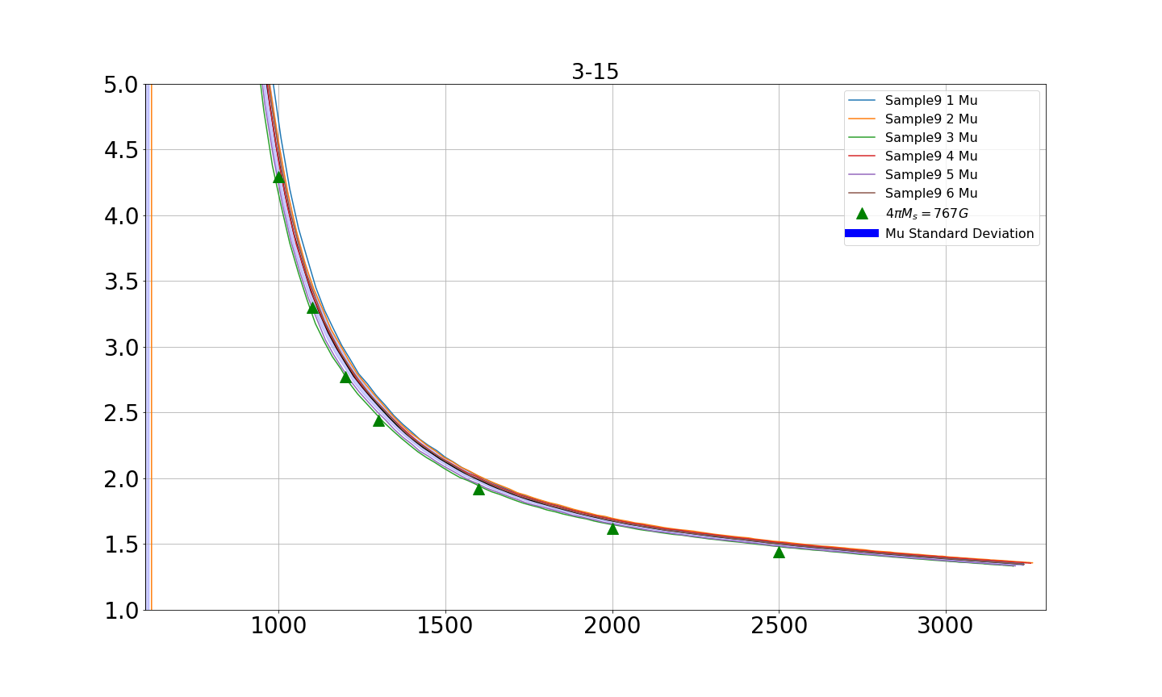
Results Sample 9

Slide 7
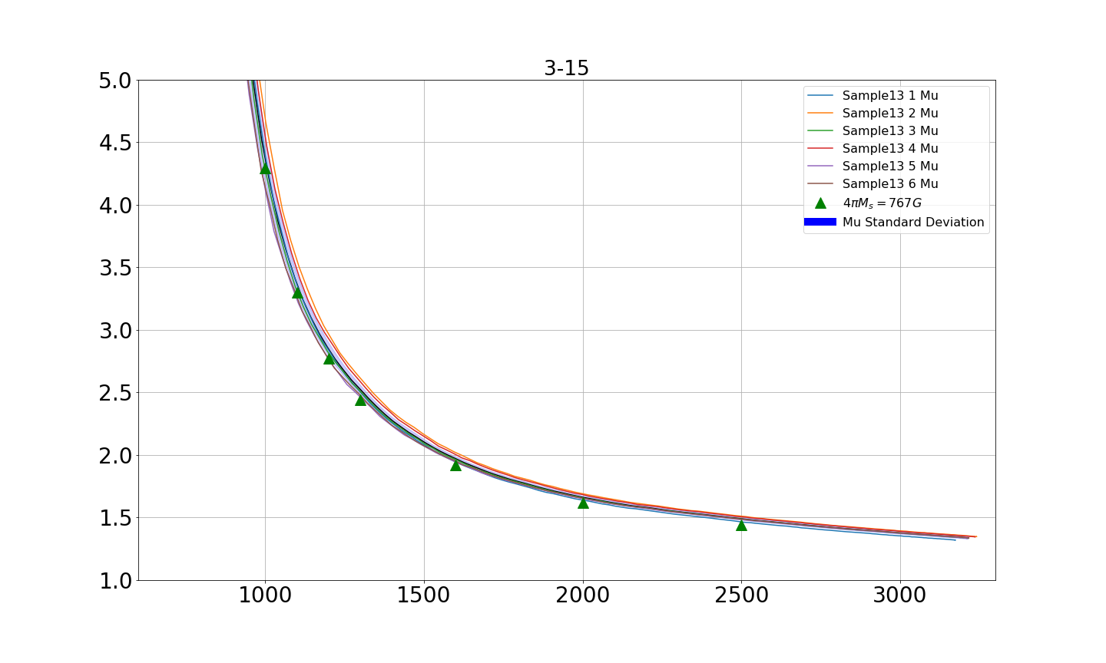
Results Sample 13

Slide 8
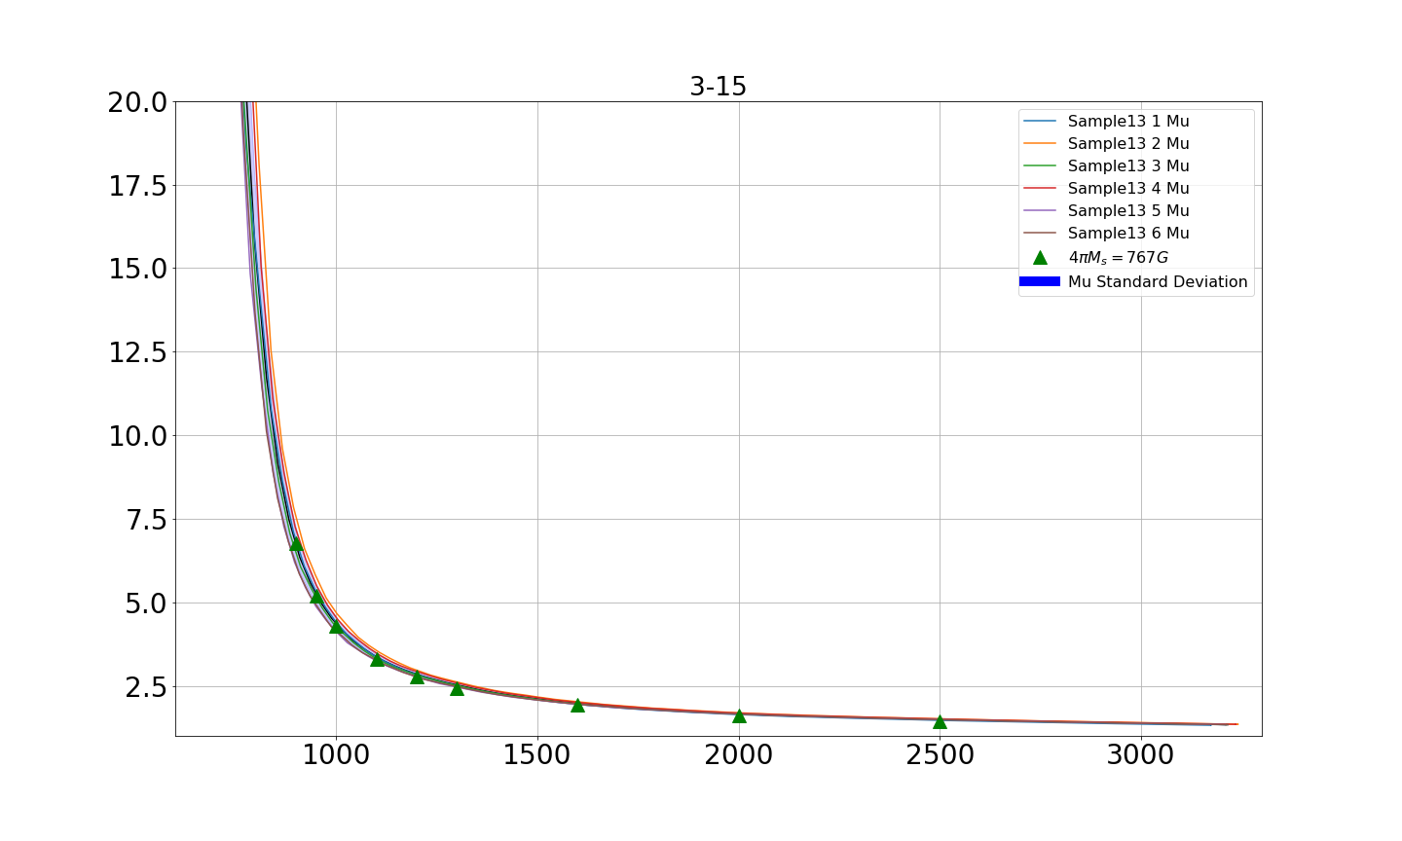
Results Sample 13

Slide 9
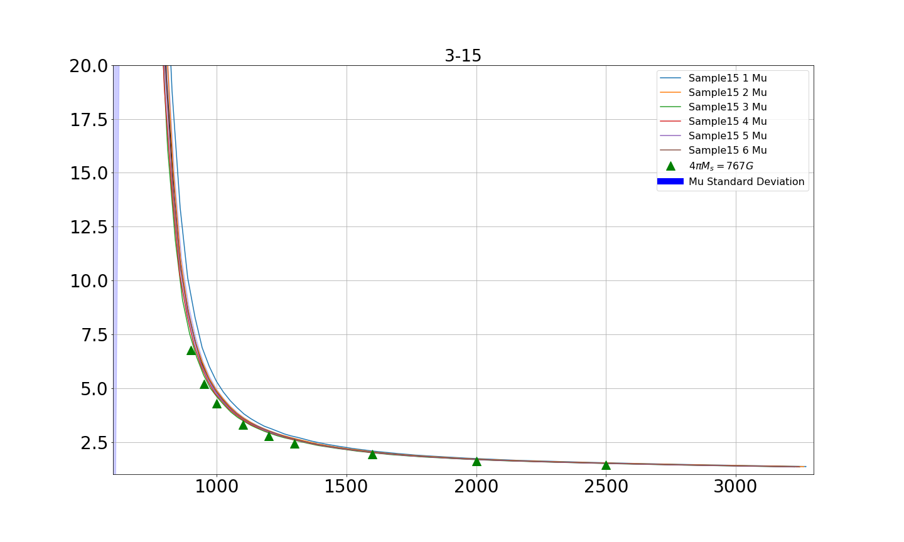
Results Sample 15

Slide 10
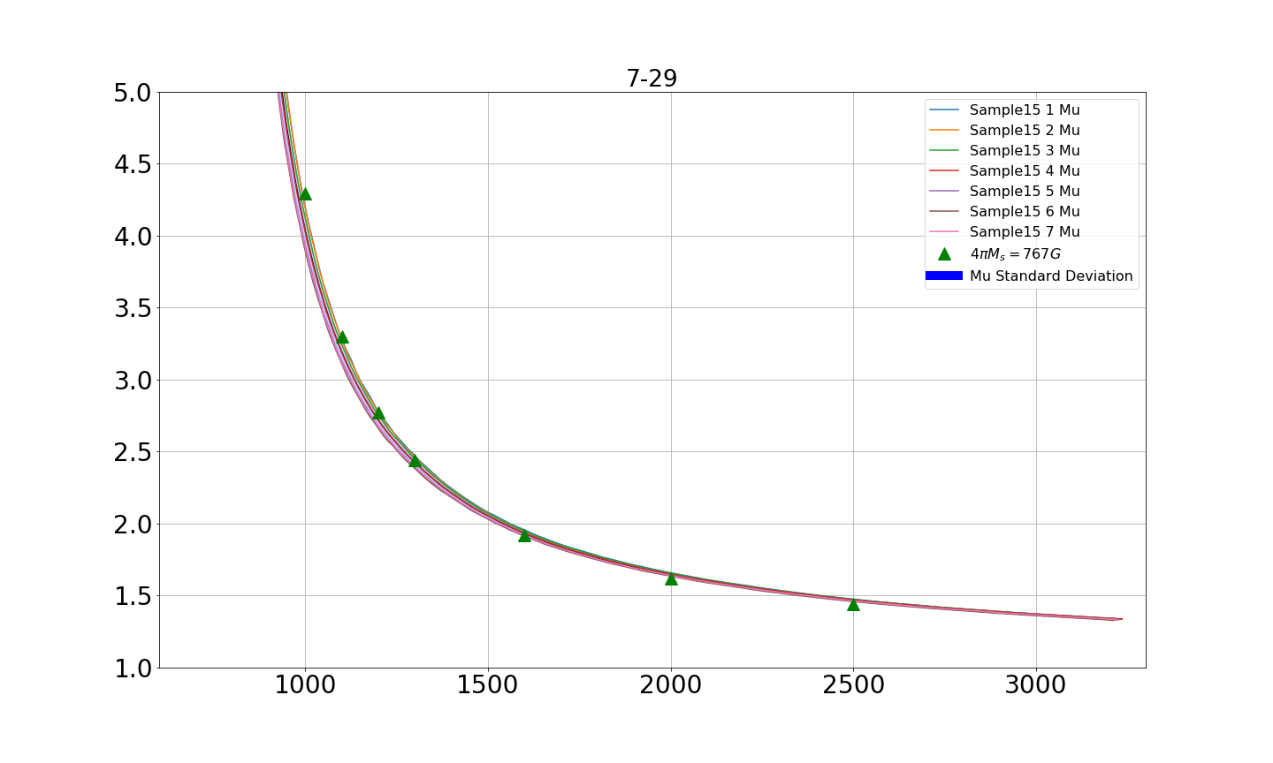
Results Sample 15

Slide 11
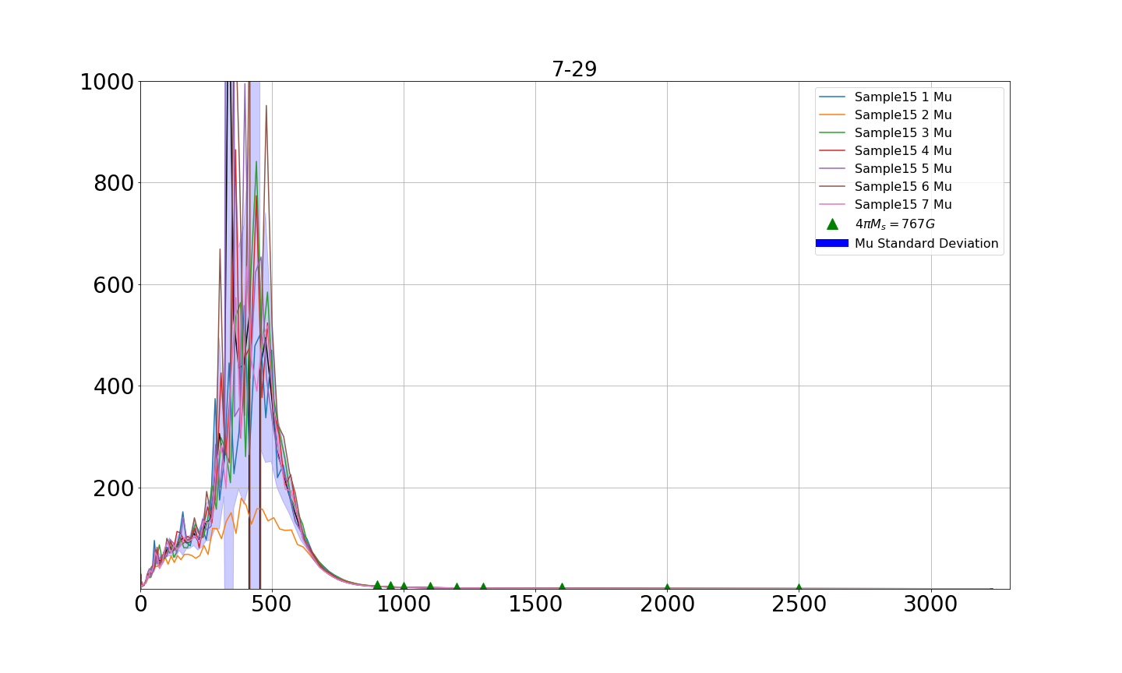
Results Sample 15 Full Scale

Slide 12
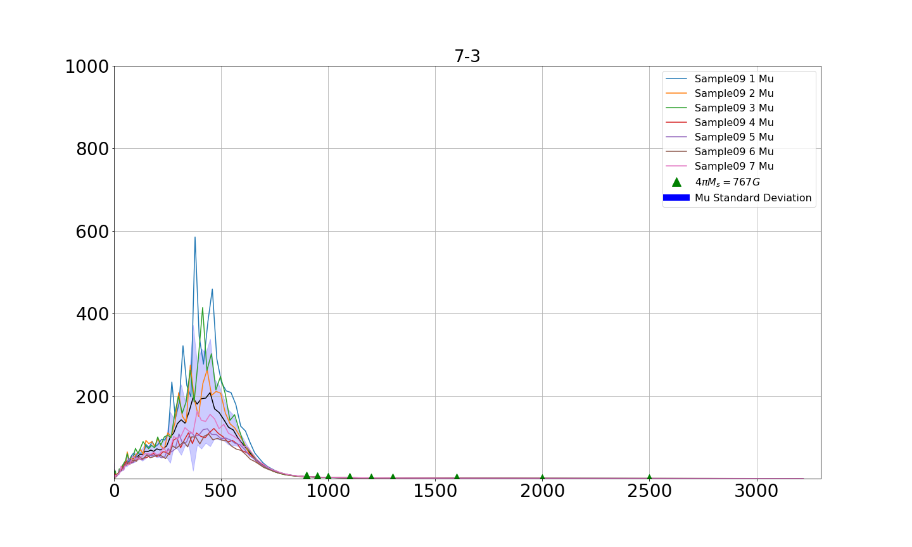
Results Sample 9 Full Scale

