Slide 1
Mechanical Update
Kevin Duel
Booster 2nd Harmonic Cavity
20 July 2017

Slide 2
Garnet Ring Orders
PO issued for 5 ring assemblies
Alumina due to arrive NMG August 7th

Slide 3
RF Spring
Enlarged OD of groove to remove contact outboard of spring

Slide 4
RF Spring

Slide 5
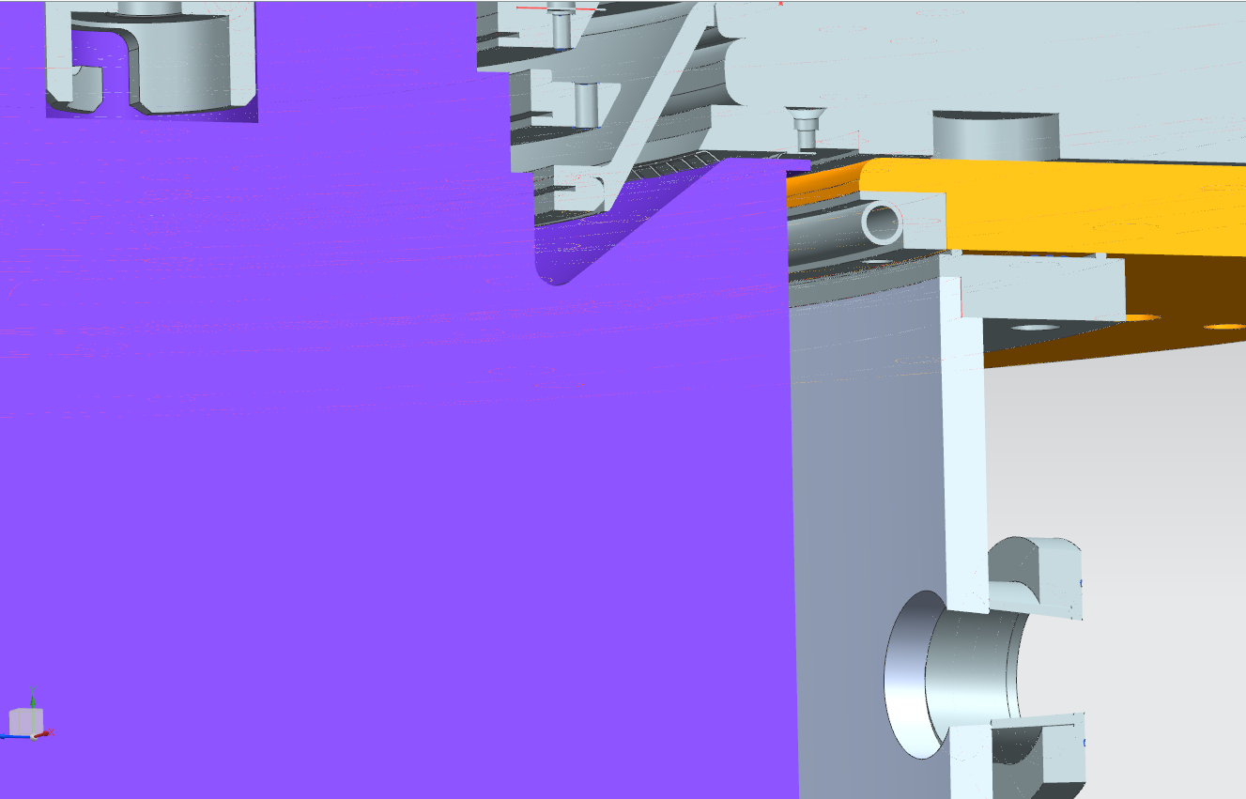
PA Outer Shell
RF Lip

Slide 6
Garnet and Alumina Shim
Opened up groove diameters to allow for .004” glue thickness
Tightened OD and ID tolerances so that NMG can match it to the other rings
Added radii to corners of groove for tooling purposes
NMG were impressed with machinability and quality (no pitting, etc.) of CoorsTek alumina
Hope Morgan can provide same quality
Will ask for a sample

Slide 7
Garnet and Alumina Shim
Added chamfers and tightened OD and ID tolerances

Slide 8
RF Probes
.5”

Slide 9
Tube Anode Cable Snout

Slide 10
Anode Monitor Port

Slide 11
Clocking for ports?

