Slide 1
Garnet Ring Measurements
John Kuharik
Robyn Madrak
August 17, 2017

Slide 2
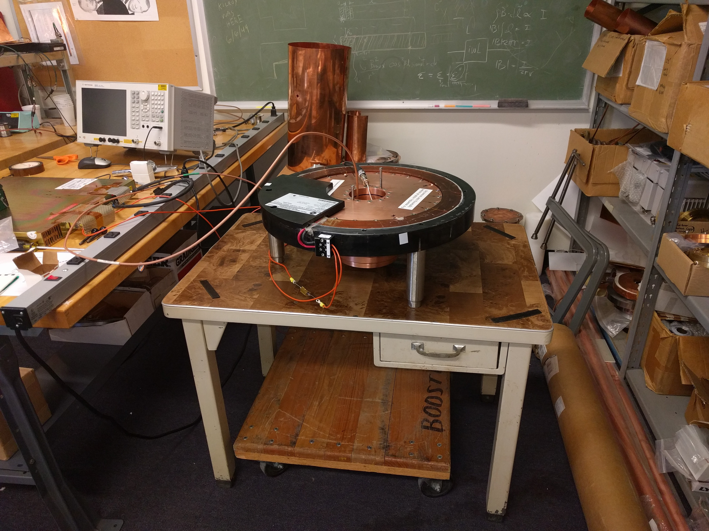
Garnet Ring Test Stand
Measurements have been made on
Ring 1 (wrong size)
Ring 2 (chipped)
Empty cavity.

Slide 3
First Result
First measurements on the rings showed a significant difference in Q between the rings and from the predicted curve.

Slide 4
Second Measurement
The second set of measurements on Ring 1 found a small hysteresis effect by walking the bias current up and down while reversing the power leads.
The cavity was not opened between measurement 1 and this measurement.

Slide 5
3rd Measurement – Empty Cavity

Slide 6
Repeatability Measurements 4-9
Made several measurements on both rings. Best measurements of ring 1 and ring 2 match.
The difference between measurement 8 and 9 was only the torque used to tighten the cavity screws. (21 and 30 in-lbs). The cavity was not opened between them.
The new electric screwdriver with torque control was used starting with measurement 4.

Slide 7
Repeatability Round 2
Repeatability round two had good results. Both Rings had matching results and the best previously measured values.
One measurement had a low result due to screws not tightened properly.

Slide 8
Empty Cavity Again, with Torque Control

Slide 9
Q of the empty cavity
Before the torque control screwdriver, the highest Q measured was 1400
Initially, we did an experiment to see if tightening more than 30 in lb (with the manual torque wrench) helped, and did not see an increase in Q
Now with the torque control screwdriver, Q ~ 1600
Still, all measured Q’s are substantially less than the predicted value of ~2200
Probably would be good to use the torque control screwdriver to tighten to 40 in lb and see what happens (contact effect) - No significant change found.
We will clean the cavity with Copper Brite (acid) Citrus Strip in case there is any remaining surface problem
This needs to be understood before we can be confident in our measurements of the garnet loss.

