Slide 1
Parallel-Biased Replacement Booster Cavity
Mohamed Hassan
PIP Replacement Booster Cavity
Aug 15th 2017

Slide 2
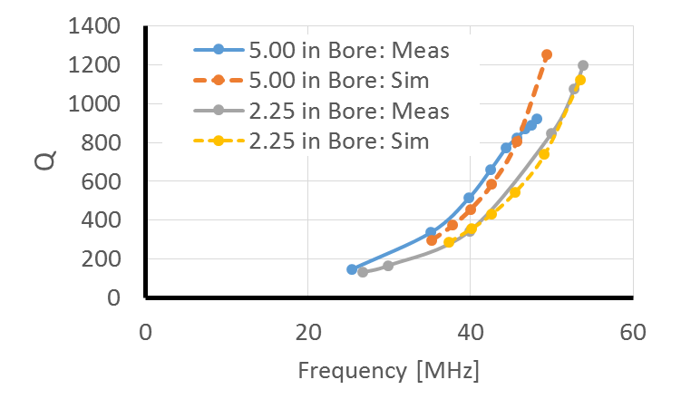
Large Bore Cavity Testing
With large bore the whole frequency range will move to lower range, tuning range decreases
First design goal is to adjust the sweep range with the new 3.25” bore radius

Slide 3
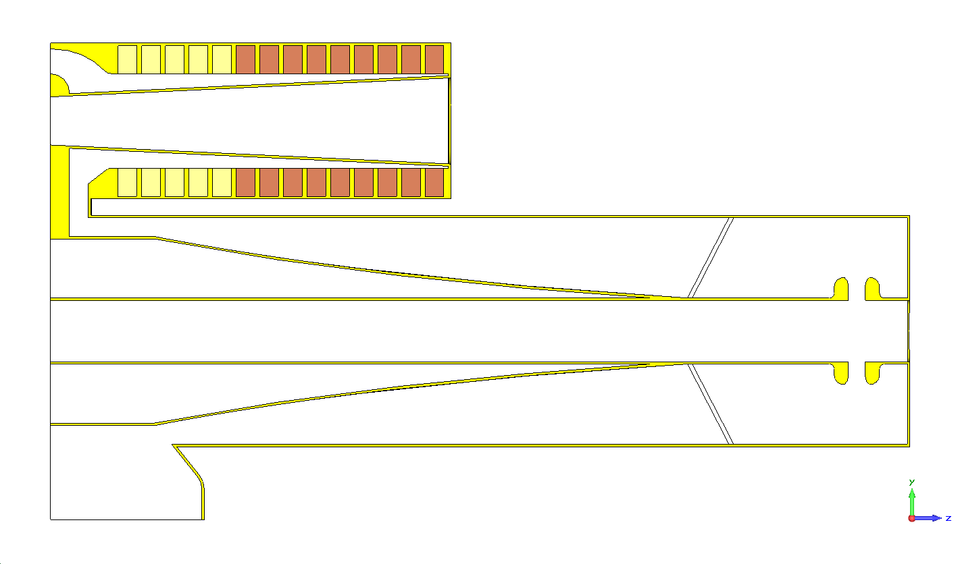
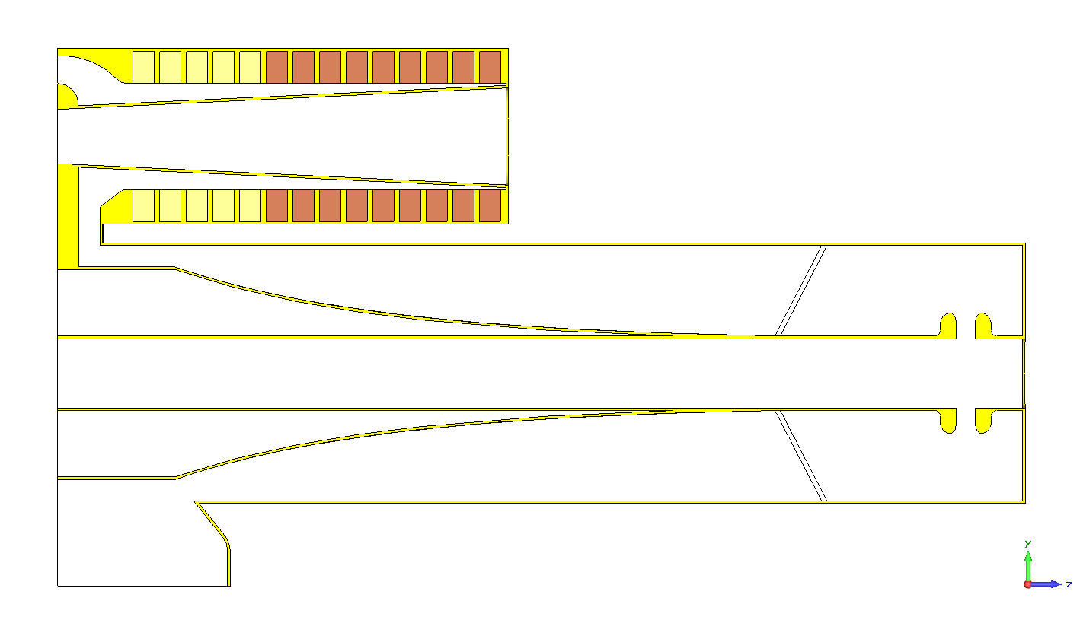
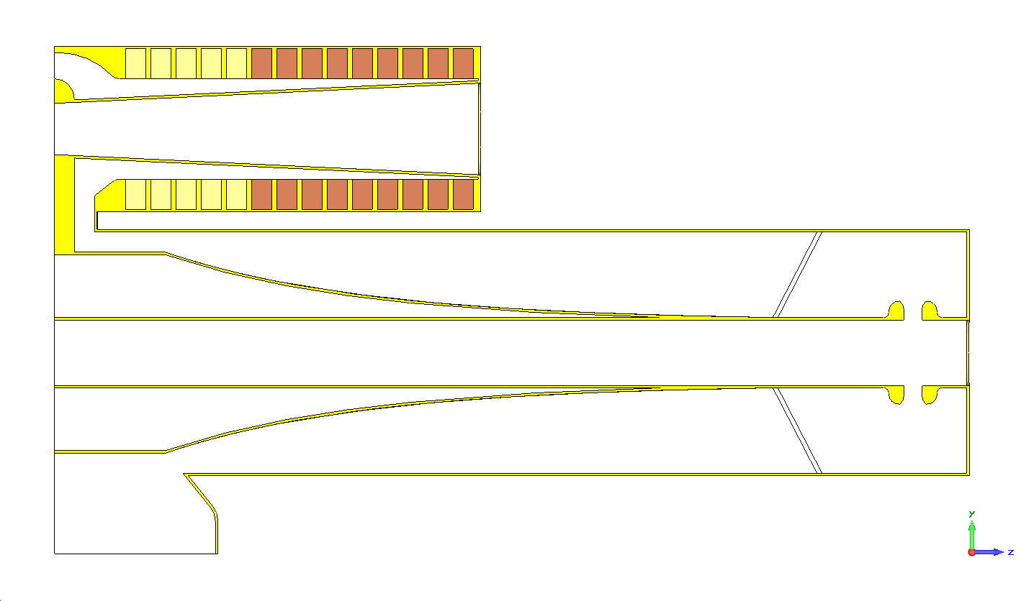
Trials for 3.25” Bore
 | F1 [MHz] | F2 [MHz]
Taper close to current (-0.04) | 35.2 | 50.4
Taper is steeper (-0.1) | 36.1 | 51.3
Gap piece diameter | 36.4 | 51.9
Moving dielectric window 2” towards gap | 36.3 | 51.8
Center cast diameter | 37.6 | 52.8
Center cast diameter | 37.8 | 52.9

Slide 4
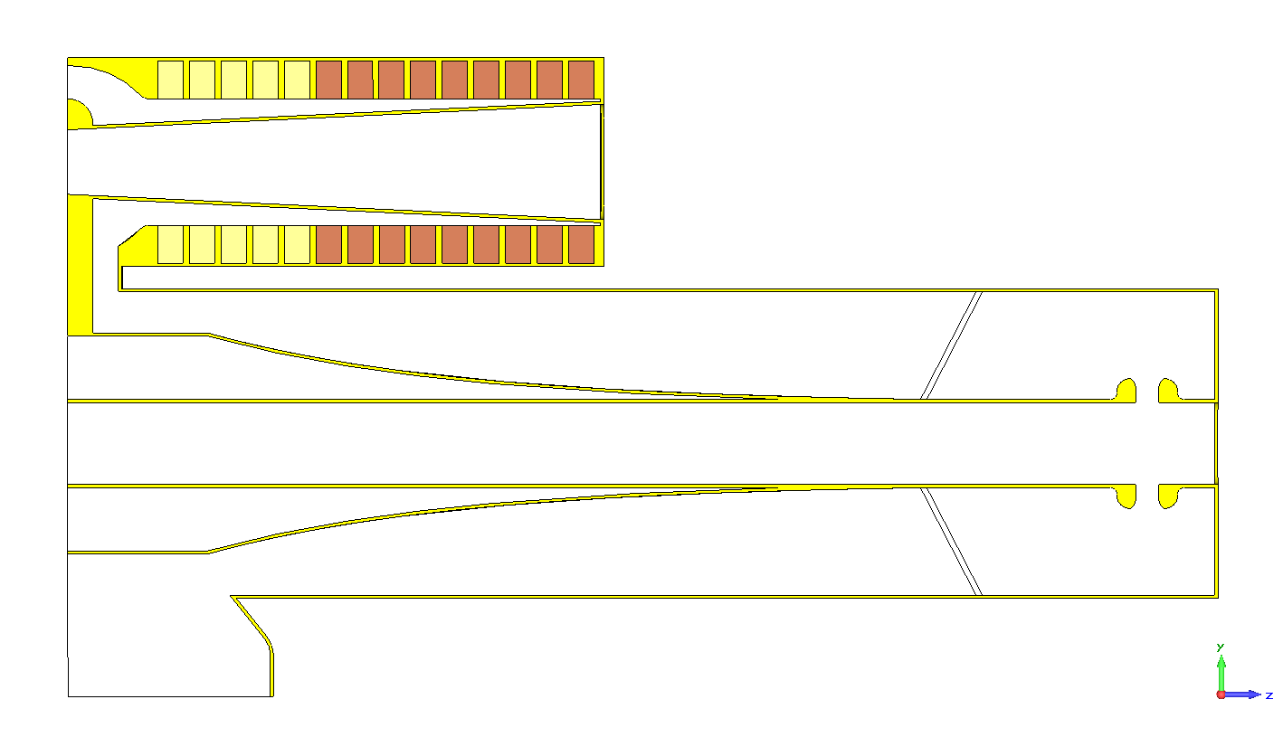
Preliminary Design
Steeper Taper
8.5”
3.25” Bore
Meeting first goal (37.8 MHz to 52.9 MHz)

Slide 5
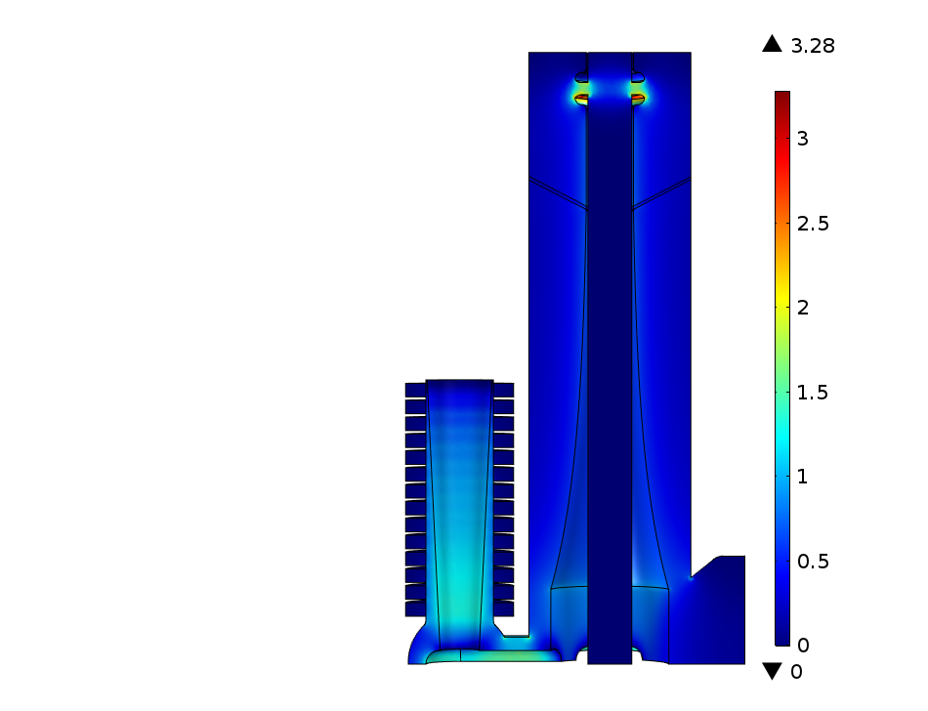
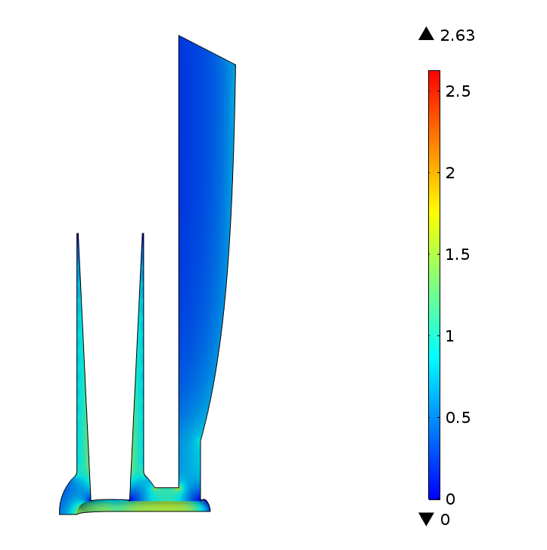
Electric Field at 37.8 MHz (60 kV)
MV/m
MV/m

Slide 6
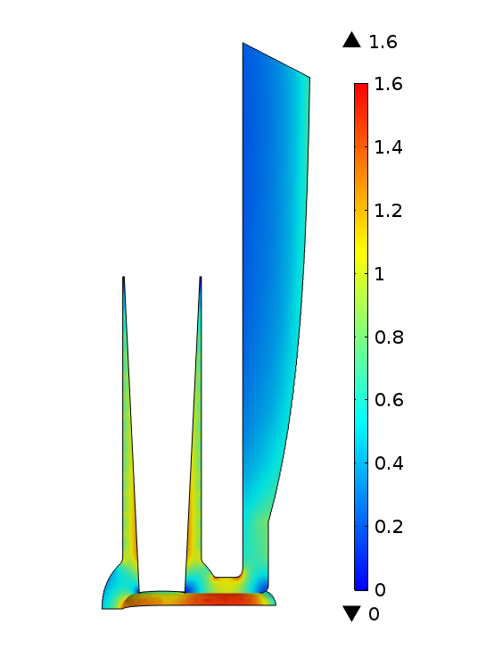
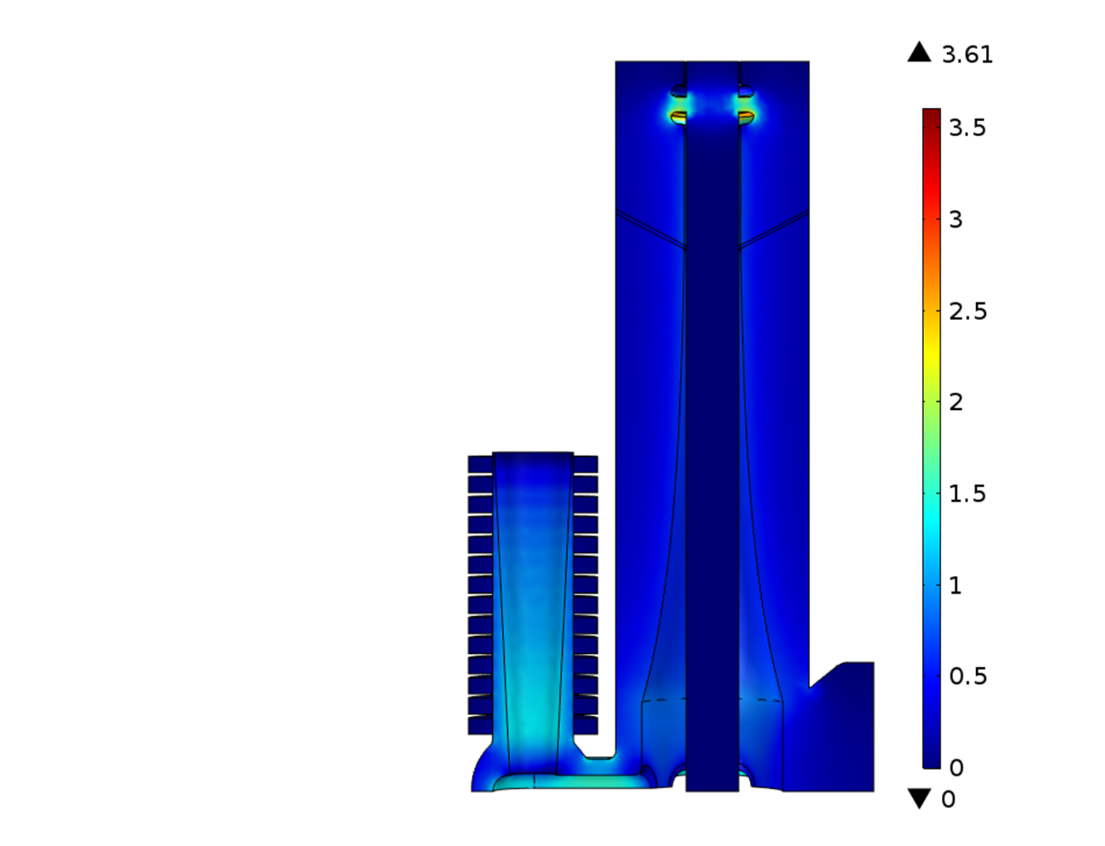
After Blending Edges with 0.5” (60 kV)

Slide 7
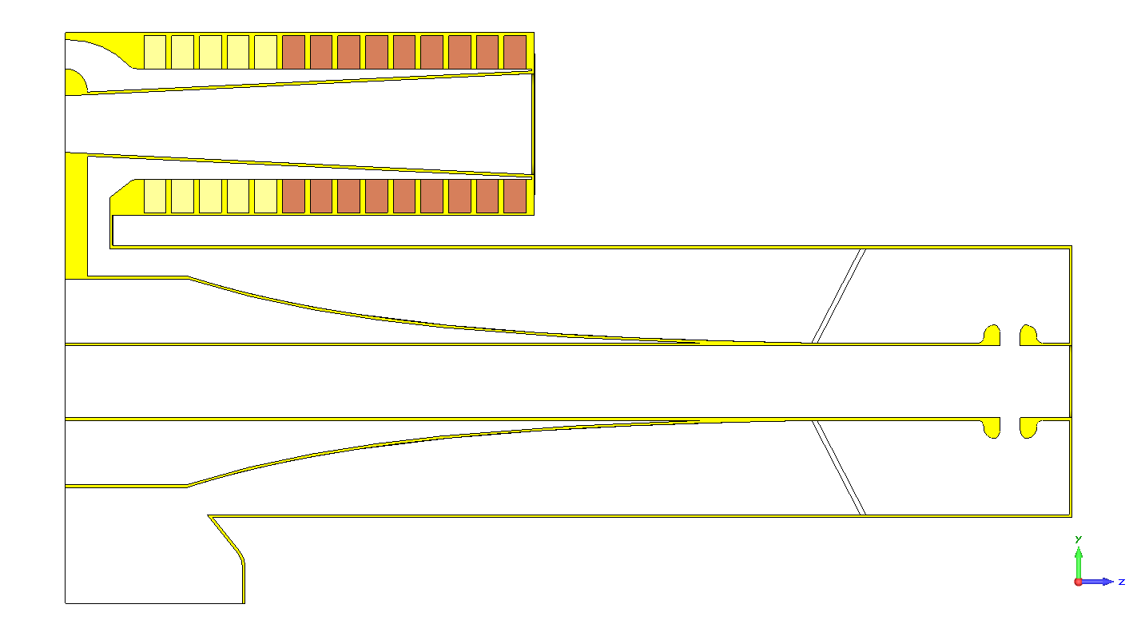
Preliminary Design2
Longer Stem +0.5”
Steeper Taper
9.284”
3.25” Bore

Slide 8
Preliminary Design2 Tuner Changes
 | F1 [MHz] | F2 [MHz]
As Is | 36.8 | 52.1
One Stackpole Out (replaced by copper) | 38.2 | 53.2
4Tsh+10Sp | 37.3 | 52.6
3Tsh+11Sp | 37.7 | 52.9
2Tsh+12Sp | 38.1 | 53.3
1Tsh+13Sp | 38.4 | 53.7
All Sp | 38.7 | 54.0
13 SP | 39.2 | 54.5
3Tsh+10SP | 38.1 | 53.4

Slide 9
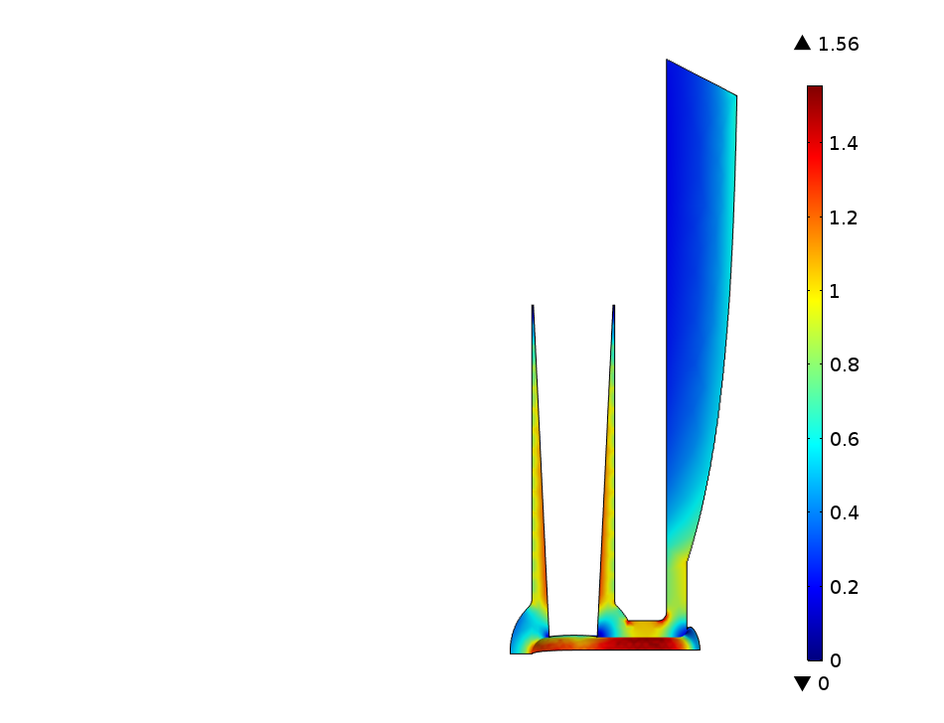
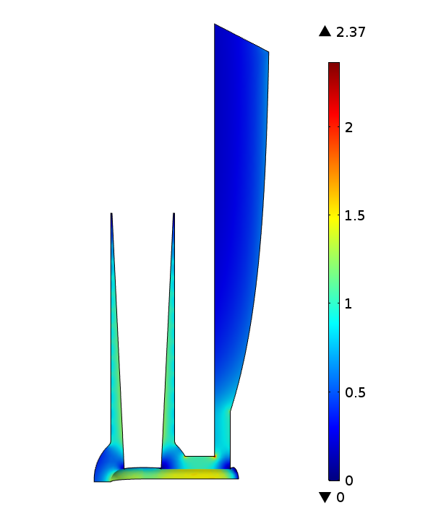
Preliminary Design2 Max Field with 0.5” Rounding (60 kV)
All SP 38.7 MHz with 60 kV

Slide 10
Energy and Heeating
 |  | mu=8.4 | mu=3
 |  | f1 [MHz] | f2 [MHz] | Q1 | Q2 | E1 [mJ] | E2 [mJ] | Eav [mJ] | Ecycle [mJ] | Gap [kV] | BW[ MHz]
Ref Cavity |  | 37.3 | 53.5 | 286 | 1123 | 42.9 | 14.8 | 28.85 | 19.91 | 55 | 16.2
 |  | 38.7 | 54.0 | 337 | 1490 | 38.9 | 13.4 | 26.2 | 18.1 | 55 | 15.3
New All SP |  | 38.7 | 54.0 | 337 | 1490 | 46.3 | 15.9 | 31.1 | 21.5 | 60 | 15.3
Estimated
New All SP |  | 37.3 | 53.5 |  |  | 43.7 | 13.0 | 28.35 | 19.56 | 55 | 15.3
New All SP |  | 37.3 | 53.5 |  |  | 52.1 | 15.4 | 33.75 | 23.29 | 60 | 15.3

Slide 11
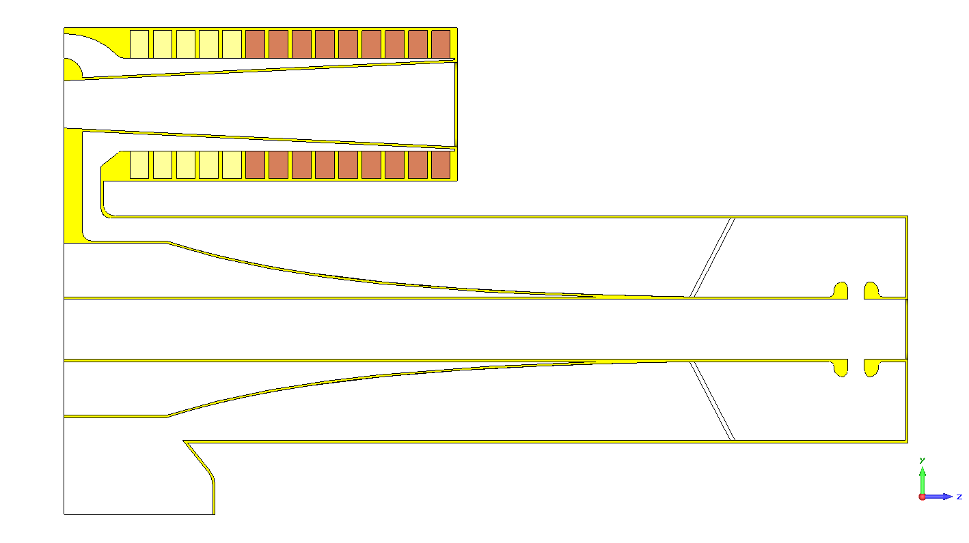
Preliminary Design3
Longer Stem +1”
Steeper Taper
9.284”
3.25” Bore

Slide 12
Preliminary Design3 Tuner Changes
 | F1 [MHz] | F2 [MHz]
Design2: 3Tsh+10SP | 38.1 | 53.4
Design3: 3Tsh+10SP | 37.8 | 53.1
 |  | mu=8.4 | mu=3
 |  | f1 [MHz] | f2 [MHz] | Q1 | Q2 | E1 [mJ] | E2 [mJ] | Eav [mJ] | Ecycle [mJ] | Gap [kV] | BW[ MHz]
Ref Cavity |  | 37.3 | 53.5 | 286 | 1123 | 42.9 | 14.8 | 28.85 | 19.91 | 55 | 16.2
 |  | 38.7 | 54.0 | 337 | 1490 | 38.9 | 13.4 | 26.2 | 18.1 | 55 | 15.3
New All SP |  | 38.7 | 54.0 | 337 | 1490 | 46.3 | 15.9 | 31.1 | 21.5 | 60 | 15.3
Design3 3Tsh+10SP |  | 37.8 | 53.1 | 309 | 1327 | 49.27 | 16.89 | 33.08 | 22.83 | 60 | 15.3

Slide 13
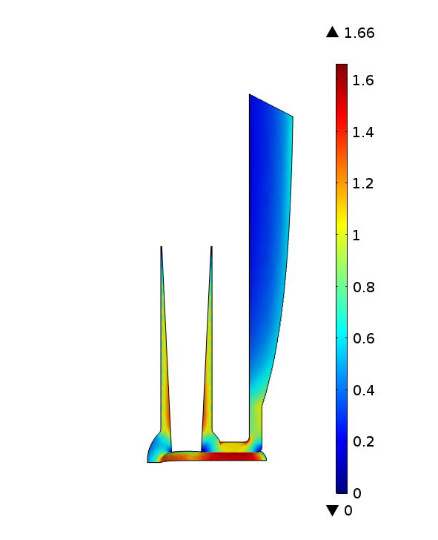
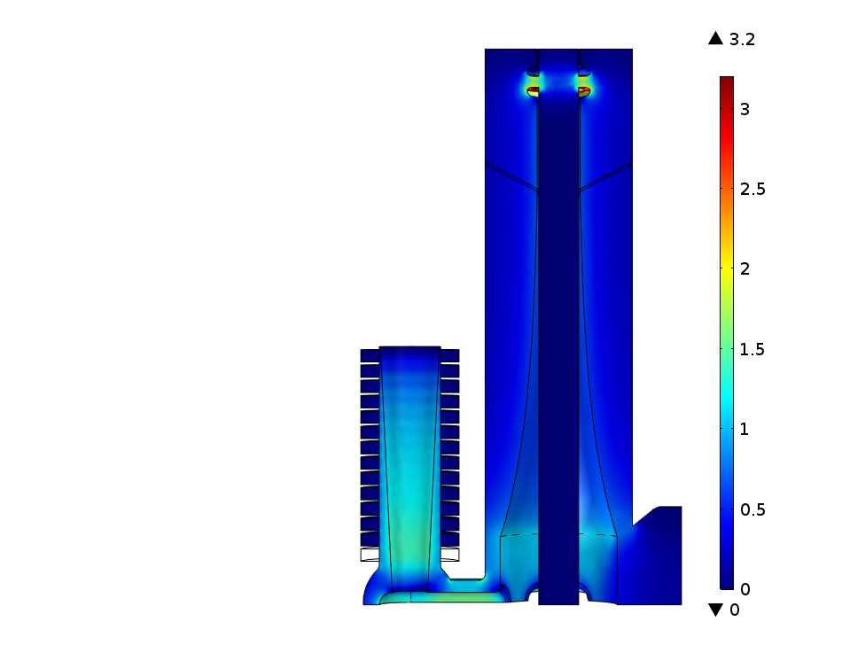
Design3 3Tsh+10SP

Slide 14
Near Flat Tuner
Longer Stem +1”
1.6”
Steeper Taper
9.284”
3.25” Bore
 | F1 [MHz] | F2 [MHz]
Design2: 3Tsh+10SP | 38.1 | 53.4
Design3: 3Tsh+10SP | 37.8 | 53.1
Near Flat Tuner 3Tsh+10SP | 38.2 | 50.5

Slide 15
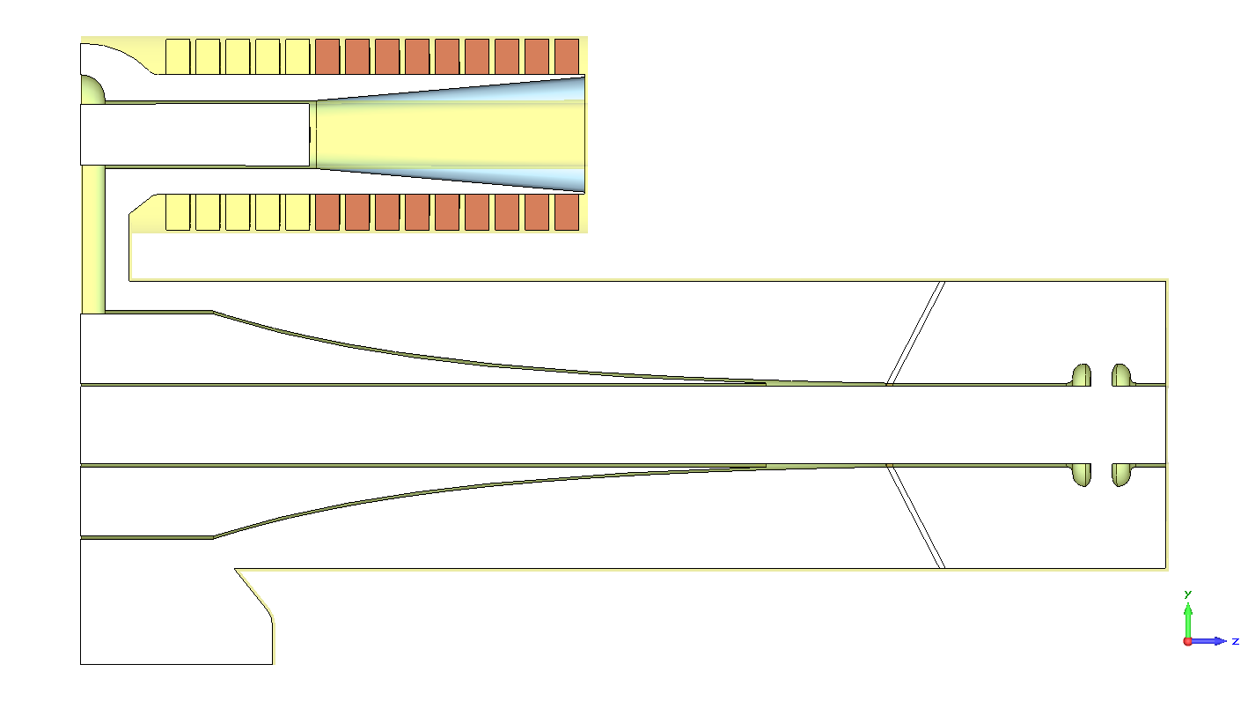
Double Taper Tuner
Longer Stem +1”
2.4”
Steeper Taper
9.284”
3.25” Bore
 | F1 [MHz] | F2 [MHz]
Design2: 3Tsh+10SP | 38.1 | 53.4
Design3: 3Tsh+10SP | 37.8 | 53.1
Near Flat Tuner 3Tsh+10SP | 38.2 | 50.5
Double Taper Tuner 3Tsh+10SP | 38.9 | 52.3

Slide 16
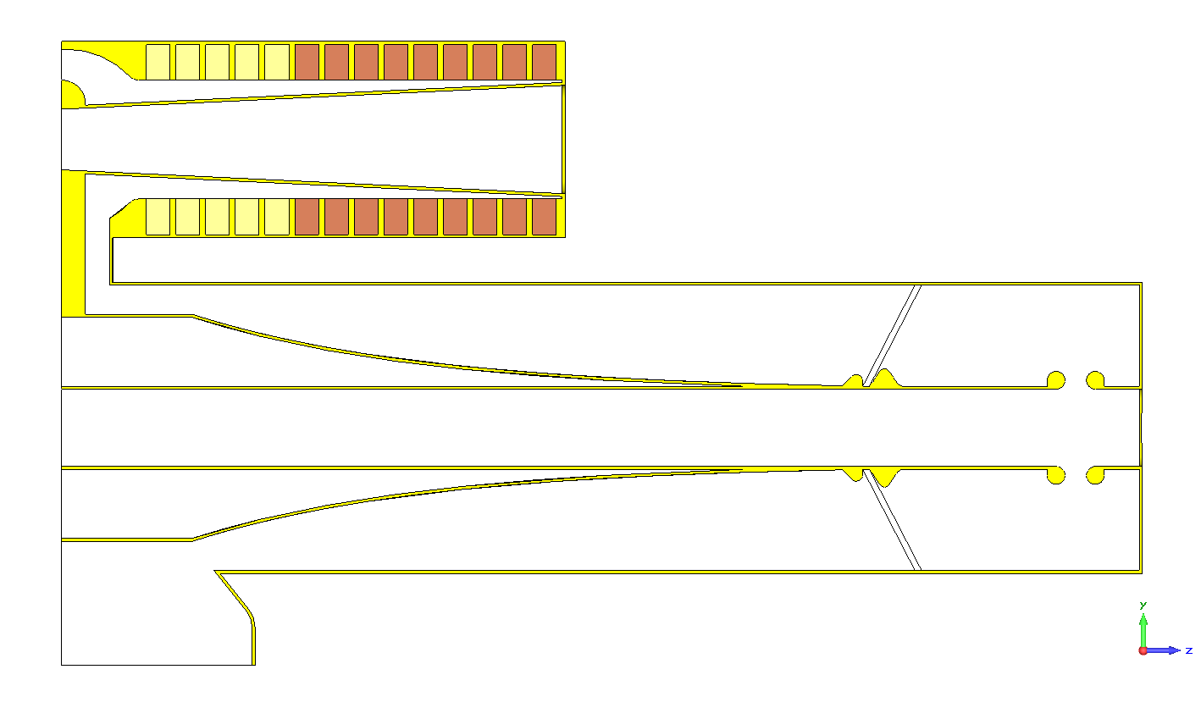
Longer Stem +1”
Clamp
Corona
Gap
Steeper Taper
9.284”
3.25” Bore
 | F1 [MHz] | F2 [MHz]
Design A: 3Tsh+10SP | 37.8 | 53.0
Design B: 5Tsh+9SP | 37.1 | 52.3
Steeper Taper -0.12, 4Tsh+9SP | 37.26 | 52.45
Steeper Taper -0.15, 4Tsh+9SP | 37.46 | 52.54
Design C: 5Tsh+8SP | 38.5 | 53.5

Slide 17
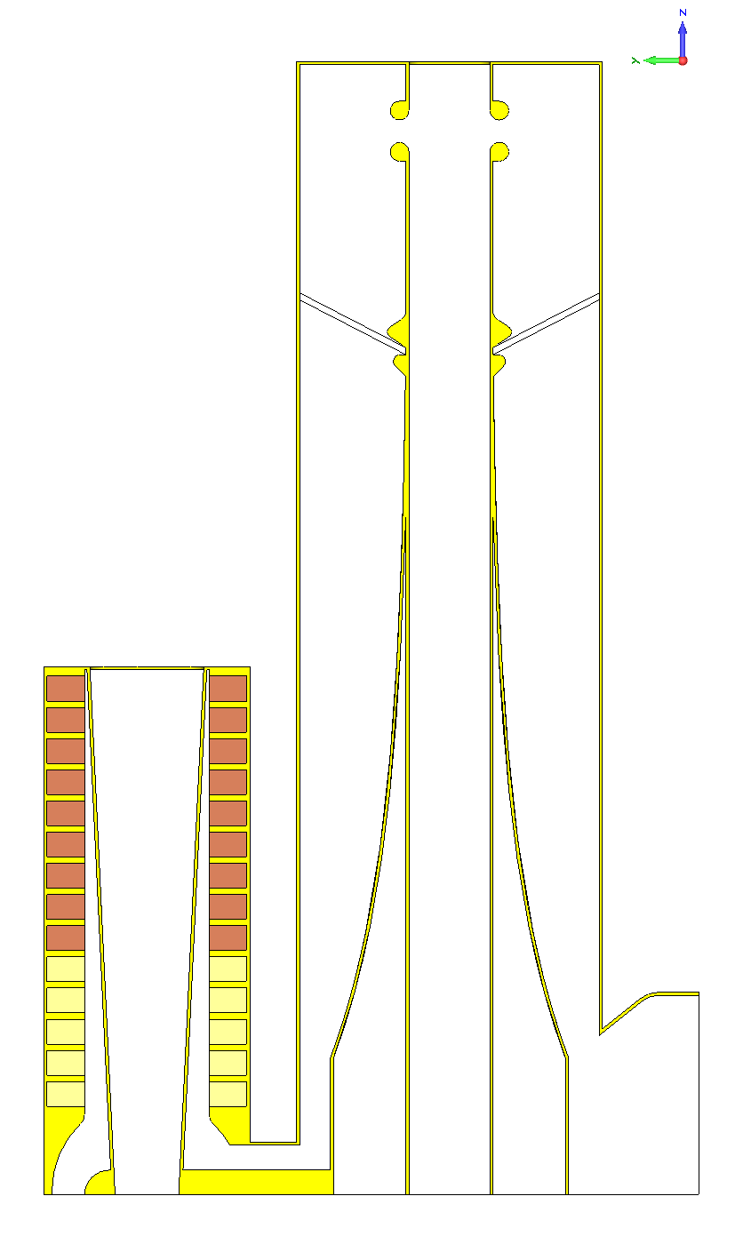
-0.1
-0.12
-0.15

Slide 18
Shorter Cavity with Existing Tuner
Upon shortening the total length of cavity by 6", frequency range is 37.6 to 53.6 MHz with the existing tuner (5 Toshiba, 9 Stackpole per each half tuner)
It is definitely a good option if the beam dynamics and mechanical design allows.
4” shorter 37.4 to 53.2 MHz

Slide 19
Decisions
Cavity length can’t be changed
We settled on using Design A; 3Tsh, 10SP (1st Tsh ferrite ring will be replaced by copper filling).
Longer Stem +1”
Clamp
Corona
Gap
Steeper Taper
9.284”
3.25” Bore

Slide 20
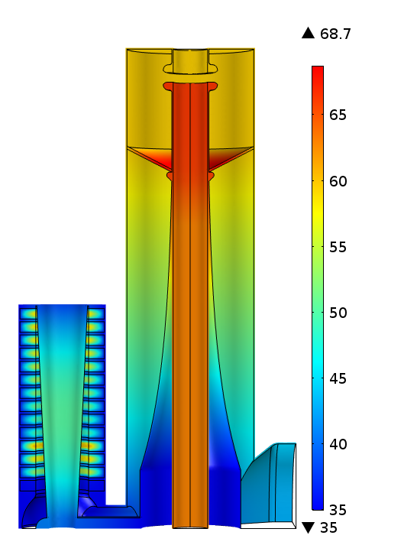
Preliminary Thermal Analysis
60 kV
Simplified averaging over the cycle
More accurate analysis is undergoing

Slide 21
Accurate Cycle Averaging for the Current Booster Cavity
Time [ms] | mu | Frequency [MHz] | Energy [mJ] | V [kV] | Q | R/Q | Vol Losses [kW] | Surf Losses [kW] | Ploss-55kV [kW] | Ratio
0 | 8.200 | 37.7 | 170.51 | 55 | 293 | 37.47 | 137.83 | 7.15 | 144.98 | 19.26
1 | 7.900 | 38.3 | 163.84 | 55 | 306 | 38.38 | 128.72 | 7.07 | 135.78 | 18.22
2 | 7.400 | 39.3 | 152.78 | 55 | 331 | 40.11 | 113.97 | 7.03 | 121.00 | 16.20
3 | 6.800 | 40.7 | 139.60 | 55 | 367 | 42.39 | 97.63 | 7.00 | 104.63 | 13.95
4 | 6.100 | 42.4 | 124.40 | 55 | 419 | 45.66 | 79.09 | 6.96 | 86.05 | 11.36
5 | 5.400 | 44.4 | 109.42 | 55 | 489 | 49.57 | 62.49 | 6.89 | 69.38 | 9.07
6 | 4.950 | 45.8 | 99.94 | 55 | 547 | 52.62 | 52.65 | 6.76 | 59.41 | 7.79
7 | 4.550 | 47.2 | 91.65 | 55 | 611 | 55.68 | 44.49 | 6.68 | 51.17 | 6.66
8 | 4.250 | 48.3 | 85.52 | 55 | 670 | 58.31 | 38.73 | 6.58 | 45.30 | 5.89
9 | 4.020 | 49.2 | 80.88 | 55 | 723 | 60.52 | 34.60 | 6.50 | 41.10 | 5.32
10 | 3.810 | 50.1 | 76.70 | 55 | 779 | 62.67 | 30.98 | 6.44 | 37.41 | 4.81
11 | 3.670 | 50.7 | 73.95 | 55 | 821 | 64.24 | 28.67 | 6.40 | 35.07 | 4.48
12 | 3.570 | 51.1 | 71.99 | 55 | 854 | 65.47 | 27.07 | 6.38 | 33.45 | 4.24
13 | 3.480 | 51.5 | 70.25 | 55 | 886 | 66.57 | 25.67 | 6.32 | 31.99 | 4.06
14 | 3.420 | 51.8 | 69.09 | 55 | 909 | 67.29 | 24.75 | 6.30 | 31.05 | 3.93
15 | 3.380 | 52.0 | 68.33 | 55 | 924 | 67.79 | 24.15 | 6.28 | 30.43 | 3.85
16 | 3.340 | 52.2 | 67.56 | 55 | 940 | 68.29 | 23.55 | 6.26 | 29.81 | 3.76
17 | 3.320 | 52.3 | 67.18 | 55 | 949 | 68.55 | 23.26 | 6.25 | 29.51 | 3.72
18 | 3.300 | 52.4 | 66.80 | 55 | 957 | 68.81 | 22.96 | 6.24 | 29.21 | 3.68
19 | 3.255 | 52.6 | 65.94 | 55 | 977 | 69.43 | 22.31 | 6.22 | 28.53 | 3.59
20 | 3.255 | 52.6 | 65.94 | 55 | 977 | 69.43 | 22.31 | 6.22 | 28.53 | 3.59
21 | 3.255 | 52.6 | 65.94 | 55 | 977 | 69.43 | 22.31 | 6.22 | 28.53 | 3.59
22 | 3.230 | 52.7 | 65.47 | 55 | 988 | 69.80 | 21.95 | 6.21 | 28.16 | 3.53
23 | 3.230 | 52.7 | 65.47 | 55 | 988 | 69.80 | 21.95 | 6.21 | 28.16 | 3.53
24 | 3.230 | 52.7 | 65.47 | 55 | 988 | 69.80 | 21.95 | 6.21 | 28.16 | 3.53
25 | 3.230 | 52.7 | 65.47 | 55 | 988 | 69.80 | 21.95 | 6.21 | 28.16 | 3.53
26 | 3.205 | 52.8 | 65.00 | 55 | 999 | 70.18 | 21.60 | 6.20 | 27.79 | 3.48
27 | 3.205 | 52.8 | 65.00 | 55 | 999 | 70.18 | 21.60 | 6.20 | 27.79 | 3.48
28 | 3.205 | 52.8 | 65.00 | 55 | 999 | 70.18 | 21.60 | 6.20 | 27.79 | 3.48
29 | 3.205 | 52.8 | 65.00 | 55 | 999 | 70.18 | 21.60 | 6.20 | 27.79 | 3.48
30 | 3.205 | 52.8 | 65.00 | 55 | 999 | 70.18 | 21.60 | 6.20 | 27.79 | 3.48
31 | 3.205 | 52.8 | 65.00 | 55 | 999 | 70.18 | 21.60 | 6.20 | 27.79 | 3.48
32 | 3.205 | 52.8 | 65.00 | 55 | 999 | 70.18 | 21.60 | 6.20 | 27.79 | 3.48
33 | 3.205 | 52.8 | 65.00 | 55 | 999 | 70.18 | 21.60 | 6.20 | 27.79 | 3.48
34 | 3.205 | 52.8 | 65.00 | 55 | 999 | 70.18 | 21.60 | 6.20 | 27.79 | 3.48
35 | 3.205 | 52.8 | 65.00 | 55 | 999 | 70.18 | 21.60 | 6.20 | 27.79 | 3.48
 |  |  |  |  |  | Sum | 1391.94 | 230.97 | 1622.91
 |  |  |  |  |  | Ploss (CW) | 39.77 | 6.60 | 46.37
 |  |  |  |  |  | Ploss (15 Hz) | 19.88 | 3.30 | 23.18 | 6.03
R/Q=V^2/(2wU)

Slide 22
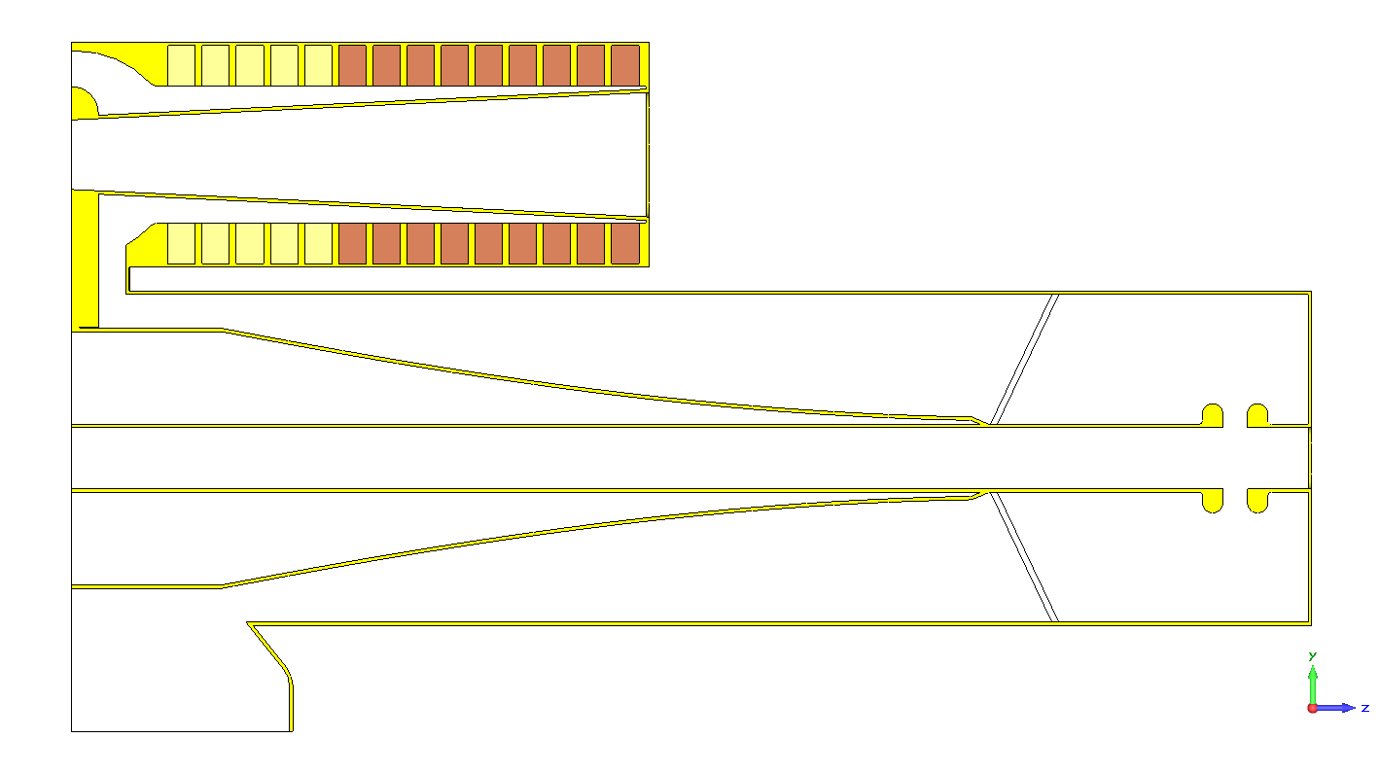

Slide 23
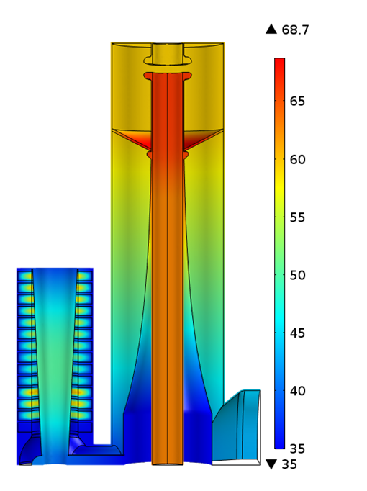
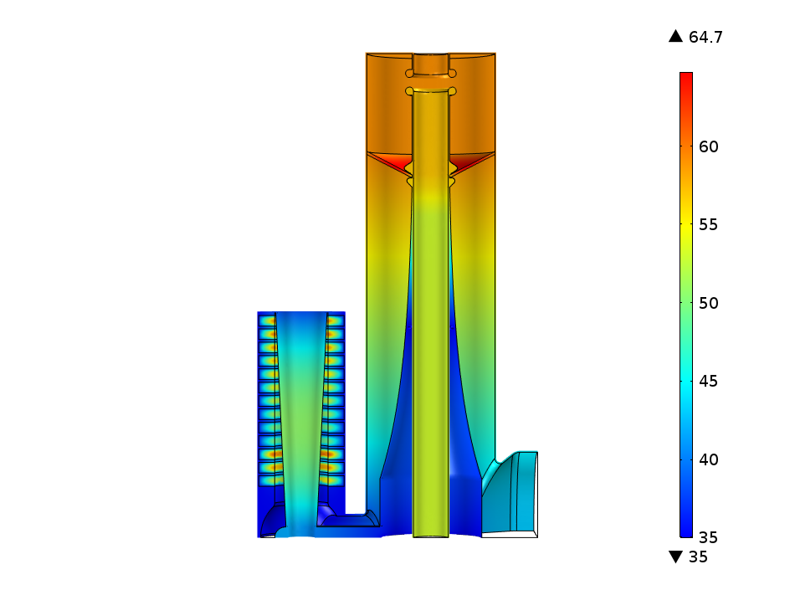
Replacement Cavity (60 kV)

Slide 24
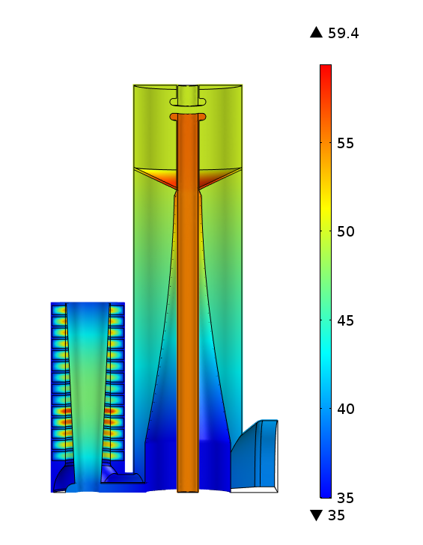
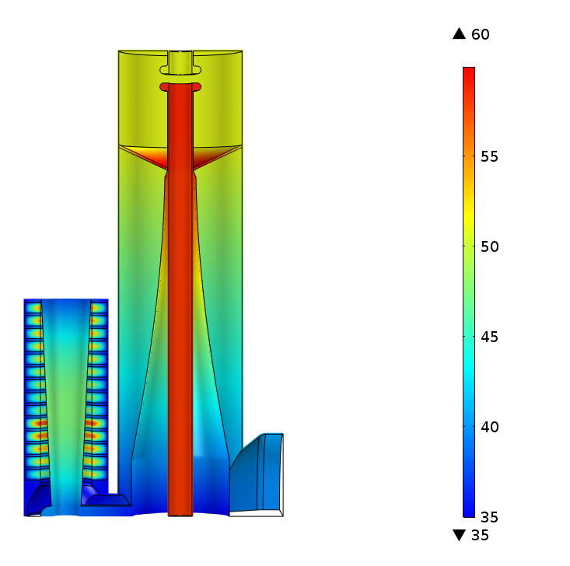
Booster Cavity (55 kV)

Slide 25
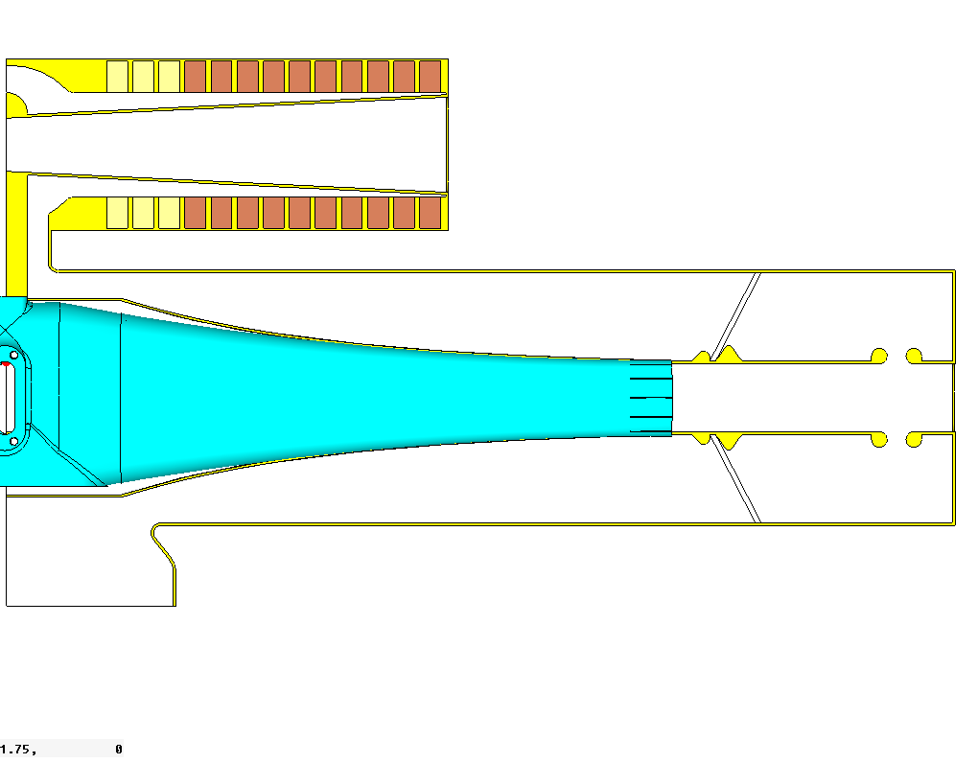
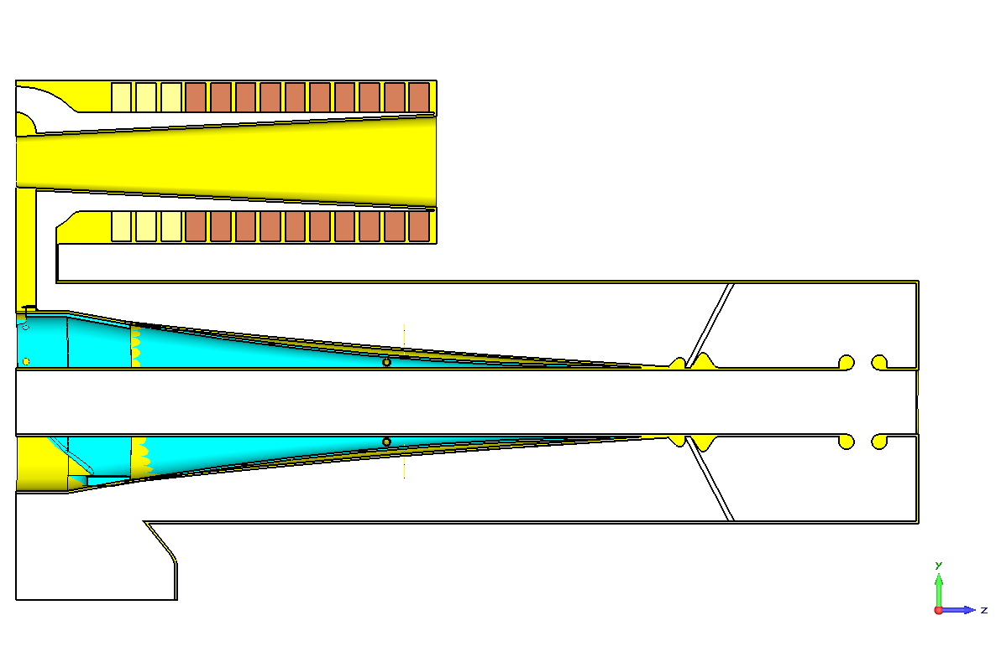
frequency range is 38.0 to 53.1 MHz

Slide 26
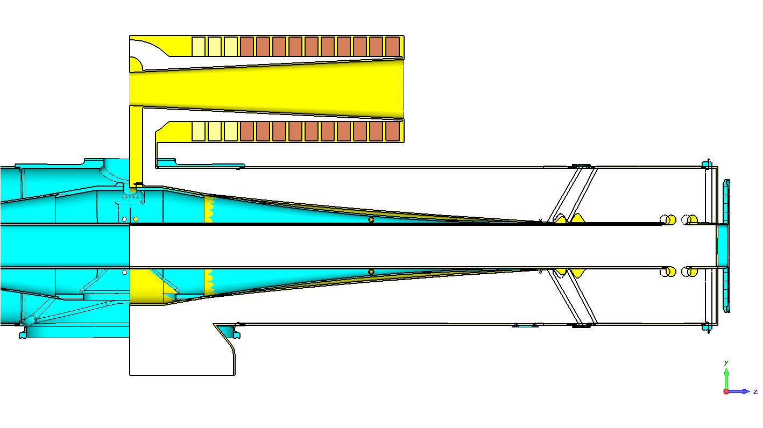

Slide 27
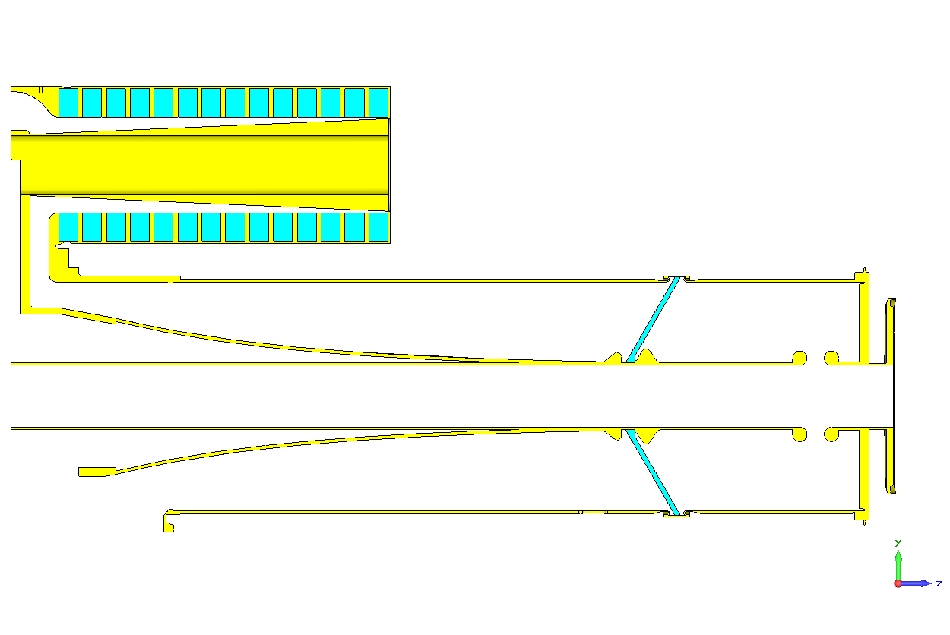
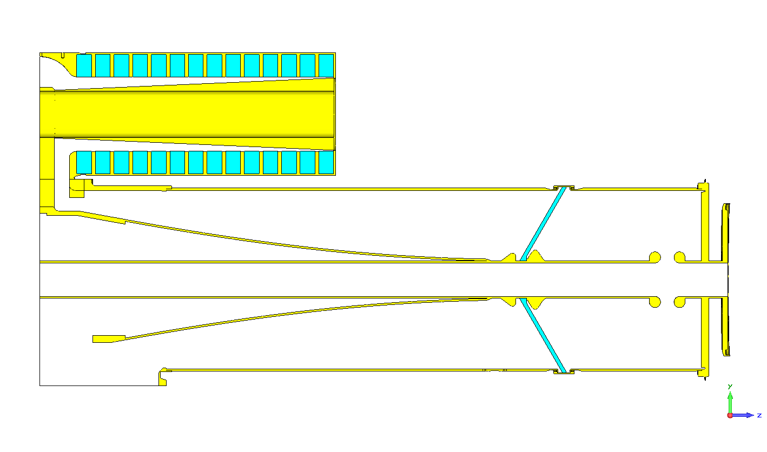
Matched Mechanical Models
Current Booster Cavity
Booster Replacement Cavity
x
x
 | Mu=8.4 | Mu=3 | Mu=9 | Mu=3.7
Current Cavity | 40 | 56.4 | 37.8 | 53
Replacement Cavity (slope -0.1, 1st Tsh is removed) 9SP, 4Tsh | 38.3 | 54.2 | 37.2 | 51.2

Slide 28
 | Mu=9 | Mu=3.7
10 SP, 1Tsh (removing 3 Tsh) | 38.6 | 53
12 SP (removing 2 Tsh) | 38.5 | 52.8

Slide 29
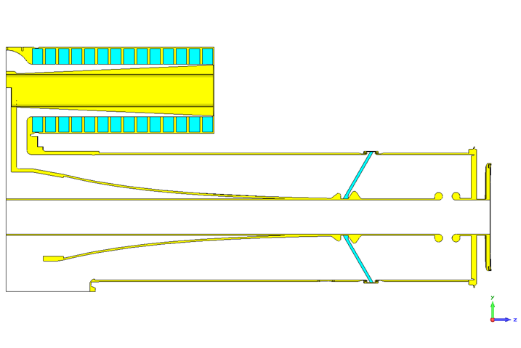
 | Mu=9 | Mu=3.7
9SP, 5Tsh | 37.2 | 51.2
10SP, 1Tsh (Mx3) | 39.3 | 53.6
12SP (Mx2) | 39.2 | 53.4
1Tsh,11SP (Mx2) | 38.0 | 52.4
(E1x) 1Tsh,11 SP (Mx1) | 39.5 | 53.5
(E1x) 2Tsh, 10 SP (Mx1) | 38.4 | 52.6
(E1x) 2Tsh, 10 SP (Mx1), B | 38.8 | 52.7
(E1x) 2Tsh,9 SP (Mx1), B | 38.9 | 53.2
 | Mu=9 | Mu=3.7
9SP, 5Tsh | 35.8 | 50
9SP, 4Tsh (Mx1) | 36.4 | 50.5
9SP, 3Tsh (Mx2) | 37.2 | 51.4
9SP, 2Tsh (Mx3) | 38.1 | 52.5
10 SP, 1Tsh (Mx3) | 38.6 | 53
13 SP (Mx1) | 38.0 | 52.2
12 SP (Mx2) | 38.5 | 52.8
12 SP (Ex2) | 41.4 | 55
13 SP (Ex1) | 39.4 | 53.3

Slide 30
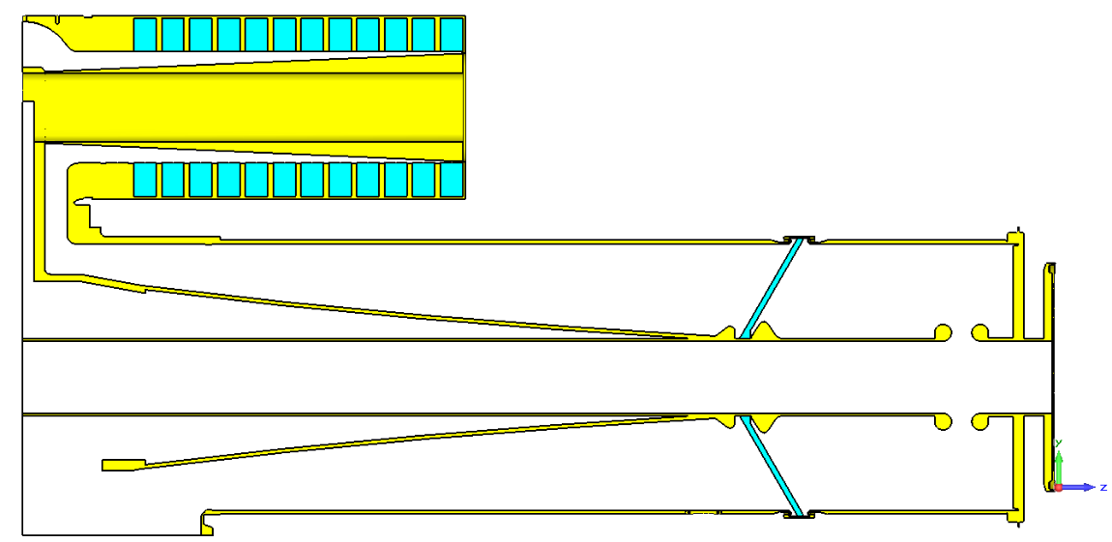
Fine Tuning for Frequency Range with Taper
C=-0.01 | 12 SP (Mx2) | 38.5 | 52.8
C=-0.03 | 12 SP (Mx2) | 38.7 | 53

Slide 31
R/Q Comparison
Current Cavity
Mu | freq [MHz] | Q | V [kV] | E [mJ] | R/Q | E60kV [mJ]
9 | 37.8 | 260 | 61.119 | 197.087 | 39.9 | 189.94
3.7 | 53 | 809 | 102.21 | 197.087 | 79.59 | 67.92
Replacement Cavity
Mu | freq [MHz] | Q | V [kV] | E [mJ] | R/Q | E60kV [mJ]
9 | 38.7 | 299 | 56.69 | 197.087 | 33.53 | 220.77382
3.7 | 53 | 1014 | 94.228 | 197.087 | 67.64 | 79.90989
R/Q=V^2/(2wU)

Slide 34
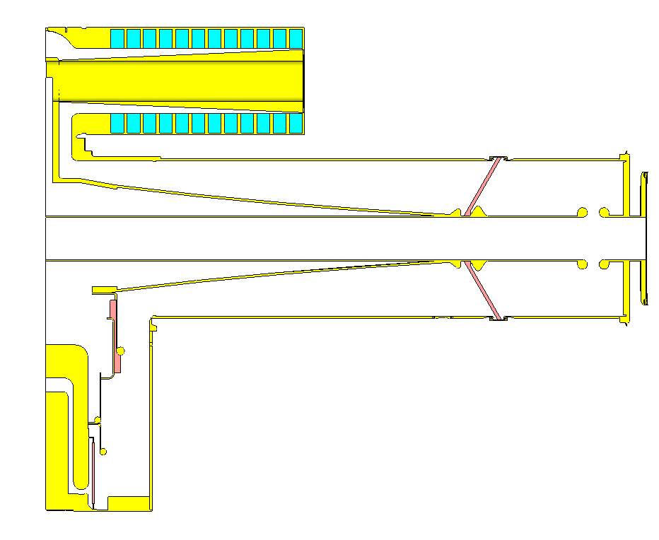
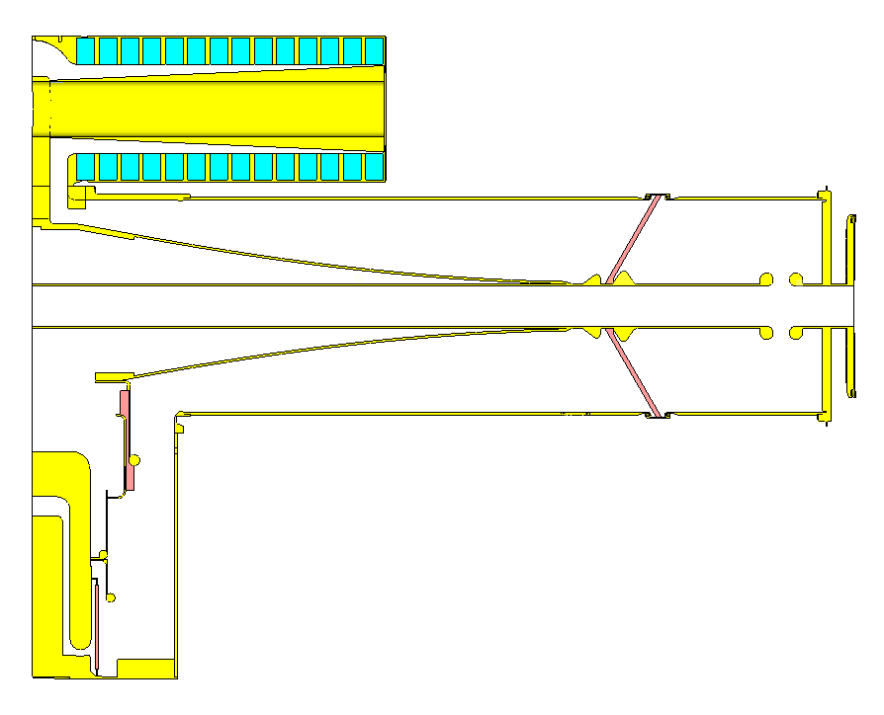
After Adding the Tetrode
 | Mu=9 | Mu=3.7 | Mu=6.6 | Mu=2.1
Current Cavity | 33.3 | 45.9 | 37.7 | 52.9
Replacement Cavity (slope -0.05, 12SP (Mx2) | 37.9 | 47.0 | 39.2 | 53.2

Slide 35
Adjusting Loss Tangent to Adjust Q
Measurements Booster Cavity
f0 [MHz] | Q
26.731 | 132
29.872 | 166
39.912 | 345
49.974 | 847
52.79 | 1077
53.855 | 1197
 | Current Booster |  |  | Replacement Cavity
mu | 17 | 6.6 | 2.1 | 17 | 6.6 | 2.1
Freq [MHz] | 24.7 | 37.7 | 52.9 | 26.7 | 39.2 | 53.2
Q | 123 | 391 | 2050 | 150 | 469 | 2785
 | Current Booster |  |  | Replacement Cavity
mu | 17 | 6.6 | 2.1 | 17 | 6.6 | 2.1
Freq [MHz] | 24.7 | 37.7 | 52.9 | 26.7 | 39.2 | 53.2
Adjusted Q | 65 | 208 | 1128 | 79 | 250 | 1544

Slide 36
Replacement vs Current Booster Cavities
 | Current Booster |  | Replacement Cavity
mu | 6.6 | 2.1 | 7.35 | 2.1
Freq [MHz] | 37.7 | 52.9 | 37.7 | 53.2
Adjusted Q | 208 | 1128 | 407 | 1544
E[mJ]-60kV | 243.80 | 98.32 | 283.53 | 104.93
R/Q | 31.17 | 55.08 | 26.80 | 51.32
Eav [mJ] | 171.06 |  | 194.23
Ecycle [mJ] | 118.03 |  | 134.02 |  | 1.14
R/Q=V^2/(2wU)

Slide 37
Booster Cavity
Time [ms] | mu | Frequency [MHz] | Energy [mJ] | V [kV] | Q | R/Q | Vol Losses [kW] | Surf Losses [kW] |  | Energy [mJ] 60kV | Vol Losses for 60 kV [kW] | Surf Losses forr 60kV [kW] | Ploss-60kV [kW] | Ratio
0 | 6.64 | 37.7 | 197.087 | 54.113 | 389 | 31.36 | 119.990 | 10.713 |  | 242.30 | 147.52 | 13.17 | 160.69 | 11.20
1 | 6.38 | 38.3 | 197.087 | 55.164 | 409 | 32.08 | 115.840 | 11.155 |  | 233.16 | 137.04 | 13.20 | 150.24 | 10.38
2 | 5.94 | 39.3 | 197.087 | 57.076 | 448 | 33.47 | 108.580 | 11.979 |  | 217.80 | 119.99 | 13.24 | 133.23 | 9.06
3 | 5.39 | 40.7 | 197.087 | 59.374 | 508 | 34.97 | 99.097 | 13.163 |  | 201.26 | 101.20 | 13.44 | 114.64 | 7.53
4 | 4.77 | 42.4 | 197.087 | 63.158 | 598 | 37.99 | 87.801 | 14.751 |  | 177.87 | 79.24 | 13.31 | 92.55 | 5.95
5 | 4.16 | 44.4 | 197.087 | 67.059 | 723 | 40.89 | 76.016 | 16.641 |  | 157.78 | 60.85 | 13.32 | 74.18 | 4.57
6 | 3.75 | 45.8 | 197.087 | 70.036 | 838 | 43.24 | 67.712 | 18.137 |  | 144.65 | 49.70 | 13.31 | 63.01 | 3.73
7 | 3.39 | 47.2 | 197.087 | 72.921 | 971 | 45.49 | 60.179 | 19.627 |  | 133.43 | 40.74 | 13.29 | 54.03 | 3.07
8 | 3.12 | 48.3 | 197.087 | 75.269 | 1099 | 47.36 | 54.395 | 20.853 |  | 125.24 | 34.56 | 13.25 | 47.82 | 2.61
9 | 2.90 | 49.2 | 197.087 | 77.307 | 1229 | 49.05 | 49.614 | 21.958 |  | 118.72 | 29.89 | 13.23 | 43.11 | 2.26
10 | 2.70 | 50.1 | 197.087 | 79.261 | 1372 | 50.63 | 45.228 | 23.020 |  | 112.94 | 25.92 | 13.19 | 39.11 | 1.96
11 | 2.58 | 50.7 | 197.087 | 80.482 | 1474 | 51.58 | 42.586 | 23.689 |  | 109.54 | 23.67 | 13.17 | 36.83 | 1.80
12 | 2.50 | 51.1 | 197.087 | 81.316 | 1549 | 52.25 | 40.823 | 24.148 |  | 107.30 | 22.23 | 13.15 | 35.37 | 1.69
13 | 2.41 | 51.5 | 197.087 | 82.272 | 1642 | 53.07 | 38.840 | 24.678 |  | 104.82 | 20.66 | 13.13 | 33.78 | 1.57
14 | 2.34 | 51.8 | 197.087 | 83.033 | 1721 | 53.74 | 37.299 | 25.100 |  | 102.91 | 19.48 | 13.11 | 32.58 | 1.49
15 | 2.31 | 52 | 197.087 | 83.362 | 1757 | 53.96 | 36.640 | 25.283 |  | 102.10 | 18.98 | 13.10 | 32.08 | 1.45
16 | 2.27 | 52.2 | 197.087 | 83.804 | 1807 | 54.32 | 35.762 | 25.529 |  | 101.03 | 18.33 | 13.09 | 31.42 | 1.40
17 | 2.25 | 52.3 | 197.087 | 84.026 | 1833 | 54.51 | 35.323 | 25.654 |  | 100.49 | 18.01 | 13.08 | 31.09 | 1.38
18 | 2.23 | 52.4 | 197.087 | 84.25 | 1860 | 54.69 | 34.885 | 25.779 |  | 99.96 | 17.69 | 13.07 | 30.77 | 1.35
19 | 2.19 | 52.6 | 197.087 | 84.701 | 1915 | 55.07 | 34.010 | 26.030 |  | 98.90 | 17.07 | 13.06 | 30.13 | 1.31
20 | 2.19 | 52.6 | 197.087 | 84.701 | 1915 | 55.07 | 34.010 | 26.030 |  | 98.90 | 17.07 | 13.06 | 30.13 | 1.31
21 | 2.19 | 52.6 | 197.087 | 84.701 | 1915 | 55.07 | 34.010 | 26.030 |  | 98.90 | 17.07 | 13.06 | 30.13 | 1.31
22 | 2.17 | 52.7 | 197.087 | 84.927 | 1944 | 55.26 | 33.573 | 26.157 |  | 98.37 | 16.76 | 13.06 | 29.81 | 1.28
23 | 2.17 | 52.7 | 197.087 | 84.927 | 1944 | 55.26 | 33.573 | 26.157 |  | 98.37 | 16.76 | 13.06 | 29.81 | 1.28
24 | 2.17 | 52.7 | 197.087 | 84.927 | 1944 | 55.26 | 33.573 | 26.157 |  | 98.37 | 16.76 | 13.06 | 29.81 | 1.28
25 | 2.17 | 52.7 | 197.087 | 84.927 | 1944 | 55.26 | 33.573 | 26.157 |  | 98.37 | 16.76 | 13.06 | 29.81 | 1.28
26 | 2.15 | 52.8 | 197.087 | 85.155 | 1973 | 55.45 | 33.137 | 26.285 |  | 97.85 | 16.45 | 13.05 | 29.50 | 1.26
27 | 2.15 | 52.8 | 197.087 | 85.155 | 1973 | 55.45 | 33.137 | 26.285 |  | 97.85 | 16.45 | 13.05 | 29.50 | 1.26
28 | 2.15 | 52.8 | 197.087 | 85.155 | 1973 | 55.45 | 33.137 | 26.285 |  | 97.85 | 16.45 | 13.05 | 29.50 | 1.26
29 | 2.15 | 52.8 | 197.087 | 85.155 | 1973 | 55.45 | 33.137 | 26.285 |  | 97.85 | 16.45 | 13.05 | 29.50 | 1.26
30 | 2.15 | 52.8 | 197.087 | 85.155 | 1973 | 55.45 | 33.137 | 26.285 |  | 97.85 | 16.45 | 13.05 | 29.50 | 1.26
31 | 2.15 | 52.8 | 197.087 | 85.155 | 1973 | 55.45 | 33.137 | 26.285 |  | 97.85 | 16.45 | 13.05 | 29.50 | 1.26
32 | 2.15 | 52.8 | 197.087 | 85.155 | 1973 | 55.45 | 33.137 | 26.285 |  | 97.85 | 16.45 | 13.05 | 29.50 | 1.26
33 | 2.15 | 52.8 | 197.087 | 85.155 | 1973 | 55.45 | 33.137 | 26.285 |  | 97.85 | 16.45 | 13.05 | 29.50 | 1.26
34 | 2.15 | 52.8 | 197.087 | 85.155 | 1973 | 55.45 | 33.137 | 26.285 |  | 97.85 | 16.45 | 13.05 | 29.50 | 1.26
35 | 2.15 | 52.8 | 197.087 | 85.155 | 1973 | 55.45 | 33.137 | 26.285 |  | 97.85 | 16.45 | 13.05 | 29.50 | 1.26
 |  |  |  |  |  |  |  |  |  | Sum | 1268.43 | 472.74 | 1741.16 | 2.68
 |  |  |  |  |  |  |  |  |  | Ploss (CW) | 35.23 | 13.13 | 48.37
 |  |  |  |  |  |  |  |  |  | Ploss (15 Hz) | 17.62 | 6.57 | 24.18
8 | 3.12 | 48.3 | 197.087 | 75.269 | 1099 | 47.36 | 54.395 | 20.853 |  |  | 34.56 | 13.25 | 47.82 | 2.61

Slide 38
Booster Replacement Cavity
Time [ms] | mu | Frequency [MHz] | Energy [mJ] | V [kV] | Q | R/Q | Vol Losses [kW] | Surf Losses [kW] |  | Energy [mJ] 60kV | Vol Losses for 60 kV [kW] | Surf Losses forr 60kV [kW] | Ploss-60kV [kW] | Ratio
0 | 7.35 | 37.7 | 197.087 | 50.023 | 216 | 26.80 | 216.032 | 11.104 |  | 283.5443592 | 310.80 | 15.98 | 326.78 | 19.46
1 | 7.05 | 38.3 | 197.087 | 51.078 | 228 | 27.50 | 207.62 | 11.552 |  | 271.9522849 | 286.49 | 15.94 | 302.43 | 17.97
2 | 6.56 | 39.3 | 197.087 | 52.934 | 252 | 28.79 | 193.46 | 12.352 |  | 253.2159472 | 248.56 | 15.87 | 264.43 | 15.66
3 | 5.93 | 40.7 | 197.087 | 55.597 | 289 | 30.66 | 174.444 | 13.520 |  | 229.5396759 | 203.17 | 15.75 | 218.91 | 12.90
4 | 5.25 | 42.4 | 197.087 | 58.882 | 343 | 33.02 | 152.832 | 14.992 |  | 204.6422837 | 158.69 | 15.57 | 174.26 | 10.19
5 | 4.53 | 44.4 | 197.087 | 62.293 | 427 | 35.29 | 128.712 | 16.836 |  | 182.8445357 | 119.41 | 15.62 | 135.03 | 7.65
6 | 4.07 | 45.8 | 197.087 | 65.86 | 503 | 38.24 | 112.68 | 18.200 |  | 163.5750369 | 93.52 | 15.11 | 108.63 | 6.19
7 | 3.66 | 47.2 | 197.087 | 68.743 | 596 | 40.42 | 98.06 | 19.544 |  | 150.1424565 | 74.70 | 14.89 | 89.59 | 5.02
8 | 3.33 | 48.3 | 197.087 | 71.258 | 695 | 42.45 | 86.144 | 20.720 |  | 139.7311463 | 61.07 | 14.69 | 75.76 | 4.16
9 | 3.10 | 49.2 | 197.087 | 73.119 | 782 | 43.88 | 77.816 | 21.588 |  | 132.7088828 | 52.40 | 14.54 | 66.93 | 3.60
10 | 2.85 | 50.1 | 197.087 | 75.243 | 902 | 45.63 | 68.792 | 22.580 |  | 125.3222761 | 43.74 | 14.36 | 58.10 | 3.05
11 | 2.70 | 50.7 | 197.087 | 76.568 | 990 | 46.69 | 63.42 | 23.196 |  | 121.0224312 | 38.94 | 14.24 | 53.19 | 2.73
12 | 2.60 | 51.1 | 197.087 | 77.473 | 1057 | 47.43 | 59.864 | 23.616 |  | 118.2115012 | 35.91 | 14.16 | 50.07 | 2.53
13 | 2.51 | 51.5 | 197.087 | 78.301 | 1125 | 48.07 | 56.692 | 24.000 |  | 115.7246464 | 33.29 | 14.09 | 47.38 | 2.36
14 | 2.43 | 51.8 | 197.087 | 79.047 | 1191 | 48.70 | 53.892 | 24.344 |  | 113.5506685 | 31.05 | 14.03 | 45.08 | 2.21
15 | 2.38 | 52 | 197.087 | 79.519 | 1235 | 49.10 | 52.16 | 24.560 |  | 112.2066664 | 29.70 | 13.98 | 43.68 | 2.12
16 | 2.33 | 52.2 | 197.087 | 79.995 | 1283 | 49.50 | 50.432 | 24.776 |  | 110.8752965 | 28.37 | 13.94 | 42.31 | 2.04
17 | 2.31 | 52.3 | 197.087 | 80.186 | 1302 | 49.64 | 49.748 | 24.864 |  | 110.3477241 | 27.85 | 13.92 | 41.77 | 2.00
18 | 2.30 | 52.4 | 197.087 | 80.282 | 1313 | 49.66 | 49.404 | 24.908 |  | 110.0839776 | 27.59 | 13.91 | 41.51 | 1.98
19 | 2.25 | 52.6 | 197.087 | 80.763 | 1365 | 50.07 | 47.7 | 25.128 |  | 108.7766286 | 26.33 | 13.87 | 40.20 | 1.90
20 | 2.25 | 52.6 | 197.087 | 80.763 | 1365 | 50.07 | 47.7 | 25.128 |  | 108.7766286 | 26.33 | 13.87 | 40.20 | 1.90
21 | 2.25 | 52.6 | 197.087 | 80.763 | 1365 | 50.07 | 47.7 | 25.128 |  | 108.7766286 | 26.33 | 13.87 | 40.20 | 1.90
22 | 2.22 | 52.7 | 197.087 | 81.054 | 1398 | 50.34 | 46.684 | 25.260 |  | 107.9969711 | 25.58 | 13.84 | 39.42 | 1.85
23 | 2.22 | 52.7 | 197.087 | 81.054 | 1398 | 50.34 | 46.684 | 25.260 |  | 107.9969711 | 25.58 | 13.84 | 39.42 | 1.85
24 | 2.22 | 52.7 | 197.087 | 81.054 | 1398 | 50.34 | 46.684 | 25.260 |  | 107.9969711 | 25.58 | 13.84 | 39.42 | 1.85
25 | 2.22 | 52.7 | 197.087 | 81.054 | 1398 | 50.34 | 46.684 | 25.260 |  | 107.9969711 | 25.58 | 13.84 | 39.42 | 1.85
26 | 2.20 | 52.8 | 197.087 | 81.249 | 1421 | 50.48 | 46.008 | 25.352 |  | 107.4792014 | 25.09 | 13.83 | 38.92 | 1.81
27 | 2.20 | 52.8 | 197.087 | 81.249 | 1421 | 50.48 | 46.008 | 25.352 |  | 107.4792014 | 25.09 | 13.83 | 38.92 | 1.81
28 | 2.20 | 52.8 | 197.087 | 81.249 | 1421 | 50.48 | 46.008 | 25.352 |  | 107.4792014 | 25.09 | 13.83 | 38.92 | 1.81
29 | 2.20 | 52.8 | 197.087 | 81.249 | 1421 | 50.48 | 46.008 | 25.352 |  | 107.4792014 | 25.09 | 13.83 | 38.92 | 1.81
30 | 2.20 | 52.8 | 197.087 | 81.249 | 1421 | 50.48 | 46.008 | 25.352 |  | 107.4792014 | 25.09 | 13.83 | 38.92 | 1.81
31 | 2.20 | 52.8 | 197.087 | 81.249 | 1421 | 50.48 | 46.008 | 25.352 |  | 107.4792014 | 25.09 | 13.83 | 38.92 | 1.81
32 | 2.20 | 52.8 | 197.087 | 81.249 | 1421 | 50.48 | 46.008 | 25.352 |  | 107.4792014 | 25.09 | 13.83 | 38.92 | 1.81
33 | 2.20 | 52.8 | 197.087 | 81.249 | 1421 | 50.48 | 46.008 | 25.352 |  | 107.4792014 | 25.09 | 13.83 | 38.92 | 1.81
34 | 2.20 | 52.8 | 197.087 | 81.249 | 1421 | 50.48 | 46.008 | 25.352 |  | 107.4792014 | 25.09 | 13.83 | 38.92 | 1.81
35 | 2.20 | 52.8 | 197.087 | 81.249 | 1421 | 50.48 | 46.008 | 25.352 |  | 107.4792014 | 25.09 | 13.83 | 38.92 | 1.81
 |  |  |  |  |  |  |  |  |  | Sum | 2337.46 | 515.80 | 2853.26 | 4.53
 |  |  |  |  |  |  |  |  |  | Ploss (CW) | 66.78 | 14.74 | 81.52
 |  |  |  |  |  |  |  |  |  | Ploss (15 Hz) | 33.39 | 7.37 | 40.76
 | 3.48 | 47.8 | 197.087 | 70.093 | 646 | 41.50 | 22.893 | 5.044 |  |  | 16.77 | 3.70 | 20.47 | 4.54

Slide 40
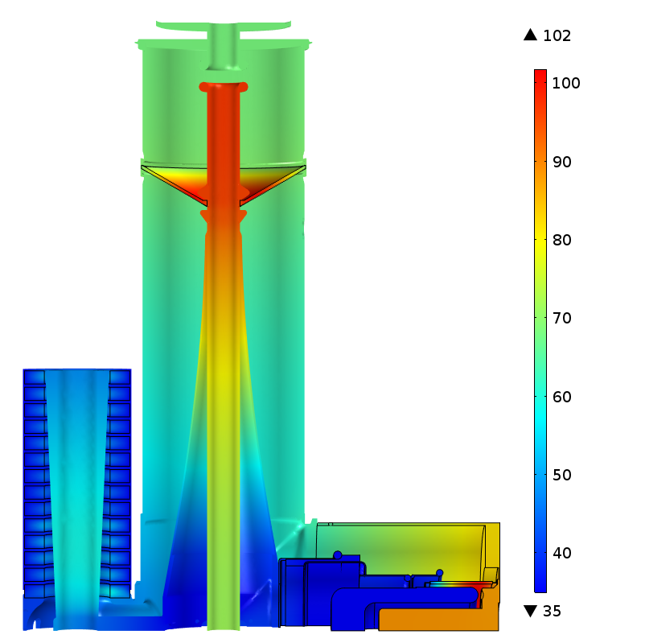

Slide 41
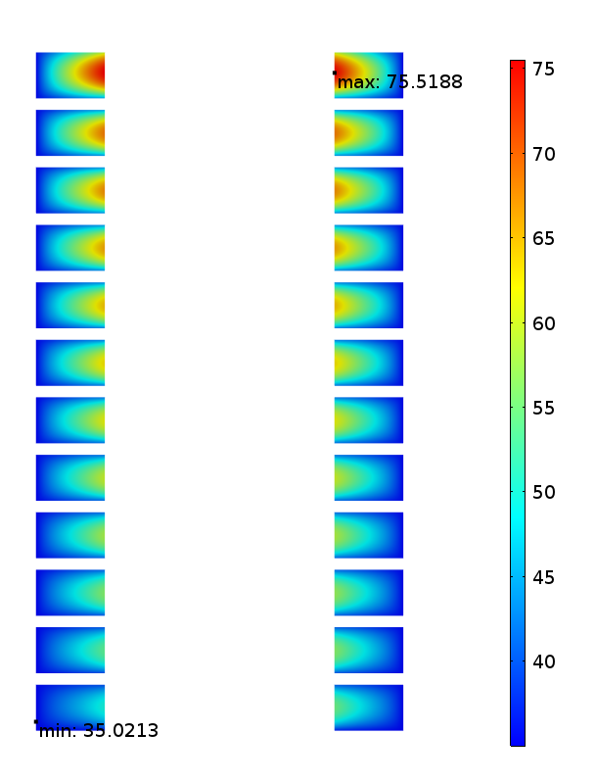

Slide 43
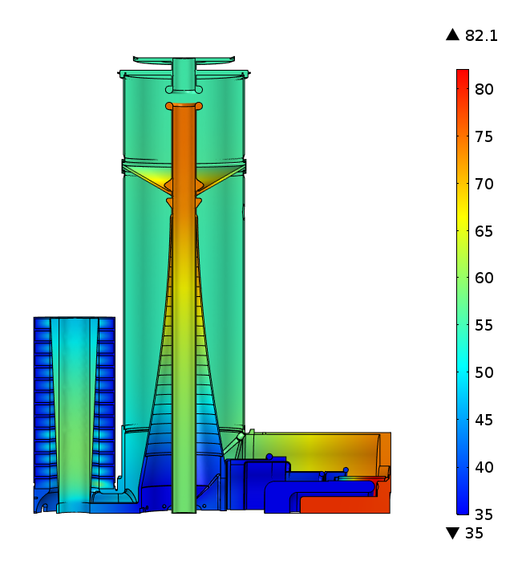
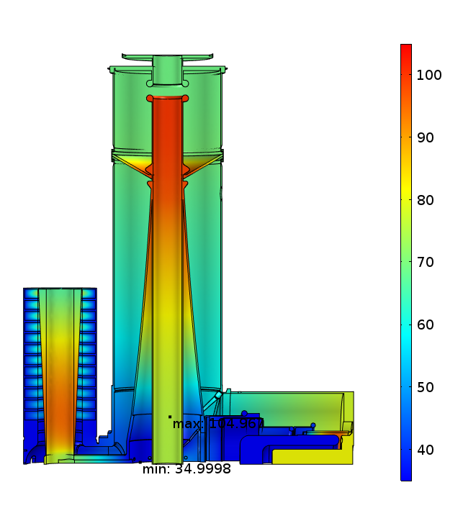
Reduced Alumina Loss Tangent from 0.0004 to 0.0001
Booster Cavity
Replacement Cavity

Slide 44
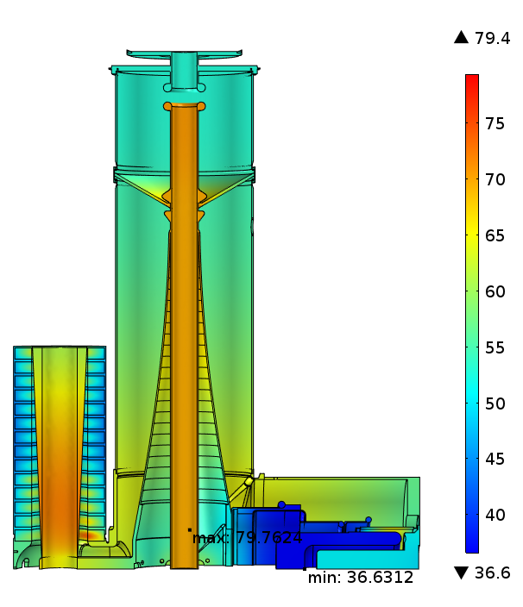
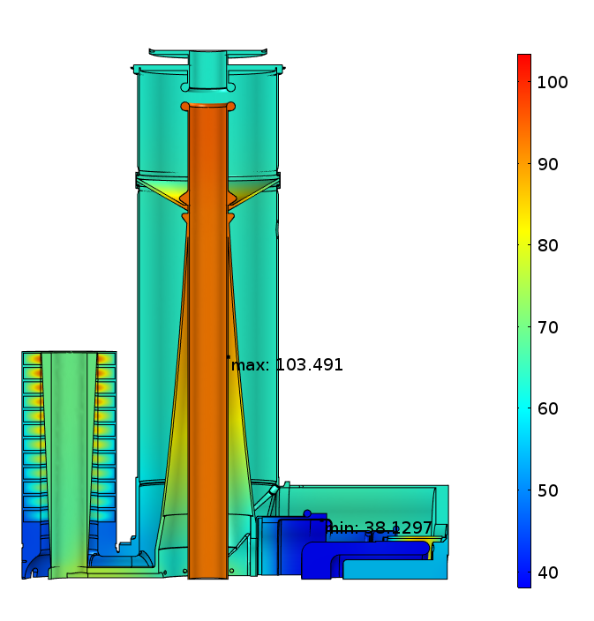
Reduced Alumina Loss Tangent from 0.0004 to 0.0001 Cont.
Booster Cavity
Replacement Cavity
With Convective Cooling Boundaries

Slide 45
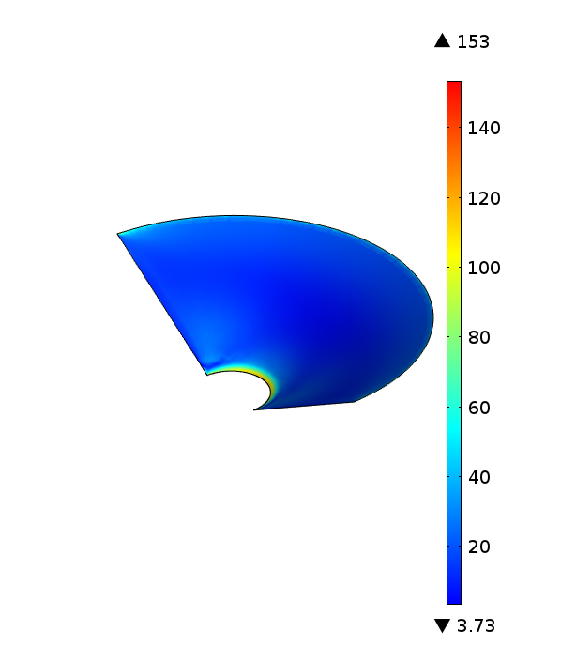
Ceramic Stresses
Booster Cavity
Replacement Cavity

Slide 46
Booster Cavity with 84 MHz Damper
 | Current Booster
 | Without Damper | With Damper
Freq [MHz] | 84.354 | 84.362
Rsh [kΩ] | 6940 | 10.59

Slide 47
With HOM Damper
84 MHz
All Dampers (quarter symmetry)
 | Current Booster |  | Replacement Cavity
mu | 6.6 | 2.1 | 7.35 | 2.1
Freq [MHz] | 37.7→37.3 | 52.9→52.4 | 37.7→37 | 53.2→52.1
 | Current Booster |  |  | Replacement Cavity
mu | 6.6 | 2.1 | 2.0 | 7.35 | 2.1 | 2.0
Freq [MHz] | 37.7→37.2 | 52.9→52.2 | 52.8 | 37.7→ | 53.2→ | 52.55

Slide 48
Booster Replacement Cavity with 84 MHz Damper
 | Current Booster |  | Replacement Cavity
 | w/o Damper | w Damper | w/o Damper | w Damper | Damper moved by +10 cm | Damper trimmed
Freq [MHz] | 52.383 | 52.384 | 53.226 | 52.546 | 52.905 | 52.770
Freq (HOM1) [MHz] | 84.354 | 84.362 | 83.786 | 84.855 | 84.224 | 84.620
Rsh [kΩ] | 6940 | 10.59 | 1767 | 6.85 | 11.05 | 8.51

Slide 49
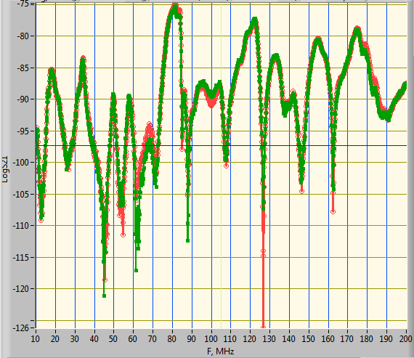
HOM Meas
Cavity with no bias
Tertode port was matched with load
S21 Gap Probe to Gap Probe
Cavity Frequency
84 MHz Large HOM
2nd
Green: 84 MHz Port is open
Red: 84 MHz Port is matched

Slide 50
HOM Meas Cont.
S21 Gap Probe (US) to 84 MHz Port (DS)
84 MHz Large HOM, Q=185

Slide 51
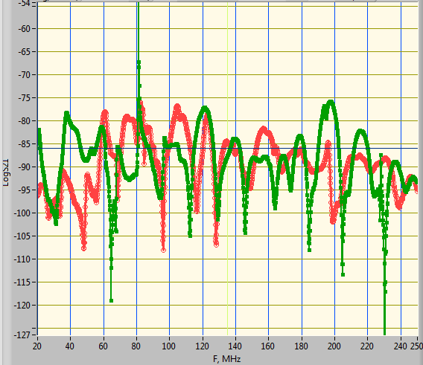
HOM Meas Cont.
S21 Gap Probe (US) to 165 Port (DS)
Q-undamped (84 MHz) ~2700
Q-damped (84 MHz)~115
Simulated Q0 (84 MHz)=75000
Simulated Q-damped (84 MHz) =116
84 MHz Large HOM
Green: 84 MHz Port is open
Red: 84 MHz Port is matched

Slide 52
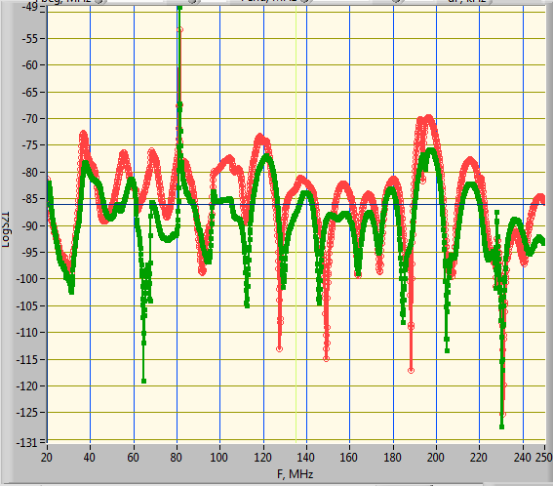
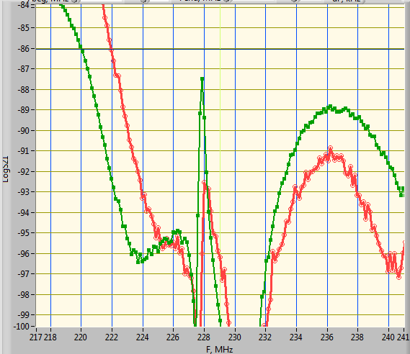
HOM Meas Cont.
S21 Gap Probe (US) to 165 Port (DS)
This mode doesn’t look dangerous
Green: 217 MHz Port is open
Red: 217 MHz Port is matched

Slide 53
HOM Meas Cont.
84 MHz is the most dangerous HOM with very large shunt impedance (in agreement with simulation)
Other two modes doesn’t look dangerous
217 MHz was noticed in meas but the 165 MHz was not observed

